Slide 1

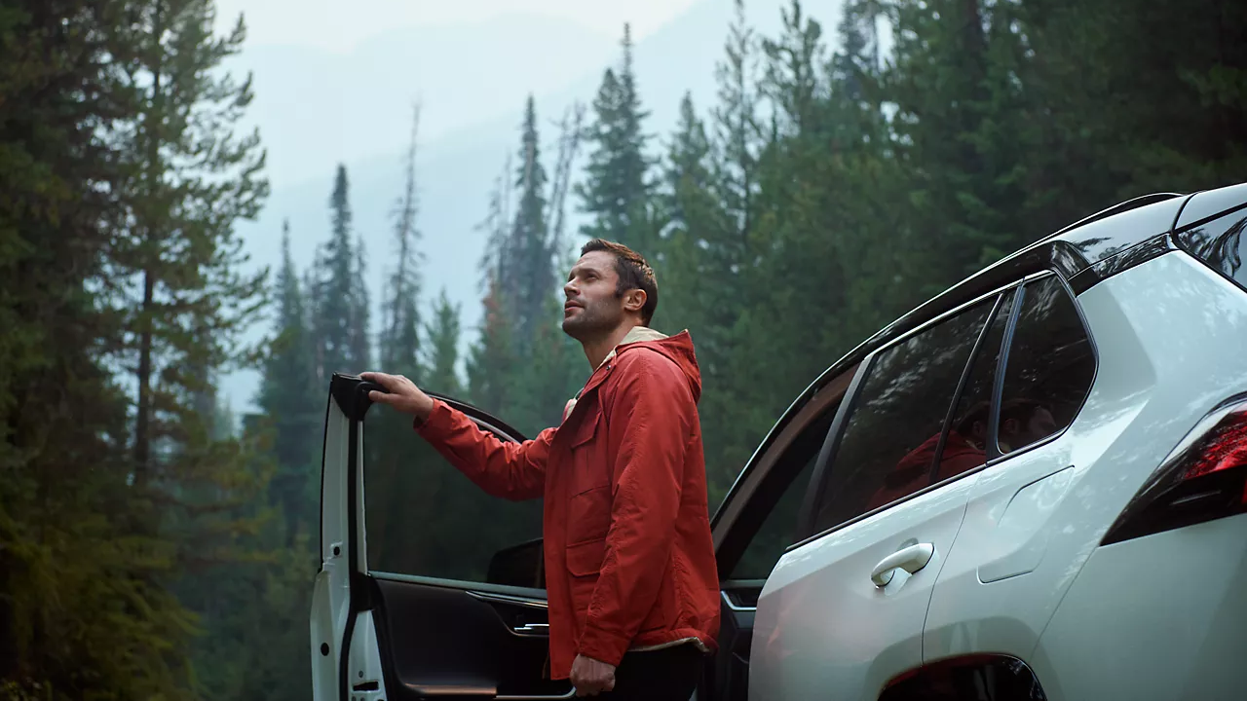

CONTENT
bucket 2 - August

Slide 2

One stop shop

Slide 3




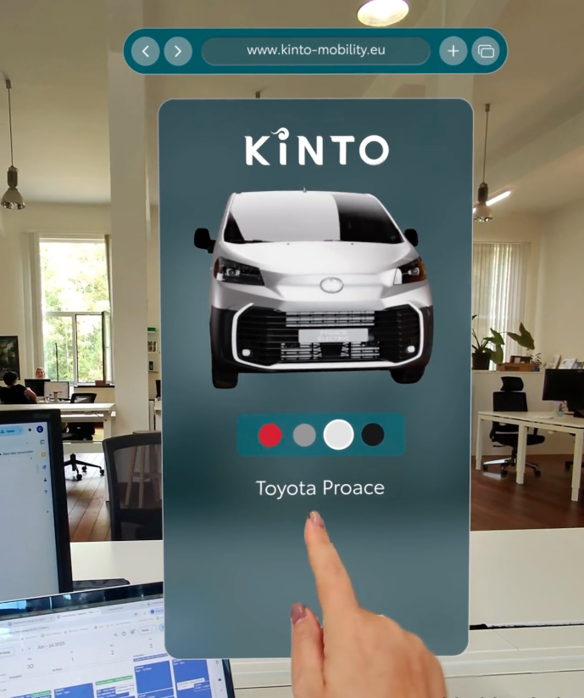
ANIMATION VIDEO POV FLEET MANAGER
COPY - LI:
Smart fleet decisions. Made simple. Watch how one fleet manager gets total visibility and more flexibility with KINTO.
🚘 Choose cars.
📊 Control costs.
🧭 Adapt to needs.
From short-term rentals to long-term leases, KINTO brings it all together in one seamless experience.
#KINTO #FleetManagement #CorporateMobility #FlexibleMobility #MobilitySolutions
CONTENT BUCKET 1- JULY
FORMATS AVAILABLE:
1/1 - 16/9 - 9/16 - 4/5

Slide 4

ANIMATION VIDEO POV FLEET MANAGER
COPY - IG:
💡Swipe. Choose. Go. This is how easy fleet management can be. In this POV: you’re in control. From electric to hybrid. From 4 hours to 4 years.
✅ All-in-one tool
✅ Instant options
✅ Stress-free decisions
#KINTO #FleetManagement #CorporateMobility #FlexibleMobility #MobilitySolutions
CONTENT BUCKET 1- JULY
FORMATS AVAILABLE:
1/1 - 16/9 - 9/16 - 4/5

Slide 5

ANIMATION VIDEO POV FLEET MANAGER
COPY - FB:
Managing vehicles doesn’t have to be hard. With KINTO, you pick what fits in just a few clicks. Watch how easy it is to:
✅ Choose the right car
✅ Pick the right formula
✅ Keep everything in one place
Less stress, more control. That’s KINTO.
#KINTO #FleetManagement #CorporateMobility #FlexibleMobility #MobilitySolutions
CONTENT BUCKET 1- JULY
FORMATS AVAILABLE:
1/1 - 16/9 - 9/16 - 4/5

Slide 6


VIDEO SWIPE “WHICH FLEET”
CONTENT BUCKET 1- JULY
COPY - LI
🚘 One size doesn’t fit all.
Whether you manage a small or a global fleet. Whether you’re all about efficiency, space, or style. We’ve got the right car, right when you need it. Because mobility should move with you.
👉 Ready to swipe your match?
#KINTO #FleetManagement #CorporateMobility #FlexibleMobility #MobilitySolutions
FORMATS AVAILABLE:
1/1 - 16/9 - 9/16 - 4/5

Slide 7
VIDEO SWIPE “WHICH FLEET”
CONTENT BUCKET 1- JULY
COPY - IG
One platform. 🌍 Multiple services.
Leasing? ✅ Renting? ✅ Sharing? ✅
KINTO = mobility your way. 💡
What ride fits your lifestyle?
#KINTO #FleetManagement #CorporateMobility #FlexibleMobility #MobilitySolutions
FORMATS AVAILABLE:
1/1 - 16/9 - 9/16 - 4/5

Slide 8
VIDEO SWIPE “WHICH FLEET”
COPY - FB
Fleets aren’t all the same, so why should mobility be? With KINTO’s multiservice strategy, you get flexibility built in: leasing, renting, sharing, and more.
Whether it’s long-term needs or quick trips, we’ve got a solution for every kind of fleet and every kind of journey. 🚗
#KINTO #FleetManagement #CorporateMobility #FlexibleMobility #MobilitySolutions
CONTENT BUCKET 1- JULY
FORMATS AVAILABLE:
1/1 - 16/9 - 9/16 - 4/5

Slide 9
Multipath/
Multiservice
Pillar 4

Slide 10

CAROUSEL:
LOCATIONS
LI COPY:
🌍We’re proud to support businesses across Europe with smart, flexible mobility solutions tailored to every fleet.
Wherever you are, we’re probably closer than you think. 😉
🔎 Find out more about our local presence
#KINTO #FleetManagement #CorporateMobility #FlexibleMobility #Europe
FORMATS AVAILABLE:
1/1

Slide 11
CAROUSEL:
LOCATIONS
FORMATS AVAILABLE:
1/1
IG COPY:
📍KINTO across Europe? Oh yes.
From Germany to Spain — we’ve got your back (and your wheels). 🚗✨
Discover our locations!
#KINTO #FleetManagement #CorporateMobility #FlexibleMobility #Europe

Slide 12
CAROUSEL:
LOCATIONS
FB COPY:
Did you know KINTO is already helping businesses move smarter all across Europe? 🇪🇺 We’re in cities big and small — making fleet management simple. From north to south, east to west.
📍 Come see what we’re up to near you
#KINTO #FleetManagement #CorporateMobility #FlexibleMobility #Europe
FORMATS AVAILABLE:
1/1

Slide 13
Vox Pop Leasing Must Have
CONTENT BUCKET 1- JULY
COPY - IG
We asked a simple question 👉 “What’s your number one must-have in a leasing car?” The answers?
💸 Budget-friendly
🌱 Eco-conscious
🚗 Stylish
📱 Easy to manage
And guess what? With KINTO, you don’t have to choose. You get it all.
👇Tap to see what people had to say.
#KINTO #FlexibleMobility #MobilityForAll #DriveYourWay #SmartCommuting #GreenFleet
FORMATS AVAILABLE:
1/1 - 16/9 - 9/16 - 4/5

Slide 14
Vox Pop Leasing Must Have
CONTENT BUCKET 1- JULY
COPY - LI
We asked: “What’s the number one thing you look for in a leasing car?” Answers ranged from predictability 📊 to sustainability 🌍 to simplicity 🧭.
At KINTO, we build flexible mobility solutions that reflect those real needs.
Because mobility isn’t one-size-fits-all. It’s personal, professional, and always moving.
See what people had to say, and how KINTO makes it happen.
#KINTO #FleetManagement #CorporateMobility #FlexibleLeasing #SmartCommuting #SustainableMobility #PeopleInMotion
FORMATS AVAILABLE:
1/1 - 16/9 - 9/16 - 4/5

Slide 15
Vox Pop Leasing Must Have
CONTENT BUCKET 1- JULY
COPY - FB
❓We hit the streets with one question:❓“What matters most in a leasing car?”
Here’s what we heard:
✅ No hidden costs
✅ Reliable service
✅ Easy to use
✅ Sustainability
At KINTO, that’s exactly what we offer. Flexible mobility with zero hassle.
🎥 Watch the answers. Recognize yourself?
#KINTO #MobilityMadeSimple #FlexibleMobility #SmartCommuting
FORMATS AVAILABLE:
1/1 - 16/9 - 9/16 - 4/5

Slide 16
Flexible mobility solutions
Pillar 3

Slide 17
FOLLOW ALONG AD
COPY - LI
Mobility isn’t one-size-fits-all. That’s why KINTO is designed to adapt.
One platform. One partner. Multiple users. Multiple vehicles. One seamless experience. Watch how we move with different professionals and how that flexibility makes the workday smoother, simpler, smarter.
#KINTO #FlexibleMobility #SmartMobility #PeaceOfMind #WorkLifeDrive
CONTENT BUCKET 1- JULY
FORMATS AVAILABLE:
1/1 - 4/5

Slide 18
FOLLOW ALONG AD
CONTENT BUCKET 1- JULY
COPY - IG
Your day’s already full. Your mobility shouldn’t add stress. KINTO fits into your life, not the other way around. Watch how people move through their day with KINTO. That’s smart mobility, the KINTO way.
#KINTO #FlexibleMobility #SmartMobility #PeaceOfMind #WorkLifeDrive
.
FORMATS AVAILABLE:
1/1 - 4/5

Slide 19
FOLLOW ALONG AD
COPY - FB
Meet a few people who move through life with KINTO by their side. 🚗✨
Whether you’re heading off to work, to school, or the next big thing … KINTO adapts to your day, your needs, your life. Swipe into their stories. And imagine how it could fit yours.
#KINTO #FlexibleMobility #SmartMobility #PeaceOfMind #WorkLifeDrive
CONTENT BUCKET 1- JULY
FORMATS AVAILABLE:
1/1 - 4/5

Slide 20
Community & connection
Empowerment & Expertise

Slide 21
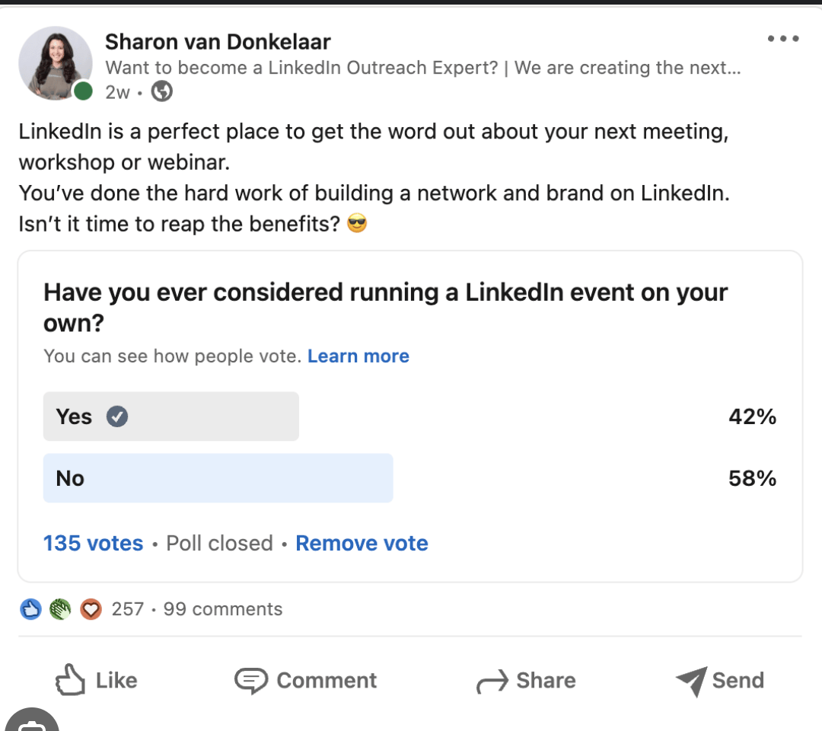
POLL EASIER JOB
COPY - LI
Fleet managers – we want to hear from you!
What’s the one thing that would make your day-to-day easier? 🚗📊
Take a moment to vote in our quick poll and let us know where the biggest impact could be.
Your input helps us shape better mobility solutions—designed around real operational challenges.
At KINTO, we’re committed to making fleet management smarter, more efficient, and more seamless for professionals like you.
👇 What would make your job as a fleet manager easier today?
Options:
Vehicle & powertrain guide
Less admin & paperwork
Fuel & trip manager
Easy insights access
#KINTO #FleetManagement #CorporateMobility #FlexibleMobility #MobilitySolutions
CONTENT BUCKET 1- JULY

Slide 22
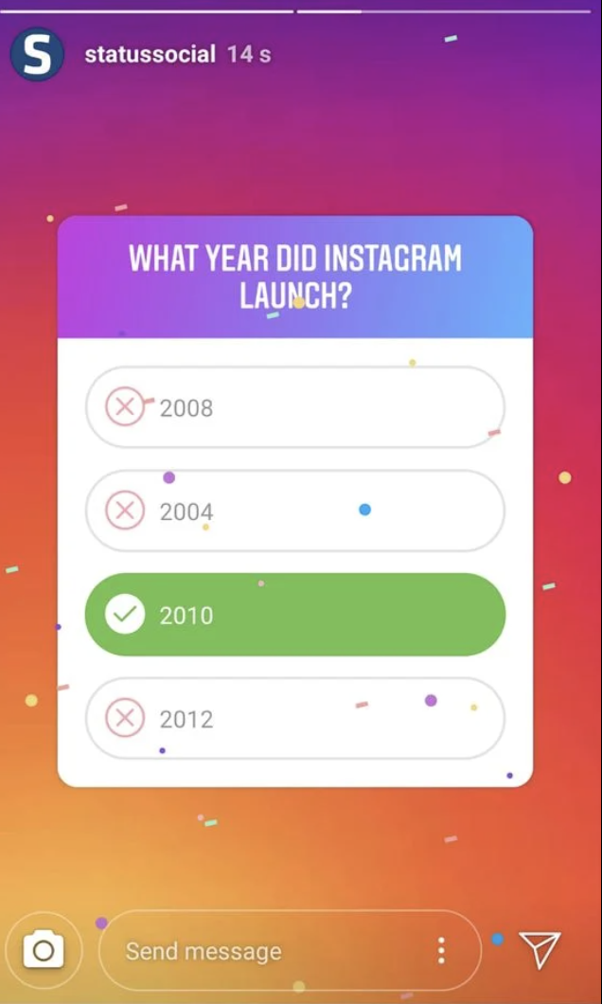
POLL EASIER JOB
COPY - IG STORY
👇 What would make your job as a fleet manager easier today?
Options:
Vehicle & powertrain guide
Less admin & paperwork
Fuel & trip manager
Easy insights access
CONTENT BUCKET 1- JULY

Slide 23
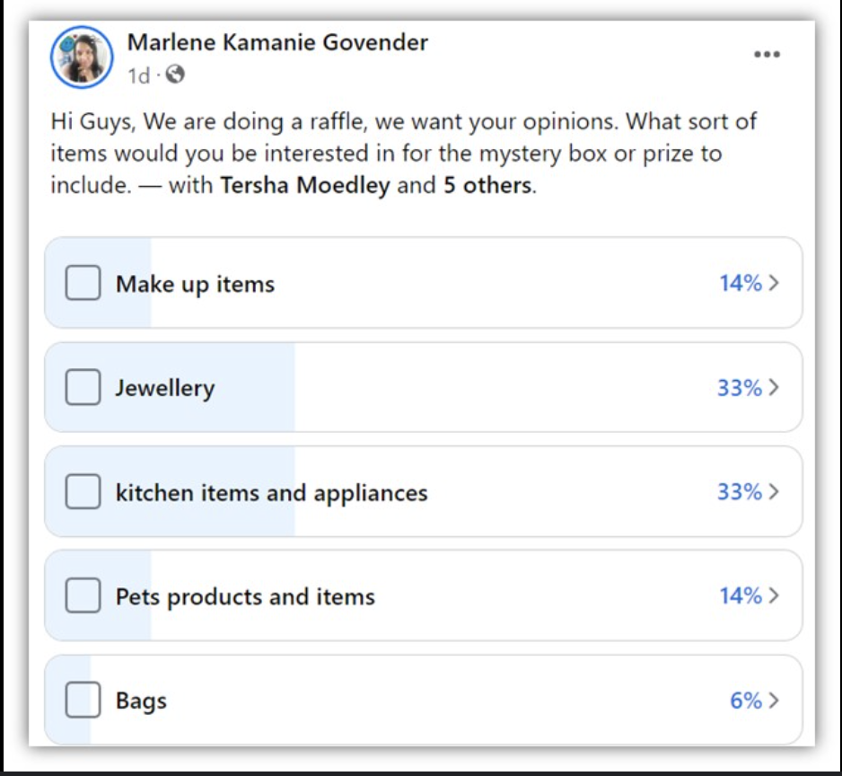
POLL EASIER JOB
COPY - FB
Fleet managers – this one’s for you!
What would take some stress out of your day? Less paperwork? Smarter tools? More clarity?
We’re always working on ways to support you better, and your vote helps us focus on the tools and features that matter most. Click and share your thoughts!
👇 What would make your job as a fleet manager easier today?
Options:
Vehicle & powertrain guide
Less admin & paperwork
Fuel & trip manager
Easy insights access
#KINTO #FleetManagement #CorporateMobility #FlexibleMobility #MobilitySolutions
CONTENT BUCKET 1- JULY

Slide 24
LOOPING VIDEO
COPY - LI
Your mobility should fit your life, not the other way around. That’s why KINTO offers tailored solutions for real people with real jobs. Whether you're managing a fleet, running a team, or working solo: you get the right car, in the right place, for the right time. It’s not just smart. It’s what works.
#KINTO #FlexibleMobility #FleetManagement #SmartCommuting #MobilitySolutions #MobilityForAll
CONTENT BUCKET 1- JULY
FORMATS AVAILABLE:
1/1 - 16/9 - 9/16 - 4/5

Slide 25
LOOPING VIDEO
COPY - IG
Different people. Different jobs. Different cars. One thing stays the same: mobility that fits. 🔁🚗
Whether you lease, rent, share or pool,
KINTO adapts to your work, your rhythm, your life. Because there’s no one-size-fits-all. There’s just what fits you.
#KINTO #FlexibleMobility #MobilityForAll #DriveYourWay #SmartCommuting
CONTENT BUCKET 1- JULY
FORMATS AVAILABLE:
1/1 - 16/9 - 9/16 - 4/5

Slide 26
LOOPING VIDEO
COPY - FB
Not everyone needs the same car. That’s why KINTO lets you choose what fits best for your job, your lifestyle, your timing.
From hybrid to electric. From city drives to country work. From one day to one year.
We keep it simple, so you can keep moving.
#KINTO #MobilityThatFits #FlexibleMobility #SmartMobility #MobilityForAll #NoHassle
CONTENT BUCKET 1- JULY
FORMATS AVAILABLE:
1/1 - 16/9 - 9/16 - 4/5

Slide 27
BEHIND THE SCENES FOLLOW ALONG
COPY - LI
Our latest shoot brings to life KINTO’s approach on designing flexible mobility solutions for every kind of driver. Because smart fleet management starts with smart choices.
#KINTO #MobilityThatFits #FlexibleMobility #SmartMobility #MobilityForAll #
CONTENT BUCKET 1- JULY
FORMATS AVAILABLE:
1/1 - 16/9 - 9/16 - 4/5

Slide 28
BEHIND THE SCENES FOLLOW ALONG
COPY - IG
🎬 A peek behind the scenes.
We recently filmed a new video showing how KINTO fits every kind of journey. And here’s what it looked like on set.
Our multiservice approach means more than just car choices. It’s about giving people and businesses the flexibility they really need. And yes, we had a lot of fun making it happen. 😄
#KINTO #MobilityThatFits #FlexibleMobility #SmartMobility #MobilityForAll #
CONTENT BUCKET 1- JULY
FORMATS AVAILABLE:
1/1 - 16/9 - 9/16 - 4/5

Slide 29
BEHIND THE SCENES FOLLOW ALONG
COPY - FB
🎥 Behind the scenes with KINTO.
Our latest shoot was all about showing how KINTO moves with you, no matter who you are or how you drive. We captured the heart of our multiservice mobility strategy in action.
#KINTO #MobilityThatFits #FlexibleMobility #SmartMobility #MobilityForAll #
CONTENT BUCKET 1- JULY
FORMATS AVAILABLE:
1/1 - 16/9 - 9/16 - 4/5

Slide 30
VISUAL INVISIBLE CAR
local fleet manager
COPY - LI:
Meet Alexa. Alexa manages a multi powertrain fleet for 200+ employees.
She's under pressure to electrify, reduce downtime, and keep total cost predictable. Her priority? A partner who simplifies everything: from contracts to reporting. That’s where KINTO fits.
#KINTO #FleetManagement #SmartMobility #SustainableFleet #CorporateMobility #MultipathStrategy
CONTENT BUCKET 1- JULY
FORMATS AVAILABLE:
1/1 - 4/5

Slide 31
VISUAL INVISIBLE CAR
local fleet manager
COPY - IG:
This is Alexa. Her fleet just went greener - and simpler. From combustion to hybrid to full electric, Alexa uses KINTO to flex and adapt. Less admin. More clarity. Just what a modern fleet manager needs. 🌿📊
#KINTO #FlexibleMobility #SmartMobility #PeaceOfMind #WorkLifeDrive
CONTENT BUCKET 1- JULY
FORMATS AVAILABLE:
1/1 - 4/5

Slide 32
VISUAL INVISIBLE CAR
local fleet manager
COPY - FB:
Alexa was buried in fleet paperwork. Now she’s not. KINTO gave her a single dashboard, simpler contracts, and cars that fit each team. Now Alexa has more time and a greener fleet.
#KINTO #FlexibleMobility #SmartMobility #PeaceOfMind #WorkLifeDrive
CONTENT BUCKET 1- JULY
FORMATS AVAILABLE:
1/1 - 4/5

Slide 33
VISUAL INVISIBLE CAR
caterer
COPY - LI:
Sam doesn’t want 10 vendors. She wants 1 partner. As an SME owner, she just wants mobility to work without the admin. And she trusts KINTO to keep it simple.
✅ Lease or rent
✅ Scale up or down
✅ All-in-one support
#KINTO #BusinessMobility #SMEs #FlexibleMobility #MobilityThatFits #PeaceOfMind
CONTENT BUCKET 1- JULY
FORMATS AVAILABLE:
1/1 - 4/5

Slide 34
VISUAL INVISIBLE CAR
caterer
COPY - IG:
Meet Sam. She runs a business, not a car fleet. That’s why she picked KINTO. One contact. One monthly cost. Zero stress. Mobility that gets out of her way. 💼🚗
#KINTO #FlexibleMobility #SmartMobility #PeaceOfMind #WorkLifeDrive
CONTENT BUCKET 1- JULY
FORMATS AVAILABLE:
1/1 - 4/5

Slide 35
VISUAL INVISIBLE CAR
caterer
COPY - FB:
💡Sam had no time to manage cars. So she didn’t. Instead, she partnered with KINTO. We take care of leasing, renting, servicing. She focuses on running her business.
#KINTO #FlexibleMobility #SmartMobility #PeaceOfMind #WorkLifeDrive
CONTENT BUCKET 1- JULY
FORMATS AVAILABLE:
1/1 - 4/5

Slide 36
VISUAL INVISIBLE CAR
global fleet manager
COPY - LI:
Thomas manages across borders and complexity. He’s in charge of a multi-country fleet. ESG goals. Local pushback. Vendor chaos. What he needs?
🔹 One framework
🔹 Unified dashboards
🔹 Centralised billing
KINTO delivers scalable, flexible mobility.
#KINTO #FlexibleMobility #FleetLeaders #ESG
CONTENT BUCKET 1- JULY
FORMATS AVAILABLE:
1/1 - 4/5

Slide 37
VISUAL INVISIBLE CAR
global fleet manager
COPY - IG:
Running a cross-border fleet isn’t easy unless you have the right partner. KINTO gives Thomas tools that scale, flex, and simplify. So he leads with confidence. 🌍📈
#KINTO #FlexibleMobility #SmartMobility #PeaceOfMind #WorkLifeDrive
CONTENT BUCKET 1- JULY
FORMATS AVAILABLE:
1/1 - 4/5

Slide 38
VISUAL INVISIBLE CAR
global fleet manager
COPY - FB:
Thomas runs a fleet across 6 countries. And sleeps at night. Thanks to KINTO, he has one contract, one dashboard, and full control. Less chaos. More strategy. That’s how mobility works, the KINTO way.
#KINTO #FlexibleMobility #SmartMobility #PeaceOfMind #WorkLifeDrive
CONTENT BUCKET 1- JULY
FORMATS AVAILABLE:
1/1 - 4/5

Slide 39

CAROUSEL EMPLOYEE QUOTE
COPY LI
Meet the faces behind KINTO! 🚗
Our team shares their favorite rides to lease and why they love them. What’s would be your perfect match?
#KINTO #PeopleOfKINTO #FlexibleMobility #CustomerExperience #SmartMobility
CONTENT BUCKET 1- JULY
FORMATS AVAILABLE:
1/1

Slide 40
CAROUSEL EMPLOYEE QUOTE
COPY IG
Ever wondered which cars our KINTO team can’t get enough of? 🤩 Swipe through to see their top picks.
Which one would you lease?
#KINTO #PeopleOfKINTO #FlexibleMobility #CustomerExperience #SmartMobility
CONTENT BUCKET 1- JULY
FORMATS AVAILABLE:
1/1

Slide 41
CAROUSEL EMPLOYEE QUOTE
COPY FB
Our team’s favorite KINTO rides? Swipe to see which cars they love to drive (and rent)! 🚗✨ Which one would fit your lifestyle?
#KINTO #PeopleOfKINTO #FlexibleMobility #CustomerExperience #SmartMobility
CONTENT BUCKET 1- JULY
FORMATS AVAILABLE:
1/1

