Slide 1

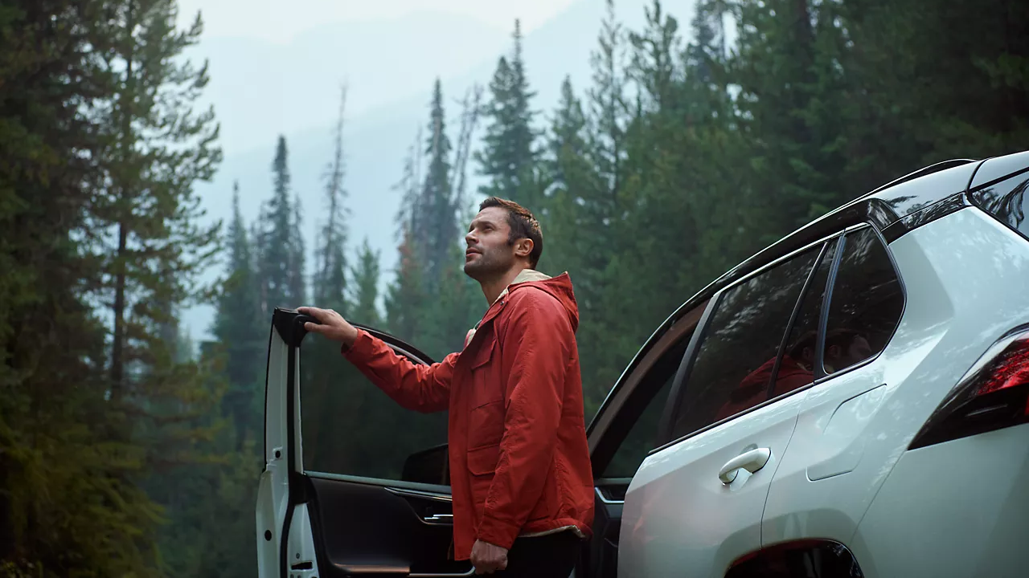

CONTENT
bucket 3 - September

Slide 2

One stop shop

Slide 3





1. ANIMATION VIDEO “THIS OR THAT” PROACE VERSION
COPY - LI:
Two Proaces. Two powertrains. One simple choice. 🚗 Which one would you choose?
With KINTO’s one stop shop, you get more than just vehicles. 💡 You get a partner who makes fleet management simple.
From selecting the perfect ride to choosing the best lease formula, it’s all in one place.
#KINTO #FleetManagement #CorporateMobility #ToyotaProace #MobilitySolutions
CONTENT BUCKET 1- SEPTEMBER
FORMATS AVAILABLE:
1/1 - 9/16 - 4/5
Notes:
#KINTO #FleetManagement #CorporateMobility #FlexibleMobility #MobilitySolutions

Slide 4

1.ANIMATION VIDEO “THIS OR THAT” PROACE VERSION
COPY - IG:
🚐 Diesel or electric? Choose what fits your business.
Swipe. Pick. Drive. Your Proace, your way.
✅ All-in-one tool
✅ Flexible lease options
✅ Reliable quality & service
KINTO, your fleet management made easy.
#KINTO #FleetManagement #CorporateMobility #OneStopShop #ToyotaProace #MobilitySolutions
CONTENT BUCKET 1- SEPTEMBER
FORMATS AVAILABLE:
1/1 - 9/16 - 4/5

Slide 5

1.ANIMATION VIDEO “THIS OR THAT” PROACE VERSION
COPY - FB:
Whether you go for diesel or electric, the Toyota Proace is ready for your business. 🤝
And with KINTO’s one stop shop, choosing, leasing and managing your fleet is all in one place.
🚐 Pick your model
🛞Choose your powertrain
🔧 Enjoy KINTO service & support
Less hassle, more time for what matters.
#KINTO #FleetManagement #CorporateMobility #ToyotaProace #MobilitySolutions
CONTENT BUCKET 1- SEPTEMBER
FORMATS AVAILABLE:
1/1 - 9/16 - 4/5

Slide 6



2. VIDEO FOLLOW ALONG - PERSONA CARPENTER
CONTENT BUCKET 1- SEPTEMBER
COPY - LI
Leo builds more than furniture. He builds trust with every client.
His secret? A Toyota Proace from KINTO that’s as reliable as his craftsmanship. 🚐
➕ Room for every tool.
➕ Flexibility for every project.
➕ Service that fits his schedule.
Work smarter. Lease with KINTO.
#KINTO #FleetManagement #SmartMobility #CorporateMobility #MobilitySolutions
FORMATS AVAILABLE:
1/1 - 16/9 - 9/16 - 4/5

Slide 7
2. VIDEO FOLLOW ALONG - PERSONA CARPENTER
COPY - IG
Leo’s morning alarm? Snoozed. ⏰ His coffee? Slow. ☕ His Proace? Always on time. 🚐
From tools to transport . He’s got it sorted.
Be like Leo. Lease with KINTO.
#KINTO #ToyotaProace #OneStopShop #FleetManagement #MobilitySolutions
CONTENT BUCKET 1- SEPTEMBER
FORMATS AVAILABLE:
1/1 - 16/9 - 9/16 - 4/5

Slide 8
2. VIDEO FOLLOW ALONG - PERSONA CARPENTER
COPY - FB
Leo is a carpenter who takes his time… with coffee and with clients. ⏳
But when it’s time to work, his Toyota Proace from KINTO is ready to roll. 🚐
✔ Space for tools and ideas
✔ Flexible leasing
✔ Service that works as hard as you do
Be like Leo. Lease with KINTO.
#KINTO #ToyotaProace #OneStopShop #FleetManagement #MobilitySolutions
CONTENT BUCKET 1- SEPTEMBER
FORMATS AVAILABLE:
1/1 - 16/9 - 9/16 - 4/5

Slide 9
Multipath/
Multiservice
Pillar 4

Slide 10
3. LONGREAD
OPEN LABS
CONTENT BUCKET 1- SEPTEMBER

Slide 11
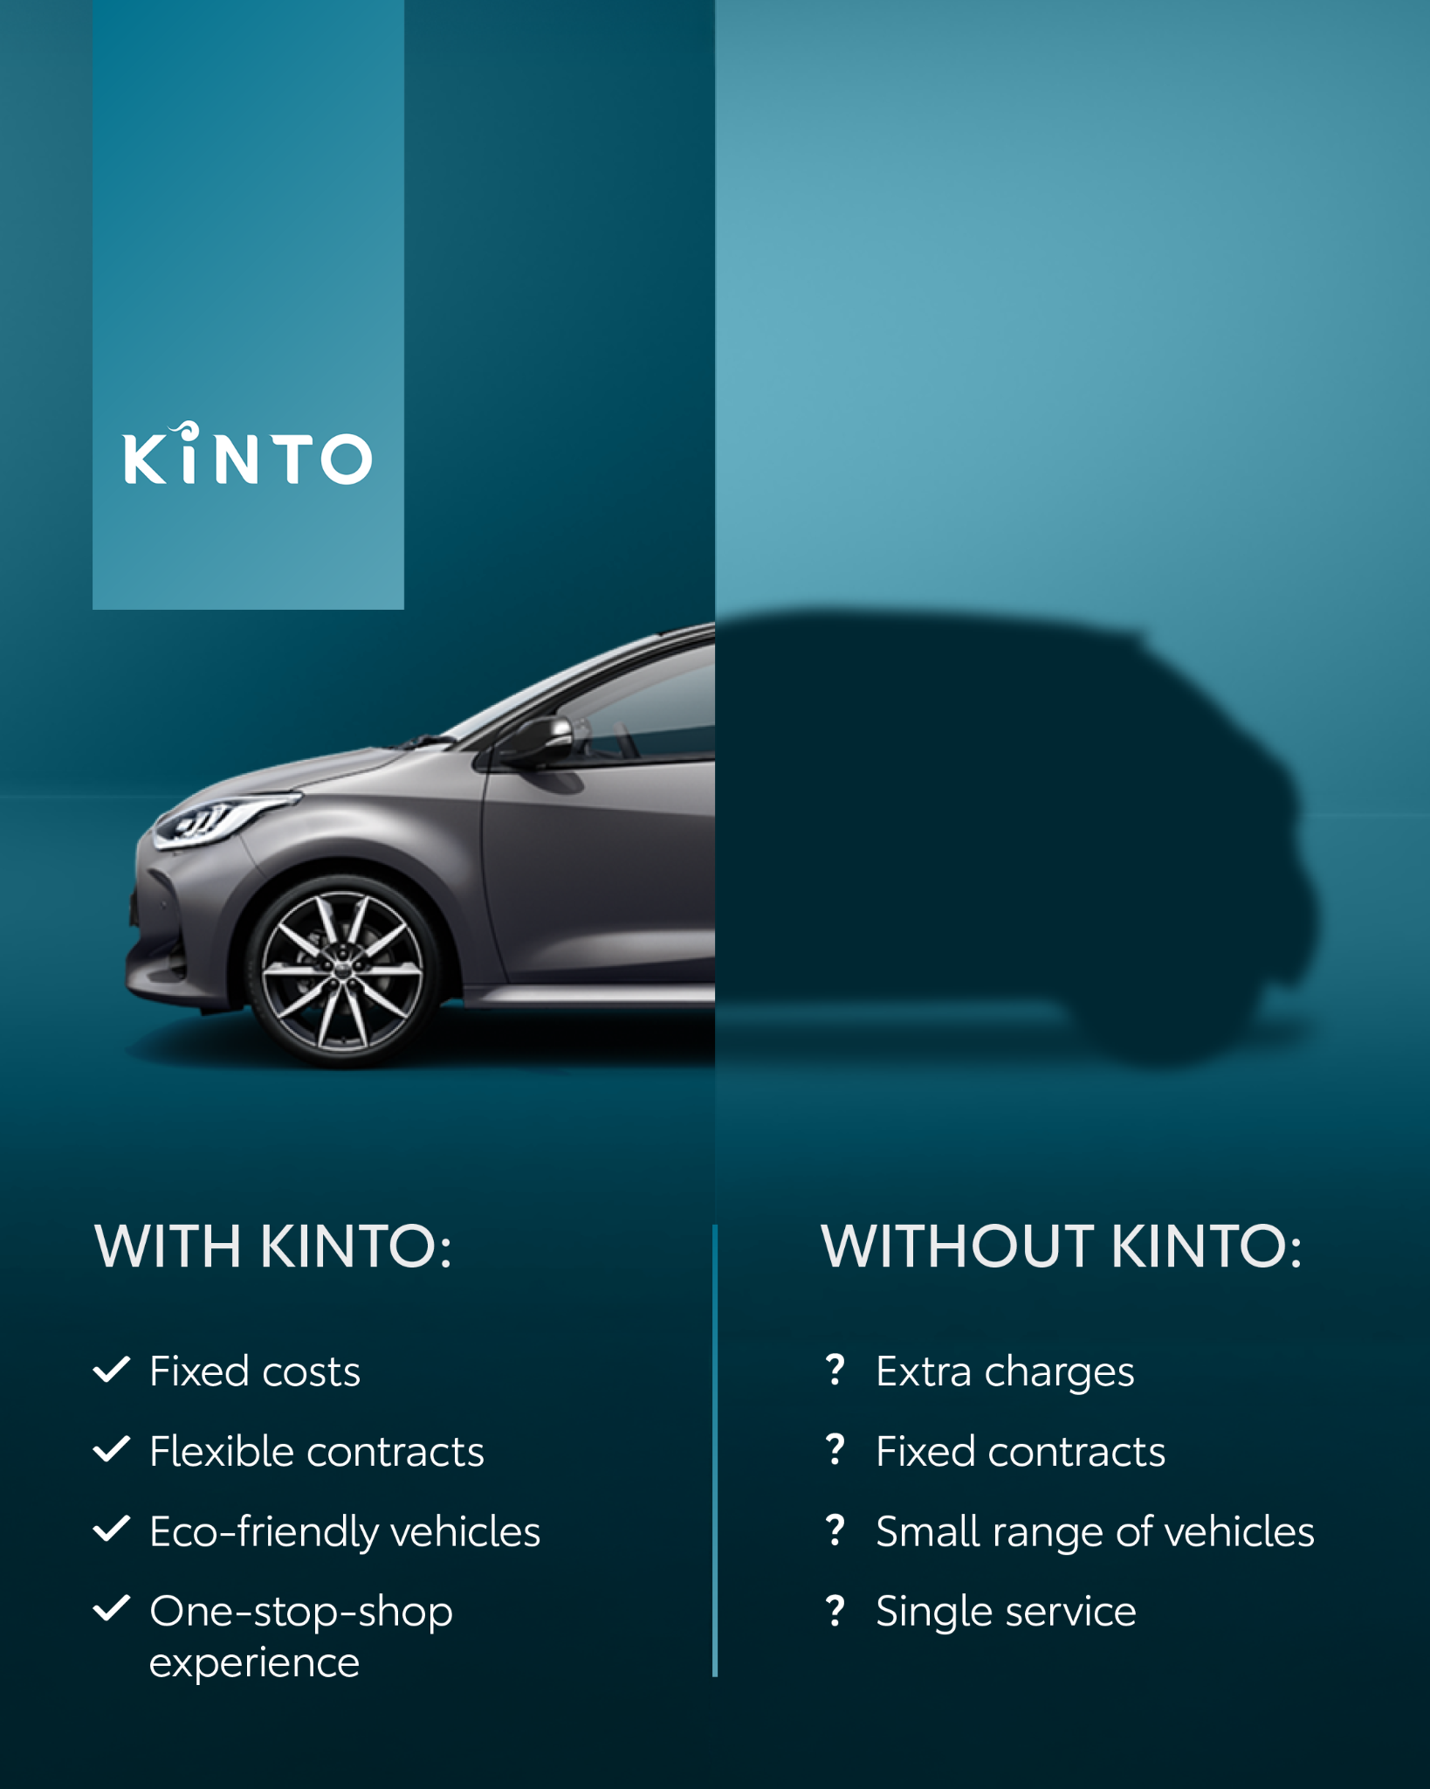
4. INFOGRAPHIC TOYOTA YARIS
COPY - LI:
Choosing the right mobility partner makes all the difference. 👇
KINTO is not just a lease program. It’s peace of mind for your fleet.
🚐 You’re backed by Toyota’s expertise
🔧 You enjoy seamless service
🤝 You can trust in quality
#KINTO #ToyotaYaris #OneStopShop #FleetManagement #MobilitySolutions
CONTENT BUCKET 1- SEPTEMBER
FORMATS AVAILABLE:
1/1 - 4/5

Slide 12
4. INFOGRAPHIC TOYOTA YARIS
COPY - IG:
Same car. ↔️ Different service.
KINTO brings you Toyota quality, expert support, and service that simply works. So you can focus on driving your business forward.
Because the right partner makes your fleet management effortless. 🤝🚐
#KINTO #ToyotaYaris #OneStopShop #FleetManagement #MobilitySolutions
CONTENT BUCKET 1- SEPTEMBER
FORMATS AVAILABLE:
1/1 - 4/5

Slide 13
4. INFOGRAPHIC TOYOTA YARIS
COPY - FB:
A Toyota Yaris doesn’t change. But your leasing experience can. ☝️
With KINTO, you get more than a car: you get expert support, reliable service, and peace of mind for your fleet. 🚐It’s the difference that makes your day easier and your business run smoother.
#KINTO #ToyotaYaris #OneStopShop #FleetManagement #MobilitySolutions
CONTENT BUCKET 1- SEPTEMBER
FORMATS AVAILABLE:
1/1 - 4/5

Slide 14
Flexible mobility solutions
Pillar 3

Slide 15




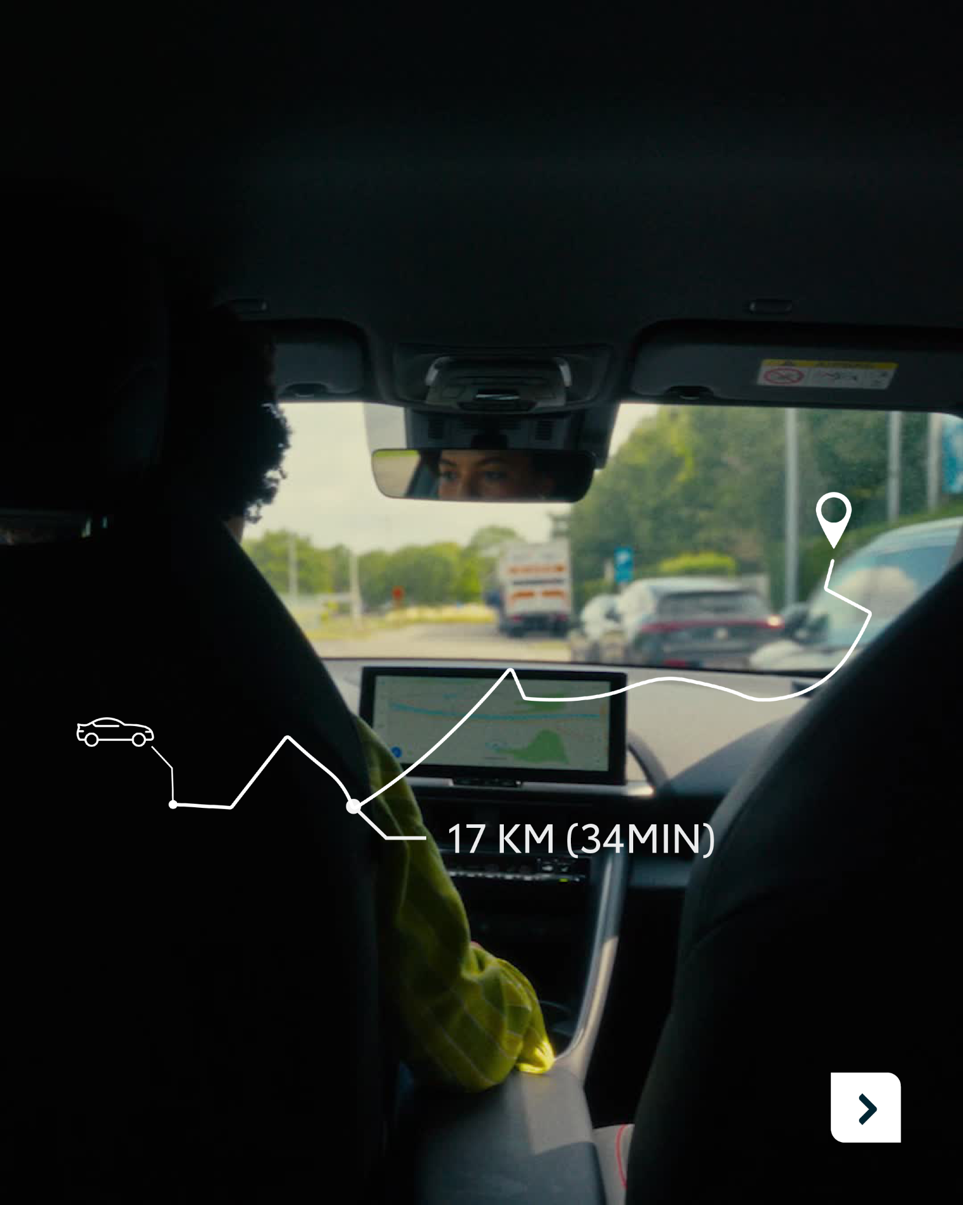

5. CAROUSEL:
YOUR DAY, THE KINTO WAY (LOCAL FLEET)
FORMATS AVAILABLE:
4/5
LI COPY:
A productive day starts with less stress and more control.
With KINTO’s flexible mobility solutions you can:
✅ Set your own lease duration, mileage & services
✅ Keep admin to a minimum
✅ Reduce your team’s carbon footprint
Better for business. Better for people.
Your day, the KINTO way.
#KINTO #FleetManagement #FlexibleMobility #CorporateMobility #MobilitySolutions

Slide 16
5. CAROUSEL:
YOUR DAY, THE KINTO WAY (LOCAL FLEET)
FORMATS AVAILABLE:
4/5
IG COPY:
Stress-free from A to B? That’s the KINTO way.
☀️ Start your day with peace of mind.
🚐 Pick the lease that fits your life.
🌱 Drive smarter, with less impact.
#KINTO #FlexibleMobility #FleetManagement #MobilitySolutions #SustainableMobility

Slide 17
5. CAROUSEL:
YOUR DAY, THE KINTO WAY (LOCAL FLEET)
FB COPY:
From your first coffee to the last meeting of the day. KINTO keeps things running smoothly.
🗓️ Keep your schedule on track
🚐 Lease on your terms, not ours
🌱 Cut costs and emissions in one go
Enjoy your day, the KINTO way.
#KINTO #FleetManagement #OneStopShop #FlexibleMobility #MobilitySolutions
FORMATS AVAILABLE:
4/5

Slide 18

6.VISUAL “THANKS TO KINTO” - OFFICE CHATS
COPY - LI:
Thanks to KINTO, office chats are no longer about “who’s got the keys?” 🔑
Our flexible mobility solutions work quietly in the background, keeping your team moving without the usual admin or stress. 🚐
Because when mobility just works, your business works better too.
#KINTO #FleetManagement #OneStopShop #FlexibleMobility #MobilitySolutions
CONTENT BUCKET 1- JULY
FORMATS AVAILABLE:
1/1 - 4/5

Slide 19
6.VISUAL “THANKS TO KINTO” - OFFICE CHATS
COPY - IG:
“Who’s got the keys?” 🔑Not your problem anymore.
With KINTO, your fleet is ready when you are. No chaos. No chasing. No last-minute stress. 👉 That’s what we call mobility without fuzz.
#KINTO #FleetManagement #OneStopShop #FlexibleMobility #MobilitySolutions
CONTENT BUCKET 1- JULY
FORMATS AVAILABLE:
1/1 - 4/5

Slide 20
6.VISUAL “THANKS TO KINTO” - OFFICE CHATS
COPY - FB:
With KINTO’s flexible mobility solutions, there’s less fuss over car keys.
🗓️ Your vehicles are booked.
🚐 Your team is on the road.
☝️And you haven’t had to lift a finger.
When mobility runs this smoothly, you get to focus on new projects. 💼
#KINTO #FleetManagement #OneStopShop #FlexibleMobility #MobilitySolutions
CONTENT BUCKET 1- JULY
FORMATS AVAILABLE:
1/1 - 4/5

Slide 21


7. VISUAL SERVICE HIGHLIGHT
COPY - LI
A company car, ready when you are? 🫵
Your day is busy and your fleet is complex. That’s why KINTO keeps things simple.
🚐 Whether you’re managing a fleet of dozens or just need a car for yourself, handle everything in one place and you’re good to go.
☝️ No long forms. No endless calls. Just flexible mobility, made easy.
#KINTO #FleetManagement #FlexibleMobility #MobilitySolutions
CONTENT BUCKET 1- JULY
FORMATS AVAILABLE:
1/1 - 4/5

Slide 22
7. VISUAL SERVICE HIGHLIGHT
COPY - IG
Whether it’s a short trip or a long lease, KINTO gets you on the road in minutes. 🚐
Confirm the time, grab the keys, and go. No fuss, no waiting, no stress. 😌
Because your work doesn’t wait…⏳ And neither should your car.
#KINTO #FleetManagement #FlexibleMobility #MobilitySolutions
CONTENT BUCKET 1- JULY
FORMATS AVAILABLE:
1/1 - 4/5

Slide 23
7. VISUAL SERVICE HIGHLIGHT
COPY - FB
Need a car for a quick job or a long-term project? 🚐
KINTO makes car pick-up easy because you can handle everything in one place.
🕐 Pick the time that works for you
🔑 Grab the keys
🏁 And you’re on the road.
Yes, it that’s simple. 👉 No stress, no waiting, no fuss. Just freedom to start your day your way.
#KINTO #FleetManagement #FlexibleMobility #MobilitySolutions
CONTENT BUCKET 1- JULY
FORMATS AVAILABLE:
1/1 - 4/5

Slide 24

8.VISUAL “THANKS TO KINTO” - GLOBAL FLEET
COPY - LI:
Finally, a partner that works as hard as you do.👇
Managing dozens of vehicles across multiple locations can feel like juggling. 🤹‍♀️
With KINTO, you keep your vehicles, costs, and schedules under control, all in one place. ✅
Big or small? Short-term or long-term?
🫵 You stay in control and your fleet runs smoothly.
#KINTO #FleetManagement #FlexibleMobility #MobilitySolutions
CONTENT BUCKET 1- SEPTEMBER
FORMATS AVAILABLE:
1/1 - 4/5

Slide 25
8.VISUAL “THANKS TO KINTO” - GLOBAL FLEET
COPY - IG:
One glance, and your fleet is under control. 🪄
No, it’s not magic. It’s mobility made easy, thanks to KINTO. 🚐
From tracking vehicles to keeping costs in check, our flexible and full-service leasing options give you the overview and peace of mind you’ve always wanted. 🤝
#KINTO #FleetManagement #FlexibleMobility #MobilitySolutions
CONTENT BUCKET 1- SEPTEMBER
FORMATS AVAILABLE:
1/1 - 4/5

Slide 26
8.VISUAL “THANKS TO KINTO” - GLOBAL FLEET
COPY - FB:
Big fleet or small, short-term or long-term? Your day just got easier. 🤝KINTO gives you clarity, flexibility, and peace of mind, all in your pocket.
Manage your fleet with ease, all in one place:
🚐 See every vehicle
📊 Track costs
🗓️ Check schedules
#KINTO #FleetManagement #FlexibleMobility #MobilitySolutions
CONTENT BUCKET 1- SEPTEMBER
FORMATS AVAILABLE:
1/1 - 4/5

Slide 27
Community & connection
Empowerment & Expertise

Slide 28

9.VIDEO
“SUMMER RECAP”
COPY - IG
This was our summer in motion: laughter on set, ideas coming to life, and people moving together. ☀️
Mobility is more than cars. 🚐 It’s the moments, the stories and the energy that drives us.
#KINTO #FleetManagement #Summer #BehindTheScenes #CorporateMobility #MobilitySolutions
CONTENT BUCKET 1- SEPTEMBER
FORMATS AVAILABLE:
1/1 - 16/9 - 9/16 - 4/5

Slide 29
9.VIDEO
“SUMMER RECAP”
COPY - LI
Summer at KINTO was full of moments that make us proud.☀️
From behind-the-scenes creativity to events that brought teams together, we saw how ideas turn into action and connections turn into impact. 💪
Mobility isn’t just about vehicles. It’s about people, collaboration, and the stories we create along the way. 👥
#KINTO #FleetManagement #Summer #BehindTheScenes #CorporateMobility #MobilitySolutions
CONTENT BUCKET 1- SEPTEMBER
FORMATS AVAILABLE:
1/1 - 16/9 - 9/16 - 4/5

Slide 30
9.VIDEO
“SUMMER RECAP”
COPY - FB
Step behind the scenes and feel the KINTO summer. ☀️
This summer, we captured more than events and photoshoots. We captured energy, teamwork, and the spark that makes KINTO more than a fleet. 🔥
From brainstorming sessions to shared laughter, every moment reminded us: mobility is about people, the stories they create, and the connections they build. 👥
#KINTO #FleetManagement #Summer #BehindTheScenes #CorporateMobility #MobilitySolutions
CONTENT BUCKET 1- SEPTEMBER
FORMATS AVAILABLE:
1/1 - 16/9 - 9/16 - 4/5

Slide 31
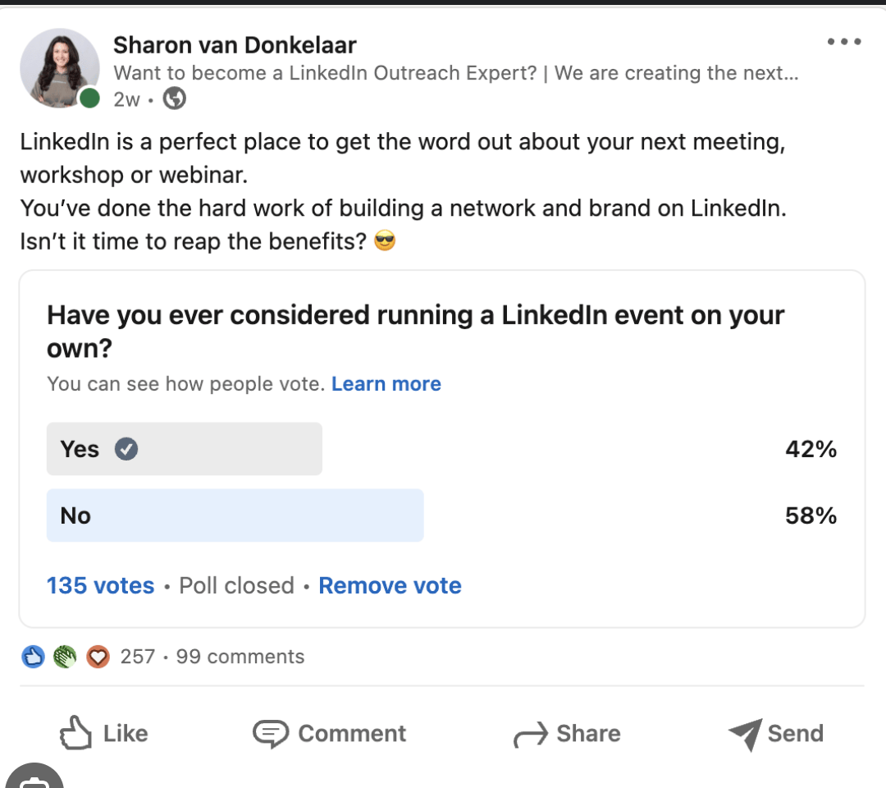
10.POLL MOST IMPORTANT FEATURE
COPY - LI
Your fleet, your rules. 🚘 Which feature drives your choices?
Some swear by fuel efficiency or electric range. Others won’t compromise on driver comfort and safety.
Cargo space? Advanced connectivity? It all matters. But what matters most to you? 🫵
Vote and share your thoughts in the comments. Let’s see what really drives your decisions.
#KINTO #FleetManagement #CorporateMobility #MobilitySolutions #Poll
Poll:
What's the most important feature in a leased company vehicle?
1. Fuel efficiency or electric range
2. Driver comfort and safety features
3. Cargo space and practicality
4. Advanced connectivity (e.g. GPS, telematics, infotainment)
CONTENT BUCKET 1- SEPTEMBER

Slide 32
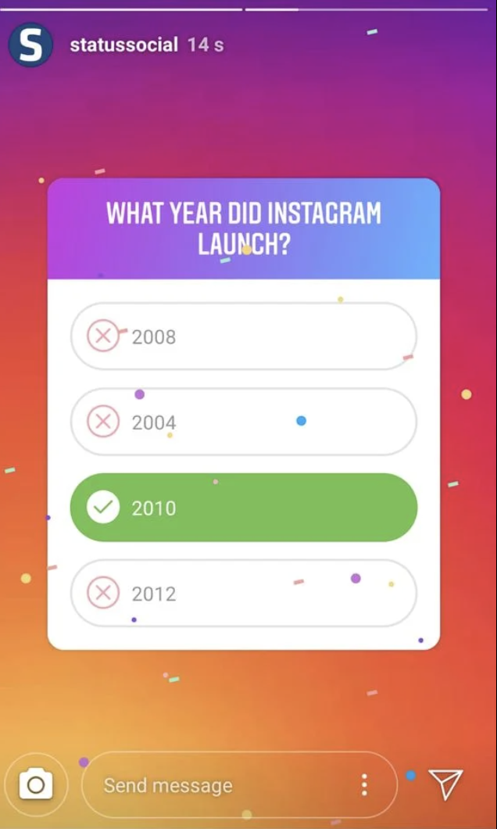
10.POLL MOST IMPORTANT FEATURE
COPY - IG STORY
Story 1 (intro)
What matters most in a company car?
Share your thoughts →
Story 2 (poll)
Top feature for your fleet?
Fuel efficiency / electric
Comfort & safety
Cargo & practicality
Connectivity & tech
Story 3 (CTA)
Thanks for voting! 👏
At KINTO, mobility adapts to you.
CONTENT BUCKET 1- SEPTEMBER

Slide 33
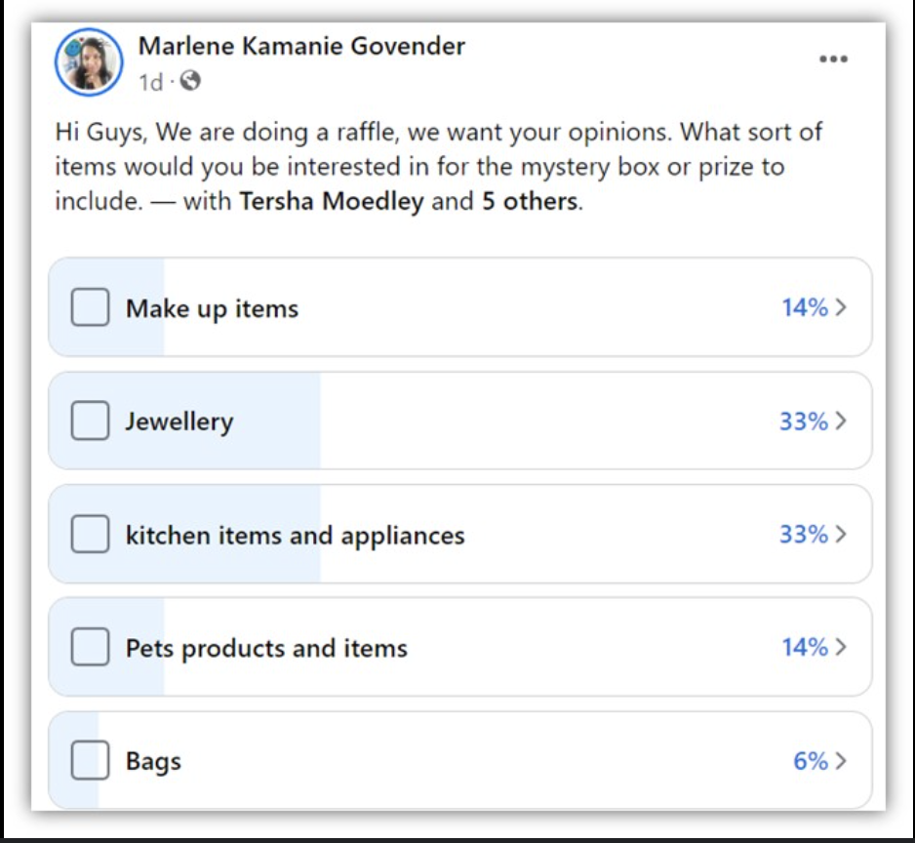
10.POLL MOST IMPORTANT FEATURE
COPY - FB
Your fleet, your priorities. 🚐 When it comes to leasing a company vehicle, every choice says something about what you value most.
👉 For some, it’s all about fuel efficiency or electric range.
👉 For others, nothing beats driver comfort and safety.
👉 And then there are those who look first at cargo space, or the latest in connectivity.
If you could pick just one, which feature would top your list? Vote and share your ideas in the comments.
#KINTO #FleetManagement #CorporateMobility #MobilitySolutions #Poll
CONTENT BUCKET 1- SEPTEMBER

Slide 34


11.CAROUSEL EMPLOYEE QUOTE
CONTENT BUCKET 1- SEPTEMBER
COPY LI
At KINTO, mobility is serious business.
Yet our people always bring in personality and fun. 🙋
We asked our colleagues: “Which emoji best describes your work at KINTO?”
👉 Swipe through to discover their answers and get to know the people behind KINTO.
#KINTO #FleetManagement #CorporateMobility #MobilitySolutions #Teamwork
FORMATS AVAILABLE:
4/5

Slide 35
11.CAROUSEL EMPLOYEE QUOTE
CONTENT BUCKET 1- SEPTEMBER
COPY IG
At KINTO, mobility is our business, but people are our heartbeat. 💙
And sometimes, the best way to describe what drives us isn’t with long sentences… but with a single emoji.
We asked our colleagues: “If your work at KINTO was an emoji, which one would it be?” 🚀🌍🔑💡
Swipe through, discover their answers and get a fun peek into the energy, creativity, and teamwork that keep KINTO moving forward.
#KINTO #FleetManagement #CorporateMobility #MobilitySolutions #Teamwork
FORMATS AVAILABLE:
4/5
Notes:
☀️🤝😌💚🔥💪✅☝️👉🫵⏰🚐🚘🫵👉👥💪💼🥳🙋

Slide 36
11.CAROUSEL EMPLOYEE QUOTE
CONTENT BUCKET 1- SEPTEMBER
COPY FB
Behind every car and contract, there’s a team that makes it happen. 💙
We asked our colleagues a fun question: “Which emoji sums up your work at KINTO?” 👉 Swipe to discover their answers and meet the team behind KINTO.
#KINTO #FleetManagement #CorporateMobility #MobilitySolutions #Teamwork
FORMATS AVAILABLE:
4/5

Slide 37


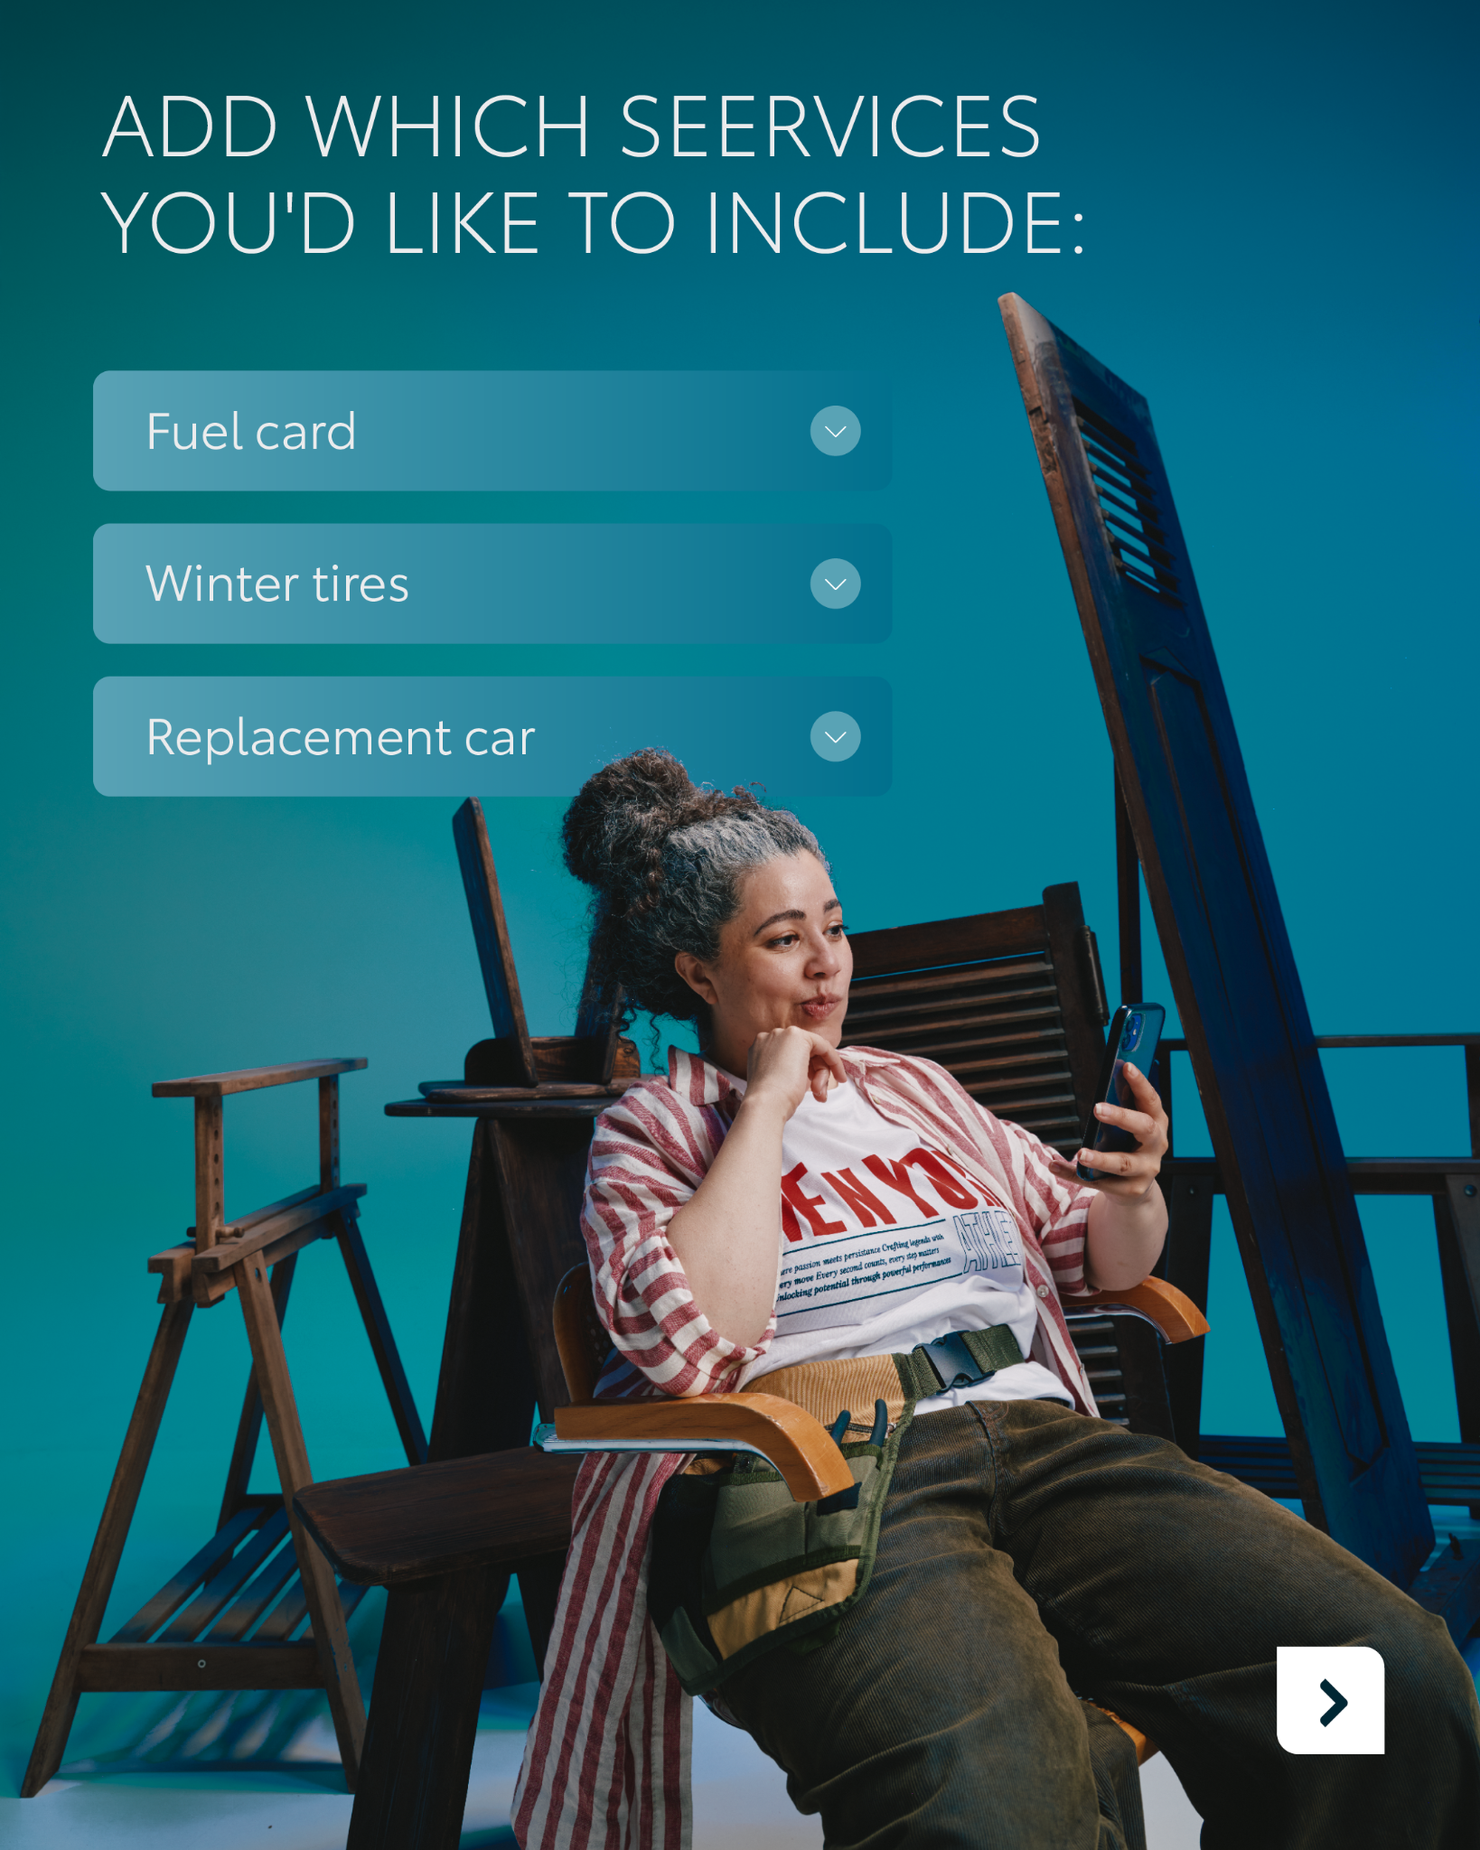
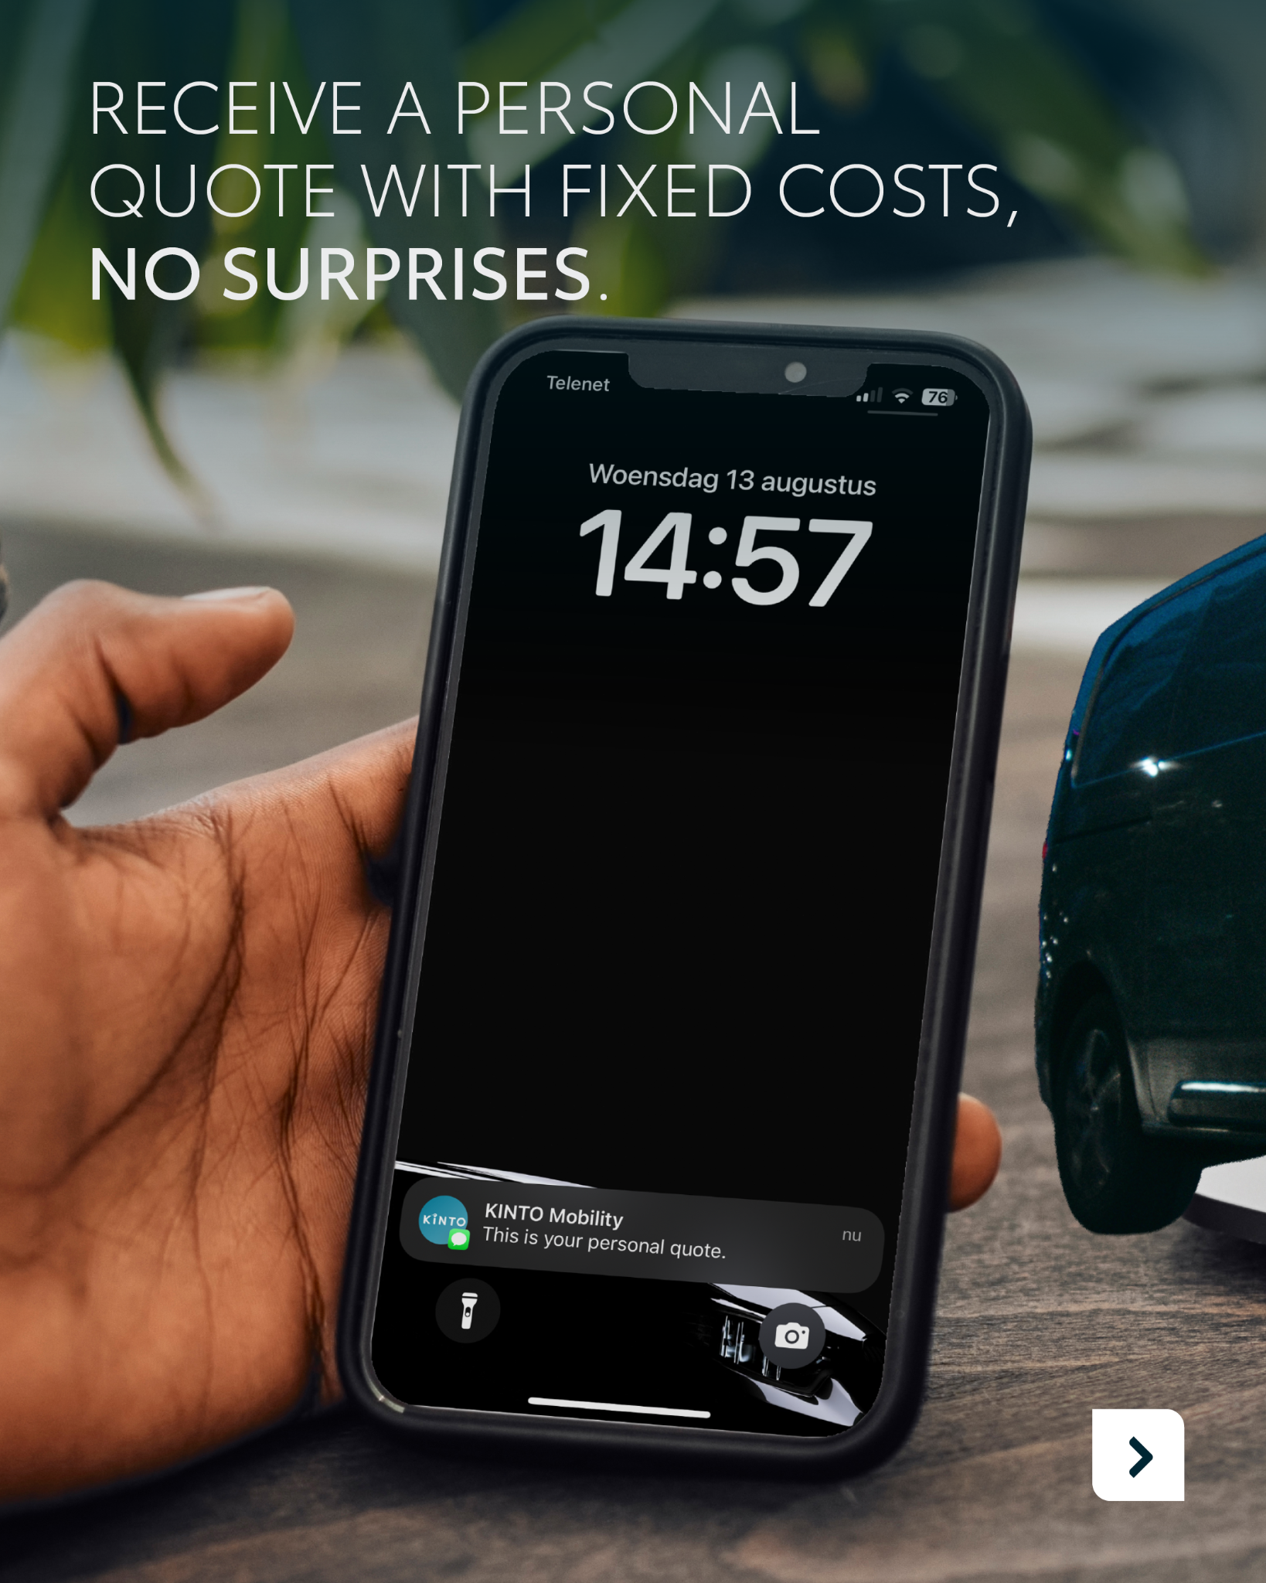

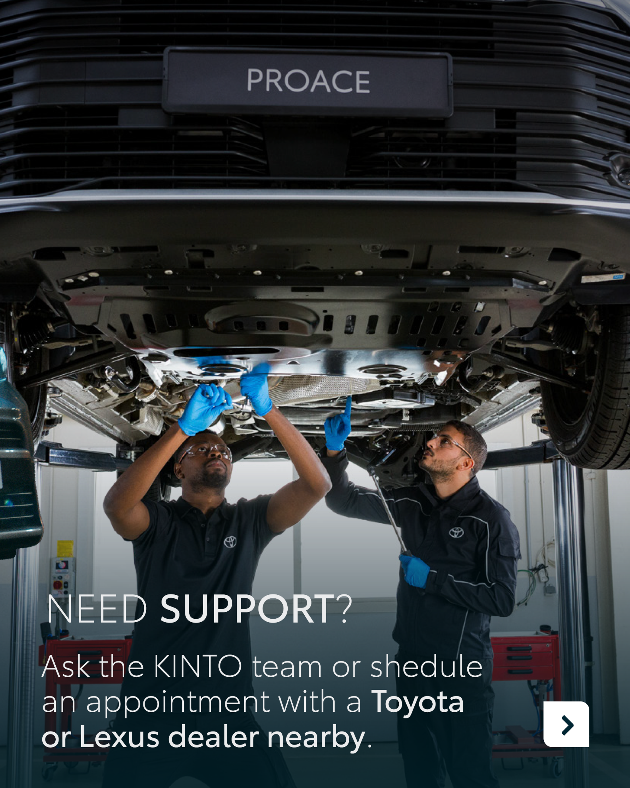
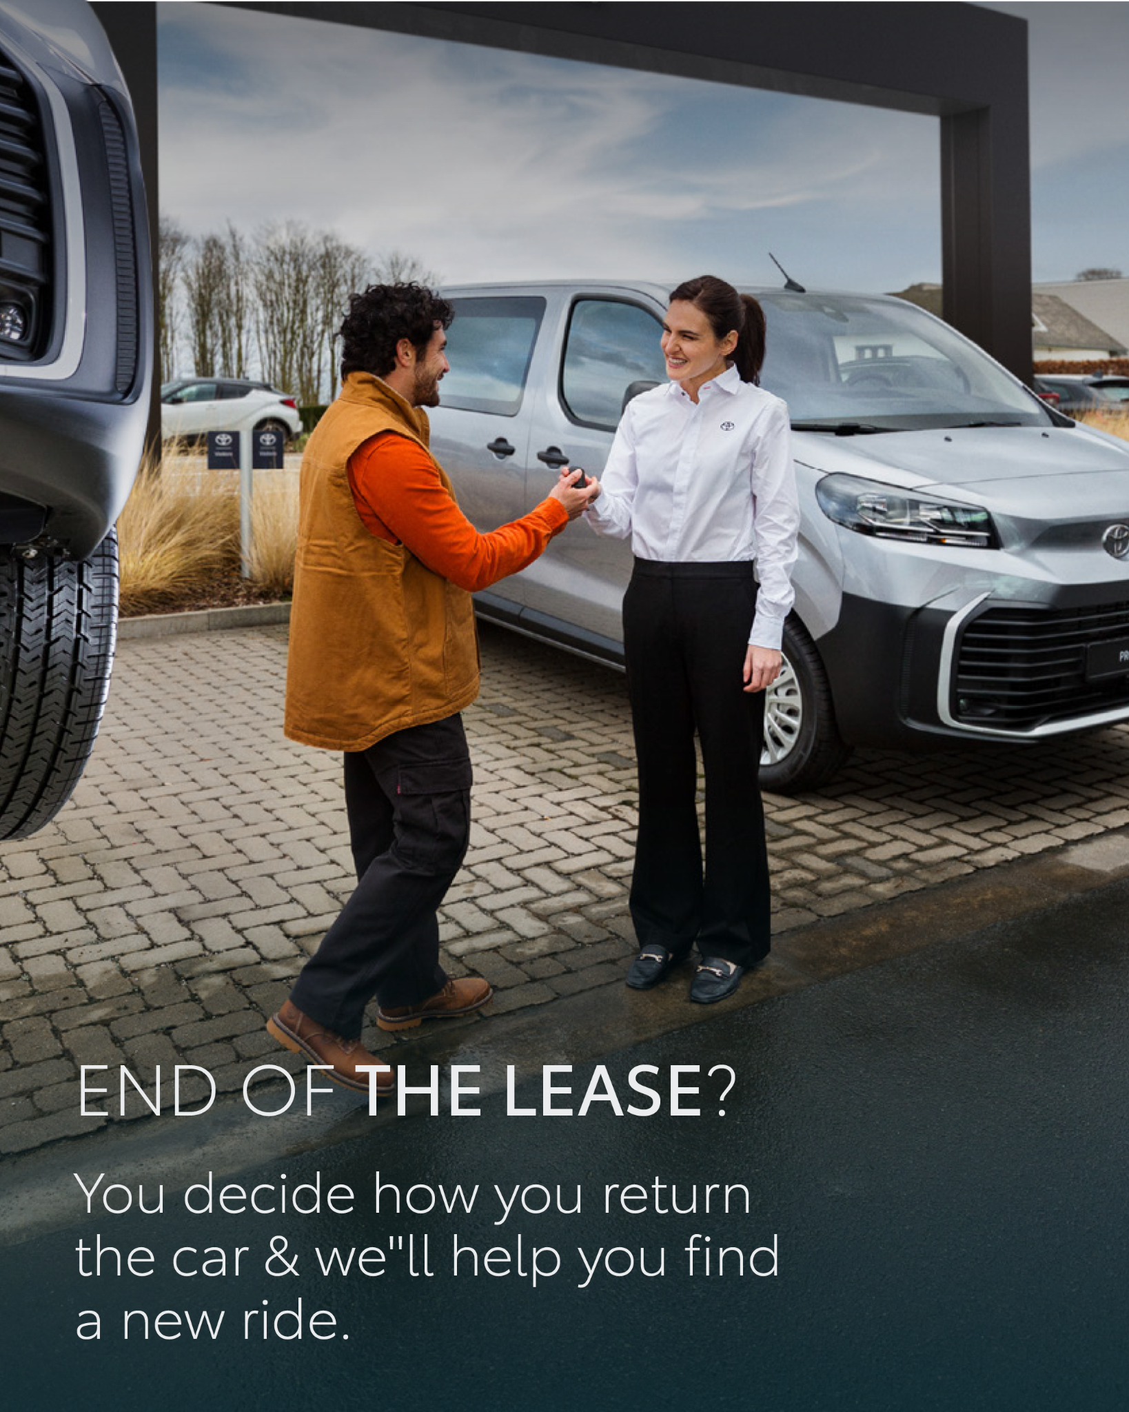
12.CAROUSEL CUSTOMER QUESTION
CONTENT BUCKET 1- SEPTEMBER
COPY LI
Thinking about leasing but not sure where to start? 🚐
👉 Swipe through our guide to see how easy leasing can be with KINTO.
From choosing your vehicle to adding services and receiving a fixed monthly cost, you stay in control—every step of the way.
With KINTO, the process is simple, transparent, and tailored to your business needs.
#KINTO #FleetManagement #CorporateMobility #MobilitySolutions #HowTo
FORMATS AVAILABLE:
4/5

Slide 38
12.CAROUSEL CUSTOMER QUESTION
CONTENT BUCKET 1- SEPTEMBER
COPY IG
With KINTO, leasing is smooth and flexible:
🚘 You choose the ride
📈 Add your extras
🤝 We take care of the rest
Your car. Your choice. Your way.
#KINTO #FleetManagement #CorporateMobility #MobilitySolutions #HowTo
FORMATS AVAILABLE:
4/5

Slide 39
12.CAROUSEL CUSTOMER QUESTION
CONTENT BUCKET 1- SEPTEMBER
COPY FB
Leasing made easy? 🚘 At KINTO, we keep it simple: pick your car, select the services that matter to you, and enjoy fixed monthly costs with no surprises.
👉 Swipe through our step-by-step guide and see how easy leasing can be.
#KINTO #FleetManagement #CorporateMobility #MobilitySolutions #HowTo
FORMATS AVAILABLE:
4/5

