Slide 1

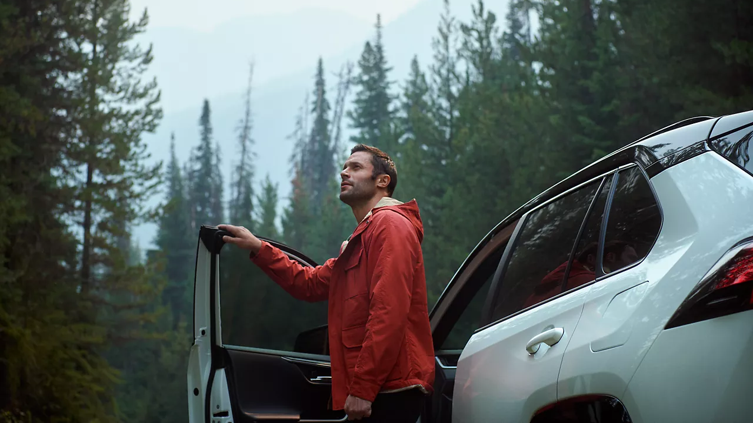

CONTENT
bucket 4 - October

Slide 2
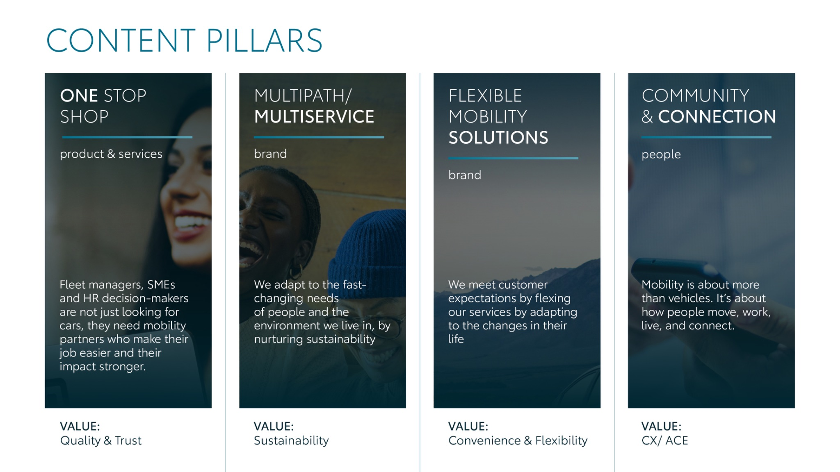
Notes:
“At KINTO, we work with content pillars: themes that carry our brand. We use different content types: inspiring, informative, topical. Your contributions add the human layer that makes the strategy work.”

Slide 3
Tag lines pillars
1. One Stop Shop
One place. Every solution. Always Kinto
2. Flexible Mobility Solutions
Wherever life takes you, Kinto finds the right solution for you
3. Community and connection (important to keep it broad enough to fit clients as well as people working at Kinto)
Join the Kinto community
4. Vision & Impact (Multipath/multiservice)
Kinto: your flexible copilot to fit your lifestyle

Slide 4

One stop shop

Slide 5





1. ANIMATION VIDEO “THIS OR THAT”
YARIS x YARIS CROSS
COPY - LI:
Does one size really fit all when it comes to your company fleet? Managing different vehicles for different roles shouldn't mean juggling multiple contracts and suppliers.
KINTO makes it simple to equip every team member with the right vehicle for their role.
✅ The agile Toyota Yaris: perfect for navigating busy urban environments.
✅ The versatile Toyota Yaris Cross: ready for longer journeys and varied terrain.
We provide flexible access to a range of quality Toyota vehicles, allowing you to build a smarter, more efficient fleet tailored to your business.
Discover the right fit for your team at kinto-mobility.eu
One place. Every solution. Always KINTO.
#KINTO #FleetManagement #OneStopShop #CorporateMobility #FlexibleMobility #MobilitySolutions #ToyotoYaris
CONTENT BUCKET 1- OCTOBER
FORMATS AVAILABLE:
1/1 - 9/16 - 4/5
Notes:
#KINTO #FleetManagement #CorporateMobility #FlexibleMobility #MobilitySolutions

Slide 6

1.ANIMATION VIDEO “THIS OR THAT”
YARIS x YARIS CROSS
COPY - IG:
City explorer or weekend adventurer? 🧭
Your ambition, your choice. Whether it's the city-smart Toyota Yaris or the ready-for-anything Toyota Yaris Cross, KINTO provides the wheels to match your workday. 🚗
Mobility that adapts to you? One place. Every solution. Always KINTO.
Check the link in bio to learn more.
#KINTO #ThisOrThat #ToyotaYaris #ToyotaYarisCross #OneStopShop #MobilitySolutions #DriveYourBusiness
CONTENT BUCKET 1- OCTOBER
FORMATS AVAILABLE:
1/1 - 9/16 - 4/5

Slide 7

1.ANIMATION VIDEO “THIS OR THAT” YARIS x YARIS CROSS
COPY - FB:
City streets or country roads? Your business needs a fleet that can handle both. 🚗
With KINTO, you can easily provide the right vehicle for any task. Choose the compact and efficient Toyota Yaris for your urban team, or the adventurous Toyota Yaris Cross for those who need a bit more versatility.
Ready to offer your team more flexibility? One place. Every solution. Always KINTO.
CONTENT BUCKET 1- OCTOBER
FORMATS AVAILABLE:
1/1 - 9/16 - 4/5

Slide 8



2. VIDEO FOLLOW ALONG - GLOBAL FLEET MANAGER
CONTENT BUCKET 1- OCTOBER
COPY - LI
For a Global Fleet Manager like Anna, a calm morning isn't a luxury. It's the result of a smart system.
Thanks to her partnership with KINTO, everything is streamlined on a single platform.
✅ Complete overview of the entire fleet.
✅ One point of contact for all mobility needs.
✅ Less admin, more time for strategic decisions.
When your mobility partner works as a one-stop-shop, you're not just managing vehicles; you're driving business forward.
Discover how to simplify your fleet management. 💼
#KINTO #FleetManagement #CorporateMobility #OneStopShop
FORMATS AVAILABLE:
1/1 - 16/9 - 9/16 - 4/5

Slide 9
2. VIDEO FOLLOW ALONG - GLOBAL FLEET MANAGER
COPY - IG
Packed schedule? Busy day ahead? For Global Fleet Manager Anna, that's business as usual. So what's her secret to a smooth start? 🤫
Her mobility partner, KINTO, handles the details as a true one-stop-shop.
💡 All vehicles for her team managed in one place.
💡 One clear monthly invoice without surprises.
💡 Happy drivers and less admin for her.
When your fleet runs this smoothly in the background, you can focus on the road ahead. Be like Anna!
Learn more about our all-in-one solutions. 🚗
#KINTO #OneStopShop #FleetManagement #MobilitySolutions
CONTENT BUCKET 1- OCTOBER
FORMATS AVAILABLE:
1/1 - 16/9 - 9/16 - 4/5

Slide 10
2. VIDEO FOLLOW ALONG - GLOBAL FLEET MANAGER
COPY - FB
Anna's alarm? 8 AM. ⏰ Her schedule? Packed. Her KINTO? Ready when she is. 🚗
From home office to head office. No morning chaos, just a smooth start to a busy day thanks to her mobility partner that handles all the details.
Be like Anna. Lease with KINTO. 💡
CONTENT BUCKET 1- OCTOBER
FORMATS AVAILABLE:
1/1 - 16/9 - 9/16 - 4/5

Slide 11

3. VIDEO CAR TROUBLE
COPY - LI:
Is "part-time mechanic" in your job description? It shouldn't be.
A single vehicle breakdown can derail your team's entire day, pulling you away from your real job: managing the fleet.
With KINTO's all-in service, you get more than just vehicles. You get a partner that handles the unexpected, so you don't have to.
✅ In house maintenance and repairs
✅ Assistance to ensure business continuity
✅ Peace of mind knowing it's all taken care of
Stop fixing, start managing. We'll handle the wrenches. 🔧
Discover our all-in-one leasing solutions today.
#KINTO #FleetManagement #OneStopShop #VehicleMaintenance #CorporateMobility
CONTENT BUCKET 1- OCTOBER
FORMATS AVAILABLE:
1/1 - 9/16 - 4/5
Notes:
#KINTO #FleetManagement #CorporateMobility #FlexibleMobility #MobilitySolutions

Slide 12
3. VIDEO CAR TROUBLE
COPY - IG:
From roadside chaos to total calm. 🔧
One call is all it takes for Simon. Maintenance, repairs, and assistance are all handled by his one-stop-shop partner KINTO.
Don't be like the old Simon. Let the pros handle it. 🚗
#KINTO #OneStopShop #FleetManagement #CorporateMobility #FlexibleMobility #MobilitySolutions
CONTENT BUCKET 1- OCTOBER
FORMATS AVAILABLE:
1/1 - 9/16 - 4/5

Slide 13
3. VIDEO CAR TROUBLE
COPY - FB:
Fleet manager, logistics expert... Part-time mechanic? 🤔
Simon's job title was getting a little long.Before KINTO, any vehicle problem was his headache.
Now, KINTO’s one-stop-shop solution is his peace of mind.
Thanks to our all-in service, one call handles everything:
🔧 Professional repairs & maintenance
🚗 Replacement vehicles to keep business moving
🤝 24/7 roadside assistance
Ready to simplify your job description? Let us handle the details.
CONTENT BUCKET 1- OCTOBER
FORMATS AVAILABLE:
1/1 - 9/16 - 4/5

Slide 14
Multipath/
Multiservice
Pillar 4

Slide 15
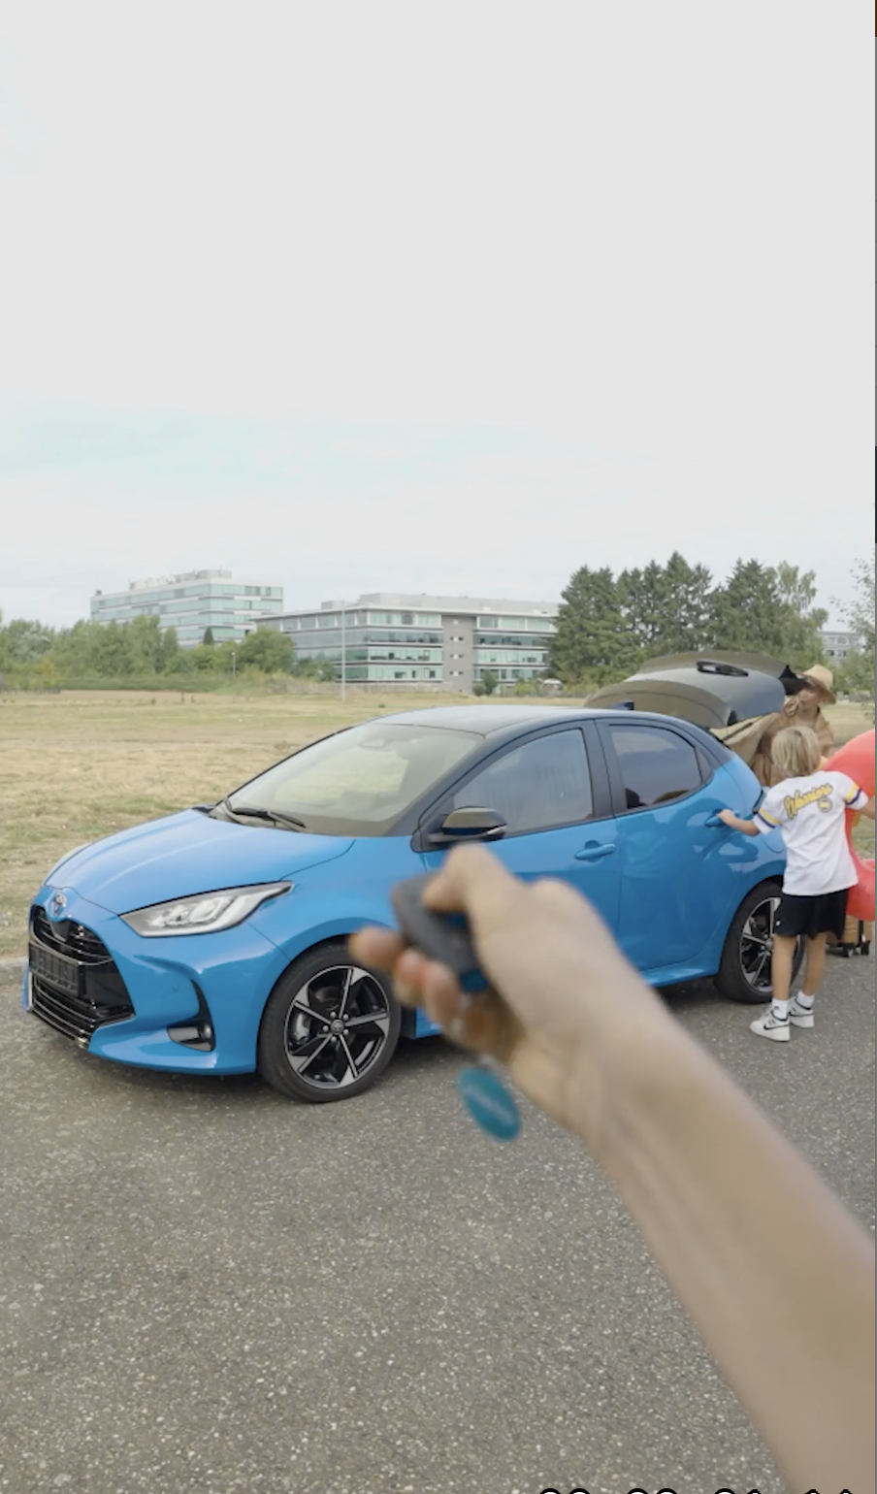
4. VIDEO JUMPCUTS
COPY - LI
The modern workday isn't linear, and neither are your employees' mobility needs.
KINTO provides solutions that adapt to both your people's changing needs and our planet's. We empower your team to choose the right mobility for every moment:
✅ Support every facet of their life: from solo commutes to family trips.
✅ Promote smarter, sustainable choices with access to a range of eco-friendly vehicles.
Offer mobility that truly works for your team and your sustainability goals. 🔄
#KINTO #FleetManagement #CorporateMobility #Sustainability #ESG #EmployeeBenefits #FutureOfWork
CONTENT BUCKET 1- OCTOBER
FORMATS AVAILABLE:
1/1 - 16/9 - 9/16 - 4/5

Slide 16
4. VIDEO JUMPCUTS
COPY - IG
Your office? Your family commute? Your express lunch spot? Your carpool ride? 🔄
Your life isn't one-size-fits-all. Why should your mobility be?
KINTO provides one flexible solution for all the paths you take. By choosing the right ride for every journey, you’re not just making your life easier. You’re making a smarter, greener choice. ✅
That’s mobility that adapts to you, and for the planet. 🌍Discover mobility that moves with you.
#KINTO #FleetManagement #CorporateMobility #WorkLifeBalance #FlexibleMobility #MobilitySolutions #Sustainability
CONTENT BUCKET 1- OCTOBER
FORMATS AVAILABLE:
1/1 - 16/9 - 9/16 - 4/5

Slide 17
4. VIDEO JUMPCUTS
COPY - FB
Your car is more than just a way to move. It's your quiet moment before a meeting or the family ride for weekend trips. 🚗 But what if your mobility could be as flexible as your life and kinder to the planet?
With KINTO, you get one business mobility solution that seamlessly adapts to every role you play, while offering access to efficient, eco-friendly vehicles. It's the freedom you need, with the sustainability we all want. 💚
Ready for fleet management that fits your life and your values? 💡
CONTENT BUCKET 1- OCTOBER
FORMATS AVAILABLE:
1/1 - 16/9 - 9/16 - 4/5

Slide 18
5. LONGREAD FLEET DAYS EVENT
CONTENT BUCKET 1- OCTOBER

Slide 19
Flexible mobility solutions
Pillar 3

Slide 20

6. VISUAL HALLOWEEN
COPY - LI:
What's the scariest thing a fleet manager can face? 👻
A chorus of unexpected calls about breakdowns, maintenance, or last-minute vehicle needs.
KINTO helps you exorcise those scary calls. Our flexible, all-in-one platform is designed to handle the unexpected, providing one simple point of contact for your team. The result is less chaos for them, and more control for you.
So the only chills you experience are the fun kind. Happy Halloween! 🎃
Wherever life takes you, Kinto finds the right solution for you.
#FleetManagement #FlexibleMobility #CorporateMobility #Halloween
CONTENT BUCKET 1- OCTOBER
FORMATS AVAILABLE:
1/1 - 4/5

Slide 21
6. VISUAL HALLOWEEN
COPY - IG:
Fleet managers, fear no more. Kinto takes care of the scary calls. ☎️👻
Don't let endless calls turn your day into a horror story. With KINTO's flexible mobility solutions, everything from maintenance to replacement vehicles, roadside assistance and 24/7 support is handled.
Wherever life takes you, Kinto finds the right solution for you.
#FleetManagement #FlexibleMobility #CorporateMobility #Halloween
CONTENT BUCKET 1- OCTOBER
FORMATS AVAILABLE:
1/1 - 4/5

Slide 22
6. VISUAL HALLOWEEN
COPY - FB:
Does your phone sound a little too much like a haunted house sometimes? 📞👻
With KINTO, you get a flexible partner that acts as your ghostbuster for fleet problems. Our all-in-one service means your drivers have one number to call for everything, giving you the peace of mind to focus on your real job.
This year, trade the scary calls for a treat. Happy Halloween from all of us at KINTO! 🎃
Wherever life takes you, Kinto finds the right solution for you .
CONTENT BUCKET 1- OCTOBER
FORMATS AVAILABLE:
1/1 - 4/5
Notes:
👻🧙‍♀️🎃🧛‍♀️🧟‍♀️📞☎️

Slide 23
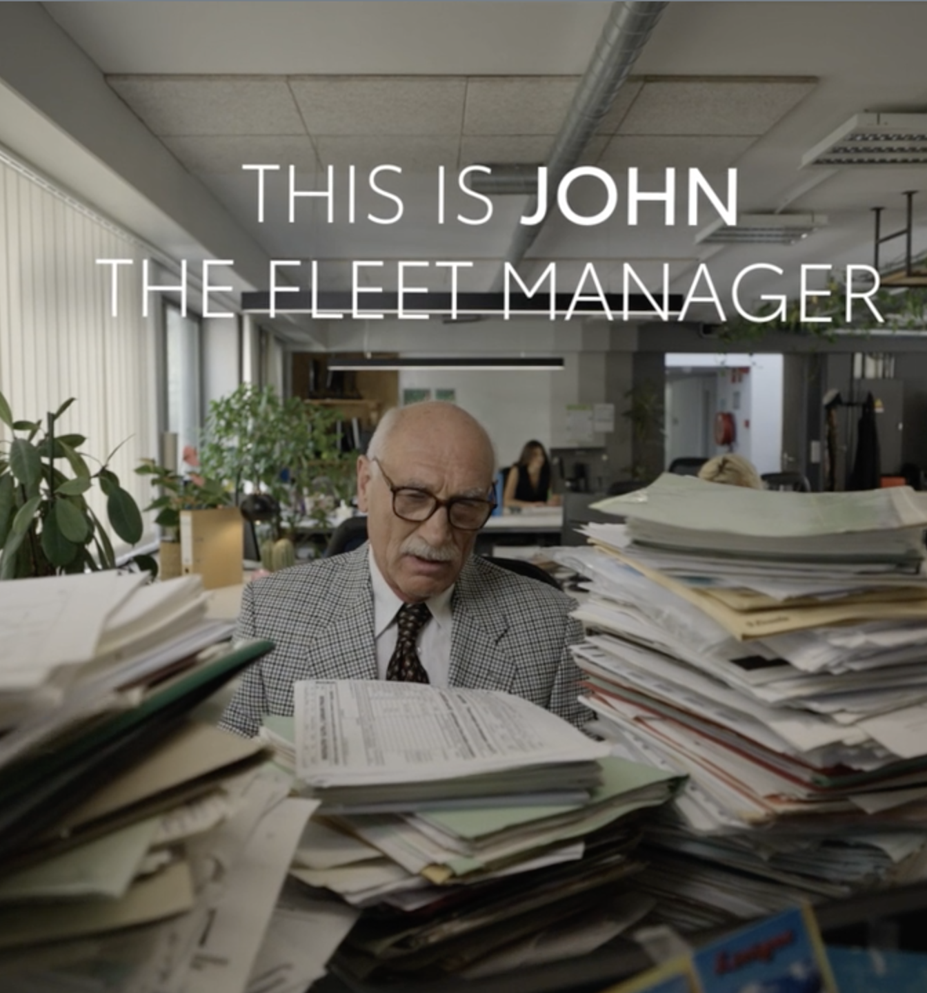
7. VIDEO PAPERWORK
COPY - LI:
Invoices, contracts, and reports can easily become a full-time job in itself.
Be like John. He partners with KINTO to trade paperwork for productivity.
We consolidate your fleet's admin into one simple, overview. The result?
✅ Less time wasted on paperwork.
✅ More time available for strategy.
✅ A clear desk and a clearer mind to focus on what matters.
Discover a smarter way to manage your fleet. 📊
#KINTO #FleetManagement #DigitalTransformation #CorporateMobility #FlexibleMobility #MobilitySolutions
CONTENT BUCKET 1- OCTOBER
FORMATS AVAILABLE:
1/1 - ⅘ - 16/9 - 9/16

Slide 24
7. VIDEO PAPERWORK
COPY - IG:
From paper-pocalypse to peace of mind? 📊
John swapped stacks of invoices for a single, smart KINTO solution. Now, whether he's managing daily admin or adding new vehicles for a project, it's all just a few clicks away. The result? Less chaos, more control.
Ready for a smarter workflow that grows with you? Be like John. Simplify your fleet management with KINTO. ✅
#KINTO #FleetManagement #CorporateMobility #FlexibleMobility #MobilitySolutions #WorkSmarter
CONTENT BUCKET 1- OCTOBER
FORMATS AVAILABLE:
1/1 - ⅘ - 16/9 - 9./16

Slide 25
7. VIDEO PAPERWORK
COPY - FB:
After KINTO, John's desk is just a desk again. His coffee is hot. And that invoice? It's two clicks away. ✅
But the real game-changer is the flexibility. When a new project starts next month, adding five more cars to his fleet will be just as simple. No new stacks of paperwork, no complex contracts.
It's amazing what a simple, flexible system can do for your workday. 🤝
Ready to reclaim your desk (and your peace of mind)? Discover how KINTO simplifies everything.
CONTENT BUCKET 1- OCTOBER
FORMATS AVAILABLE:
1/1 - ⅘ - 16/9 - 9/16

Slide 26

8. VIDEO COSTS
LINK TO VIDEO
https://limecraft.hotelhungaria.be/api/s/sgLC5N7_D4s
COPY - LI:
Can you confidently say you have a clear overview of your total fleet costs?
Analyzing expenses, digging through endless invoices, complex spreadsheets, … It can be a process that costs valuable time and offers little clarity.
KINTO changes that by bringing your scattered data into one place.
✅ Track spending with ease.
✅ Make informed, data-driven decisions.
✅ Stay in control of your budget, without the headache.
Be like Sarah. Lease with KINTO and gain the insights you need to move your business forward. 📊
#KINTO #FleetManagement #CorporateMobility #FlexibleMobility #MobilitySolutions
CONTENT BUCKET 1- OCTOBER
FORMATS AVAILABLE:
1/1 - ⅘ - 16/9 - 9/16
Notes:
#KINTO #FleetManagement #CorporateMobility #FlexibleMobility #MobilitySolutions

Slide 27
8. VIDEO COSTS
COPY - IG:
From invoice chaos to budget clarity. 📈
Sarah swapped endless spreadsheets for one simple KINTO overview.
Now she doesn't just see her costs—she sees opportunities. With clear data, she can flexibly adapt her fleet for new projects, confident she's making the smartest financial choice.
Be like Sarah. Get the control to stay flexible. ✅
#KINTO #FleetManagement #CorporateMobility #FlexibleMobility #MobilitySolutions
CONTENT BUCKET 1- OCTOBER
FORMATS AVAILABLE:
1/1 - ⅘ - 16/9 - 9./16

Slide 28
8. VIDEO COSTS
COPY - FB:
Trying to make sense of a mountain of invoices and receipts? Sarah knows the feeling. 😫
Before KINTO, analyzing her fleet's costs was a complicated puzzle. Now, she has all the key information in one place.
No more guesswork, just the confidence to adapt and grow.
Ready to simplify your fleet's finances? 📊
CONTENT BUCKET 1- OCTOBER
FORMATS AVAILABLE:
1/1 - ⅘ - 16/9 - 9/16

Slide 29
Community & connection
Empowerment & Expertise

Slide 30

9.VIDEO
REVIEW PROACE
COPY - IG
Lease it or leave it? 🚐 We skipped the sales pitch and handed the keys of the electric Toyota Proace to two craftsmen. Their mission: see if it could handle their tools, their schedule, and their high standards.
Think it passed the test? Watch the full, unfiltered review to find out! Link in bio.
#KINTO #FleetManagement #MobilitySolutions #Review #Tested #ToyotaProAce
CONTENT BUCKET 1- OCTOBER
FORMATS AVAILABLE:
1/1 - 16/9 - 9/16 - 4/5
Notes:
☀️🤝😌💚🔥💪✅☝️👉🫵⏰🚐🚘🫵👉👥💪💼🥳🙋

Slide 31
9.VIDEO
REVIEW PROACE
COPY - LI
Lease it or leave it? 🚐
We asked two craftsmen to put the electric Toyota Proace through a real-world test.
Their focus wasn't on specs, but on the practical questions every business owner has:
✅ Will our tools and materials fit?
✅ Is the leasing process actually straightforward?
✅ Does it truly make our workday easier?
Watch the full review to see if it passes the test, and learn more about our flexible solutions for professionals. 🧭
#KINTO #FleetManagement #MobilitySolutions #Review #Tested #ToyotaProAce
CONTENT BUCKET 1- OCTOBER
FORMATS AVAILABLE:
1/1 - 16/9 - 9/16 - 4/5
Notes:
#KINTO #FleetManagement #CorporateMobility #FlexibleMobility #MobilitySolutions

Slide 32
9.VIDEO
REVIEW PROACE
COPY - FB
What happens when you give two craftsmen the keys to a brand-new electric van and just say... "See what you think"? 🤔
We took a Toyota Proace to a professional's workplace to see if it passed the ultimate test: could it handle all the tools and equipment of their trade? 🔧
See their honest verdict in the video! 👇
Ready for a vehicle that works as hard as you do? Learn more about our solutions at kinto-mobility.eu.
CONTENT BUCKET 1- OCTOBER
FORMATS AVAILABLE:
1/1 - 16/9 - 9/16 - 4/5

Slide 33

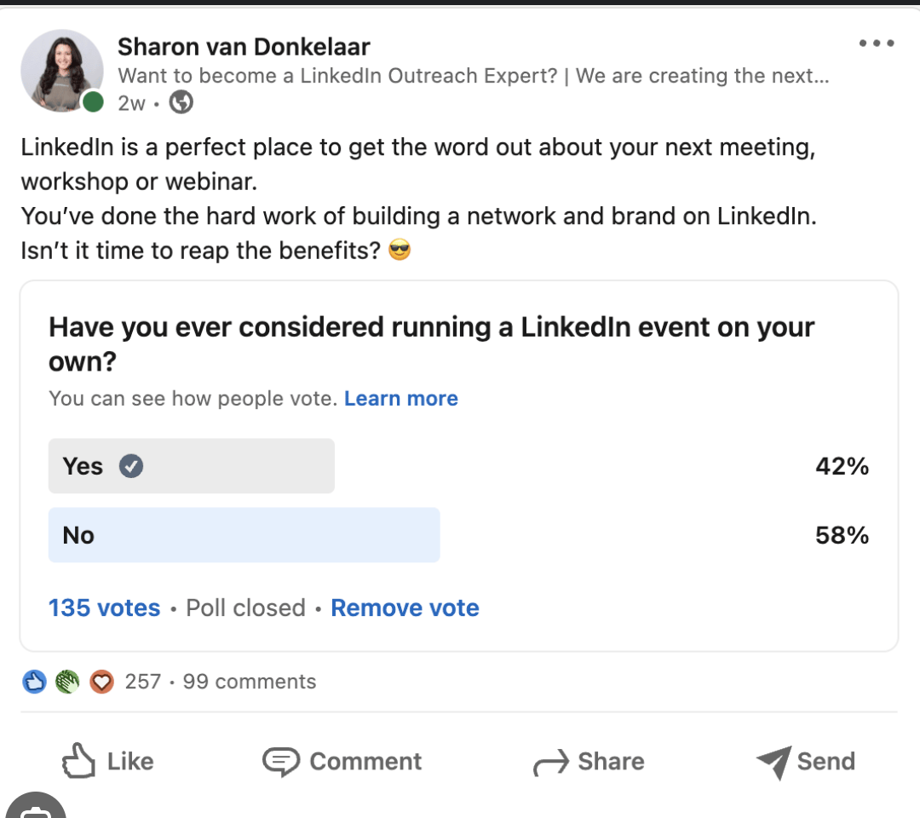
10.POLL BIGGEST IMPACT
COPY - LI
What has the biggest impact on the drivers' satisfaction with leased vehicles?
Vehicle comfort and interior quality
Ease of maintenance and servicing
Access to modern tech and features
Quick vehicle replacement when needed
Caption
A happy driver is a productive driver. But what has the biggest impact on their satisfaction with a leased vehicle?
We believe it's a combination of factors, but as a fleet professional, your perspective is key. Cast your vote and let's see what truly matters.
CONTENT BUCKET 1- OCTOBER

Slide 34
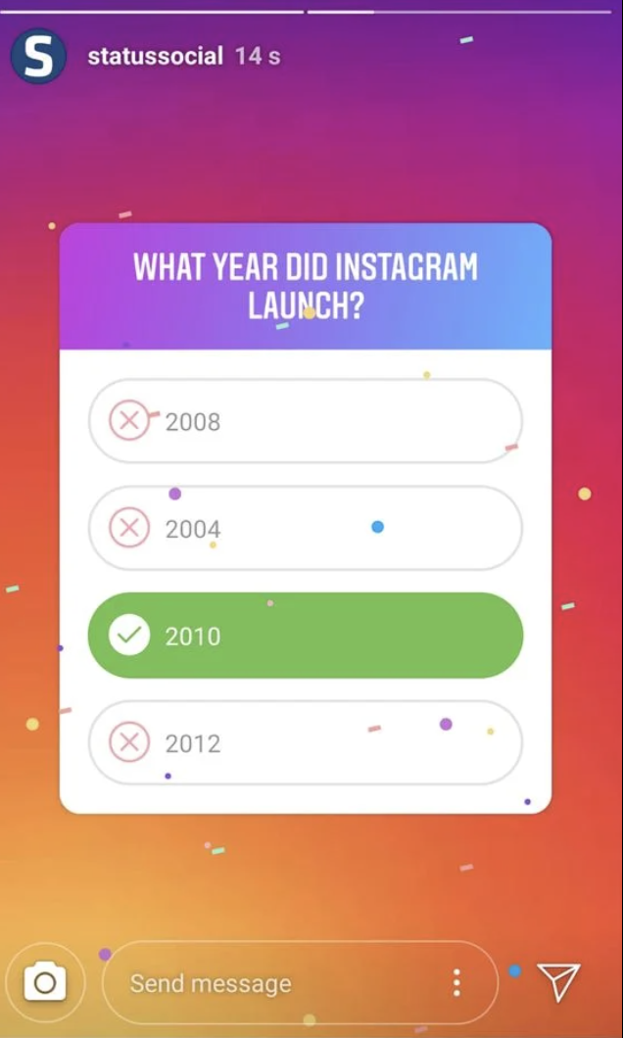
10.POLL BIGGEST IMPACT
COPY - IG STORY
What has the biggest impact on the drivers' satisfaction with leased vehicles?
Vehicle comfort and interior quality
Ease of maintenance and servicing
Access to modern tech and features
Quick vehicle replacement when needed
CONTENT BUCKET 1- OCTOBER

Slide 35
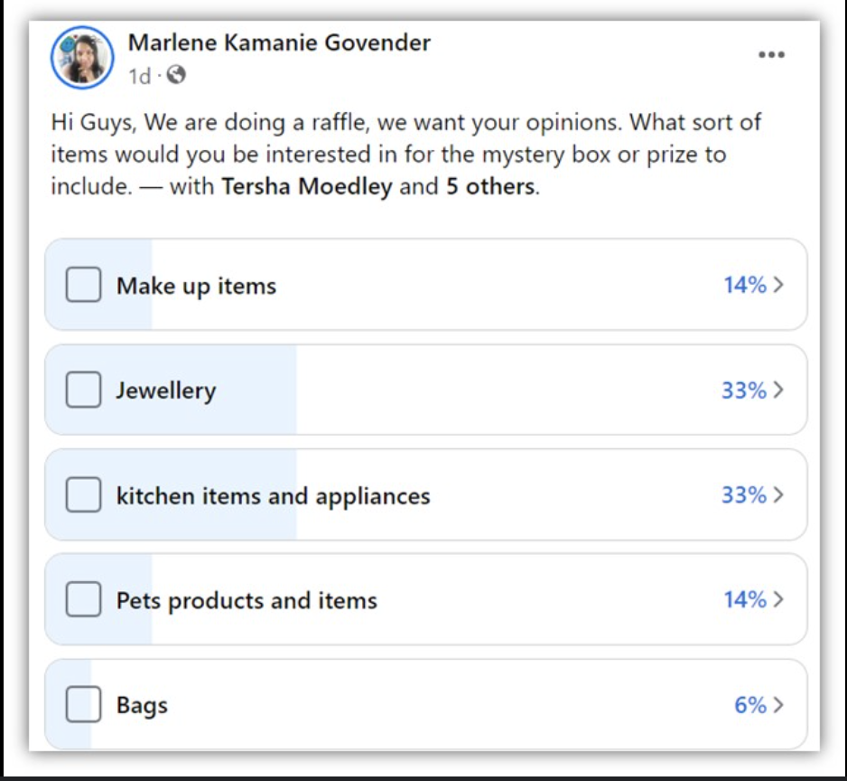
10.POLL BIGGEST IMPACT
COPY - FB
What has the biggest impact on the drivers' satisfaction with leased vehicles?
Vehicle comfort and interior quality
Ease of maintenance and servicing
Access to modern tech and features
Quick vehicle replacement when needed
Caption
Let's talk company cars! 🚗 When it comes to keeping your team happy on the road, what's the one thing you absolutely can't overlook?
Every driver has different priorities, but which of these do you think comes out on top? Vote now and let us know your thoughts in the comments.
CONTENT BUCKET 1- OCTOBER

Slide 36

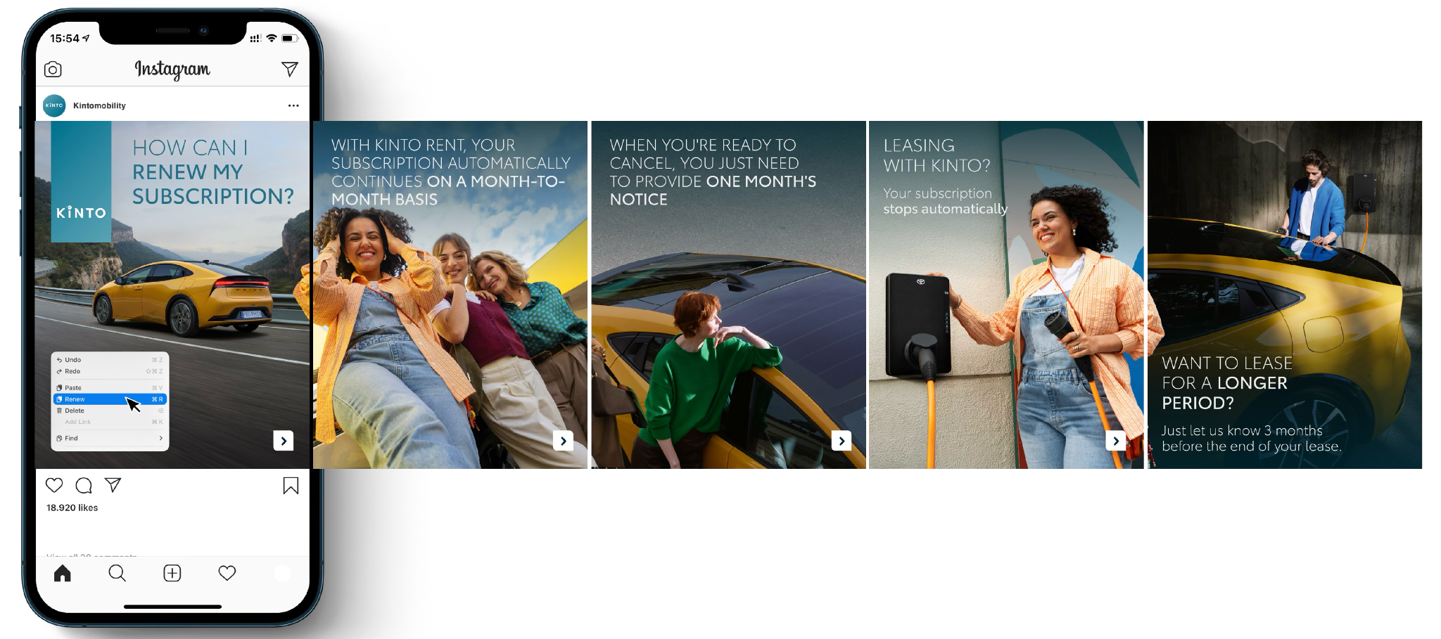
11.CAROUSEL RENEWAL
CONTENT BUCKET 1- OCTOBER
COPY LI
What's the one piece of business admin you wish would just... handle itself? 🔄
Swipe to see what effortless mobility looks like. 👉
We believe a mobility partner should remove obstacles, not create them. That’s why we designed a renewal process that gives you complete control with minimal effort, allowing your fleet to adapt at the speed of your business.
What part of fleet administration consumes most of your time? Share your thoughts in the comments and join the KINTO community. 💬
#KINTO #FleetManagement #BusinessOperations #FlexibleLeasing #CorporateMobility
FORMATS AVAILABLE:
4/5

Slide 37
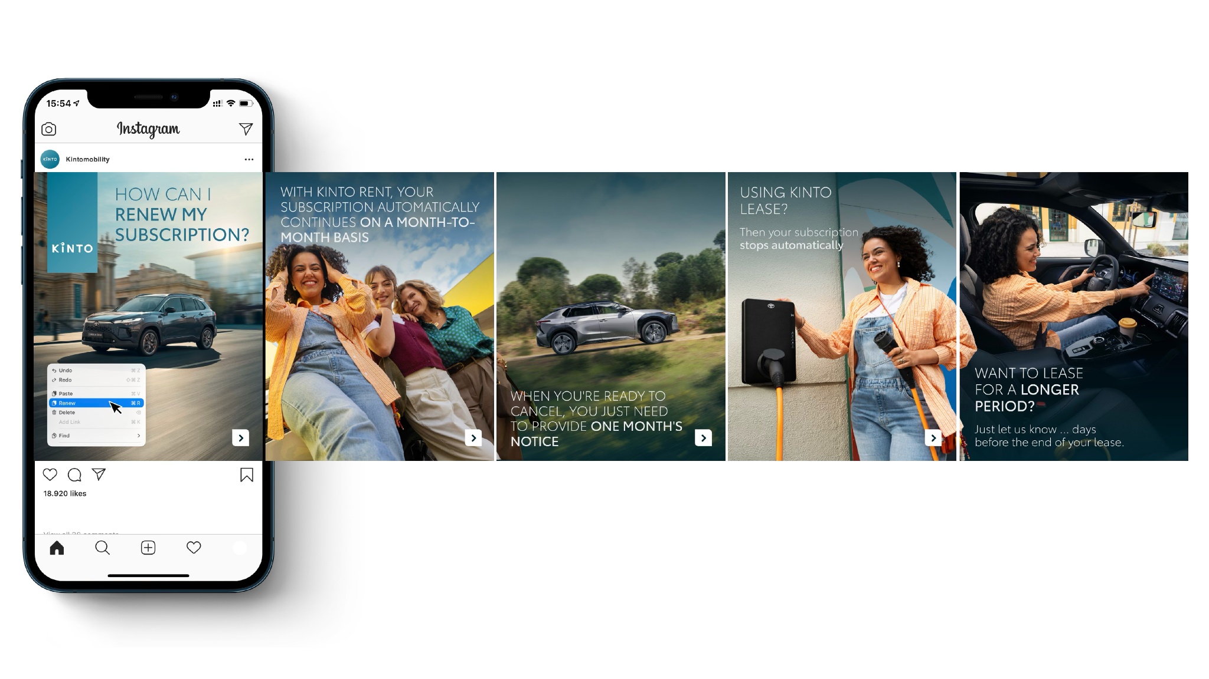
11.CAROUSEL RENEWAL
CONTENT BUCKET 1- OCTOBER
COPY IG
Keep moving, without the paperwork. 📈
Your mobility should be flexible, and that includes renewals. Whether you're on a monthly plan or a long-term lease, we make sure the process is always simple and transparent. Swipe to see how it works and join the KINTO community. ➡️
#KINTO #FleetManagement #MobilitySolutions #FlexibleLeasing
FORMATS AVAILABLE:
4/5
Notes:
☀️🤝😌💚🔥💪✅☝️👉🫵⏰🚐🚘🫵👉👥💪💼🥳🙋

Slide 38
11.CAROUSEL RENEWAL
CONTENT BUCKET 1- OCTOBER
COPY FB
Wondering what happens when your KINTO subscription is up for renewal? We keep it simple and stress-free. 🚗
Whether you need month-to-month flexibility or a long-term solution, our process is designed to work for you.
Join the KINTO community!
FORMATS AVAILABLE:
4/5

Slide 39

12.VIDEO
REVIEW YARIS CROSS
COPY - IG
Lease it or leave it? The verdict is in.
We challenged two colleagues to a test with the Toyota Yaris Cross.
From the commute to the features, they gave their honest take.
Spoiler: Their coworkers might get a little jealous. 😎
#KINTO #FleetManagement #MobilitySolutions #Review #Tested #ToyotaYarisCross
CONTENT BUCKET 1- OCTOBER
FORMATS AVAILABLE:
1/1 - 16/9 - 9/16 - 4/5

Slide 40
12.VIDEO
REVIEW YARIS CROSS
COPY - LI
Choosing the right company car is about more than just specs; it's about the daily experience. So we asked two colleagues to review the Toyota Yaris Cross.
Their verdict? It's the ideal partner for a demanding work week, with all the flexibility you need for your personal time.
Discover our flexible leasing options for your team.
#KINTO #FleetManagement #MobilitySolutions #Review #Tested #ToyotaYarisCross
CONTENT BUCKET 1- OCTOBER
FORMATS AVAILABLE:
1/1 - 16/9 - 9/16 - 4/5

Slide 41
12.VIDEO
REVIEW YARIS CROSS
COPY - FB
Lease it or leave it? 🤔 We asked two colleagues to take the Toyota Yaris Cross on their daily commute and share their experience.
Because, for many of us in an office job, the day starts in the car. But what if that drive could be more than just a commute? What if it was a space to connect? 🚗💬
Discover how KINTO’s mobility solutions can support your team's workday.
CONTENT BUCKET 1- OCTOBER
FORMATS AVAILABLE:
1/1 - 16/9 - 9/16 - 4/5

