Slide 1

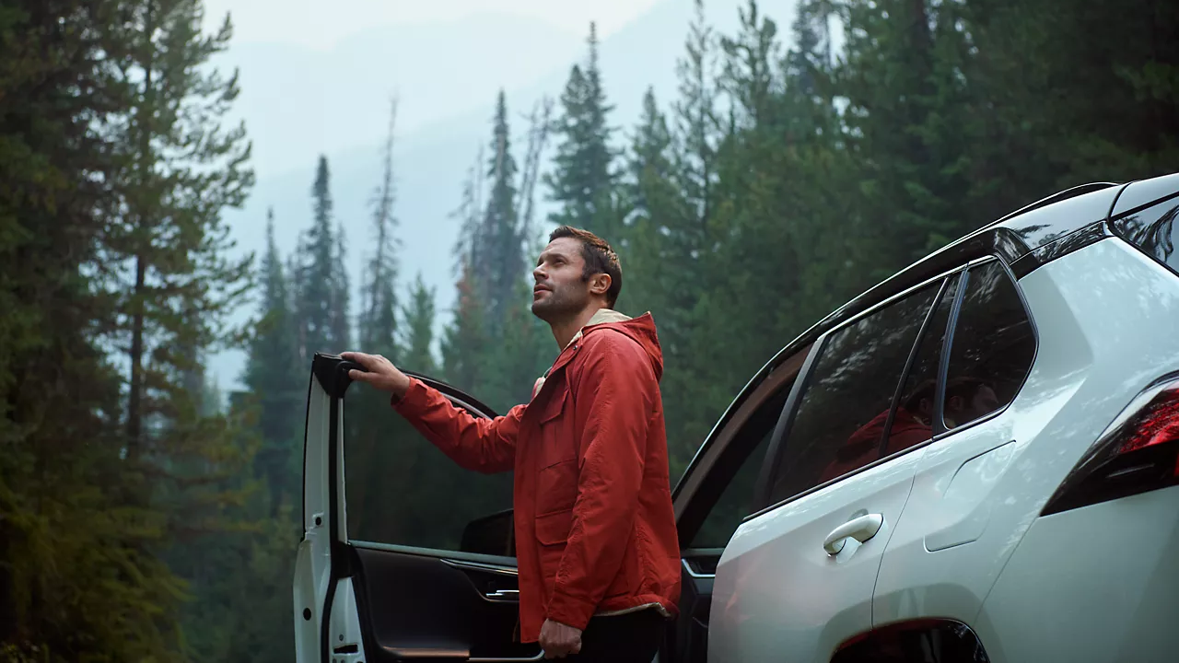

CONTENT
bucket 5 - November

Slide 2
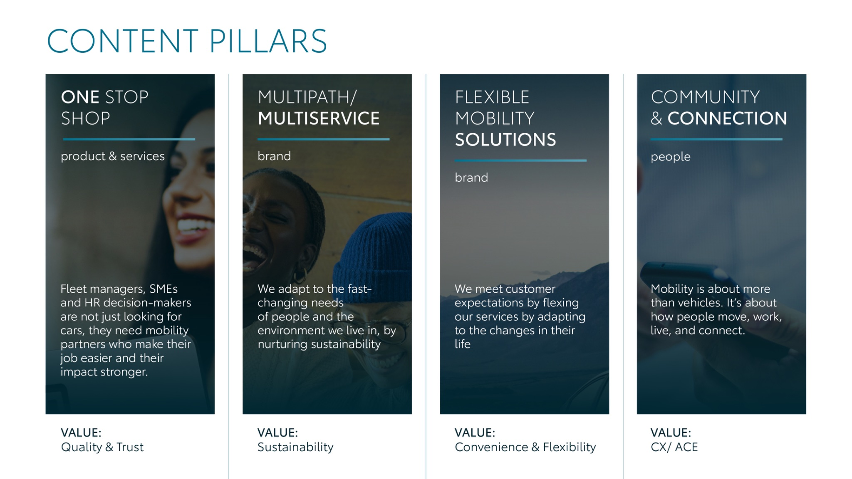
Notes:
“At KINTO, we work with content pillars: themes that carry our brand. We use different content types: inspiring, informative, topical. Your contributions add the human layer that makes the strategy work.”

Slide 3
Tag lines pillars
1. One Stop Shop
One partner, all services.
2. Flexible Mobility Solutions
Wherever life takes you, KINTO finds the right solution for you.
3. Community and connection (important to keep it broad enough to fit clients as well as people working at Kinto)
Join the KINTO community.
4. Vision & Impact (Multipath/multiservice)
KINTO: your flexible copilot to fit your lifestyle.

Slide 4
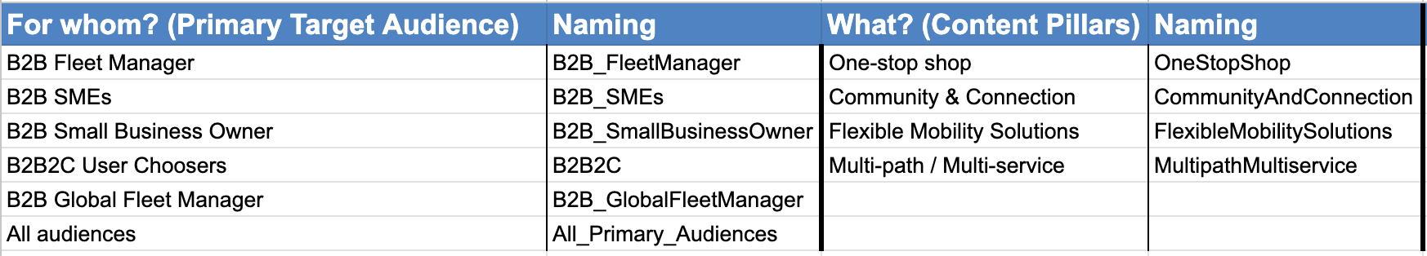
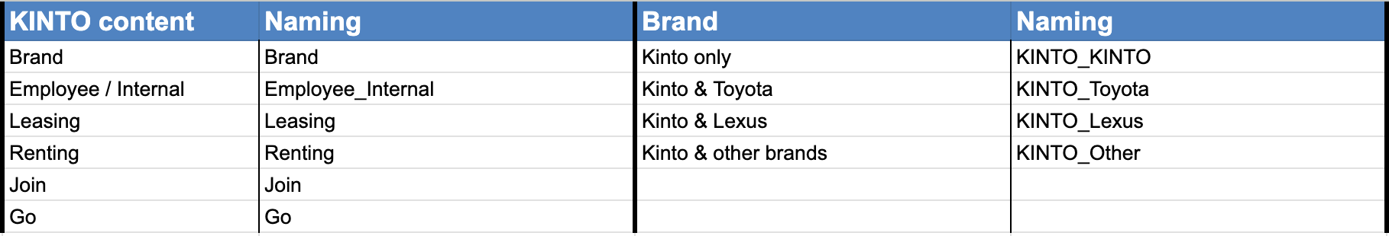
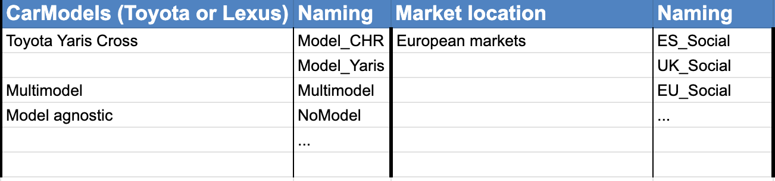
Labels Brandwatch

Slide 5

One stop shop

Slide 6




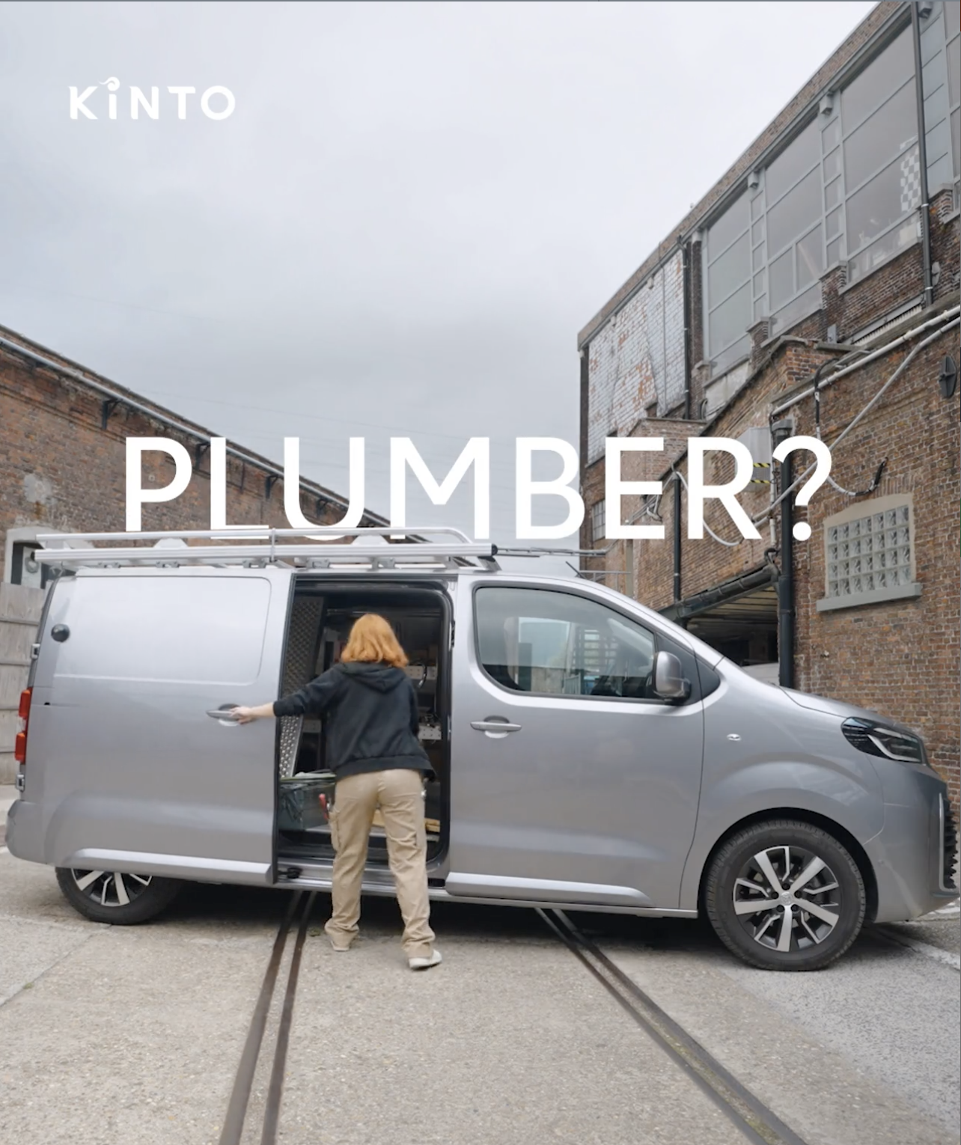
Valid for multibrand
1.VIDEO TRANSITIONS
COPY - LI:
Plumber? Dog groomer? Or delivery driver? The right vehicle is only half the solution.
At KINTO, we provide a complete solution:
✅ Get the right vehicle: we provide flexible access to a versatile, high-quality fleet.
✅ Minimize downtime with reliable service that keeps your business on the road.
✅ Simplify your admin with a single, flexible leasing partner.
#KINTO #FleetManagement #MobilitySolutions
CONTENT BUCKET 1- NOVEMBER
https://limecraft.hotelhungaria.be/api/s/4hTkWad20l6
FORMATS AVAILABLE:
1/1 - 9/16 - ⅘ - 16/9
Notes:
🚐 of 🚗
#KINTO #FleetManagement #CorporateMobility #FlexibleMobility #MobilitySolutions

Slide 7

Valid for multibrand
1.VIDEO TRANSITIONS
COPY - IG:
One van, endless possibilities. 🔧📷🐾📦
The Toyota Proace is the ultimate multi-tool for any professional. From plumber to photographer, it adapts to fit your business.
At KINTO, we provide more than just the vehicle. We offer a one-stop-shop solution with service, quality, and trust you can count on. ✅
Discover mobility that works for you.
#KINTO #FleetManagement #MobilitySolutions
CONTENT BUCKET 1- NOVEMBER
https://limecraft.hotelhungaria.be/api/s/4hTkWad20l6
FORMATS AVAILABLE:
1/1 - 9/16 - ⅘ - 16/9

Slide 8

Valid for multibrand
1.VIDEO TRANSITIONS
COPY - FB:
How can one van truly fit every profession? 🤔The versatile Toyota Proace makes it possible.
At KINTO, we provide the right vehicle and the reliable service, all in one place. ☝️
We handle the mobility details, so you can focus on what you do best — whether that's grooming dogs or delivering packages. 🚗
CONTENT BUCKET 1- NOVEMBER
https://limecraft.hotelhungaria.be/api/s/4hTkWad20l6
FORMATS AVAILABLE:
1/1 - 9/16 - ⅘ - 16/9

Slide 9
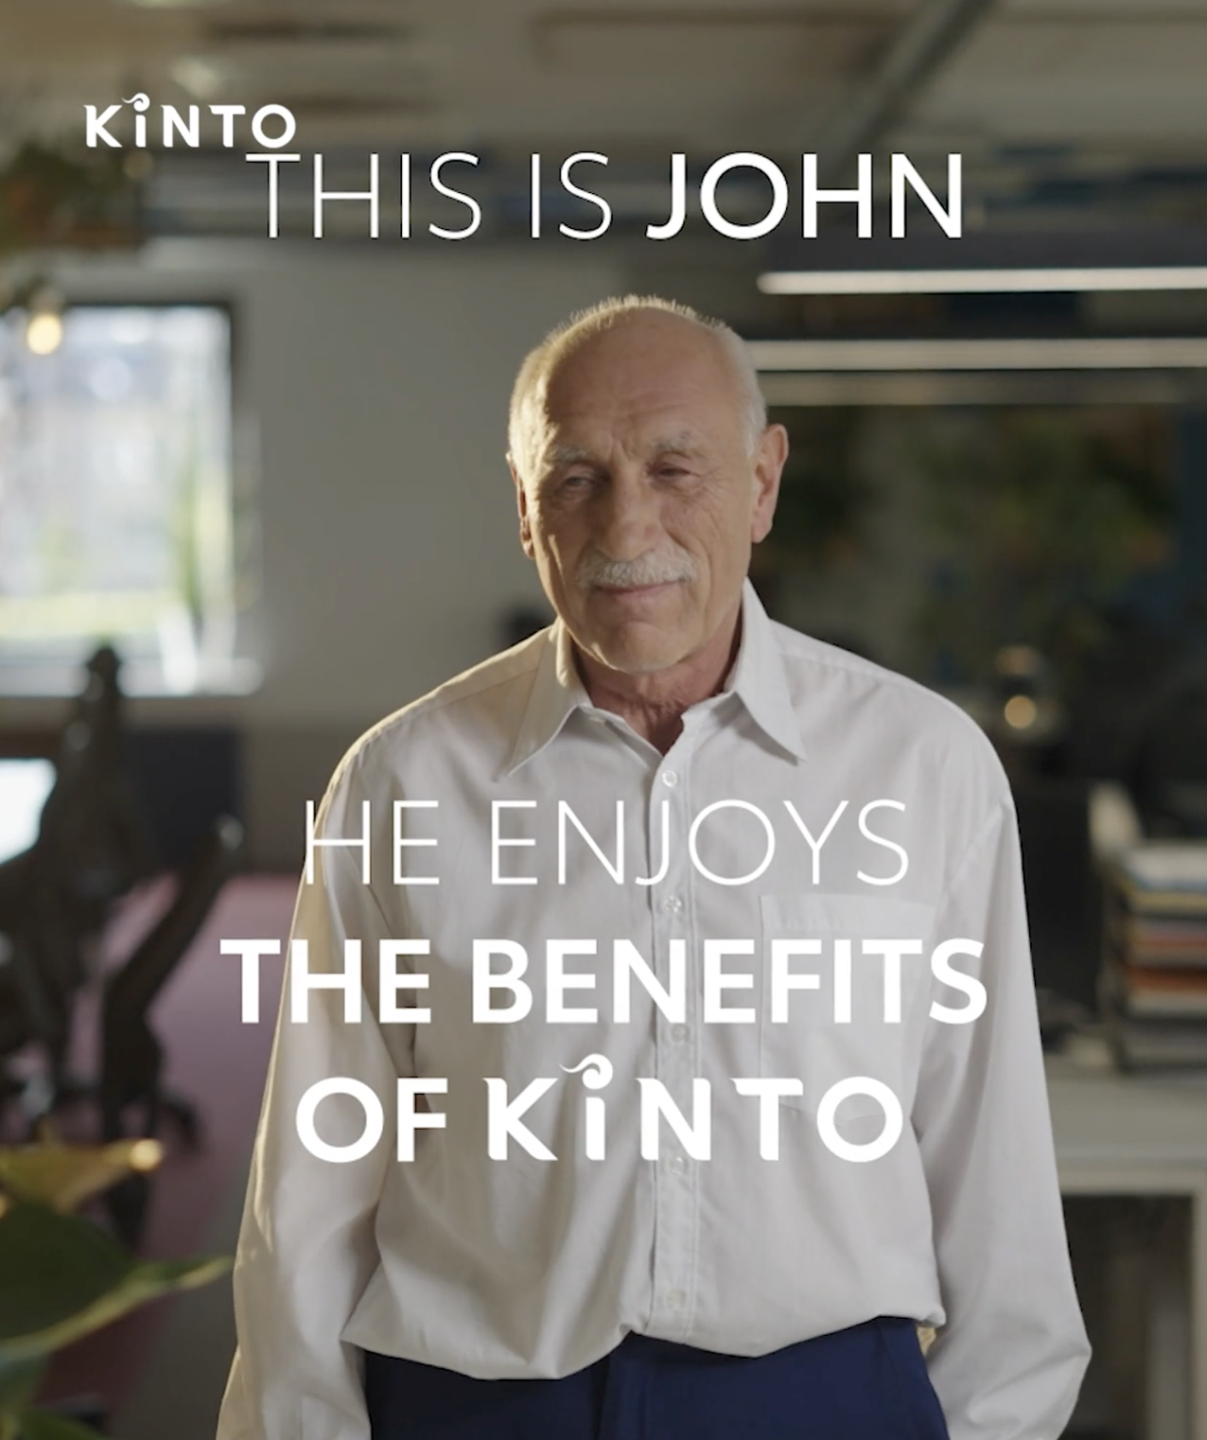
Valid for multibrand
2. VIDEO CATCH
COPY - LI:
Life throws enough at you; your mobility shouldn't be one of them.
That’s why, with KINTO, you get more than just a vehicle. Everything is included:
⛽️ A fuel card for cashless refueling
🛠️ Maintenance to keep your fleet running smoothly
☀️ Summer tire change, ready for the warmer months
❄️ Winter tire change to go safe through the colder season
🔑 A replacement car, so you stay on the road, no matter what
🤝 And even more …
Discover KINTO, your mobility partner that handles the details.
#KINTO #FleetManagement #MobilitySolutions
CONTENT BUCKET 1- NOVEMBER
https://limecraft.hotelhungaria.be/api/s/Ih76hBC2Lzd
FORMATS AVAILABLE:
1/1 - 9/16 - ⅘ -16/9
Notes:
#KINTO #FleetManagement #CorporateMobility #FlexibleMobility #MobilitySolutions

Slide 10
Valid for multibrand
2. VIDEO CATCH
COPY - IG:
Life throws you challenges. KINTO throws you solutions! 🎯
Our all-in-one leasing means you can stop worrying about the details. Everything is included:
⛽️ Fuel card convenience
🛠️ Maintenance without the stress
☀️ Effortless summer tire changes
❄️ Worry-free winter tire changes
🔑 A replacement car when you need it most
🤝 And even more …
Ready for a smoother ride? Discover the KINTO difference.
#KINTO #FleetManagement #MobilitySolutions
CONTENT BUCKET 1- NOVEMBER
https://limecraft.hotelhungaria.be/api/s/Ih76hBC2Lzd
FORMATS AVAILABLE:
1/1 - 9/16 - ⅘ - 16/9

Slide 11
Valid for multibrand
2. VIDEO CATCH
COPY - FB:
Does managing your company vehicles feel like you're constantly dodging curveballs? 😅 Not with KINTO.
Imagine a mobility solution where the perks literally come flying at you because they're all included:
⛽️ Fuel card convenience
🛠️ Maintenance without the stress
☀️ Effortless summer tire changes
❄️ Worry-free winter tire changes
🔑 A replacement car when you need it most
🤝 And even more …
Ready for a smoother ride? Discover the KINTO difference.
CONTENT BUCKET 1- NOVEMBER
https://limecraft.hotelhungaria.be/api/s/Ih76hBC2Lzd
FORMATS AVAILABLE:
1/1 - 9/16 - ⅘ - 16/9
Notes:
☀️🤝😌💚🔥💪✅☝️👉

Slide 12


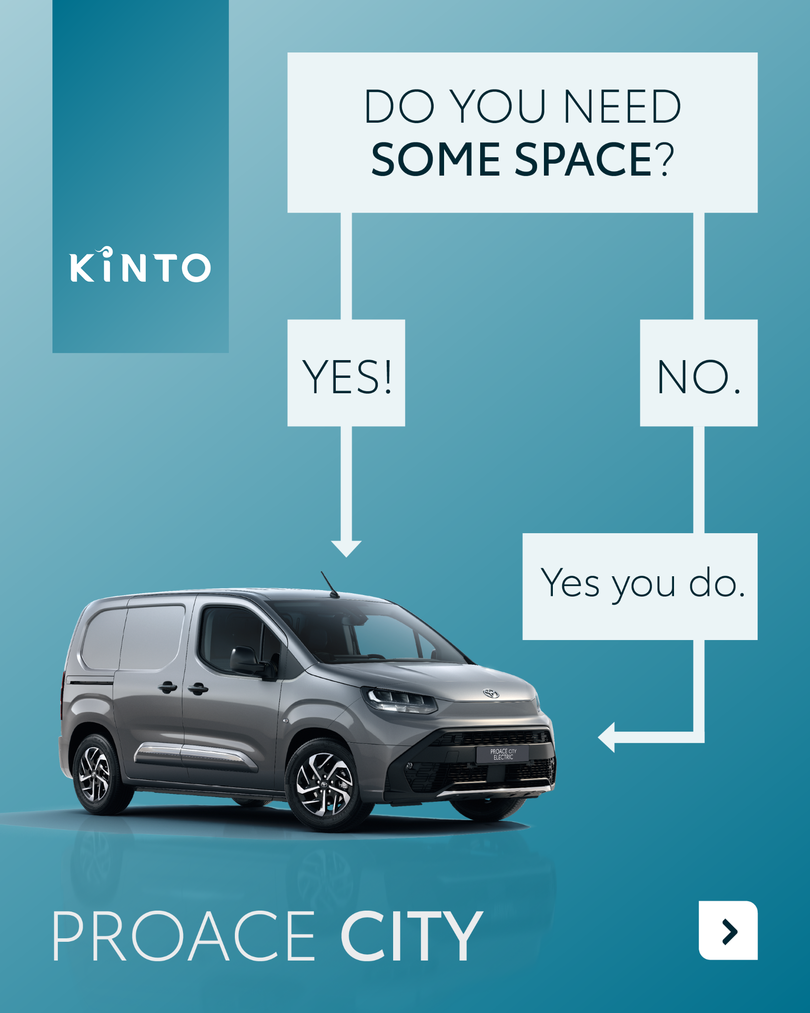
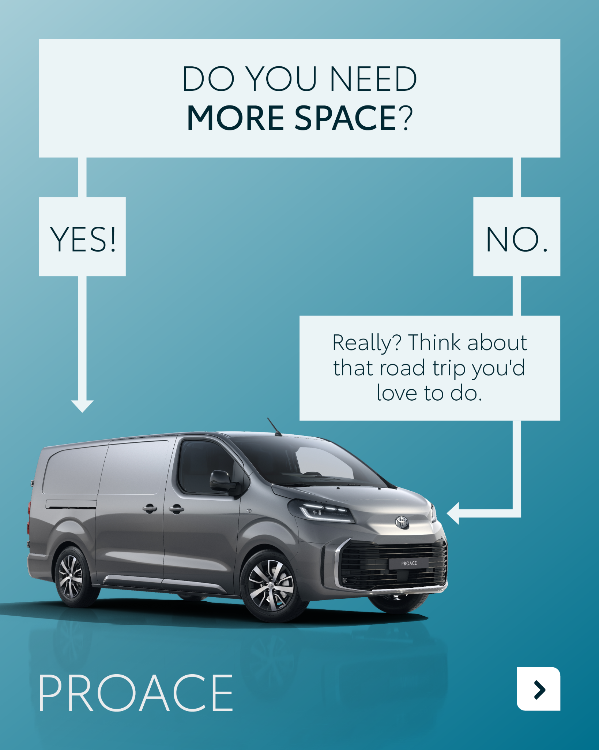
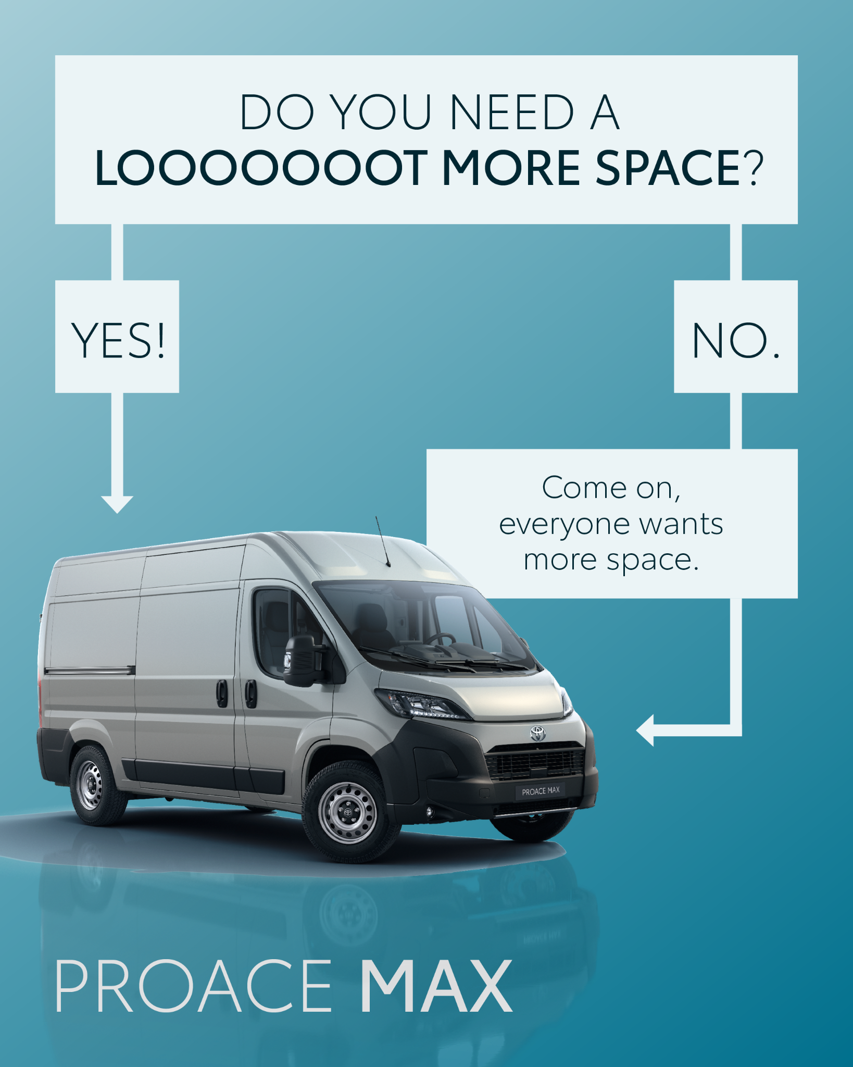
3.CAROUSEL PROACE
COPY LI
With KINTO, you get a mobility partner that helps you find the perfect fit for every stage of your business.
The Toyota Proace family offers a scalable solution:
✅ Proace City: for nimble, urban operations.
✅ Proace: the versatile all-rounder for growing needs.
✅ Proace Max: for when you need maximum cargo capacity.
Find the perfect fit for your business and optimize your fleet today. 🧭
One partner, all services.
#KINTO #FleetManagement #MobilitySolutions
CONTENT BUCKET 1- NOVEMBER
FORMATS AVAILABLE:
4/5

Slide 13
3.CAROUSEL PROACE
COPY IG
Business needs space. The only question is: how much? 🚐
From SOME space, to MORE space, to a a LOOOOOOOT of space. The Proace family scales with your ambition, all available through one partner: KINTO.
Which Proace fits your business? 🫵 Swipe through our guide to find your perfect match!
One partner, all services.
#KINTO #FleetManagement #MobilitySolutions
CONTENT BUCKET 1- NOVEMBER
FORMATS AVAILABLE:
4/5

Slide 14
3.CAROUSEL PROACE
COPY FB
One size fits all? Not when it comes to your business. Finding the right van for the right job should be simple. 🚐
That's where the Toyota Proace family comes in. We help you build the perfect fleet, whether you're just starting out or scaling up!
🏙️ Proace City: perfect for zipping through busy city streets. 🔧 Proace: the versatile workhorse for your team's growing needs.
📦 Proace Max: when you need serious cargo space, this is your van.
Let us help you find your perfect fit! 💡See the full range today.
One partner, all services.
CONTENT BUCKET 1- NOVEMBER
FORMATS AVAILABLE:
4/5

Slide 15




Valid for multibrand
4.CAROUSEL FUEL
COPY LI
Improving your fleet's efficiency starts with smarter habits. 💡
Swipe for a few effective tips to share with your drivers.
Small changes in driving style can lead to significant savings on fuel costs and a smaller carbon footprint for your business. 📈
What's the biggest challenge you face when trying to implement simple, cost-saving techniques across your entire team? 🚘
One partner, all services.
#KINTO #FleetManagement #Sustainability
CONTENT BUCKET 1- NOVEMBER
FORMATS AVAILABLE:
4/5

Slide 16
Valid for multibrand
4.CAROUSEL FUEL
COPY IG
More miles, less fuel? 💚 Little habits can have a big impact. We're sharing a few simple tips to help you boost your fuel efficiency, save money, and reduce your carbon footprint. 🌍
👉 Swipe to see how you can drive smarter.
One partner, all services.
#KINTO #FleetManagement #Sustainability
CONTENT BUCKET 1- NOVEMBER
FORMATS AVAILABLE:
4/5

Slide 17
Valid for multibrand
4.CAROUSEL FUEL
COPY FB
Want to get a little more out of every tank of fuel? ⛽️ Small changes can make a big difference for your wallet and for the planet!
Swipe through for a few of our favourite fuel-saving tips that anyone can use! 💡
Do you have a go-to trick for saving fuel? Share it in the comments! 👇
One partner, all services.
CONTENT BUCKET 1- NOVEMBER
FORMATS AVAILABLE:
4/5

Slide 18
Multipath/
Multiservice
Pillar 4

Slide 19
5. LONGREAD RENT WITH KINTO
CONTENT BUCKET 1- NOVEMBER

Slide 20
Flexible mobility solutions
Pillar 3
Notes:
Baseline: Wherever life takes you, KINTO finds the right solution for you.

Slide 21



6. VIDEO SITUATIONS
COPY - LI
A truly agile fleet is one that empowers your team to be productive, wherever their work takes them.💡
It needs the capacity for a client's biggest ideas, the flexibility for collaborative carpooling, and the functionality to become a mobile office at a moment's notice.
When you're looking for the perfect car to lease, rent, or pool to meet these challenges... There's KINTO. 🙋
#KINTO #FlexibleMobility #FleetManagement
CONTENT BUCKET 1- NOVEMBER
https://limecraft.hotelhungaria.be/api/s/ntlp-ErZORr
FORMATS AVAILABLE:
1/1 - 16/9 - 9/16 - 4/5

Slide 22
6. VIDEO SITUATIONS
COPY - IG
When you're looking for the perfect car to lease, rent, or pool... there's KINTO. 🚙
Life doesn't fit into one box, and neither should your car. That's why we provide mobility that adapts to your day, not the other way around.
From logistics manager to the team taxi to a mobile office... your ride should be able to do it all. ✅
#KINTO #FlexibleMobility #MobilitySolutions
CONTENT BUCKET 1- NOVEMBER
https://limecraft.hotelhungaria.be/api/s/ntlp-ErZORr
FORMATS AVAILABLE:
1/1 - 16/9 - 9/16 - 4/5

Slide 23
6. VIDEO SITUATIONS
COPY - FB
Your day rarely goes exactly as planned, right? 😉
Life is busy, and your mobility should make it easier, not harder. That's why we provide cars that can handle it all: big loads, extra passengers, and last-minute changes of plan.
When you're looking for the perfect car to lease, rent, or pool for your unpredictable life... there's KINTO. 💡
CONTENT BUCKET 1- NOVEMBER
https://limecraft.hotelhungaria.be/api/s/ntlp-ErZORr
FORMATS AVAILABLE:
1/1 - 16/9 - 9/16 - 4/5

Slide 24

7. VISUAL THANKS TO KINTO - FIX
Valid for multibrand
COPY - LI:
Let your team focus on what they do best. We'll handle the rest. 🧭
Every hour spent dealing with unexpected car trouble is an hour away from serving clients and growing the business.
With KINTO's full-service mobility solutions, we handle the complexities of fleet management.
Wherever life takes you, KINTO finds the right solution for you.
#KINTO #MobilitySolutions #FlexibleMobility
CONTENT BUCKET 1- NOVEMBER
FORMATS AVAILABLE:
1/1 - 4/5

Slide 25
7. VISUAL THANKS TO KINTO - FIX
Valid for multibrand
COPY - IG:
Focus on your craft. We'll handle the car. 🔧
Vehicle maintenance, repairs, and paperwork... consider it handled. 🤝 Our flexible, all-in-one leasing solutions give you the freedom to focus on building your business.
Wherever life takes you, KINTO finds the right solution for you.
#KINTO #MobilitySolutions #FlexibleMobility
CONTENT BUCKET 1- NOVEMBER
FORMATS AVAILABLE:
1/1 - 4/5

Slide 26
7. VISUAL THANKS TO KINTO - FIX
Valid for multibrand
COPY - FB:
Car trouble? Ain't nobody got time for that. Especially when you're busy running a business! 🛠️
With our all-in leasing solutions, we take care of the vehicle maintenance and paperwork, so you get the peace of mind to focus on what really matters: your work and your clients.
Spend less time fixing your van and more time fixing things for customers. 😉
Wherever life takes you, KINTO finds the right solution for you. Learn more about our stress-free services!
CONTENT BUCKET 1- NOVEMBER
FORMATS AVAILABLE:
1/1 - 4/5

Slide 27
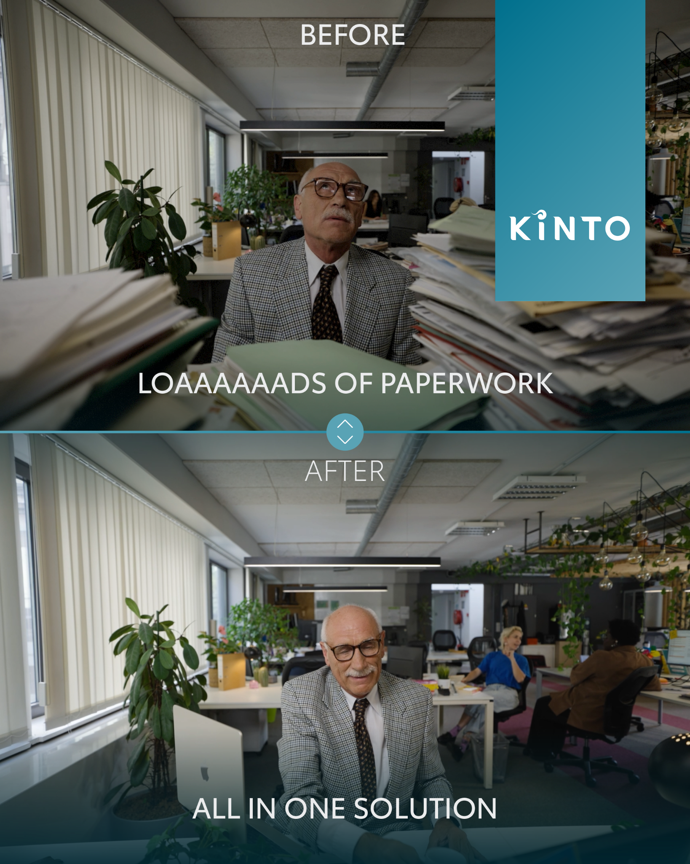
8. VISUAL SPLITSCREEN
Valid for multibrand
COPY - LI:
Ready to swap the paperwork for peace of mind? 😌Discover a smarter way to manage your fleet.
At KINTO, we believe in streamlining that complexity. 👉 Our all-in-one solution consolidates leasing, maintenance, fuel cards, and reporting into a single, manageable platform.
Wherever life takes you, KINTO finds the right solution for you.
CONTENT BUCKET 1- NOVEMBER
FORMATS AVAILABLE:
1/1 - 4/5
Notes:
Wherever life takes you, KINTO finds the right solution for you.
☀️🤝😌💚🔥💪✅☝️👉🫵⏰🚐🚘🫵👉👥💪💼🥳🙋

Slide 28
8. VISUAL SPLITSCREEN
Valid for multibrand
COPY - IG:
Less paperwork and more peace of mind ? Swap the endless admin for one simple solution with KINTO. 🤝
Our all-in-one platform handles everything from leasing to maintenance, giving you back your most valuable asset: your time. ⏰
Wherever life takes you, KINTO finds the right solution for you.
#KINTO #MobilitySolutions #FlexibleMobility
CONTENT BUCKET 1- NOVEMBER
FORMATS AVAILABLE:
1/1 - 4/5

Slide 29
8. VISUAL SPLITSCREEN
Valid for multibrand
COPY - FB:
More time managing your fleet, less time managing paperwork. Sounds good? 😉
Let us handle the details, so you can focus on the big picture.
Our all-in-one solution is designed to give you back your time by handling all the vehicle admin in one simple package. 🤝
Wherever life takes you, KINTO finds the right solution for you.
CONTENT BUCKET 1- NOVEMBER
FORMATS AVAILABLE:
1/1 - 4/5

Slide 30
Community & connection
Empowerment & Expertise
Notes:
Baseline: Join the KINTO community

Slide 31
9. FLEET EUROPEAN DAYS AFTERMOVIE
CONTENT BUCKET 1- NOVEMBER
COPY - LI
To be made end of October
FORMATS AVAILABLE:
1/1 - 16/9 - 9/16 - 4/5
Notes:
☀️🤝😌💚🔥💪✅☝️👉🫵⏰🚐🚘🫵👉👥💪💼🥳🙋

Slide 32
9. FLEET EUROPEAN DAYS AFTERMOVIE
COPY - IG
CONTENT BUCKET 1- NOVEMBER
To be made end of October
FORMATS AVAILABLE:
1/1 - 16/9 - 9/16 - 4/5

Slide 33
9. FLEET EUROPEAN DAYS AFTERMOVIE
COPY - FB
CONTENT BUCKET 1- NOVEMBER
To be made end of October
FORMATS AVAILABLE:
1/1 - 16/9 - 9/16 - 4/5

Slide 34
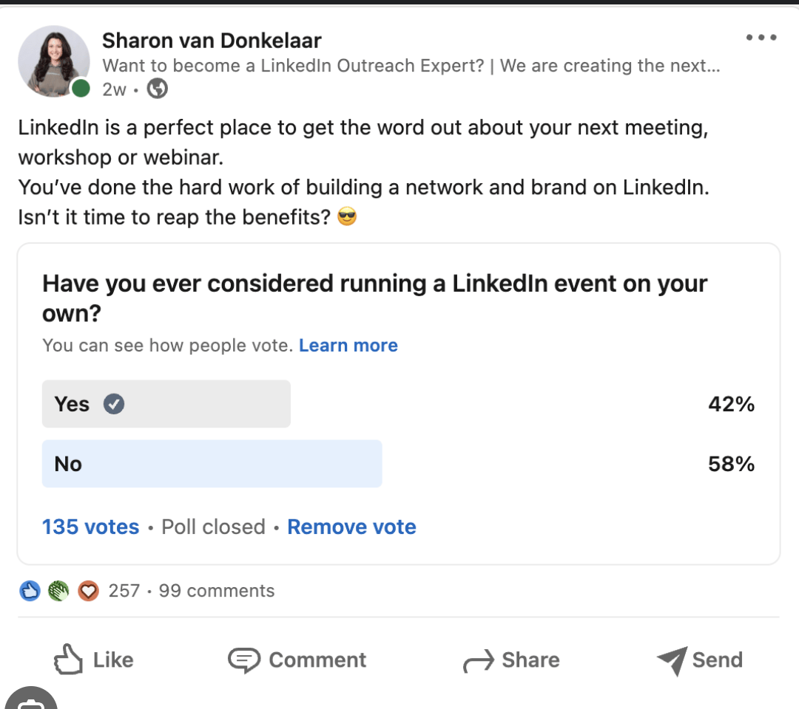
Valid for multibrand
10.POLL POWERTRAIN
COPY - LI
Electric, hybrid, or hydrogen? It’s the big question for drivers and businesses right now! ⚡️🚗
We want to hear what our community thinks! When it comes to leasing a car, which powertrain is your top choice?
Cast your vote in the poll, tell us what you believe is the future of driving and join the KINTO community.
! Add hydrogen to the poll
CONTENT BUCKET 1- NOVEMBER
Notes:
Let’s replace “fuel” by plug-in hybrid or even hydrogen

Slide 35
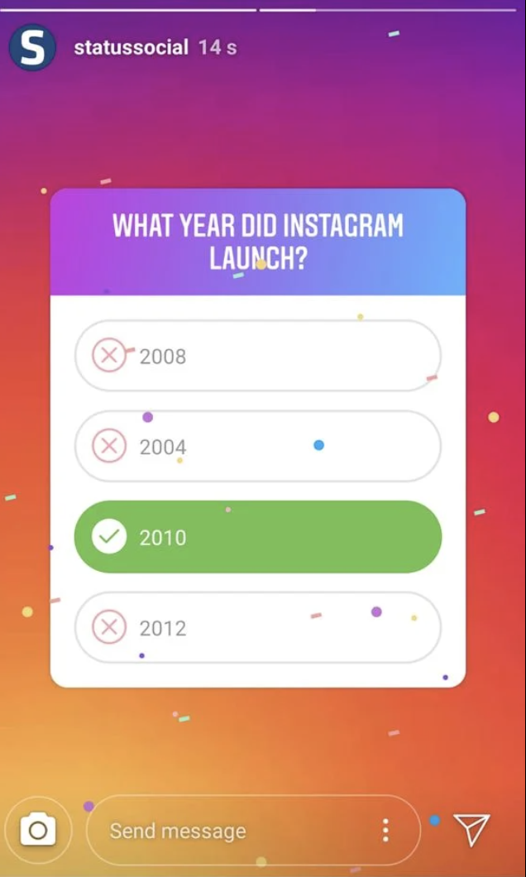
Valid for multibrand
10.POLL POWERTRAIN
COPY - IG STORY
Electric, hybrid, or hydrogen? ⚡️⛽️
! Add hydrogen to the poll
CONTENT BUCKET 1- NOVEMBER

Slide 36
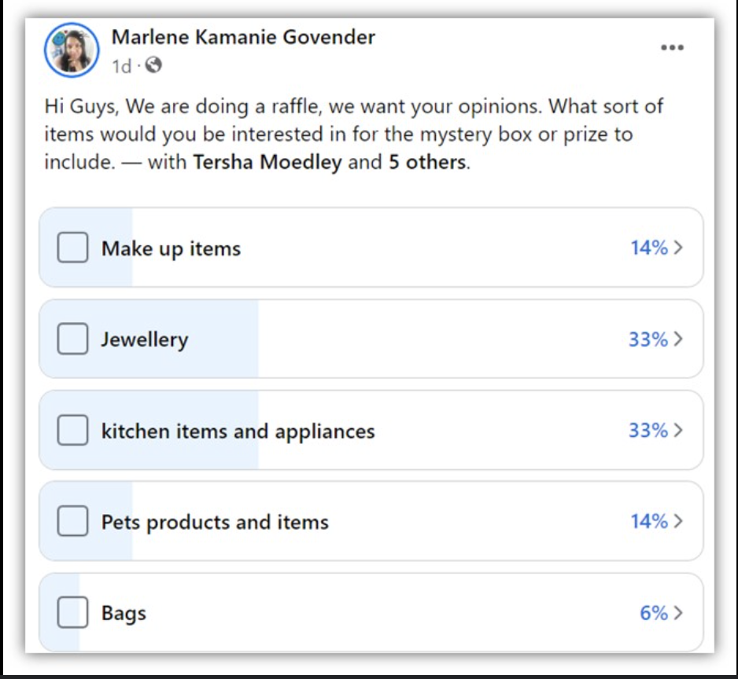
Valid for multibrand
10.POLL POWERTRAIN
COPY - FB
Electric, hybrid, or hydrogen? It’s the big question for drivers and businesses right now! ⚡️🚗
We want to hear what our community thinks! When it comes to leasing a car, which powertrain is your top choice? Cast your vote in the poll and tell us what you believe is the future of driving! 👇
Join the KINTO community.
! Add hydrogen to the poll
CONTENT BUCKET 1- NOVEMBER
Notes:
🚗🔌

Slide 37
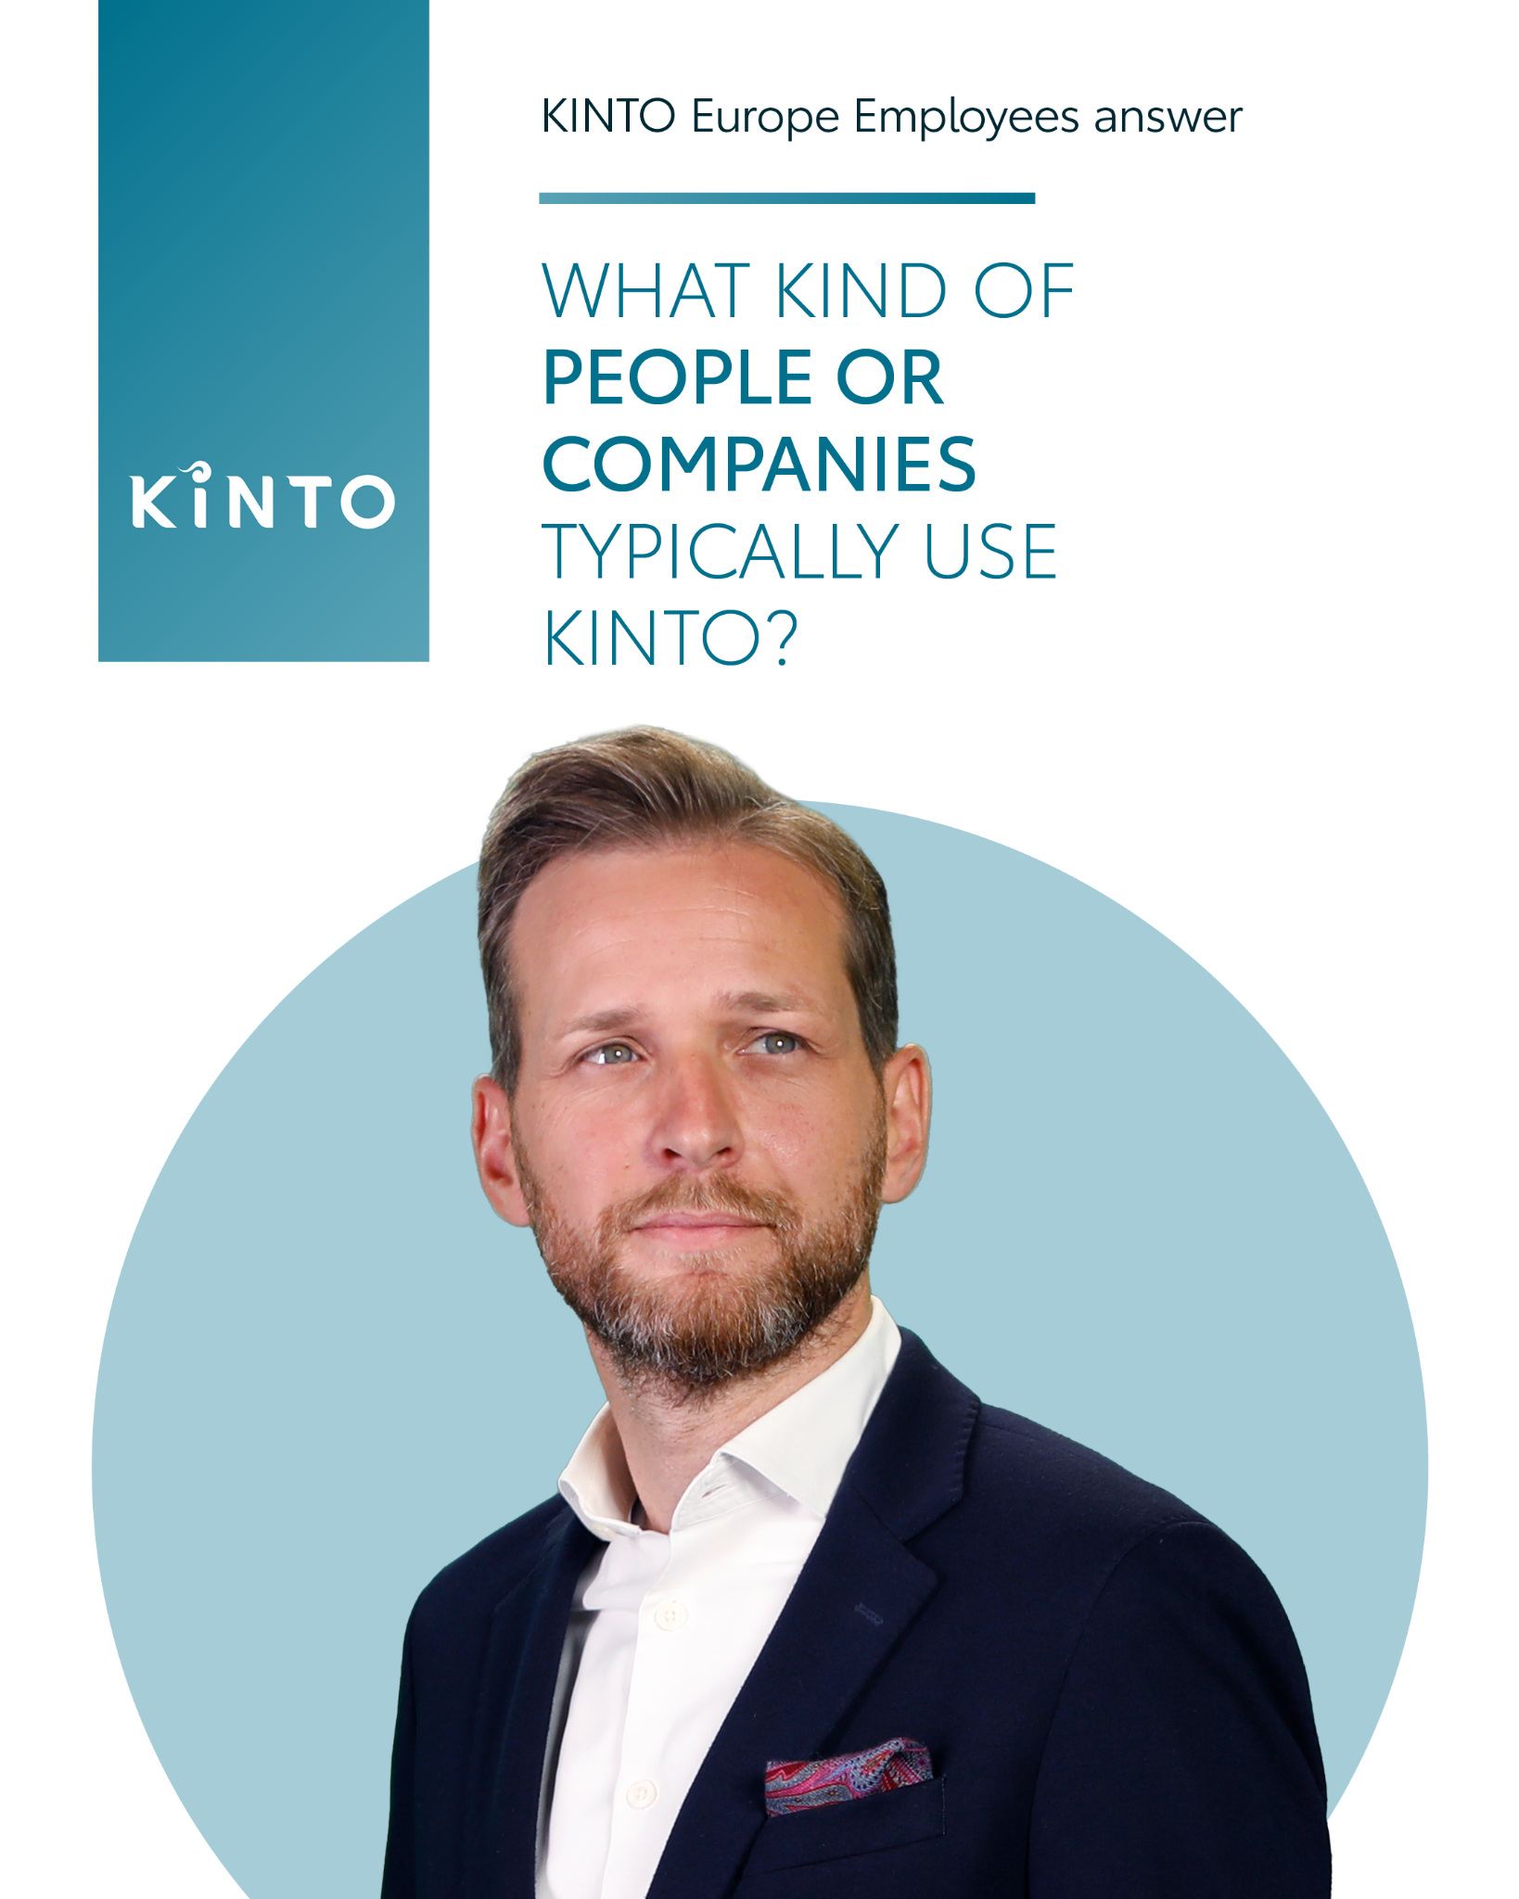
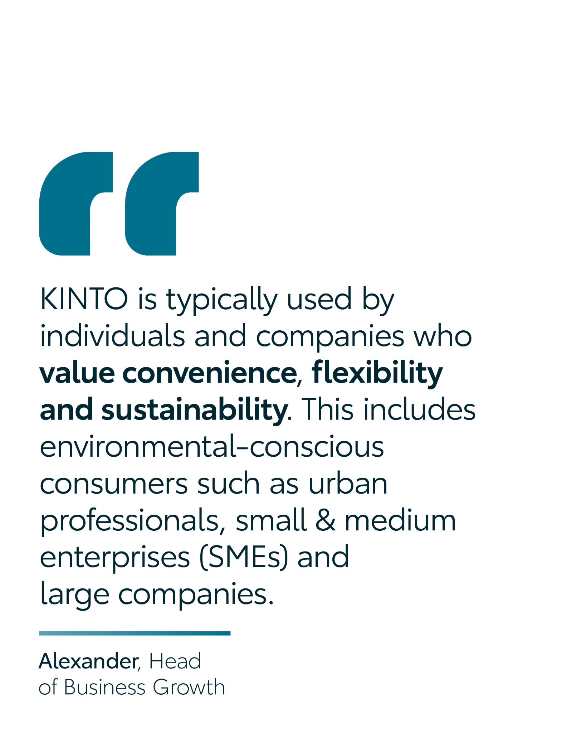
Valid for multibrand
11.CAROUSEL EMPLOYEE QUOTE
CONTENT BUCKET 1- NOVEMBER
COPY LI
Flexibility, convenience, and sustainability. 🤝
According to our Head of Business Growth, Alexander, these are the core values that unite our clients, from urban professionals to growing SMEs. He believes a modern business is defined not by its size, but by its mindset.
We're curious: which of these three values is the top priority for your business today? Share your thoughts in the comments and join the KINTO community. 👇
#KINTO #Sustainability #FlexibileMobility
FORMATS AVAILABLE:
4/5

Slide 38
Valid for multibrand
11.CAROUSEL EMPLOYEE QUOTE
CONTENT BUCKET 1- NOVEMBER
COPY IG
We believe that great mobility solutions are built for the forward-thinkers, the innovators, and the builders. 💡 We asked our Head of Business Growth, Alexander, to share his thoughts on the community we serve. ☝️
Do you also value flexibility, convenience, and a sustainable future? Join the KINTO community.
#KINTO #Sustainability #FlexibileMobility
FORMATS AVAILABLE:
4/5
Notes:
☀️🤝😌💚🔥💪✅☝️👉🫵⏰🚐🚘🫵👉👥💪💼🥳🙋

Slide 39
Valid for multibrand
11.CAROUSEL EMPLOYEE QUOTE
COPY FB
Ever wonder what a city professional, a growing local business, and an eco-conscious driver have in common? 🤔
We asked our Head of Business Growth, Alexander, for his take on who makes up the KINTO community. It turns out, it's all about sharing the same core values: convenience, flexibility, and sustainability.
It’s a community of people who want smarter, greener, and more efficient ways to move. Sound like you? You're in the right place! Join the KINTO community. 💡
CONTENT BUCKET 1- NOVEMBER
FORMATS AVAILABLE:
4/5

Slide 40
12. FLEET EUROPEAN DAYS DIDIER SPEECH
COPY - LI:
CONTENT BUCKET 1- NOVEMBER
To be made end of October
FORMATS AVAILABLE:
1/1 - ⅘ - 16/9 - 9/16

Slide 41
12. FLEET EUROPEAN DAYS DIDIER SPEECH
COPY - IG:
CONTENT BUCKET 1- NOVEMBER
To be made end of October
FORMATS AVAILABLE:
1/1 - ⅘ - 16/9 - 9./16

Slide 42
12. FLEET EUROPEAN DAYS DIDIER SPEECH
COPY - FB:
CONTENT BUCKET 1- NOVEMBER
To be made end of October
FORMATS AVAILABLE:
1/1 - ⅘ - 16/9 - 9/16

