Slide 1

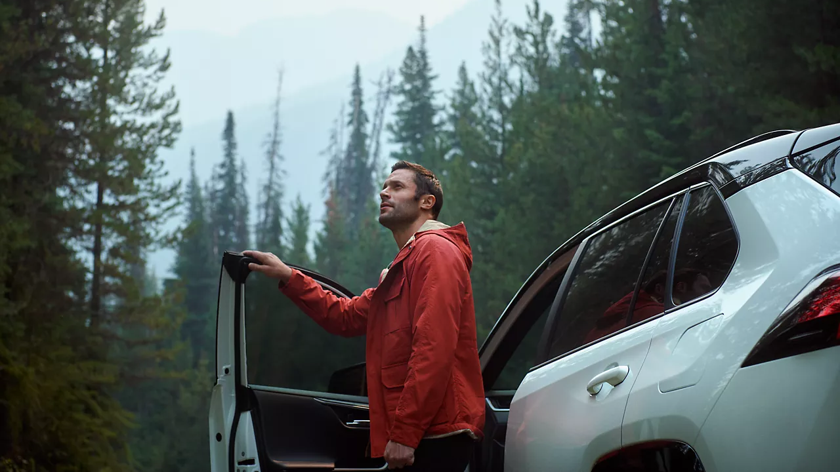

CONTENT
bucket 6 - December

Slide 2
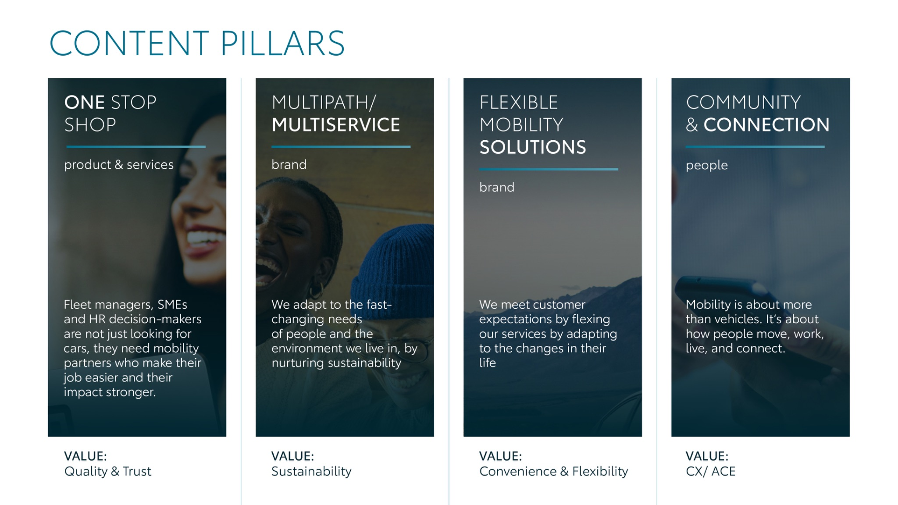
Notes:
“At KINTO, we work with content pillars: themes that carry our brand. We use different content types: inspiring, informative, topical. Your contributions add the human layer that makes the strategy work.”

Slide 3




Content pillars - content overview
December
What’s in my bag?
KINTO Santa
Car files
New me
Unboxing
Easy fit
Fragile finds
Christmas essentials
Your fleet wish
Commute poll
Small reminders
NY Wishes
ONE STOP SHOP
MULTIPATH/ MULTISERVICE
FLEXIBLE MOBILITY SOLUTIONS
COMMUNITY/ CONNECTION

Slide 4
Tag lines pillars
1. One Stop Shop
One partner. All solutions.
2. Flexible Mobility Solutions
One partner. All solutions.
3. Community and connection (important to keep it broad enough to fit clients as well as people working at Kinto)
Join the KINTO community.
4. Vision & Impact (Multipath/multiservice)
One partner. All solutions.

Slide 5

One stop shop
Notes:
One place. Every solution. Always KINTO.

Slide 6






Valid for multibrand
1. VIDEO
WHAT’S IN MY BAG
COPY - LI:
Work mode: off. ❌ KINTO ride: on. ✅
When the workday is done, your employees shouldn’t have to think about their commute. With our all-in-one leasing solution, they have everything they need to get on their way. 🚗
It’s all included:
✅ Insurance
✅ Maintenance and repair
✅ Roadside assistance
It's less admin for you and a more seamless, stress-free journey for them. Especially when there’s holiday shopping to be done.
#KINTO #BusinessMobility #FleetManagement
CONTENT BUCKET 1- DECEMBER
FORMATS AVAILABLE:
1/1 - 9/16 - ⅘ -16/9
Notes:
#KINTO #WorkLife #WorkModeOff #AfterWork #Commute #Mobility #Seamless #FlexibleLiving #MyKINTO
#KINTO #FleetManagement #CorporateMobility #FlexibleMobility #MobilitySolutions

Slide 7

Valid for multibrand
1. VIDEO
WHAT’S IN MY BAG
COPY - IG:
POV: your work bag at 5 PM. 💼
From closing the laptop to starting the engine, we make the journey seamless. Everything your team needs, from insurance to maintenance and repair, is included. 🚗
#KINTO #MobilitySolutions #WorkLifeBalance
CONTENT BUCKET 1- DECEMBER
FORMATS AVAILABLE:
1/1 - 9/16 - ⅘ - 16/9

Slide 8

Valid for multibrand
1. VIDEO
WHAT’S IN MY BAG
COPY - FB:
That instant mood shift when the day is done and your company car is ready to go. ✨
Leaving the office with a smile is simpler when everything you need for the road is in one place. Keys, insurance, maintenance and repair, … and the peace of mind that comes with a reliable ride home.
Let KINTO handle the mobility details so your team can focus on wrapping up the year (and their presents). 🎁
CONTENT BUCKET 1- DECEMBER
FORMATS AVAILABLE:
1/1 - 9/16 - ⅘ - 16/9

Slide 9



Valid for multibrand
2. VIDEO KINTO SANTA
COPY - LI
This holiday season, give your team the gift of hassle-free mobility. 🎁
KINTO offers a seamless experience that keeps your business moving, even through the busiest times of the year.
Merry Christmas!
#KINTO #BusinessMobility #MerryChristmas
CONTENT BUCKET 1- DECEMBER
FORMATS AVAILABLE:
1/1 - 16/9 - 9/16 - 4/5

Slide 10
2. VIDEO KINTO SANTA
Valid for multibrand
COPY - IG
Ho ho ho-ld on, is that KINTO Santa? 🎅
This Christmas, we're spreading the joy of hassle-free mobility, one set of keys at a time. Wishing you and your team a very Merry Christmas!
#KINTO #MerryChristmas #MobilitySolutions
CONTENT BUCKET 1- DECEMBER
FORMATS AVAILABLE:
1/1 - 16/9 - 9/16 - 4/5

Slide 11
Valid for multibrand
2. VIDEO KINTO SANTA
COPY - FB
Ho ho ho-ld on, is that KINTO Santa? 🎅Looks like he brought a gift that will last long after the holidays are over. 🎁
That’s right. He’s swapping the sleigh for a seamless ride and delivering something truly useful: the gift of hassle-free mobility.
Merry Christmas! 🎅
CONTENT BUCKET 1- DECEMBER
FORMATS AVAILABLE:
1/1 - 16/9 - 9/16 - 4/5

Slide 12

Valid for multibrand
3. VIDEO CAR FILES
CONTENT BUCKET 1- DECEMBER
COPY - LI
Ever wish your fleet admin had a delete button? Consider it done. 🚮
Managing insurance, sorting road taxes, and worrying about maintenance can feel like a never-ending task. So, we're taking it off your plate.
With KINTO, you get the vehicle, and we handle all the paperwork that comes with it. Simple as that. 🚗
Let us manage the files, so you can manage your business.
#KINTO #BusinessMobility #OneStopShop
FORMATS AVAILABLE:
1/1 - 16/9 - 9/16 - 4/5
Notes:
💚👉🫵🤝🚗🚙🚘🔧📈📊📉🆕✨❇️🆙☀️🤝😌💚🔥💪✅☝️👉🫵⏰🚐🚘🫵👉👥💪💼🥳

Slide 13
Valid for multibrand
3. VIDEO CAR FILES
COPY - IG
Fleet admin? Bin it. 🚮
We handle the insurance, maintenance, and road taxes so you don't have to. Enjoy seamless mobility, stress-free. 🚗
#KINTO #BusinessMobility #OneStopShop
CONTENT BUCKET 1- DECEMBER
FORMATS AVAILABLE:
1/1 - 16/9 - 9/16 - 4/5

Slide 14
Valid for multibrand
3. VIDEO CAR FILES
COPY - FB
It’s time to drag that fleet stress straight to the trash. 🗑️
You know that feeling when your desk is covered in car-related paperwork? Yeah, we're putting an end to that. 👋
Imagine all those bills, insurance forms, and tax reports just... disappearing. That's what we do.
KINTO handles all the admin, so you can enjoy the simple pleasure of having the right car at the right time.
CONTENT BUCKET 1- DECEMBER
FORMATS AVAILABLE:
1/1 - 16/9 - 9/16 - 4/5

Slide 15
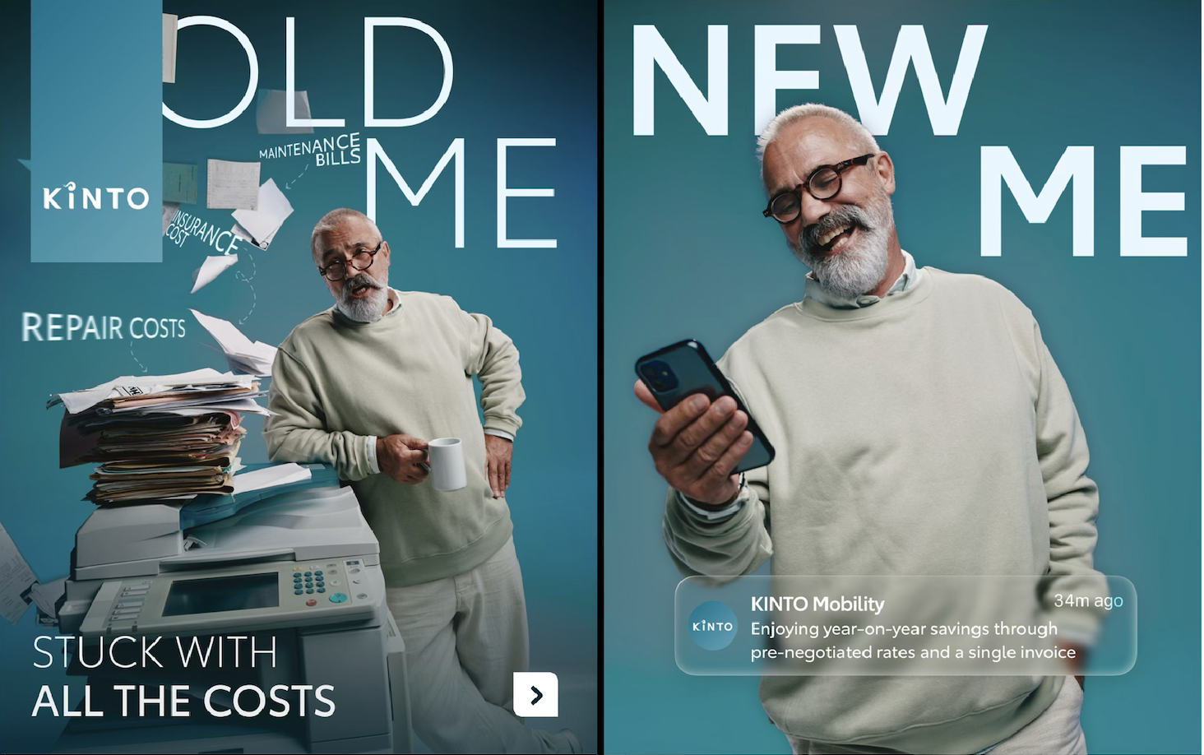
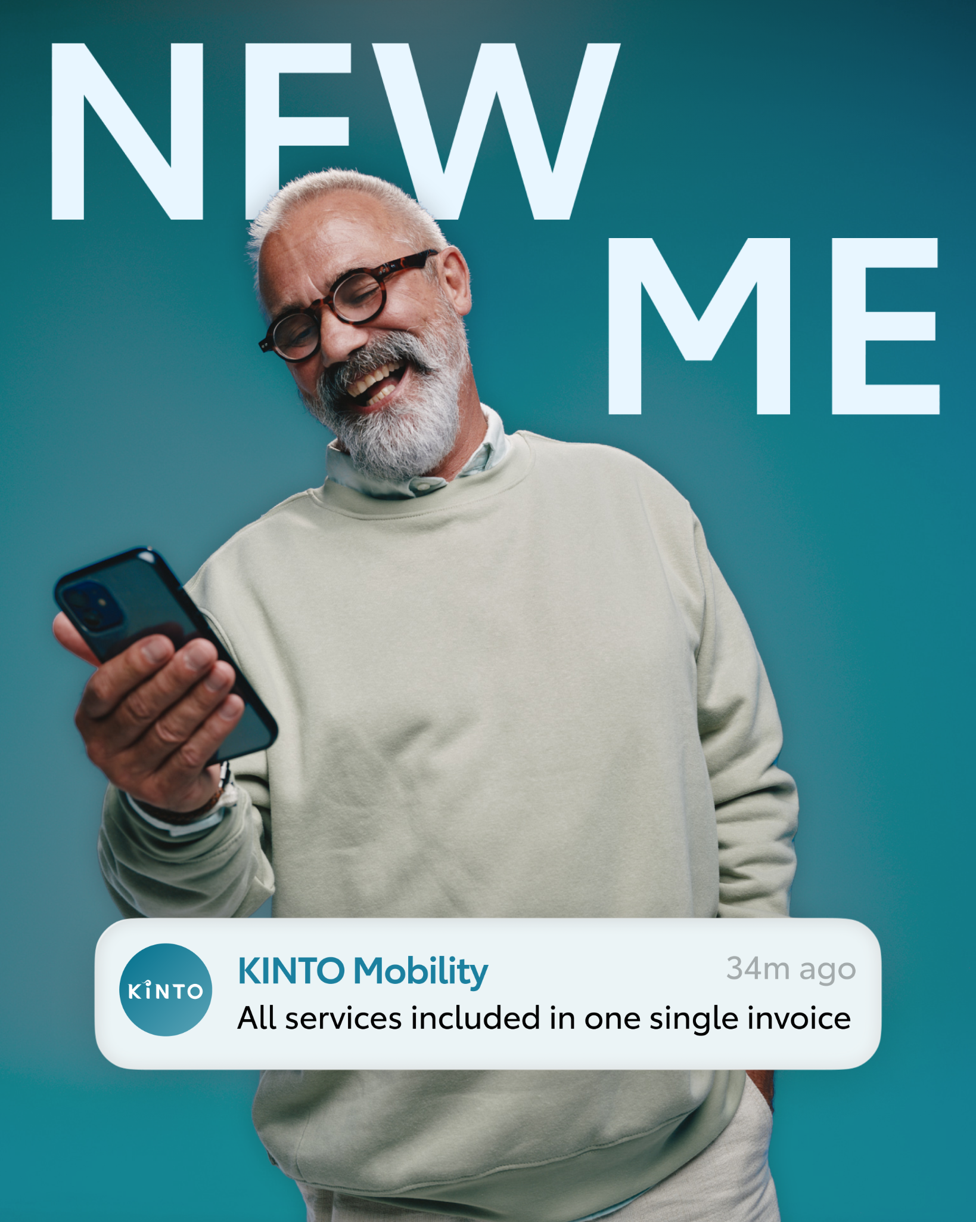
Valid for multibrand
4. CAROUSEL NEW
ME
COPY - LI:
Is your fleet management stuck in the past?
❌ The old way of managing mobility often means being buried under fragmented costs. separate bills for maintenance, insurance renewals, and unexpected repairs.
Swipe to see the new way with KINTO.
✅ By consolidating your needs, you benefit from our pre-negotiated rates, locking in year-on-year savings.
✅ Best of all? You get just one single invoice for your entire fleet.
What’s your resolution for smarter, simpler mobility in 2026?
One partner. All solutions.
#KINTO #FlexibleMobility #OneStopShop
One partner. All solutions.
#KINTO #FlexibleMobility #OneStopShop
CONTENT BUCKET 1- DECEMBER
FORMATS AVAILABLE:
⅘
Notes:
#KINTO #FleetManagement #CorporateMobility #FlexibleMobility #MobilitySolutions

Slide 16
Valid for multibrand
4. CAROUSEL NEW ME
COPY - IG:
Are you still stuck drowning in separate bills for insurance, maintenance, and repairs? 💸
➡️ Swipe to see the ‘new you’ with KINTO.
Our flexible mobility solutions streamline your business mobility into one single invoice, using pre-negotiated rates to deliver year-on-year savings. ✅
One partner. All solutions.
#KINTO #FlexibleMobility #OneStopShop
CONTENT BUCKET 1- DECEMBER
FORMATS AVAILABLE:
⅘
Notes:
☀️🤝😌💚🔥💪✅☝️👉🫵⏰🚐🚘🫵👉👥💪💼🥳🙋
#KINTO #FleetManagement #CorporateMobility #FlexibleMobility #MobilitySolutions

Slide 17
Valid for multibrand
4. CAROUSEL NEW ME
COPY - FB:
Ready for a New Year, New Fleet Strategy? 🎆
Meet the ‘new you’with KINTO.
Imagine all those costs rolled into one simple, manageable invoice.
Plus, because we handle the negotiations, you enjoy real year-on-year savings. 🤝
CONTENT BUCKET 1- DECEMBER
FORMATS AVAILABLE:
⅘
Notes:
🚐 of 🚗
#KINTO #FleetManagement #CorporateMobility #FlexibleMobility #MobilitySolutions

Slide 18
Multipath/
Multiservice
Pillar 4

Slide 19
Flexible mobility solutions
Pillar 3
Notes:
Baseline: Wherever life takes you, KINTO finds the right solution for you.

Slide 20



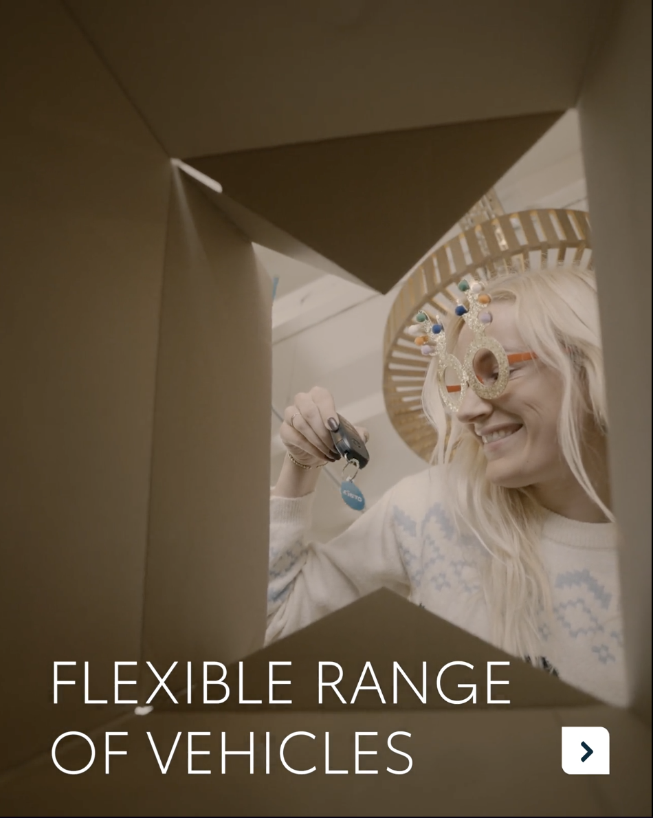
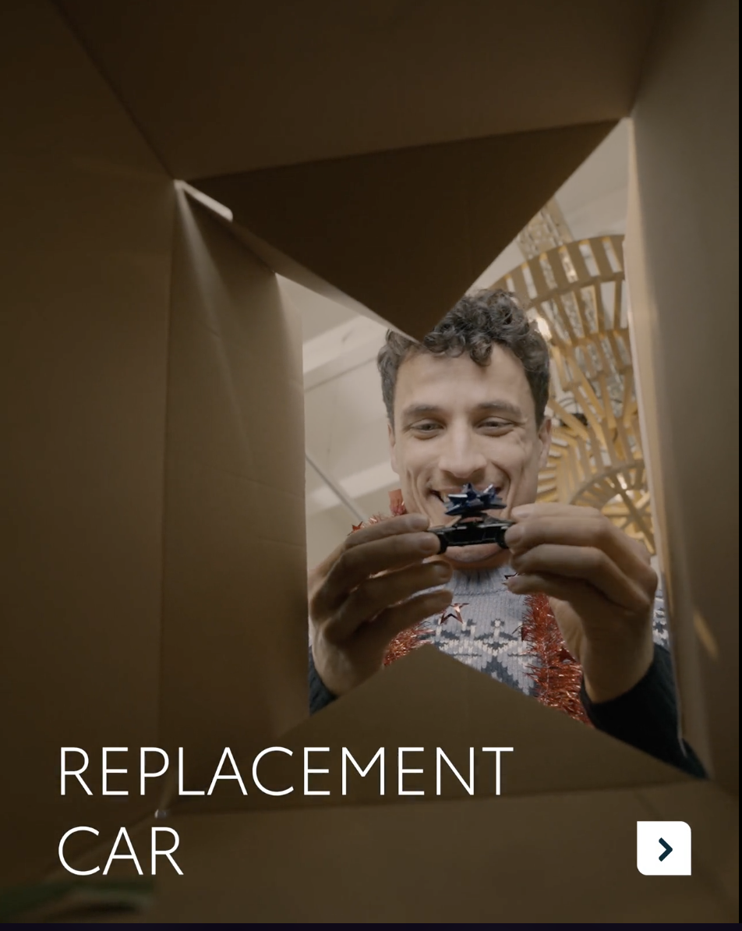
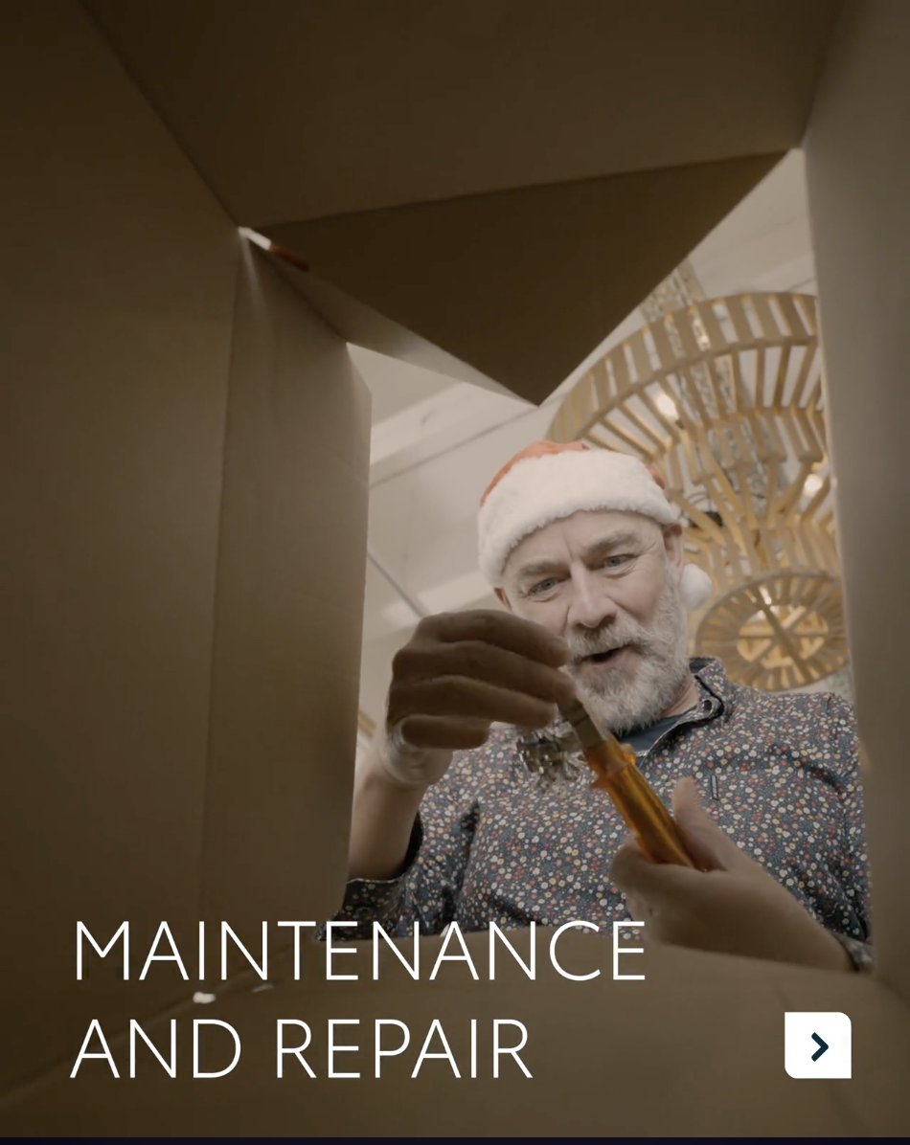
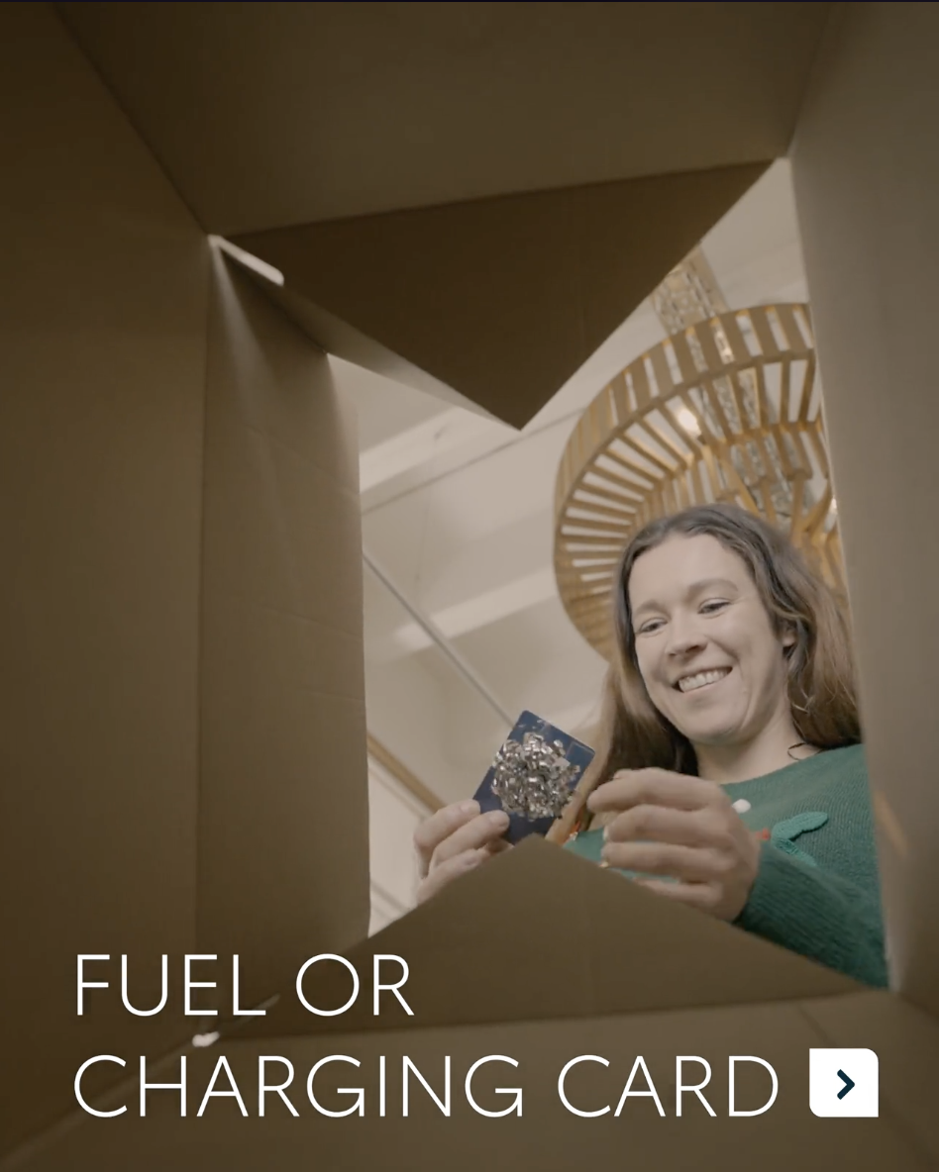
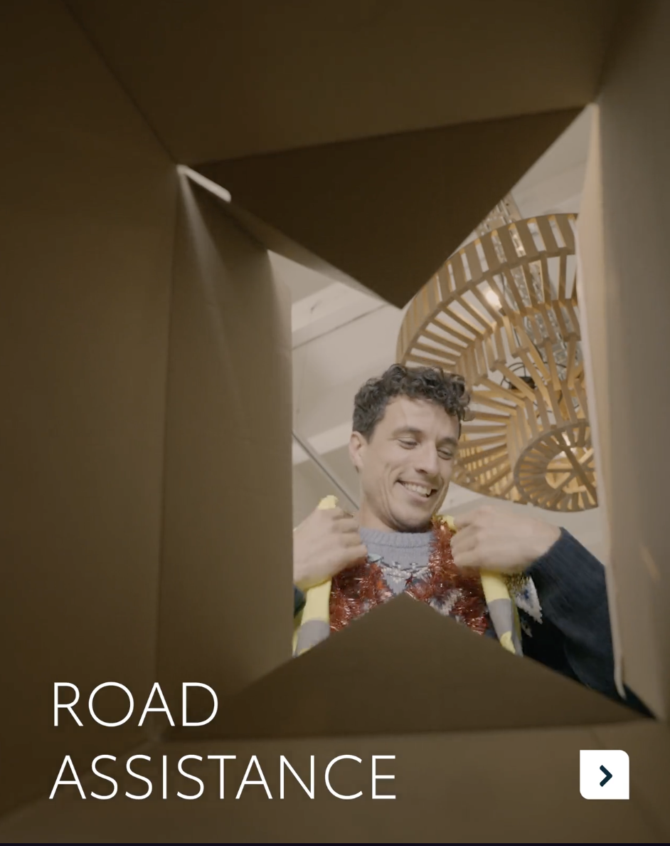
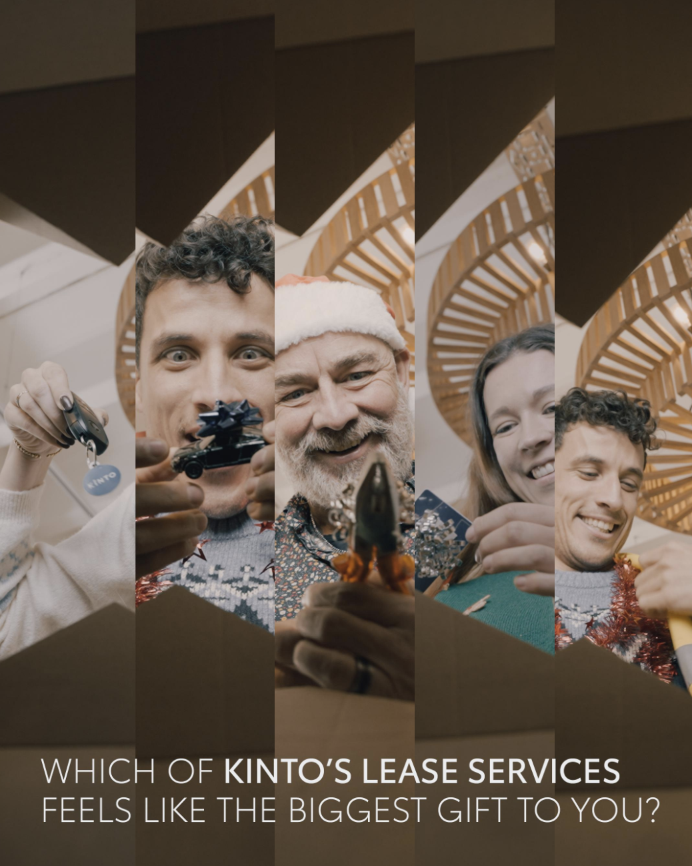
Valid for multibrand
5.CAROUSEL UNBOXING
CONTENT BUCKET 1- DECEMBER
COPY LI
What if your fleet management solution came in a single box? 🎁
Swipe to unbox the full value of our all-inclusive leasing solution.
Imagine unboxing not just a set of car keys, but a complete, streamlined experience for your business. Inside, you'd find:
✅ Comprehensive insurance and roadside assistance.
✅ Maintenance and repair.
✅ Fuel or charging cards ready for your team to use.
✅ Even a plan for seasonal needs, like fitting winter tyres.
It’s the gift of total convenience, allowing you to focus on your business.
One partner. All solutions.
#KINTO
#FleetManagement #BusinessSolutions
FORMATS AVAILABLE:
4/5

Slide 21
Valid for multibrand
5.CAROUSEL UNBOXING
CONTENT BUCKET 1- DECEMBER
COPY IG
Swipe to unbox a simpler workday. 💼
Explore the essential services included in your lease: from keys and fuel or charging cards to maintenance and winter tyres. We’ve got it all covered in one package. ✅
One partner. All solutions.
#KINTO #FleetManagement #BusinessSolutions
FORMATS AVAILABLE:
4/5

Slide 22
Valid for multibrand
5.CAROUSEL UNBOXING
CONTENT BUCKET 1- DECEMBER
COPY FB.
Swipe to unbox a simpler workday. 🎁
What exactly do you get with KINTO business leasing? It’s more than just a vehicle.
Explore some of the services included in your monthly rate, like fuel or charging cards, full maintenance, and winter tyres.
One partner. All solutions.
FORMATS AVAILABLE:
4/5

Slide 23

6.VIDEO FRAGILE FINDS
COPY - LI:
For entrepreneurs, adaptability isn't a buzzword. It's a daily reality.
Sometimes, your standard fleet just isn't enough. 🤷 Whenever your mobility needs change, KINTO lets you rent the extra capacity you need.
A couple of days, weeks or months? Get access to the perfect vehicle for the job — like a spacious Toyota Proace when you need it most — without being tied to a long-term lease. 🚐
#KINTO #FlexibleMobility #BusinessSolutions
CONTENT BUCKET 1- DECEMBER
FORMATS AVAILABLE:
1/1 - 9/16 - ⅘ - 16/9
Notes:
#KINTO #FleetManagement #CorporateMobility #FlexibleMobility #MobilitySolutions

Slide 24
6.VIDEO FRAGILE FINDS
COPY - IG:
Handle with care. 📦 Drive with confidence. 🚗
Business is unpredictable. Your mobility shouldn't be.
Whether you need a roomy Toyota Proace for a big delivery or a city car for a meeting, just rent it for a short period and return it when you're done. 🚐
#KINTO #FlexibleMobility #BusinessSolutions
CONTENT BUCKET 1- DECEMBER
FORMATS AVAILABLE:
1/1 - 9/16 - ⅘ - 16/9
Notes:
🚐 🚗 💪🪑👀💡🤷🙅

Slide 25
6.VIDEO FRAGILE FINDS
COPY - FB:
That heart-stopping moment when you've secured a fragile treasure and realize... It might not fit in your car. 😬
Business is unpredictable. Your mobility shouldn't be. Whenever your needs change, KINTO is there.
👉 You can simply rent the right vehicle for the job—like a Toyota Proace—for a short period.
❇️ No long-term commitment.
❇️ Insurance, maintenance and repair included. ❇️ Easily extendable to meet your needs.
CONTENT BUCKET 1- DECEMBER
FORMATS AVAILABLE:
1/1 - 9/16 - ⅘ - 16/9

Slide 26
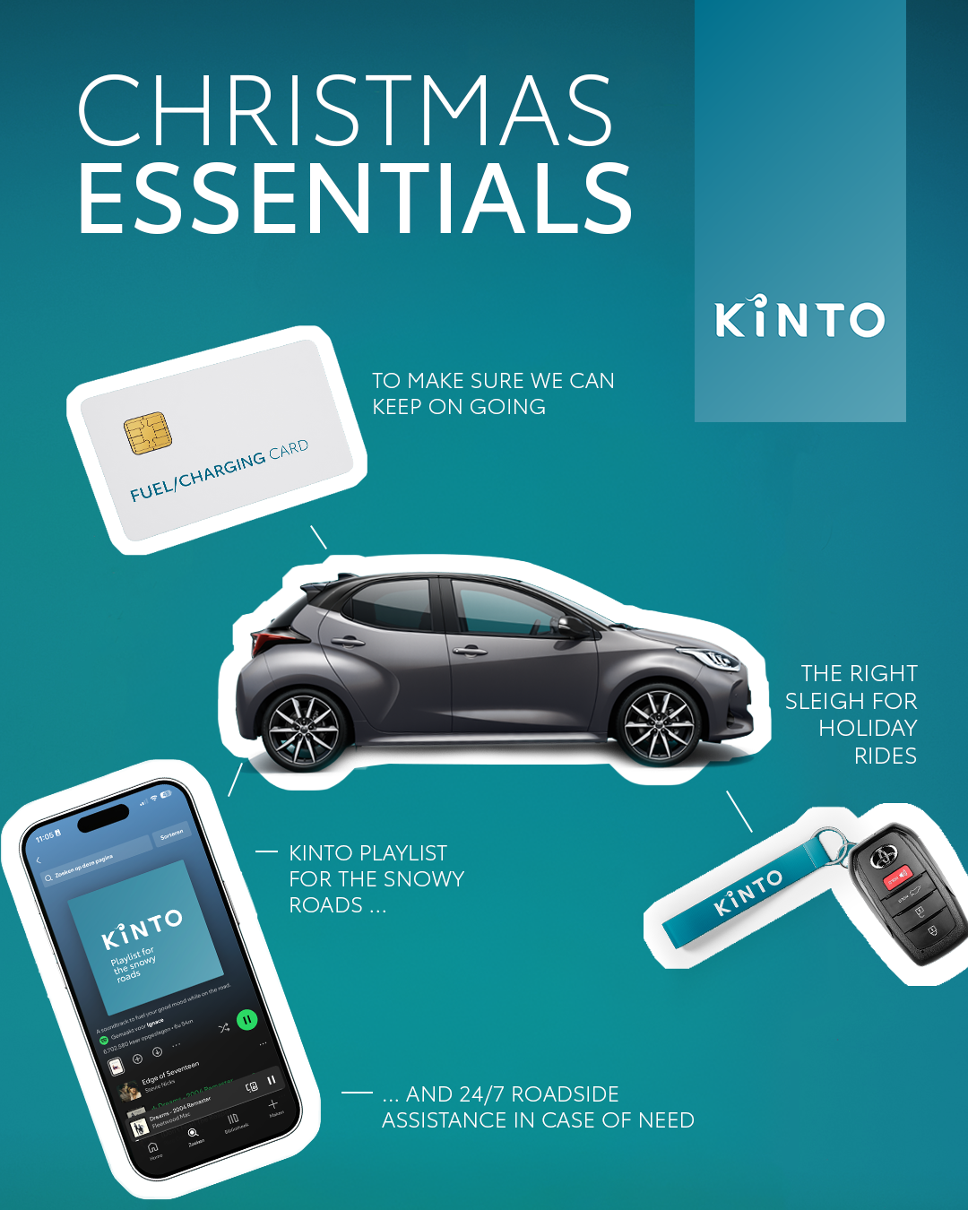
7. VISUAL CHRISTMAS ESSENTIALS
Valid for multibrand
COPY - LI:
As the year winds down, it's time to prepare for a well-deserved break. What's on your holiday essentials list? 🎄
Here's ours, designed for the perfect festive journey:
✅ The right KINTO vehicle to drive in comfort.
✅ A fuel or charging card to skip the payment hassle
✅ 24/7 roadside assistance to keep you going.
✅ The perfect soundtrack to get you in the holiday spirit.
One partner. All solutions.
#KINTO #FlexibleMobility #ChristmasEssentials
CONTENT BUCKET 1- DECEMBER
FORMATS AVAILABLE:
1/1 - 4/5

Slide 27
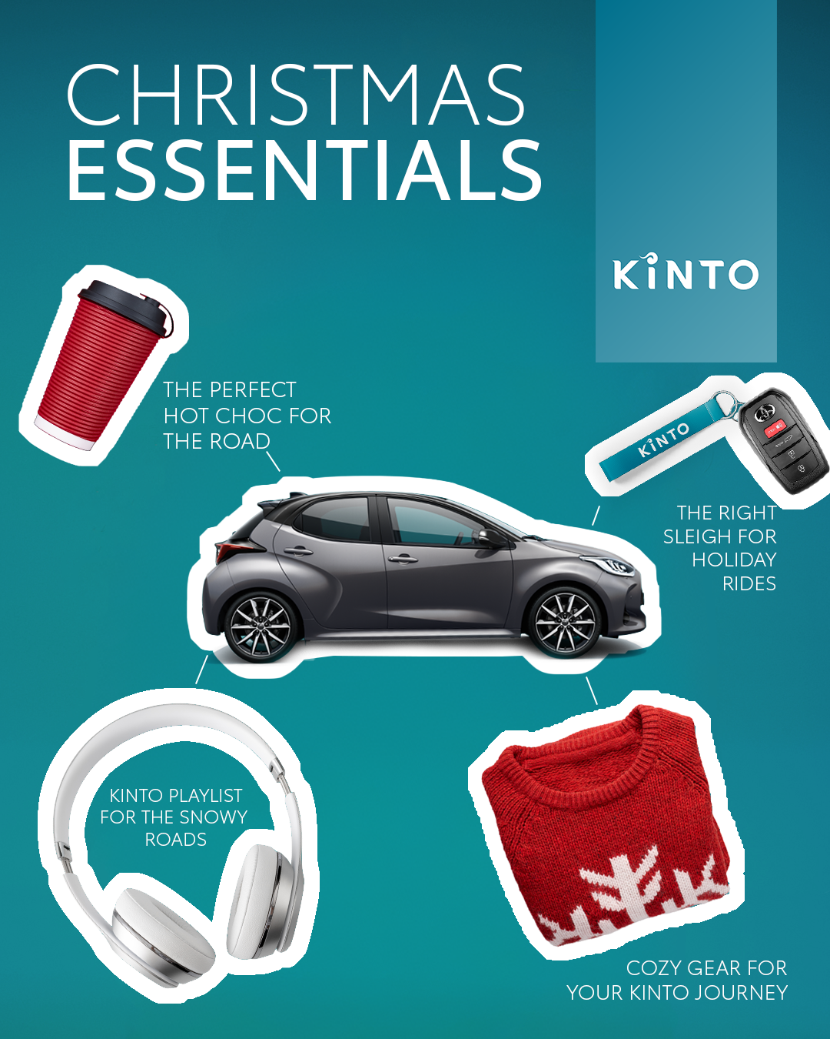
7. VISUAL CHRISTMAS ESSENTIALS
Valid for multibrand
COPY - IG:
Holiday road trip: checklist complete. ✅
We’ve curated the ultimate KINTO Christmas Essentials Kit for your drives home, to the Christmas market, or wherever the holidays take you.
✅ The right KINTO vehicle to drive in comfort.
✅ A fuel or charging card to skip the payment hassle
✅ 24/7 roadside assistance to keep you going.
✅ The perfect soundtrack to get you in the holiday spirit.
One partner. All solutions.
#KINTO #FlexibleMobility #DrivingHomeForChristmas
CONTENT BUCKET 1- DECEMBER
FORMATS AVAILABLE:
1/1 - 4/5

Slide 28
7. VISUAL CHRISTMAS ESSENTIALS
Valid for multibrand
COPY - FB:
Holiday road trip checklist? ✅ We've got ours ready to go!
🔑Keys to the perfect KINTO sleigh.
🚘 Fuel or charging costs sorted.
🔧 24/7 support, wherever you are.
🎵 The ultimate holiday playlist.
What's the one song or item that HAS to be on your holiday essentials list? Let us know in the comments.
One partner. All solutions.
CONTENT BUCKET 1- DECEMBER
FORMATS AVAILABLE:
1/1 - 4/5
Notes:
🚐💚👉🫵🤝🚗🚙🚘🔧📈📊📉🆕✨❇️🆙☀️🤝😌💚🔥💪✅☝️👉🫵⏰🚐🚘🫵👉👥💪💼

Slide 29
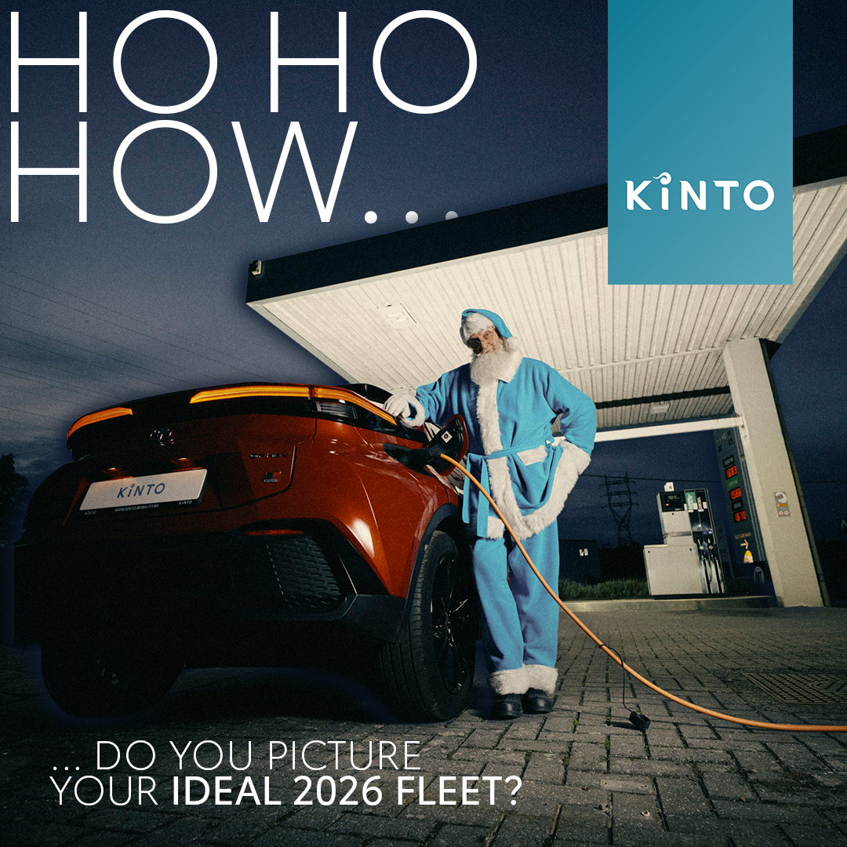
8. VISUAL YOUR FLEET WISH
Valid for multibrand
COPY - LI:
If you could change ONE thing about managing your fleet this year, what would it be?
Is it...
✅ Reducing paperwork?
📈 A smoother repair process?
🌍 Making sustainable, greener choices?
We believe small changes can make a big impact. We'd love to hear your perspective and priorities for 2026 in the comments. 👇
One partner. All solutions.
#KINTO #FleetManagement #BusinessMobility
CONTENT BUCKET 1- DECEMBER
FORMATS AVAILABLE:
1/1 - 4/5
Notes:
Wherever life takes you, KINTO finds the right solution for you.
☀️🤝😌💚🔥💪✅☝️👉🫵⏰🚐🚘🫵👉👥💪💼🥳🙋

Slide 30
8. VISUAL YOUR FLEET WISH
Valid for multibrand
COPY - IG:
If you could change ONE thing about managing your fleet this year... what would it be?
Less paperwork? 🧘 Smoother repair process? ⏳ Greener choices? 🌍
We believe small changes can make a big impact. We'd love to hear your perspective. 👇
One partner. All solutions.
#KINTO #MobilitySolutions #SmarterWorking
CONTENT BUCKET 1- DECEMBER
FORMATS AVAILABLE:
1/1 - 4/5

Slide 31
8. VISUAL YOUR FLEET WISH
Valid for multibrand
COPY - FB:
If you could change ONE thing about managing your fleet this year, what would it be? 🤔
Less paperwork? 🧘 Smoother repair process? ⏳ Greener choices? 🌍
At KINTO, we believe small changes can make a big impact. We'd love to hear your perspective! Let us know in the comments. 👇
One partner. All solutions.
CONTENT BUCKET 1- DECEMBER
FORMATS AVAILABLE:
1/1 - 4/5

Slide 32

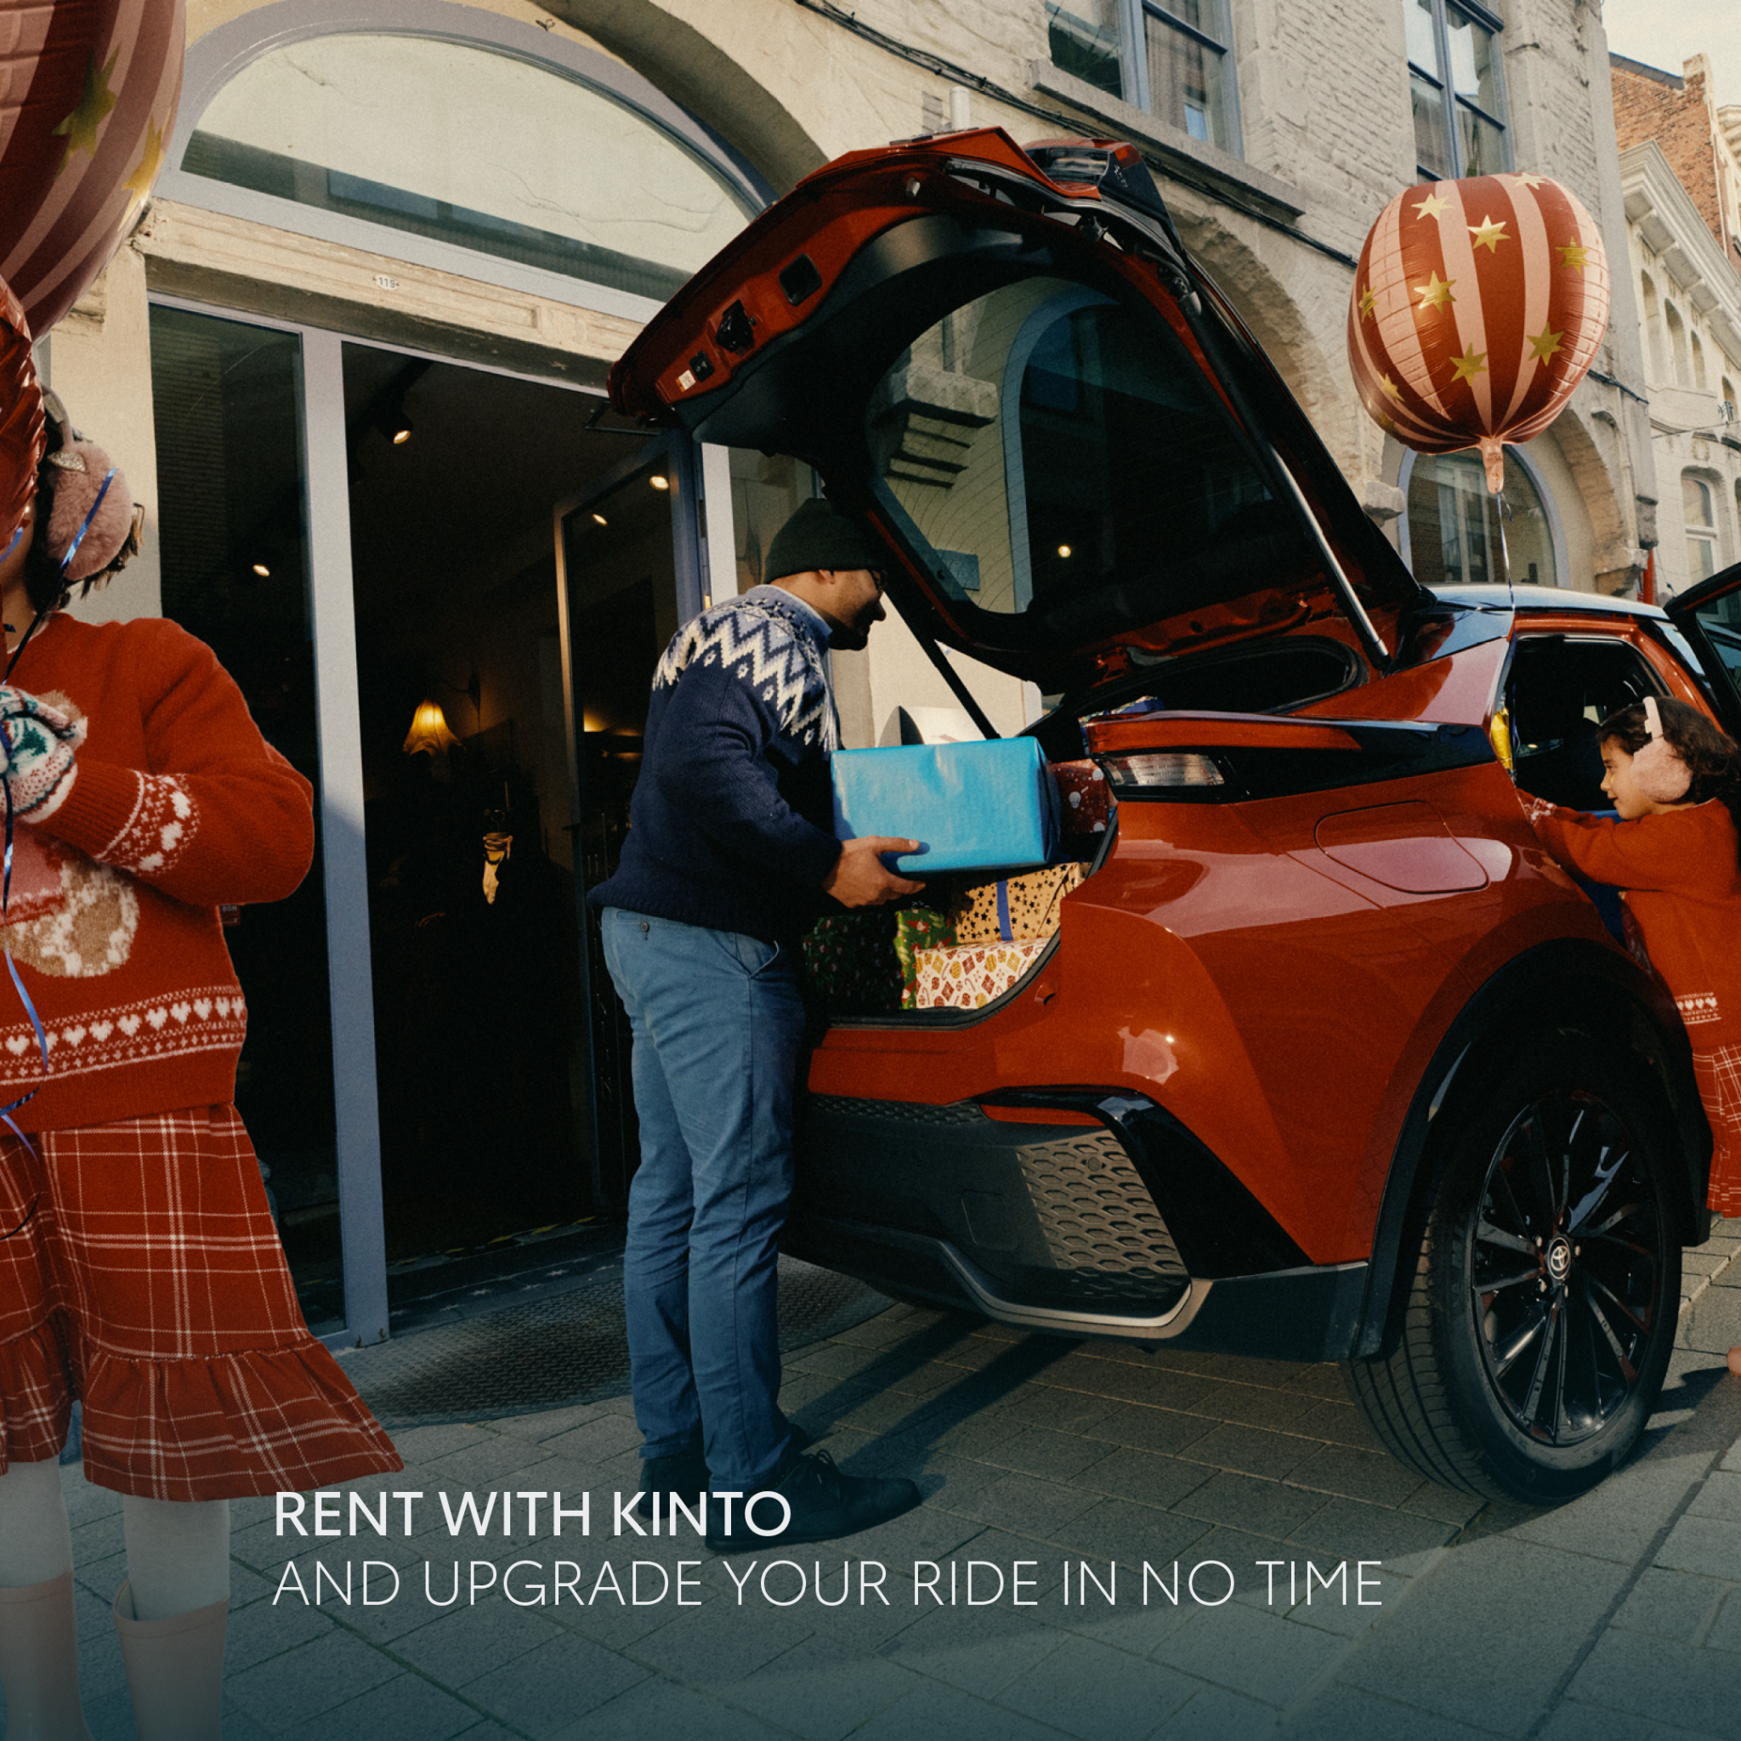
9.CAROUSEL EASY FIT
COPY LI
Need the flexibility to scale up? 📈
Stop trying to fit your needs into one box. Get the fleet that fits you.
With KINTO, you can rent the right vehicle for the task, exactly when you need it, whether for business purposes or private use.
Need a vehicle for a short period? Simply access a compact car for a quick city trip 🚘 or a larger SUV for a big project. 🚐
One partner. All solutions.
#KINTO #FlexibleMobility #FleetManagement
CONTENT BUCKET 1- DECEMBER
FORMATS AVAILABLE:
1/1
Notes:
☀️🤝😌💚🔥💪✅☝️👉🫵⏰🚐🚘🫵👉👥💪💼🥳🙋
LINKEDIN
A one-size-fits-all fleet rarely fits anyone perfectly.
Your team's mobility needs aren't static. A compact Yaris is ideal for efficient city travel, but what about when you need more capacity for an event, client transport, or moving equipment?
That's when you need the flexibility to scale up. 📈
KINTO provides seamless access to the right vehicle for the right task, exactly when you need it—whether it's a compact car for a day or a larger C-HR for a specific project.
Stop trying to fit your needs into one box. Get the fleet that fits you.
Wherever life takes you, Kinto fits right in [Link]
#FlexibleMobility #FleetManagement #KINTO #BusinessAgility #RightSizing #CorporateMobility
FACEBOOK
We've all had that moment: "This is not going to fit." 😅
Whether you're loading up gifts, luggage for a trip, or equipment for a weekend project, sometimes your everyday car just isn't up to the task. (Swipe to see the problem... and the solution!)
Life is full of moments, big and small. With KINTO, you get the flexibility to access the right ride for all of them.
Wherever life takes you, Kinto fits right in [Link]
INSTAGRAM
That moment you realize you need a bigger car. 😬 (Swipe for that sweet, sweet relief. 😌)
From holiday shopping to a spontaneous road trip, life's needs can change fast. Your mobility should be able to keep up.
Get the car you need, when you need it. 🚗
Wherever life takes you, Kinto fits right in [Link in Bio]
#KINTO #ProblemSolved #LifeHacks #FlexibleLiving #NeedMoreSpace #CHR #MobilitySolutions #OnDemand

Slide 33
9.CAROUSEL EASY FIT
COPY IG
Life is full of moments, big and small. With KINTO, you get the flexibility to rent the right ride for all of them. 🚗
From holiday shopping and spontaneous road trips to important client meetings. Access a larger SUV or a city car, for business or private use, instantly.
One partner. All solutions.
#KINTO #FlexibleMobility #FleetManagement
CONTENT BUCKET 1- DECEMBER
FORMATS AVAILABLE:
1/1

Slide 34
9.CAROUSEL EASY FIT
COPY FB
We've all had that moment: "This is not going to fit." 😅
Whether you're loading up gifts, luggage for a trip, or equipment for a weekend project, sometimes your everyday car just isn't up to the task.
With KINTO, you can rent the extra space you need for a short period. Whether for business or private use, you have the flexibility to swap to a larger vehicle whenever the situation demands it.
One partner. All solutions.
CONTENT BUCKET 1- DECEMBER
FORMATS AVAILABLE:
1/1

Slide 35
Community & connection
Empowerment & Expertise
Notes:
Baseline: Join the KINTO community

Slide 36
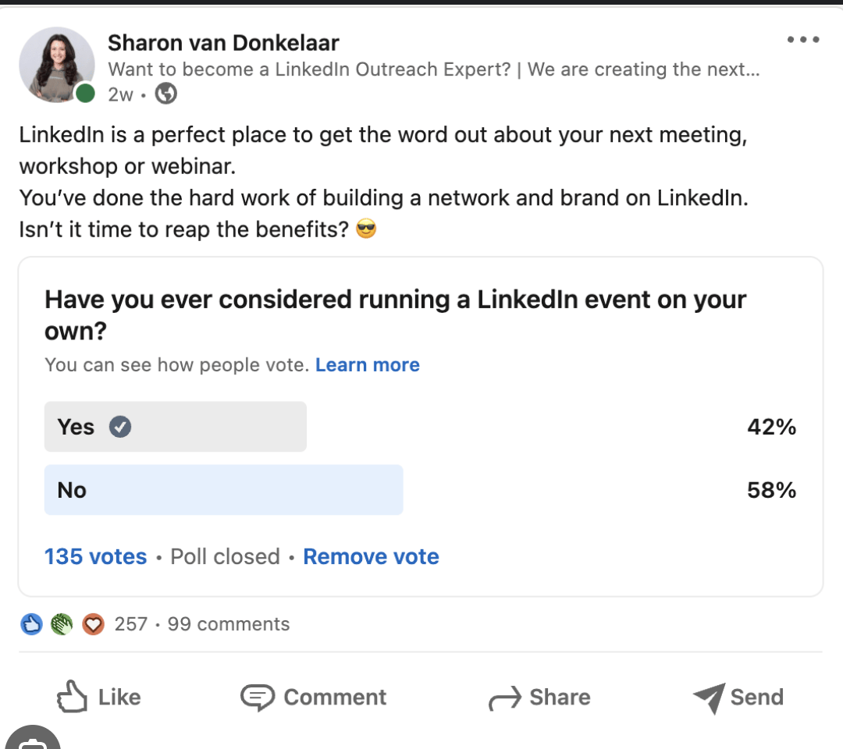
10.POLL COMMUTE
COPY - LI
The modern commute is changing. With hybrid work, flexible schedules, and a growing focus on sustainability, how we get to work (or don't!) is more varied than ever.
💬 We're curious to learn about our community's preferences. Cast your vote in our poll and join the KINTO community. We'd love to see the "why" behind your mobility choice in the comments!
#KINTO #CommunityPoll #Commute
Poll: What’s your favorite way to commute to work?
Company car
Public transport
Cycling
I work remotely
CONTENT BUCKET 1- DECEMBER

Slide 37
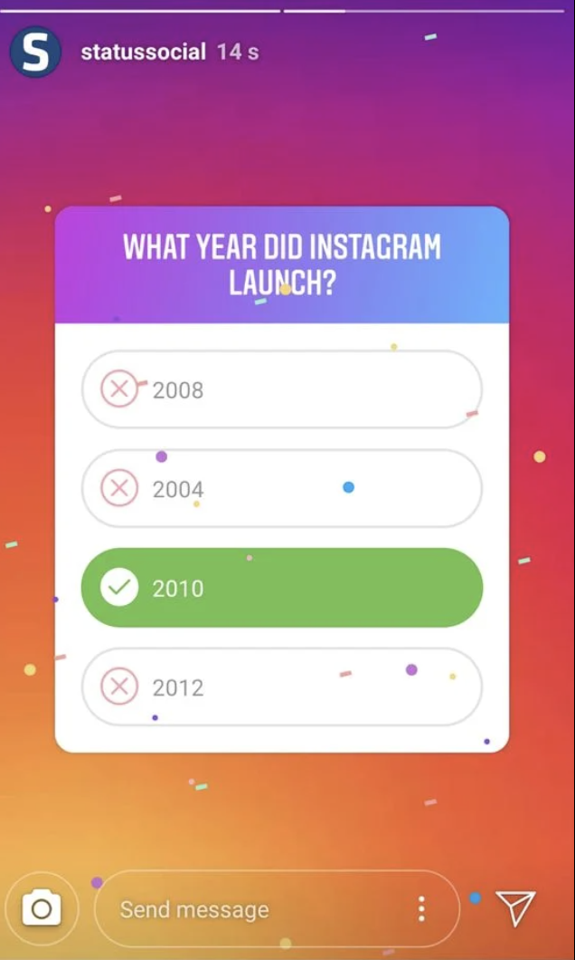
10.POLL COMMUTE
COPY - IG STORY
Question: How do you commute to work?
[Poll Options]
Company car
Public transport
Cycling
I work remotely
CONTENT BUCKET 1- DECEMBER

Slide 38
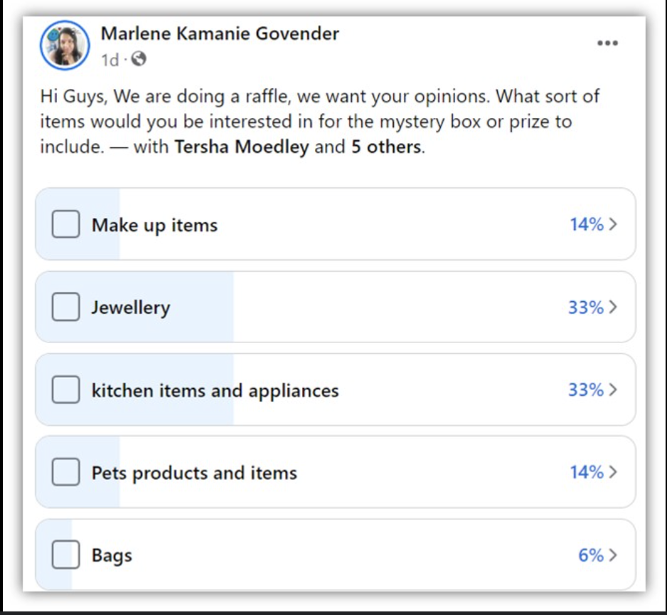
10.POLL COMMUTE
COPY - FB
Everyone's routine is different, and we want to know what works for you. So, tell us: what's your favorite way to commute to work? 🚗 🚌 🚲
Vote below and tell us why you picked it in the comments.
[Poll Options]
Company car
Public transport
Cycling
I work remotely
CONTENT BUCKET 1- DECEMBER
Notes:
FACEBOOK
(This text will appear above the native poll)
Time for a quick community poll! 🚗 🚌 🚲 💻
Everyone's routine is different, and we want to know what works for you.
What's your favorite way to commute to work?
Vote below and tell us why you picked it in the comments!
[Poll Options]
Company car
Public transport
Cycling
I work remotely
Join the Kinto community.
INSTAGRAM
(This copy is for a feed post. The poll question would be in the graphic, and this caption would drive engagement in the comments.)
The great commute debate... 🚗 🚌 🚲 💻
What's your absolute favorite way to start your workday?
Let us know your number one pick in the comments! 👇
Company car
Public transport
Cycling
I work remotely
Join the Kinto community
#KINTO #Poll #Commute #WorkLife #Community #FutureOfWork #RemoteWork #CyclingLife #Mobility

Slide 39




Valid for multibrand
11.CAROUSEL LITTLE REMINDERS
CONTENT BUCKET 1- DECEMBER
COPY LI
Safety comes first, right?
Whether you're heading home, visiting family, or making a last-minute delivery... We've compiled 3 little reminders that can make a big difference in ensuring your journey is seamless, safe, and efficient.
Swipe through for our holiday driving tips. 🚗
☝️ What's your #1 tip for staying safe on the road during the holidays? Tell us in the comments and join the Kinto community.
#KINTO #RoadSafety #HolidayDriving
FORMATS AVAILABLE:
4/5
Notes:
INSTAGRAM
Holiday travels? 🚗✨ Safety first.
Swipe for 3 small reminders that make a big difference on your journey.
From essential checks to driving smarter (and greener! 🌲), we've got you covered.
Kinto: your co-pilot for what’s next
[Link in Bio]
#KINTO #HolidayDriving #RoadSafety #DrivingTips #SafeTravels #EVmode #RoadTrip #SafetyFirst

Slide 40
Valid for multibrand
11.CAROUSEL LITTLE REMINDERS
CONTENT BUCKET 1- DECEMBER
COPY IG
Holiday travels? 🚗✨ Safety first.
Swipe for 3 little reminders that make a big difference on your journey.
From essential checks to driving smarter and greener, we've got you covered.
☝️ What's your #1 tip for staying safe on the road during the holidays?
Join the KINTO community.
#KINTO #RoadSafety #HolidayDriving
FORMATS AVAILABLE:
4/5
Notes:
☀️🤝😌💚🔥💪✅☝️👉🫵⏰🚐🚘🫵👉👥💪💼🥳🙋

Slide 41
Valid for multibrand
11.CAROUSEL LITTLE REMINDERS
COPY FB
The holiday rush is on! 🎄
Whether you're heading home to visit family or making a last-minute delivery, safety always comes first.
Here are 3 little reminders from us that can make a big difference on the road. 👉 Swipe to see them all, and travel safely this holiday season!
Join the Kinto community.
CONTENT BUCKET 1- DECEMBER
FORMATS AVAILABLE:
4/5

Slide 42

12. VIDEO NY WISHES
Valid for multibrand
COPY - LI:
What drives the people behind your mobility solutions?
We asked our KINTO EU team to share their wishes for 2026. 💌 Their answers reflect the passion and community spirit that power our service every day.
💬 What is your key professional goal for the year ahead? Share your thoughts in the comments.
From all of us at KINTO, we wish our entire network a successful and prosperous New Year.
#KINTO #HappyNewYear #Wishes
CONTENT BUCKET 1- DECEMBER
FORMATS AVAILABLE:
1/1 - ⅘ - 16/9 - 9/16

Slide 43
12. VIDEO NY WISHES
Valid for multibrand
COPY - IG:
Our KINTO EU team's 2026 wishes are in... 💌
We asked them to share their real hopes and dreams for the new year.
Their answers?
✅ Less traffic
✅ A greener world
✅ Flexible mobility solutions
✅ And … a request for better handwriting. ✍️🤭
Happy New Year from all of us at KINTO!
#KINTO #HappyNewYear #Wishes
CONTENT BUCKET 1- DECEMBER
FORMATS AVAILABLE:
1/1 - ⅘ - 16/9 - 9./16

Slide 44
12. VIDEO NY WISHES
Valid for multibrand
COPY - FB:
We asked our KINTO EU team for their New Year's wishes... and the answers did not disappoint.
The KINTO team wishes you a happy 2026 with:
💌 Less traffic
💌 A greener world
💌 And... a request for better handwriting. ✍️🤭
Watch the video and take a moment to meet the real people behind your mobility.
CONTENT BUCKET 1- DECEMBER
FORMATS AVAILABLE:
1/1 - ⅘ - 16/9 - 9/16

Slide 45
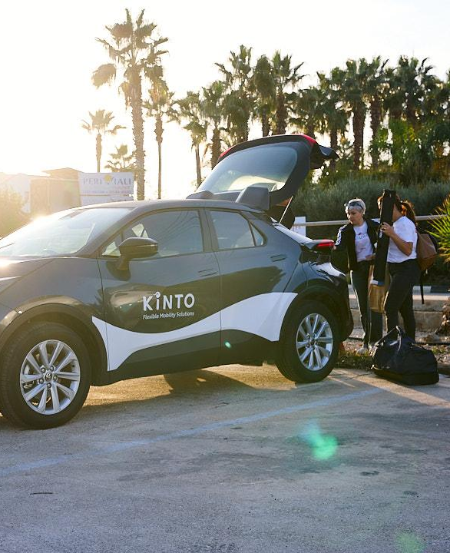
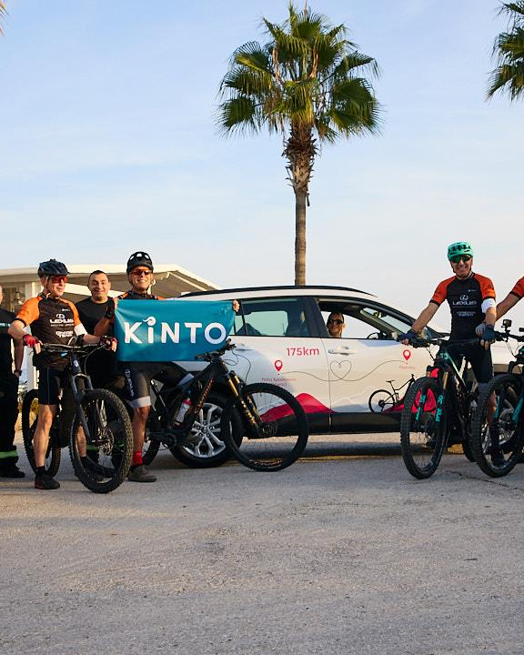
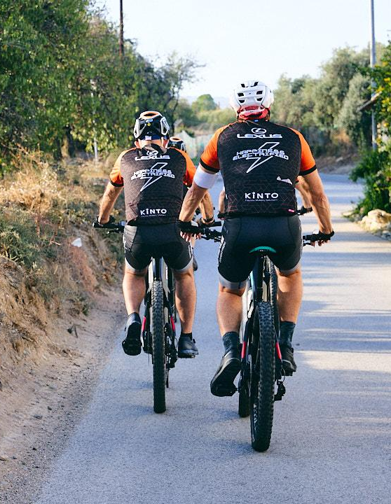
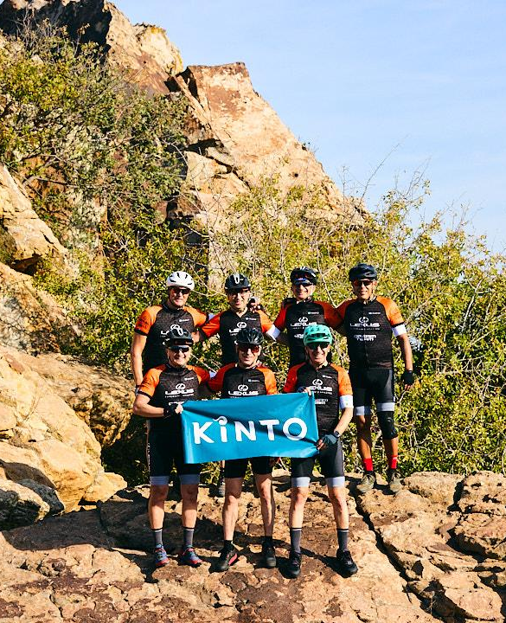
13.CAROUSEL CHARITY CYCLING RACE - CYPRUS
COPY LI
This month, mobility meant much more
than getting from A to B. 💛🚴 KINTO proudly supported the Ride of Love 2025 as mobility partner: a two-day, 175 km off-road charity ride by the @Lexus Cycling Dream Team in aid of the @Karaiskakio Foundation and its childhood cancer centre.
Together with the @Rotary Clubs of Cyprus and Toyota’s European network, the team turned pedal strokes into hope. Along the route, volunteers also helped register new bone marrow donors.
👏 Huge respect to everyone who rode, supported, volunteered, or donated.
Join the Kinto community. #FlexibleMobility #MobilityWithPurpose
CONTENT BUCKET 1- DECEMBER
design: a blue dotted line (visualising the 175km) links every slide together
FORMATS AVAILABLE:
4/5
Notes:
INSTAGRAM
Holiday travels? 🚗✨ Safety first.
Swipe for 3 small reminders that make a big difference on your journey.
From essential checks to driving smarter (and greener! 🌲), we've got you covered.
Kinto: your co-pilot for what’s next
[Link in Bio]
#KINTO #HolidayDriving #RoadSafety #DrivingTips #SafeTravels #EVmode #RoadTrip #SafetyFirst

