Slide 1

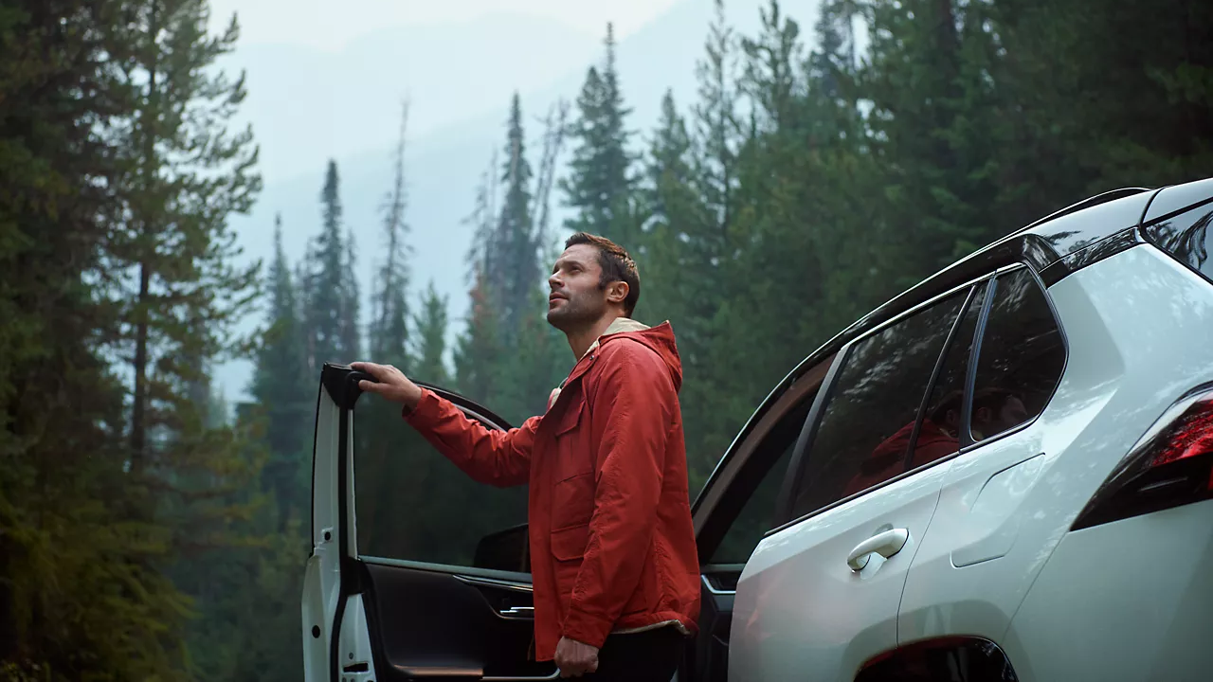

CONTENT
bucket 7 - January

Slide 2
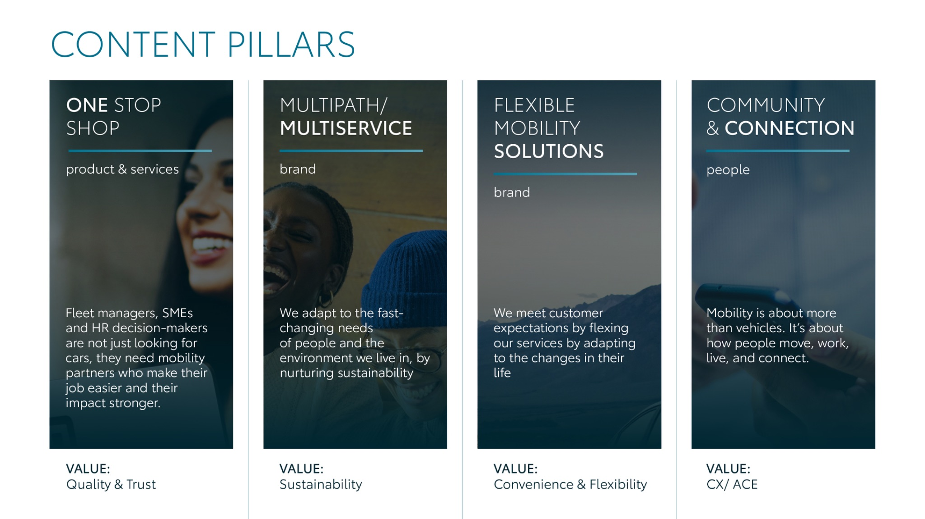
Notes:
“At KINTO, we work with content pillars: themes that carry our brand. We use different content types: inspiring, informative, topical. Your contributions add the human layer that makes the strategy work.”

Slide 3



Content pillars - content overview
January
Back to work
Website buzz
Kinto formulas
Business needs
Fleet resolutions
Kinto-Un
5 Fleet actions
Car Trouble
Rent
Sustainable mobility initiative
Year in Review
Rating Yaris cross
ONE STOP SHOP
MULTIPATH/ MULTISERVICE
FLEXIBLE MOBILITY SOLUTIONS
COMMUNITY/ CONNECTION

Slide 4
Tag lines pillars
1. One Stop Shop
One partner. Every solution.
2. Flexible Mobility Solutions
One partner. Every solution.
3. Community and connection (important to keep it broad enough to fit clients as well as people working at Kinto)
Join the KINTO community.
4. Vision & Impact (Multipath/multiservice)
One partner. Every solution.

Slide 5

One stop shop
Notes:
One place. Every solution. Always KINTO.

Slide 6





Valid for multibrand
1. VIDEO
BACK TO WORK
COPY - LI:
How to make 2026 your smoothest year yet?
It’s time to leave the fleet management stress in the past. 😌
Be the Nr. 1 Fleet Manager who knows that the secret to a smooth operation isn't working harder; it's choosing the right partner.
At KINTO, we handle the insurance, maintenance and other services, so you can handle your coffee. ☕️
#KINTO #OneStopShop #BusinessMobility
CONTENT BUCKET 1- JANUARY
FORMATS AVAILABLE:
1/1 - 9/16 - ⅘ -16/9

Slide 7

Valid for multibrand
1. VIDEO
BACK TO WORK
COPY - IG:
New year, fresh start? ✨ Walk into 2026 knowing your fleet is sorted.
With KINTO by your side, you are the Nr. 1 Fleet Manager who knows that the secret to a smooth operation isn't working harder; it's choosing the right partner.
Whether it's full-service leasing or flexible car rental for you business’ mobility needs, let us handle the included services such as insurance, and maintenance, so you can handle your coffee. ☕️
#KINTO #OneStopShop #BusinessMobility
CONTENT BUCKET 1- JANUARY
FORMATS AVAILABLE:
1/1 - 9/16 - ⅘ - 16/9
Notes:
🔄🚗✅

Slide 8

Valid for multibrand
1. VIDEO
BACK TO WORK
COPY - FB:
New year, fresh start? ✨ Walk into 2026 knowing your fleet is sorted.
With KINTO by your side, you are the Nr. 1 Fleet Manager who knows that the secret to a smooth operation isn't working harder; it's choosing the right partner.
Whether it's full-service leasing or flexible car rental for you business’ mobility needs, let us handle the included services such as insurance, and maintenance, so you can handle your coffee. ☕️
CONTENT BUCKET 1- JANUARY
FORMATS AVAILABLE:
1/1 - 9/16 - ⅘ - 16/9

Slide 9

Valid for multibrand
2. VIDEO WEBSITE BUZZ
COPY - LI:
What gets the whole office talking? A smarter, simpler way to work.
We’re excited to share the new KINTO website, redesigned to give you a closer look at our vision, our history, and the people driving us forward.
👀 Find out what all the buzz is about. Discover the new KINTO website today: www.kinto-mobility.eu
#KINTO #BusinessMobility #OneStopShop
CONTENT BUCKET 1- JANUARY
FORMATS AVAILABLE:
1/1 - 9/16 - ⅘ - 16/9
Notes:
🚐 of 🚗
#KINTO #FleetManagement #CorporateMobility #FlexibleMobility #MobilitySolutions

Slide 10
Valid for multibrand
2. VIDEO WEBSITE BUZZ
COPY - IG:
Find out what all the buzz is about. 👀
Our new website just dropped. We've created a simpler, more seamless online experience to give you a closer look at our vision, our history, and the people driving us forward.
Discover it for yourself via the link in our bio.
#KINTO #BusinessMobility #OneStopShop
CONTENT BUCKET 1- JANUARY
FORMATS AVAILABLE:
1/1 - 9/16 - ⅘ - 16/9

Slide 11
Valid for multibrand
2.VIDEO WEBSITE BUZZ
COPY - FB:
Find out what all the buzz is about. 👀
We're excited to share our completely redesigned KINTO website.
We’ve put everything you need in one easy-to-navigate place, to give you a closer look at our vision, our history, and the people driving us forward. 🚗
Come see what all the excitement is about: www.kinto-mobility.eu
CONTENT BUCKET 1- JANUARY
FORMATS AVAILABLE:
1/1 - 9/16 - ⅘ - 16/9

Slide 12




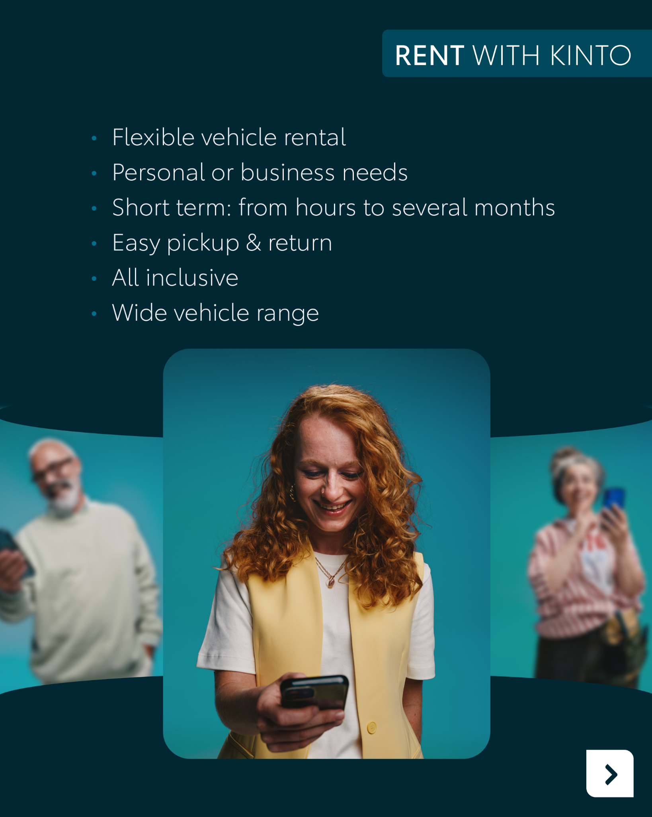

Valid for multibrand
3.CAROUSEL KINTO
FORMULAS
COPY LI
Business mobility is rarely a straight line.
One month you’re planning for the long haul. The next, you need a vehicle yesterday for a sudden project. Or maybe you’re just trying to help your team commute a little greener.
Swipe through to see how KINTO handles the full spectrum of your needs:
👉 Lease with KINTO for long-term stability (+6 months) and get the personal support you need to plan ahead.
👉 Rent with KINTO for short-term agility (-6 months). It’s all-inclusive and hassle-free.
👉 Or do you want to connect the team? KINTO Join makes the daily commute sustainable and social.
One partner. Every solution.
#KINTO #BusinessMobility #FleetManagement
CONTENT BUCKET 1- JANUARY
FORMATS AVAILABLE:
4/5

Slide 13
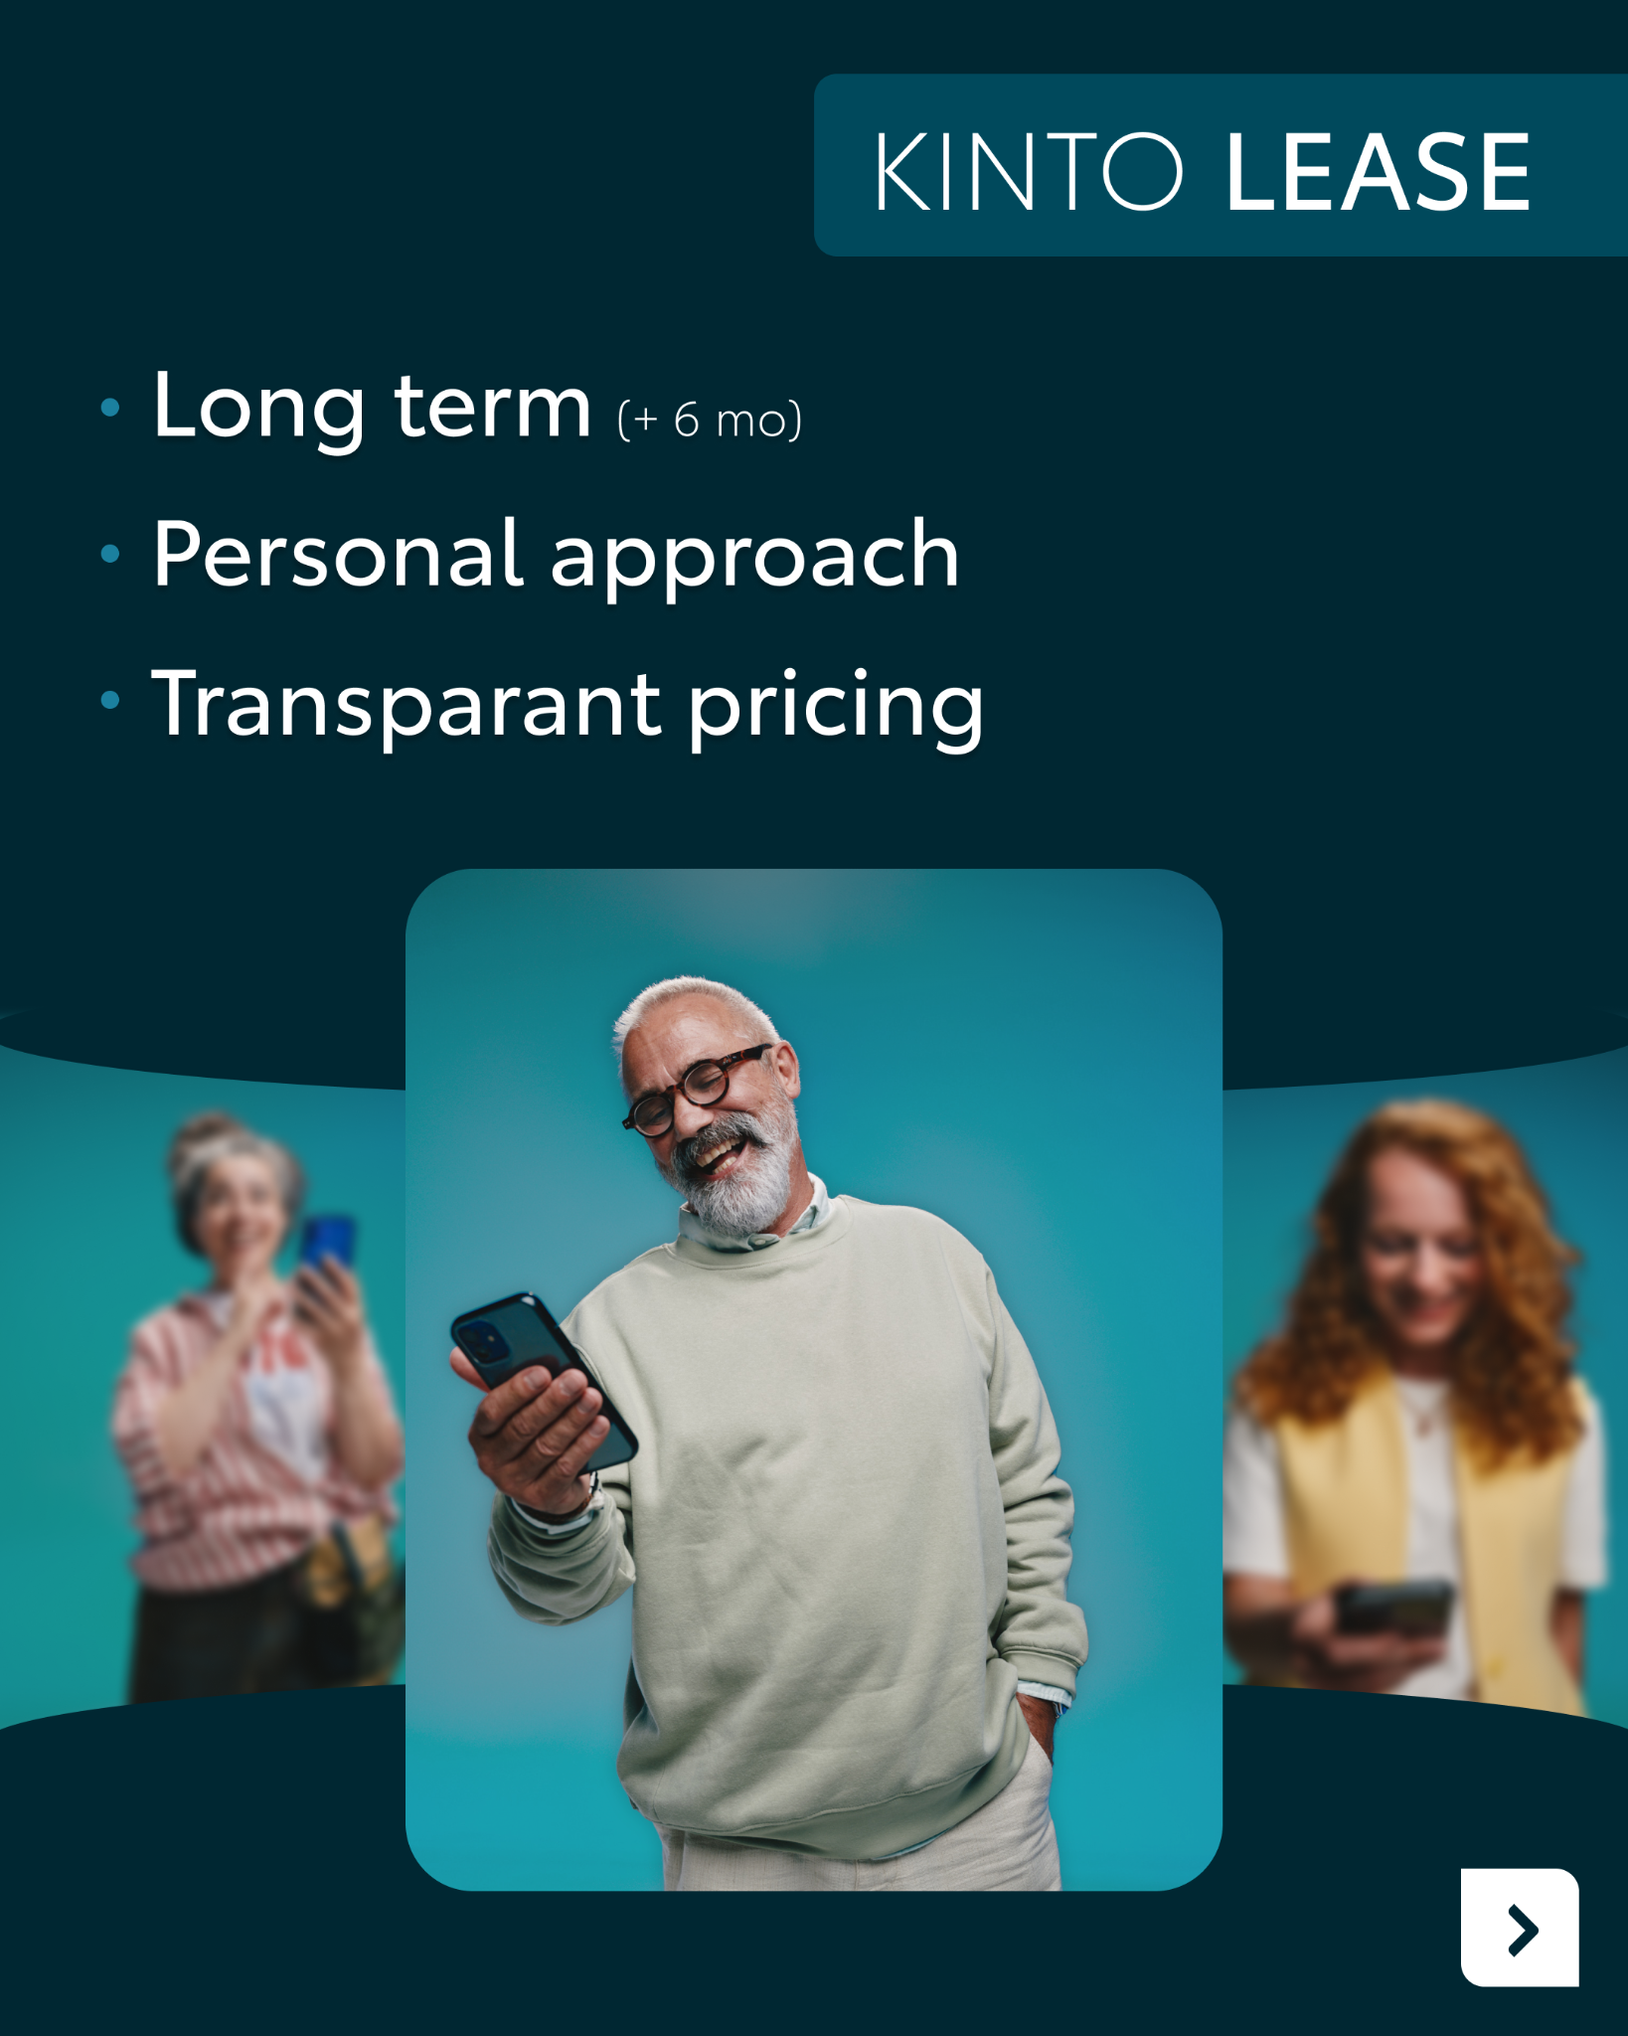


Valid for multibrand
3.CAROUSEL KINTO
FORMULAS
COPY IG
3 ways to move. 1 partner to trust. 📲
From fleet management to carpooling, we’ve got the formula to keep you moving. Swipe to find the KINTO formula that fits your business right now:
1️⃣ Lease with KINTO for long-term stability (+6 months) with fixed prices and a personal contact.
2️⃣ Rent with KINTO for short-term agility (-6 months), all-inclusive and hassle-free.
3️⃣ KINTO Join: connect your team using a platform to track and encourage sustainable commuting.
One partner. Every solution.
#KINTO #BusinessMobility #FleetManagement
CONTENT BUCKET 1- JANUARY
FORMATS AVAILABLE:
4/5

Slide 14
Valid for multibrand
3.CAROUSEL KINTO
FORMULAS
COPY FB
What does your mobility look like today? 🚗
Maybe you need a reliable fleet partner for the long haul. Maybe you just need a vehicle for a few busy months. Or maybe you're looking for a way to help your team commute greener.
Discover the KINTO formula that fits your current vibe:
🔹 Lease with KINTO for long-term stability (+6 months) with fixed prices and a personal contact.
🔹 Rent with KINTO for short-term agility (-6 months), all-inclusive and hassle-free.
🔹 KINTO Join: connect your team using a platform to track and encourage sustainable commuting.
One partner. Every solution.
CONTENT BUCKET 1- JANUARY
FORMATS AVAILABLE:
4/5

Slide 15

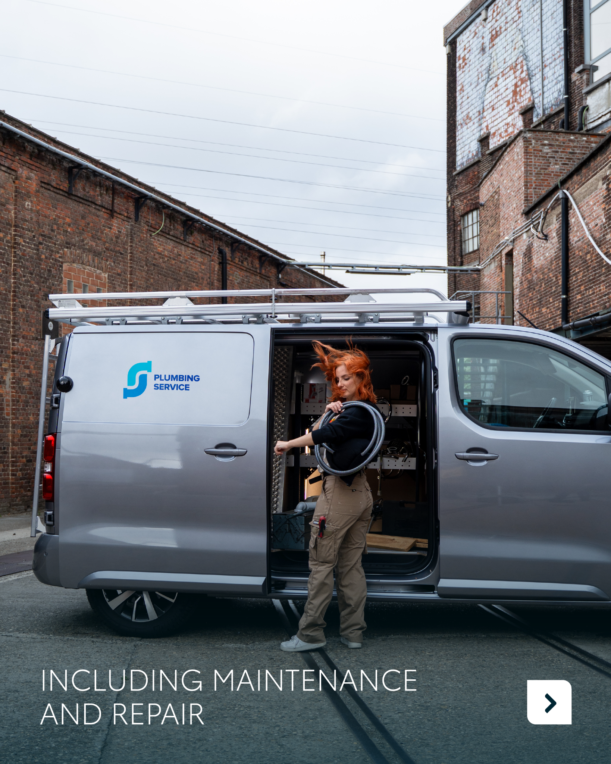

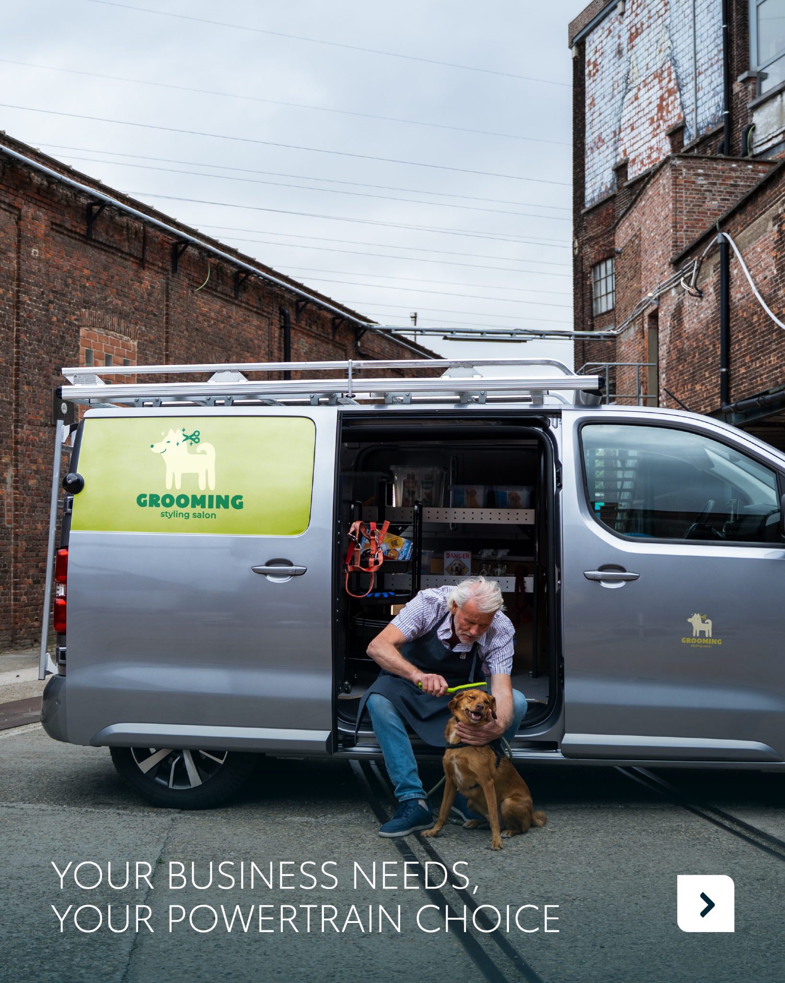
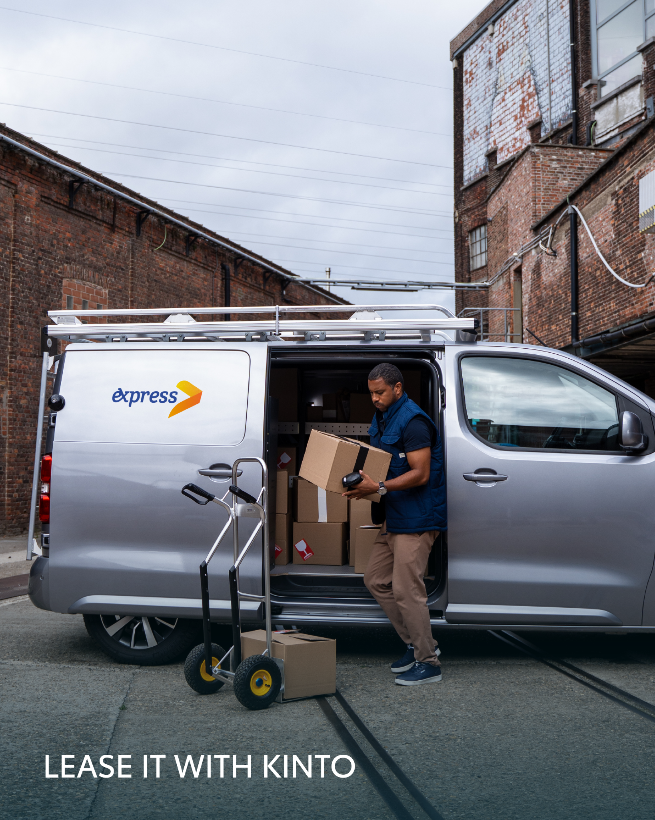
4.CAROUSEL BUSINESS NEEDS
CONTENT BUCKET 1- JANUARY
COPY LI
Don't let logistics limit your business opportunities. 💼
Whether you’re hauling heavy equipment, managing deliveries, or transporting your team, with KINTO, you get access to spacious vehicles like the Proace, wrapped in a service designed for peace of mind.
Swipe through to see how KINTO adapts to your daily reality:
✅ Maintenance & repair included, so your business keeps moving.
✅ Roadside assistance: support whenever and wherever you need it.
✅ Powertrain choice: select the engine that fits your specific business goals and sustainability targets.
✅ And more...
One partner. Every solution.
#KINTO #FlexibleMobility #ToyotaProace
FORMATS AVAILABLE:
4/5

Slide 16

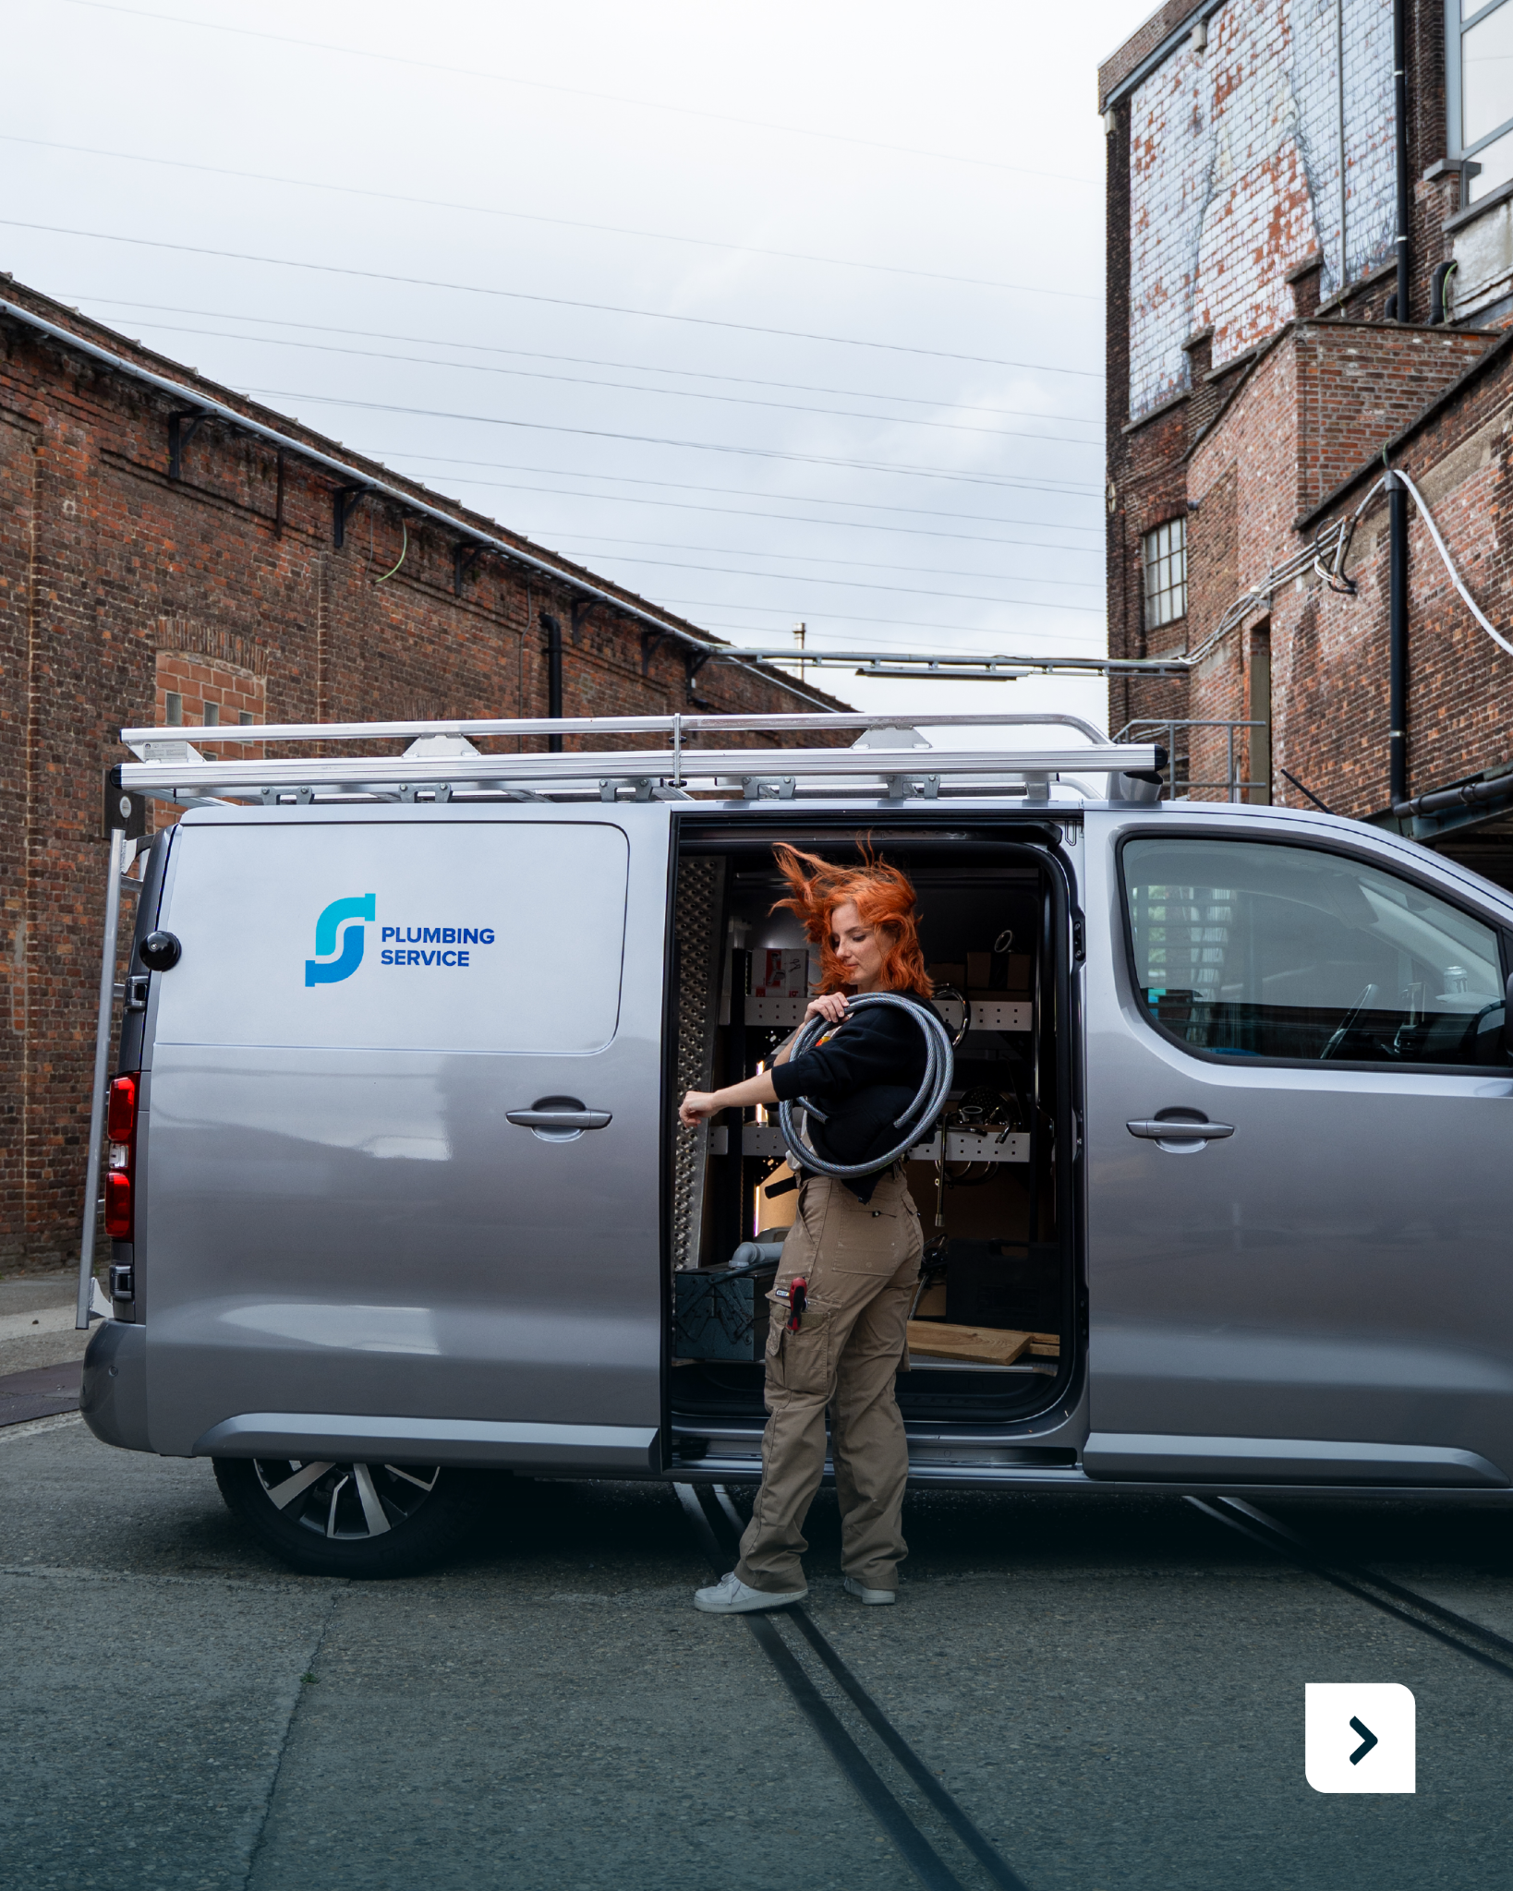
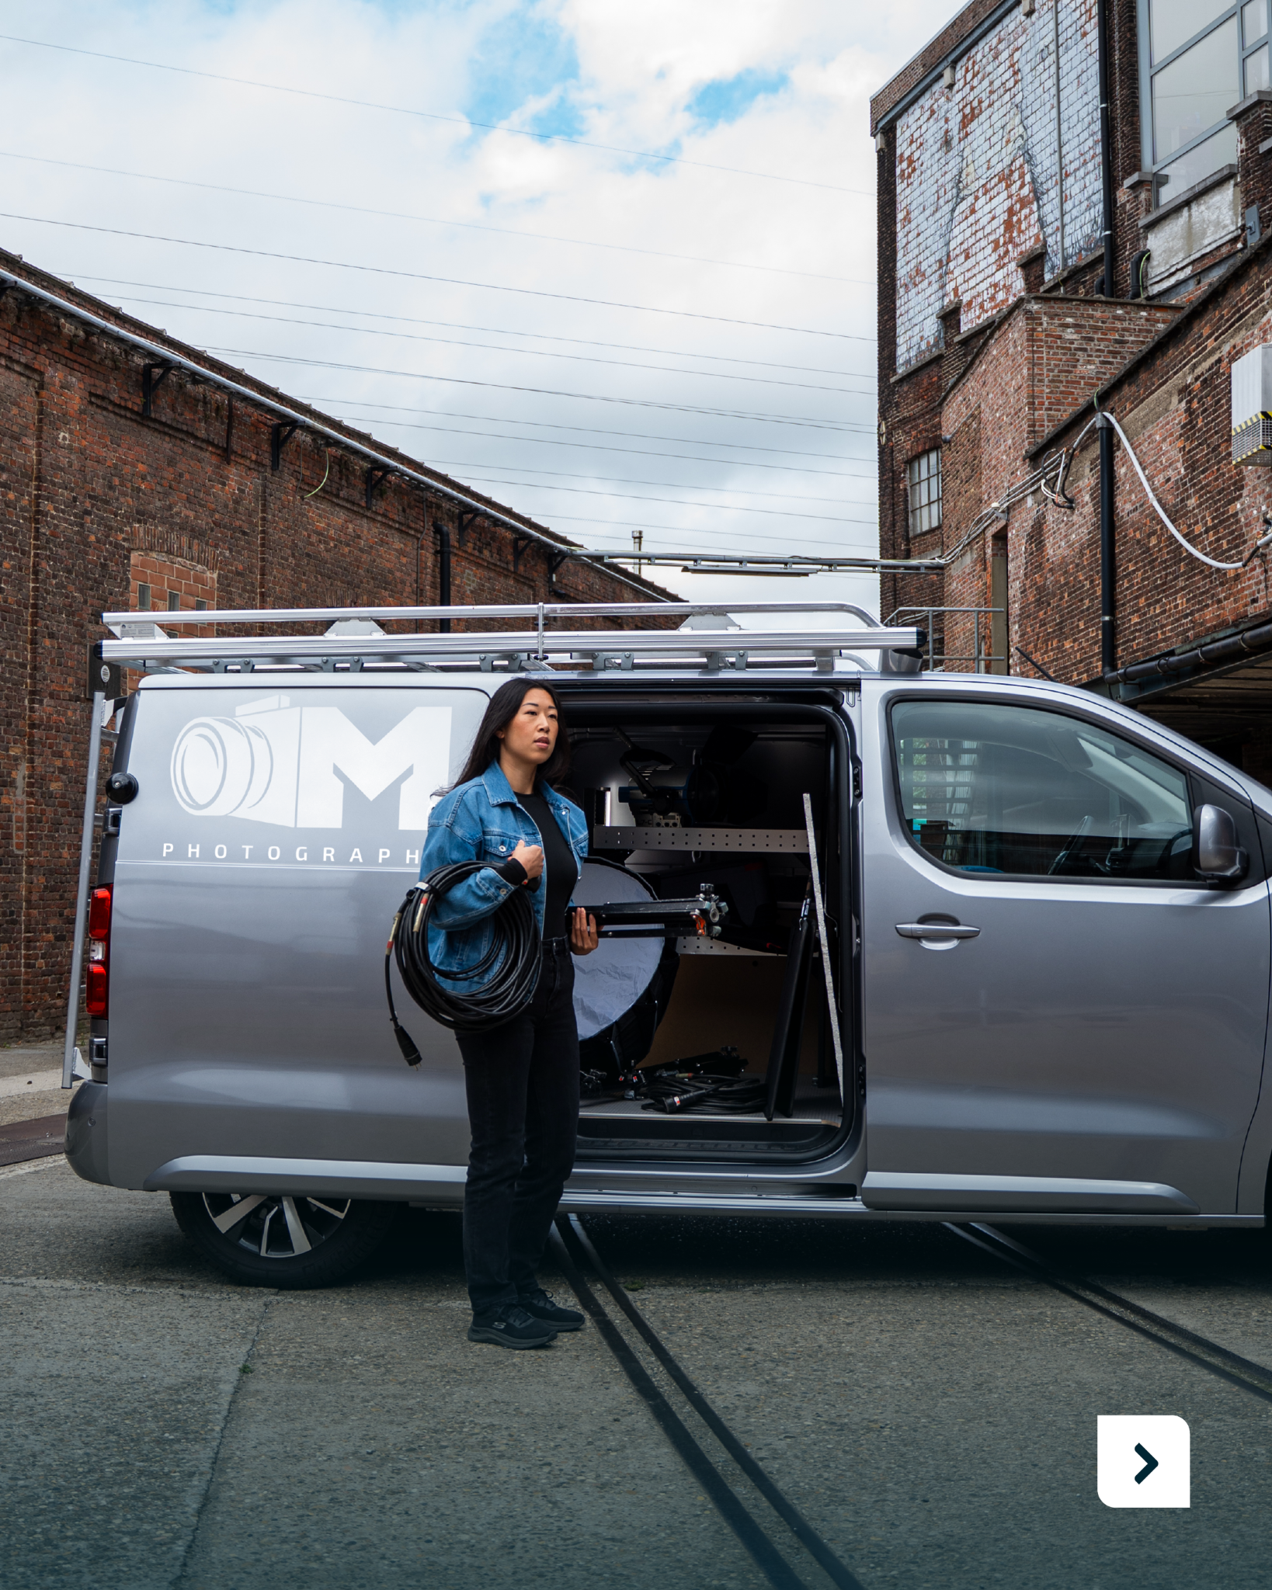
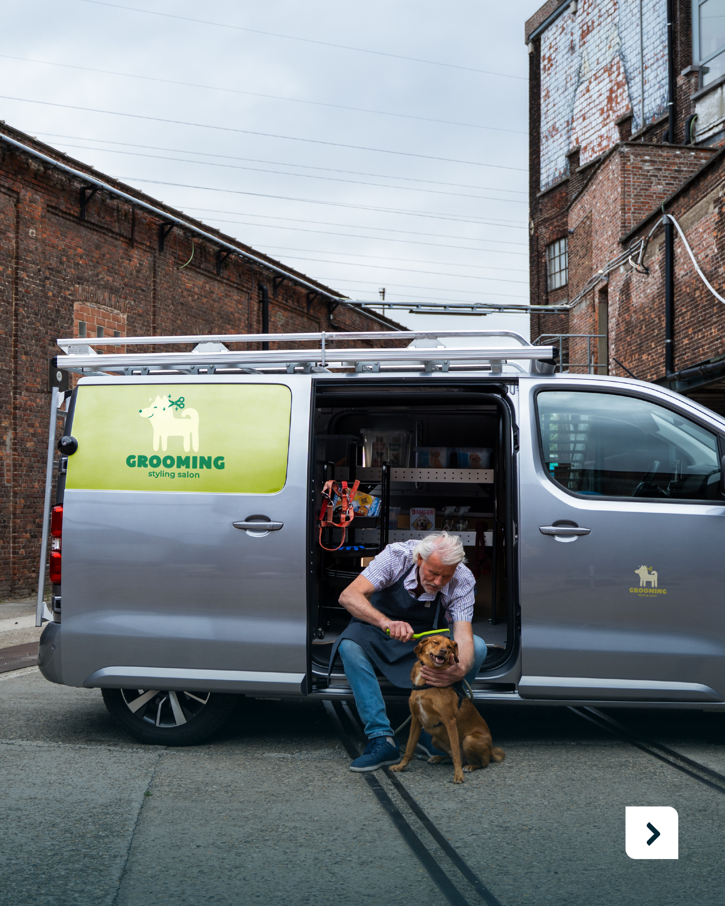
4.CAROUSEL BUSINESS NEEDS
CONTENT BUCKET 1- JANUARY
COPY IG
When your finds, deliveries of team gets bigger, your mobility needs to get smarter. 💡
With KINTO, you get the loading space you need, backed by the services that keep you worry-free. 🔄 Swipe to see how we adapt to your business’ daily reality.
Secure the load, close the doors, and drive with confidence. ✅
One partner. Every solution.
#KINTO #BusinessMobility #ToyotaProace
FORMATS AVAILABLE:
4/5

Slide 17
4.CAROUSEL BUSINESS NEEDS
CONTENT BUCKET 1- JANUARY
COPY FB
When your finds, deliveries of team gets bigger, your mobility needs to get smarter.💡
Whether you are hauling heavy timber or delivering fragile goods. With KINTO, you can get the loading space you need, backed by the services that keep you worry-free. 🔄
👉 Swipe to see how we adapt to your business’ daily reality.
One partner. Every solution.
FORMATS AVAILABLE:
4/5

Slide 18

Valid for multibrand
5.CAROUSEL FLEET RESOLUTIONS
COPY LI
New year, new strategy. 📅
Resolutions are often about self-improvement, but what about business improvement?
If your goals for the year involve a more efficient, cost-effective, and sustainable fleet, you don't have to tackle them alone.
KINTO can turn your ambitions into reality:
✅ Simplify fleet admin: leave the paperwork and logistics to us.
✅ Gain cost predictability: clear pricing, no unpleasant surprises.
✅ Cut emissions footprint: a diverse portfolio to help you transition to green. ✅ Save time & stress, so you can focus on your core business.
One partner. Every solution.
#KINTO #NewYearResolutions #SustainableMobility
CONTENT BUCKET 1- JANUARY
FORMATS AVAILABLE:
4/5

Slide 19
Valid for multibrand
5.CAROUSEL FLEET RESOLUTIONS
COPY IG
What is on your business wish list this year? ✉️ ✨
Swipe and discover our 4 resolutions to transform the way you and your business move.
Ready to tick these off your list?
One partner. Every solution.
#KINTO #NewYearResolutions #SustainableMobility
CONTENT BUCKET 1- JANUARY
FORMATS AVAILABLE:
4/5

Slide 20
Valid for multibrand
5.CAROUSEL FLEET RESOLUTIONS
COPY FB
What is on your business wish list this year? ✉️ ✨
Our resolution is to make your life easier.
Swipe and open the envelopes to discover how we can help you:
🔹 Simplify your admin load.
🔹 Keep costs predictable and clear.
🔹 Lower your carbon footprint.
🔹 And most importantly... give you back your time.
One partner. Every solution.
CONTENT BUCKET 1- JANUARY
FORMATS AVAILABLE:
4/5

Slide 21
Multipath/
Multiservice
Pillar 4

Slide 22


Valid for multibrand
6.CAROUSEL KINTO-UN
COPY LI
Ever wondered what the little cloud on our logo stands for? ☁️
It represents ‘KINTO-UN’, the flying nimbus from Japanese folklore. Legend has it, this magical cloud transports you wherever you wish to go, no matter the time or place.
This symbol is the foundation of our vision. Just like the KINTO-UN, our goal is to make mobility seamless, effortless, and available exactly when your business needs it.
From the dot on our 'i' to the service on the road, we exist to move you forward.
One partner. Every solution.
#KINTO #MobilityVision #KintoUn
CONTENT BUCKET 1- JANUARY
FORMATS AVAILABLE:
4/5

Slide 23


Valid for multibrand
6.CAROUSEL KINTO-UN
COPY IG
Ever wondered what the little cloud on our logo stands for? ☁️
It represents KINTO-UN, the flying nimbus from Japanese folklore. It’s a magical cloud known for taking people exactly where they need to go, no matter the time or place.
That is the spirit behind everything we do at KINTO. We are here to make your mobility as simple, friendly, and effortless as a ride on a cloud. 🌍
One partner. Every solution.
#KINTO #MobilityVision #KintoUn
CONTENT BUCKET 1- JANUARY
FORMATS AVAILABLE:
4/5

Slide 24
Valid for multibrand
6.CAROUSEL KINTO-UN
COPY FB
Ever wondered what the little cloud on our logo stands for? ☁️
It represents KINTO-UN, the flying nimbus from Japanese folklore. It’s a magical cloud known for taking people exactly where they need to go, no matter the time or place.
That is the spirit behind everything we do at KINTO. We are here to make your mobility as simple, friendly, and effortless as a ride on a cloud. 🌍
One partner. Every solution.
CONTENT BUCKET 1- JANUARY
FORMATS AVAILABLE:
4/5

Slide 25
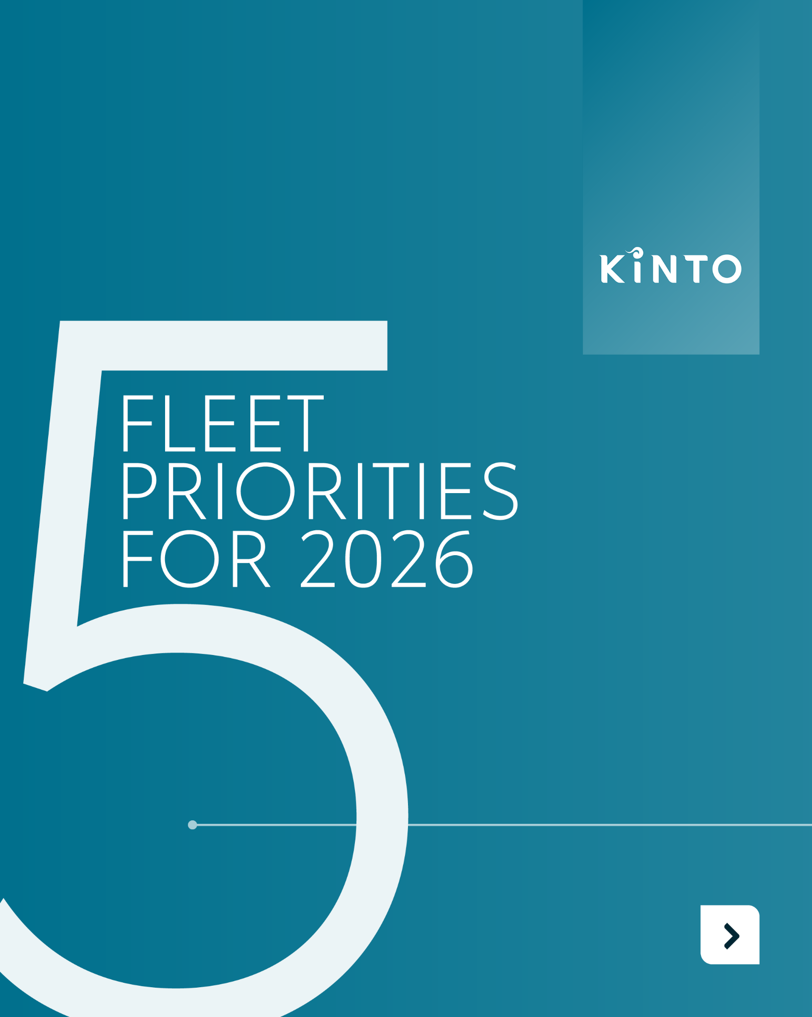
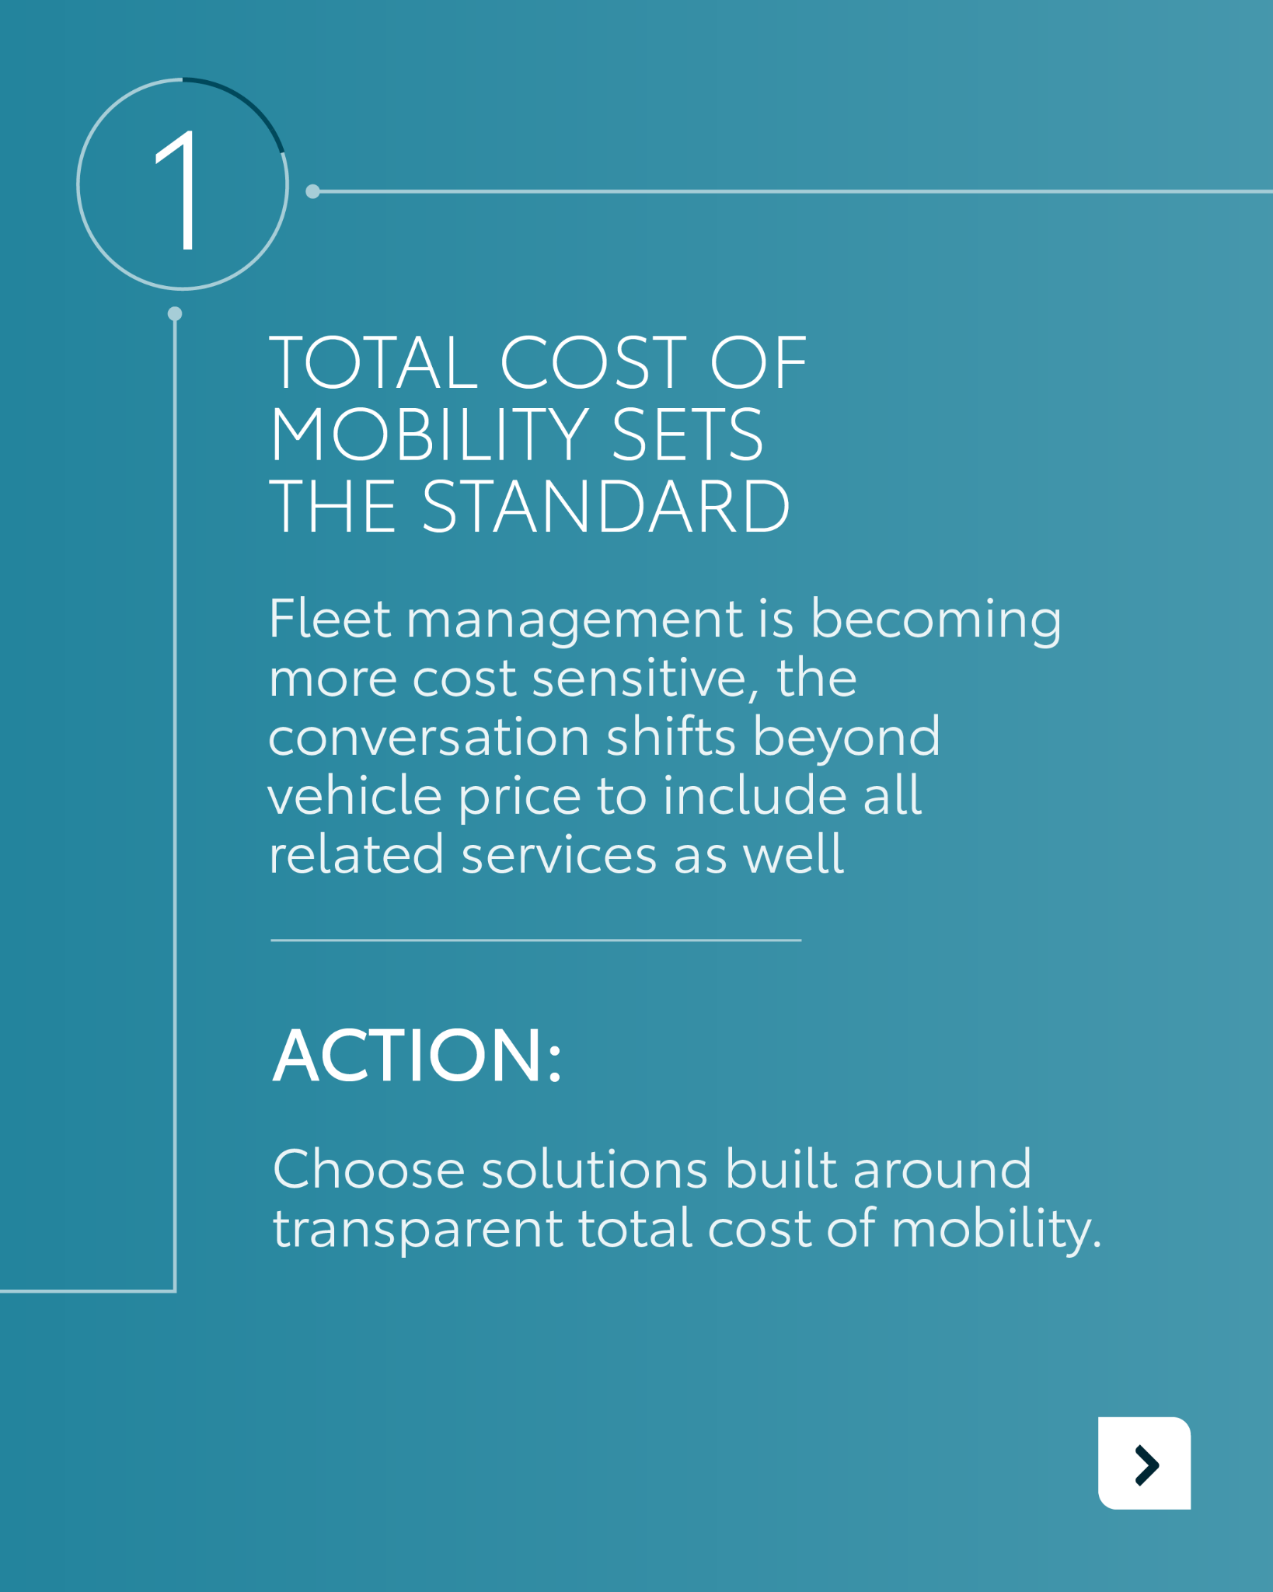

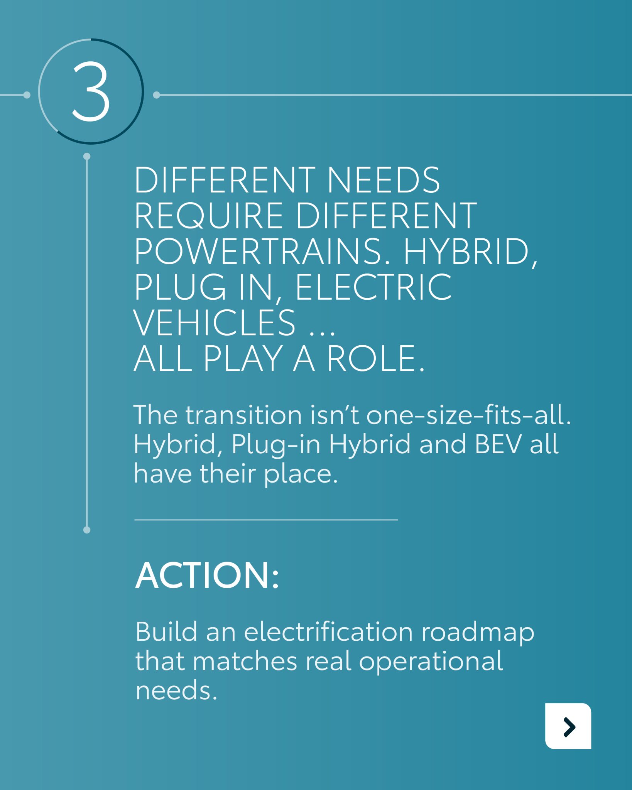
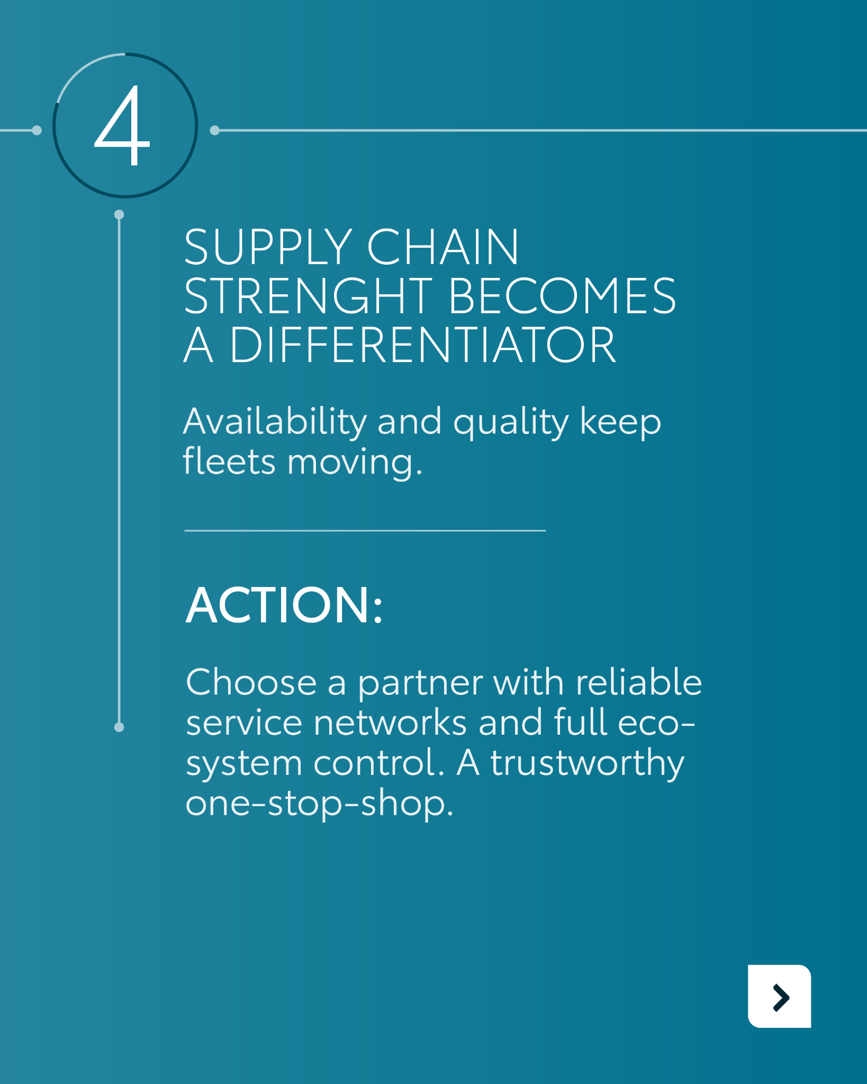


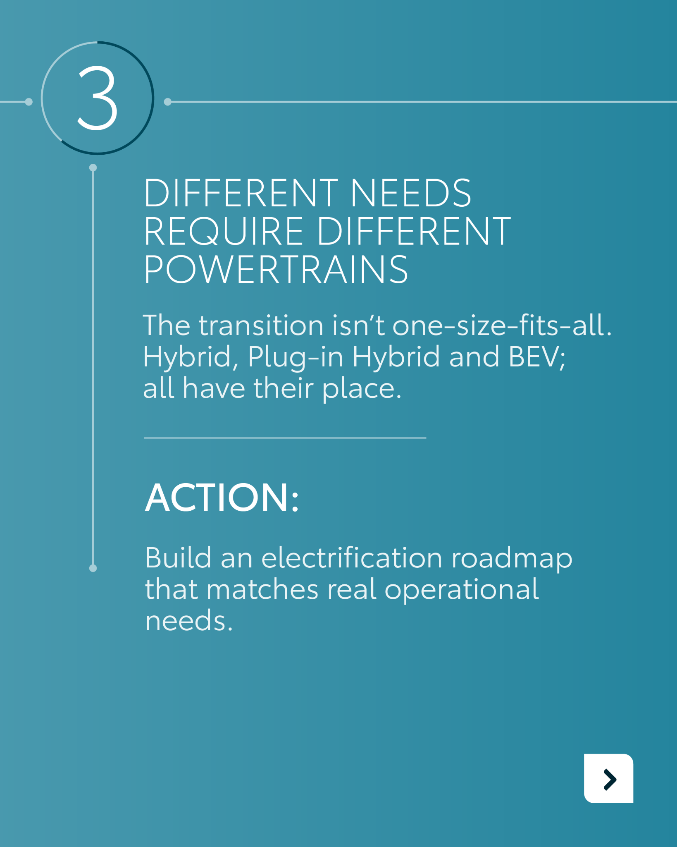
7.CAROUSEL 5 ACTIONS
Valid for multibrand
CONTENT BUCKET 1- JANUARY
COPY LI
The fleet landscape is shifting. Are you steering in the right direction? 🧭
Between evolving EU regulations, the electric shift, and the need for a strong supply chain and data integration, the fleet of tomorrow looks very different from the one of today.
We know it can feel overwhelming, but you are not navigating this transformation alone.
We have identified key actions to help you future-proof your mobility strategy. 👉 Swipe through to discover 5 fleet priorities that will keep your business ahead of the curve.
Which challenge is top of your mind right now? Let's discuss in the comments. 👇
#KINTO #MobilityStrategy #SustainableMobility
FORMATS AVAILABLE:
4/5

Slide 26
Valid for multibrand
7.CAROUSEL 5 ACTIONS
CONTENT BUCKET 1- JANUARY
COPY IG
The fleet of tomorrow is being built today. 🏗️ 🚗
Between evolving EU regulations, the electric shift, and the need for a strong supply chain and data integration, we have identified key actions to help you future-proof your mobility strategy.
👉 Swipe through to discover 5 fleet priorities that every forward-thinking business needs to know.
Which of these is your biggest challenge? Let us know in the comments.
#KINTO #MobilityStrategy #SustainableMobility
FORMATS AVAILABLE:
4/5

Slide 27
7.CAROUSEL 5 ACTIONS
Valid for multibrand
CONTENT BUCKET 1- JANUARY
COPY FB
Is your fleet ready for what’s next? 🚗 ⚡
Managing a fleet used to be about vehicles. Now, it’s also about flexible and sustainable energy, cost efficiency, strong supply chains and data integration.
To help you navigate the changes coming your way, we’ve put together a shortlist of essential actions for the fleet of tomorrow.
Swipe to see the 5 steps you should be thinking about right now to stay efficient and compliant.
💡 Save this post and join the KINTO community.
FORMATS AVAILABLE:
4/5

Slide 28
Flexible mobility solutions
Pillar 3
Notes:
Baseline: Wherever life takes you, KINTO finds the right solution for you.

Slide 29
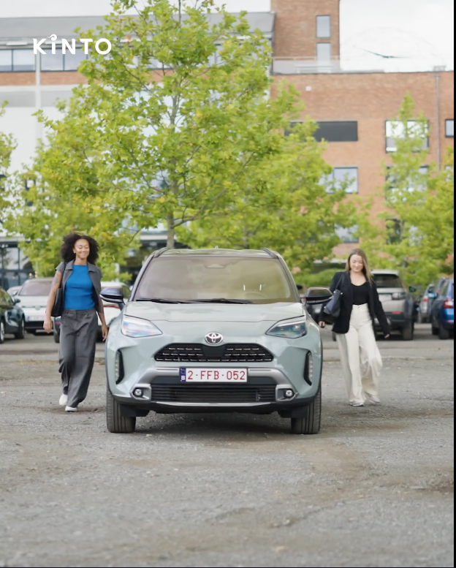
8.VIDEO
RENT
COPY - LI:
Business moves fast. Sometimes, that means a sudden trip with colleagues or welcoming an expat for a temporary project. 💼
At that point, you just need a reliable ride for the mission at hand.
With KINTO’s renting solutions, you get flexible access to vehicles like the Toyota Yaris—perfect for city meetings or short-term stays.
Rent for a few days, a few weeks, or a few months. It's mobility that adapts to your schedule, not the other way around.
#KINTO #SustainableMobility #Renting
CONTENT BUCKET 1- JANUARY
FORMATS AVAILABLE:
1/1 - 9/16 - ⅘ - 16/9
Notes:
Smarter commuting starts with sharing the ride. 🚗
Implementing a corporate carpooling solution isn't just about reducing your carbon footprint—it's about connecting your team.
With KINTO, flexible mobility means providing the right vehicles, like the compact Toyota Yaris, to make shared commutes easy and efficient. Lower costs, lower emissions, and a better start to the workday for your colleagues.
One partner. Every solution.
#CorporateCarpooling #SustainableMobility #EmployeeBenefits #KINTO #Teamwork
--- FACEBOOK ---
City-sized. Colleague-approved! ✅
Why drive alone when you can share the journey? With KINTO's carpooling solutions, your team can travel together in comfort. It’s the perfect way to cut down on travel costs and emissions while enjoying the ride.
Wherever life (or work) takes you, KINTO fits right in.
One partner. Every solution.
--- INSTAGRAM ---
Squad goals, but for the commute. 🚗💨
Carpooling with KINTO means less traffic, less stress, and more team spirit. City-sized and colleague-approved, our flexible solutions fit effortlessly into your workday.
Share the ride, split the impact.
One partner. Every solution.
#Carpooling #CommuteSmart #KINTO #FlexibleMobility #ToyotaYaris #UrbanMobility

Slide 30
8.VIDEO
RENT
COPY - IG:
Sudden team trip? Welcoming an expat for a project? 🚗 💨
You don't need a long-term contract to keep them moving. With KINTO’s flexible renting solutions, you can grab a Toyota Yaris for a few days, weeks, or months.
#KINTO #FlexibleMobility #ToyotaYaris
CONTENT BUCKET 1- JANUARY
FORMATS AVAILABLE:
1/1 - 9/16 - ⅘ - 16/9
Notes:
#KINTO #FleetManagement #CorporateMobility #FlexibleMobility #MobilitySolutions

Slide 31
8.VIDEO
RENT
COPY - FB:
Sudden team trip? Welcoming an expat for a project? 🚗 💨
You don't need a long-term contract to keep them moving. With KINTO’s flexible renting solutions, you can grab a Toyota Yaris for a few days, weeks, or months.
CONTENT BUCKET 1- JANUARY
FORMATS AVAILABLE:
1/1 - 9/16 - ⅘ - 16/9
Notes:
#KINTO #FleetManagement #CorporateMobility #FlexibleMobility #MobilitySolutions

Slide 32
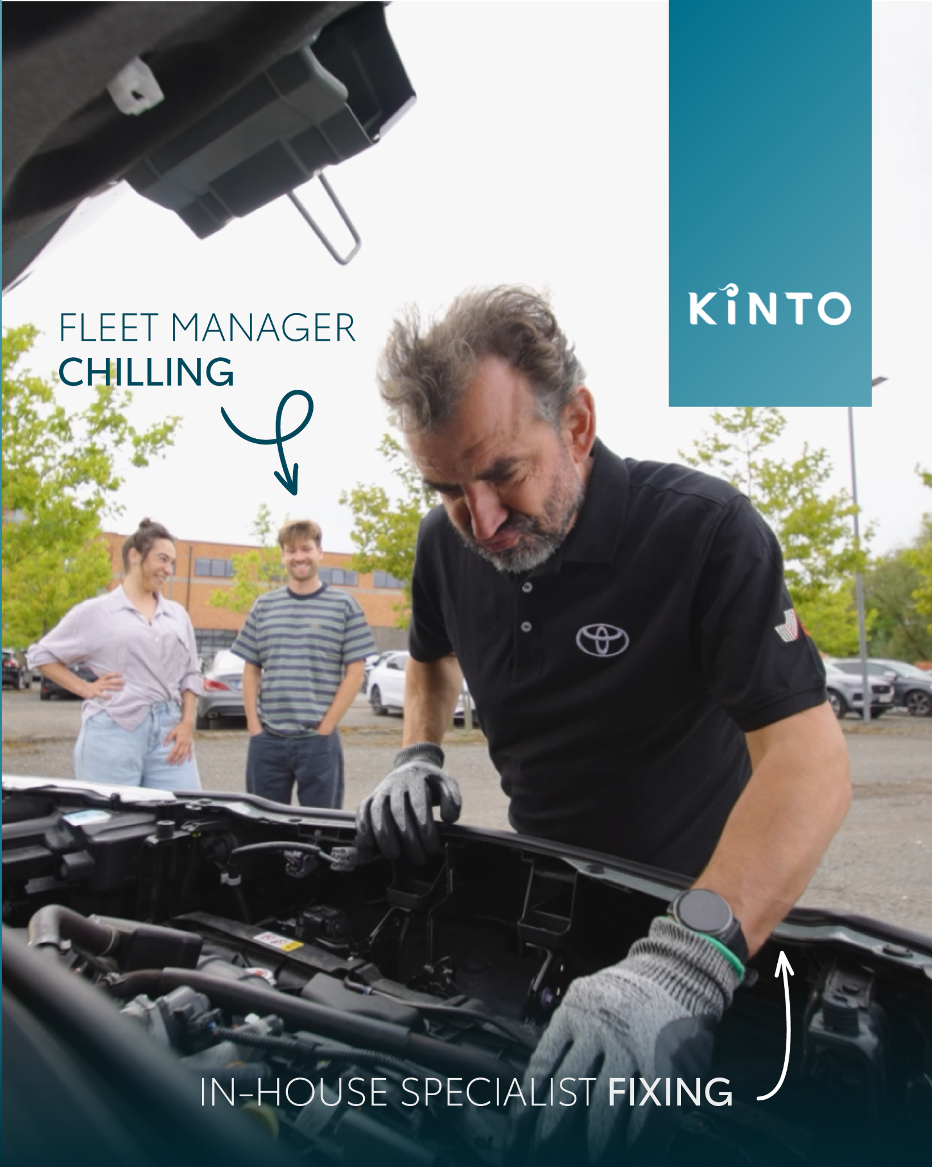
Valid for multibrand
9.VISUAL CAR TROUBLE
COPY LI
Did you know that …
when you lease with KINTO, you aren't just getting a car; you're getting a dedicated support team. 🔧 🤝
That’s right, maintenance and repairs are part of the package:
✅ Expert technicians at your service.
✅ We keep your fleet running smoothly, with replacement cars.
✅ Maintenance & repair, done with original parts.
One partner. Every solution.
#KINTO #MaintenanceIncluded #FleetManagement
CONTENT BUCKET 1- JANUARY
FORMATS AVAILABLE:
4/5

Slide 33
Valid for multibrand
9.VISUAL CAR TROUBLE
COPY IG
The best kind of fleet maintenance? The kind you never have to worry about.
With KINTO, maintenance and repairs are part of the package. We handle the technical details. Your team handles the business.
✅ Expert technicians at your service.
✅ We keep your fleet running smoothly, with replacement cars.
✅ Maintenance & repair, done with original parts.
One partner. Every solution.
#KINTO #MaintenanceIncluded #FleetManagement
CONTENT BUCKET 1- JANUARY
FORMATS AVAILABLE:
4/5

Slide 34
Valid for multibrand
9.VISUAL CAR TROUBLE
COPY FB
Your KINTO car broke down? You can count on our specialists.
When you lease with KINTO, you aren't just getting a car; you're getting a dedicated support team.
✅ Expert technicians at your service.
✅ Included maintenance packages, done with original parts.
✅ We keep your fleet running smoothly, with replacement cars.
One partner. Every solution.
CONTENT BUCKET 1- JANUARY
FORMATS AVAILABLE:
4/5

Slide 35
Community & connection
Empowerment & Expertise
Notes:
Baseline: Join the KINTO community

Slide 36



10.CAROUSEL RATING YARIS CROSS
COPY LI
We apologize for the inconvenience. ⚠️
👉 Swipe to see the ‘burdens’ of a flawless fleet.
Join the KINTO community.
#KINTO #FleetManagement #YarisCross
CONTENT BUCKET 1- JANUARY
FORMATS AVAILABLE:
4/5

Slide 37
10.CAROUSEL RATING YARIS CROSS
COPY IG
Sounds like: “I got 99 problems, but my KINTO fleet ain't one.” 💬 👀
Join the KINTO community.
#KINTO #FleetManagement #YarisCross
CONTENT BUCKET 1- JANUARY
FORMATS AVAILABLE:
4/5

Slide 38
10.CAROUSEL RATING YARIS CROSS
COPY FB
⚠️ We apologize for the inconvenience. ⚠️
Just kidding. Swipe to see the ‘burdens’ of a flawless fleet. 😌
Join the KINTO community.
CONTENT BUCKET 1- JANUARY
FORMATS AVAILABLE:
4/5

Slide 39

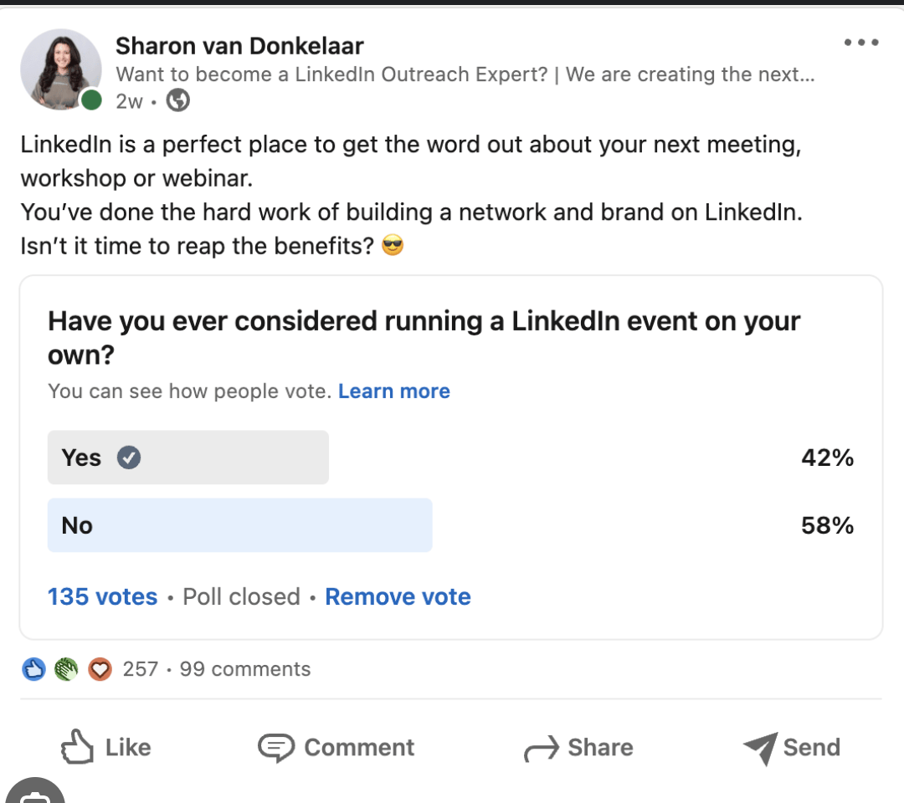
11.POLL SUSTAINABLE MOBILITY INITIATIVE
COPY - LI
Sustainability is no longer a nice-to-have. It’s the new baseline for business mobility. But every company takes a different route to get there. 🌍
We are curious to take the pulse of our network. Where is your major focus lying right now?
Share your thoughts and join the KINTO community.
POLL:
What's the top sustainable mobility initiative your company is working on?
1️⃣ Switching to electric/plug-in
2️⃣ Stimulating car sharing/pooling
3️⃣ Reducing business travel
4️⃣ Other: tell us in the comments
CONTENT BUCKET 1- JANUARY

Slide 40

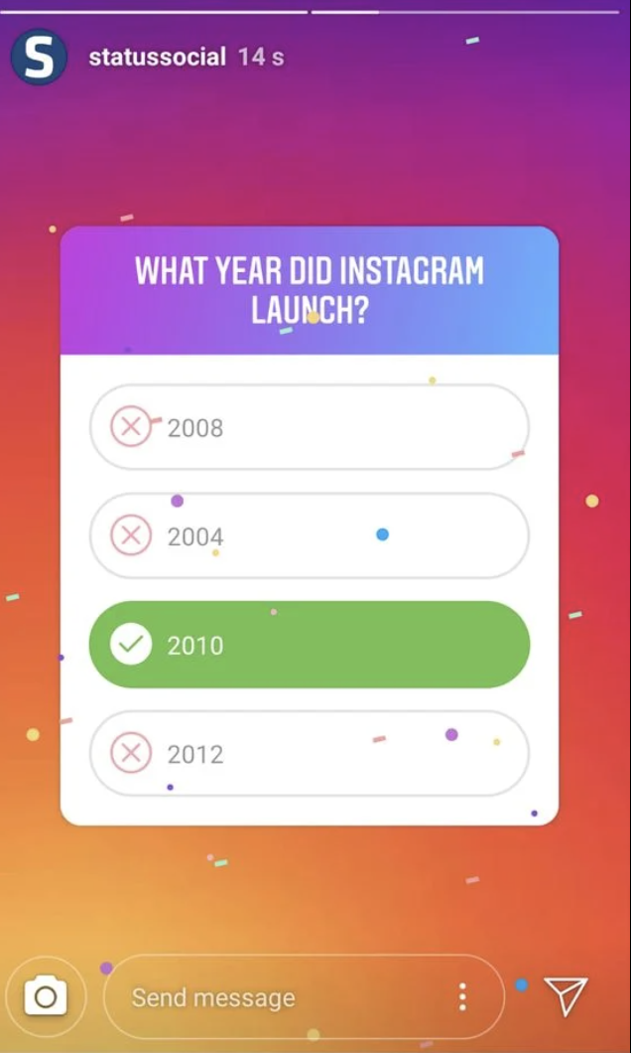
11.POLL SUSTAINABLE MOBILITY INITIATIVE
COPY - IG STORY
How is your company driving towards a sustainable future?
A. Switching to electric & plug-in
B. Stimulating car sharing & pooling
C. Reducing business travel
D. Other (tell us!)
CONTENT BUCKET 1- JANUARY

Slide 41
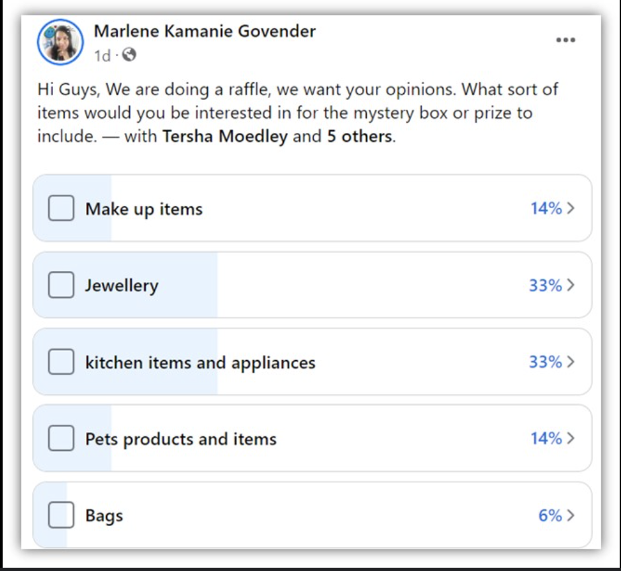
11.POLL SUSTAINABLE MOBILITY INITIATIVE
COPY - FB
Everyone is talking about ‘going green’, but we want to know what that actually looks like on the ground for your business. What is the #1 initiative keeping you busy right now? ☝️💚
Let’s compare notes with the community. Vote for your top priority or drop a comment if you are doing something completely different! ⬇️
Join the KINTO community.
POLL:
What's the top sustainable mobility initiative your company is working on?
1️⃣ Switching to electric/plug-in
2️⃣ Stimulating car sharing/pooling
3️⃣ Reducing business travel
4️⃣ Other: tell us in the comments
CONTENT BUCKET 1- JANUARY

Slide 42
12.VIDEO
YEAR IN REVIEW
COPY - LI:
CONTENT BUCKET 1- JANUARY
TO BE MADE END OF JANUARY
FORMATS AVAILABLE:
1/1 - 9/16 - ⅘ - 16/9
Notes:
#KINTO #FleetManagement #CorporateMobility #FlexibleMobility #MobilitySolutions

Slide 43
12.VIDEO
YEAR IN REVIEW
COPY - IG:
CONTENT BUCKET 1- JANUARY
TO BE MADE END OF JANUARY
FORMATS AVAILABLE:
1/1 - 9/16 - ⅘ - 16/9
Notes:
#KINTO #FleetManagement #CorporateMobility #FlexibleMobility #MobilitySolutions

Slide 44
12.VIDEO
YEAR IN REVIEW
COPY - FB:
CONTENT BUCKET 1- JANUARY
TO BE MADE END OF JANUARY
FORMATS AVAILABLE:
1/1 - 9/16 - ⅘ - 16/9
Notes:
#KINTO #FleetManagement #CorporateMobility #FlexibleMobility #MobilitySolutions

