Slide 1

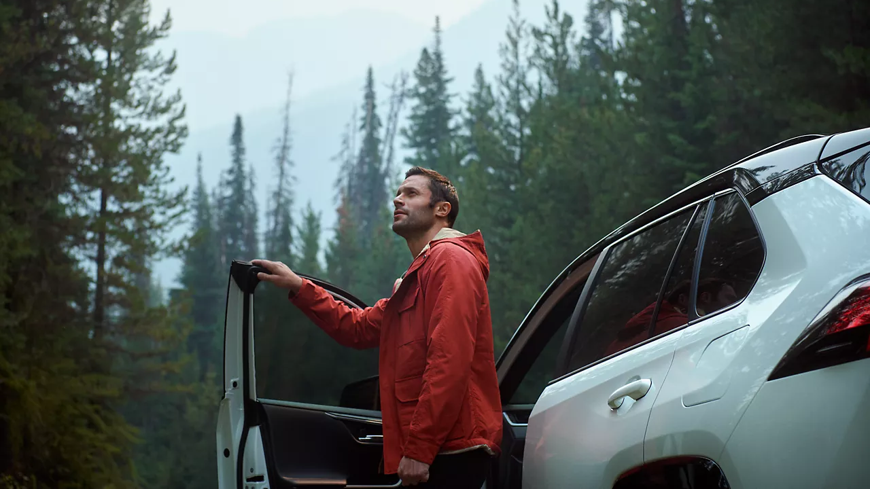

CONTENT
bucket 8 - February

Slide 2
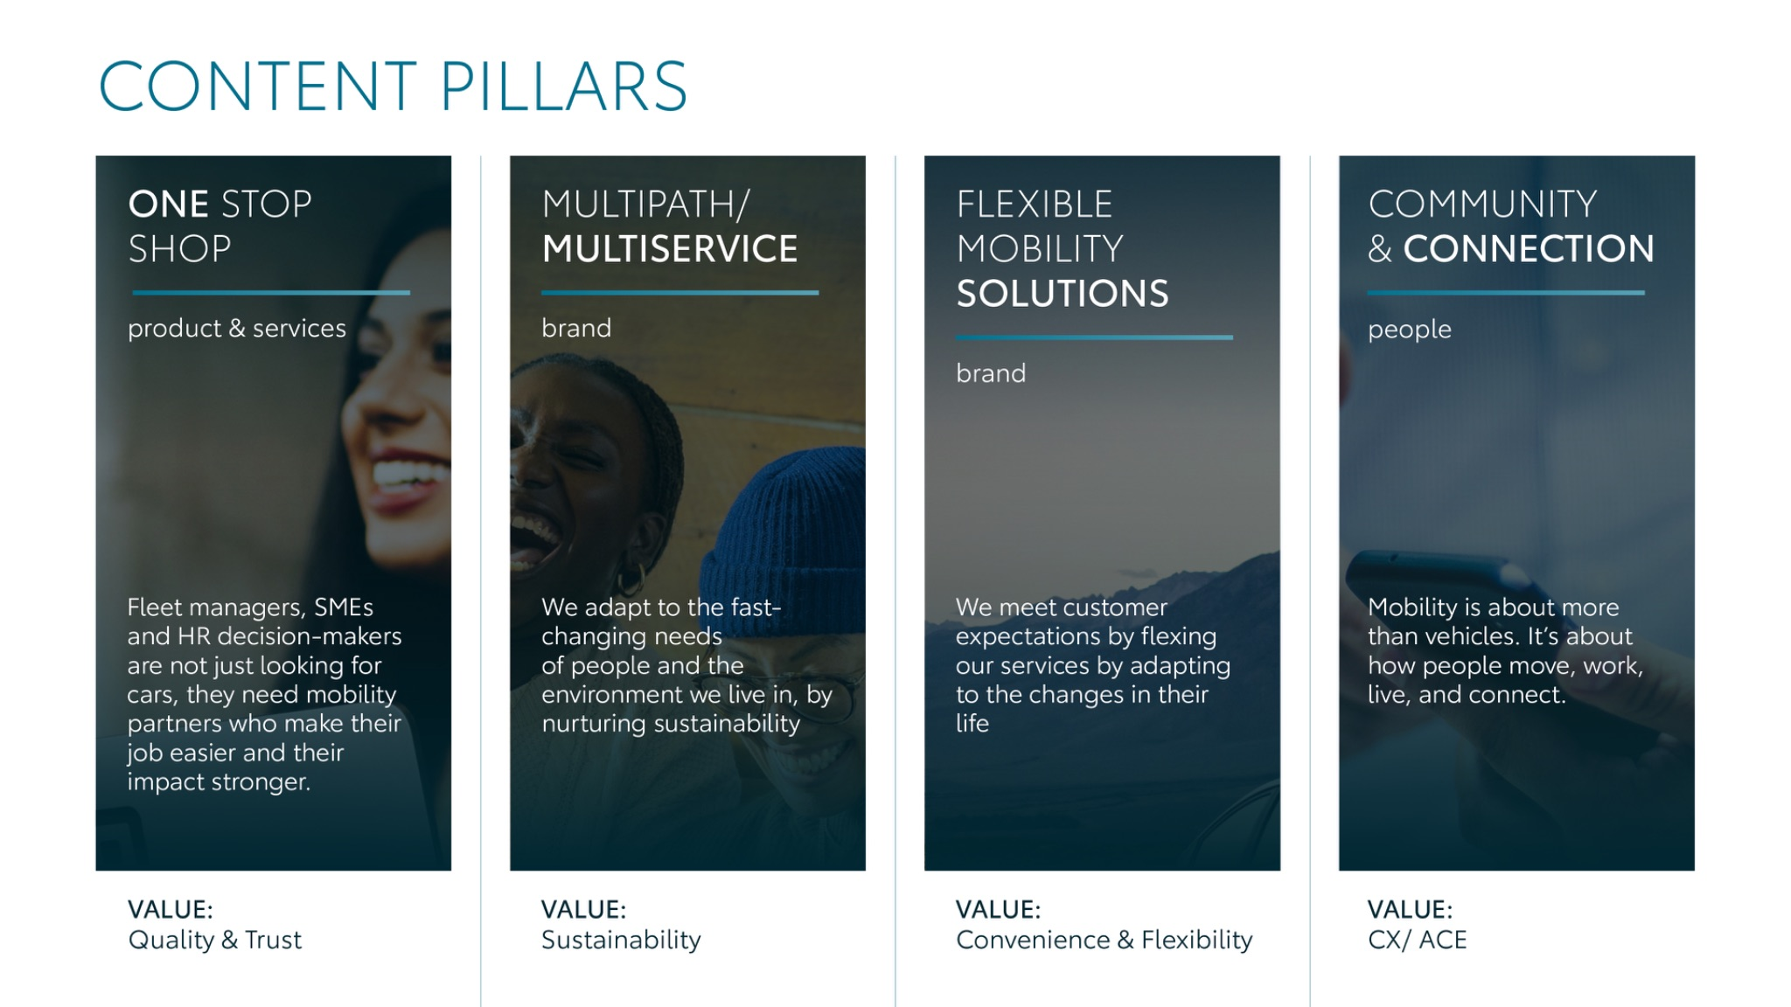
Notes:
“At KINTO, we work with content pillars: themes that carry our brand. We use different content types: inspiring, informative, topical. Your contributions add the human layer that makes the strategy work.”

Slide 3




Content pillars - content overview
February
Seasons
Perks of leasing
EV or Plugin
The road to
Videocall
Valentines
Fleet Portal
Proace toggle
30 Minutes
Q&A Employees
Shareable quote
Employee quote
ONE STOP SHOP
MULTIPATH/ MULTISERVICE
FLEXIBLE MOBILITY SOLUTIONS
COMMUNITY/ CONNECTION

Slide 4
Tag lines pillars
1. One Stop Shop
One partner. Every solution.
2. Flexible Mobility Solutions
One partner. Every solution.
3. Community and connection (important to keep it broad enough to fit clients as well as people working at Kinto)
Join the KINTO community.
4. Vision & Impact (Multipath/multiservice)
One partner. Every solution.

Slide 5

One stop shop
Notes:
One place. Every solution. Always KINTO.

Slide 6




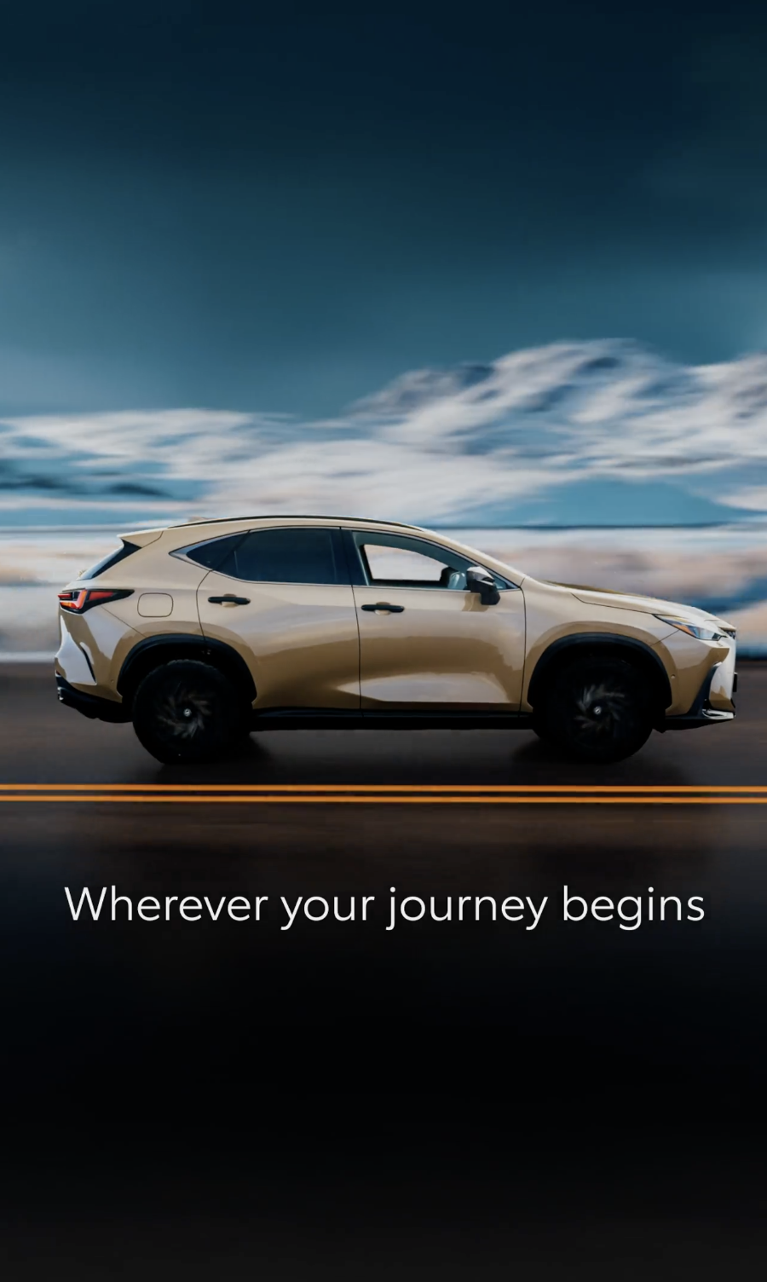
1. VIDEO
SEASONS
COPY - LI:
Is your fleet ready for the unexpected? 🚘
Whatever the season brings, KINTO is with you all year round.
You get a complete support ecosystem designed to keep your operations running smoothly:
✅ Seamless tire changes to match the season. ✅ Roadside assistance to support you 24/7.
✅ Maintenance to avoid unexpected downtime.
✅ Repair to avoid unexpected extra costs.
#KINTO #FleetManagement #OneStopShop
CONTENT BUCKET 1- FEBRUARY
FORMATS AVAILABLE:
1/1 - 9/16 - ⅘

Slide 7

1. VIDEO
SEASONS
COPY - IG:
See how KINTO keeps you moving. 👀
February weather can be unpredictable … Luckily, KINTO is with you to manage the storm.
So, rain or snow, repair or tow. KINTO’s got you covered. 🚘
#KINTO #FleetManagement #OneStopShop
CONTENT BUCKET 1- FEBRUARY
FORMATS AVAILABLE:
1/1 - 9/16 - ⅘

Slide 8

1. VIDEO
SEASONS
COPY - FB:
Snow or shine, business doesn’t stop and neither do we. 🚘🤝
KINTO is with you all year round, whatever the season brings
CONTENT BUCKET 1- FEBRUARY
FORMATS AVAILABLE:
1/1 - 9/16 - ⅘

Slide 9


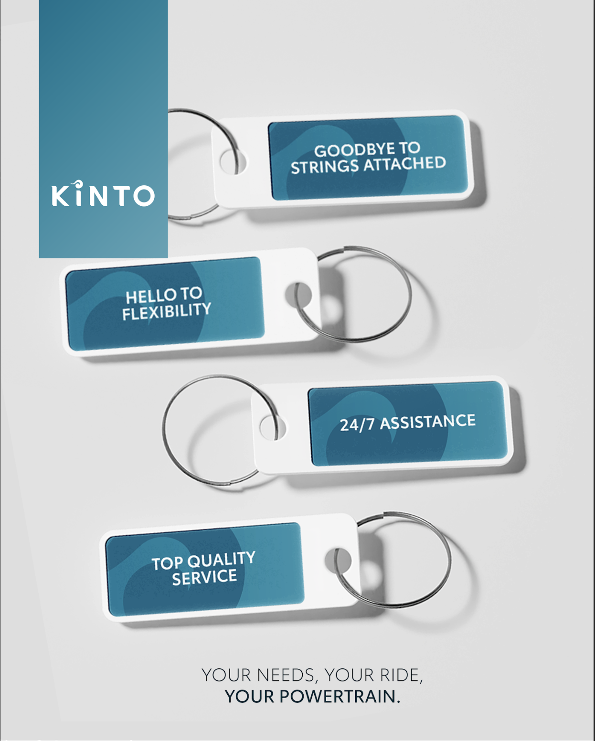
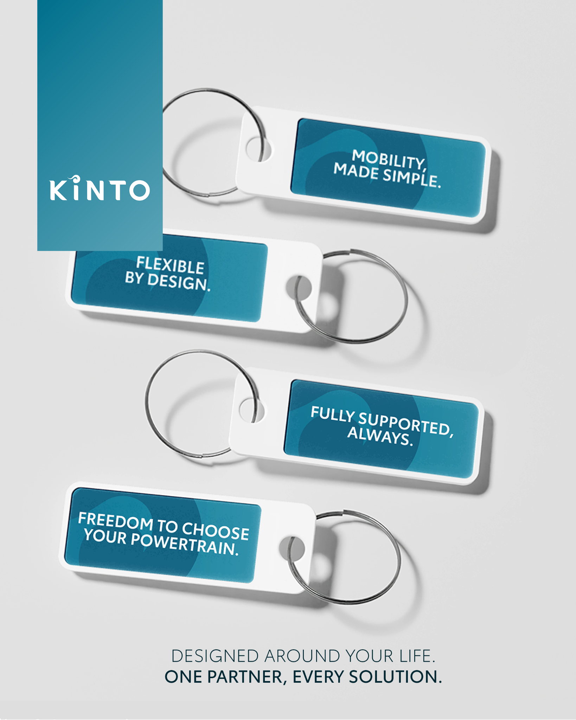

Valid for multibrand
2.VISUAL PERKS OF LEASING
COPY LI
Unlock a smarter approach to business mobility. 🔑
Let KINTO give you the keys to flexibility, convenience, and peace of mind.
💼 Get the choice of solution your business needs.
✅ Access the widest range of electrified models..
🔧 360 and 24/7 support.
One place. Every solution.
#KINTO #FleetManagement #BusinessMobility
CONTENT BUCKET 1- FEBRUARY
FORMATS AVAILABLE:
4/5

Slide 10
Valid for multibrand
2.VISUAL PERKS OF LEASING
CONTENT BUCKET 1- FEBRUARY
COPY IG
Unlock a smarter way to move. 🔑✨
KINTO’s leasing solutions put real perks in your pocket. Forget the hassle and enjoy the ride:
👋 Goodbye to rigid contracts.
🛠️ Hello to mobility your way.
🌿 Choose a more sustainable ride with 360 support.
One place. Every solution.
#KINTO #FleetManagement #BusinessMobility
FORMATS AVAILABLE:
4/5

Slide 11
Valid for multibrand
2.VISUAL PERKS OF LEASING
COPY FB
Ready to unlock a better driving experience for your business? 🔑✨
Discover how KINTO fits to your business: simply flexible with a wide range of powertrains and services. Why choose when you can have it all?
It’s your ride, your way!
One place. Every solution.
CONTENT BUCKET 1- FEBRUARY
FORMATS AVAILABLE:
4/5

Slide 12
Multipath/
Multiservice
Pillar 4

Slide 13
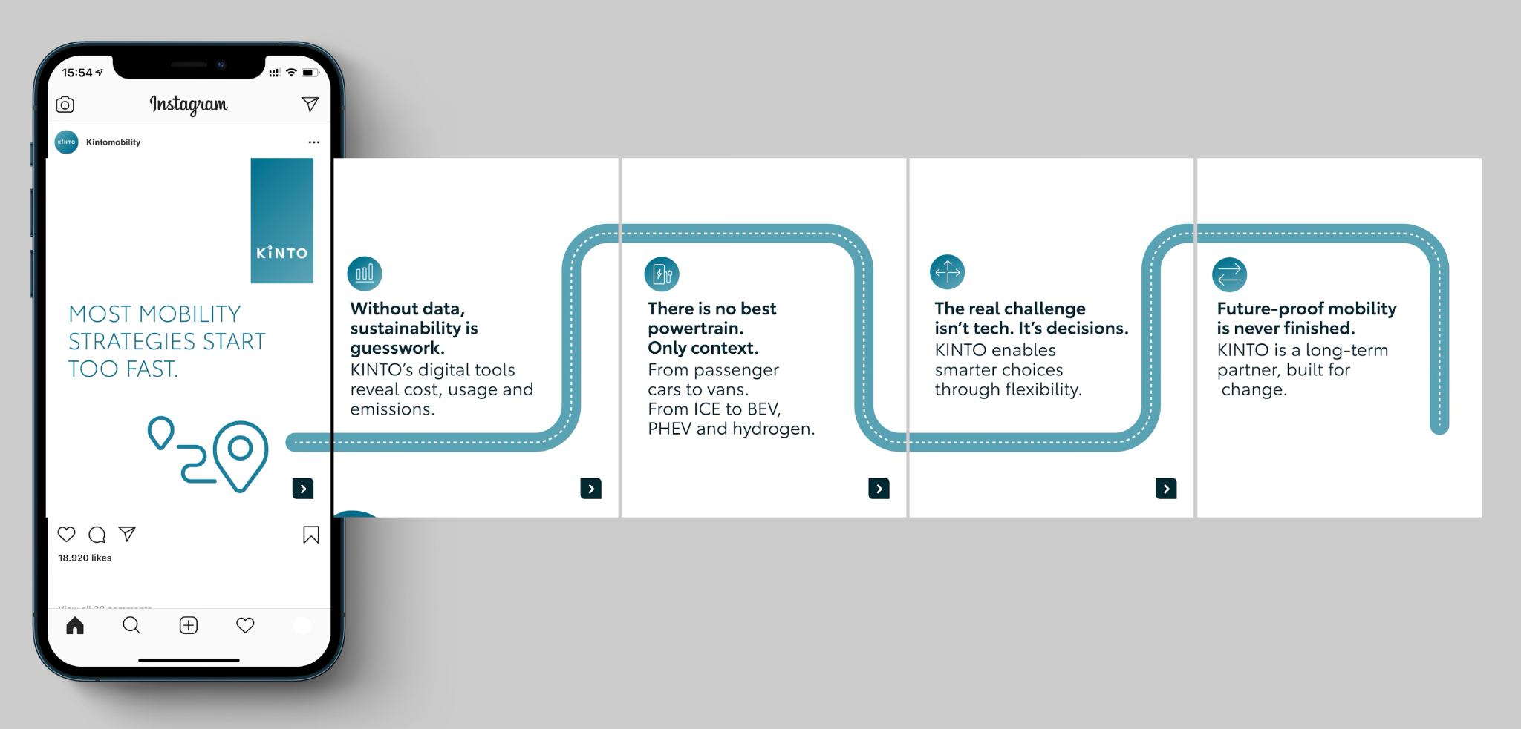
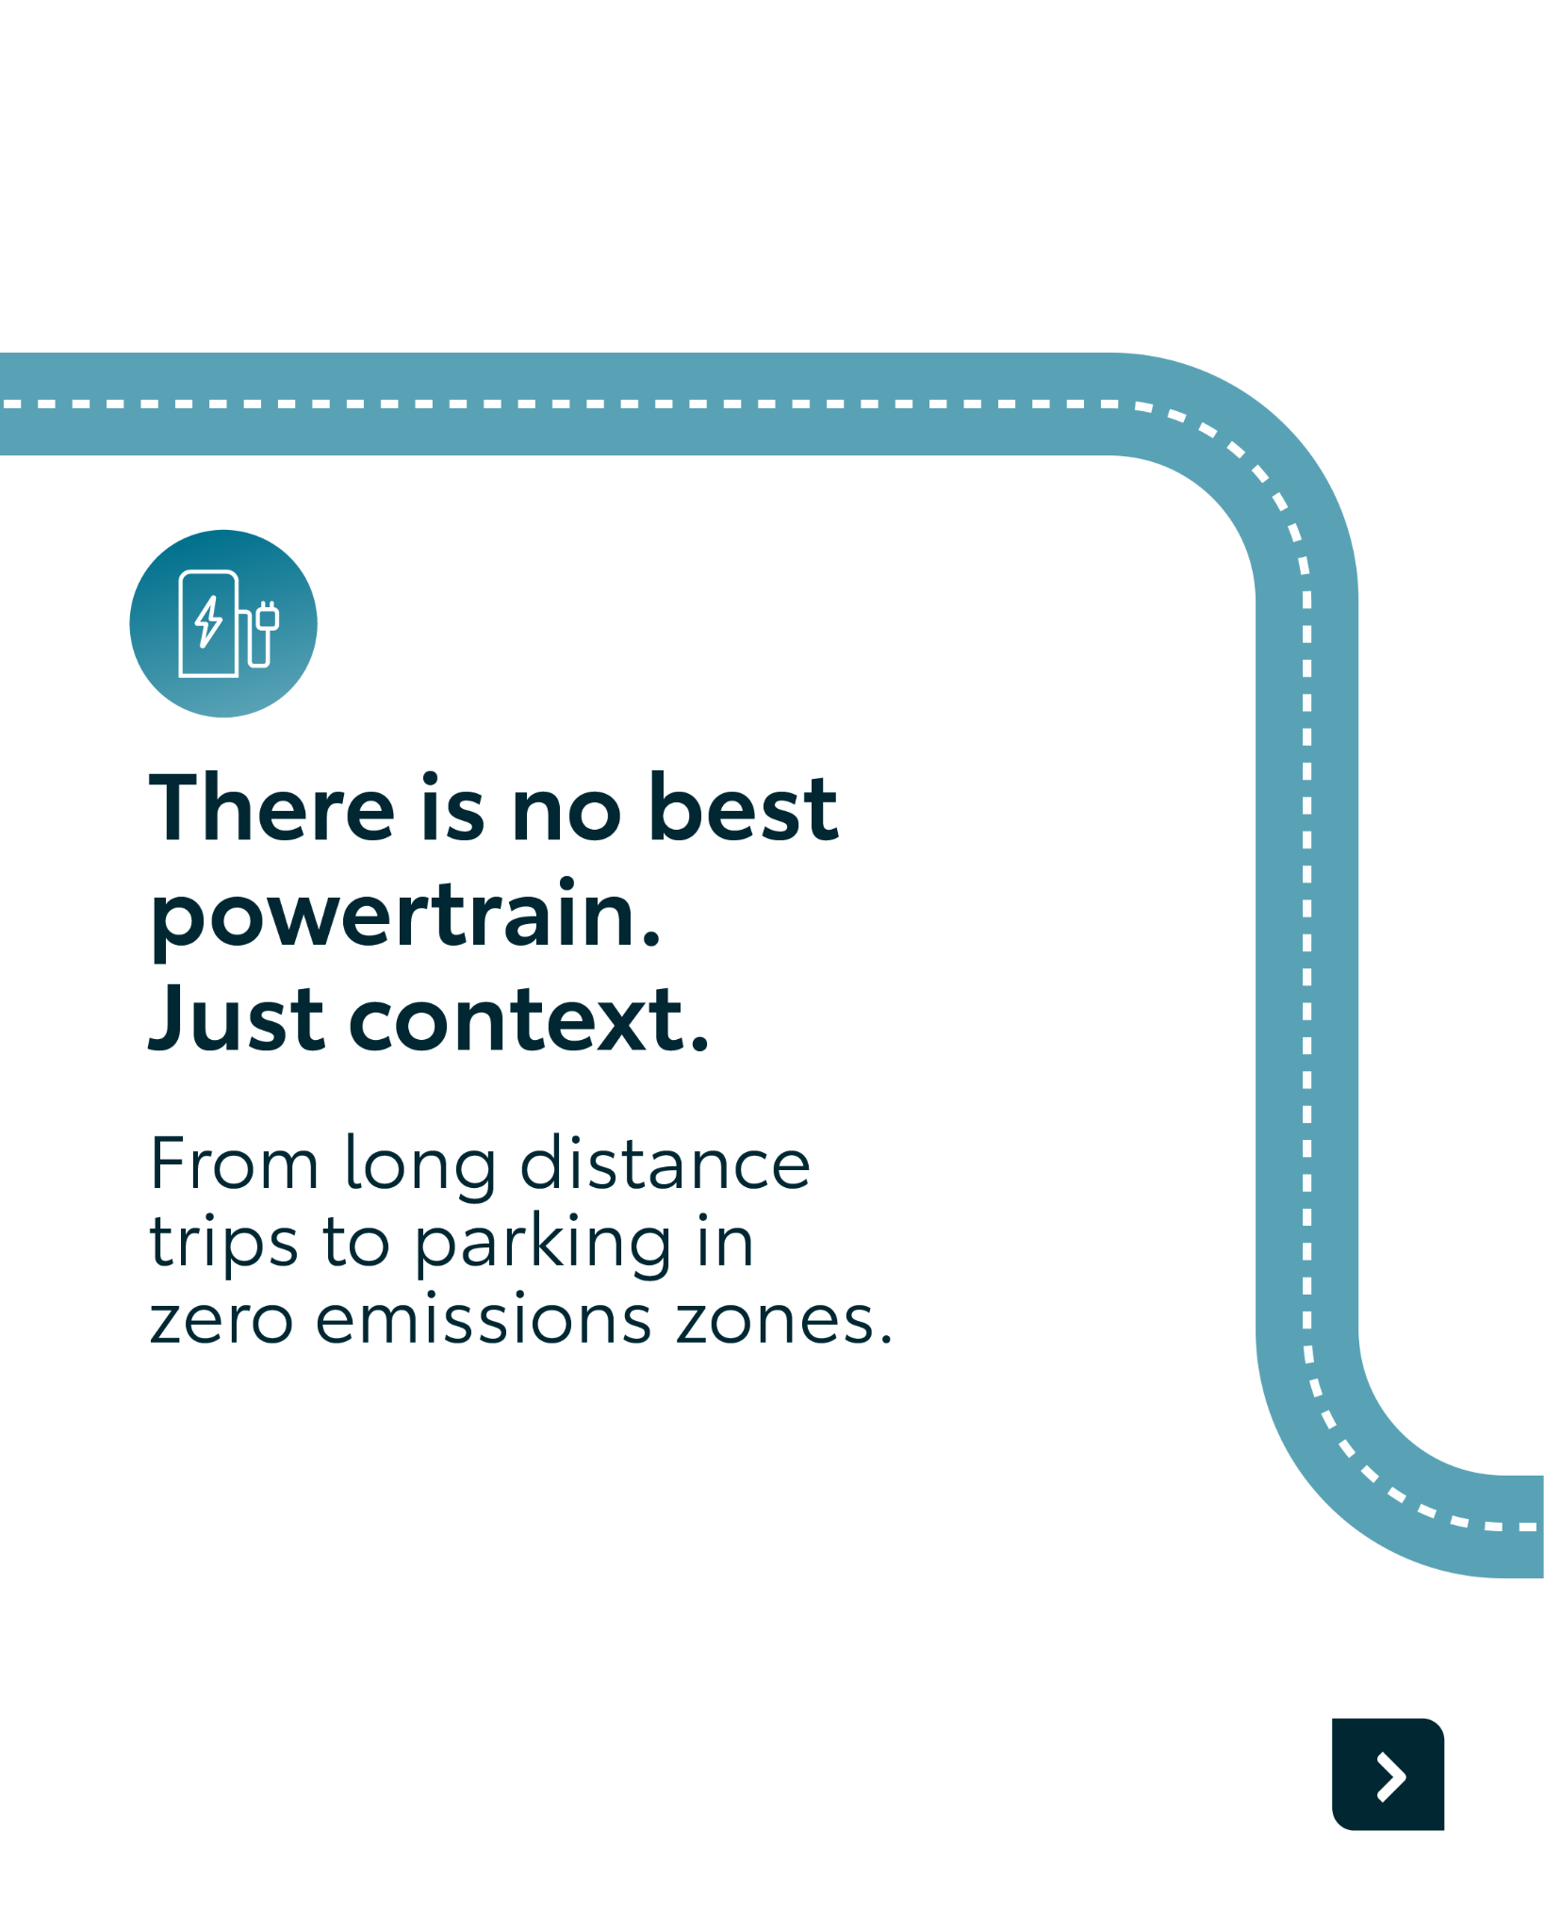
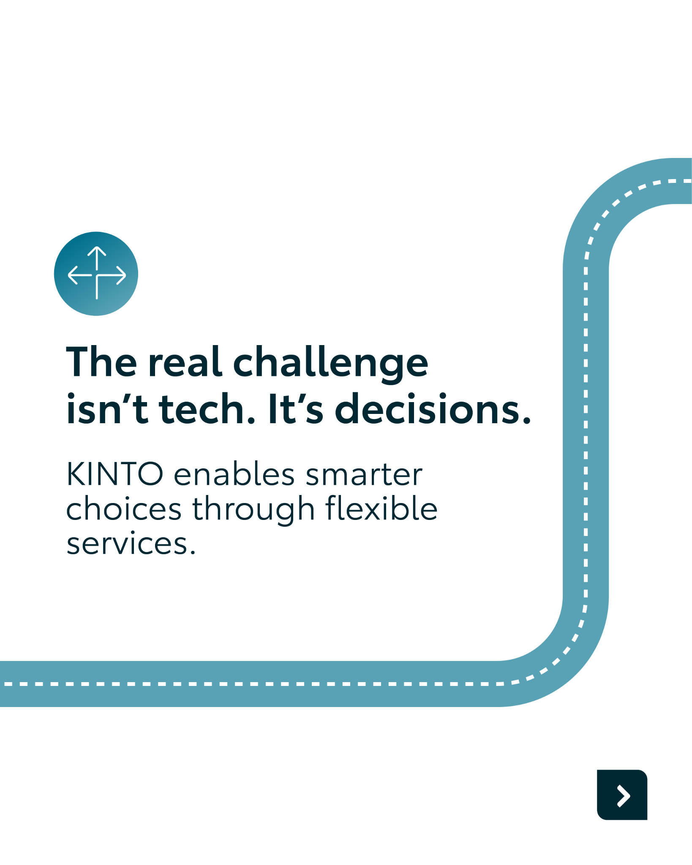
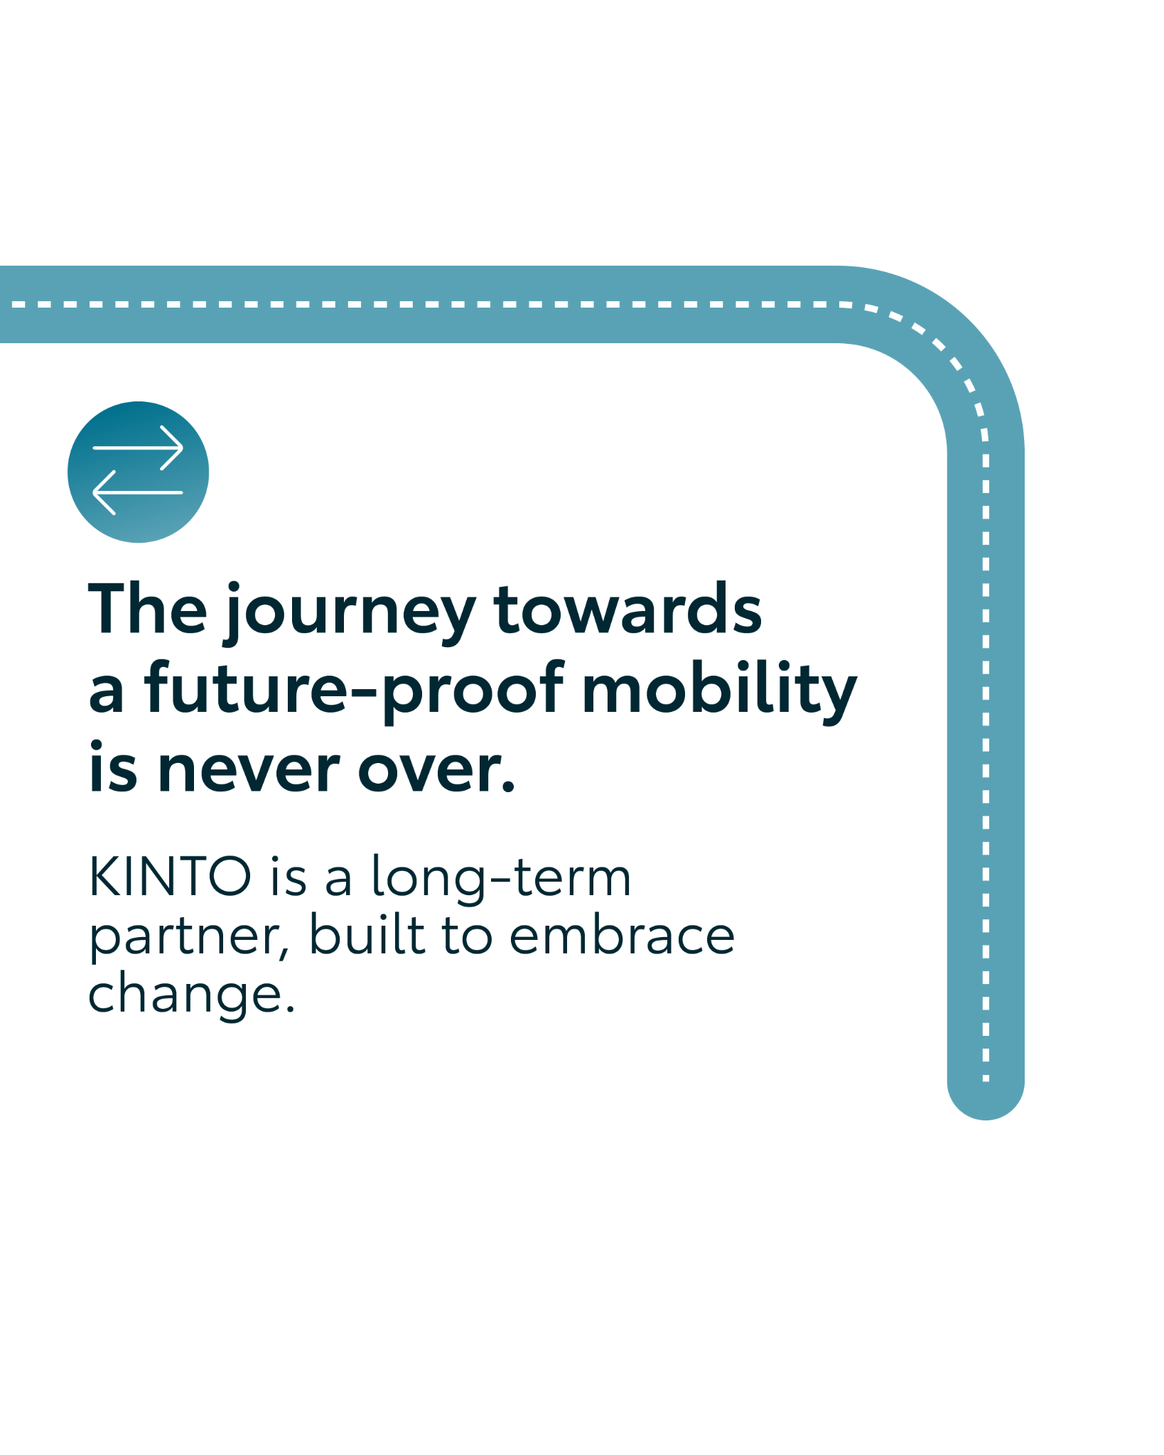
Valid for multibrand
3.CAROUSEL THE ROAD TO
COPY LI
Many mobility strategies start too fast. 🚦
And rushing can lead to ‘guesswork’.
At KINTO, we believe that a truly sustainable strategy is built on accuracy, data and context.
Future-proofing isn't just about picking new cars; it’s about making smarter decisions through flexibility:
📊 Our digital tools reveal the real data behind usage, emissions and costs of your fleet.
🧭The best choice depends on your context: your business needs to drive the best array of powertrains .
🚘 Decisions over tech: The real challenge isn't the technology. It's having the flexibility to adapt when things change.
Swipe through to see how we build mobility strategies that are built for change. ➡️
One partner. Every solution.
#KINTO #FleetManagement #SmarterMobility
CONTENT BUCKET 1- FEBRUARY
FORMATS AVAILABLE:
4/5
Notes:
📊📌✏️🔎

Slide 14
Valid for multibrand
3.CAROUSEL THE ROAD TO
COPY IG
Sit back and let us speed up your business. 📈
At KINTO, we believe that to truly future-proof your fleet, you need more than just new tech. You need data, context, and the flexibility to adapt. 🧭
From choosing the right powertrain to revealing your true emissions, KINTO helps you move from guesswork to smart decisions.
Swipe through to see how we build mobility strategies that are built for change. ➡️
One partner. Every solution.
#KINTO #FleetManagement #SmarterMobility
CONTENT BUCKET 1- FEBRUARY
FORMATS AVAILABLE:
4/5

Slide 15
Valid for multibrand
3.CAROUSEL THE ROAD TO
COPY FB
It’s easy to get caught up in the tech, but without the right data, sustainability is just an assumption.
KINTO helps you look at the bigger picture, from cost and usage to the right mix of powertrains for your team, to make smarter choices as your business evolves. 🌍
Whether it's passenger cars or vans, and whether you need electric or hybrid, the ‘best’ choice is the one that fits your specific context. 🚗
One partner. Every solution.
CONTENT BUCKET 1- FEBRUARY
FORMATS AVAILABLE:
4/5

Slide 16

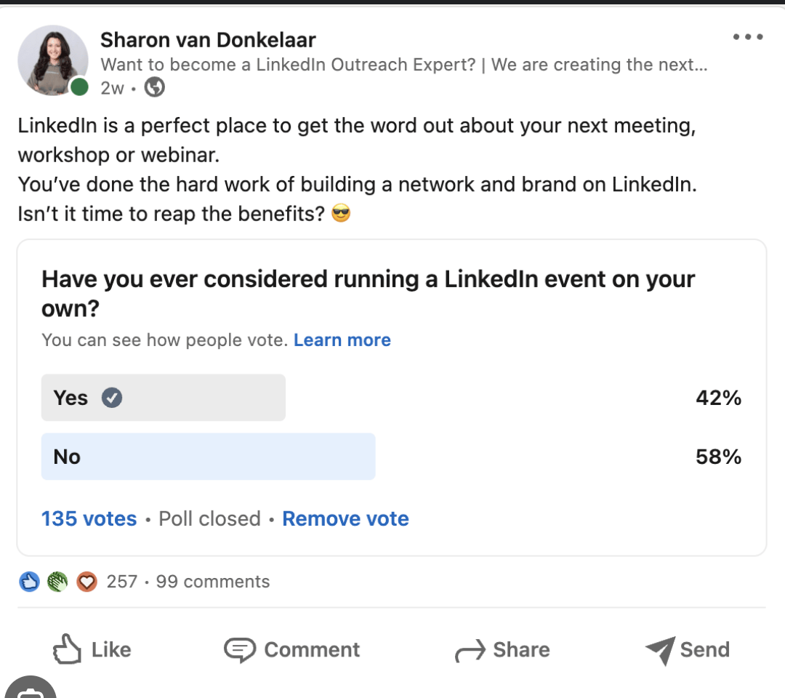
Valid for multibrand
4. EV OR PLUGIN
COPY - LI
EV or Plug-in hybrid: what’s your fleet’s next move?
Option A: all-in on full electric (EV)
Option B: plug-in hybrid for flexibility
Option C: a mix of both
Caption:
The road to a sustainable fleet isn't always a straight line. 🛣️
For some businesses, going full electric is the clear winner for lowering TCO and meeting immediate green targets. For others, plug-in hybrids offer the necessary bridge, combining electric range for city commutes with the flexibility to cover long distances without infrastructure anxiety.
At KINTO, we believe in a multipath approach. There is no single ‘right’ engine, only the right solution for your specific operational needs.
We are curious to see where the market stands today. Cast your vote in the poll below! 👇
One partner. Every solution.
CONTENT BUCKET 1- FEBRUARY

Slide 17

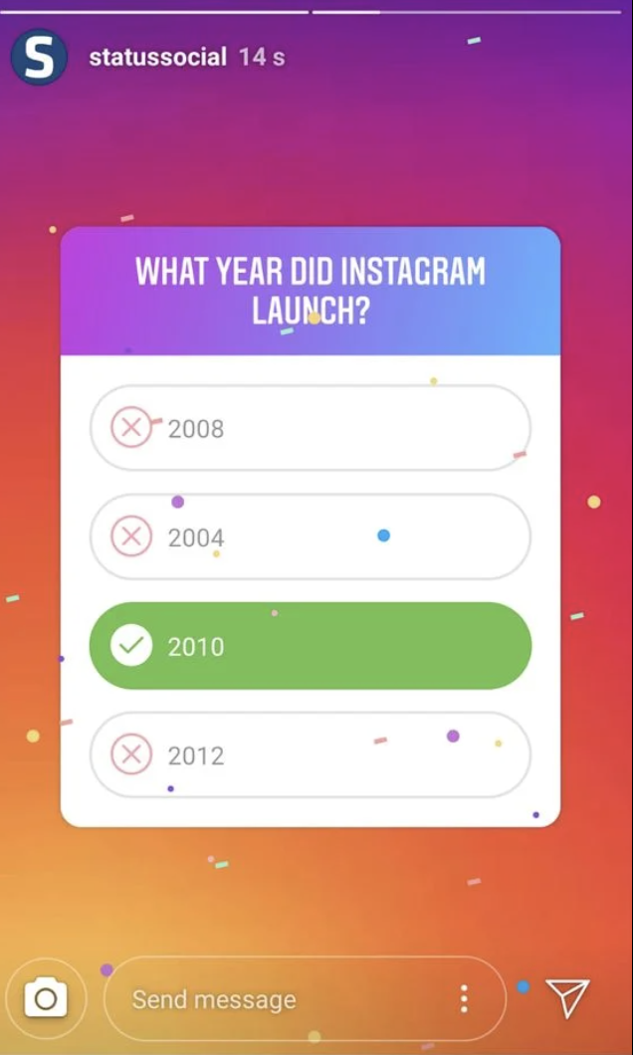
4. EV OR PLUGIN
COPY - IG STORY
Question (sticker): The future of mobility is... ? 🔮
Option 1: Full electric ⚡
Option 2: Plug-in hybrid 🔌
Option 3: A mix of both 🔀
CONTENT BUCKET 1- FEBRUARY

Slide 18
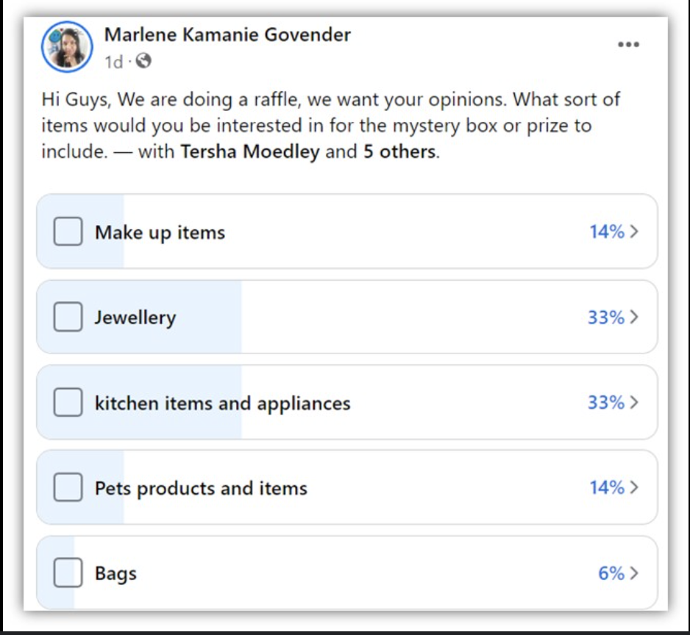
4. EV OR PLUGIN
COPY - FB
Are you team full electric ⚡ or team plug-in hybrid 🔌?
For some businesses, going full electric is the clear winner for lowering TCO and meeting immediate green targets. For others, plug-in hybrids offer the necessary bridge, combining electric range for city commutes with the flexibility to cover long distances without infrastructure anxiety.
At KINTO, we believe in a multipath approach. There is no single ‘right’ engine, only the right solution for your specific operational needs.
We are curious to see where the market stands today. Cast your vote in the poll below! 👇
One partner. Every solution
CONTENT BUCKET 1- FEBRUARY

Slide 19
Flexible mobility solutions
Pillar 3
Notes:
Baseline: Wherever life takes you, KINTO finds the right solution for you.

Slide 20
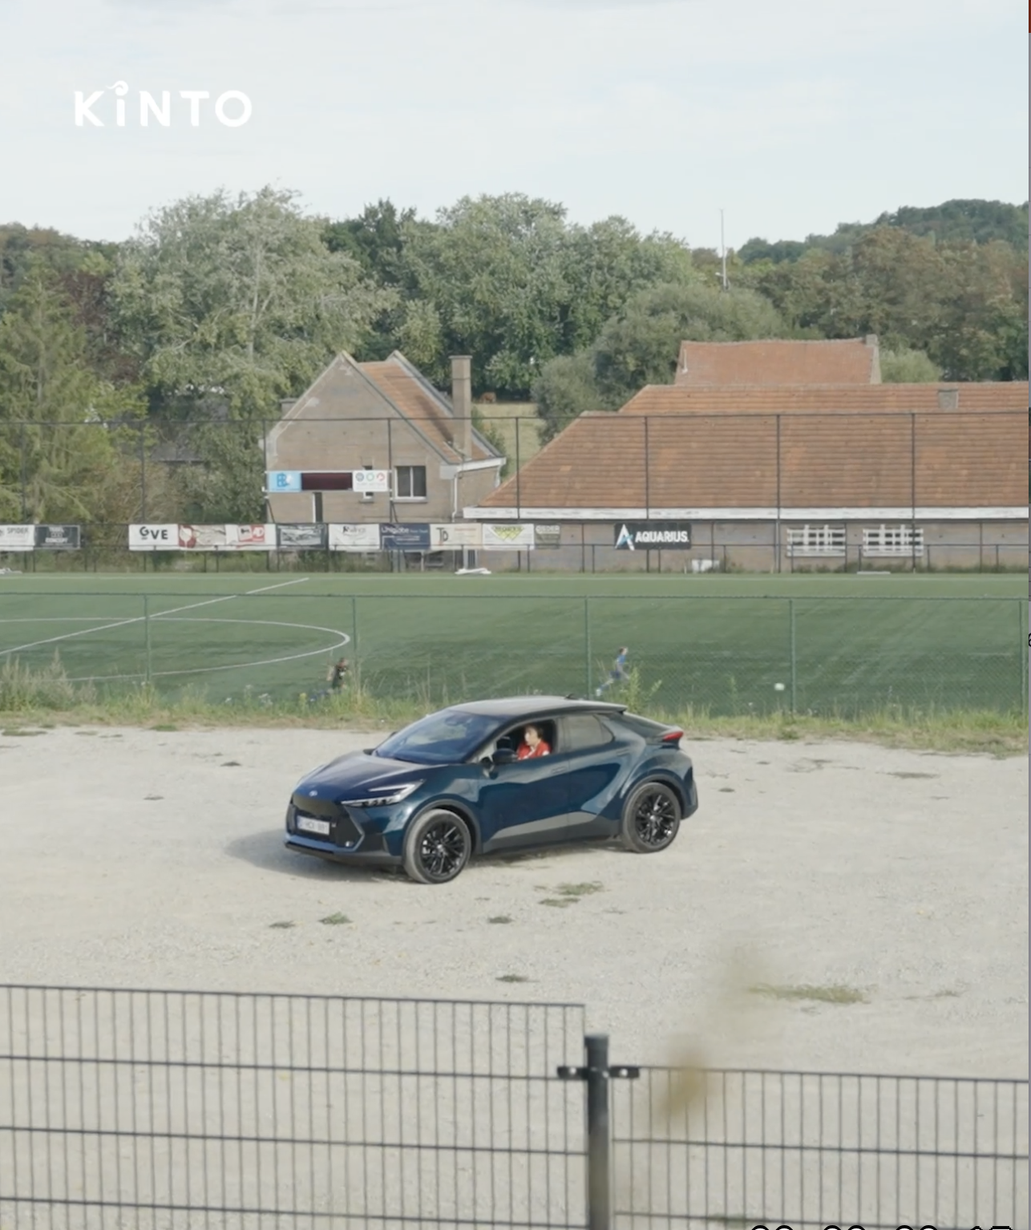
5.VIDEO
VIDEOCALL
COPY - LI:
In a hybrid world, mobility isn't just about getting from A to B. It’s about providing a space where your team can connect and balance their day.
With KINTO, you provide the flexibility your workforce needs to perform at their best, wherever they are.
#KINTO #HybridWork #MobileOffice
CONTENT BUCKET 1- FEBRUARY
FORMATS AVAILABLE:
1/1 - 9/16 - ⅘ - 16/9
Notes:
#KINTO #FleetManagement #CorporateMobility #FlexibleMobility #MobilitySolutions

Slide 21
5.VIDEO
VIDEOCALL
COPY - IG:
POV: your meeting room has four wheels. 🚗💻
From meeting goals to scoring them, KINTO is there for every turn.
We keep you fully charged and ready for whatever the schedule throws at you. Work, play, and everything in between.
#KINTO #FlexibleMobilty #HybridWork
CONTENT BUCKET 1- FEBRUARY
FORMATS AVAILABLE:
1/1 - 9/16 - ⅘ - 16/9
Notes:
#KINTO #FleetManagement #CorporateMobility #FlexibleMobility #MobilitySolutions

Slide 22
5.VIDEO
VIDEOCALL
COPY - FB:
Meeting at 4:00 PM. Soccer training at 5:30 PM. 🕓⚽
Life moves fast, and you need a mobility partner that moves with you.
Whether you are closing a deal from the passenger seat or heading to the sideline to cheer on your favorite team, KINTO ensures you have the right vehicle for every part of your day. 🚘
CONTENT BUCKET 1- FEBRUARY
FORMATS AVAILABLE:
1/1 - 9/16 - ⅘ - 16/9
Notes:
#KINTO #FleetManagement #CorporateMobility #FlexibleMobility #MobilitySolutions

Slide 23

6.VIDEO
VALENTINES
COPY - LI:
Love moves us. 💙
It’s the peace of mind in a care-free commute. The confidence to scale up when you're growing. The spark that keeps your team moving forward.
At KINTO, we don't just provide cars. We provide the trust that lets you focus on what you love most.
Love is the fuel that moves us all forward. So, where will it take you? 🚙
#KINTO #ValentinesDay #KeepMoving
CONTENT BUCKET 1- FEBRUARY
FORMATS AVAILABLE:
1/1 - 9/16 - ⅘ - 16/9
Notes:
#KINTO #FleetManagement #CorporateMobility #FlexibleMobility #MobilitySolutions

Slide 24
6.VIDEO
VALENTINES
COPY - IG:
Love isn't just a feeling. Love moves us. 💙
It’s the peace of mind in a care-free commute. The confidence to scale up when you're growing. The spark that keeps your team moving forward.
At KINTO, we don't just provide cars. We provide the trust that lets you focus on what you love doing most.
Love is the fuel that moves us all forward. So, where will it take you? 🚙
#KINTO #ValentinesDay #KeepMoving
CONTENT BUCKET 1- FEBRUARY
FORMATS AVAILABLE:
1/1 - 9/16 - ⅘ - 16/9
Notes:
#KINTO #FleetManagement #CorporateMobility #FlexibleMobility #MobilitySolutions

Slide 25
6.VIDEO
VALENTINES
COPY - FB:
Love isn't just a feeling. Love moves us. 💙
It’s the peace of mind in a care-free commute. The confidence to scale up when you're growing. The spark that keeps your team moving forward.
At KINTO, we don't just provide cars. We provide the trust that lets you focus on what you love most.
Love is the fuel that moves us all forward. So, where will it take you? 🚙
CONTENT BUCKET 1- FEBRUARY
FORMATS AVAILABLE:
1/1 - 9/16 - ⅘ - 16/9
Notes:
#KINTO #FleetManagement #CorporateMobility #FlexibleMobility #MobilitySolutions

Slide 26
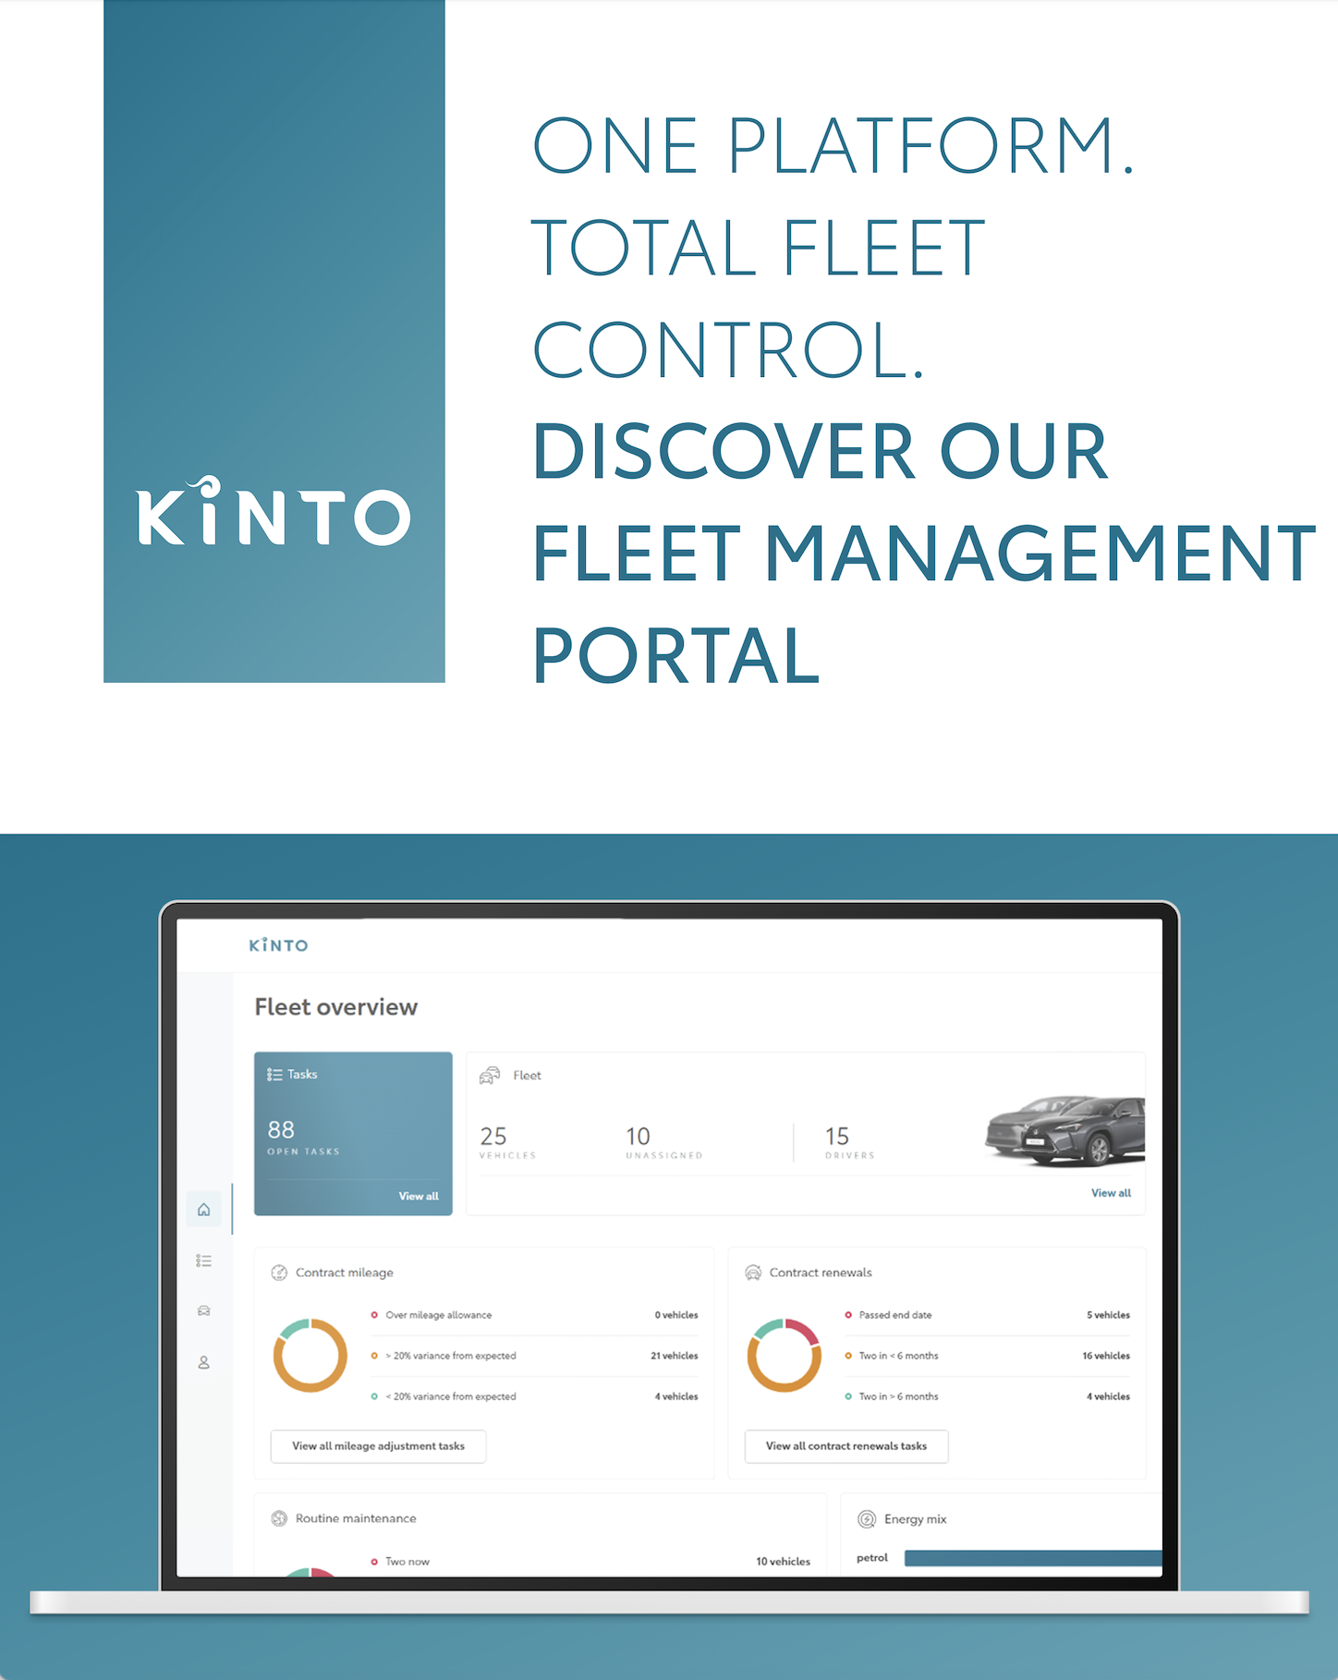
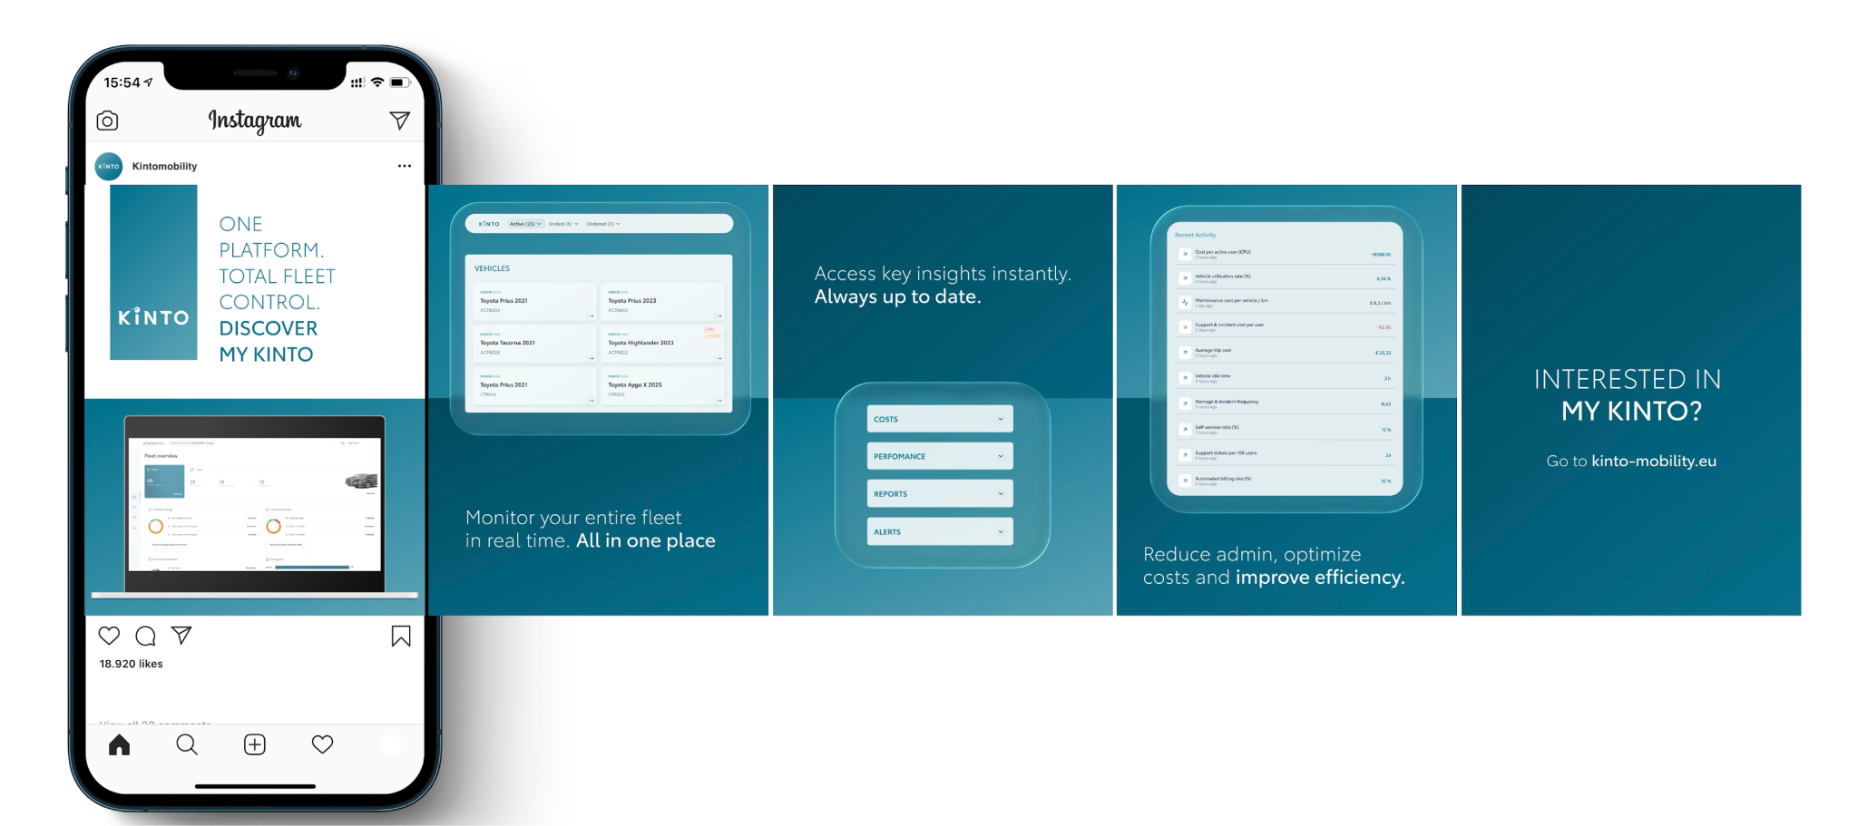
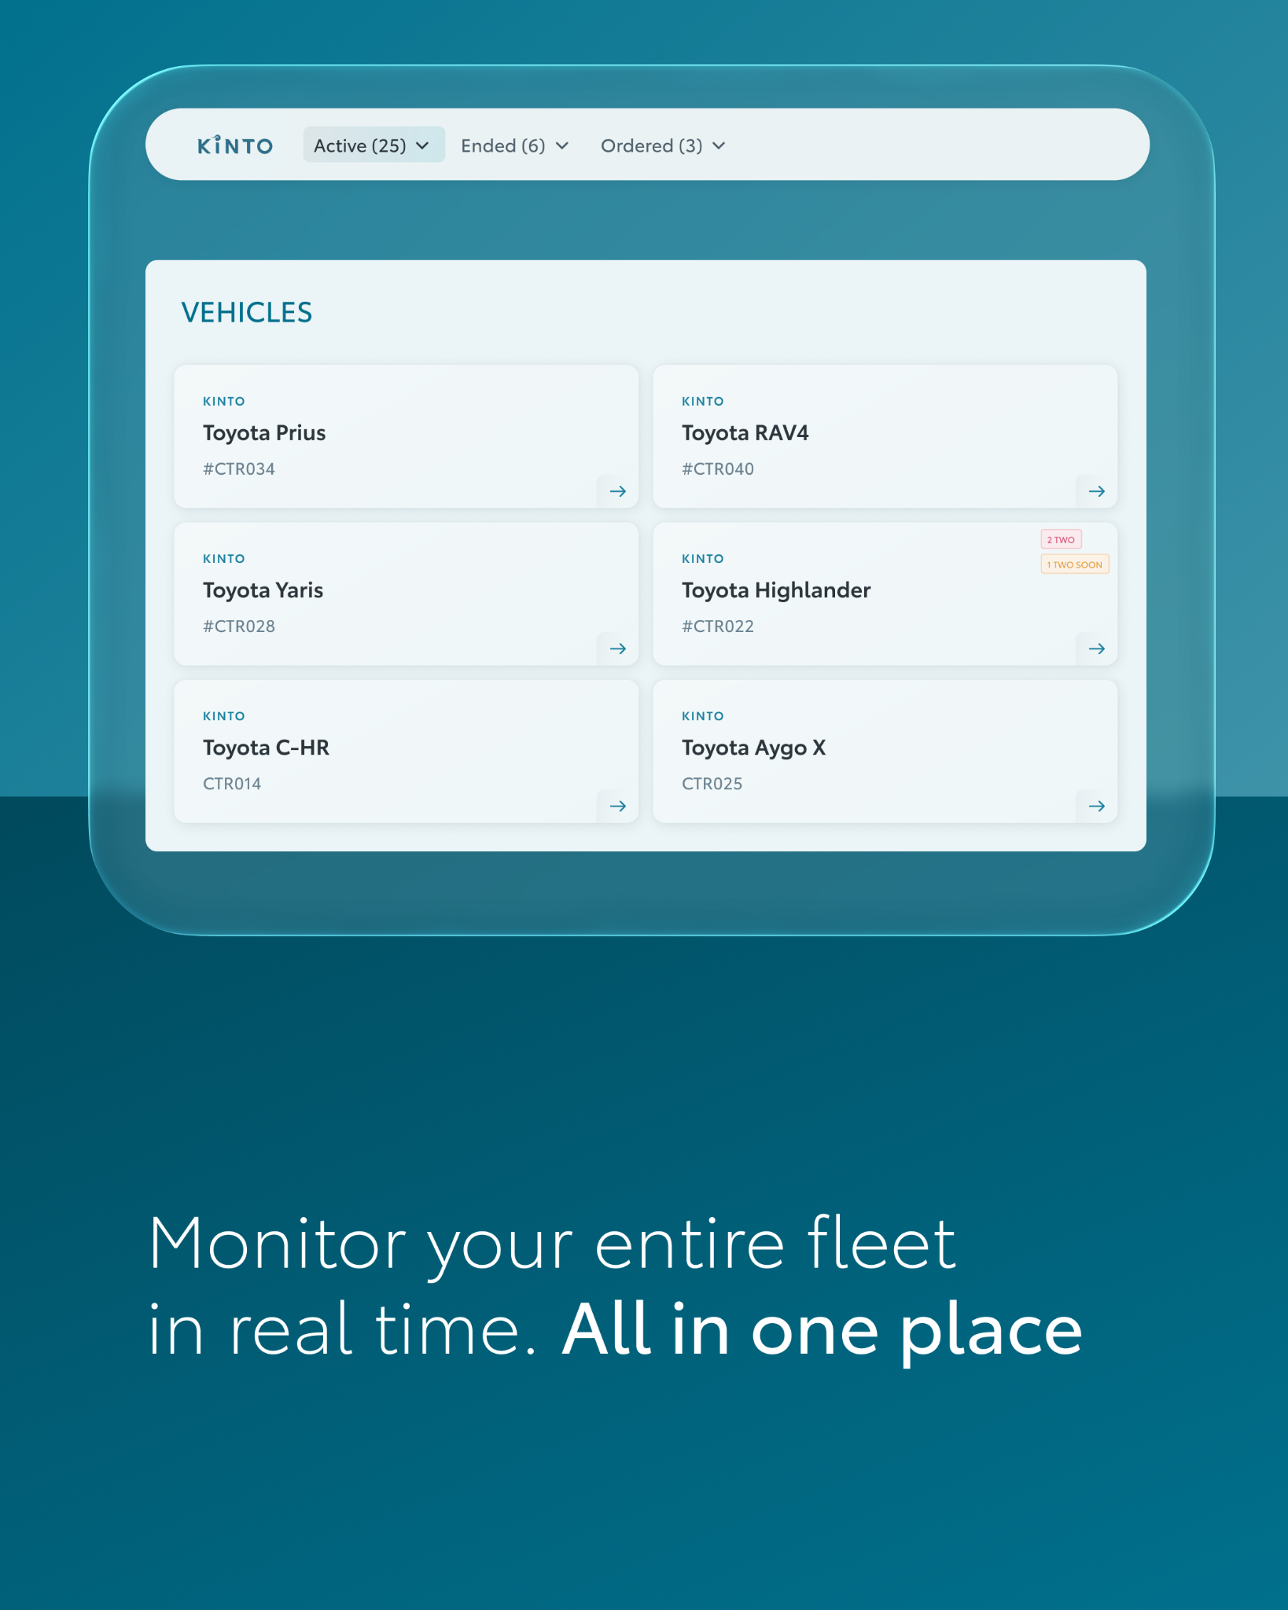
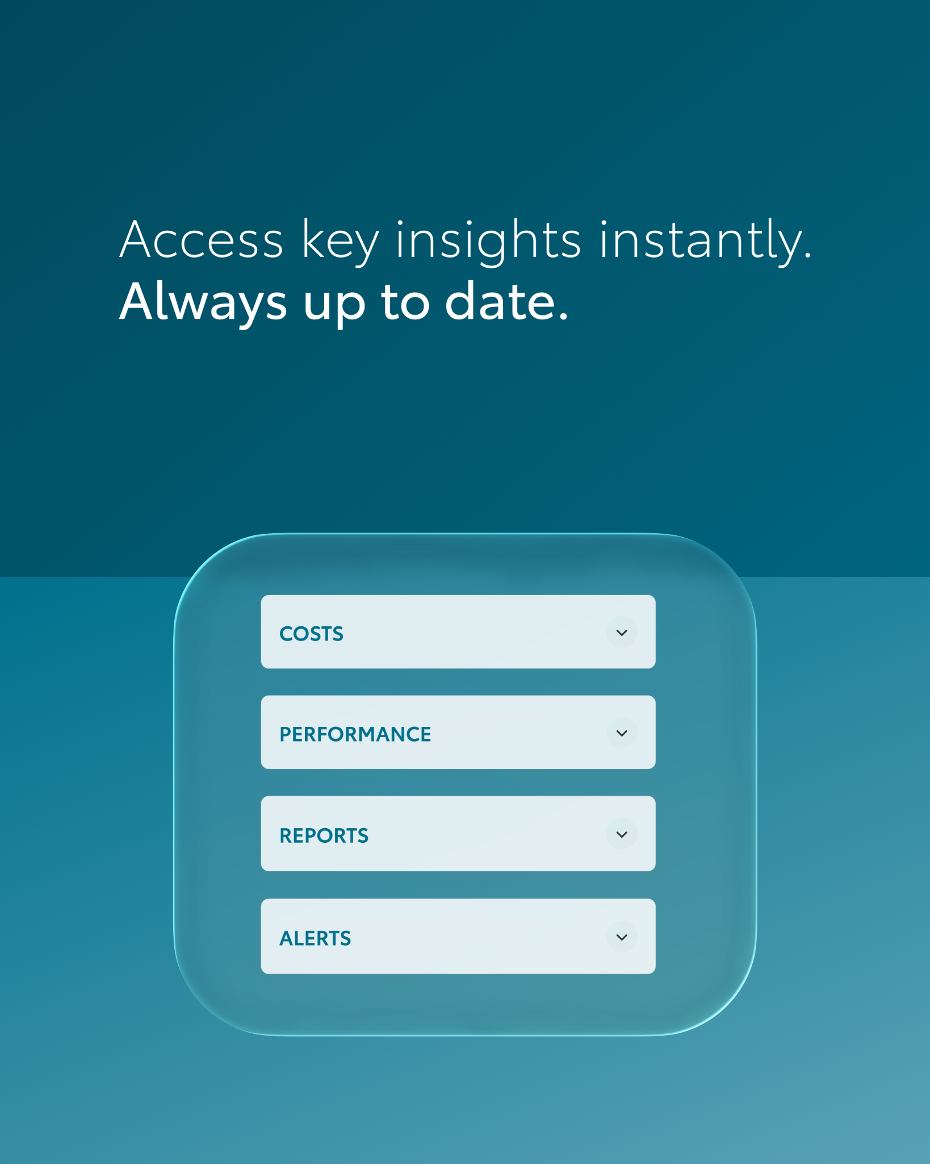

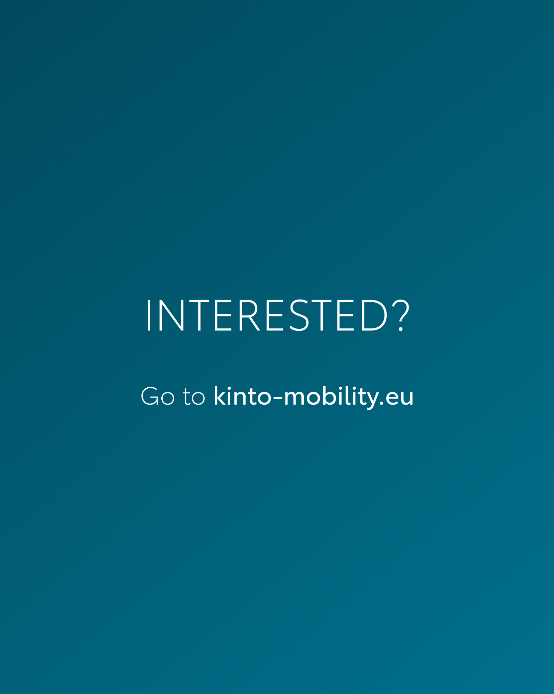
Valid for multibrand
7.CAROUSEL FLEET PORTAL
CONTENT BUCKET 1- FEBRUARY
COPY LI
Total fleet control is finally in one place. ☝️
With our fleet management portal, you can monitor your entire fleet in real time, helping you reduce paperwork, cut down on hidden costs and save your team's valuable time.
Whether you need to check performance reports or stay ahead of maintenance alerts, My KINTO keeps your data as mobile as your business.
🔗 Go to kinto-mobility.eu.
One partner. Every solution.
#KINTO #FleetControl #MobilitySolutions
FORMATS AVAILABLE:
4/5

Slide 27
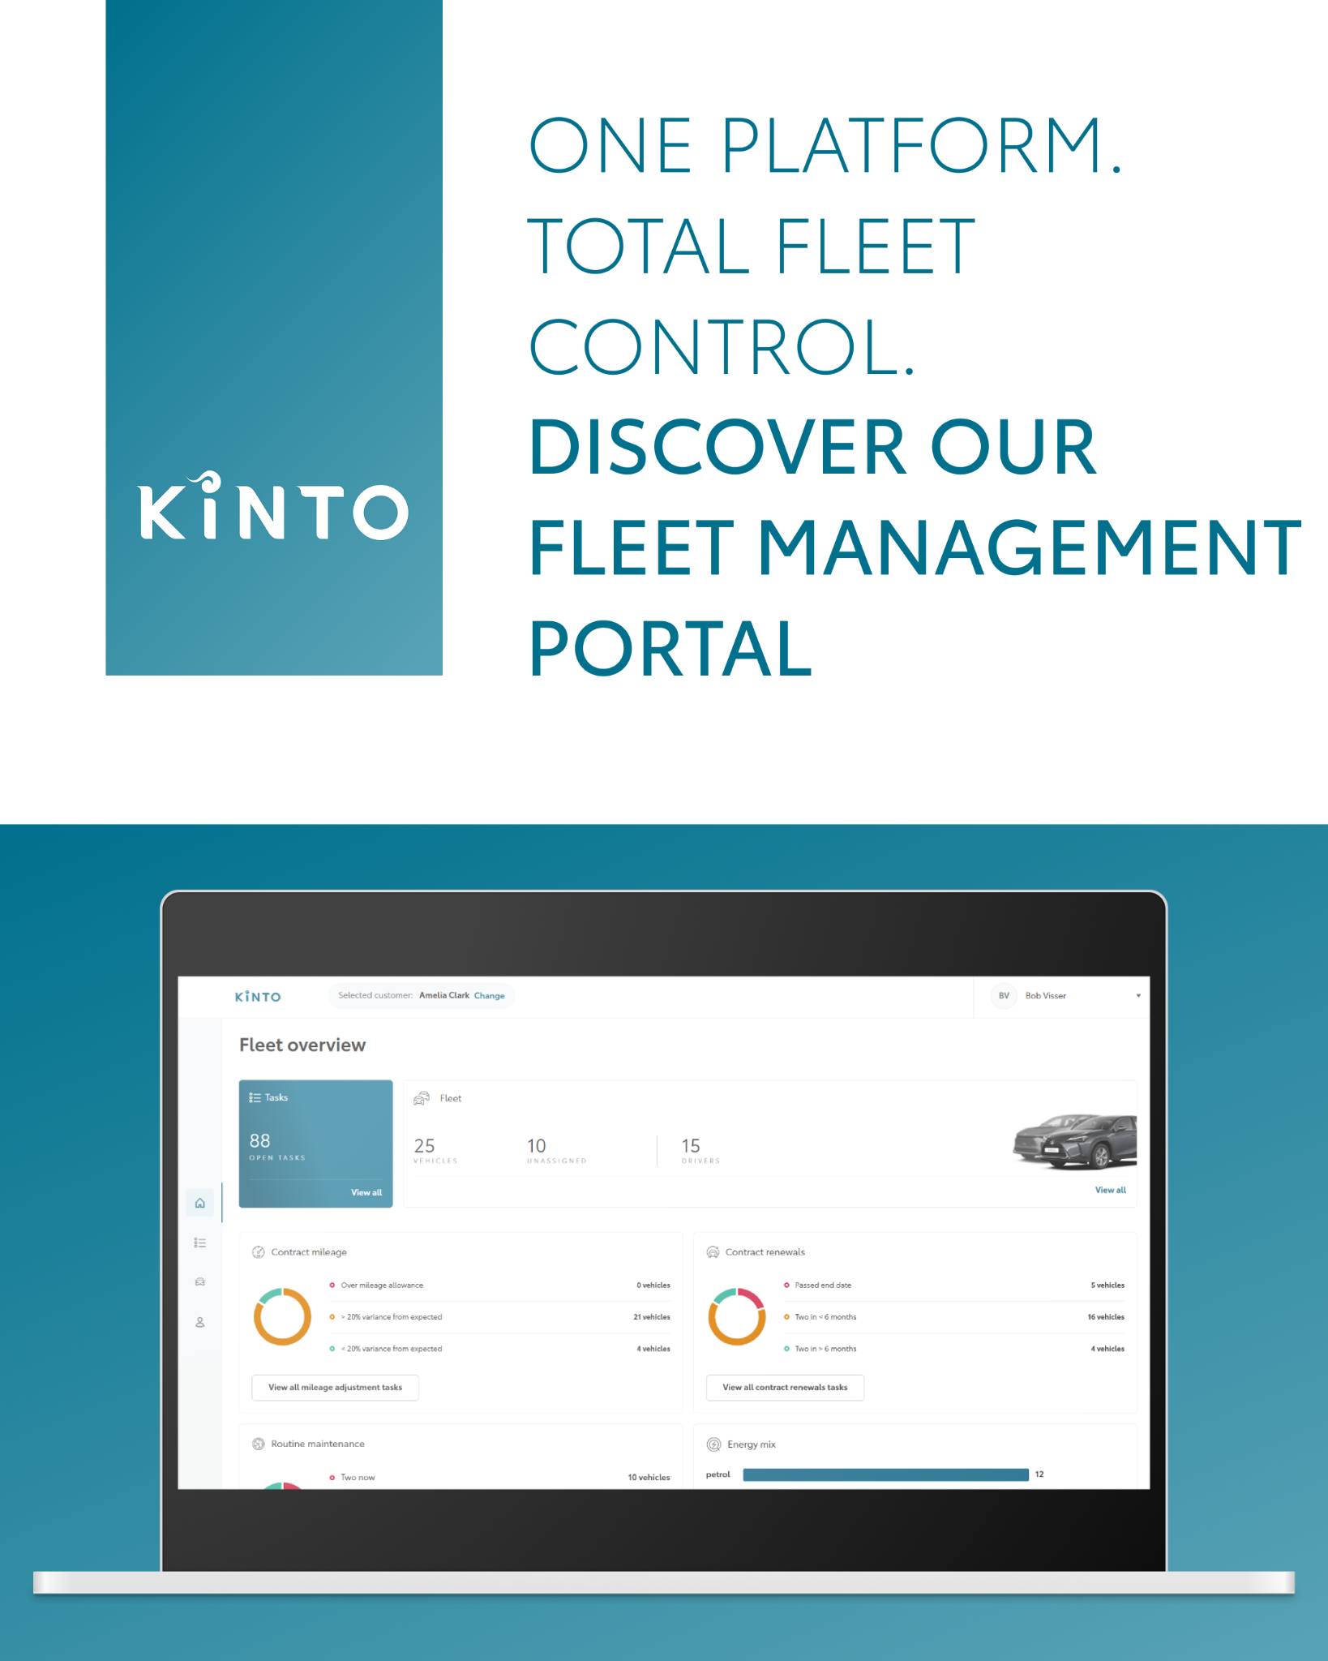
Valid for multibrand
7.CAROUSEL FLEET PORTAL
CONTENT BUCKET 1- FEBRUARY
COPY IG
One platform. Total fleet control. 📈✨
Discover our fleet management portal, the all-in-one portal designed to help you monitor your fleet in real time.
➡️ Swipe to see how easy it is to access key insights instantly,reduce admin costs and improve daily efficiency.
One partner. Every solution.
#KINTO #FleetControl #MobilitySolutions
FORMATS AVAILABLE:
4/5

Slide 28
Valid for multibrand
7.CAROUSEL FLEET PORTAL
CONTENT BUCKET 1- FEBRUARY
COPY FB
One platform. Total fleet control. 📈✨
Discover our fleet management portal, the all-in-one portal designed to help you monitor your fleet in real time.
➡️ Swipe to see how easy it is to access key insights instantly, reduce admin costs and improve daily efficiency.
One partner. Every solution.
FORMATS AVAILABLE:
4/5

Slide 29
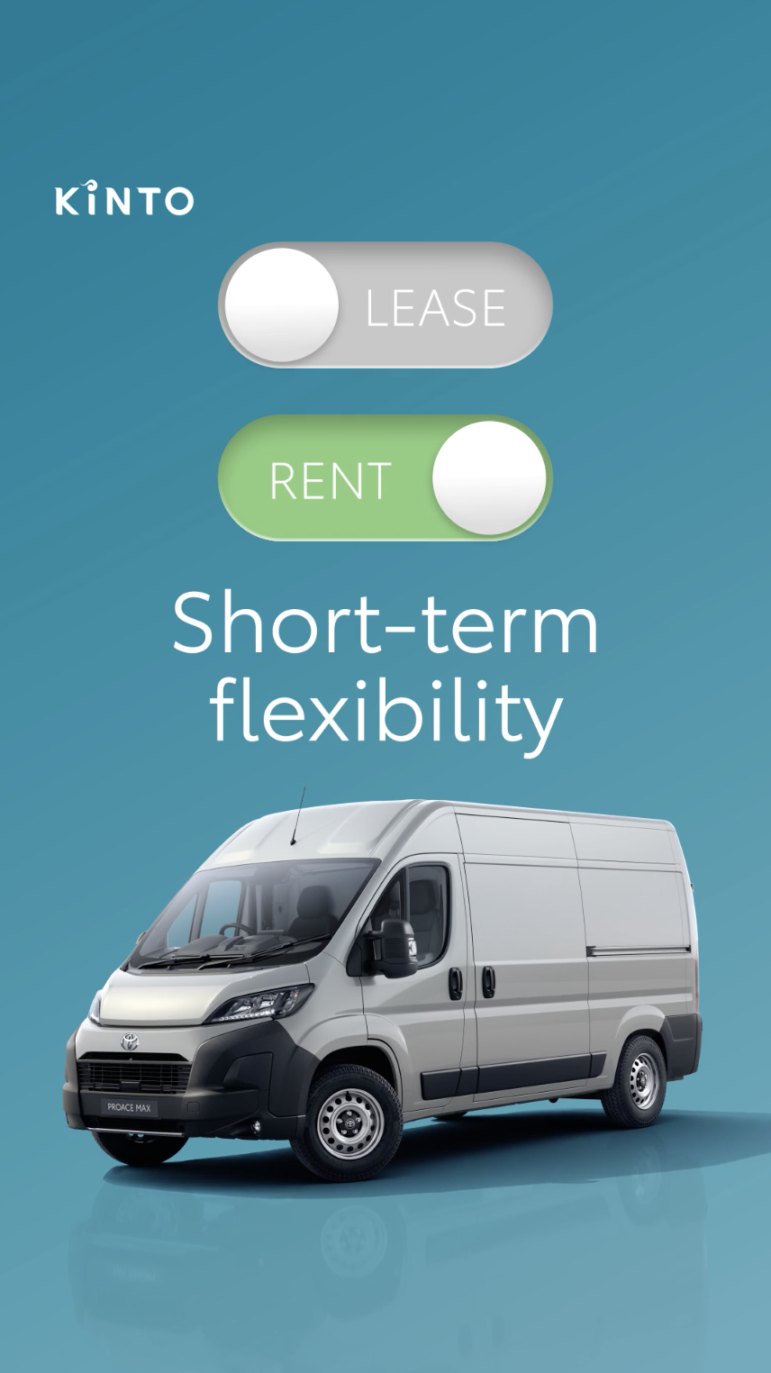
8.VIDEO
PROACE TOGGLE
COPY - LI:
Should your business rent or lease? The answer is: yes. 🔄
Choosing between flexibility and stability shouldn't be a compromise.
📈 Rent for ad-hoc mobility, pay only for what you use and maintain ultimate flexibility for seasonal peaks.
🚙 Lease for structural business use. Enjoy long-term peace of mind with an all-inclusive monthly cost.
KINTO provides flexible access to quality vehicles like the Proace Max and keeps you moving with insurance and maintenance included as standard.
#KINTO #FlexibleMobility #BusinessSolutions
CONTENT BUCKET 1- FEBRUARY
FORMATS AVAILABLE:
1/1 - 9/16 - ⅘ - 16/9
Notes:
#KINTO #FleetManagement #CorporateMobility #FlexibleMobility #MobilitySolutions

Slide 30
8.VIDEO
PROACE TOGGLE
COPY - IG:
Need a van for a couple of weeks or years? We’ve got the keys ready. 🔑
Whether it’s the flexibility of renting a car for a short-term project or the peace of mind of leasing a ride for your permanent fleet, KINTO makes it simple. 🚙
🔄 Switch between flexibility and stability as your business grows.
🔧 Power your business with insurance and maintenance always included.
#KINTO #FlexibleMobility #BusinessSolutions
CONTENT BUCKET 1- FEBRUARY
FORMATS AVAILABLE:
1/1 - 9/16 - ⅘ - 16/9
Notes:
#KINTO #FleetManagement #CorporateMobility #FlexibleMobility #MobilitySolutions

Slide 31
8.VIDEO
PROACE TOGGLE
COPY - FB:
Need a van for a couple of weeks or years? We’ve got the keys ready. 🔑🚗
At KINTO, we know that business needs change. That’s why we offer both renting and leasing solutions for the Proace Max, tailored to how you work today, with insurance and maintenance included.
✅ Rent when you need the flexibility of ad hoc usage. Perfect for those unexpected busy periods!
✅ Lease for structural peace of mind with a predictable, all-inclusive monthly cost.
CONTENT BUCKET 1- FEBRUARY
FORMATS AVAILABLE:
1/1 - 9/16 - ⅘ - 16/9
Notes:
#KINTO #FleetManagement #CorporateMobility #FlexibleMobility #MobilitySolutions

Slide 32
Community & connection
Empowerment & Expertise
Notes:
Baseline: Join the KINTO community

Slide 33
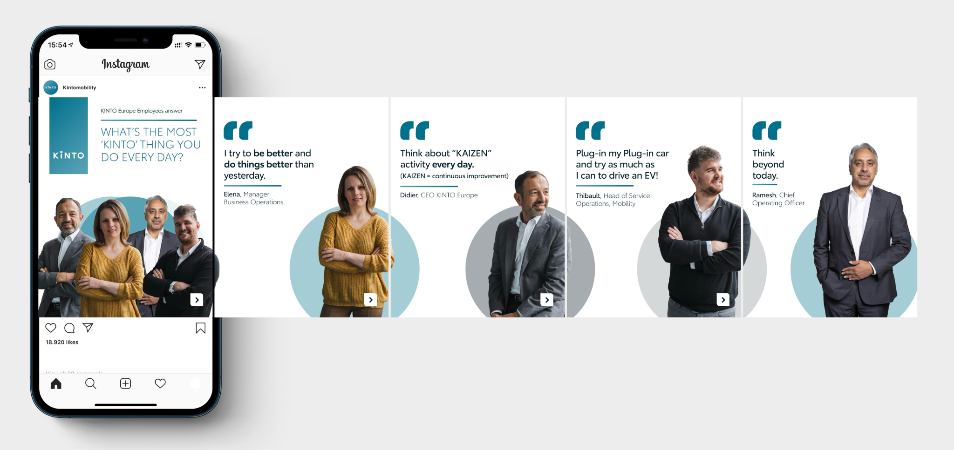

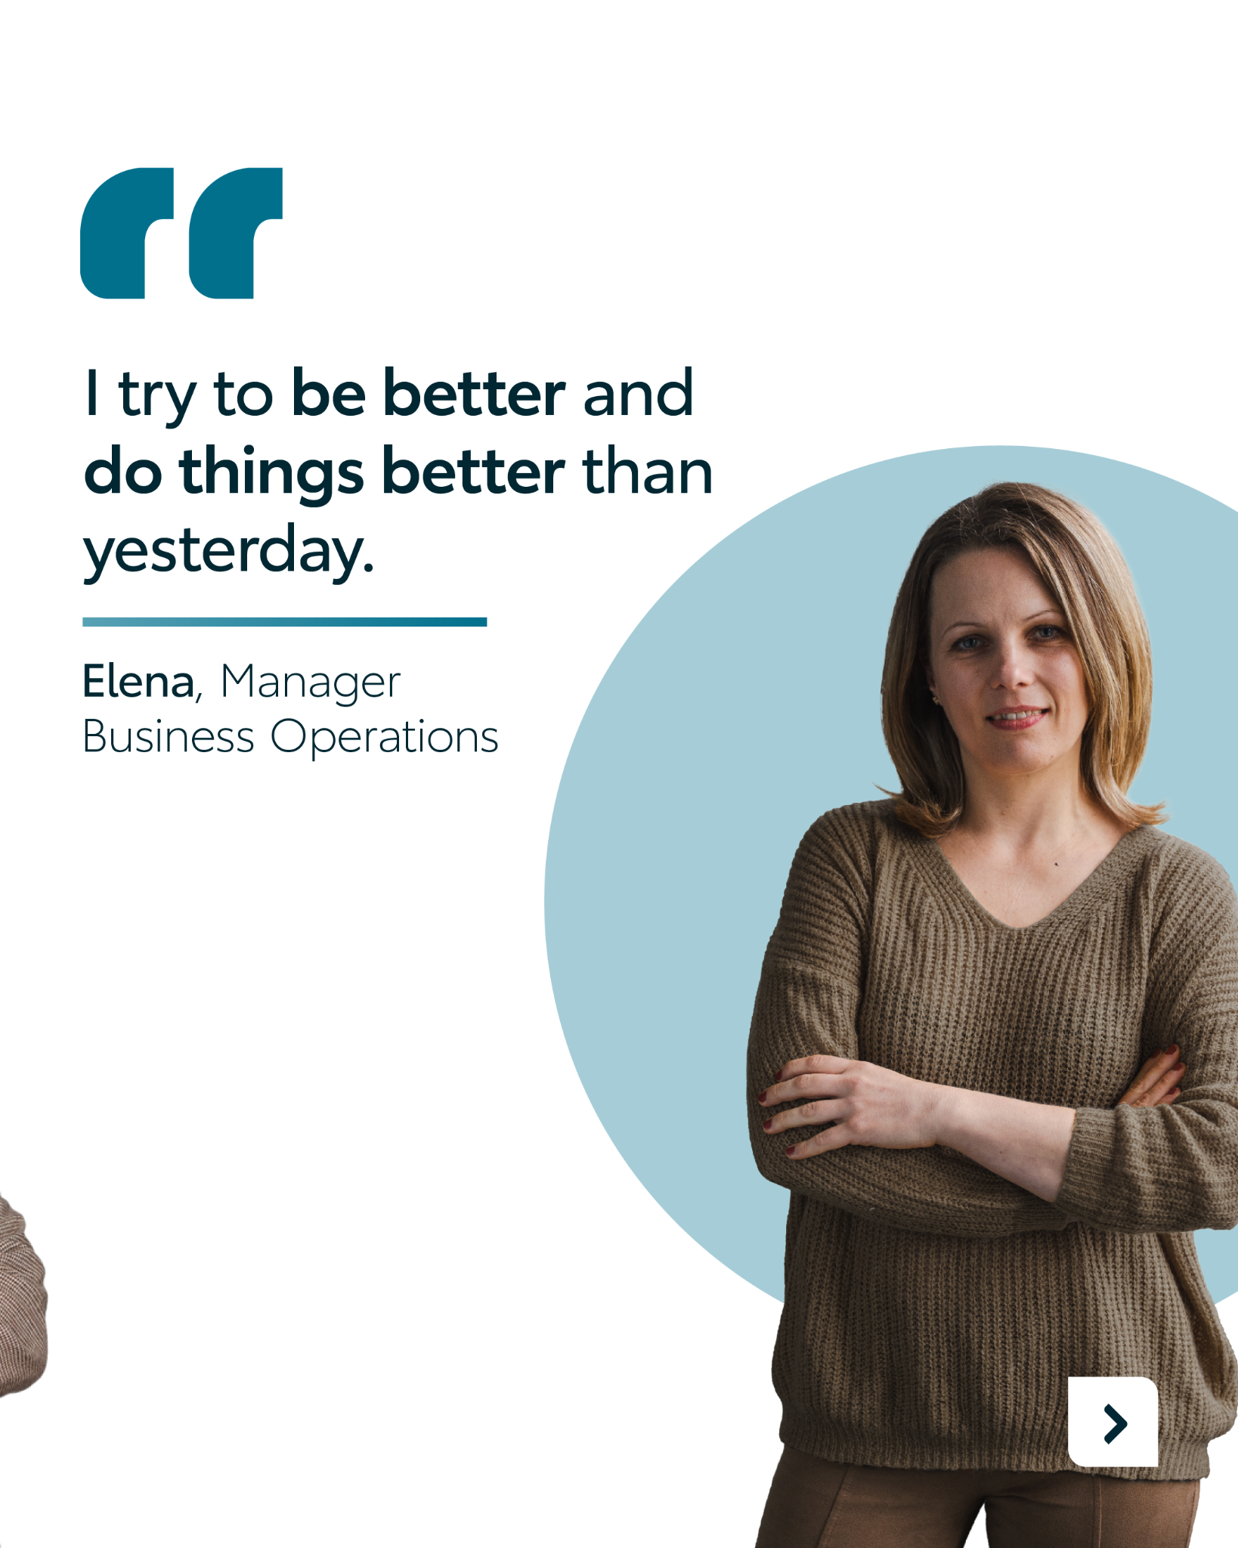

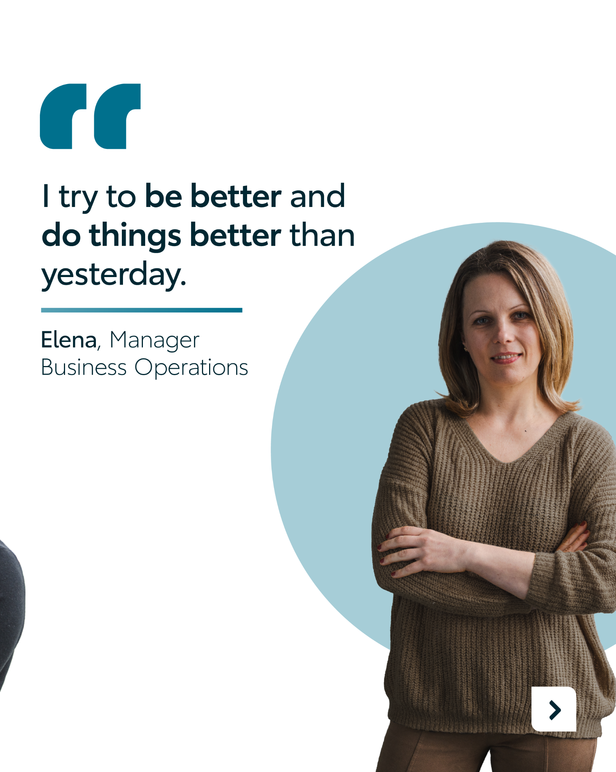
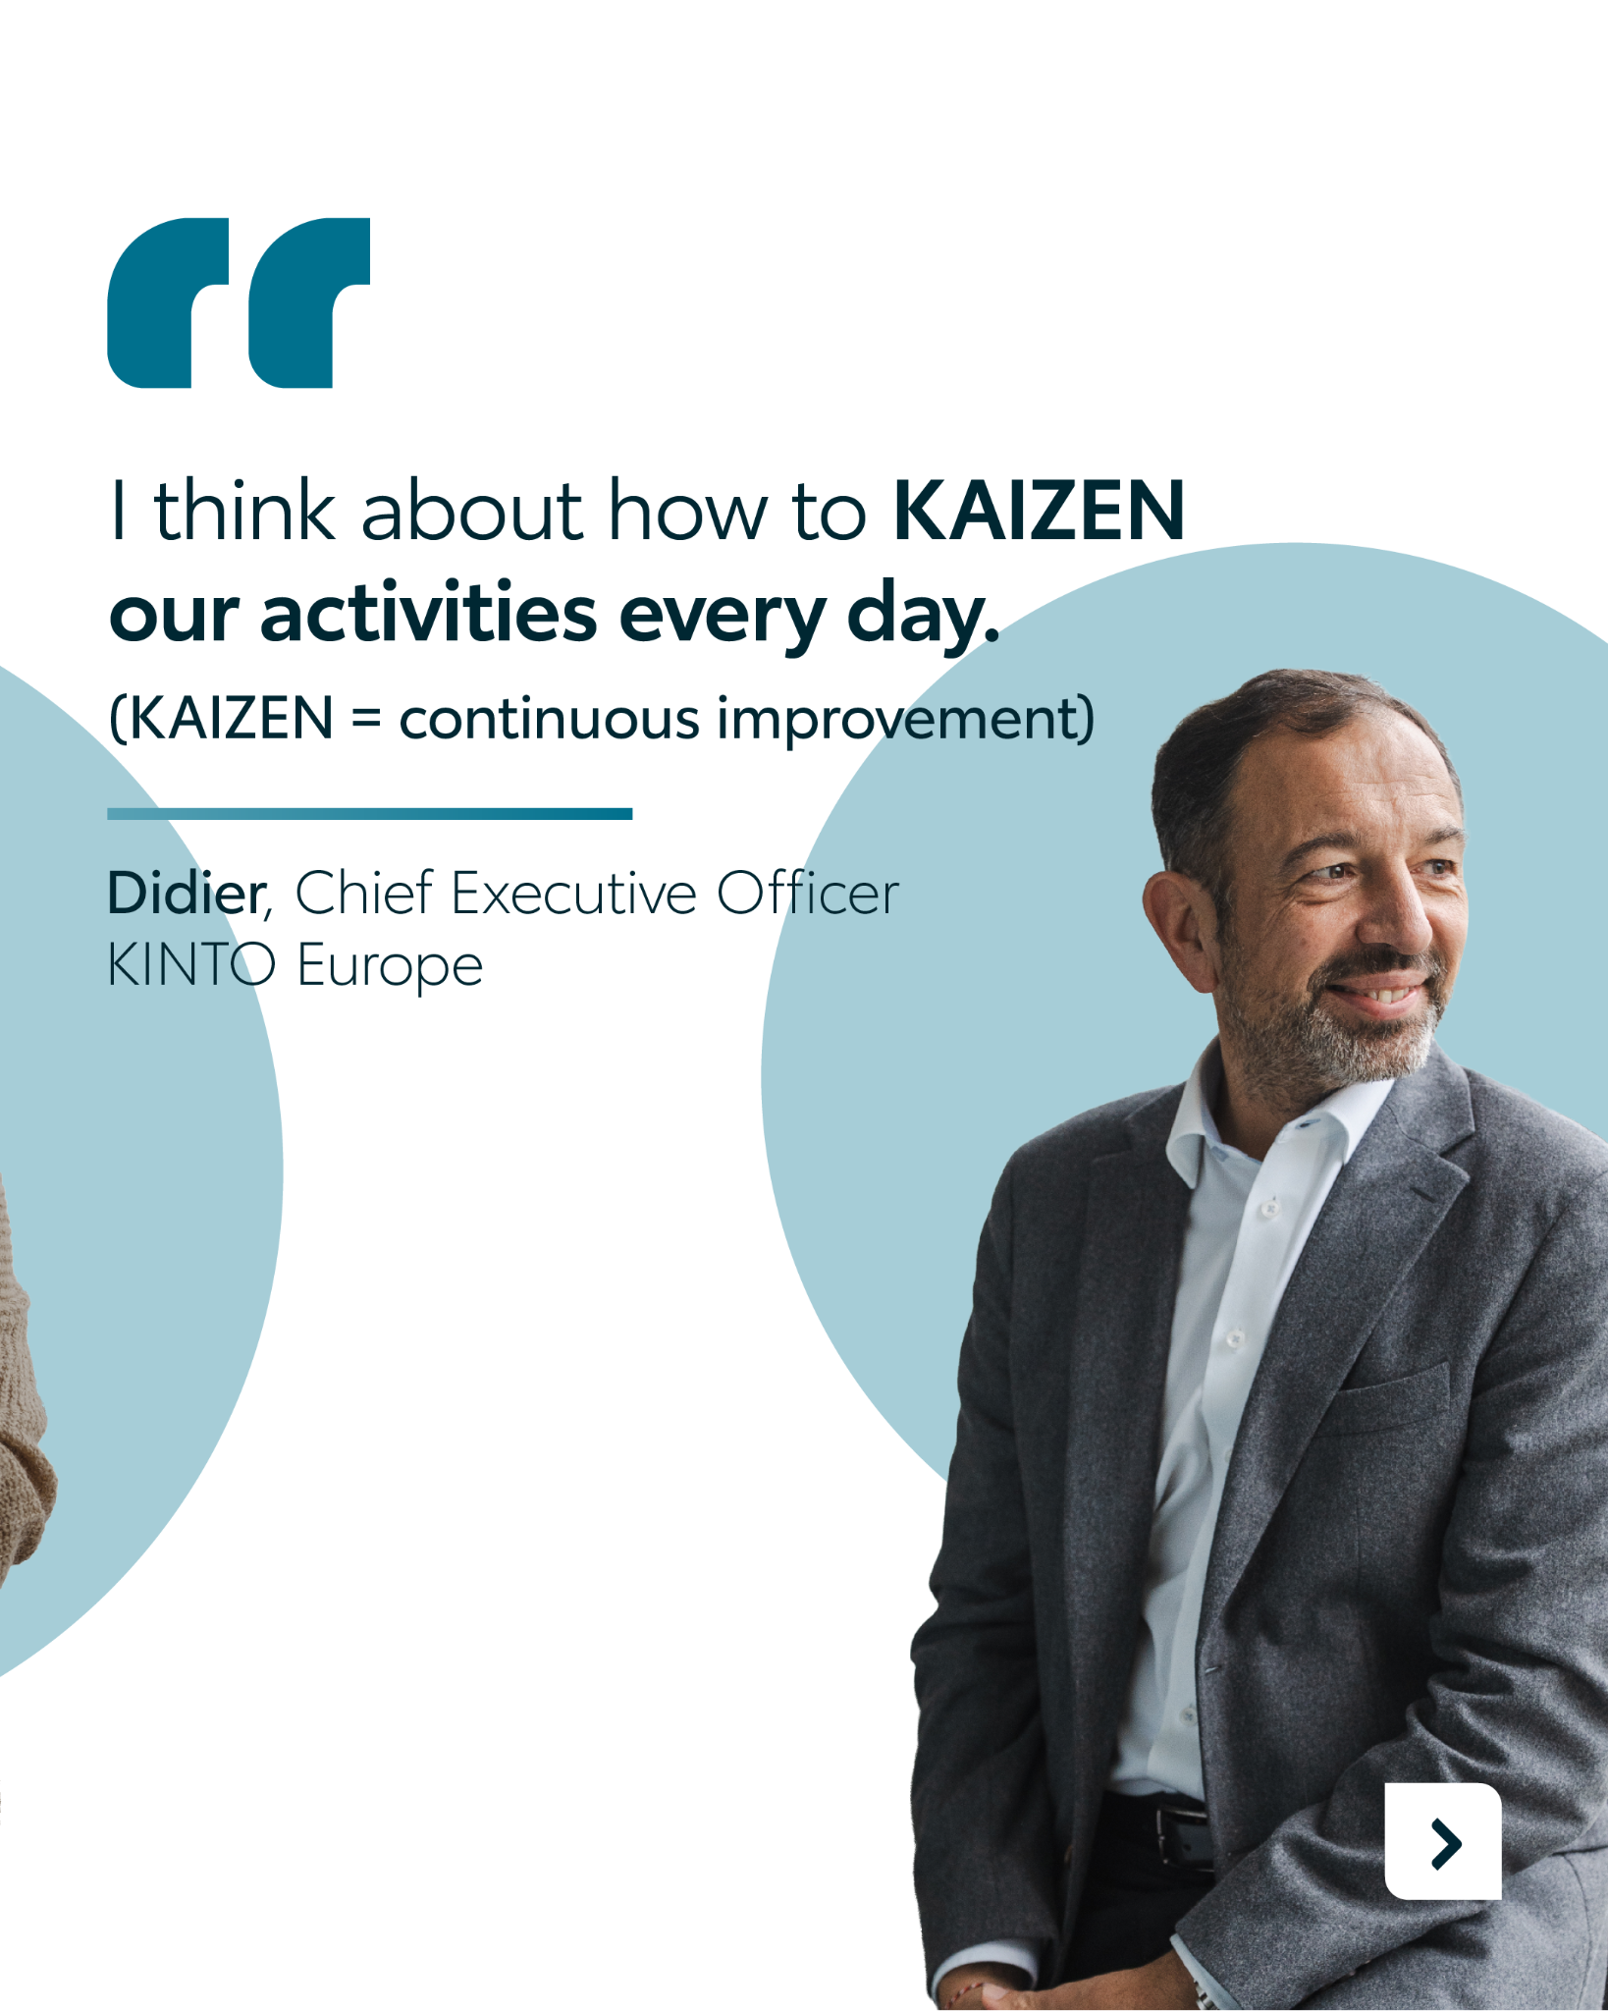
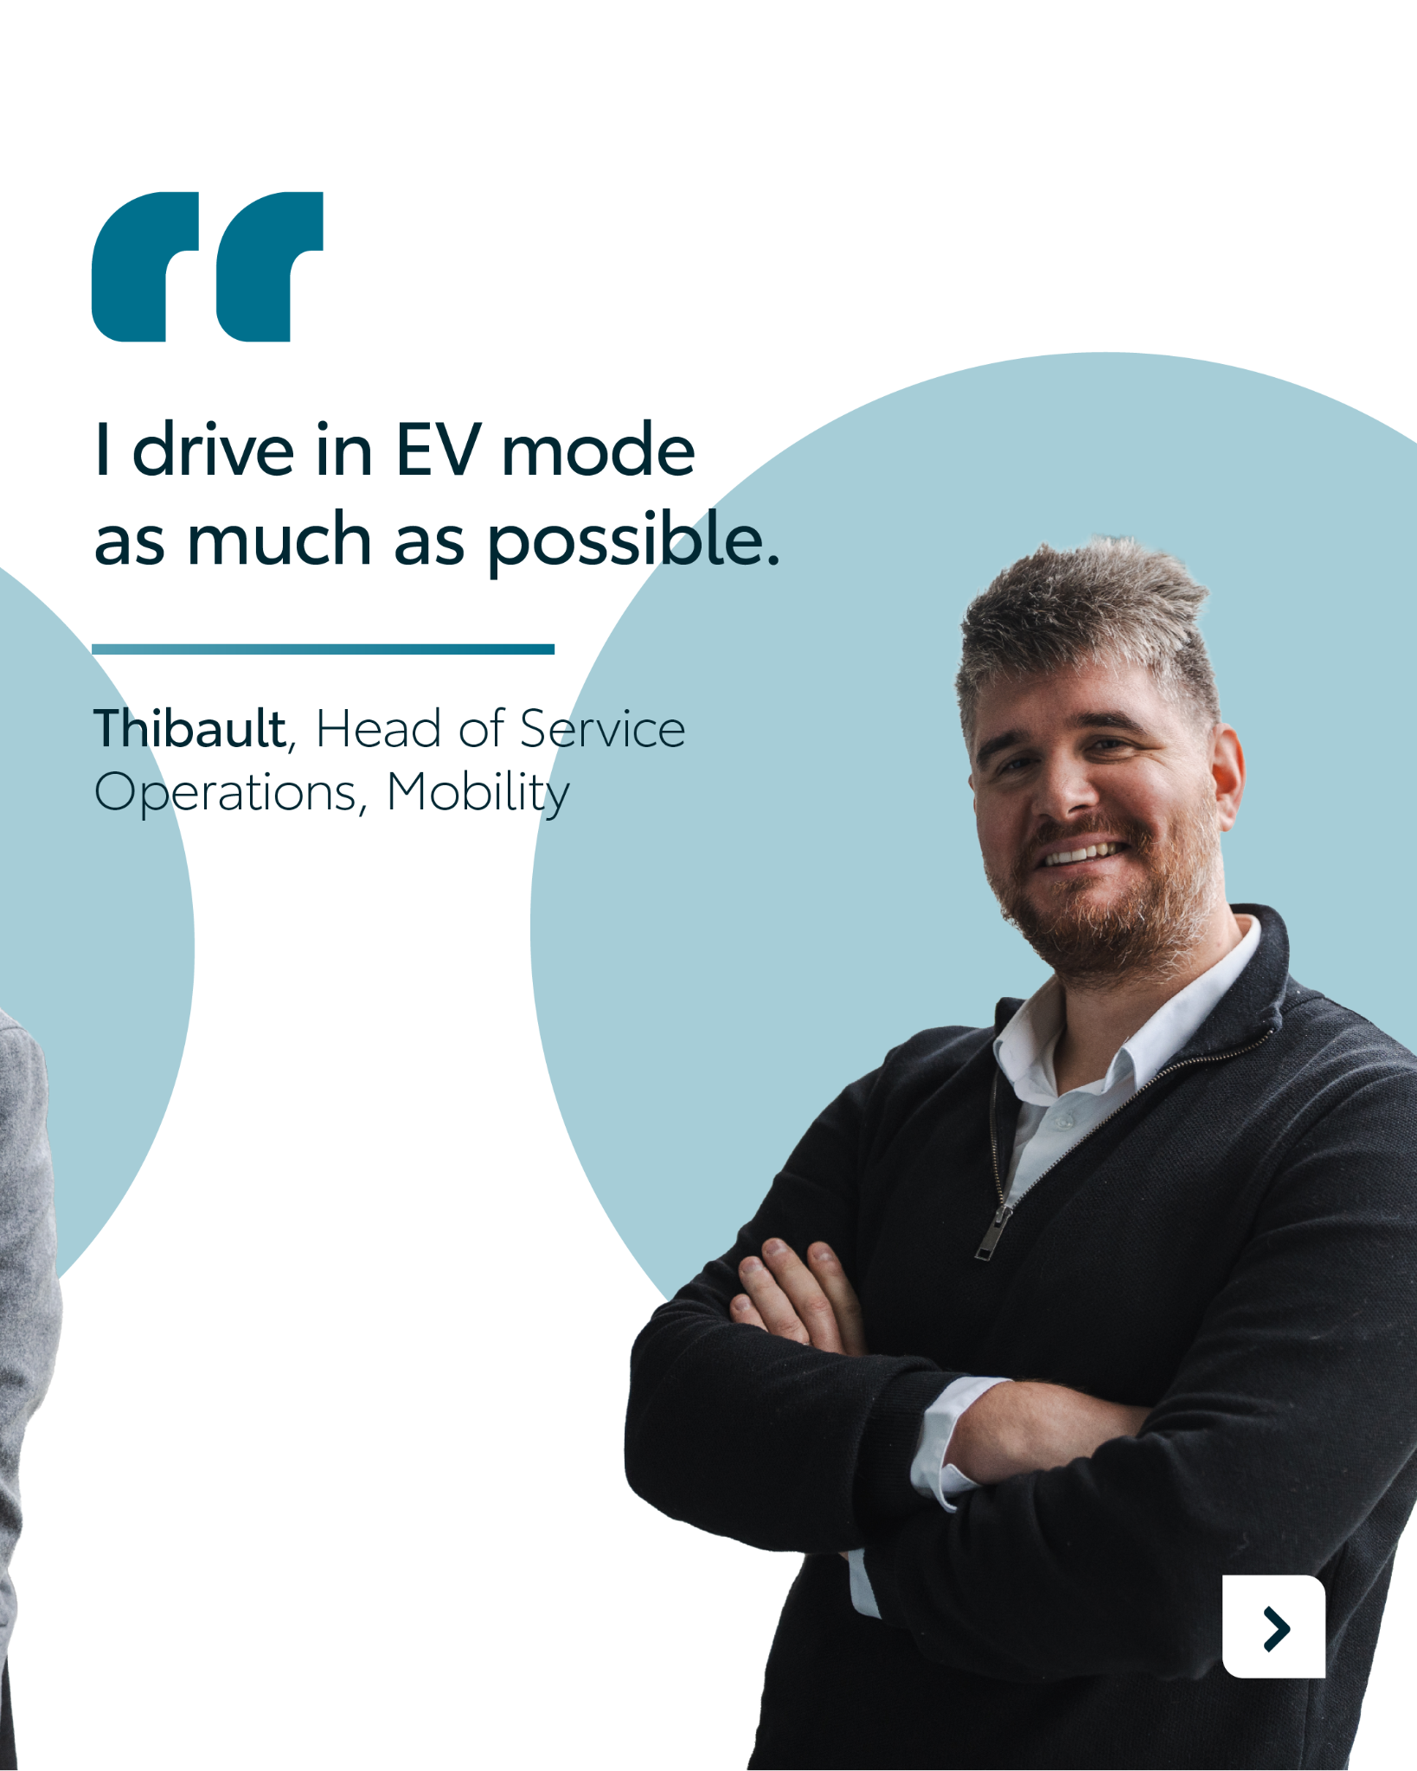

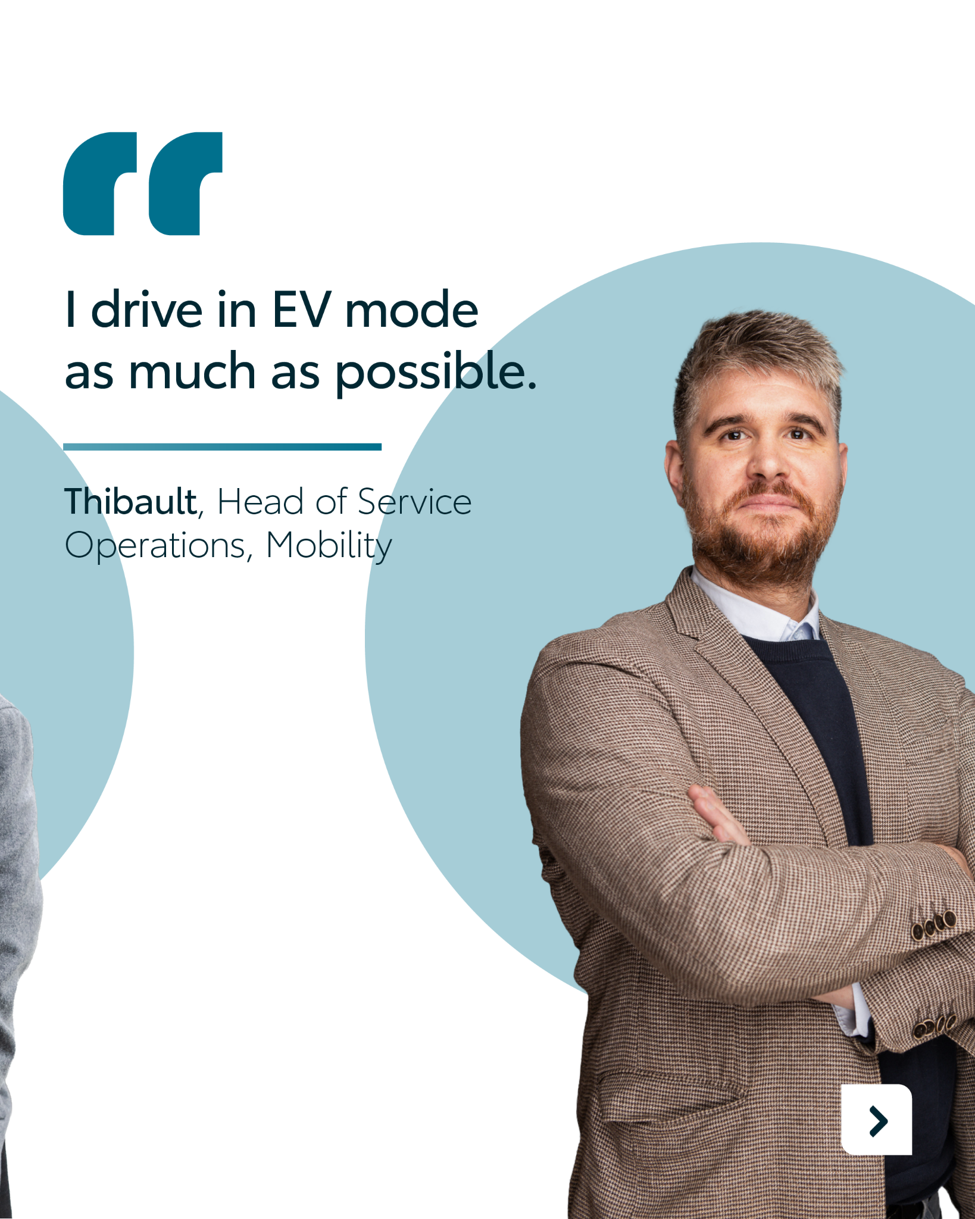
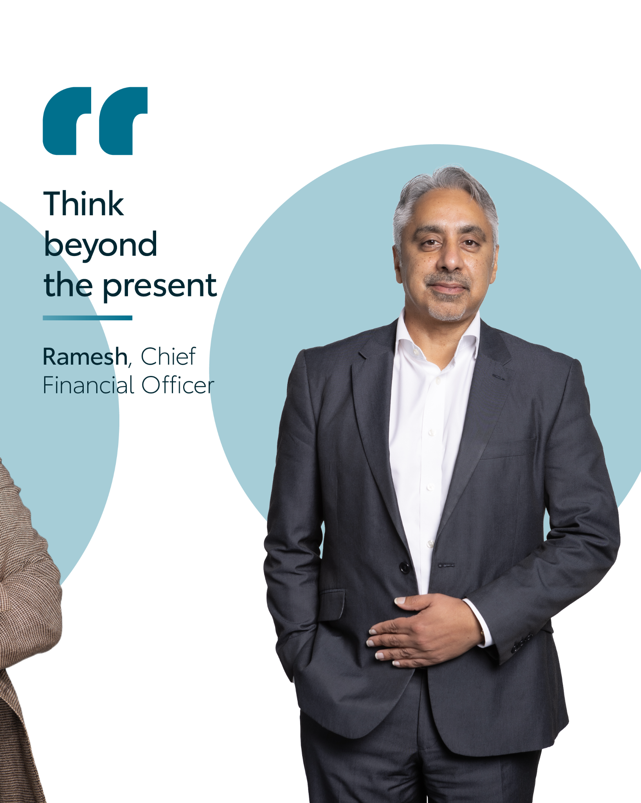
Valid for multibrand
9.CAROUSEL EMPLOYEE Q&A
CONTENT BUCKET 1- FEBRUARY
COPY LI
Ever wonder who’s behind the wheel at KINTO? 🚗
Behind every seamless mobility solution is a team committed to making your workday a little easier.
We sat down with our colleagues to talk about the small daily KINTO actions that make a big difference for our clients. ➡️ Swipe through to meet the team and see what drives them everyday.
#KINTO #BehindTheScenes #Community
FORMATS AVAILABLE:
4/5

Slide 34
Valid for multibrand
9.CAROUSEL EMPLOYEE Q&A
CONTENT BUCKET 1- FEBRUARY
COPY IG
What does it actually mean to build the future of mobility?
We asked our team what’s the ‘most KINTO thing’ they do in their everyday lives.
For the KINTO Europe team, it’s about a daily mindset of growth, sustainability, and thinking beyond today. 🧭
Swipe through to meet the people who keep us moving. ➡️
Join the KINTO community.
#KINTO #MeetTheTeam #Community
FORMATS AVAILABLE:
4/5

Slide 35
Valid for multibrand
9.CAROUSEL EMPLOYEE Q&A
CONTENT BUCKET 1- FEBRUARY
COPY FB
What does it actually mean to build the future of mobility?
We asked our team what’s the ‘most KINTO thing’ they do in their everyday lives.
For the KINTO Europe team, it’s about a daily mindset of growth, sustainability, and thinking beyond today. 🧭
a
Swipe through to meet the people who keep us moving. ➡️
Join the KINTO community.
#KINTO #MeetTheTeam #Community
FORMATS AVAILABLE:
4/5

Slide 36
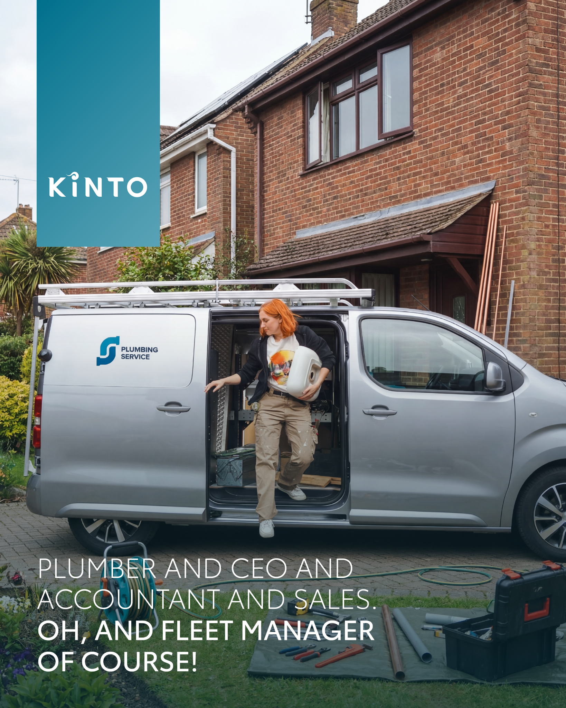

10.VISUAL SHAREABLE QUOTE PROACE
COPY LI
Do you run your business as a CEO, Head of Sales and … Fleet Manager? 🚘🤝
What if we say you can get the van you need without the headaches of managing maintenance or insurance yourself? Let KINTO keep your van running so you can keep your business growing. 📈
#KINTO #WorkSmarter #MobilitySolutions
CONTENT BUCKET 1- FEBRUARI
FORMATS AVAILABLE:
4/5

Slide 37
10.VISUAL SHAREABLE QUOTE PROACE
COPY IG
Plumber by morning, accountant by afternoon, and fleet manager by… never? 🛠️
We know that running a business means wearing a lot of hats. That’s why KINTO is here to take one off your hands.
With our all-inclusive leasing, you get the van you need without the headaches of managing maintenance or insurance. 🚘🤝
You run your business. We keep the van running. Deal?
Join the KINTO community.
#KINTO #WorkSmarter #MobilitySolutions
CONTENT BUCKET 1- FEBRUARY
FORMATS AVAILABLE:
4/5

Slide 38
10.VISUAL SHAREABLE QUOTE PROACE
COPY FB
Plumber by morning, accountant by afternoon, and fleet manager by… never? 🛠️
We know that running a business means wearing a lot of hats. That’s why KINTO is here to take one off your hands.
With our all-inclusive leasing, you get the van you need without the headaches of managing maintenance or insurance. 🚘🤝
You run your business. We keep the van running. Deal?
Join the KINTO community.
CONTENT BUCKET 1- FEBRUARY
FORMATS AVAILABLE:
4/5

Slide 39
Valid for multibrand
11.POLL 30 MINUTES
COPY - LI
Understanding charging habits is key to building a mobility strategy that actually works for your team. Whether you’re already behind the wheel of an EV or just starting to explore the options, we want to hear from you.
Cast your vote below! 👇
If you drive en EV or plugin, where do you charge most often?
At home
At work
Public fast chargers
I don't drive an EV (yet)
CONTENT BUCKET 1- FEBRUARY

Slide 40
11.POLL 30 MINUTES
COPY - IG STORY
Where do you charge your EV or plugin most often?
At home
At work
Public fast chargers
I don't drive an EV (yet)
CONTENT BUCKET 1- FEBRUARY

Slide 41
11.POLL 30 MINUTES
COPY - FB
The transition to electric is a journey that looks different for every driver. 🌍If you’re driving an EV or a plug-in hybrid, we want to know: where is your go-to charging spot? 🔌
Your habits help us understand how to make mobility even more seamless for everyone. Let us know in the comments!
At home
At work
Public fast chargers
I don't drive an EV (yet)
CONTENT BUCKET 1- FEBRUARY

Slide 42
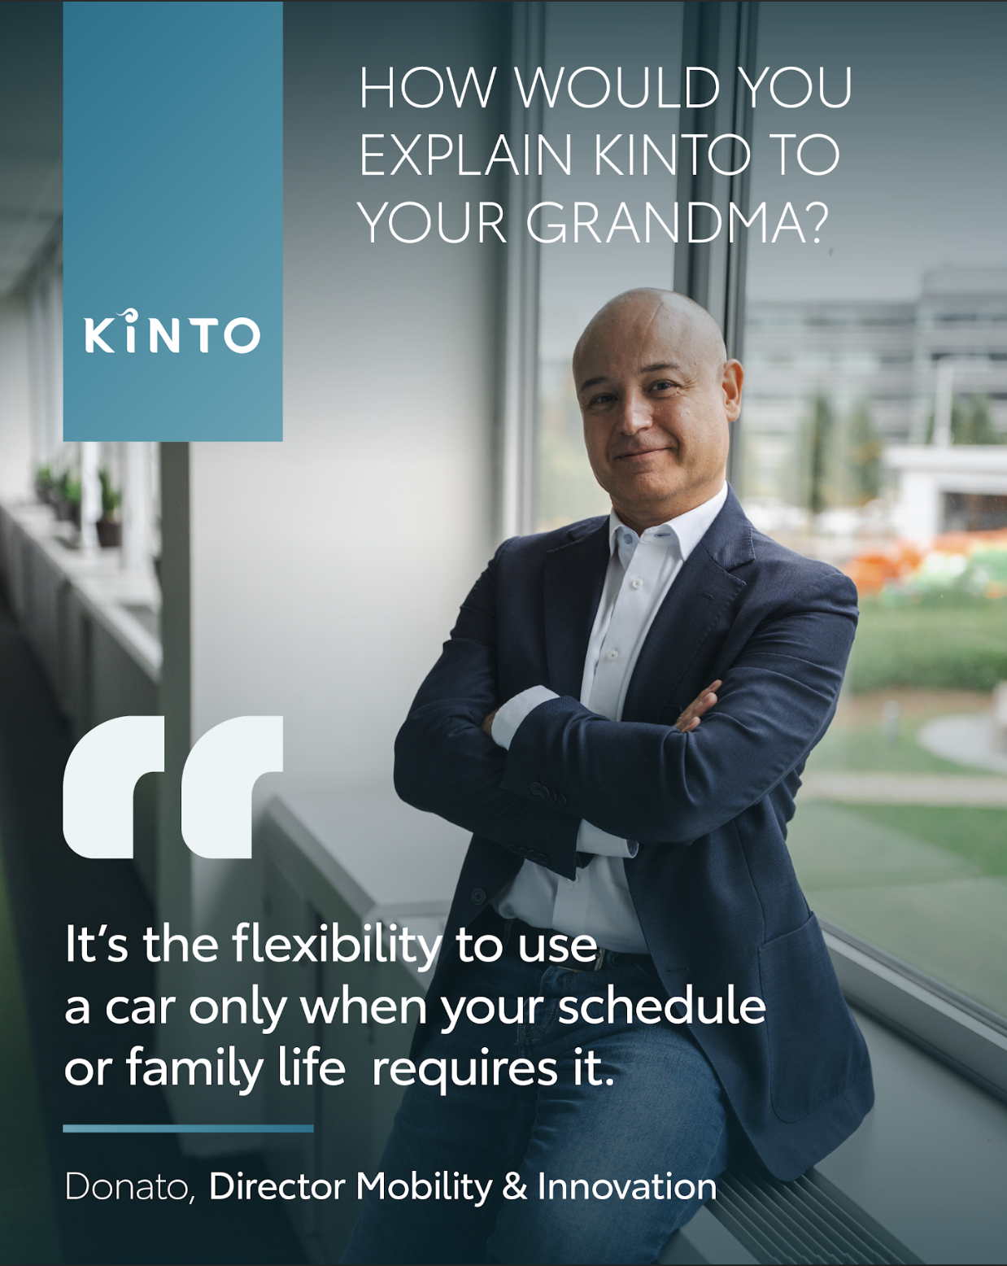
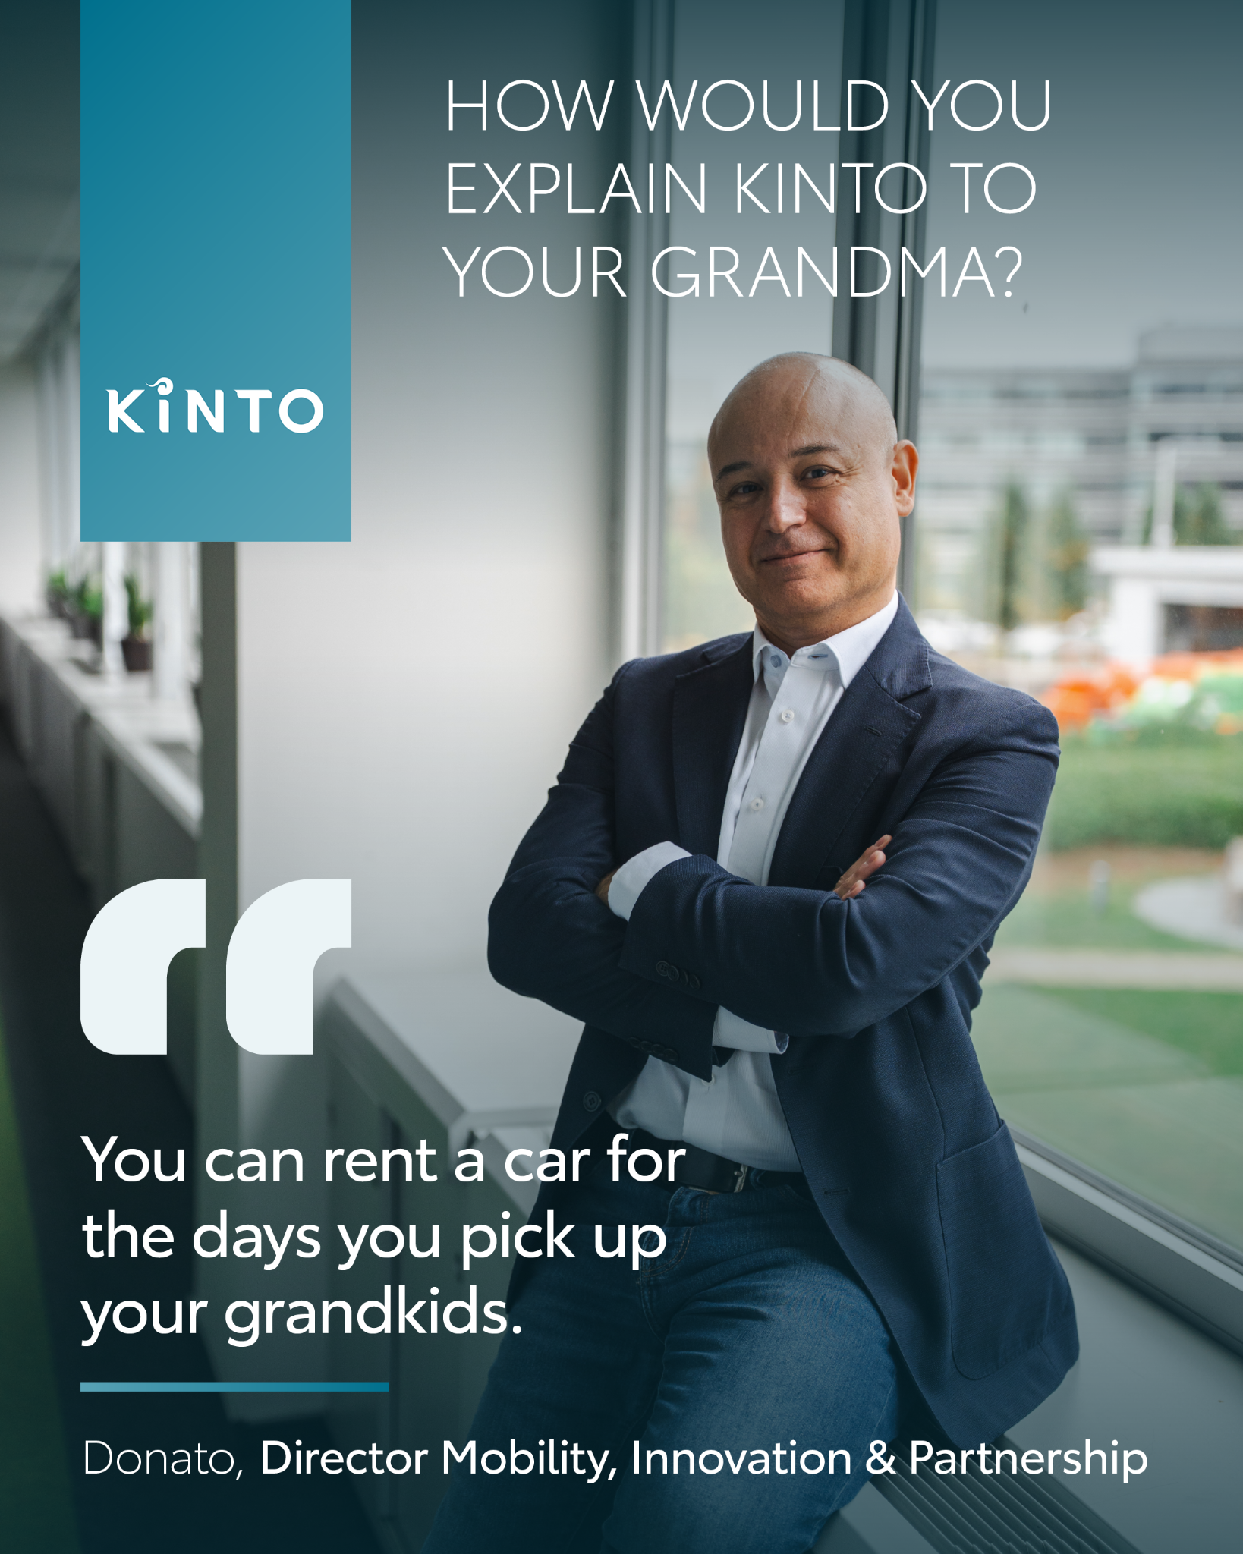
Valid for multibrand
12. VISUAL EMPLOYEE
QUOTE
COPY - LI:
How do you explain a complex mobility service simply? You use the ‘grandma test’. 👵
Donato, our Director of Mobility & Innovation, believes that at its core, KINTO is about one thing: making life easier.
For a high-pressure work week or a busy family weekend, it’s the freedom to have a car only when you actually need it.
Do you agree? Share your thoughts in the comments and join the KINTO community.
#KINTO #FlexibleMobility #Community
CONTENT BUCKET 1- FEBRUARY
FORMATS AVAILABLE:
1/1 - 9/16 - ⅘ -16/9
Notes:
#KINTO #FleetManagement #CorporateMobility #FlexibleMobility #MobilitySolutions

Slide 43
Valid for multibrand
12. VISUAL EMPLOYEE
QUOTE
COPY - IG:
How would you explain KINTO to your grandma? 👵
Sometimes the simplest explanations are the best. Donato from our team breaks it down: it’s the flexibility to use a car exactly when your work or family life requires it. No more, no less. 🚗
It’s about mobility that adapts to you, helping you stay focused on what’s important.
Do you agree? Share your thoughts in the comments and join the KINTO community.
#KINTO #FlexibleMobility #Community
CONTENT BUCKET 1- FEBRUARY
FORMATS AVAILABLE:
1/1 - 9/16 - ⅘ - 16/9

Slide 44
Valid for multibrand
12. VISUAL EMPLOYEE
QUOTE
COPY - FB:
How would you explain KINTO to your grandma? 👵
Sometimes the simplest explanations are the best. Donato from our team breaks it down: it’s the flexibility to use a car exactly when your work or family life requires it. No more, no less. 🚗
It’s about mobility that adapts to you, helping you stay focused on what’s important.
Do you agree? Share your thoughts in the comments and join the KINTO community.
CONTENT BUCKET 1- FEBRUARY
FORMATS AVAILABLE:
1/1 -⅘

