Slide 1

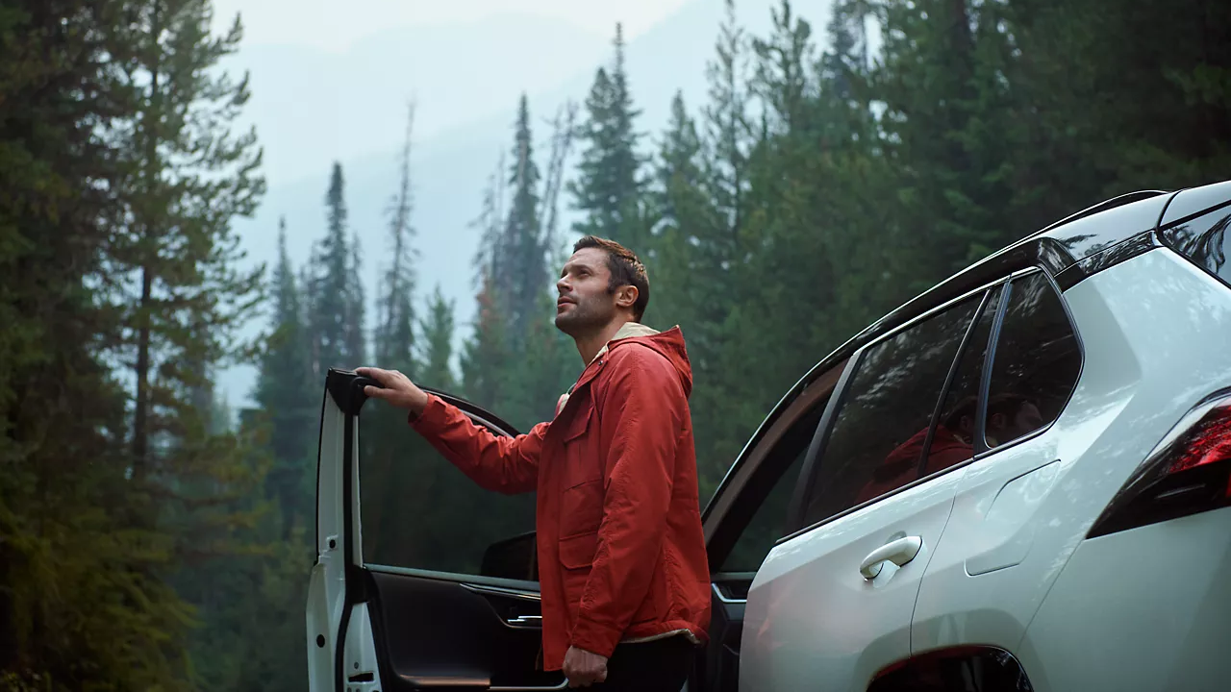

CONTENT
bucket - April 2026

Slide 2
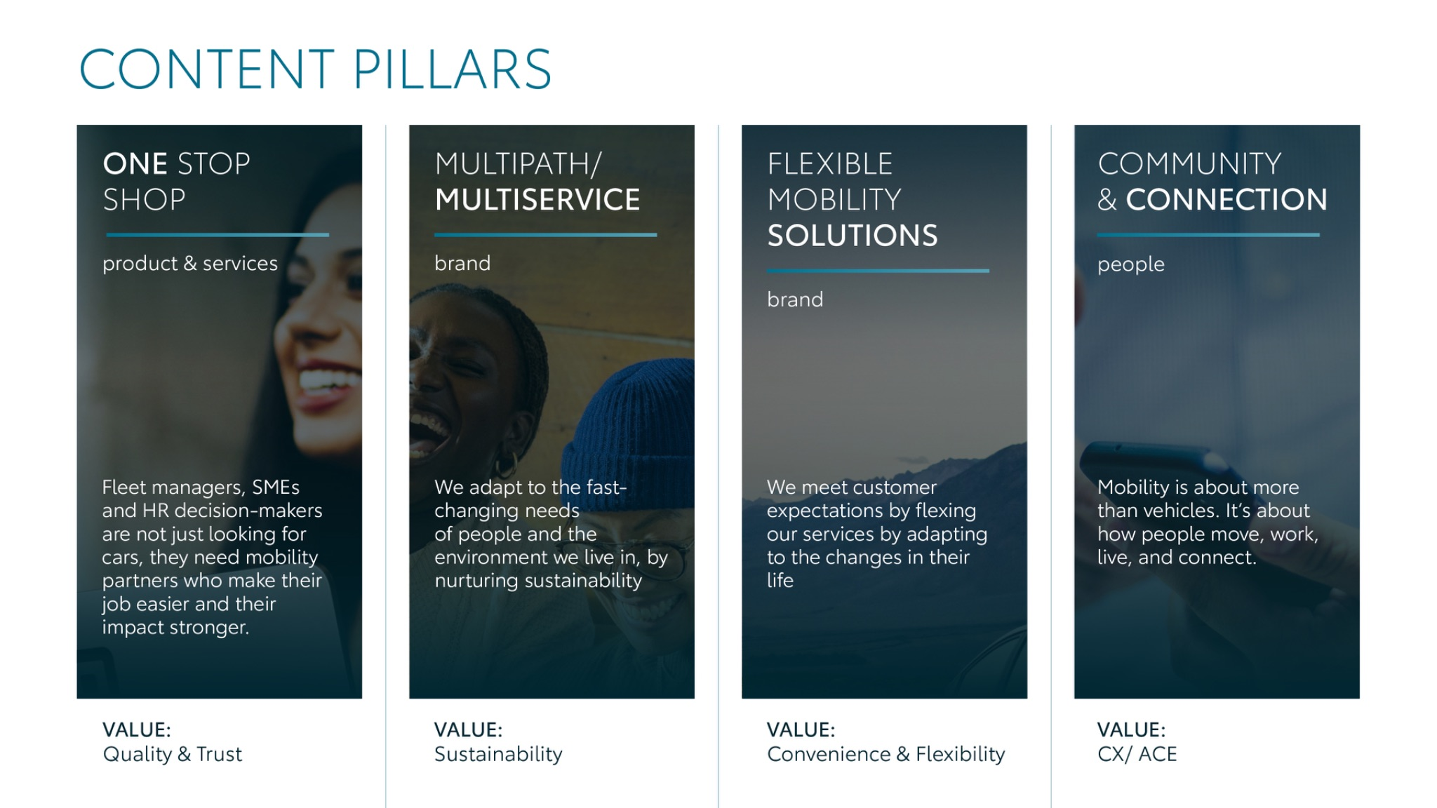
Notes:
“At KINTO, we work with content pillars: themes that carry our brand. We use different content types: inspiring, informative, topical. Your contributions add the human layer that makes the strategy work.”

Slide 3



Content pillars - content overview
APRIL
Top Topical Easter
Service & maintenance
Pick up Rent
FY results
Perks of Renting
KINTO Join
Longread Remarketing
Fleet Manager scale
Mobility Solution
Q&A April
Career Journey
ONE STOP SHOP
MULTIPATH/ MULTISERVICE
FLEXIBLE MOBILITY SOLUTIONS
COMMUNITY/ CONNECTION

Slide 4
Tag lines pillars
1. One Stop Shop
One partner. Every solution.
2. Flexible Mobility Solutions
One partner. Every solution.
3. Community and connection (important to keep it broad enough to fit clients as well as people working at Kinto)
Join the KINTO community.
4. Vision & Impact (Multipath/multiservice)
One partner. Every solution.

Slide 5

One stop shop
Notes:
One place. Every solution. Always KINTO.

Slide 6





Valid for multibrand
1. VISUAL EASTER
COPY - LI:
With KINTO, we’ve redefined traditional rental to get you on the road faste.
Whether you need an easy to park Aygo CX for a client visit downtown or a temporary addition to your fleet, we provide flexible access without the admin headaches.
Let us handle the details so you can focus on your business goals. 💼
One partner. Every solution.
#FleetManagement #BusinessMobility #KINTO
CONTENT BUCKET 1- APRIL
FORMATS AVAILABLE:
1/1 - ⅘

Slide 7
Valid for multibrand
1. VISUAL EASTER
COPY - IG:
Freshly hatched and ready for the road. 🚗
This Easter, discover how easy business mobility can be. One partner. Every solution.
#EasterDrive #SmartMobility #KINTO
CONTENT BUCKET 1- APRIL
FORMATS AVAILABLE:
1/1 - ⅘

Slide 8
Valid for multibrand
1. VISUAL EASTER
COPY - FB:
Ready to unwrap and go this Easter? 🐣
Forget long queues and complicated paperwork. Just choose your preferred Toyota vehicle, and we’ll take care of the rest.
One partner. Every solution.
#FleetManagement #HappyEaster
CONTENT BUCKET 1- APRIL
FORMATS AVAILABLE:
1/1 - ⅘

Slide 9


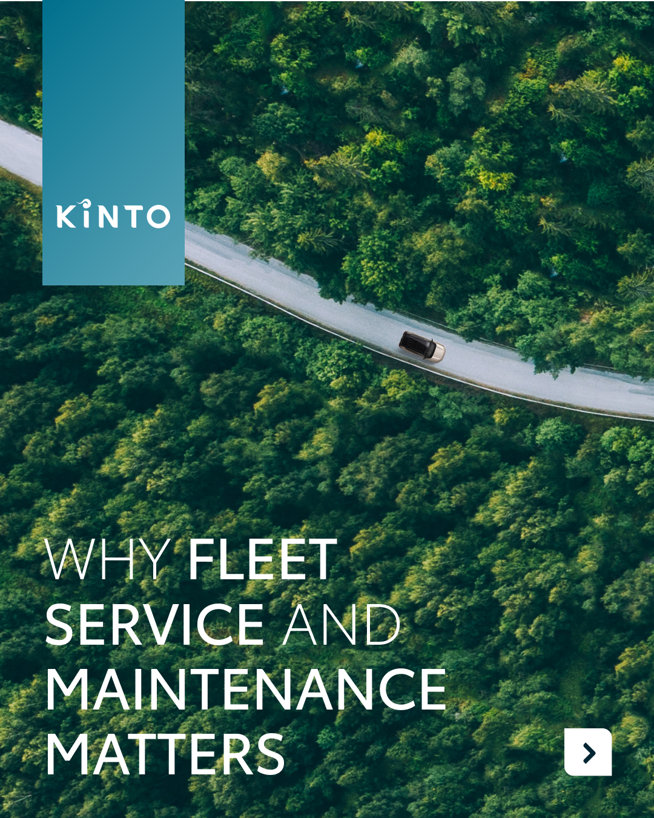
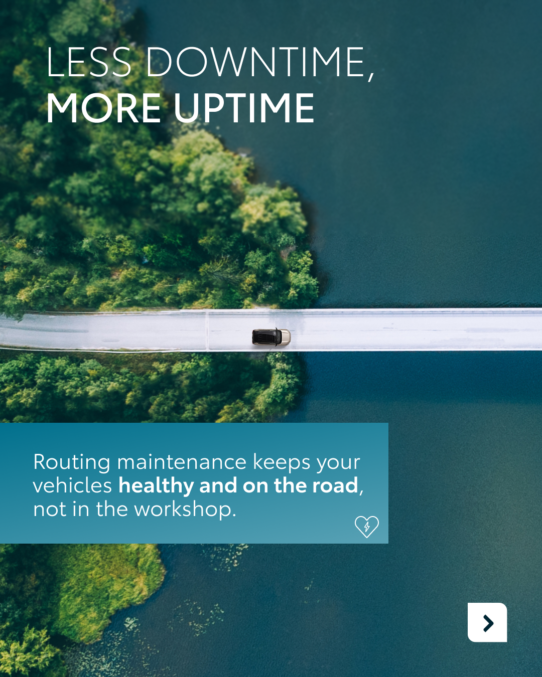

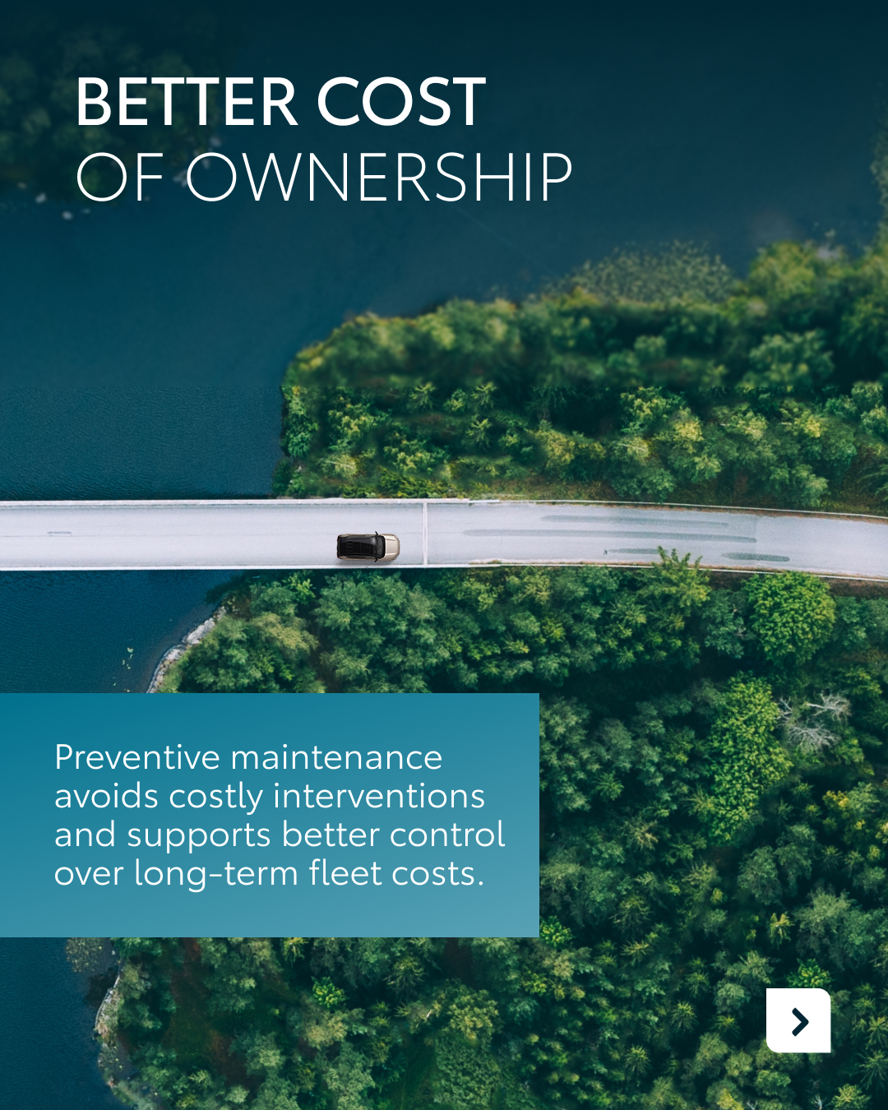

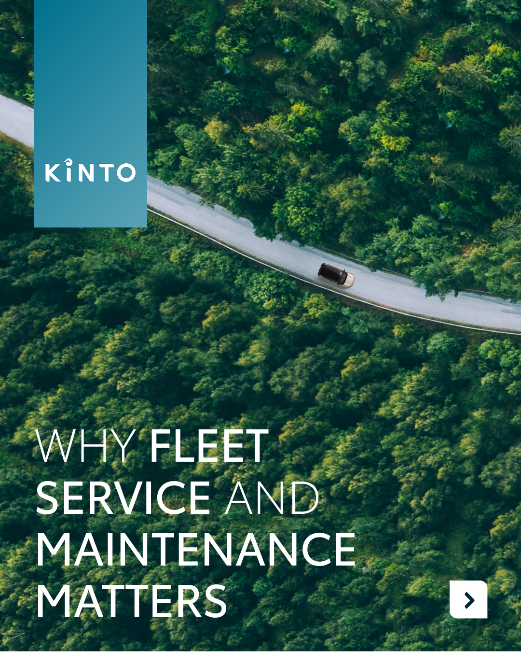
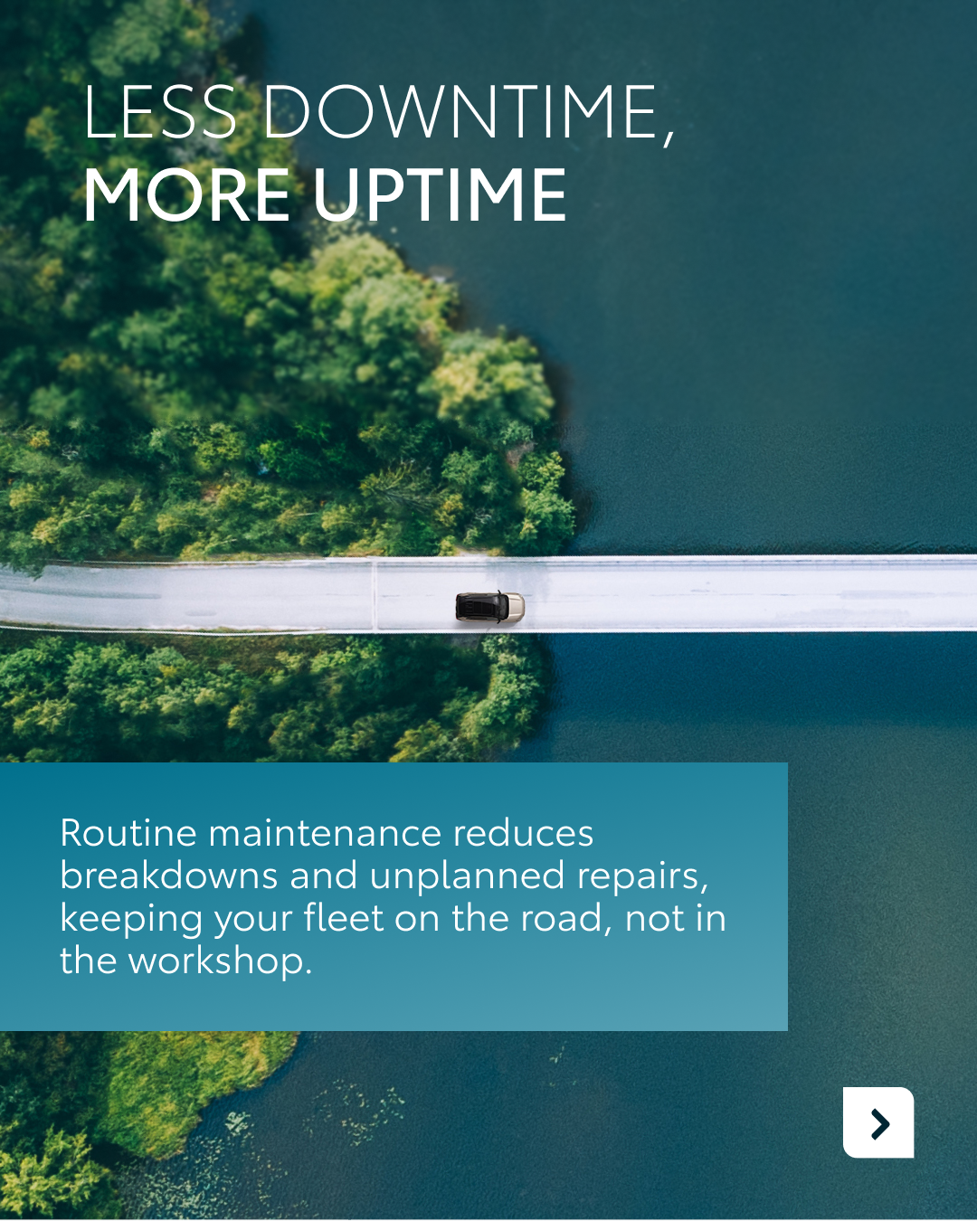

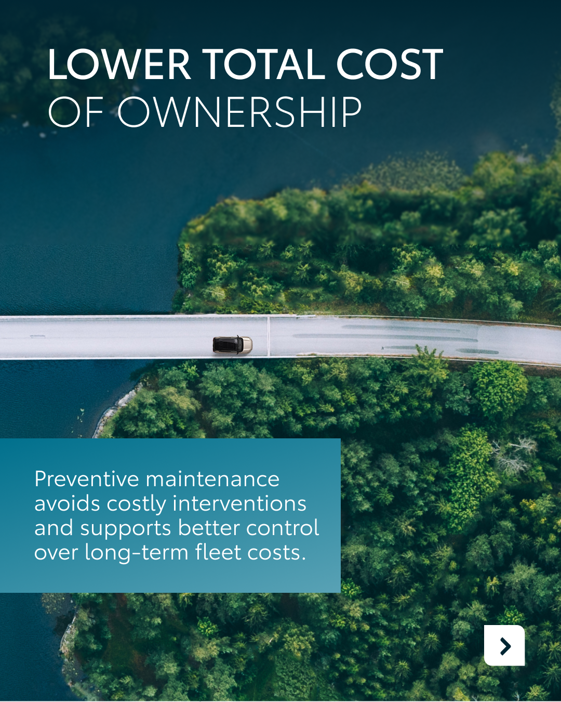
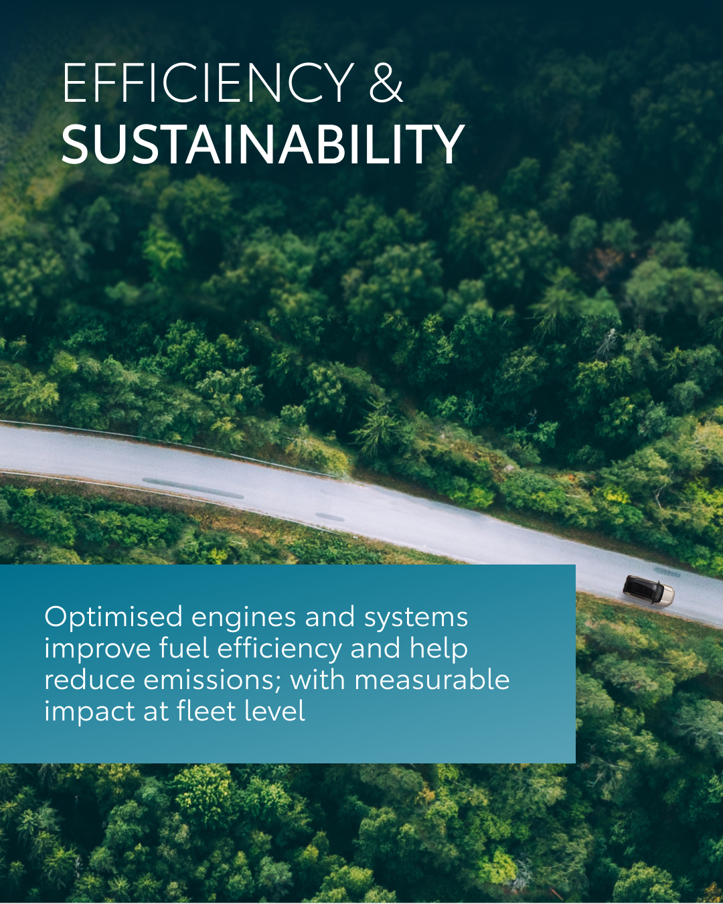
Valid for multibrand
2.CAROUSEL SERVICE & MAINTENANCE
CONTENT BUCKET 1- MARCH
COPY LI
Is your fleet running at peak performance?
Effective fleet management is about more than just getting from A to B; it’s about maximizing uptime and minimizing costs. At KINTO, we provide flexible access to quality vehicles with comprehensive maintenance built into your service.
One partner. Every solution.
#FleetManagement #BusinessMobility #KINTO
FORMATS AVAILABLE:
4/5

Slide 10
Valid for multibrand
2.CAROUSEL SERVICE & MAINTENANCE
CONTENT BUCKET 1- MARCH
COPY IG
Swipe through to see why routine maintenance is the backbone of a smart fleet. From reducing downtime to boosting sustainability, KINTO takes care of the details so you can focus on the drive. 🧭
One partner. Every solution.
#KINTO #MobilitySolutions #FleetCare
FORMATS AVAILABLE:
4/5

Slide 11
Valid for multibrand
2.CAROUSEL SERVICE & MAINTENANCE
CONTENT BUCKET 1- MARCH
COPY FB
Keep your business moving forward. 🚗
Service and maintenance aren't just checkboxes, they are the key to a stress-free fleet. With KINTO, we handle the preventive care so you can avoid costly surprises and keep your drivers confident and safe.
One partner. Every solution.
#KINTO #BusinessSolutions #SmartMaintenance
FORMATS AVAILABLE:
4/5

Slide 12
Multipath/
Multiservice
Pillar 4

Slide 13
Flexible mobility solutions
Pillar 3
Notes:
Baseline: Wherever life takes you, KINTO finds the right solution for you.

Slide 14
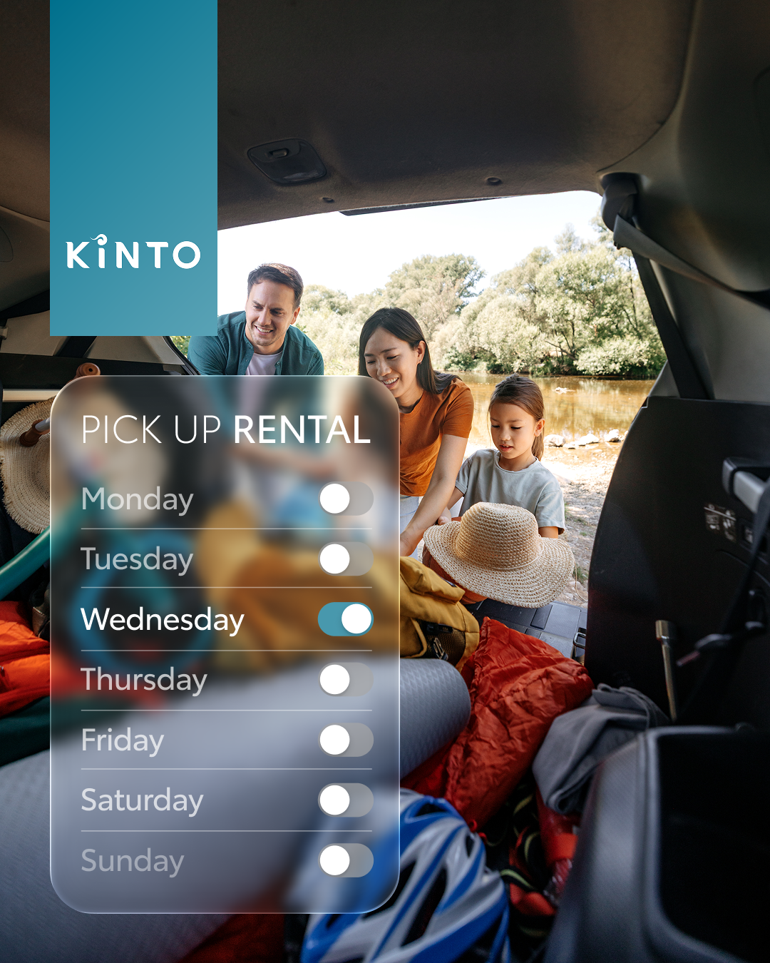
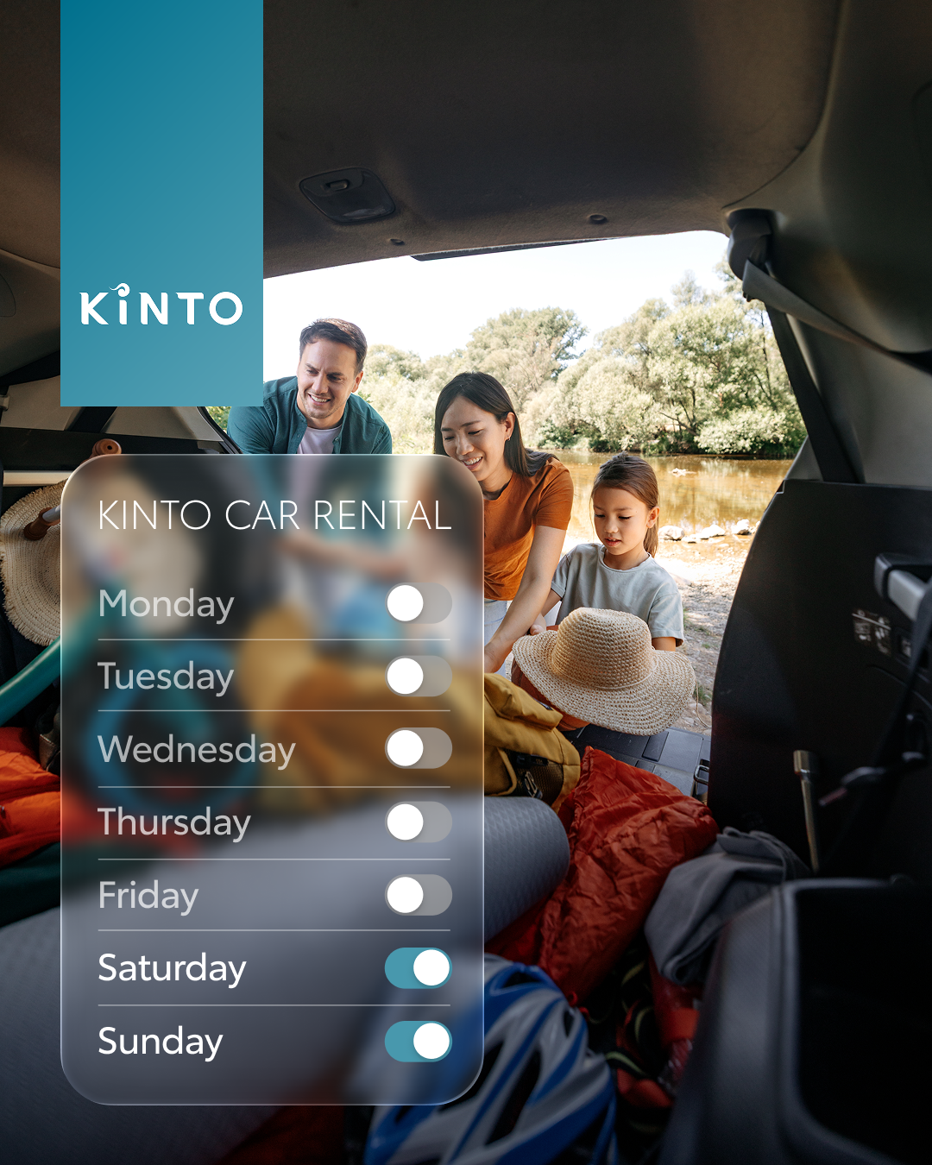
Valid for multibrand
3.VISUAL PICK UP RENT
CONTENT BUCKET 1- APRIL
COPY LI
Flexibility isn’t just a business advantage, it’s a lifestyle upgrade.
Spontaneous weekend getaway?
Extra space for a family trip?
Just need the right car for the moment?
With KINTO, you get access to quality vehicles exactly when you need them. No long-term commitments, just smart mobility that fits your plans.
Pick up. Load up. Head out. 🧳
One partner. Every journey.
#Mobility #CarRental #WeekendReady
FORMATS AVAILABLE:
4/5 1X1

Slide 15
Valid for multibrand
Valid for multibrand
3.VISUAL PICK UP RENT
COPY IG
Weekend mode: ON ☀️
More bags. More plans. More memories.
With KINTO, you get the right car for the right moment: no long-term commitments, just pure flexibility.
Load up and go. 🚗✨
One partner. Every journey.
#WeekendVibes #FlexibleMobility #FamilyTrip
CONTENT BUCKET 1- APRIL
FORMATS AVAILABLE:
4/5 1X1

Slide 16
Valid for multibrand
3.VISUAL PICK UP RENT
COPY FB
Big weekend plans?
Whether it’s a family escape, a city trip or simply needing more space for all the essentials: KINTO gives you the flexibility to choose the right car, right when you need it.
No long-term commitment.
No stress. Just pack your bags and enjoy the ride. 🧳🚗
One partner. Every journey.
#CarRental #FamilyTime #MobilityMadeEasy
CONTENT BUCKET 1- APRIL
FORMATS AVAILABLE:
4/5 1X1

Slide 17
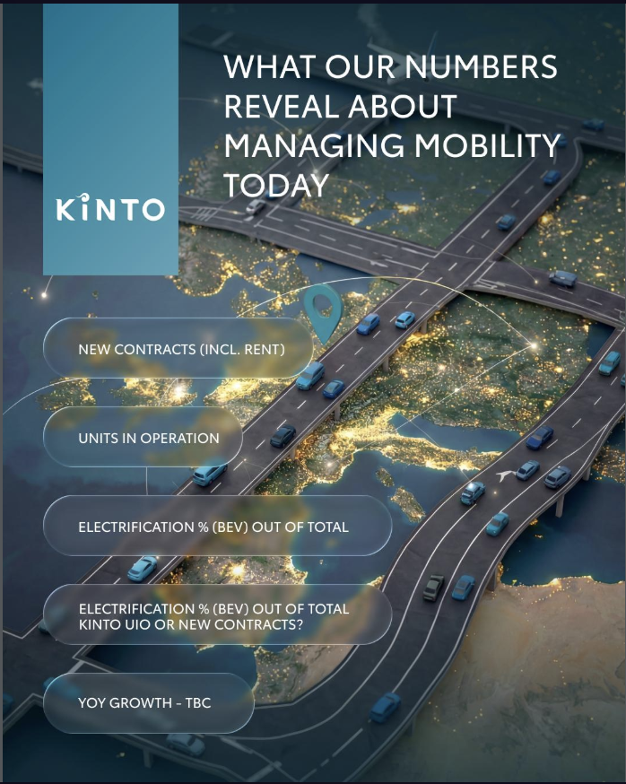
4.INFOGRAPHIC FY RESULTS
INPUT TO BE GIVEN ON WHICH KPI - TEMPORARY COPY (TBD WHEN VISUAL IS DONE)
COPY - LI:
At KINTO, we’re seeing more than just growth; we’re seeing a fundamental change in how businesses approach their fleets.
We are proud to be a smart advisor for companies navigating this transition, providing flexible access to quality vehicles that fit modern business needs.
Is your fleet ready for what's next? Discover our latest mobility insights. 📊
One partner. Every solution.
#FleetManagement #CorporateMobility
CONTENT BUCKET 1- APRIL
FORMATS AVAILABLE:
1/1 - 9/16 - ⅘ - 16/9
Notes:
#KINTO #FleetManagement #CorporateMobility #FlexibleMobility #MobilitySolutions

Slide 18
4.INFOGRAPHIC FY RSULTS
INPUT TO BE GIVEN ON WHICH KPI
COPY - IG:
At KINTO, we’re tracking the numbers that matter for your business: from fleet growth to the shift toward electrification. We make it easy to transition your fleet into the future with flexible, high-quality solutions.
One partner. Every solution.
#BusinessGrowth #Sustainability
CONTENT BUCKET 1- APRIL
FORMATS AVAILABLE:
1/1 - 9/16 - ⅘ - 16/9
Notes:
#KINTO #FleetManagement #CorporateMobility #FlexibleMobility #MobilitySolutions

Slide 19
4.INFOGRAPHIC FY RESULTS
INPUT TO BE GIVEN ON WHICH KPI
COPY - FB:
Ever wondered what the future of business travel looks like?
Our latest data is in, and it’s clear: businesses are moving toward smarter, greener ways to stay mobile.
One partner. Every solution.
#SmartMobility #Electrification
CONTENT BUCKET 1- APRIL
FORMATS AVAILABLE:
1/1 - 9/16 - ⅘ - 16/9
Notes:
#KINTO #FleetManagement #CorporateMobility #FlexibleMobility #MobilitySolutions

Slide 20
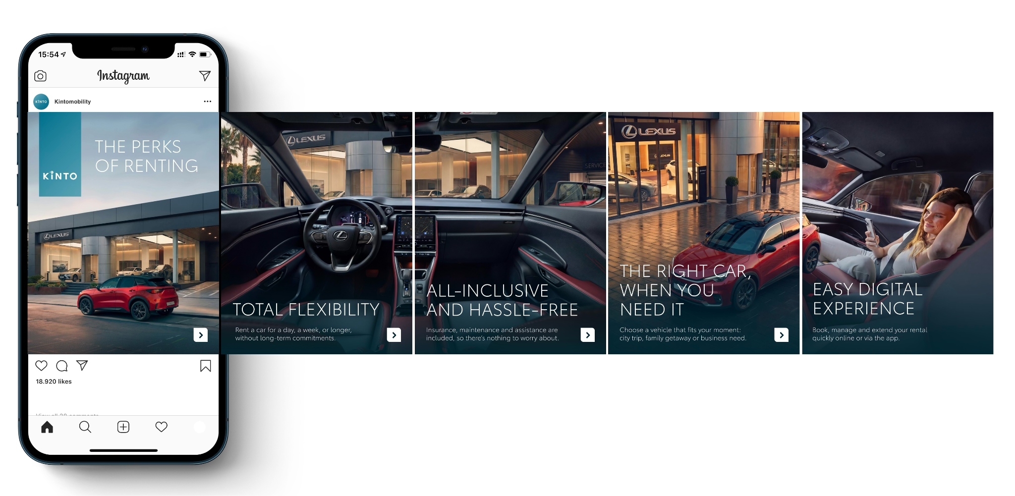
5.CAROUSEL PERKS OF RENTING
CONTENT BUCKET 1- APRIL
COPY LI
Why commit to one car when your business needs are always changing? From client meetings in the city to long-distance business trips, KINTO gives you the keys to the right vehicle, exactly when you need it. Our all-inclusive rental experience means:
Total Flexibility: Rent for a day, a week, or longer.
Zero Stress: Insurance, maintenance, and assistance are all covered.
Digital First: Book and manage everything through the app.
One partner. Every solution.
#BusinessMobility #FleetFlexibility #KINTO
FORMATS AVAILABLE:
4/5

Slide 21
5.CAROUSEL PERKS OF RENTING
CONTENT BUCKET 1- APRIL
COPY IG
The ultimate business flex? Not being tied down. ✨
Rent with KINTO, gets you: ✅ The right car for every moment. ✅ Insurance & maintenance included. ✅ A 100% digital booking experience. 📱
Swipe to see why renting is the new owning. ➡️
One partner. Every solution.
#KINTORent #SmartBusiness #OnTheGo
FORMATS AVAILABLE:
4/5

Slide 22
5.CAROUSEL PERKS OF RENTING
CONTENT BUCKET 1- APRIL
COPY FB
Your business moves fast. Your rental service should too. 🚗
Whether it’s a quick city trip or a team getaway, KINTO is all about making your life easier. Forget the paperwork and book your next ride in seconds.
Ready to experience the perks? 💡
One partner. Every solution.
#KINTOPerks #BusinessProof
FORMATS AVAILABLE:
4/5

Slide 23
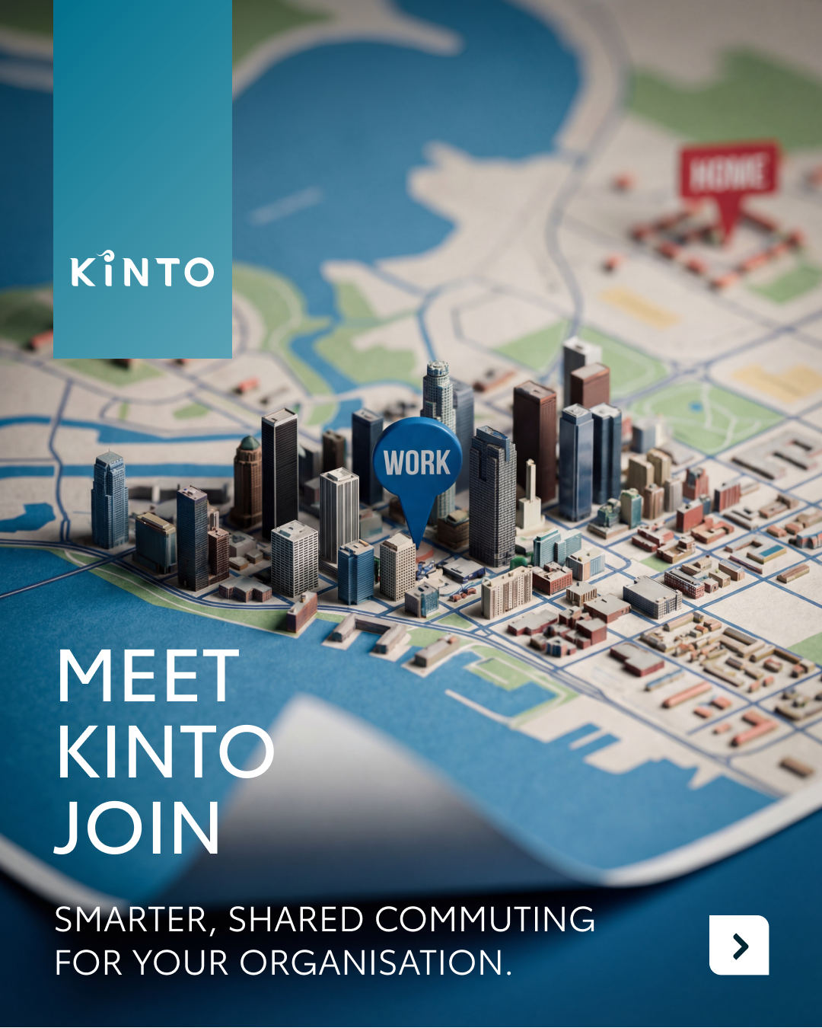



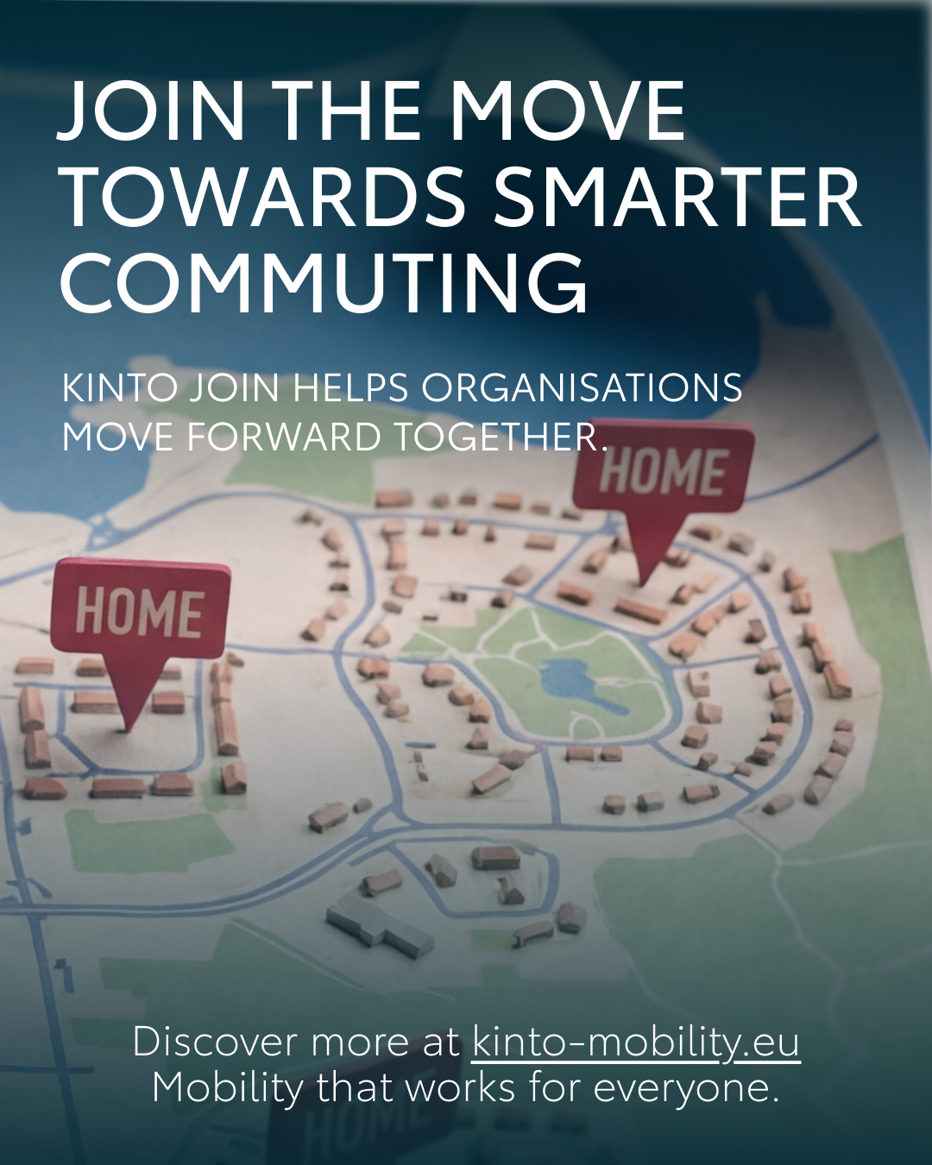
Valid for multibrand
6.CAROUSEL KINTO JOIN
COPY LI
Commuting is changing, and organizations like yours are looking for smarter, more flexible ways to get their people to work. KINTO Join is the digital solution that makes it easy to connect colleagues on the move.
✅ Lower commuting costs for your employees. ✅ Reduced emissions to meet your sustainability goals. ✅ Less parking pressure at your office locations.
One partner, every solution.
#CorporateMobility #SustainableBusiness #KINTOJoin
CONTENT BUCKET 1- APRIL
FORMATS AVAILABLE:
4/5

Slide 24
Valid for multibrand
6.CAROUSEL KINTO JOIN
COPY IG
Commuting is changing. But are you? ✨
KINTO Join helps your organization connect colleagues on the move, making the daily trip to work better for your team and the planet. 🌍 Swipe to see why carpooling is the smart move for your business.
One partner, every solution.
#KINTOJoin #Carpool #SustainableCommute
CONTENT BUCKET 1- APRIL
FORMATS AVAILABLE:
4/5

Slide 25
Valid for multibrand
6.CAROUSEL KINTO JOIN
COPY FB
We know that getting to the office can be a daily hurdle 🚗. That’s why we created KINTO Join: to help organizations move forward together. Swipe through to see how we’re making commuting better for people and smarter for business! ➡️
Ready to join the move? 💡
One partner, every solution.
#Carpooling #KINTOJoin
CONTENT BUCKET 1- APRIL
FORMATS AVAILABLE:
4/5

Slide 26
Community & connection
Empowerment & Expertise
Notes:
Baseline: Join the KINTO community

Slide 27
Valid for multibrand
7. LONGREAD REMARKETING EVENT
COPY LI
During a remarketing event we attended last month, we shared our latest KINTO strategy and took with us some key changes happening in this market:
Remarketing is no longer just about managing end-of-lease vehicles, it’s about redefining the role they play in the mobility ecosystem.
As the used car market continues to flourish, forward-thinking organisations are shifting from asset disposal to value creation. From a single traditional pricing to a multi-cycle vehicle utilisation, remarketing is quickly becoming a critical lever for sustainable growth.
At KINTO, we see it as an opportunity to build smarter, more flexible mobility solutions while unlocking the full potential of every vehicle.
Curious to explore how this shift is shaping the future of fleet mobility?
Read more below 👇
#KINTO #ThoughtLeadership #Remarketing
CONTENT BUCKET 1- APRIL
Notes:
💚👉🫵🤝🚗🚙🚘🔧📈📊📉🆕✨❇️🆙☀️🤝😌💚🔥💪✅☝️👉🫵⏰🚐🚘🫵👉👥💪💼🥳👀

Slide 28
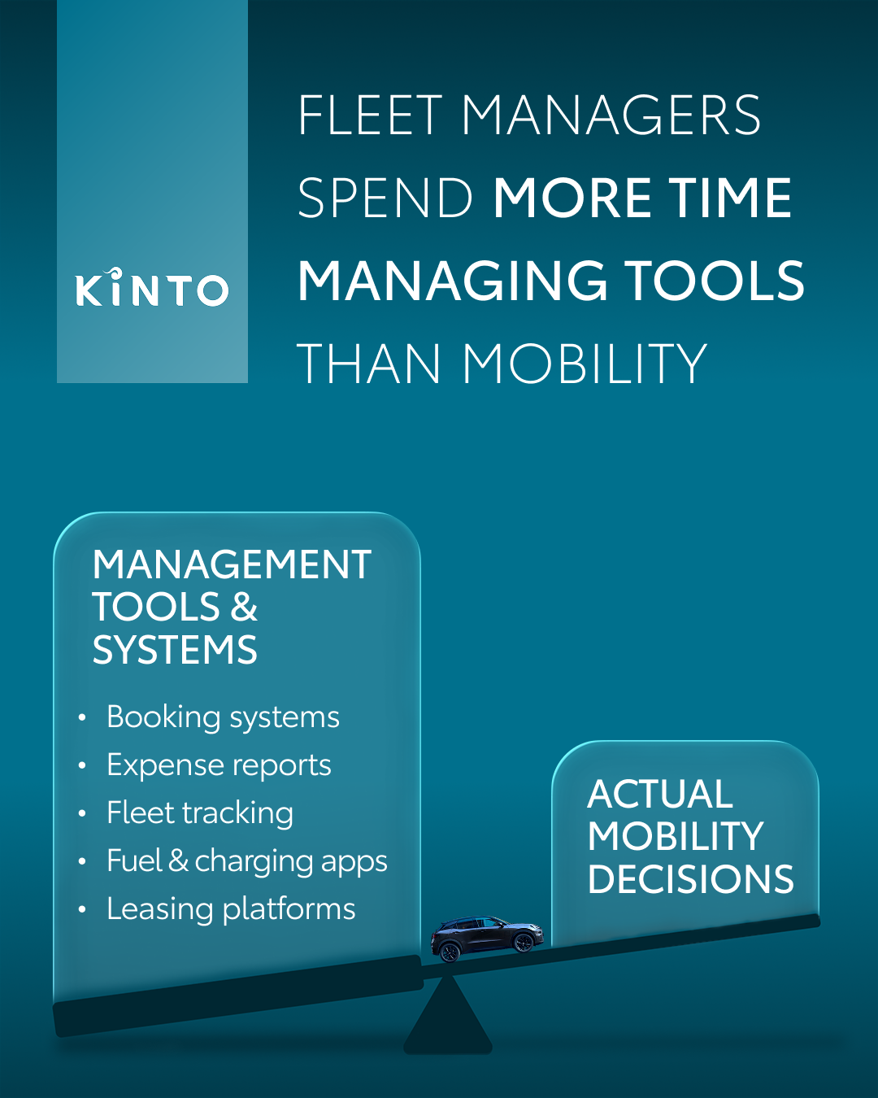
Valid for multibrand
8.VISUAL FLEET MANAGER SCALE
COPY LI
Is your fleet management spending more time on spreadsheets than on strategy?
Managing mobility shouldn't feel like a full-time job in data entry. From juggling booking systems and expense reports to tracking fuel and charging apps, the "tools" of the trade often get in the way of actual mobility decisions.
At KINTO, we act as your smart advisor to rebalance the scales. We provide flexible access to high-quality Toyota vehicles through a streamlined, digital-first approach that cuts through the admin noise.
Let's make your mobility management as seamless as the drive itself. 💼
Join the KINTO community.
#FleetManagement #BusinessEfficiency
CONTENT BUCKET 1- APRIL
FORMATS AVAILABLE:
4/5
Notes:
💚👉🫵🤝🚗🚙🚘🔧📈📊📉🆕✨❇️🆙☀️🤝😌💚🔥💪✅☝️👉🫵⏰🚐🚘🫵👉👥💪💼🥳👀

Slide 29
Valid for multibrand
8.VISUAL FLEET MANAGER SCALE
COPY IG
Stop managing tools. Start managing mobility. 📈
Is your team losing hours to admin headaches and fragmented systems? KINTO simplifies the complex so you can focus on the big picture.
Get flexible access to quality vehicles with a partner that handles the heavy lifting for you. 🔧
Join the KINTO community.
#SmartMobility #FleetManagerLife #KINTO
CONTENT BUCKET 1- APRIL
FORMATS AVAILABLE:
4/5

Slide 30
Valid for multibrand
8.VISUAL FLEET MANAGER SCALE
COPY FB
Fleet managers, we hear you: there’s a lot more to the job than just moving people. 🚗
It’s easy to get buried under a mountain of expense reports, tracking apps, and leasing platforms. But managing your team’s mobility shouldn’t mean managing endless tools.
KINTO is here to help you get your time back. We offer simple, human-centred solutions that bundle your mobility needs into one easy-to-use partner. Less time on tools, more time for what matters.
Ready for a smarter way to manage your fleet? 💡
Join the KINTO community.
#TimeManagement #KINTOSolutions
.
CONTENT BUCKET 1- APRIL
FORMATS AVAILABLE:
4/5

Slide 31

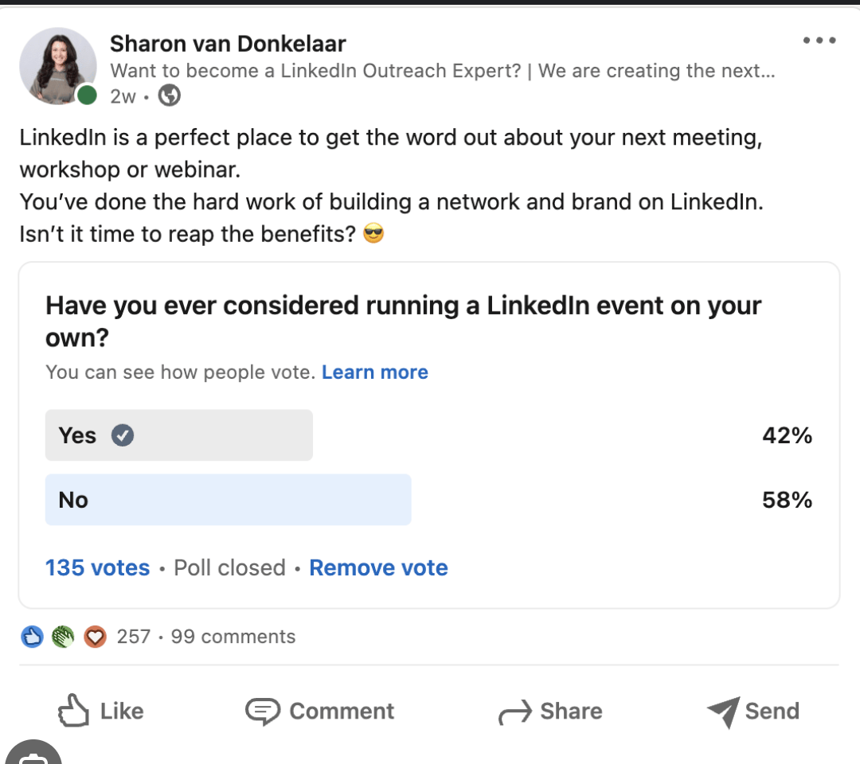
9.POLL MOBILITY SOLUTION
COPY - LI
What is the must-have for your fleet in 2026?
As business needs evolve, the perfect mobility solution looks different for every company. But what is the non-negotiable for your business right now? 🗳️
What matters most in a mobility solution?
Flexibility
Cost predictability
Ease & convenience
Sustainability
Join the KINTO community.
#FleetManagement #BusinessStrategy
CONTENT BUCKET 1- APRIL

Slide 32

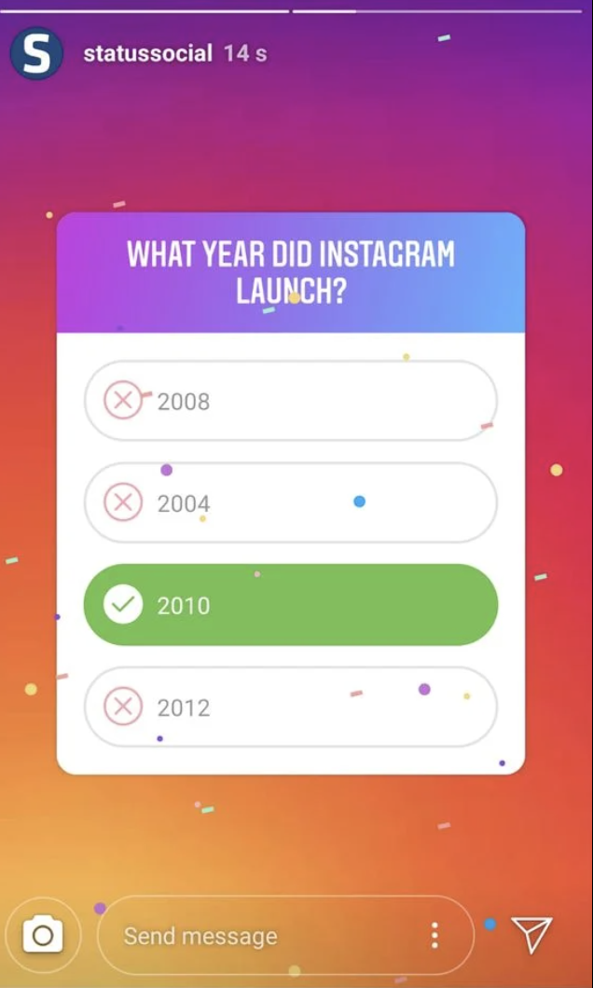
9.POLL MOBILITY SOLUTION
COPY - IG STORY
What matters most in a mobility solution?
Flexibility
Cost predictability
Ease & convenience
Sustainability
CONTENT BUCKET 1- APRIL

Slide 33
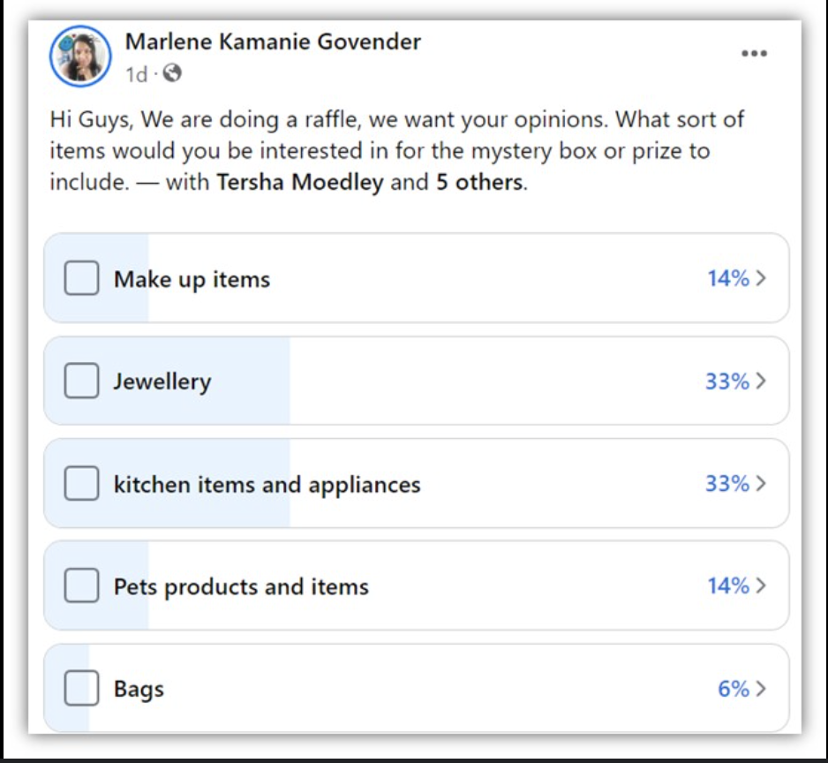
9.POLL MOBILITY SOLUTION
COPY - FB
Time for a quick check-in: What makes your workday easier? 🚗
When it comes to getting your team from A to B, everyone has a different priority. We’re curious to hear from our community: What matters most in a mobility solution?
Flexibility
Cost predictability
Ease & convenience
Sustainability
Join the KINTO community.
#FleetManagement #PollOfTheDay
CONTENT BUCKET 1- APRIL

Slide 34
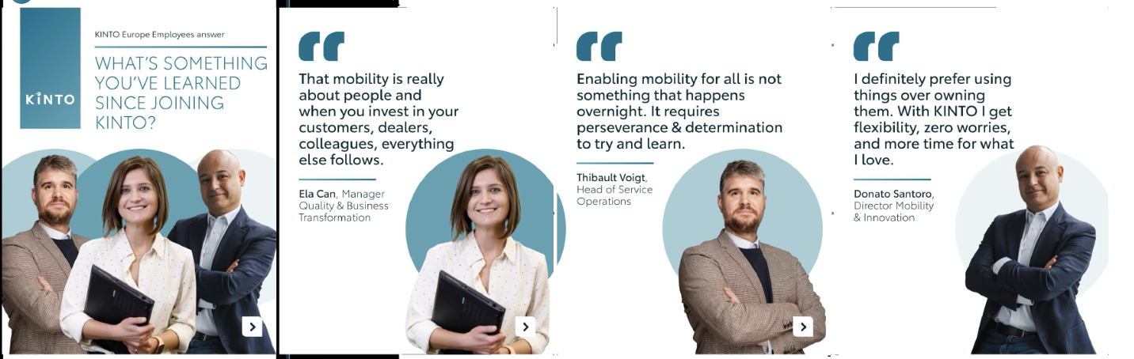
Valid for multibrand
10.CAROUSEL Q&A EMPLOYEES APRIL
CONTENT BUCKET 1- APRIL
COPY LI
What does it really mean to work in the future of mobility? We asked our team what they’ve learned since joining the KINTO community, and their insights speak to the heart of why we do what we do.
From prioritizing people and partnerships to championing the shift from "owning" to "using," our colleagues are the driving force behind our mission.
Discover the faces behind your mobility solutions. 💼
Join the KINTO community.
#LifeAtKINTO #CompanyCulture
FORMATS AVAILABLE:
4/5

Slide 35
Valid for multibrand
10.CAROUSEL Q&A EMPLOYEES APRIL
CONTENT BUCKET 1- APRIL
COPY IG
Swipe to meet Ela, Thibault, and Donato and hear their insights! ➡️
Our team members share their biggest takeaways since joining the KINTO community: from the importance of human connection to the freedom of flexible usage.
Join the KINTO community.
#KINTOTeam #MobilitySolutions #KINTO
FORMATS AVAILABLE:
4/5

Slide 36
Valid for multibrand
10.CAROUSEL Q&A EMPLOYEES APRIL
CONTENT BUCKET 1- APRIL
COPY FB
Meet the people behind the KINTO mission 🏢
Whether it's finding better ways to serve our partners or helping businesses embrace a more flexible, usage-over-ownership mindset, our team is committed to making your business life easier and less stressful.
Swipe through to see what they have to share about the world of KINTO! ➡️
Join the KINTO community.
#MobilityEvolution #KINTO
FORMATS AVAILABLE:
4/5

