Slide 1



CONTENT
bucket 9 - March

Slide 2
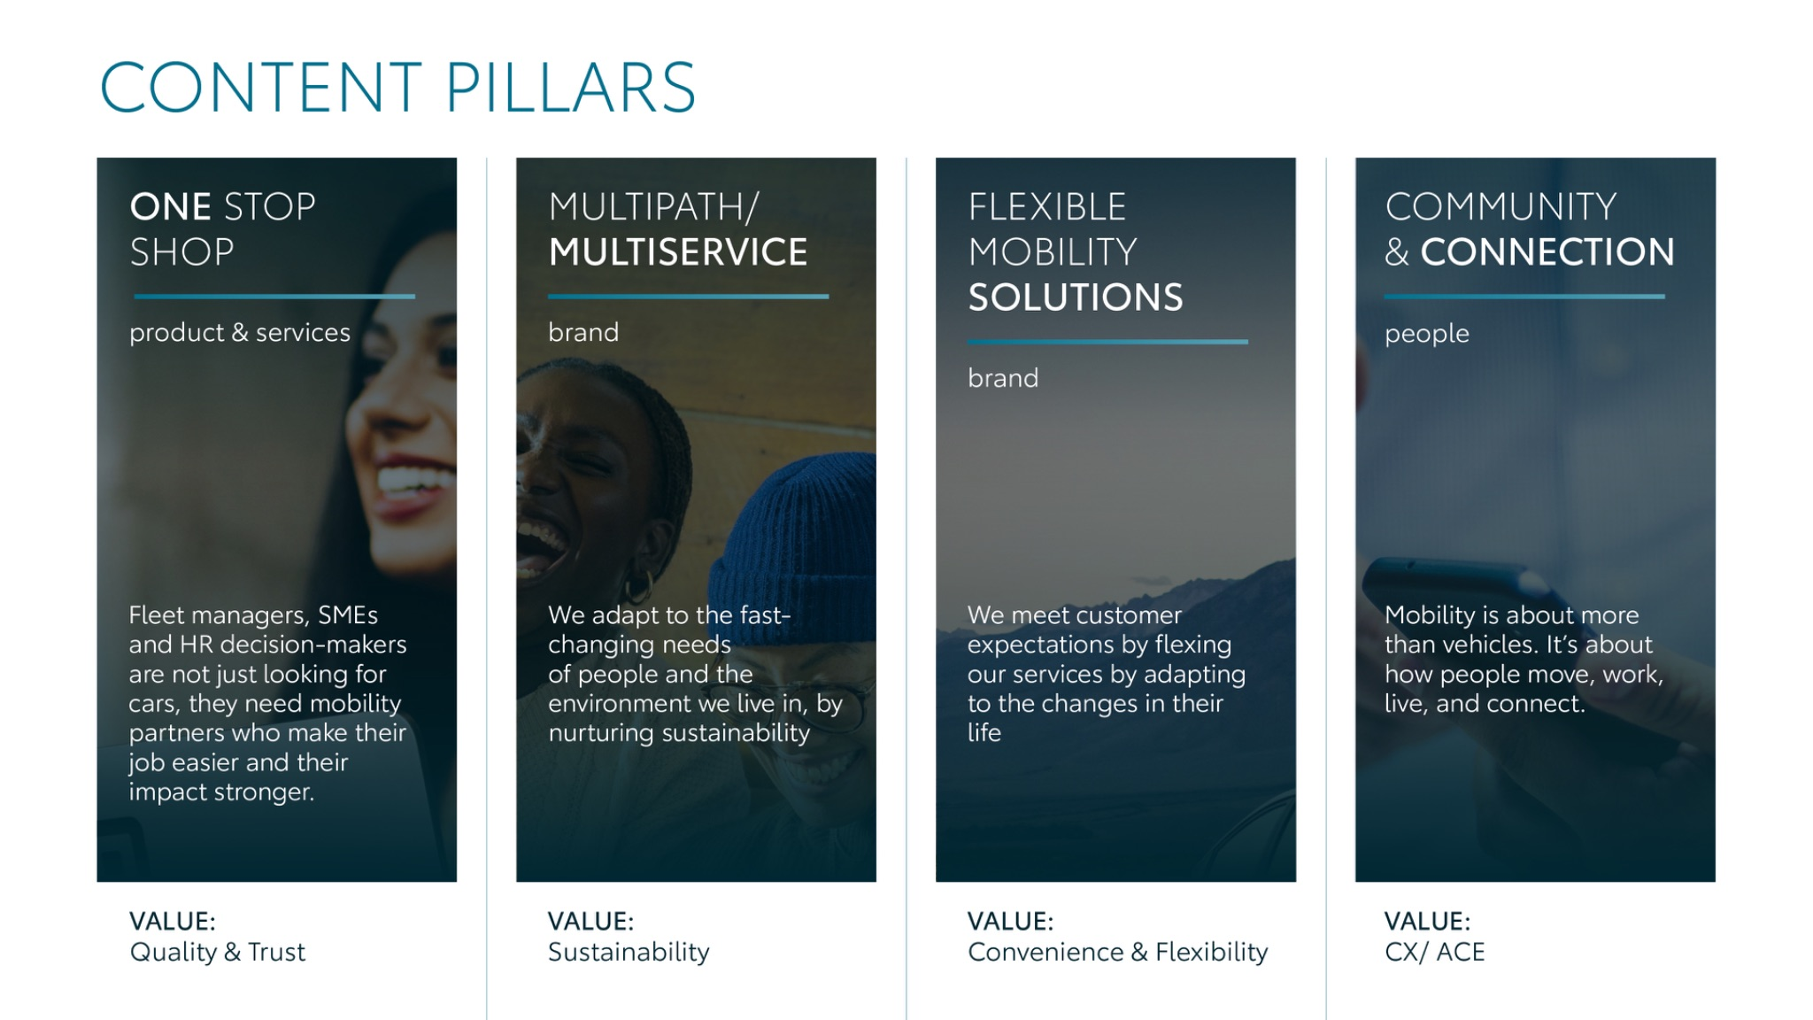
Notes:
“At KINTO, we work with content pillars: themes that carry our brand. We use different content types: inspiring, informative, topical. Your contributions add the human layer that makes the strategy work.”

Slide 3




Content pillars - content overview
March
Spring cleaning
Change your tires
Fleet portal - less chaos
RAV4 Multipath
Longread Open Labs startup
GIF B2B Rent
Why rental belongs
Womens day
World engineering day
Where are you headed?
KINTO’s first client - client version
Remarketing event Longread
ONE STOP SHOP
MULTIPATH/ MULTISERVICE
FLEXIBLE MOBILITY SOLUTIONS
COMMUNITY/ CONNECTION

Slide 4
Tag lines pillars
1. One Stop Shop
One partner. Every solution.
2. Flexible Mobility Solutions
One partner. Every solution.
3. Community and connection (important to keep it broad enough to fit clients as well as people working at Kinto)
Join the KINTO community.
4. Vision & Impact (Multipath/multiservice)
One partner. Every solution.

Slide 5

One stop shop
Notes:
One place. Every solution. Always KINTO.

Slide 6





Valid for multibrand
1. VIDEO
SPRING CLEANING
COPY - LI:
Managing a fleet shouldn’t feel like a paper storm. KINTO takes the weight off your shoulders by providing flexible access to quality vehicles with everything integrated into one seamless service:
✅ Insurance & maintenance
✅ Simplified invoicing & tax management
Clear the chaos and focus on what matters. 🧭
#FleetManagement #CorporateMobility #KINTO
CONTENT BUCKET 1- MARCH
FORMATS AVAILABLE:
1/1 - 9/16 - ⅘ -16/9

Slide 7

Valid for multibrand
1. VIDEO
SPRING CLEANING
COPY - IG:
Clear the chaos. 🌪️✨
From paperwork storms to peace of mind. We handle the insurance, maintenance, and taxes so you don't have to. 💼
#KINTO #SmarterMobility #BusinessSolutions
CONTENT BUCKET 1- MARCH
FORMATS AVAILABLE:
1/1 - 9/16 - ⅘ - 16/9

Slide 8

Valid for multibrand
1. VIDEO
SPRING CLEANING
COPY - FB:
Ready to clear the paper storm? 🌪️
Trust KINTO with your spring cleaning. We bundle insurance, maintenance, and taxes into one simple solution so you can get back to business.
Insurance & maintenance? Included. ✅
Taxes & support? Handled. ✅
Peace of mind? Restored. 💡
#KINTO #SmarterMobility #BusinessSolutions
CONTENT BUCKET 1- MARCH
FORMATS AVAILABLE:
1/1 - 9/16 - ⅘ - 16/9

Slide 9








available on Celtra
Valid for multibrand
2.CAROUSEL LESS CHAOS
CONTENT BUCKET 1- MARCH
COPY LI
Is your desk buried under fleet administration? 💼
Swipe to see how we clear the chaos, from insurance and maintenance to taxes and support. Stop managing paperwork and start managing your business. 🧭
One partner. Every solution.
#FleetManagement #BusinessMobility #KINTO
FORMATS AVAILABLE:
4/5

Slide 10
available on Celtra
Valid for multibrand
2.CAROUSEL LESS CHAOS
CONTENT BUCKET 1- MARCH
COPY IG
From buried to boss mode ➡️ Swipe to see the KINTO effect.
Simple and flexible mobility. 🚗
Kinto. One partner. Every solution.
#KINTO #BusinessLife #MobilitySolutions
FORMATS AVAILABLE:
4/5

Slide 11
available on Celtra
Valid for multibrand
2.CAROUSEL LESS CHAOS
CONTENT BUCKET 1- MARCH
COPY FB
Fleet admin piling up? Swipe to make it disappear! ✨
Managing company cars shouldn't feel like a workout for your paper shredder. At KINTO, we’re all about making mobility seamless and stress-free.
✅ No more spreadsheets. ✅ No more admin surprises.
One partner. Every solution.
#KINTO #BusinessLife #MobilitySolutions
FORMATS AVAILABLE:
4/5

Slide 12


available on Celtra
3.VISUAL CHANGE YOUR TIRES
COPY LI
Smooth rides start with the right tires, but the logistics shouldn't be your burden. KINTO provides flexible access to quality Toyota and Lexus vehicles with tire changes and maintenance already included.
✅ Zero admin hassle ✅ 100% Peace of mind
One partner. Every solution.
#FleetManagement #BusinessMobility #KINTO
CONTENT BUCKET 1- MARCH
FORMATS AVAILABLE:
4/5 - 1X1

Slide 13
available on Celtra
3.VISUAL CHANGE YOUR TIRES
CONTENT BUCKET 1- MARCH
COPY IG
Smooth rides, zero stress. 🛣️✨
Don't let maintenance paperwork slow you down. With KINTO, tire changes are already included.
One partner. Every solution.
#KINTO #MobilitySolutions #SmartBusiness
FORMATS AVAILABLE:
4/5 1X1

Slide 14
available on Celtra
3.VISUAL CHANGE YOUR TIRES
COPY FB
A little reminder from the road: smooth tires should not prevent you from a smooth ride. 🚗
With KINTO, you can relax. Tire changes are included in your service, so you can stop worrying about the scheduling and start focusing on your business.
One partner. Every solution.
#KINTO #SmarterMobility #BusinessSolutions
.
CONTENT BUCKET 1- MARCH
FORMATS AVAILABLE:
4/5 1X1

Slide 15
Multipath/
Multiservice
Pillar 4

Slide 16


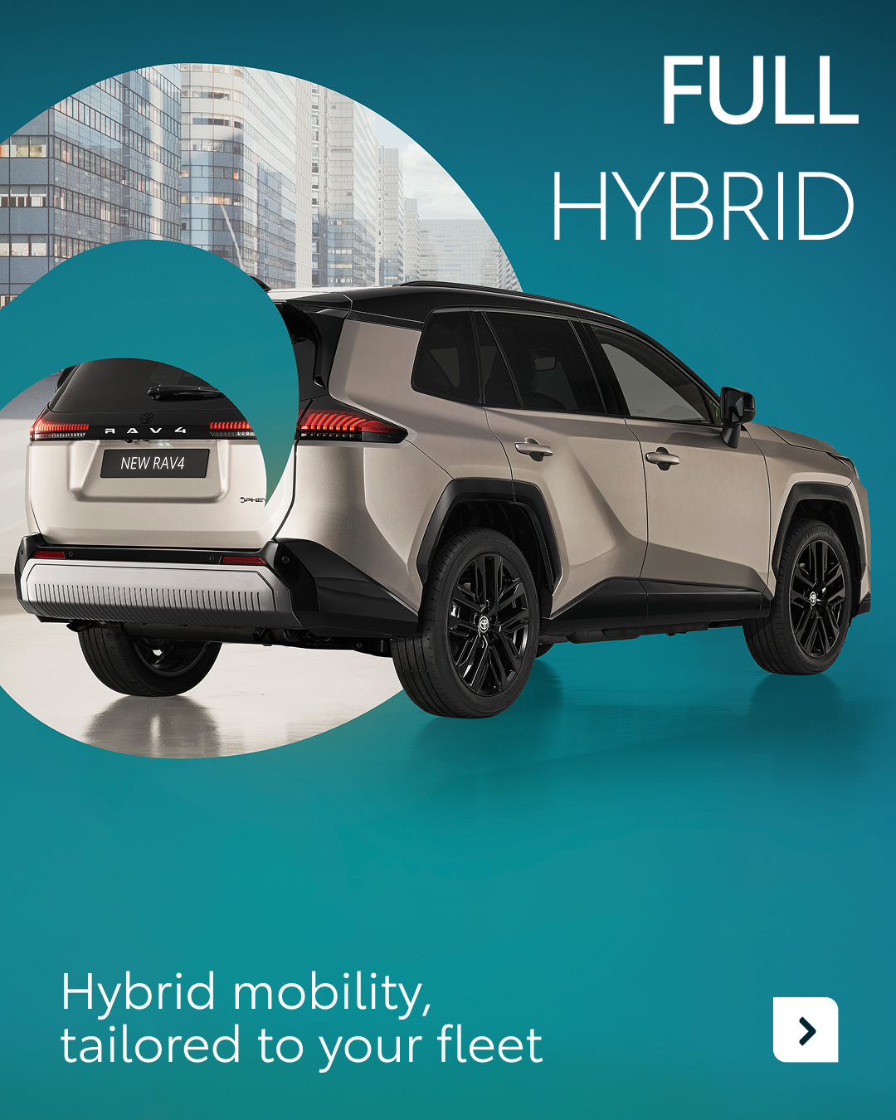


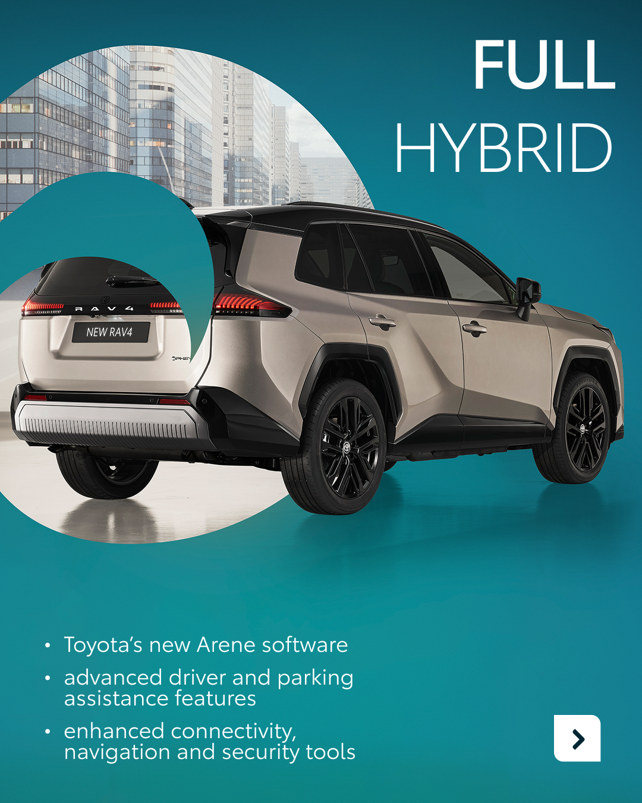
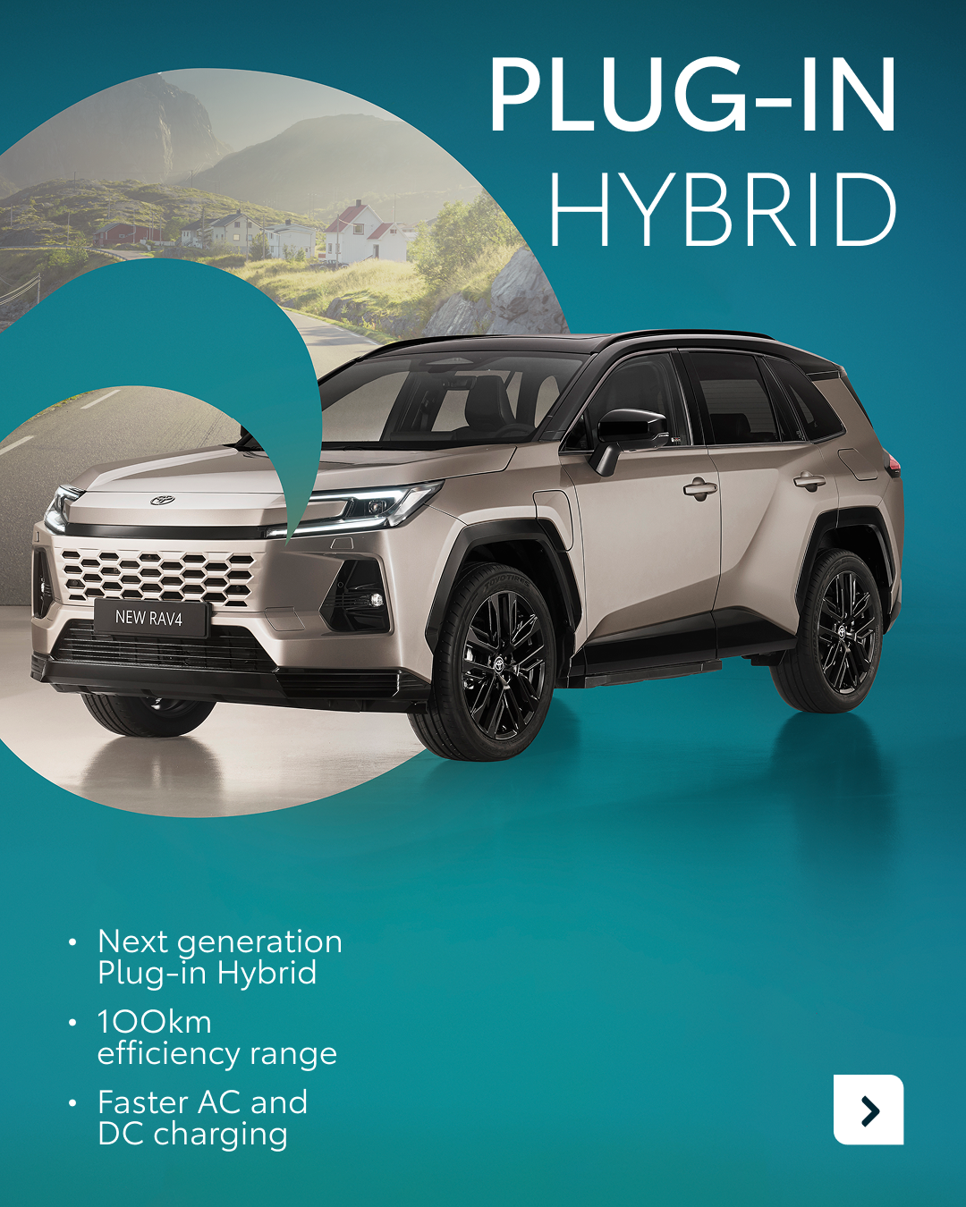

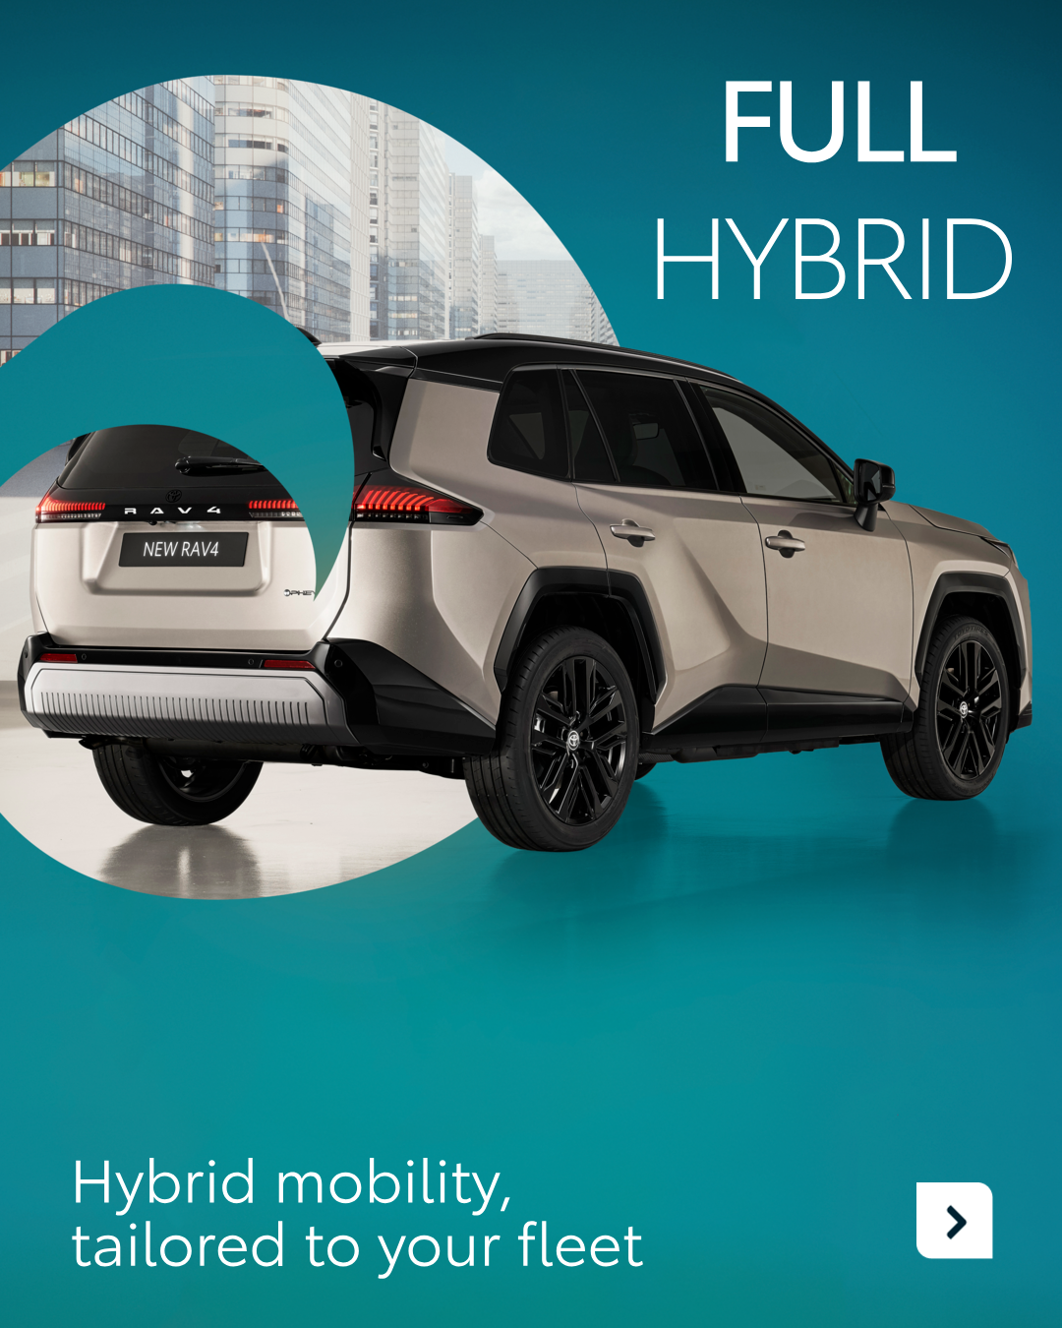



available on Celtra
4.CAROUSEL RAV4 MULTIPATH
CONTENT BUCKET 1- MARCH
COPY LI
Choosing the right fleet vehicle shouldn't mean compromising on your sustainability goals. The new RAV4 provides two distinct electrified options to match your workforce's needs.
Full Hybrid: The entry point to your electrification journey, perfect for seamless, daily efficiency.
Plug-in Hybrid: Next-generation efficiency with a deeper commitment to a sustainable future.
At KINTO, we make the transition easy. Whether you choose Full hybrid or Plug-in.
One partner. Every solution.
#FleetManagement #SustainableMobility #KINTO
FORMATS AVAILABLE:
4/5

Slide 17
available on Celtra
4.CAROUSEL RAV4 MULTIPATH
CONTENT BUCKET 1- MARCH
COPY IG
Sustainable mobility, your way. ✨
Whether you choose Full hybrid or Plug-in, you stay in control of how (and how fast) you electrify your mobility.
One partner. Every solution.
#KINTO #BusinessGrowth #ElectrifiedJourney
FORMATS AVAILABLE:
4/5

Slide 18
available on Celtra
4.CAROUSEL RAV4 MULTIPATH
CONTENT BUCKET 1- MARCH
COPY FB
Which powertrain fits your business rhythm? 🚗
We know that every business has different needs when it comes to going green. That’s why we offer the new RAV4 with two powerful options depending on your journey.
✅ Full Hybrid: Effortless efficiency for those starting their electrified feel. ✅ Plug-in Hybrid: Enhanced range and faster charging for maximum impact.
One partner. Every solution.
#KINTO #RAV4 #ElectrifiedJourney
FORMATS AVAILABLE:
4/5

Slide 19
5.LONGREAD OPEN LABS STARTUP
CONTENT BUCKET 1- MARCH

Slide 20
Flexible mobility solutions
Pillar 3
Notes:
Baseline: Wherever life takes you, KINTO finds the right solution for you.

Slide 21
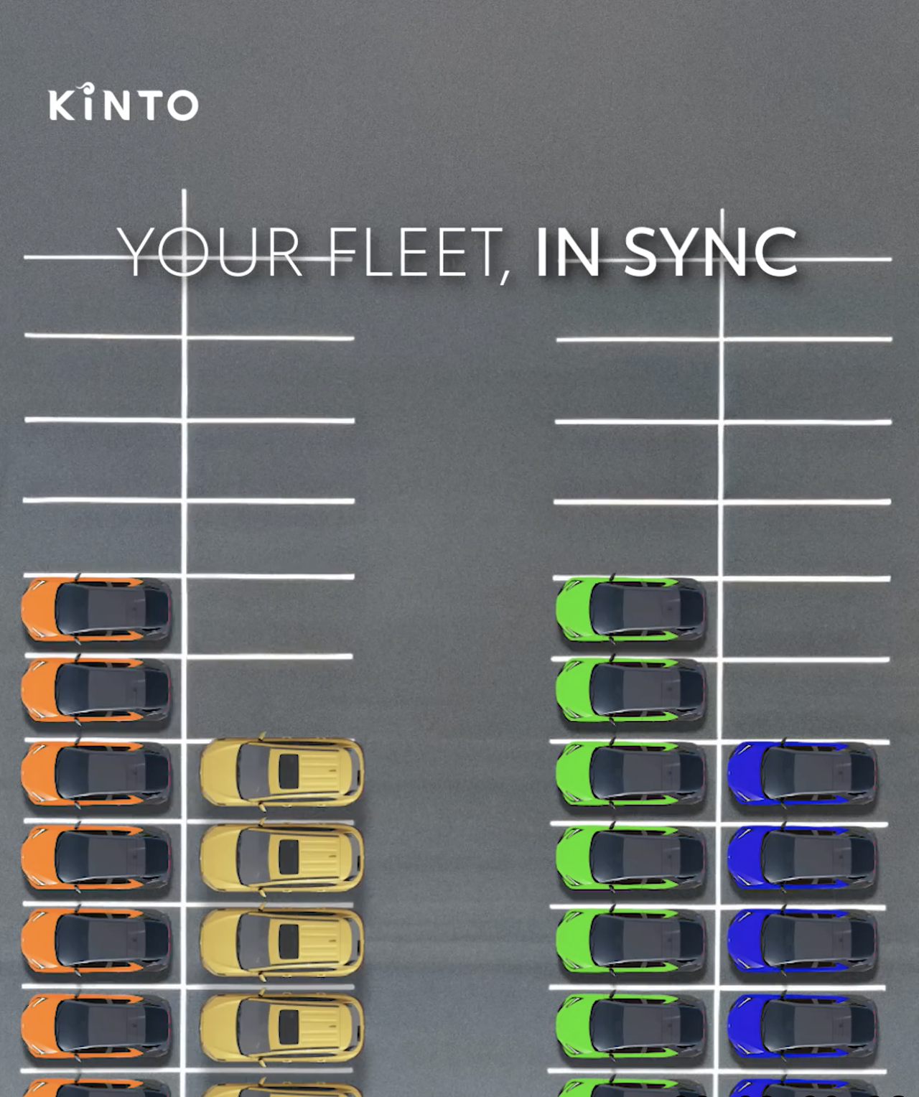
Valid for multibrand
6.GIF B2B RENT
COPY - LI:
Is your fleet playing the same tune as your business?
Fluctuating demands shouldn't mean being stuck with fixed costs. KINTO offers the agility to scale your fleet up or down as easily as adjusting the volume.
#BusinessMobility #FleetManagement #KINTO
CONTENT BUCKET 1- MARCH
FORMATS AVAILABLE:
1/1 - 9/16 - ⅘ - 16/9
Notes:
#KINTO #FleetManagement #CorporateMobility #FlexibleMobility #MobilitySolutions

Slide 22
Valid for multibrand
6. GIF B2B RENT
COPY - IG:
Mobility in perfect rhythm. 🎵✨
Scale up or down, exactly when you demand change. With KINTO, your fleet expands and contracts to match your business needs: no long-term strings attached.
#KINTO #BusinessAgility #OnDemand
CONTENT BUCKET 1- MARCH
FORMATS AVAILABLE:
1/1 - 9/16 - ⅘ - 16/9
Notes:
#KINTO #FleetManagement #CorporateMobility #FlexibleMobility #MobilitySolutions

Slide 23
Valid for multibrand
6. GIF B2B RENT
COPY - FB:
Music to your ears: a fleet that flexes when you do. 🎶
Stop worrying about rigid contracts. Whether you're hiring for a seasonal peak or wrapping up a major project, KINTO lets you scale your vehicle count up or down exactly when demand changes.
Your fleet, in sync with your business.
#KINTO #SmarterMobility #FlexibleBusiness
CONTENT BUCKET 1- MARCH
FORMATS AVAILABLE:
1/1 - 9/16 - ⅘ - 16/9
Notes:
#KINTO #FleetManagement #CorporateMobility #FlexibleMobility #MobilitySolutions

Slide 24
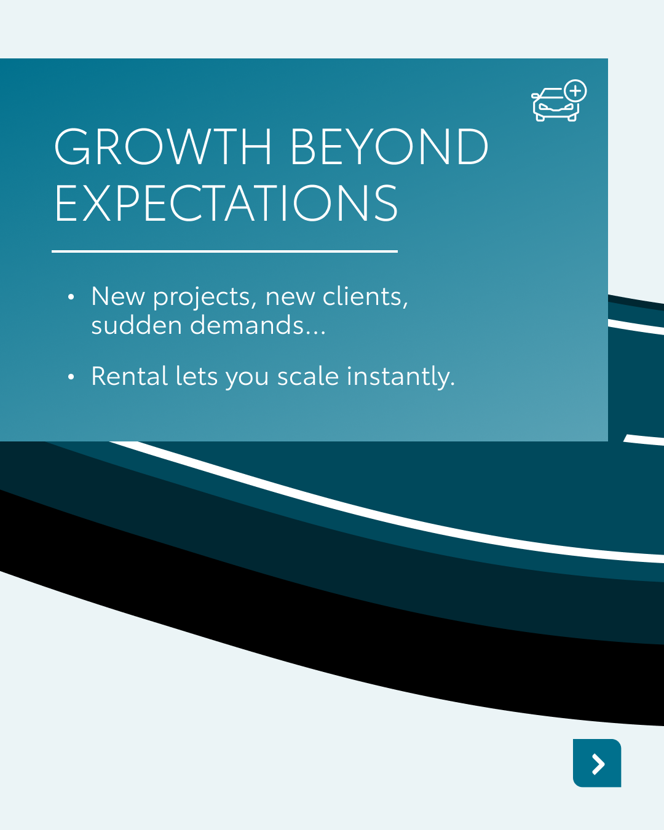


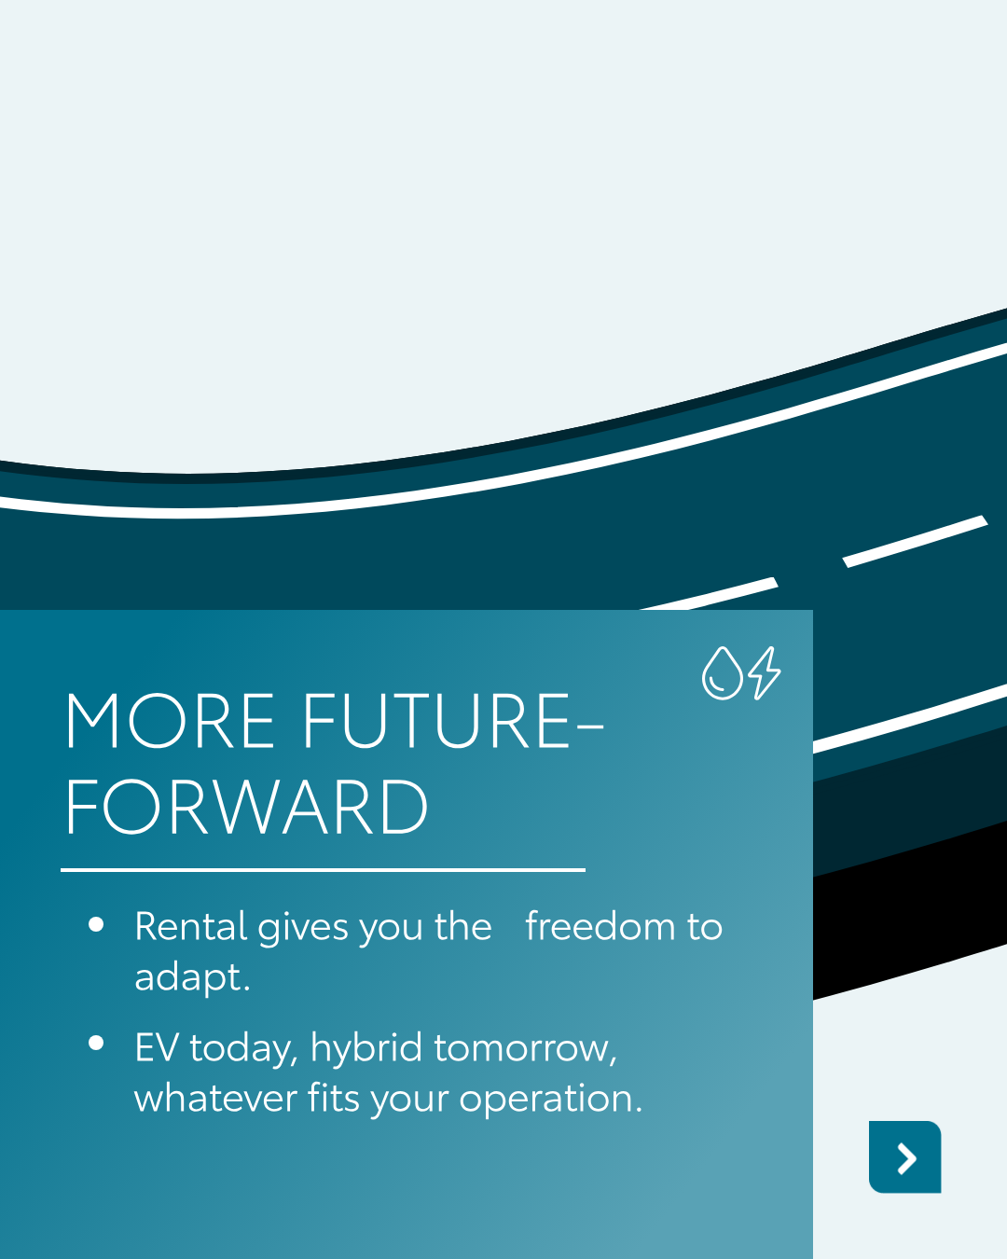


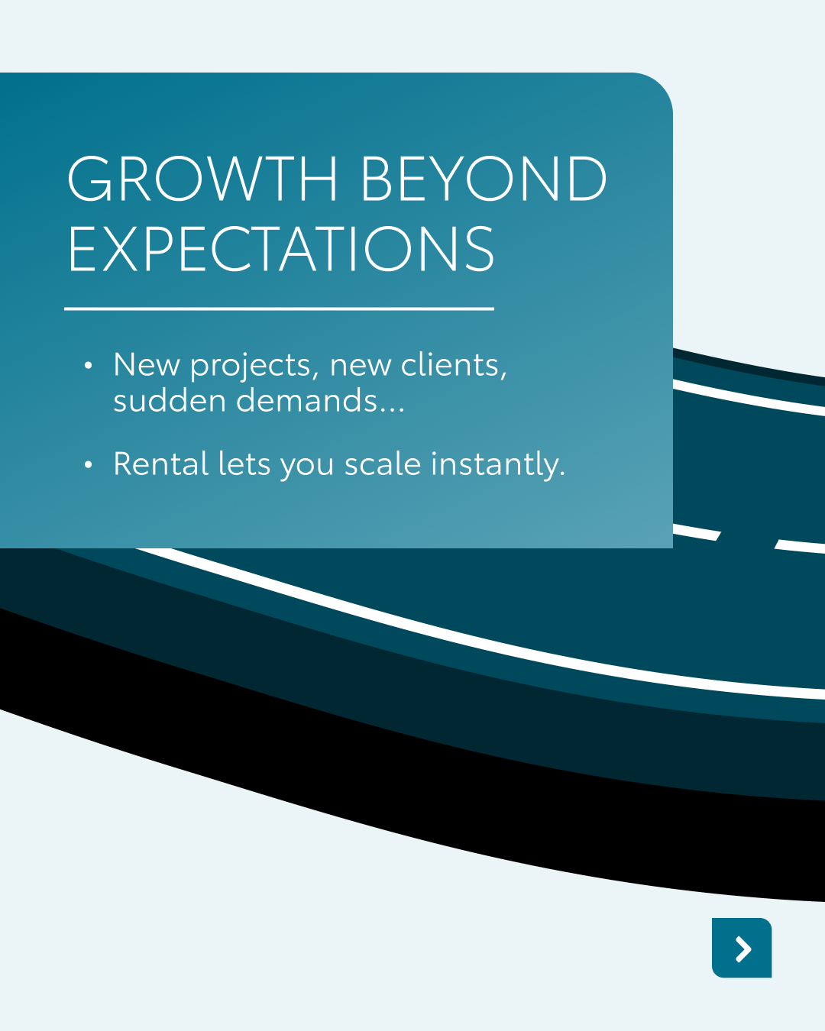
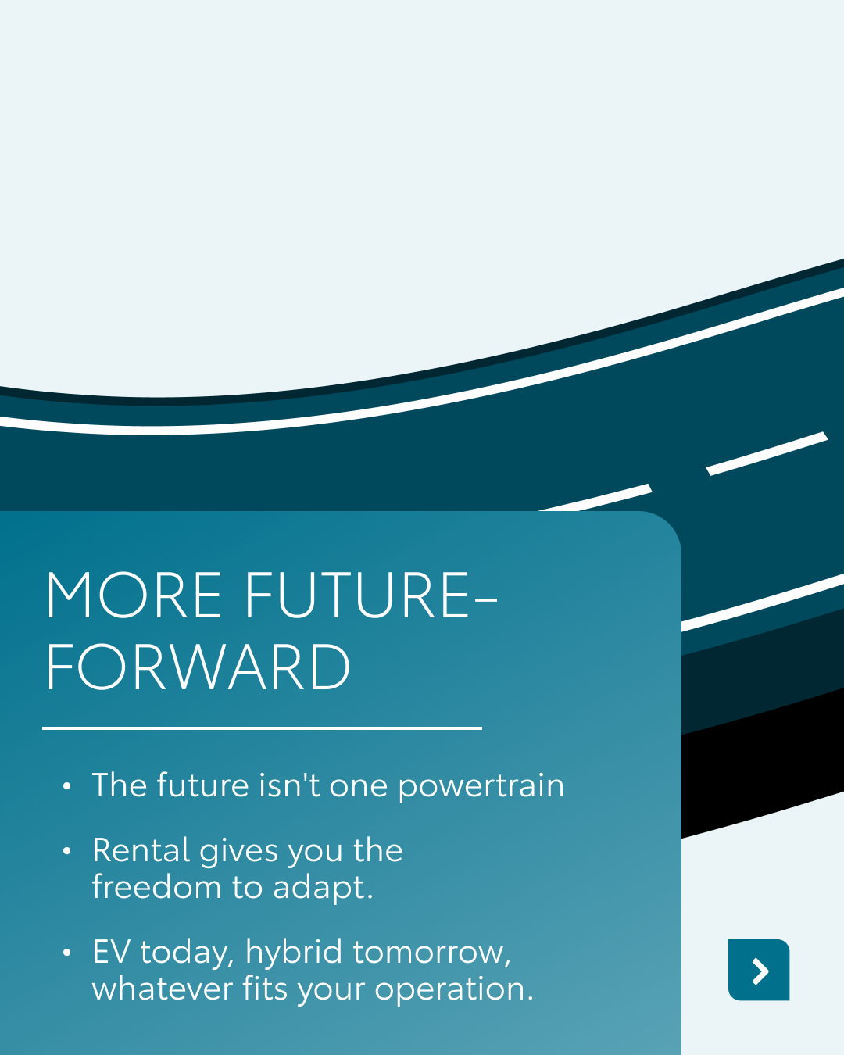

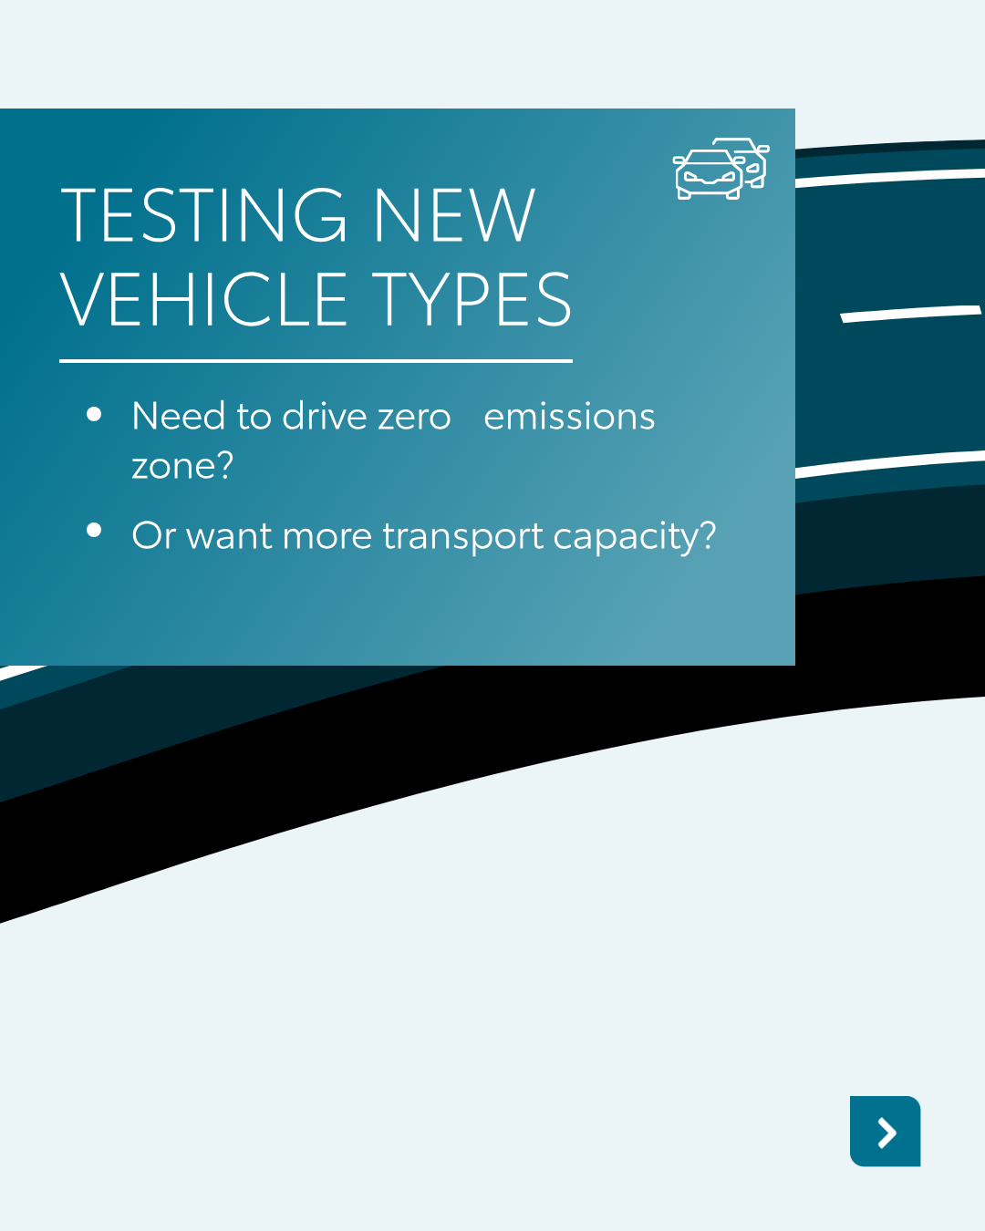
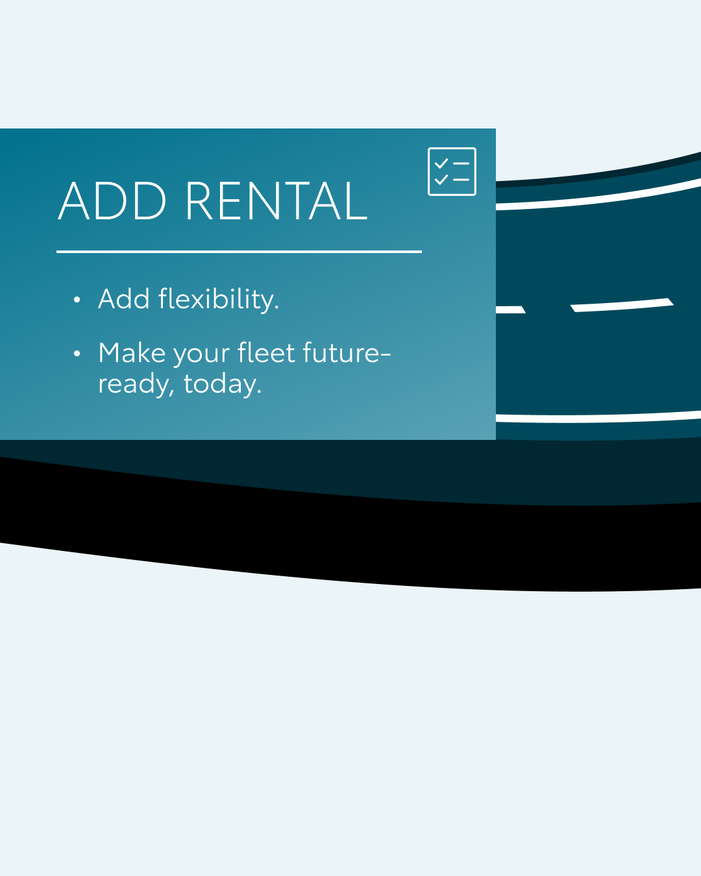
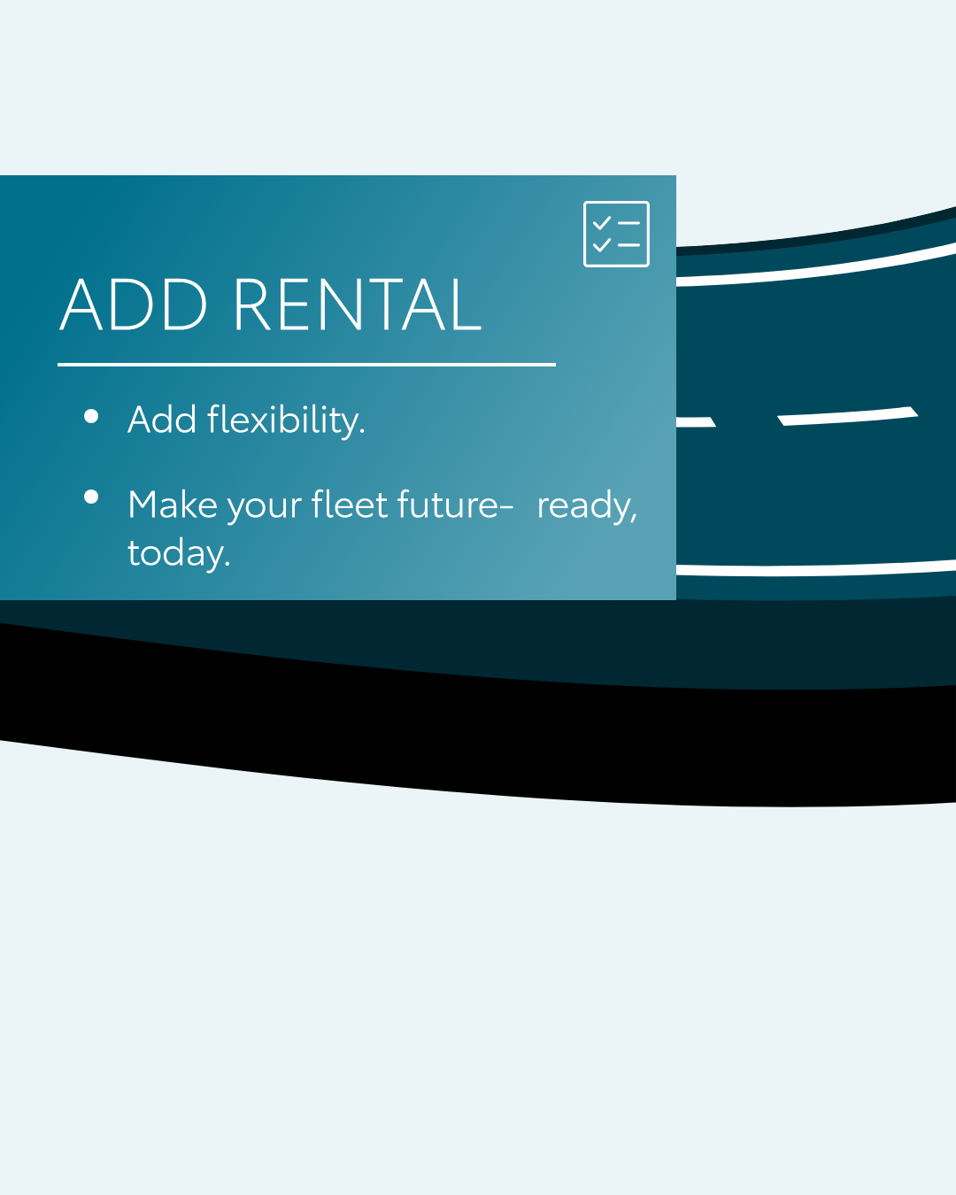


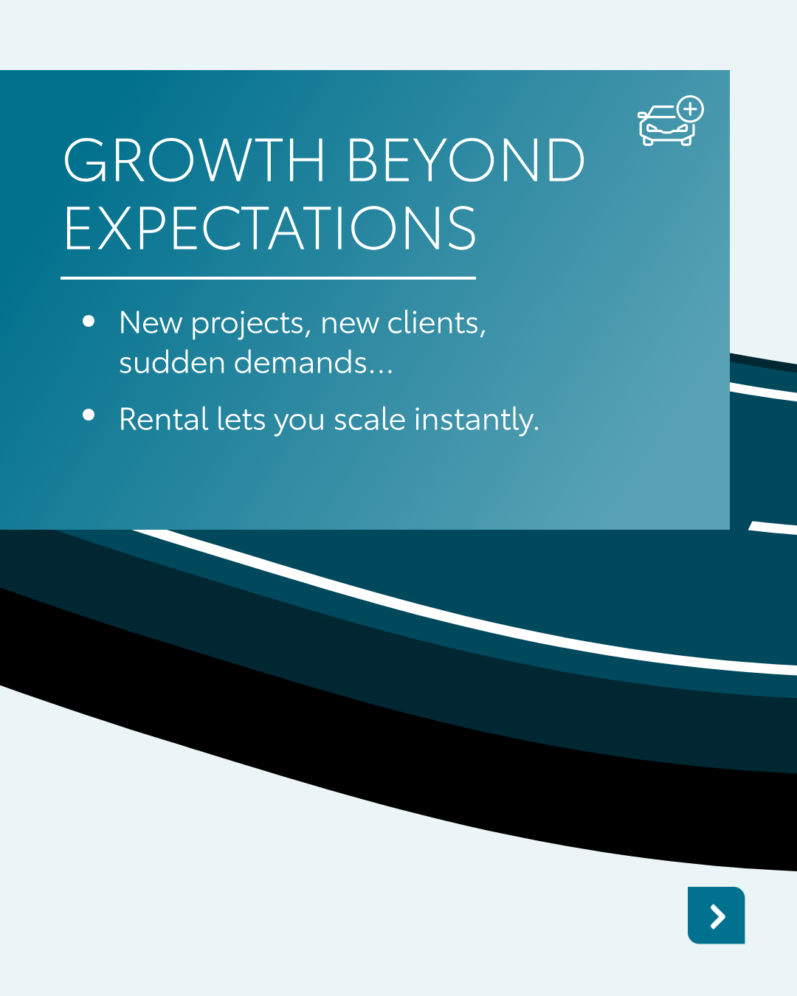

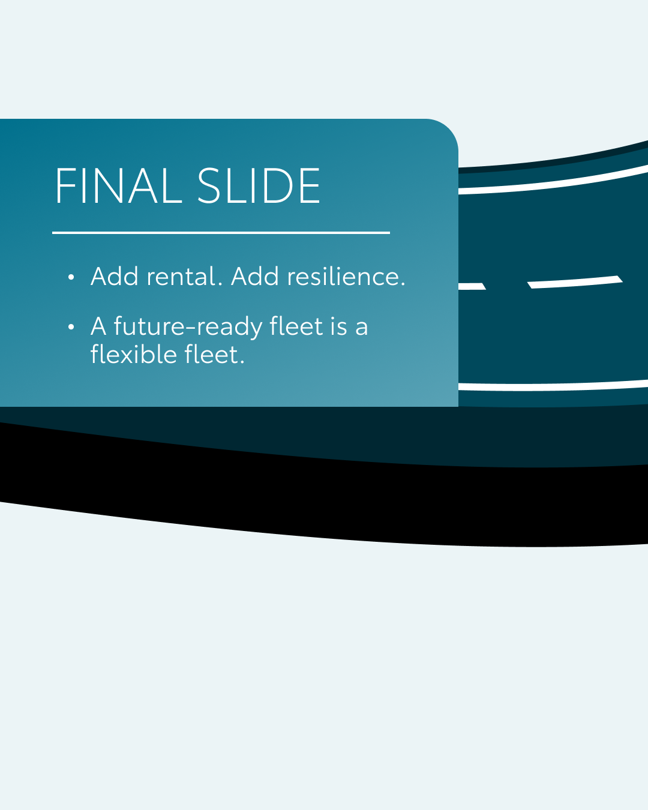


available on Celtra
Valid for multibrand
7.CAROUSEL WHY RENTAL BELONGS
CONTENT BUCKET 1- MARCH
COPY LI
Is your fleet's growth hitting a speed bump?
Business demands change. Seasonal peaks, new projects, or testing zero-emission zones shouldn't be a headache. KINTO provides the agility to scale your fleet instantly, ensuring your mobility always matches your pace.
One partner. Every solution.
#FleetManagement #BusinessAgility #KINTO
FORMATS AVAILABLE:
4/5

Slide 25
available on Celtra
Valid for multibrand
7.CAROUSEL WHY RENTAL BELONGS
CONTENT BUCKET 1- MARCH
COPY IG
Ready for every twist and turn. 🛣️
Your business doesn't always move at the same pace so your fleet shouldn't either. Whether it’s growth beyond expectations or testing the latest tech, KINTO gives you the freedom to adapt instantly. 🔄
One partner. Every solution.
#KINTO #FlexibleMobility #BusinessGrowth
FORMATS AVAILABLE:
4/5

Slide 26
available on Celtra
Valid for multibrand
7.CAROUSEL WHY RENTAL BELONGS
CONTENT BUCKET 1- MARCH
COPY FB
Is your business moving faster than your fleet? 🚀
Seasonal peaks and sudden demands happen. With KINTO, you can scale your vehicle count up or down exactly when your business needs it, without the stress of rigid contracts.
One partner. Every solution.
#KINTO #FlexibleMobility #FutureForward
FORMATS AVAILABLE:
4/5

Slide 27
Community & connection
Empowerment & Expertise
Notes:
Baseline: Join the KINTO community

Slide 28
8.LONGREAD REMARKETING EVENT
CONTENT BUCKET 1- MARCH

Slide 29

9. VIDEO KINTO’S FIRST CLIENT - CLIENT VERSION
COPY LI
Every journey has a starting point.
Meet the very first KINTO customer in the world and discover how a new way of thinking about mobility made all the difference.
Through a close collaboration with their local retailer, KINTO delivered a solution built around real needs: flexible, simple, and designed for everyday life.
Because great mobility isn’t just about getting from A to B; it’s about the people behind the journey.
Thank you for your trust, Julio!
#KINTO #CustomerStory #MobilitySolutions
CONTENT BUCKET 1- MARCH
FORMATS AVAILABLE:
⅘ 1/1 16/9 9/16
Notes:
💚👉🫵🤝🚗🚙🚘🔧📈📊📉🆕✨❇️🆙☀️🤝😌💚🔥💪✅☝️👉🫵⏰🚐🚘🫵👉👥💪💼🥳👀

Slide 30


9. VIDEO KINTO’S FIRST CLIENT - CLIENT VERSION
COPY IG
CONTENT BUCKET 1- MARCH
Every first step tells a story.
Meet the very first KINTO customer and see how flexibility, simplicity, and the right local partner made all the difference.
This is mobility, built around people.
#KINTO #CustomerStory #FlexibleMobility
FORMATS AVAILABLE:
⅘ 1/1 16/9 9/16

Slide 31
9. VIDEO KINTO’S FIRST CLIENT - CLIENT VERSION
COPY FB
What does it mean to be the very first?
Meet the world’s first KINTO customer and discover how a strong collaboration with their local retailer and KINTO turned into a lasting partnership.
Still a KINTO customer today, their story shows how the right support and flexibility can go a long way.
Watch the video and hear their story.
#KINTO #CustomerStory #FlexibleMobility .
CONTENT BUCKET 1- MARCH
FORMATS AVAILABLE:
⅘ 1/1 16/9 9/16

Slide 32


available on Celtra
10.VISUAL WORLD ENGINEERING DAY
COPY LI
On World Engineering Day, we celebrate the precision that keeps our world moving. A truly stable system is never an accident; it emerges from thoughtful structures, dedicated craftsmanship, and a continuous pursuit of optimization.
At KINTO, we reflect this mindset. Our mobility solutions aren't just a collection of services, they are carefully designed systems built to strengthen one another. From leasing and renting to billing and servicing, every process is engineered for reliability, simplicity, and efficiency.
Just as good engineering brings clarity to a complex world, KINTO brings transparency and predictability to your business mobility. 🧭
Join the KINTO community.
#WorldEngineeringDay #BusinessEfficiency #KINTO
CONTENT BUCKET 1- MARCH
FORMATS AVAILABLE:
4/5
Notes:
💚👉🫵🤝🚗🚙🚘🔧📈📊📉🆕✨❇️🆙☀️🤝😌💚🔥💪✅☝️👉🫵⏰🚐🚘🫵👉👥💪💼🥳👀

Slide 33
available on Celtra
10.VISUAL WORLD ENGINEERING DAY
COPY IG
Precision in every part. ⚙️✨
At KINTO, our mobility solutions are engineered for one thing: your peace of mind. 🚗
From seamless leasing to transparent billing, we build systems that strengthen your business. Reliability isn't just a goal: it's how we’re built. 🛠️
Join the KINTO community.
#WorldEngineeringDay #KINTO #Innovation
CONTENT BUCKET 1- MARCH
FORMATS AVAILABLE:
4/5

Slide 34
available on Celtra
10.VISUAL WORLD ENGINEERING DAY
COPY FB
Happy World Engineering Day! 🛠️✨
At KINTO, we take our engineering mindset to heart. We don’t just offer services; we build carefully designed systems where renting, leasing, and billing work together perfectly to support your business. 💼
Join the KINTO community.
#KINTO #EngineeringExcellence #SmartMobility
.
CONTENT BUCKET 1- MARCH
FORMATS AVAILABLE:
4/5

Slide 35

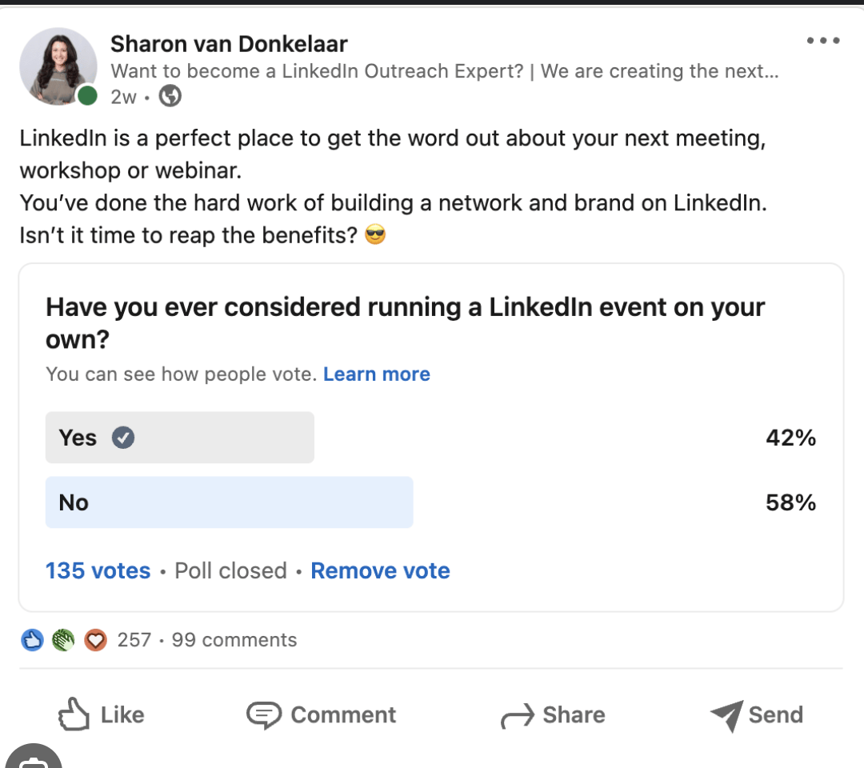
Valid for multibrand
11.POLL WHERE ARE YOU HEADED?
COPY - LI
Caption copy:
Fleet managers, your role is shifting gears. Less about cars.More about data, people & purpose. With EV rollouts, sustainability targets and smart tech, the job looks nothing like it did a few years ago.
So tell us: where are you headed next?
Operational expert with AI copilots
Mobility manager (think EVs, bikes & shared rides)
Strategic advisor for sustainability
Still putting out fires… but with undeniable style
CONTENT BUCKET 1- MARCH

Slide 36

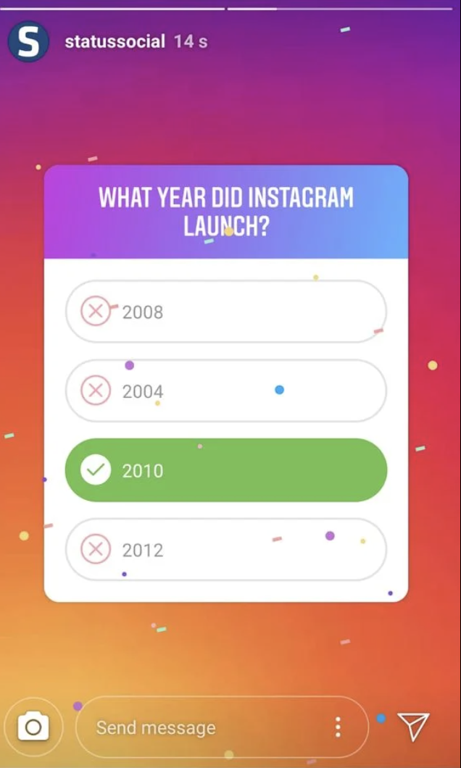
Valid for multibrand
11.POLL WHERE ARE YOU HEADED?
COPY - IG STORY
Fleet Managers!
Where do you see yourself in three years?
Operational expert with AI copilots
Mobility manager (think EVs, bikes & shared rides)
Strategic advisor for sustainability
Still putting out fires… but with undeniable style
CONTENT BUCKET 1- MARCH

Slide 37
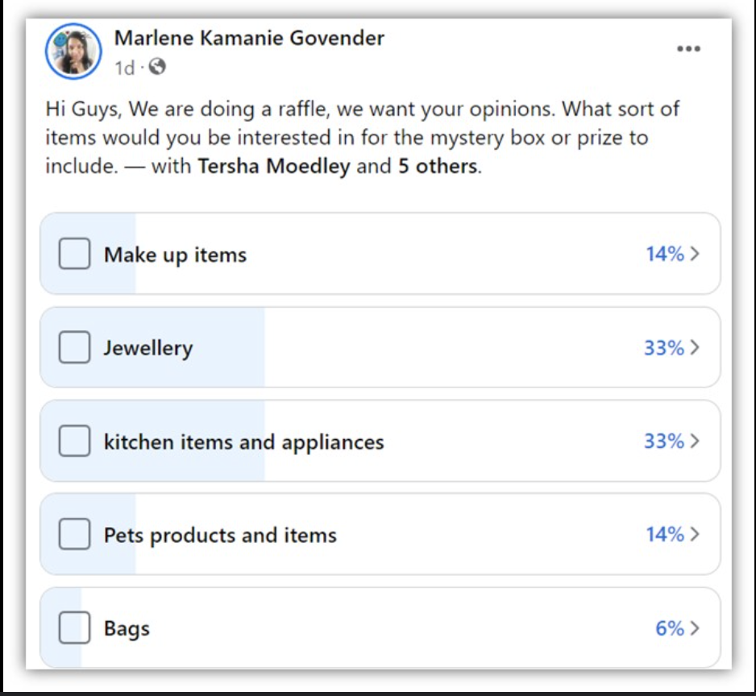
Valid for multibrand
11.POLL WHERE ARE YOU HEADED?
COPY - FB
Caption copy:
Fleet managers, your role is shifting gears. Less about cars.More about data, people & purpose. With EV rollouts, sustainability targets and smart tech, the job looks nothing like it did a few years ago.
So tell us: where are you headed next?
Operational expert with AI copilots
Mobility manager (think EVs, bikes & shared rides)
Strategic advisor for sustainability
Still putting out fires… but with undeniable style
CONTENT BUCKET 1- MARCH

Slide 38


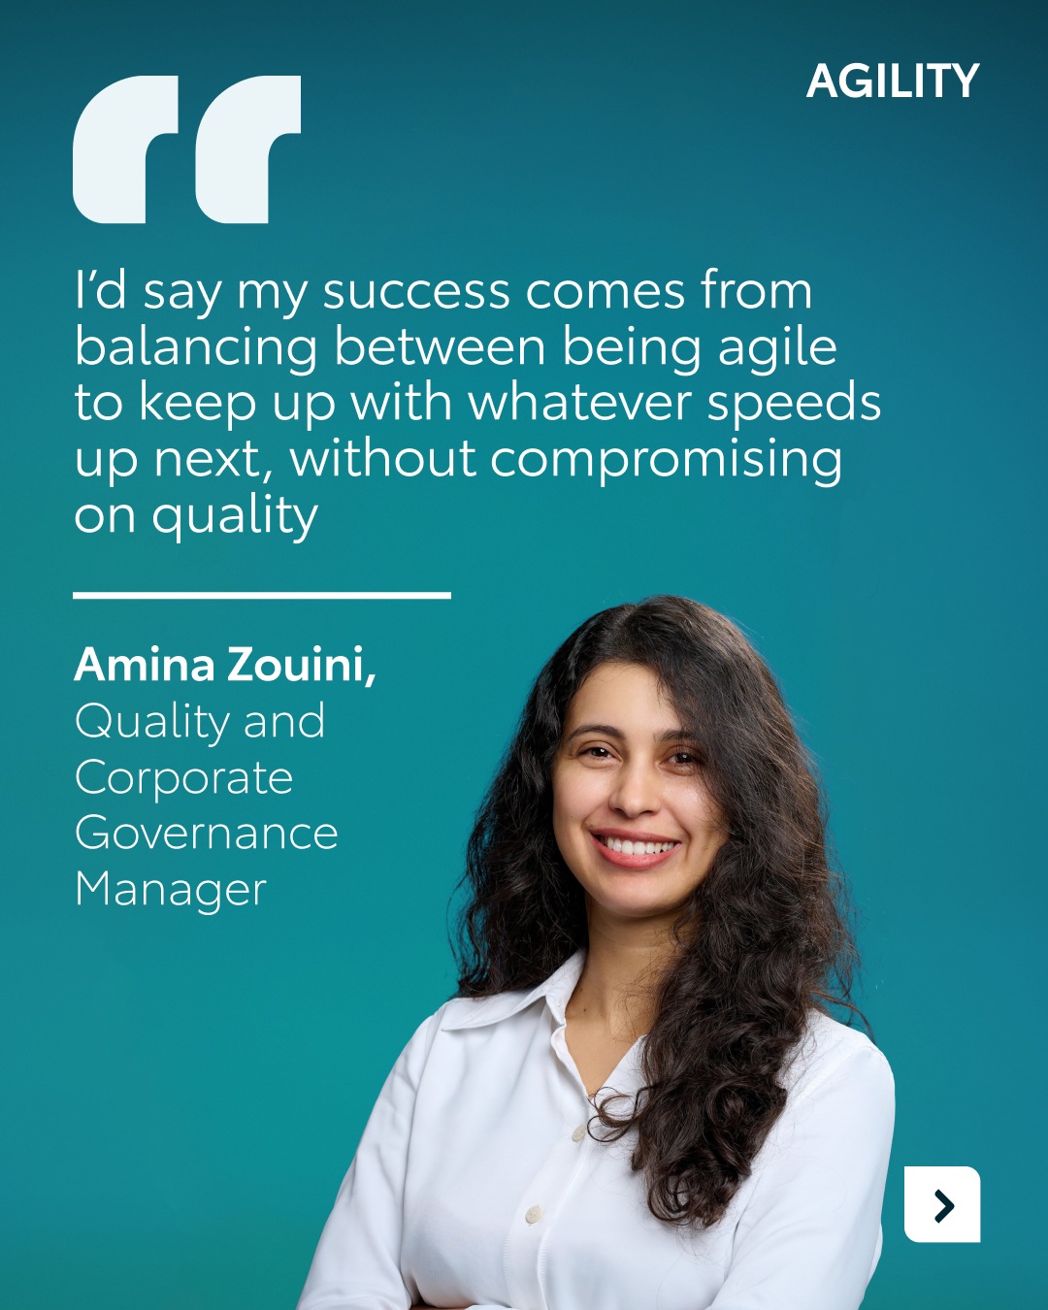

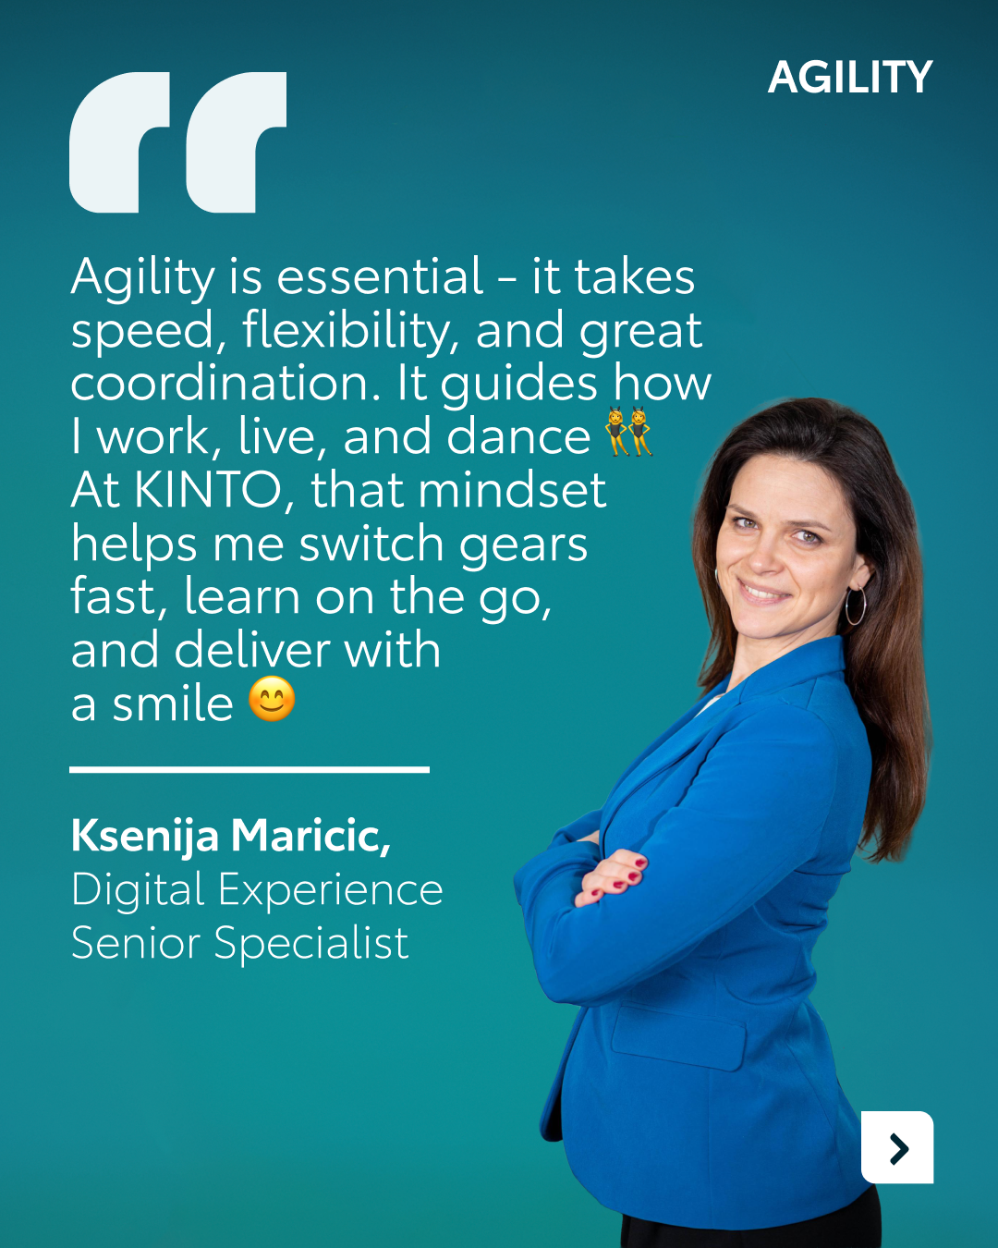
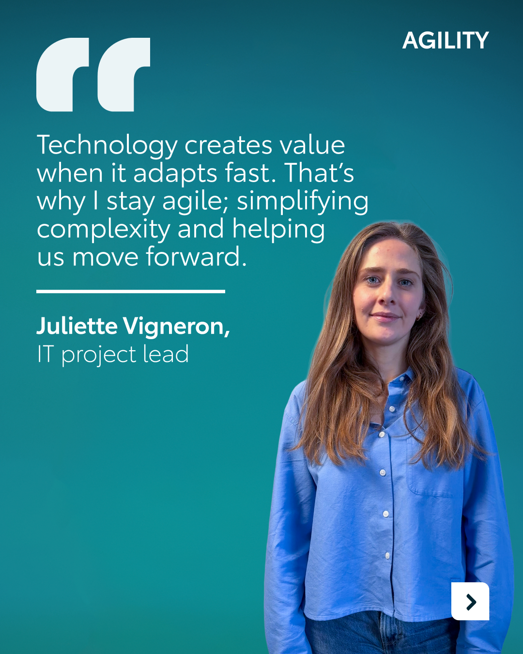
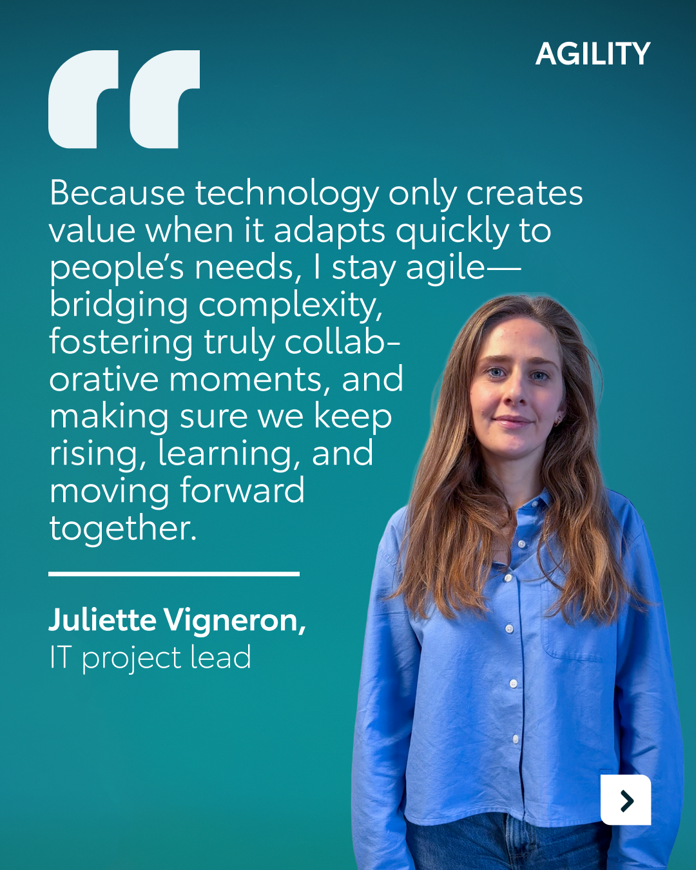
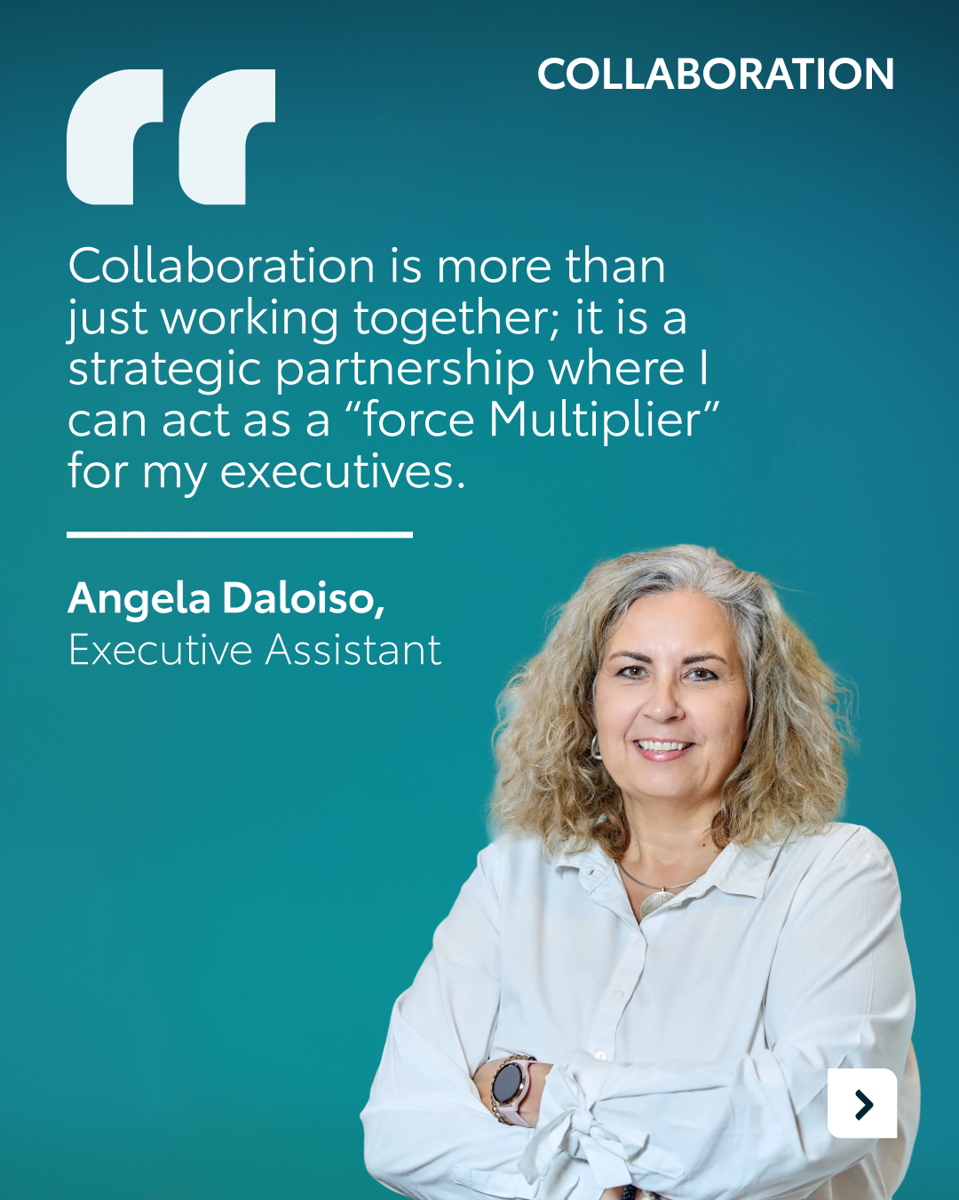
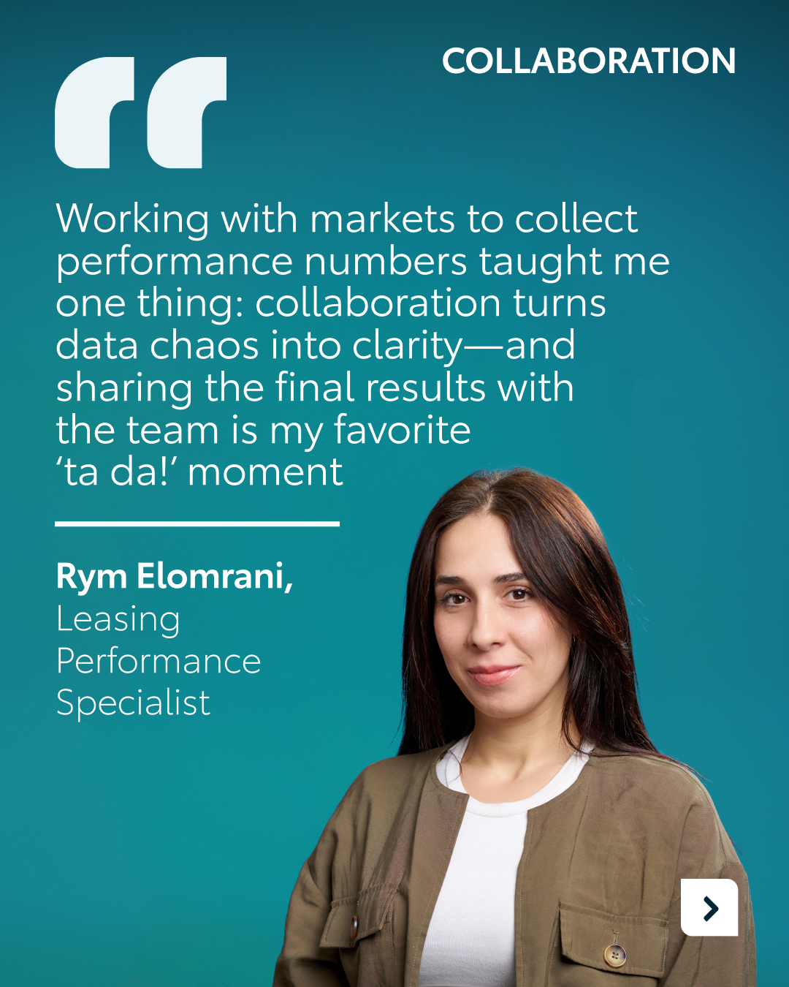
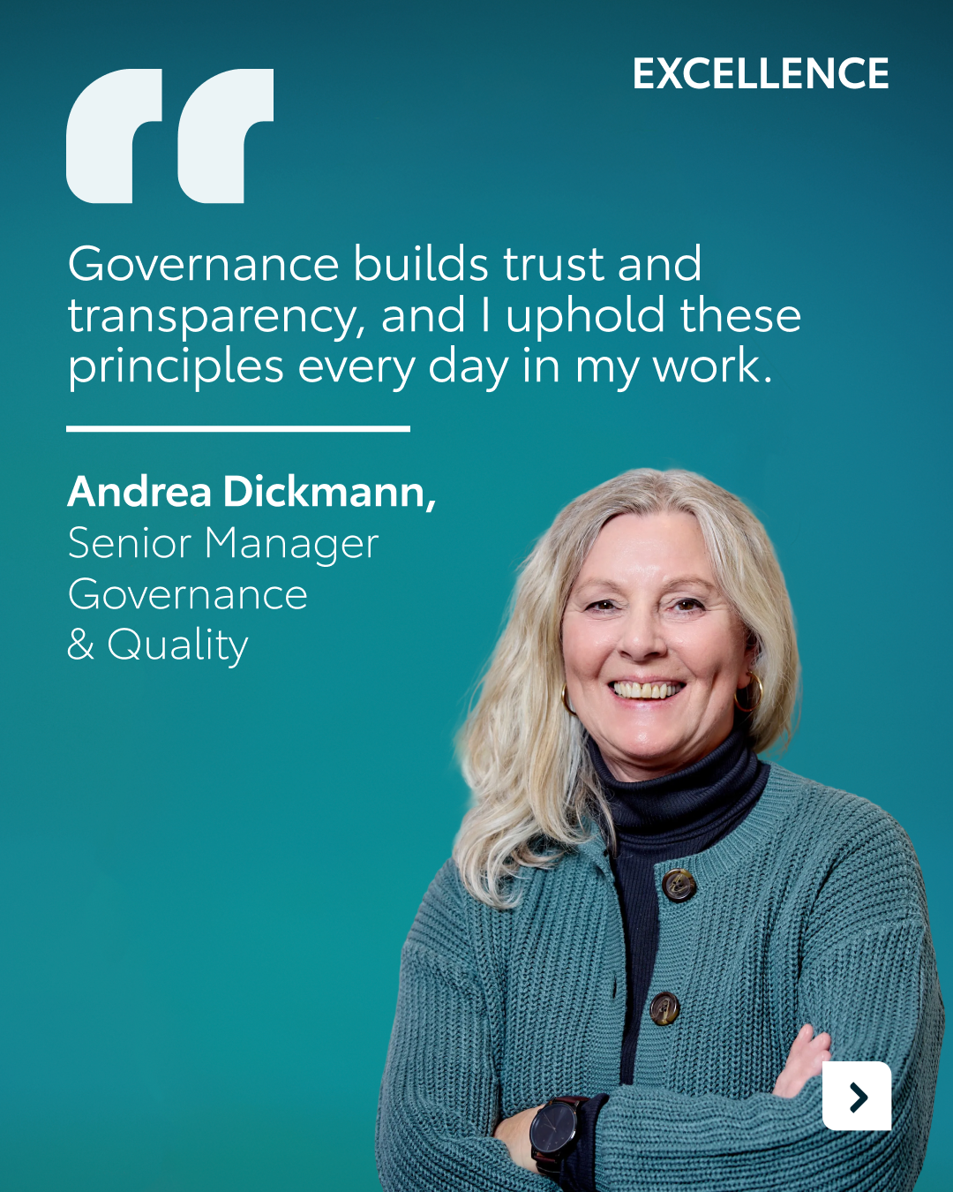
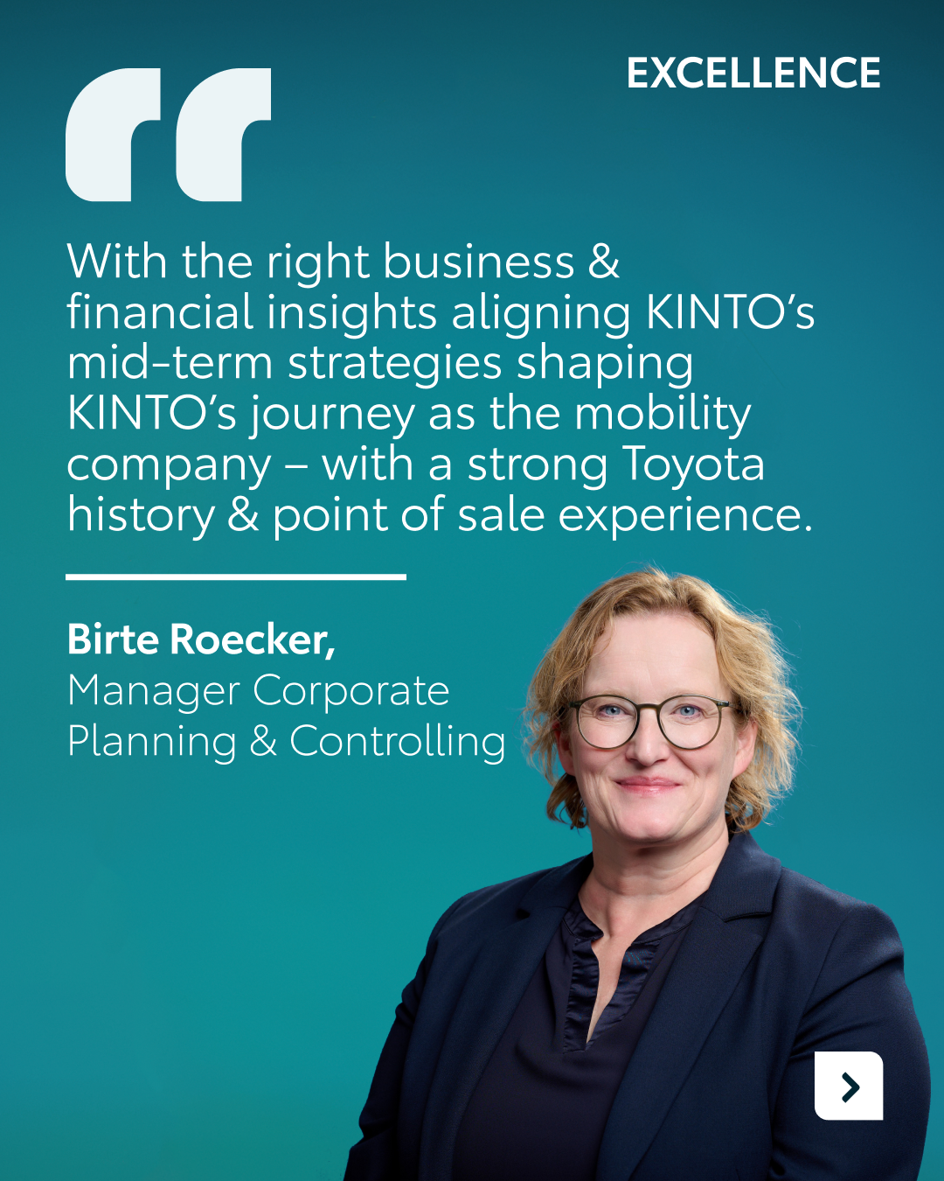

available on Celtra
Valid for multibrand
12.CAROUSEL WOMEN'S DAY
CONTENT BUCKET 1- MARCH
COPY LI
Behind every seamless journey is a team driving innovation forward. 🚀
This International Women’s Day, we’re celebrating the women at KINTO who turn complexity into clarity. From corporate governance to digital experience and IT project lead, their expertise is the engine behind our agile mobility solutions.
Join the KINTO community.
#IWD2026 #WomenInMobility #KINTO
FORMATS AVAILABLE:
4/5

Slide 39
available on Celtra
Valid for multibrand
12.CAROUSEL WOMEN'S DAY
CONTENT BUCKET 1- MARCH
COPY IG
The women driving KINTO forward. 📈✨
From IT leads to leasing specialists, their expertise ensures your business mobility is always in sync with your needs. Swipe through to meet some of the faces behind the service. ➡️
Join the KINTO community.
#IWD2026 #WomenInBusiness #KINTO
FORMATS AVAILABLE:
4/5

Slide 40
available on Celtra
Valid for multibrand
12.CAROUSEL WOMEN'S DAY
CONTENT BUCKET 1- MARCH
COPY FB
Celebrating some of the women driving KINTO forward! 💼✨
Whether it’s turning "data chaos" into clarity or staying agile to meet your business needs, these professionals are at the heart of everything we do.
Join the KINTO community.
#InternationalWomensDay #KINTO #TeamWork
FORMATS AVAILABLE:
4/5

