Slide 1



CONTENT
May 26

Slide 2
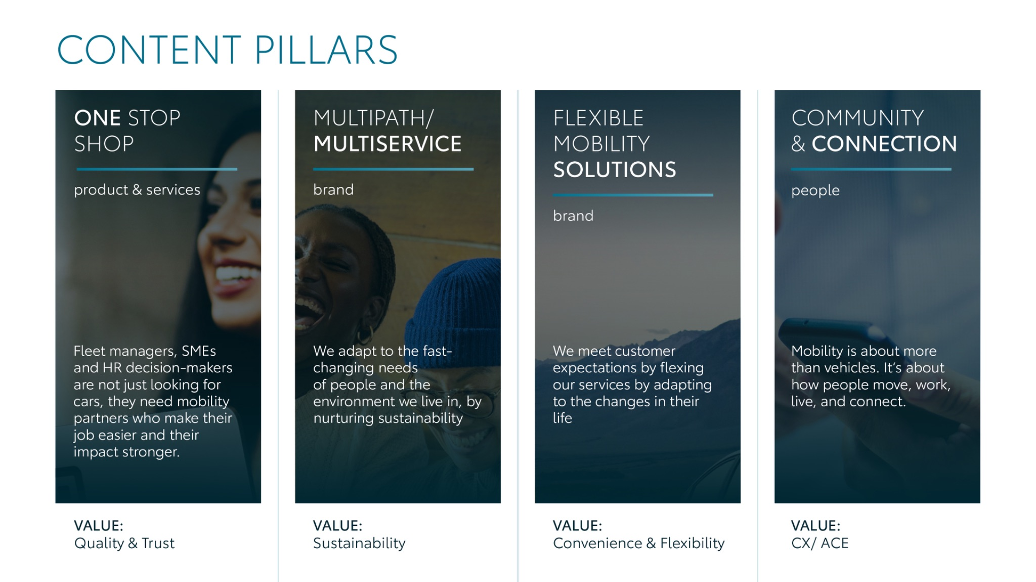
Notes:
“At KINTO, we work with content pillars: themes that carry our brand. We use different content types: inspiring, informative, topical. Your contributions add the human layer that makes the strategy work.”

Slide 3




Content pillars - content overview
May
Carousel Customer Quotes
VLV campaign
Animation Lease Proace
Carousel FAQ Rent
New Lease Website
Visual FLEXIBLE RENT
Longread FLEXIBLE RENT
Customer Fleet Delivery
Labour Day
Poll Added Value Rent
ONE STOP SHOP
MULTIPATH/ MULTISERVICE
FLEXIBLE MOBILITY SOLUTIONS
COMMUNITY/ CONNECTION

Slide 4
Tag lines pillars
1. One Stop Shop
One partner. Every solution.
2. Flexible Mobility Solutions
One partner. Every solution.
3. Community and connection (important to keep it broad enough to fit clients as well as people working at Kinto)
Join the KINTO community.
4. Vision & Impact (Multipath/multiservice)
One partner. Every solution.

Slide 5

One stop shop
Notes:
One place. Every solution. Always KINTO.

Slide 6




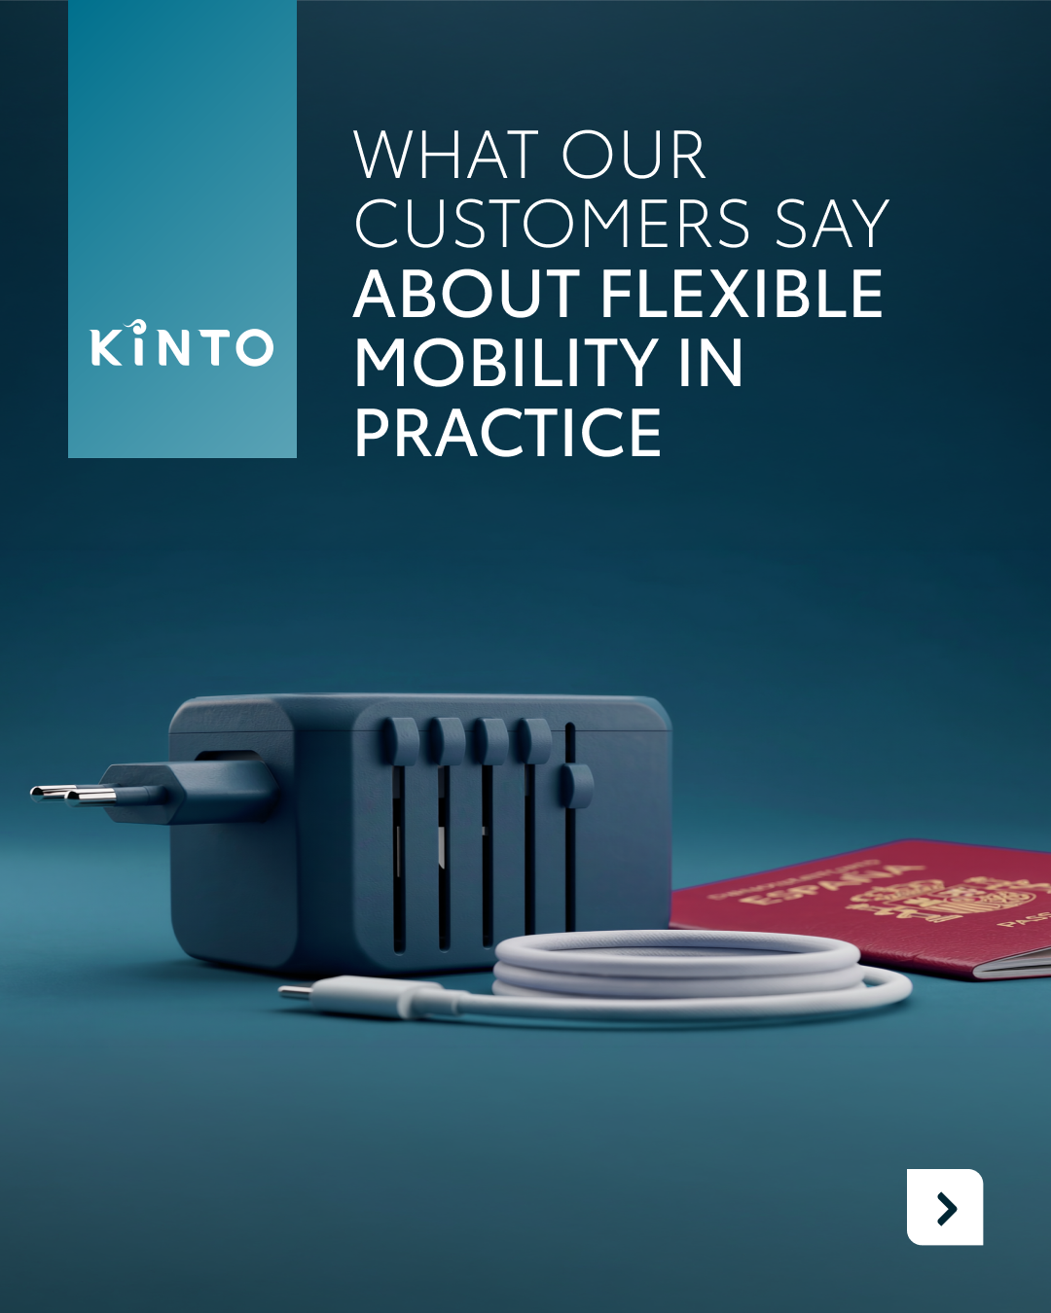
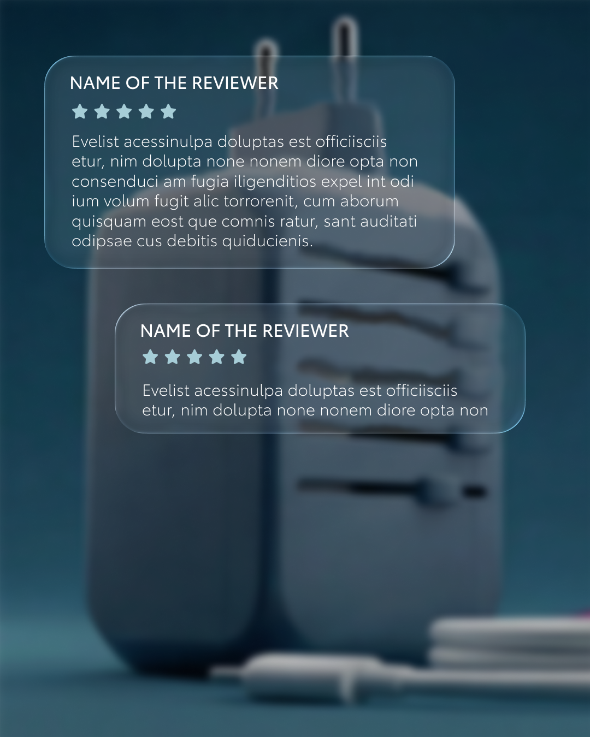
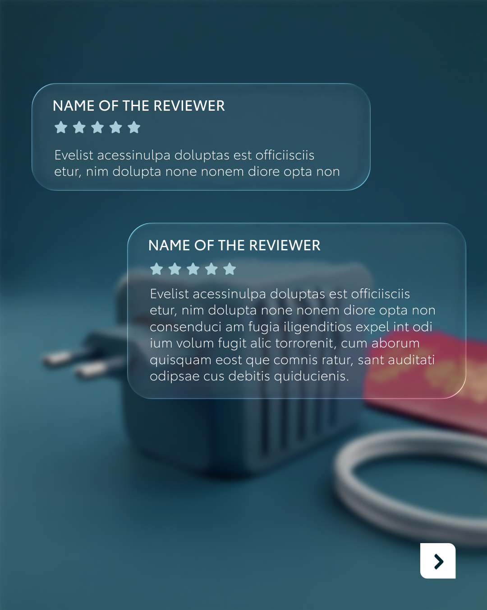

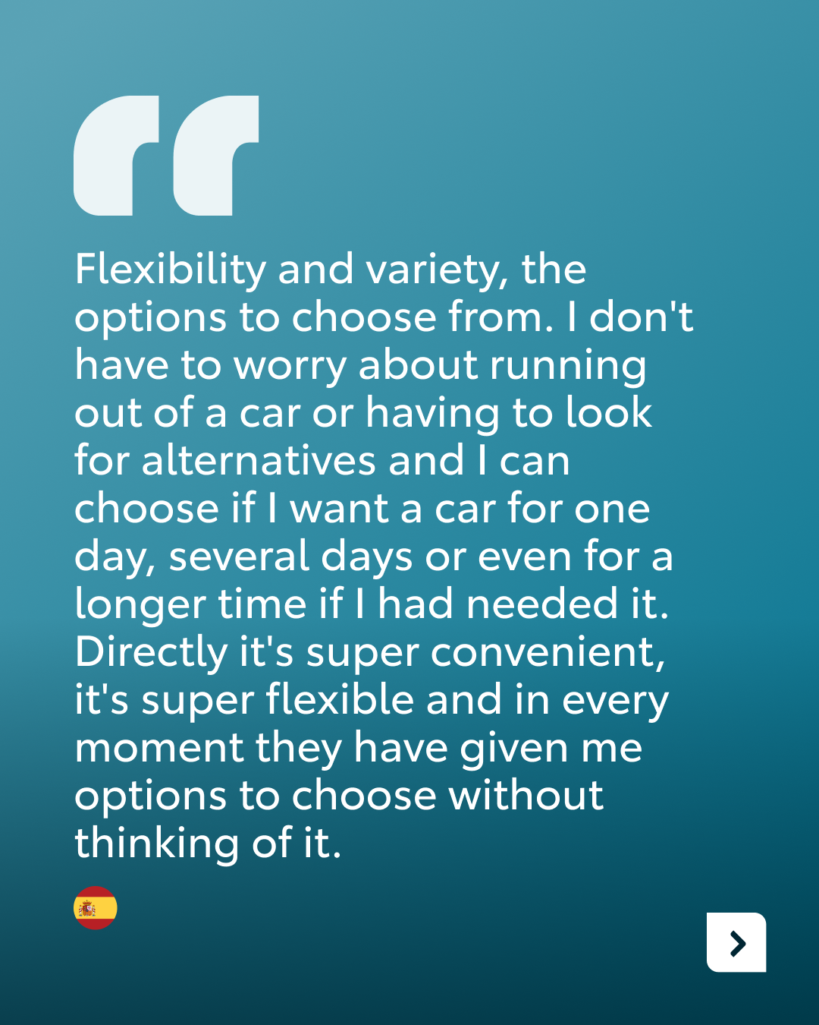
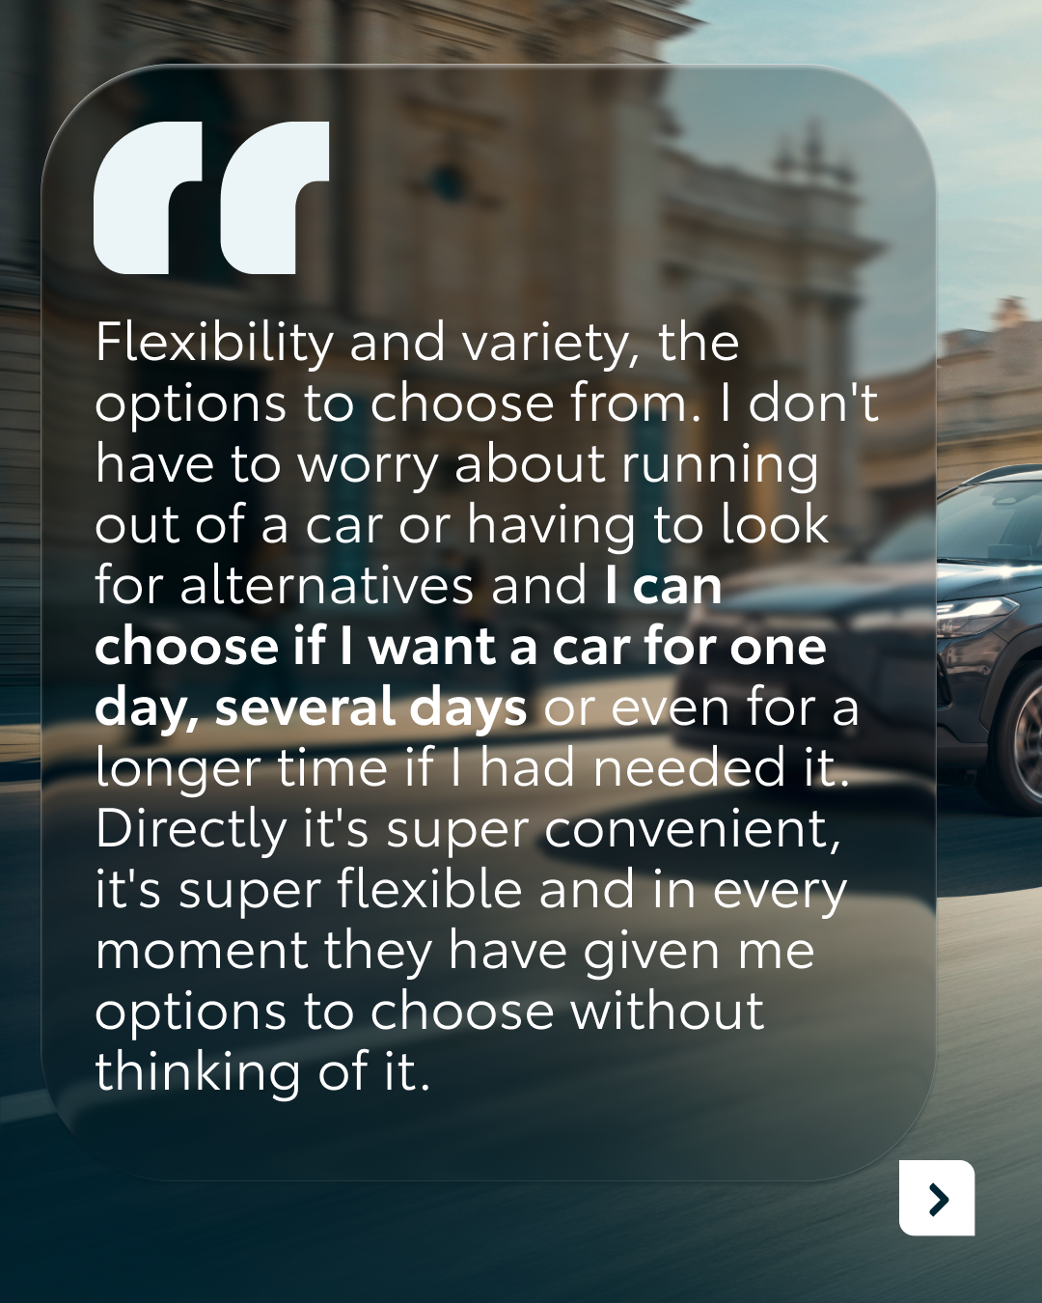
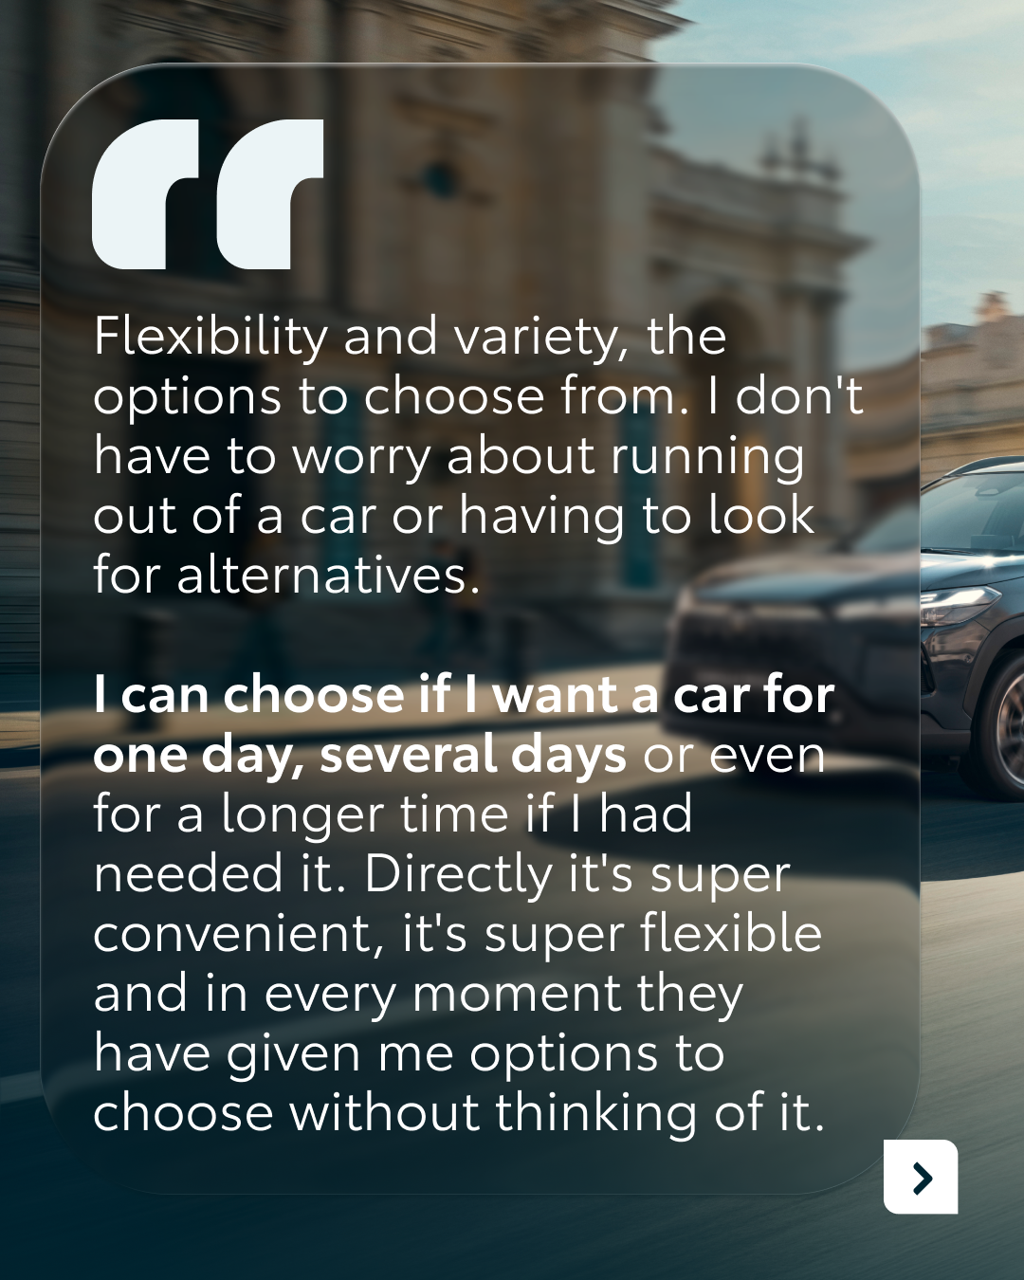
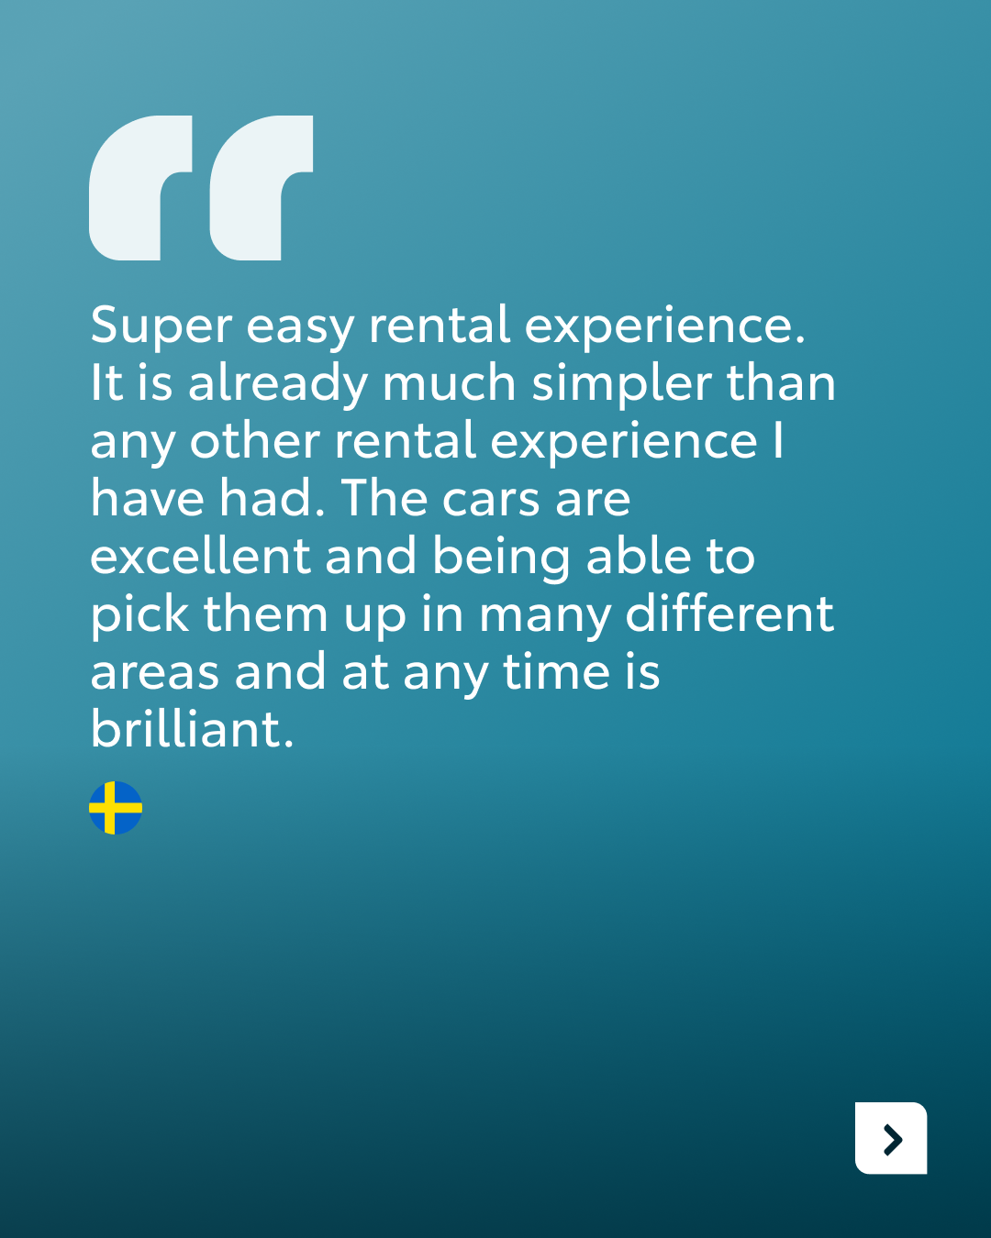
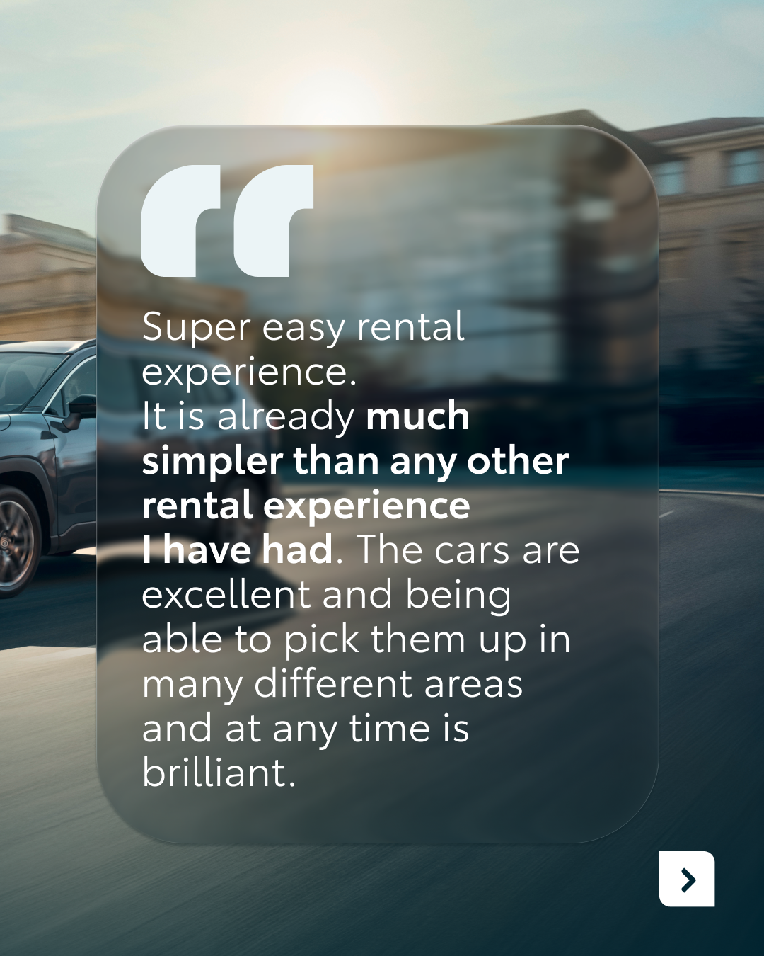
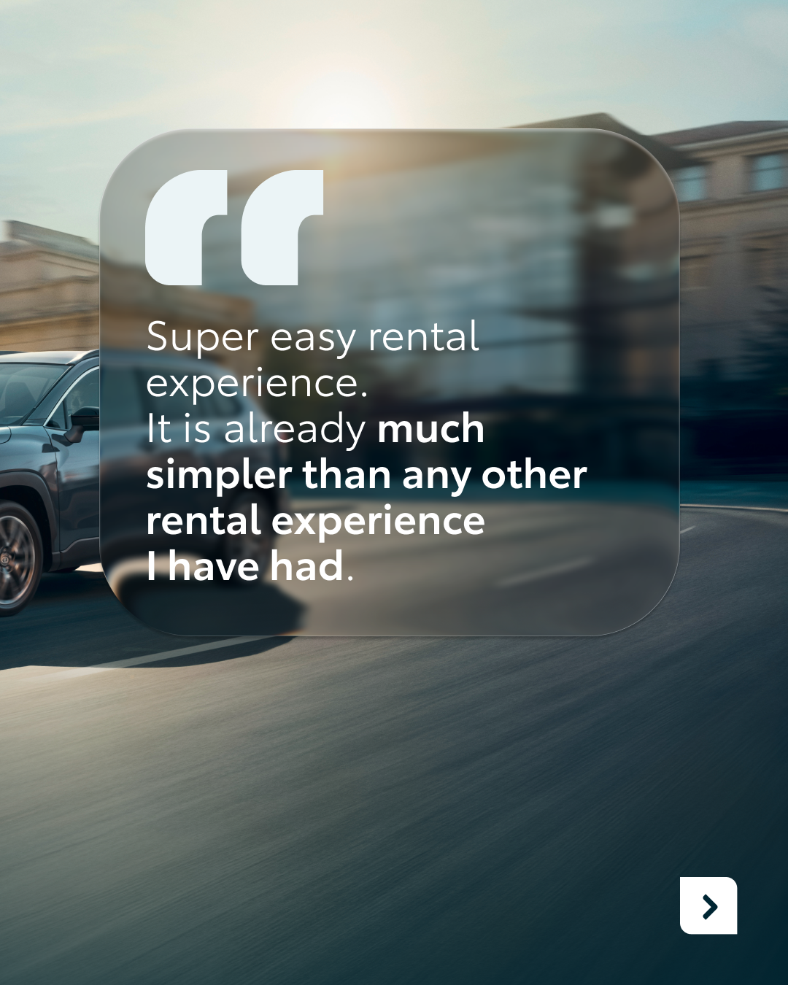
1.CAROUSEL CUSTOMER QUOTES
COPY LI
CONTENT BUCKET 1- MAY
Flexible mobility sounds good in theory. But what does it look like in practice?
At KINTO, we work closely with our customers every day. Their feedback gives us valuable insight into what truly matters: from having the flexibility to choose a car for just one day, to experiencing a rental process that is simply "brilliant" and easy to manage.
Swipe to discover what they have to say about flexible mobility in practice.
One partner. Every solution.
#KINTO #BusinessMobility #FleetManagement
FORMATS AVAILABLE:
4/5

Slide 7
Valid for multibrand
1.CAROUSEL CUSTOMER QUOTES
COPY IG
Real stories, real trust. 🤝
Flexible mobility, seen through the eyes of our customers.
Swipe to discover their experiences.
#KINTO #SmarterMobility #BusinessMobility
CONTENT BUCKET 1- MAY
FORMATS AVAILABLE:
4/5

Slide 8
Valid for multibrand
1.CAROUSEL CUSTOMER QUOTES
COPY FB
What does flexible mobility look like in real life? 📊
We asked our customers. Instead of complex planning, they talk about the freedom to choose a car for just one day and an experience that is simply "brilliant" from start to finish.
Discover what they have to say about flexible mobility in practice.
One partner. Every solution.
#KINTO #SmarterMobility #BusinessSolutions
CONTENT BUCKET 1- MAY
FORMATS AVAILABLE:
4/5

Slide 9
Multipath/
Multiservice
Pillar 4

Slide 10
Flexible mobility solutions
Pillar 3
Notes:
Baseline: Wherever life takes you, KINTO finds the right solution for you.

Slide 11


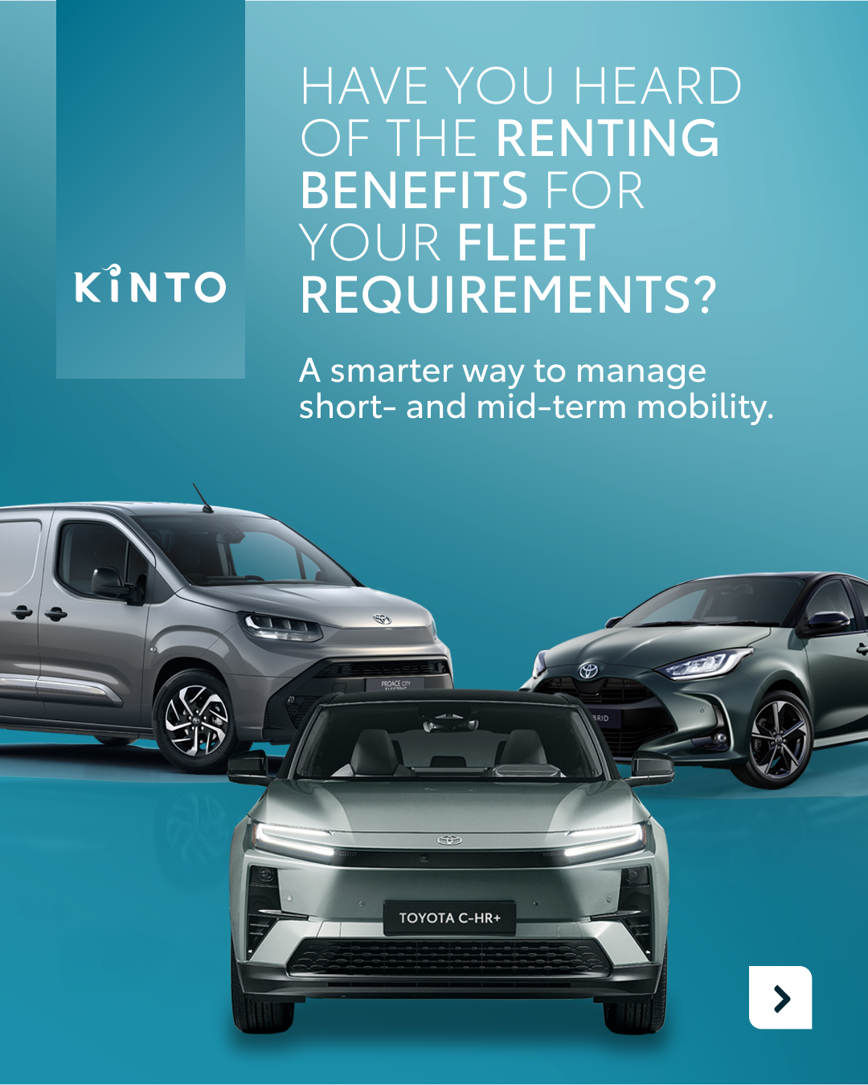
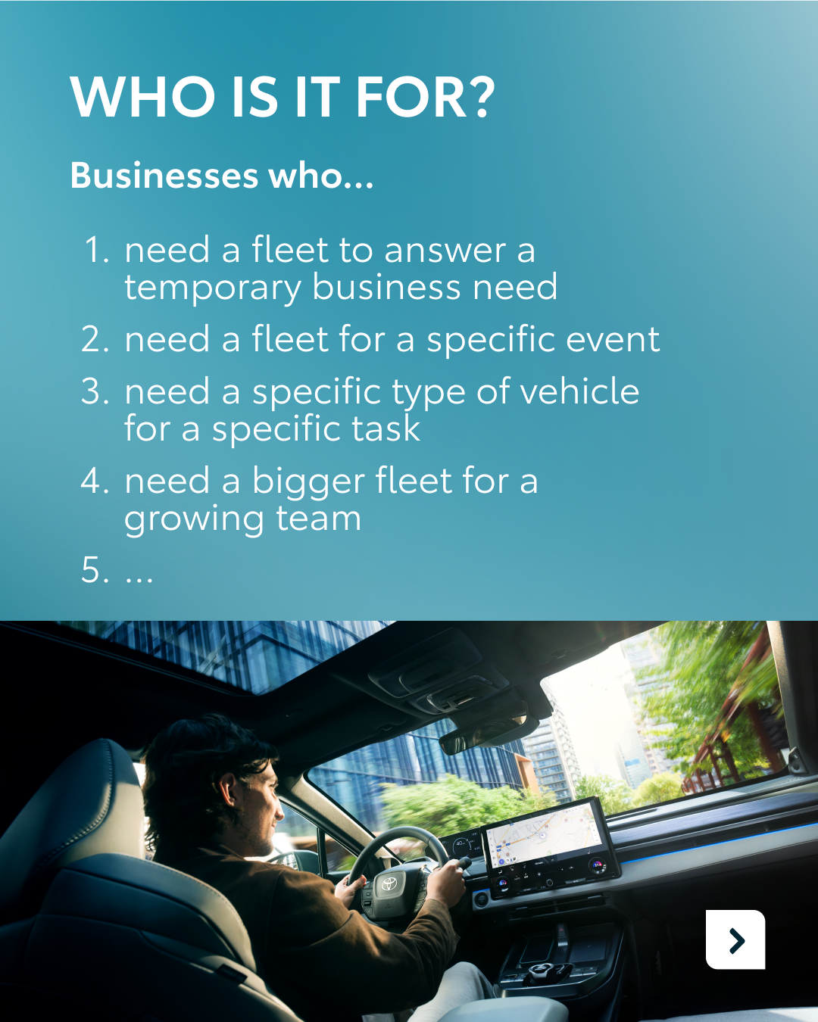










Valid for multibrand
2.CAROUSEL FAQ RENT
CONTENT BUCKET 1- MAY
COPY LI
Short and mid-term rental comes with many questions. When does it make sense? Who is it for? And what does all-inclusive really mean in practice?
At KINTO, we help businesses find the right balance between flexibility, cost control, and operational ease, without long-term commitments.
Swipe through to discover the key benefits of renting for your fleet.
One partner. Every solution.
#KINTO #FleetManagement #BusinessMobility
FORMATS AVAILABLE:
4/5

Slide 12
Valid for multibrand
2.CAROUSEL FAQ RENT
CONTENT BUCKET 1- MAY
COPY IG
Your timeline, your rules. ⏱️
Only commit to what your business needs, for as long as you need it. KINTO Rent adapts to your schedule, whether it’s for 4 hours or 18 months.
Our all-in-one fee covers insurance, maintenance, and administration. We handle the complexity so you can stay in sync with your business goals. 💨
One partner. Every solution.
#KINTO #KINTORent #FlexibleMobility
FORMATS AVAILABLE:
4/5

Slide 13
Valid for multibrand
2.CAROUSEL FAQ RENT
CONTENT BUCKET 1- MAY
COPY FB
Ready to simplify your fleet management? 🧭
Whether you need a car for a short-term project or immediate mobility for a new colleague, Renting with KINTO keeps your business moving without the paperwork storm.
Enjoy one all-inclusive fee from as little as 4 hours up to 18 months. You get exactly the mobility you need - covering insurance, maintenance, and taxes - without any long-term setup. 🚗
One partner. Every solution.
#KINTO #SmartRenting #FleetManagement
FORMATS AVAILABLE:
4/5

Slide 14




3.NEW LEASE WEBSITE
COPY - LI:
Managing your fleet requires a platform as agile as your business.
That’s why we’ve launched a complete makeover of the KINTO Lease website. The new layout simplifies navigation while keeping all the features you rely on, making your experience smoother and more intuitive.
Curious? Visit our website to explore the new look: <insert link>
One partner. Every solution.
#KINTO #LeasingSolutions #FleetManagement
CONTENT BUCKET 1- MAY
FORMATS AVAILABLE:
1/1 - 9/16 - ⅘ - 16/9
Notes:
#KINTO #FleetManagement #CorporateMobility #FlexibleMobility #MobilitySolutions

Slide 15
3. NEW LEASE WEBSITE
COPY - IG:
A fresh new look for KINTO Lease. ✨
We’ve made it easier to explore our solutions, understand your options, and find what fits your business.
Check the link in our bio to explore the update and see what’s new.
One partner. Every solution.
#KINTO #SmarterMobility #BusinessMobility
CONTENT BUCKET 1- MAY
FORMATS AVAILABLE:
1/1 - 9/16 - ⅘ - 16/9
Notes:
#KINTO #FleetManagement #CorporateMobility #FlexibleMobility #MobilitySolutions

Slide 16
3. NEW LEASE WEBSITE
COPY - FB:
Our KINTO Lease website just got a fresh new look. ✨
It’s now even easier to explore our solutions, understand your options, and find the right fit for your business. Everything you need, with a clearer and more intuitive experience.
Take a look and see what flexible mobility can do for you: <insert link>
One partner. Every solution.
#KINTO #SmarterMobility #BusinessSolutions
CONTENT BUCKET 1- MAY
FORMATS AVAILABLE:
1/1 - 9/16 - ⅘ - 16/9
Notes:
#KINTO #FleetManagement #CorporateMobility #FlexibleMobility #MobilitySolutions

Slide 17
4. JOIN - FUEL PRICES
COPY - LI:
to be made after visual is finished
CONTENT BUCKET 1- MAY
FORMATS AVAILABLE:
1/1 - 9/16 - ⅘ - 16/9
Notes:
#KINTO #FleetManagement #CorporateMobility #FlexibleMobility #MobilitySolutions

Slide 18
4. JOIN - FUEL PRICES
COPY - IG:
to be made after visual is finished
CONTENT BUCKET 1- MAY
FORMATS AVAILABLE:
1/1 - 9/16 - ⅘ - 16/9
Notes:
#KINTO #FleetManagement #CorporateMobility #FlexibleMobility #MobilitySolutions

Slide 19
4. JOIN - FUEL PRICES
COPY - FB:
to be made after visual is finished
CONTENT BUCKET 1- MAY
FORMATS AVAILABLE:
1/1 - 9/16 - ⅘ - 16/9
Notes:
#KINTO #FleetManagement #CorporateMobility #FlexibleMobility #MobilitySolutions

Slide 20
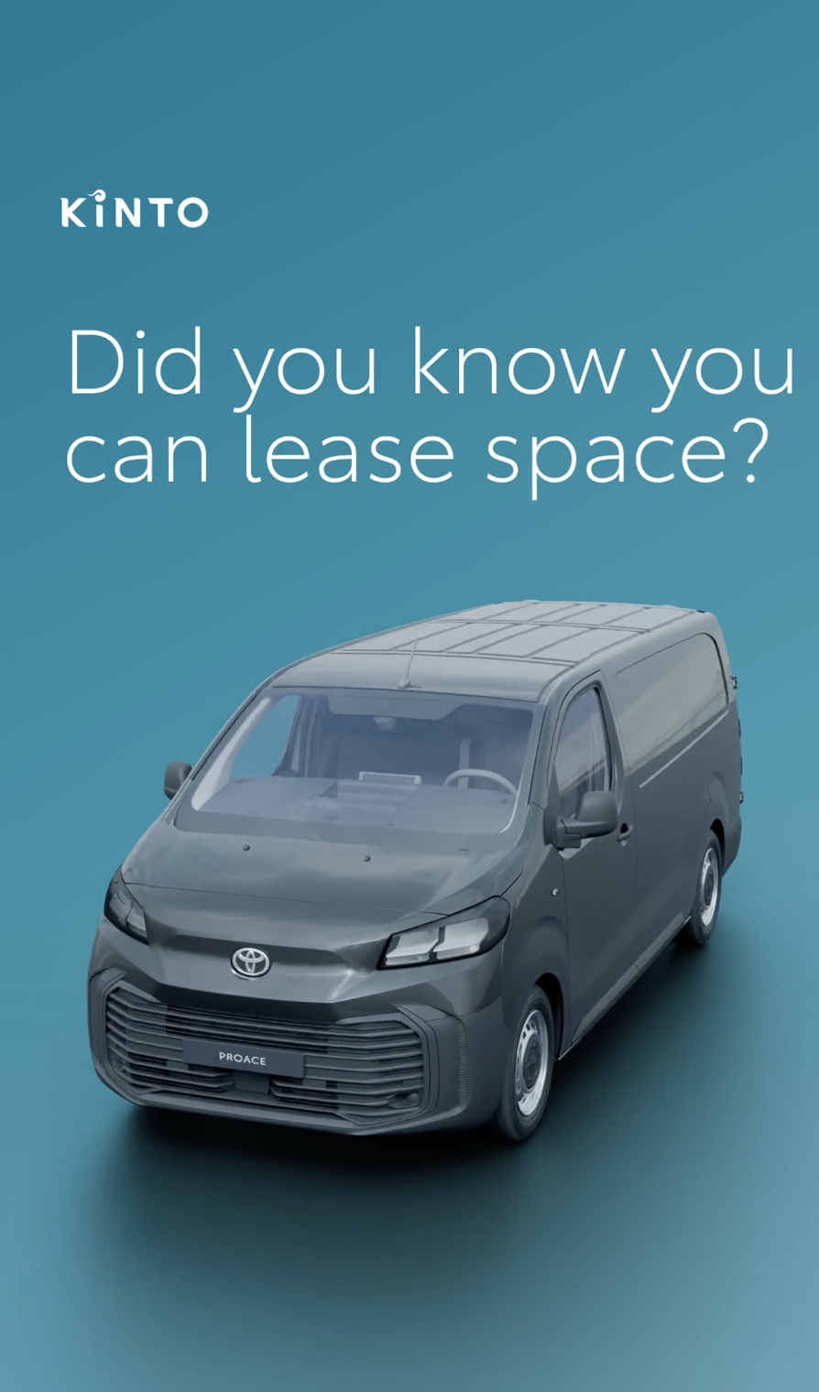
5.ANIMATION LEASE PROACE
COPY - LI:
Every business is different. So are its mobility needs.
At KINTO, we provide the flexible leasing and all-inclusive support that lets you focus on your work, rather than your fleet. Whether you are transporting tools, handling deliveries, or supporting day-to-day operations, we take the administrative complexity out of your hands.
By offering versatile vehicles, we ensure you have the capacity to match your activities while staying in full control of your costs and commitments.
#KINTO #BusinessMobility #FleetManagement
CONTENT BUCKET 1- MAY
FORMATS AVAILABLE:
1/1 - 9/16 - ⅘ - 16/9
Notes:
#KINTO #FleetManagement #CorporateMobility #FlexibleMobility #MobilitySolutions

Slide 21
5.ANIMATION LEASE PROACE
COPY - IG:
Work or play, your mobility should adapt to your plans. 📦
Did you know you can lease space? With our flexible leasing service, you get the exact capacity you need without the administrative hassle. 🚛
#KINTO #BusinessAgility #ToyotaProace
CONTENT BUCKET 1- MAY
FORMATS AVAILABLE:
1/1 - 9/16 - ⅘ - 16/9
Notes:
#KINTO #FleetManagement #CorporateMobility #FlexibleMobility #MobilitySolutions

Slide 22
5.ANIMATION LEASE PROACE
COPY - FB:
Whether you’re packing professional tools for a big project or sports gear for a weekend away, your mobility should always support your plans.
With our flexible leasing service and all-inclusive support, you get the space you need without any of the administrative hassle. We handle the maintenance and insurance while you focus on the road ahead. 🚗
#KINTO #SmarterMobility #FlexibleLeasing
CONTENT BUCKET 1- MAY
FORMATS AVAILABLE:
1/1 - 9/16 - ⅘ - 16/9
Notes:
#KINTO #FleetManagement #CorporateMobility #FlexibleMobility #MobilitySolutions

Slide 23
Community & connection
Empowerment & Expertise
Notes:
Baseline: Join the KINTO community

Slide 24
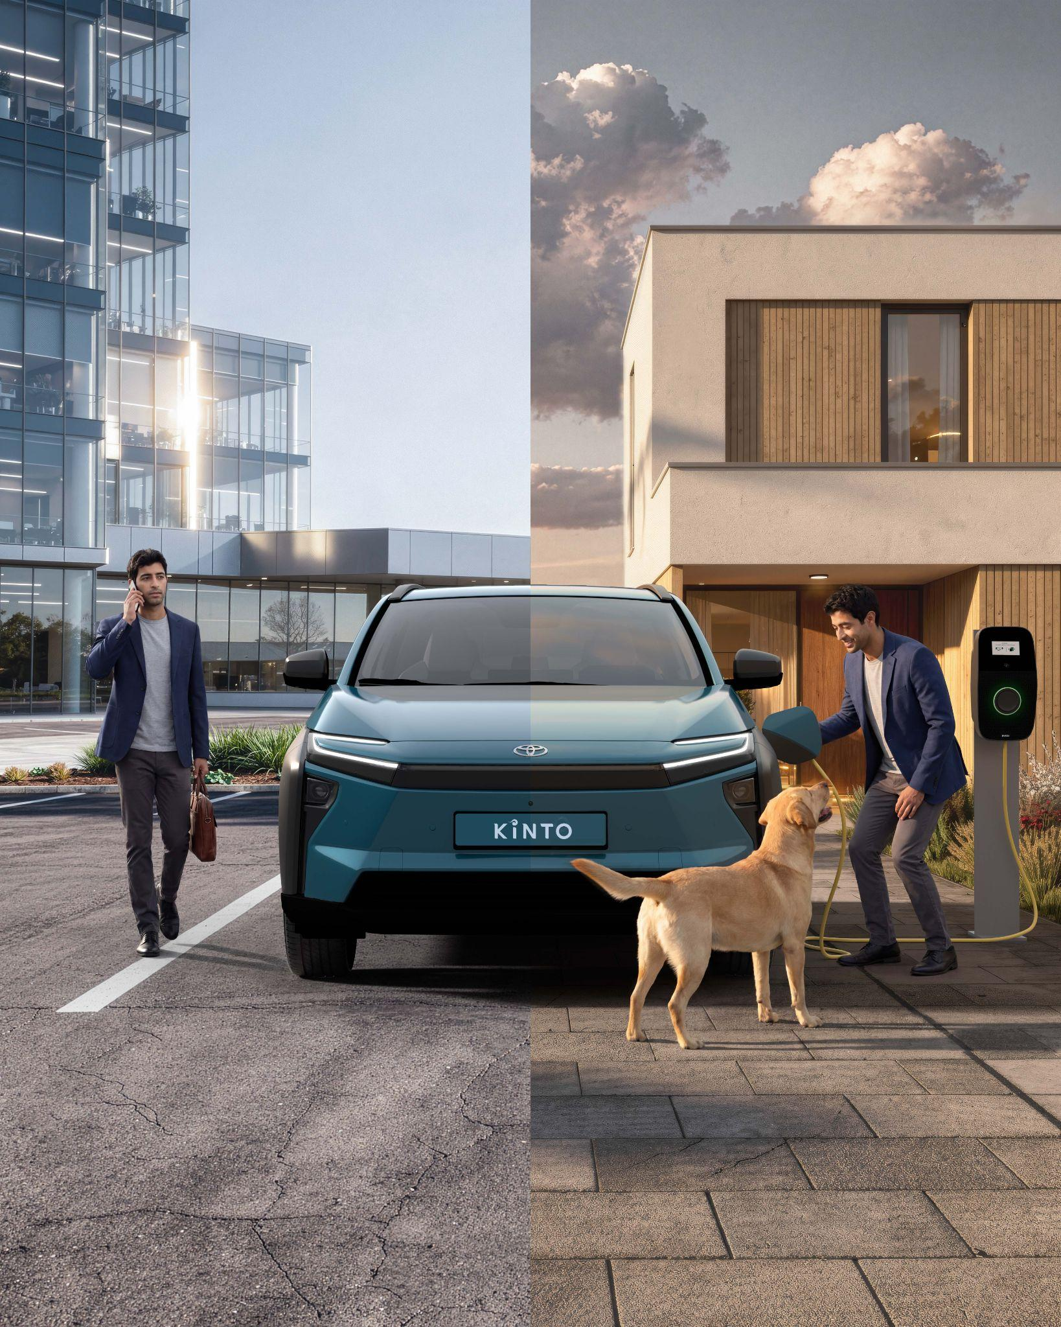


6.VISUAL LABOUR DAY
COPY LI
Labour Day is a moment to recognise the people behind the work. At KINTO, we believe that helping people show up to do their job and return home safely is not a nice-to-have, but a must.
We provide the flexible and reliable mobility solutions that support every working life. Whether you are heading to the office or returning to what matters most, our goal is to make the journey seamless.
One partner. Every solution.
#KINTO #LabourDay #BusinessMobility
CONTENT BUCKET 1- MAY
FORMATS AVAILABLE:
4/5 - 1X1

Slide 25
6.VISUAL LABOUR DAY
CONTENT BUCKET 1- MAY
COPY IG
We’re honouring the journey this Labour Day. 💼🏡
Because mobility is about more than just the commute. It’s about showing up, doing your best work, and getting home safely to what matters most. 🐶
One partner. Every solution.
#KINTO #LabourDay #WorkLifeBalance
FORMATS AVAILABLE:
4/5 1X1

Slide 26
6.VISUAL LABOUR DAY
COPY FB
Labour Day is a reminder of the importance of mobility to enable you to show up, do your best work, and return to what matters most. 🐶
Whether you are heading to the office or pulling into your driveway, we provide the flexible solutions that support your life. 🏡
One partner. Every solution.
#KINTO #LabourDay #WorkLifeBalance
.
CONTENT BUCKET 1- MAY
FORMATS AVAILABLE:
4/5 1X1

Slide 27
extra. VLV CAMPAIGN
COPY - LI:
What would you do with the time you spend on fleet admin?
With our one-stop-shop approach, we take care of the details so you can enjoy the journey. From maintenance and tyres to road assistance, we handle the complexity behind the scenes.
Move forward with confidence, knowing everything is taken care of.
#KINTO #LeasingYouCanTrust #Mobility
video:
https://limecraft.hotelhungaria.be/api/s/dvTq6zc-Y1t
CONTENT BUCKET 1- MAY
FORMATS AVAILABLE:
1/1 - 9/16 - ⅘ - 16/9
Notes:
#KINTO #FleetManagement #CorporateMobility #FlexibleMobility #MobilitySolutions

Slide 28
extra VLV CAMPAIGN
COPY - IG:
The best fleet management is the one you never think about. 🤝
It’s the tyres that are always ready, the maintenance that happens like clockwork, and the peace of mind that follows you every kilometer. We handle the complexity behind the scenes, so you can stay in the spotlight. 🧘
#KINTO #PeaceOfMind #Leasing
video:
https://limecraft.hotelhungaria.be/api/s/dvTq6zc-Y1t
CONTENT BUCKET 1- MAY
FORMATS AVAILABLE:
1/1 - 9/16 - ⅘ - 16/9
Notes:
#KINTO #FleetManagement #CorporateMobility #FlexibleMobility #MobilitySolutions

Slide 29
extraVLV CAMPAIGN
COPY - FB:
Ready to give your fleet business peace of mind? 🧘
Let us manage the admin and technical details, while you focus on growing your business. You stay in control of the big picture, we’ll handle the rest. 🛠️
#KINTO #SmarterMobility #StressFree
video:
https://limecraft.hotelhungaria.be/api/s/dvTq6zc-Y1t
CONTENT BUCKET 1- MAY
FORMATS AVAILABLE:
1/1 - 9/16 - ⅘ - 16/9
Notes:
#KINTO #FleetManagement #CorporateMobility #FlexibleMobility #MobilitySolutions

Slide 30
7.VIDEO CUSTOMER FLEET DELIVERY
TBD
CONTENT BUCKET 1- MAY
COPY LI
FORMATS AVAILABLE:
4/5

Slide 31
7.VIDEO CUSTOMER FLEET DELIVERY
TBD
CONTENT BUCKET 1- MAY
COPY IG
FORMATS AVAILABLE:
4/5

Slide 32
7.VIDEO CUSTOMER FLEET DELIVERY
TBD once video is made
CONTENT BUCKET 1- MAY
COPY FB
FORMATS AVAILABLE:
4/5

Slide 33
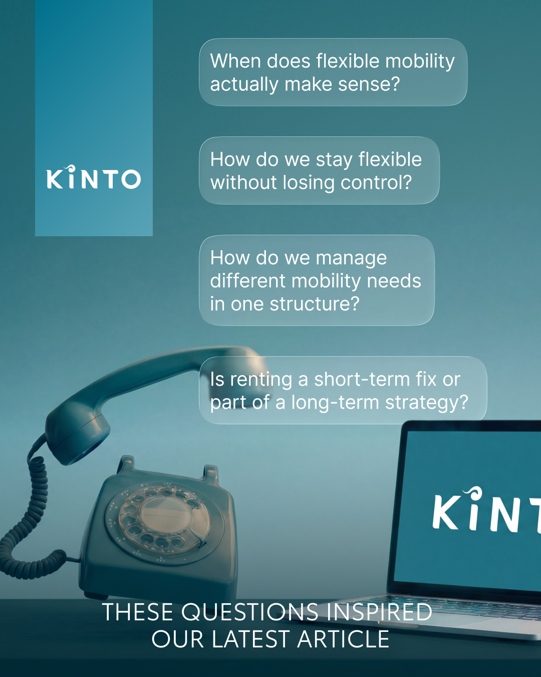
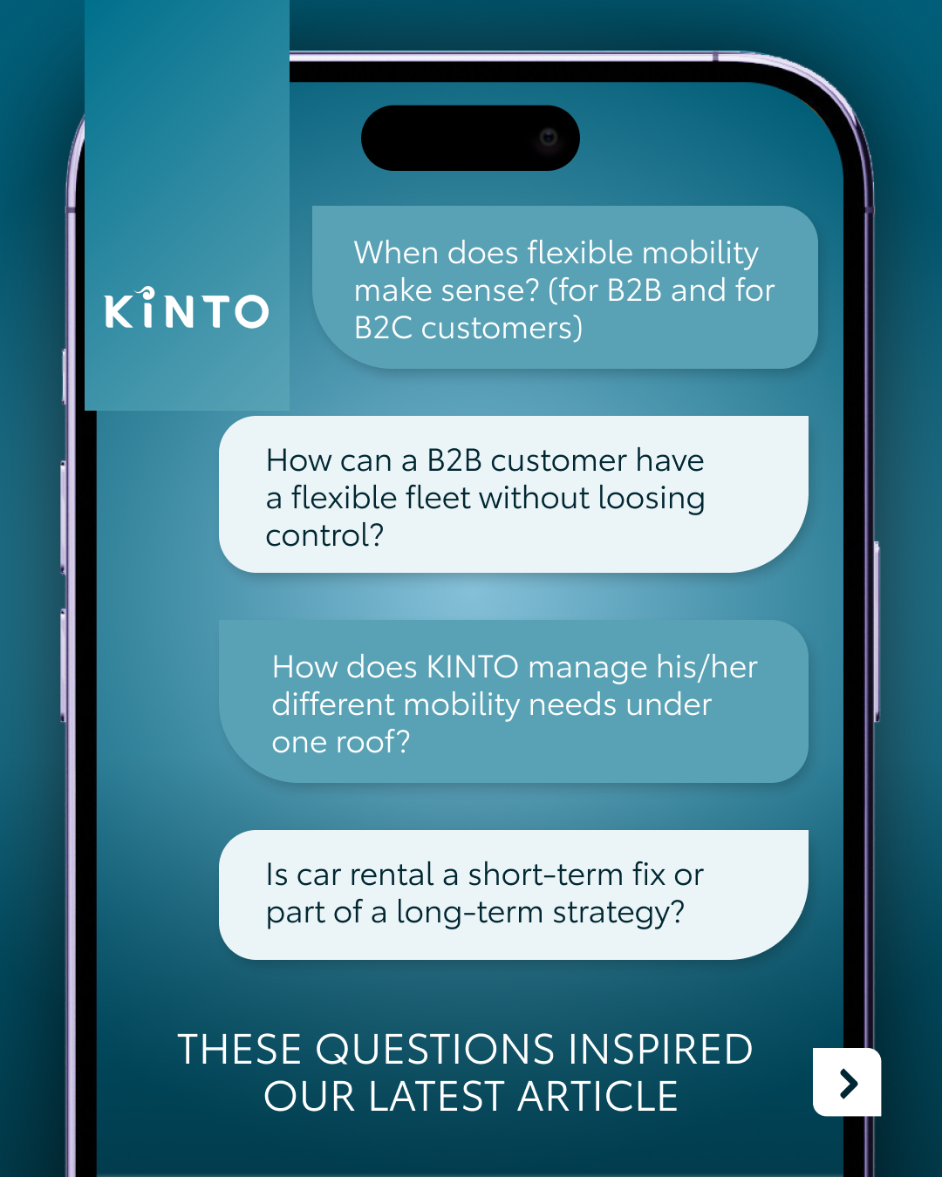
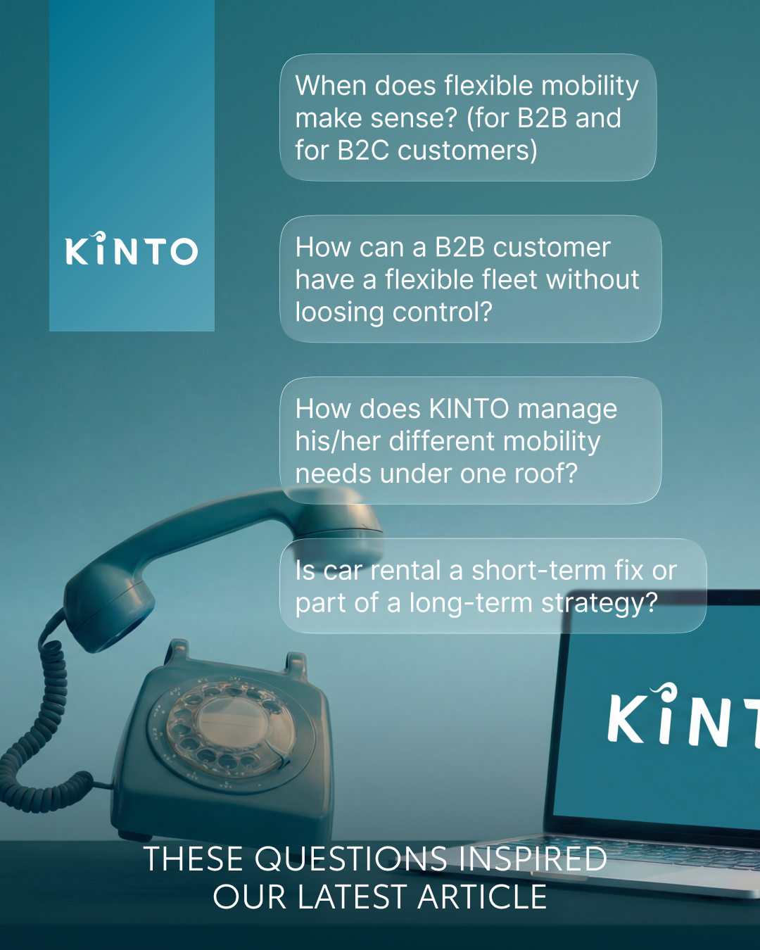
8.VISUAL FLEXIBLE RENT
CONTENT BUCKET 1- MAY
COPY LI
When does flexibility actually make sense for your business? How do you maintain control while staying agile? These are the questions we hear every day in our conversations with fleet managers.
They reflect a new reality where mobility needs are constantly evolving. We explore these topics further in our latest long read, grounded in real use cases and experience.
One partner. Every solution.
#KINTO #BusinessMobility #FleetManagement
FORMATS AVAILABLE:
4/5 1X1

Slide 34
8.VISUAL FLEXIBLE RENT
CONTENT BUCKET 1- MAY
COPY IG
Flexible mobility. When does it make sense? How do you stay in control? Is it a quick fix or a long-term strategy? 🚙
These real world questions inspired our latest insights. We explored the reality of modern fleet management through practical experience and real use cases. 📈
Read our latest long read via the link in our bio. 📍
One partner. Every solution.
#KINTO #MobilityTrends #FlexibleRent
FORMATS AVAILABLE:
4/5 1X1

Slide 35
8.VISUAL FLEXIBLE RENT
CONTENT BUCKET 1- MAY
COPY FB
Whether it’s a short-term fix or part of a long-term strategy, staying agile without losing control is a top priority for many fleet managers.💡
We recently shared our latest insights on this topic in a new long read on our LinkedIn channel. We dive deep into the practical side of flexible mobility to help you find the best fit for your business. 📖
Follow us on LinkedIn via @KINTOMobility to read the full story.
One partner. Every solution.
#KINTO #SmarterMobility #FleetManagement
FORMATS AVAILABLE:
4/5 1X1

Slide 36
9. LONGREAD FLEXIBLE RENT
CONTENT BUCKET 1- MAY
Notes:
💚👉🫵🤝🚗🚙🚘🔧📈📊📉🆕✨❇️🆙☀️🤝😌💚🔥💪✅☝️👉🫵⏰🚐🚘🫵👉👥💪💼🥳👀

Slide 37



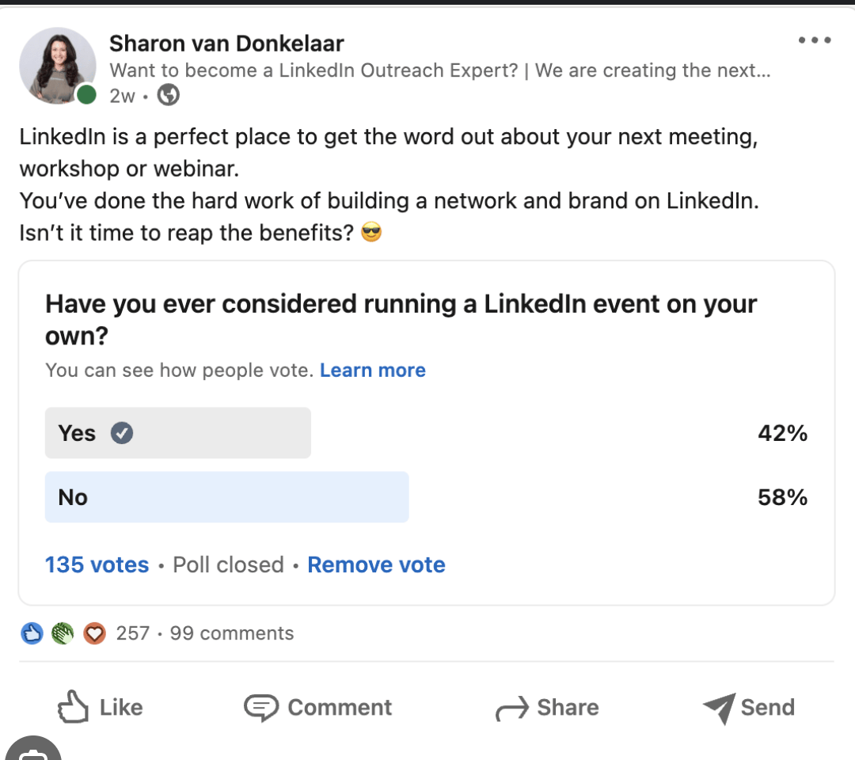
10.POLL ADDED VALUE RENT
COPY - LI
Whether you’re scaling up for a new project or bridging the gap while waiting for a long-term lease, flexibility is key to keeping your business moving.
We are curious to hear which challenge currently tops your priority list. Cast your vote below and join the conversation with fellow fleet managers.
In which situation would renting add the most value to your fleet?
Temporary capacity gaps
New hires or trial periods
Project-based or interim roles
Bridging delays in new car deliveries
CONTENT BUCKET 1- MAY

Slide 38

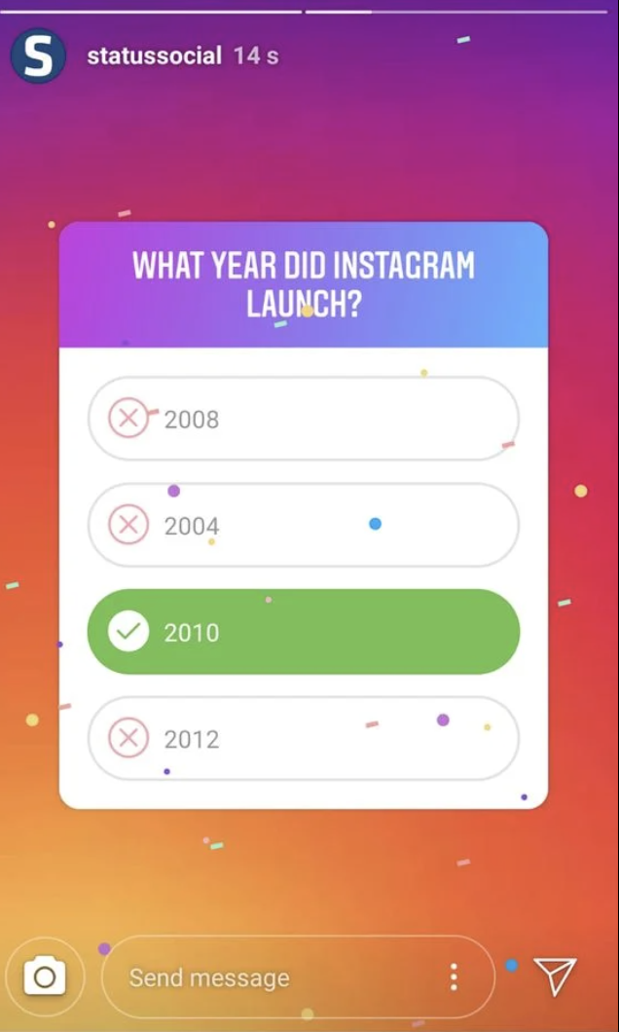
10.POLL ADDED VALUE RENT
COPY - IG STORY
Where does flexible rent add the most value?
Temporary capacity gaps
New hires or trial periods
Project-based or interim roles
Bridging delays in new car deliveries
CONTENT BUCKET 1- MAY

Slide 39
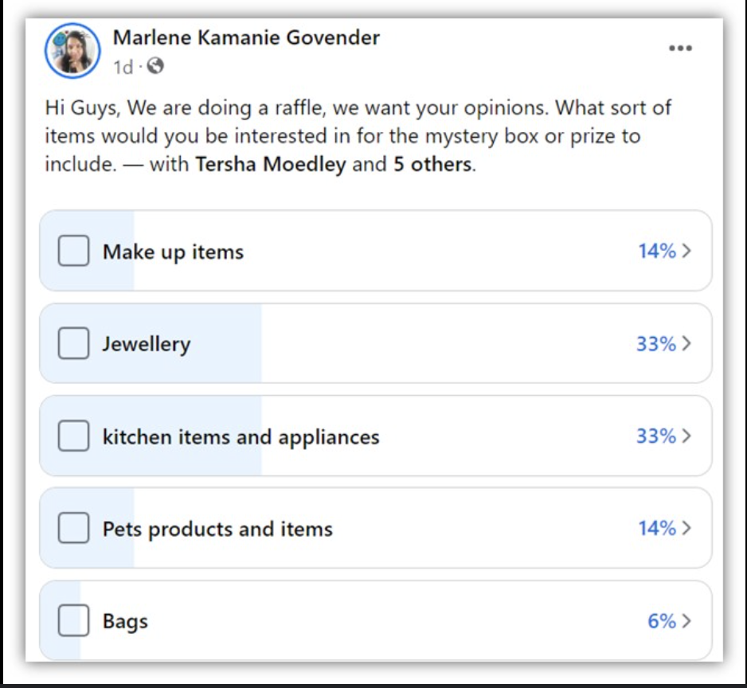
10.POLL ADDED VALUE RENT
COPY - FB
Quick check in. 👇
Sometimes you need extra vehicles faster than expected, whether it is for new team members, temporary projects, or simply for bridging a gap.
In which situation would renting make the biggest difference for you?
Temporary capacity gaps
New hires or trial periods
Project-based or interim roles
Bridging delays in new car deliveries
CONTENT BUCKET 1- MAY

