Slide 1

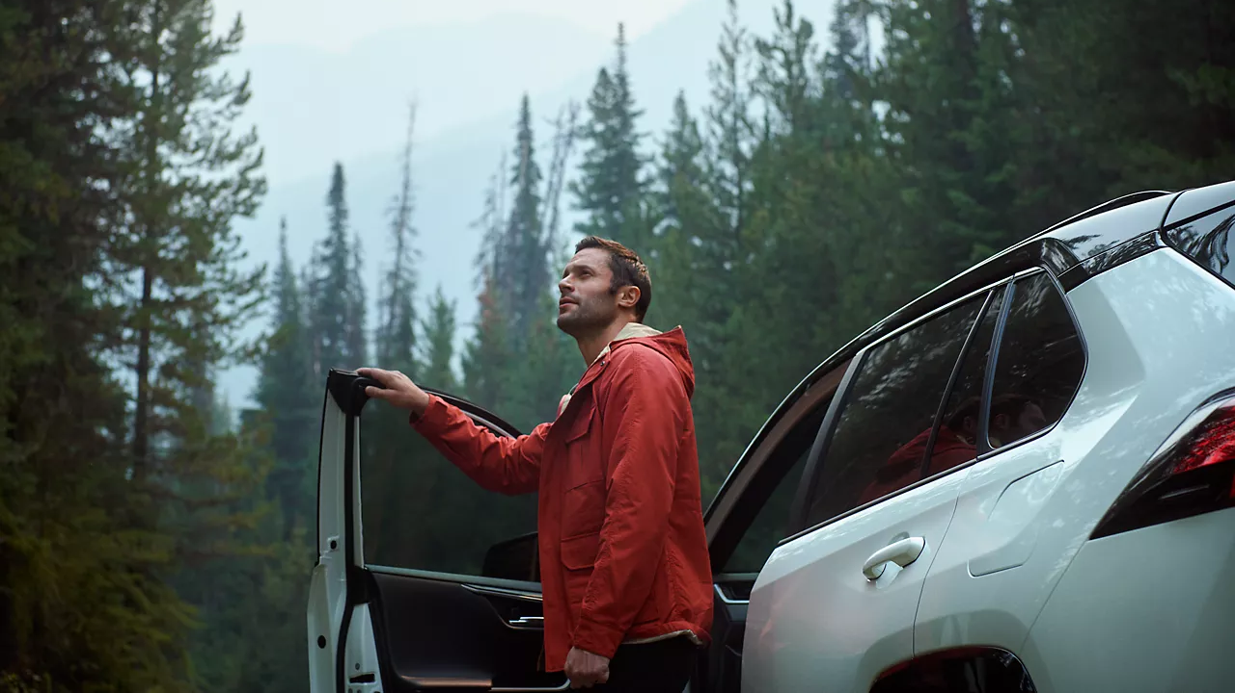

CONTENT
June

Slide 2
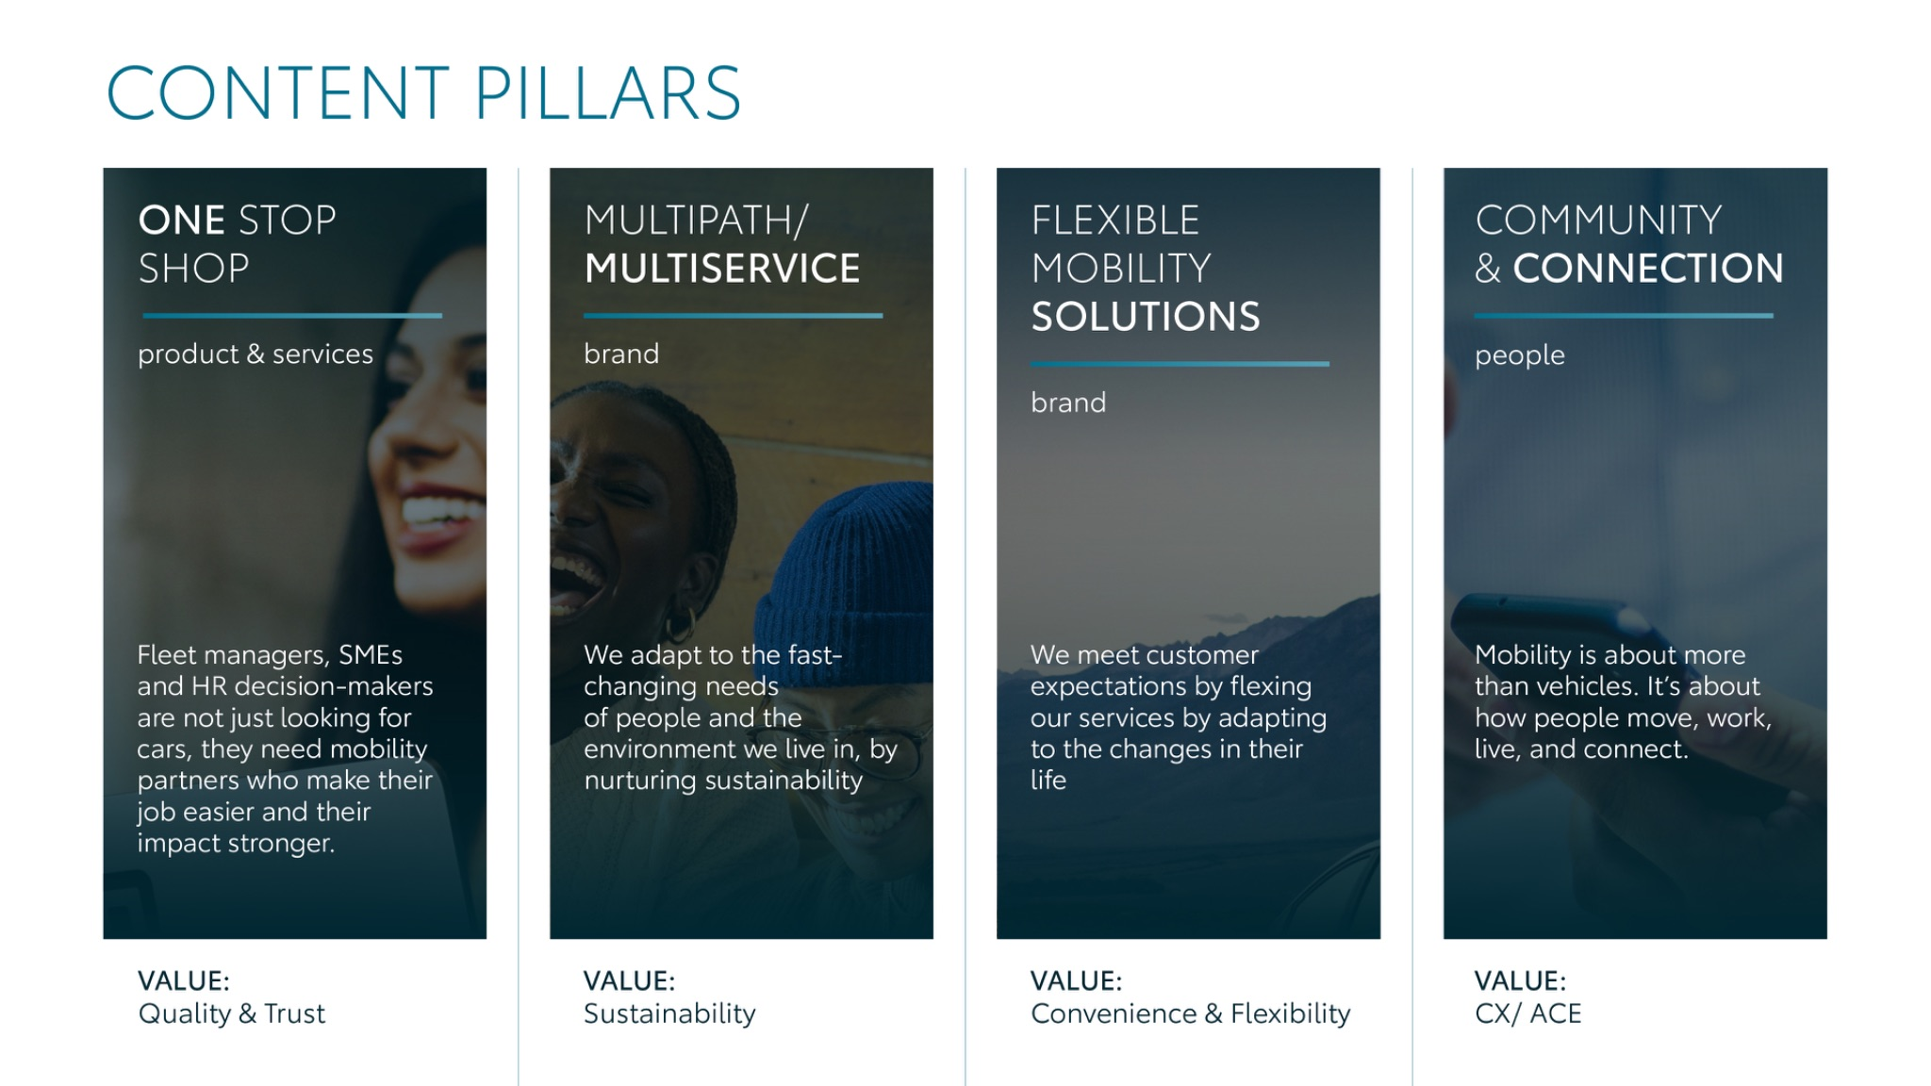
Notes:
“At KINTO, we work with content pillars: themes that carry our brand. We use different content types: inspiring, informative, topical. Your contributions add the human layer that makes the strategy work.”

Slide 3

Content pillars - content overview
JUNE
Mobility Partner
Mobility Costs
World environmental day
More Space
Car Toy
Battery Video
Assumption vs reality
Inspirational quote
End of school
solstice day
ONE STOP SHOP
MULTIPATH/ MULTISERVICE
FLEXIBLE MOBILITY SOLUTIONS
COMMUNITY/ CONNECTION

Slide 4
Tag lines pillars
1. One Stop Shop
One partner. Every solution.
2. Flexible Mobility Solutions
One partner. Every solution.
3. Community and connection (important to keep it broad enough to fit clients as well as people working at Kinto)
Join the KINTO community.
4. Vision & Impact (Multipath/multiservice)
One partner. Every solution.

Slide 5

One stop shop
Notes:
One place. Every solution. Always KINTO.

Slide 6




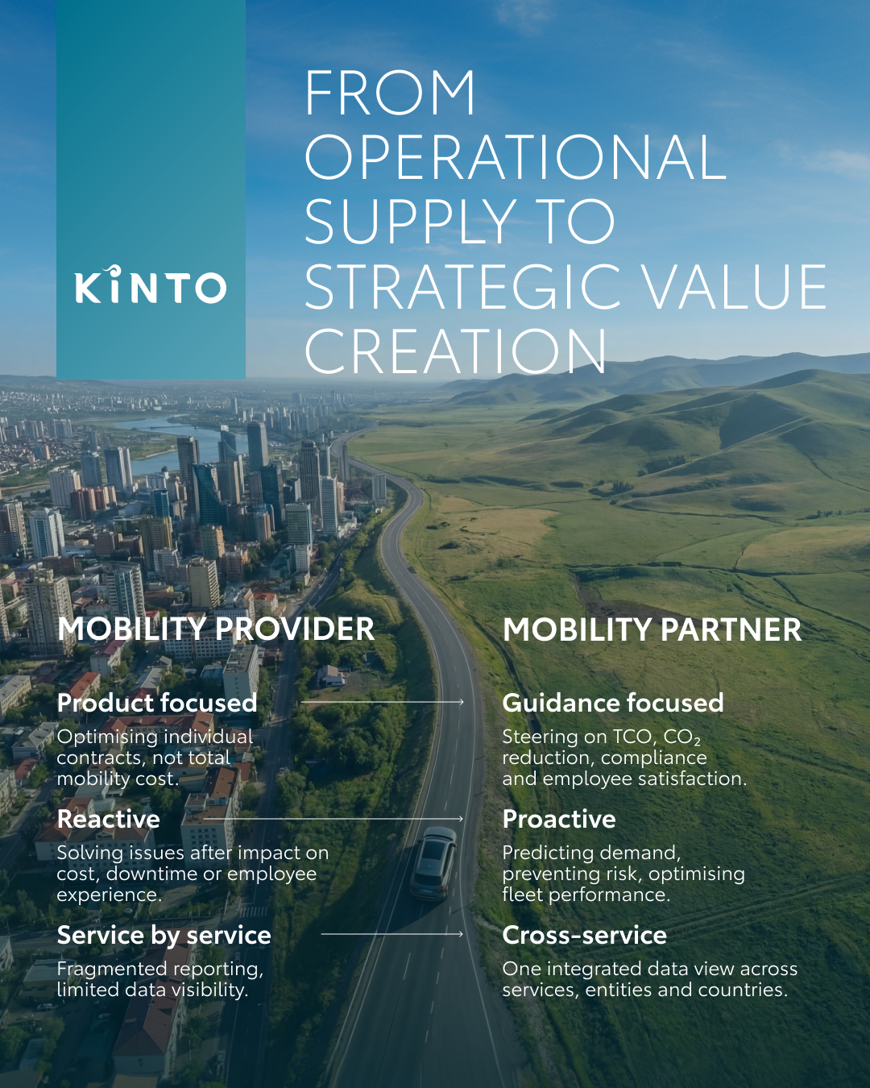
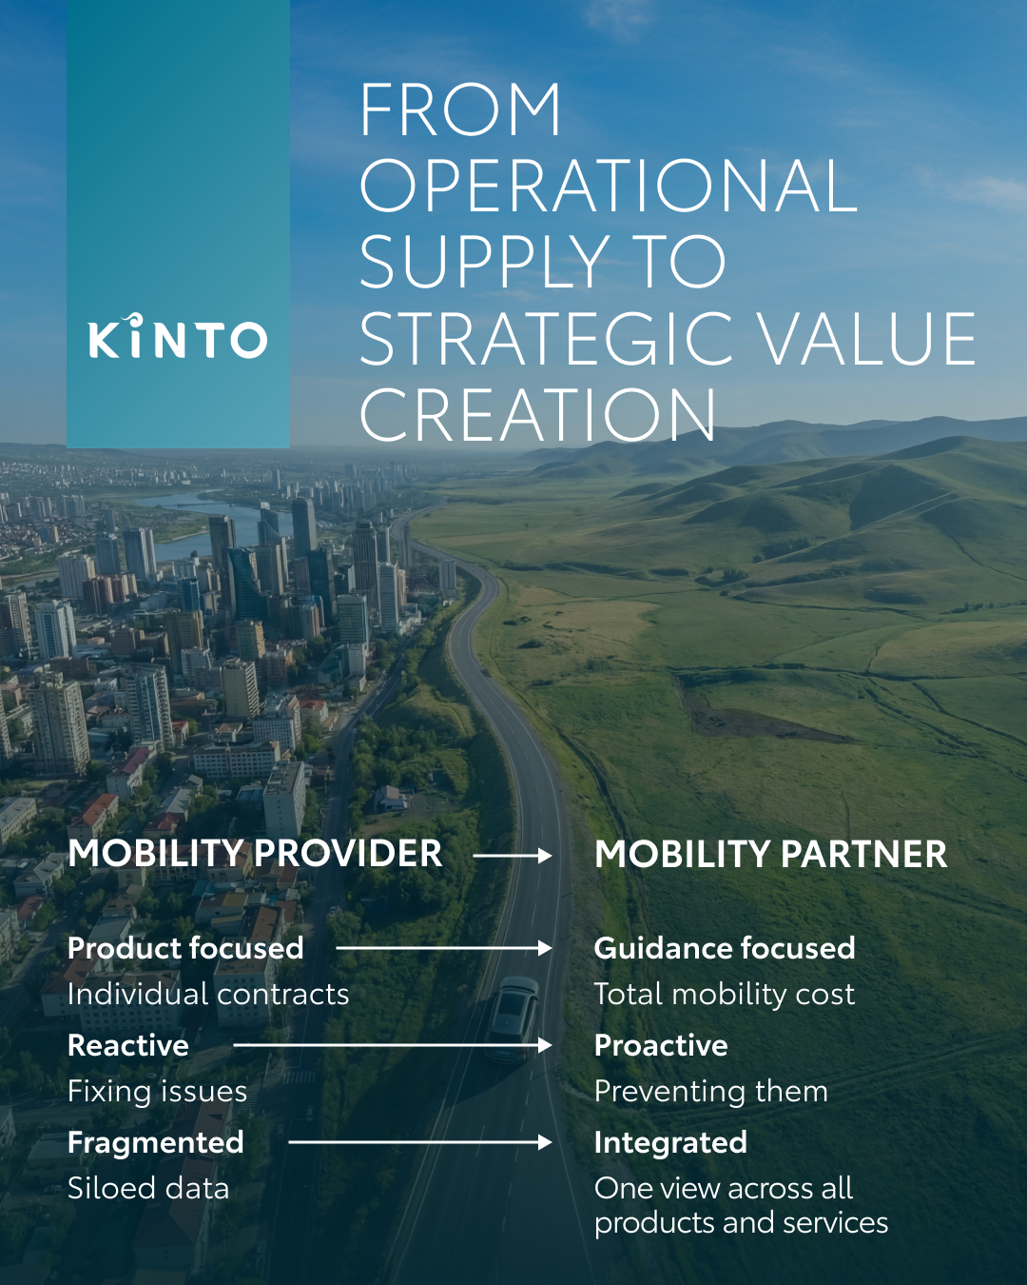
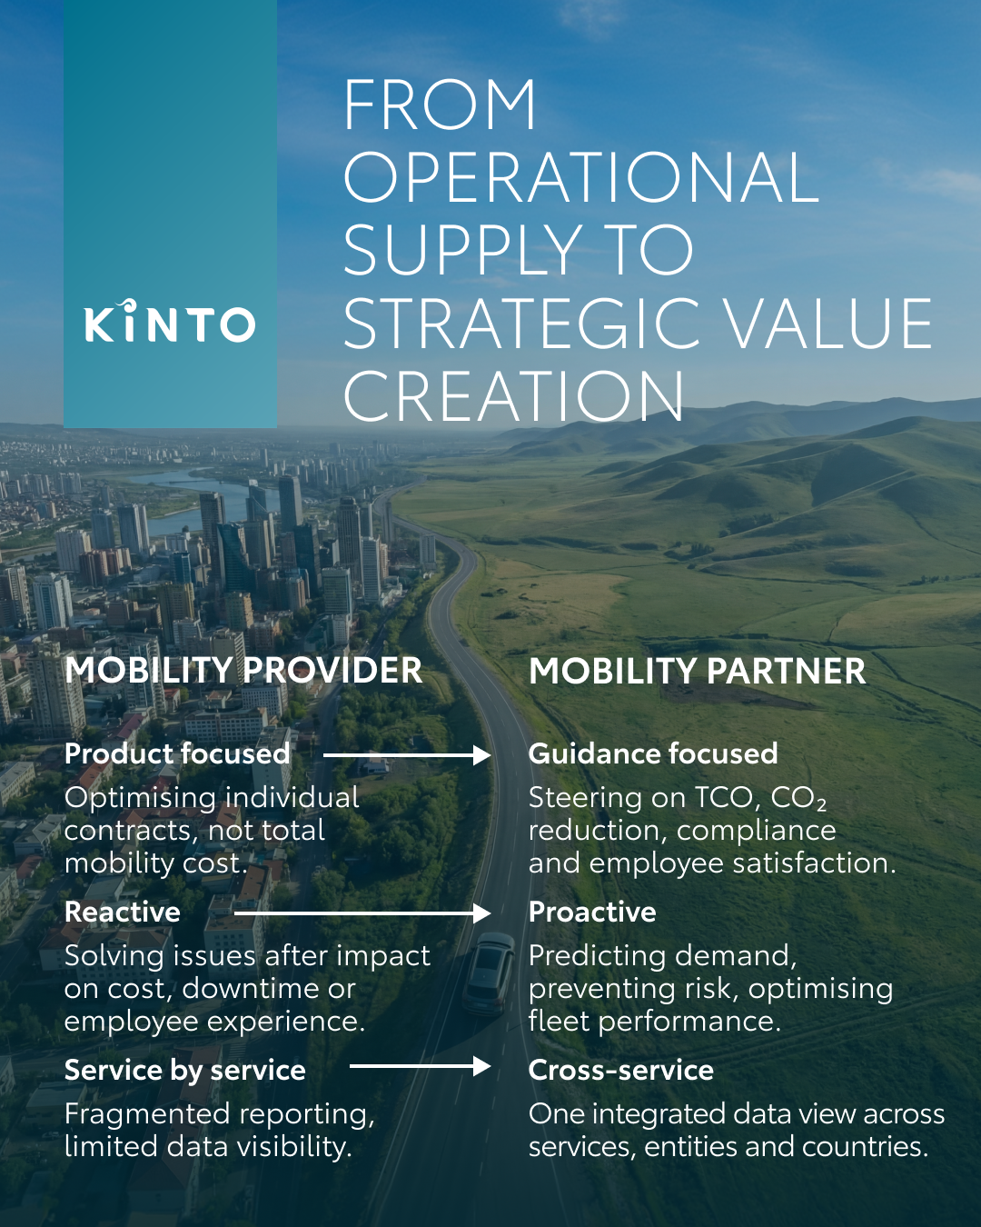
Valid for multibrand
1.VISUAL MOBILITY PARTNER
COPY LI
CONTENT BUCKET 1- MAY
Is your mobility provider just a passenger or a true co-pilot? 🏎️
In the world of fleet management, the most important connection is the one between partners. At KINTO, being a mobility partner means we anticipate the road ahead, removing any obstacle form the journey
🔹 We move beyond the basics to help you steering on TCO, CO2 reduction, compliance and employee satisfaction.
🔹 We manage your risks through our included services.
🔹 No more fragmented views. We provide one integrated data view across all services.
We’re here to turn your mobility from a logistical task into a strategic advantage. Making your journey smoother, every kilometre of the way. 🤝
What’s the one quality you value most in a business partner? Let us know below. 👇
One partner. Every solution.
#KINTO #MobilityPartner #FutureOfMobility
FORMATS AVAILABLE:
4/5 1/1

Slide 7
Valid for multibrand
1.VISUAL MOBILITY PARTNER
COPY IG
Is your mobility a one-way street or a shared journey? 🤝
Managing a fleet is one thing, but having a partner who thinks along with you is where it really clicks. That’s why KINTO is your dedicated mobility partner. We’re here to make your business journey feel like a breeze, every kilometre of the way. 🚗
Which of these three qualities makes your life the easiest? Let us know below!
One partner. Every solution.
#KINTO #MobilityPartner #FutureOfMobility
CONTENT BUCKET 1- MAY
FORMATS AVAILABLE:
4/5 1/1

Slide 8
Valid for multibrand
1.VISUAL MOBILITY PARTNER
COPY FB
Does your mobility feel like a solo trip or a shared journey? 🤝
Managing a fleet is a complex puzzle, and you shouldn't have to solve it alone. That’s why at KINTO, we’re not just a service provider, we’re your dedicated mobility partner.
For us, that means being by your side with guidance, proactive support and cross-service ease. We’re here to make the journey smoother, every kilometre of the way. 🚗
Which of these three qualities do you value most in a partner? Let us know in the comments! 👇
One partner. Every solution.
#KINTO #MobilityPartner #Partnership
CONTENT BUCKET 1- MAY
FORMATS AVAILABLE:
4/5 1/1

Slide 9


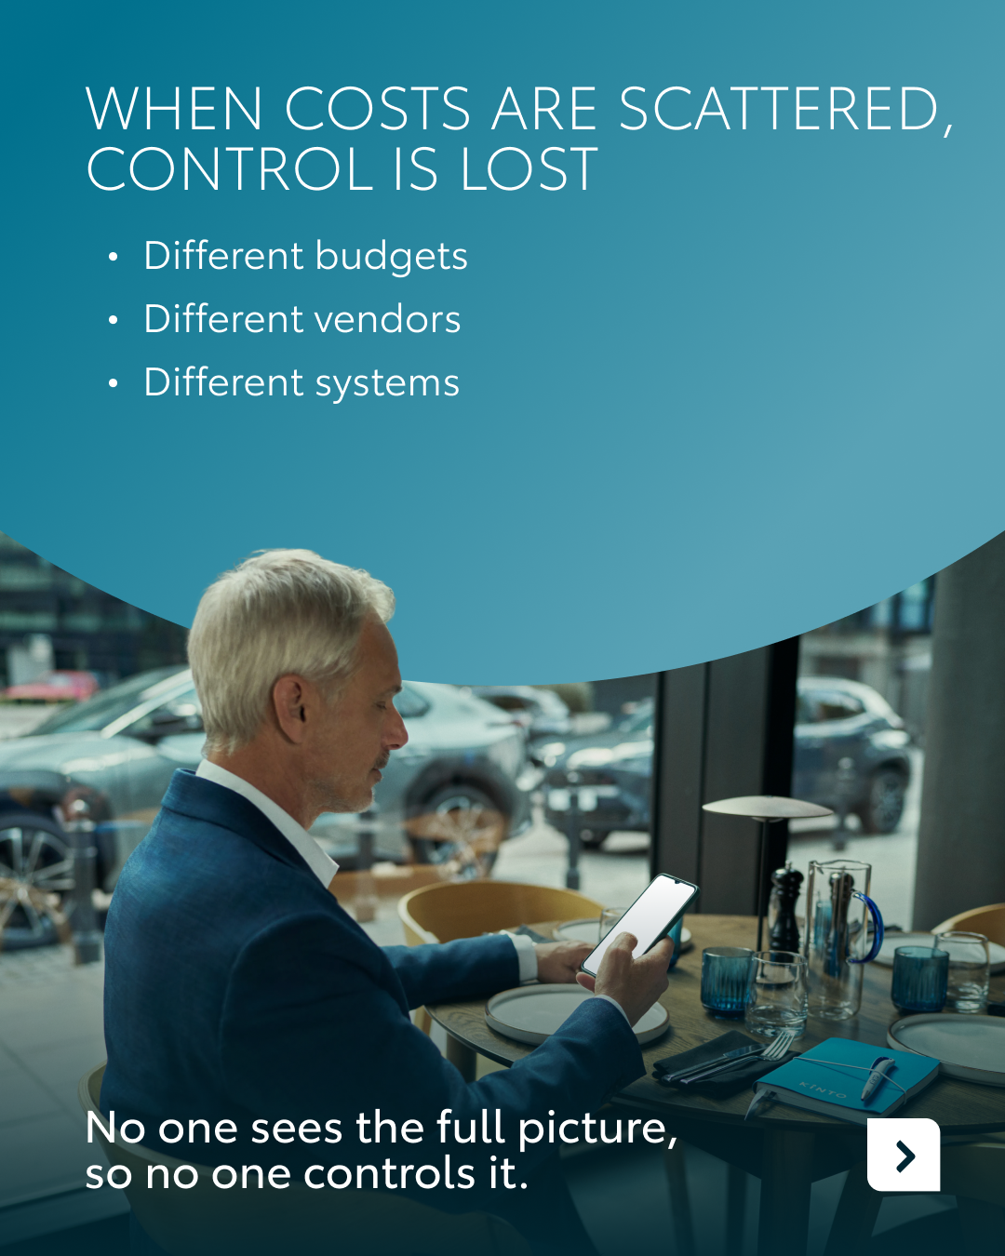




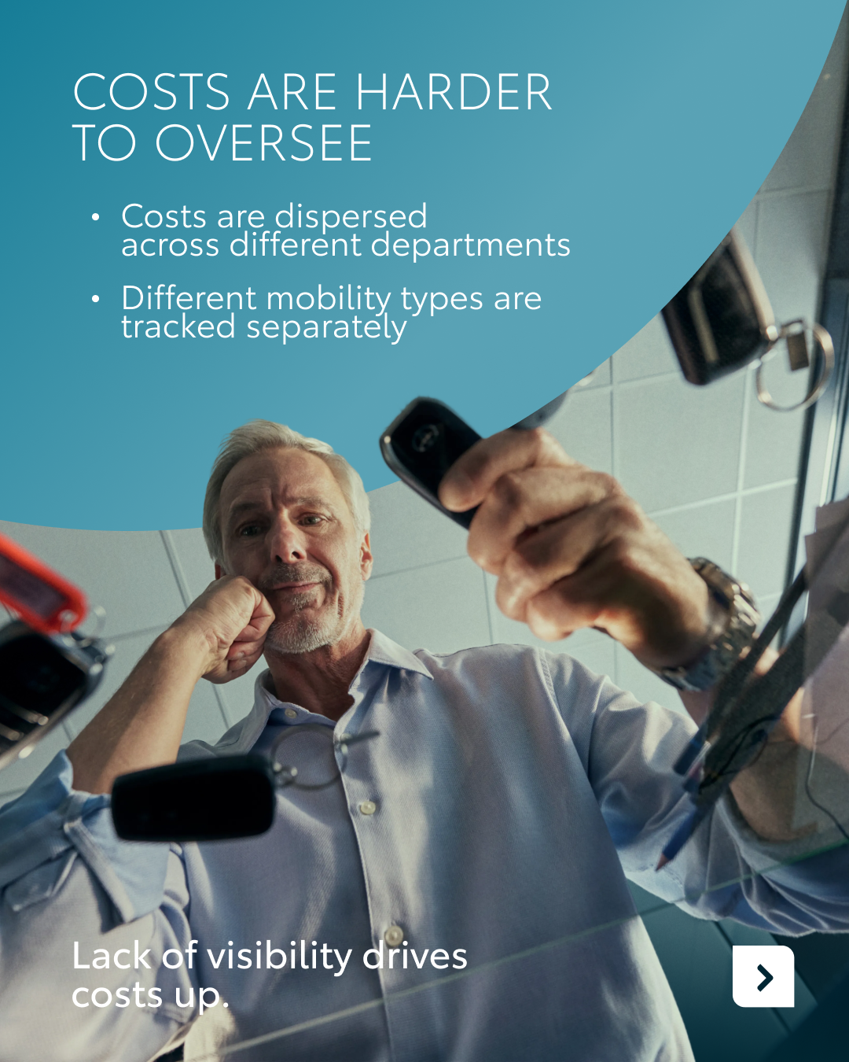

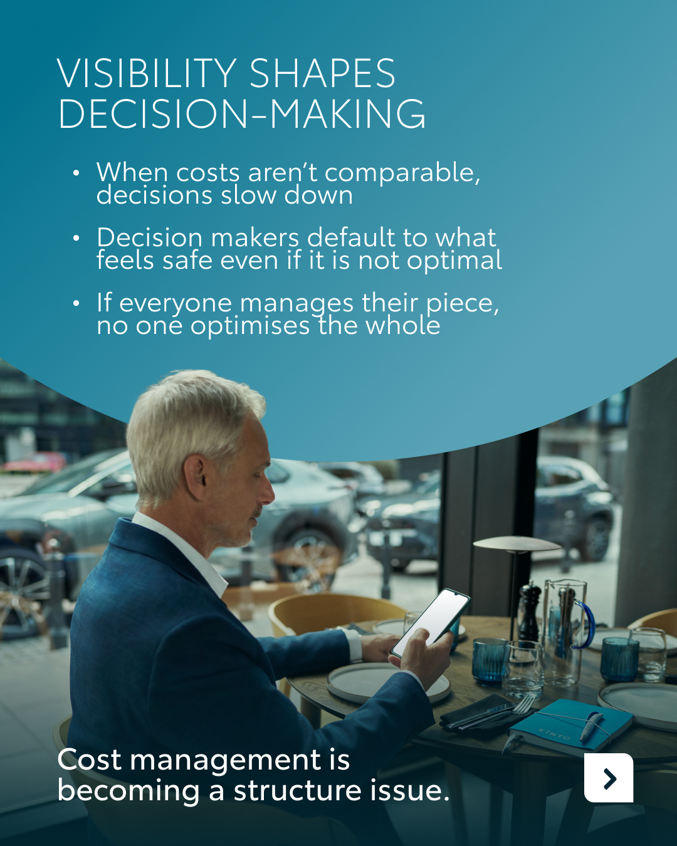
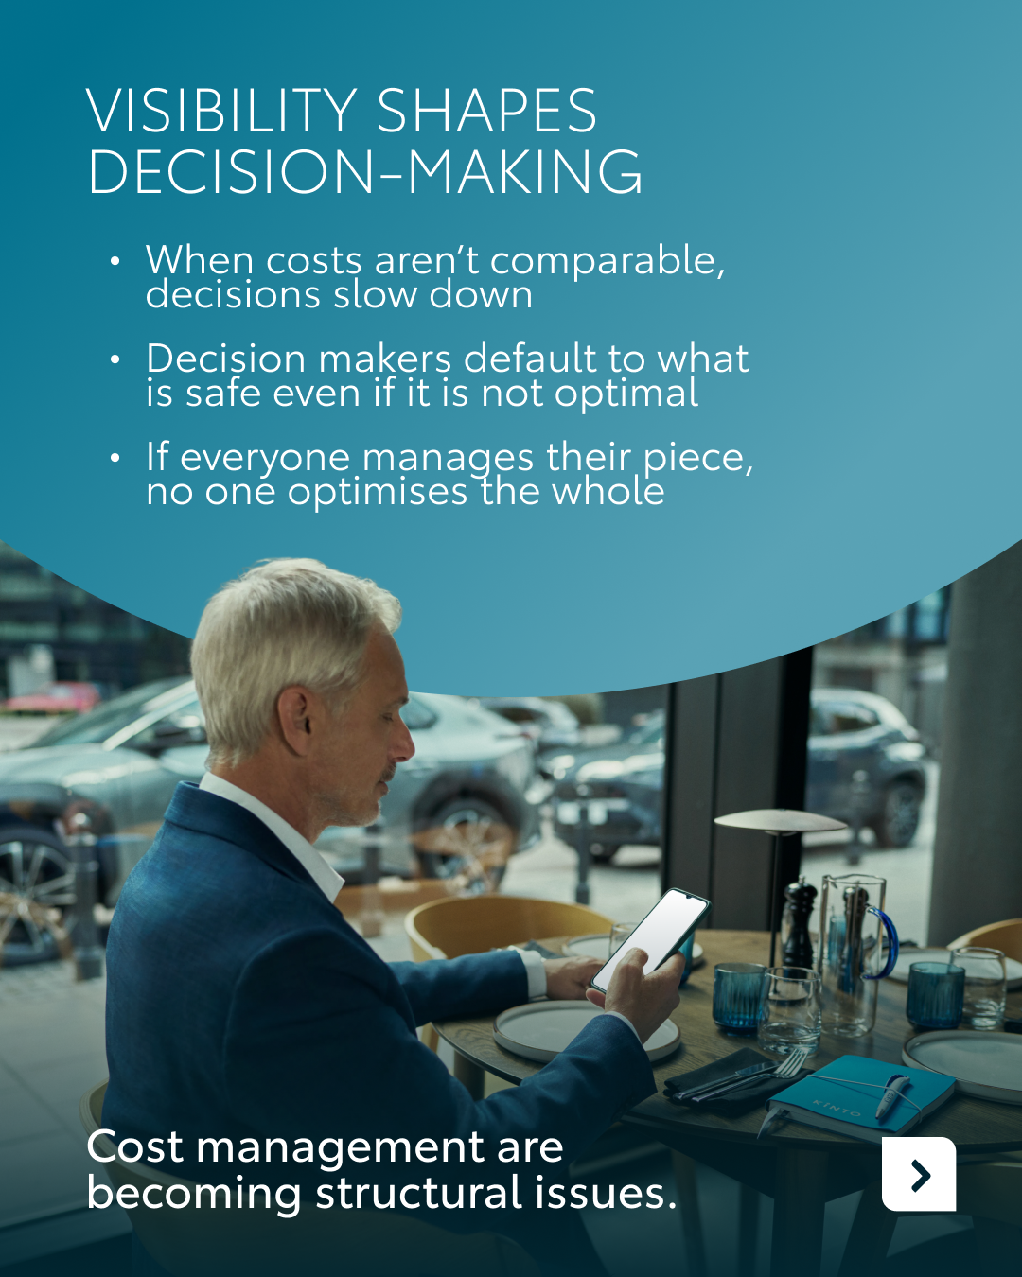
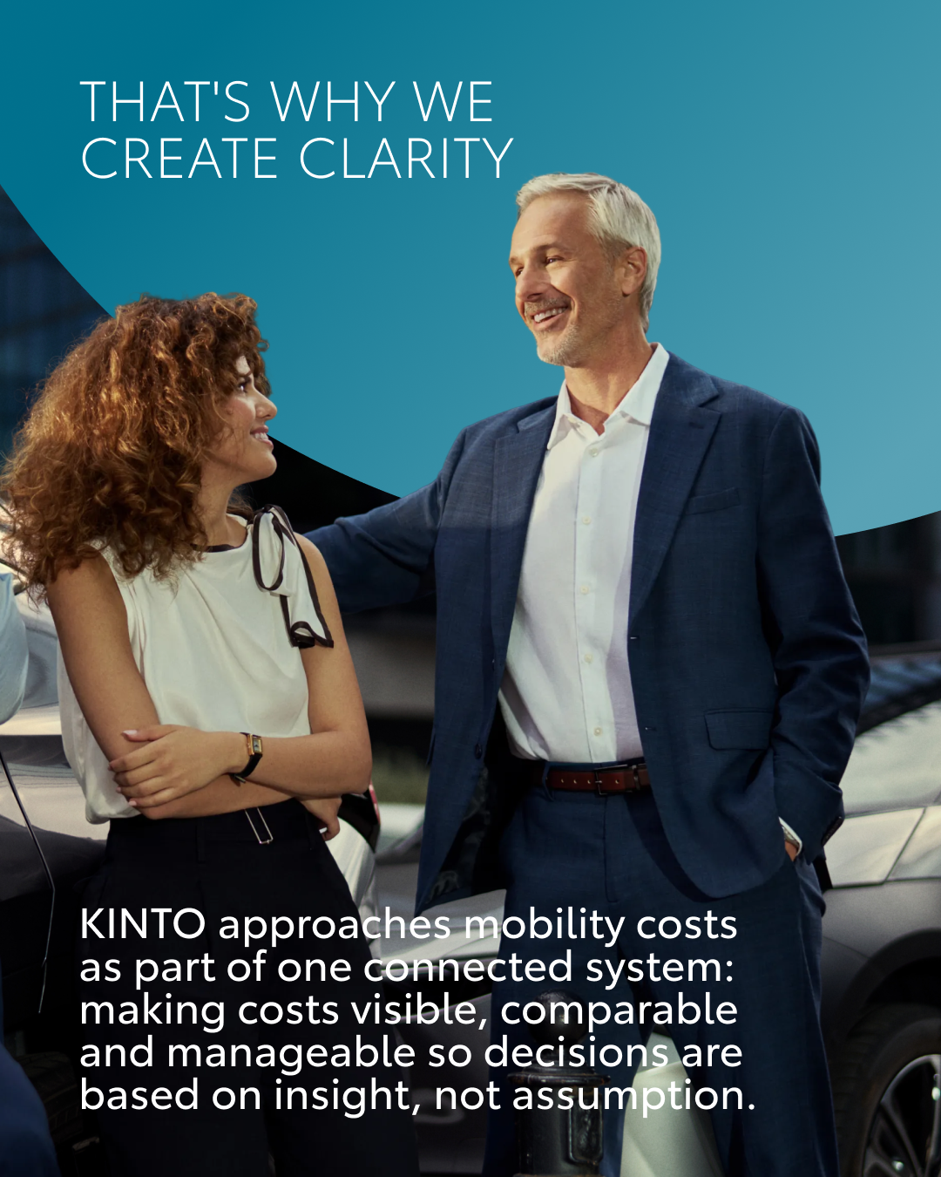
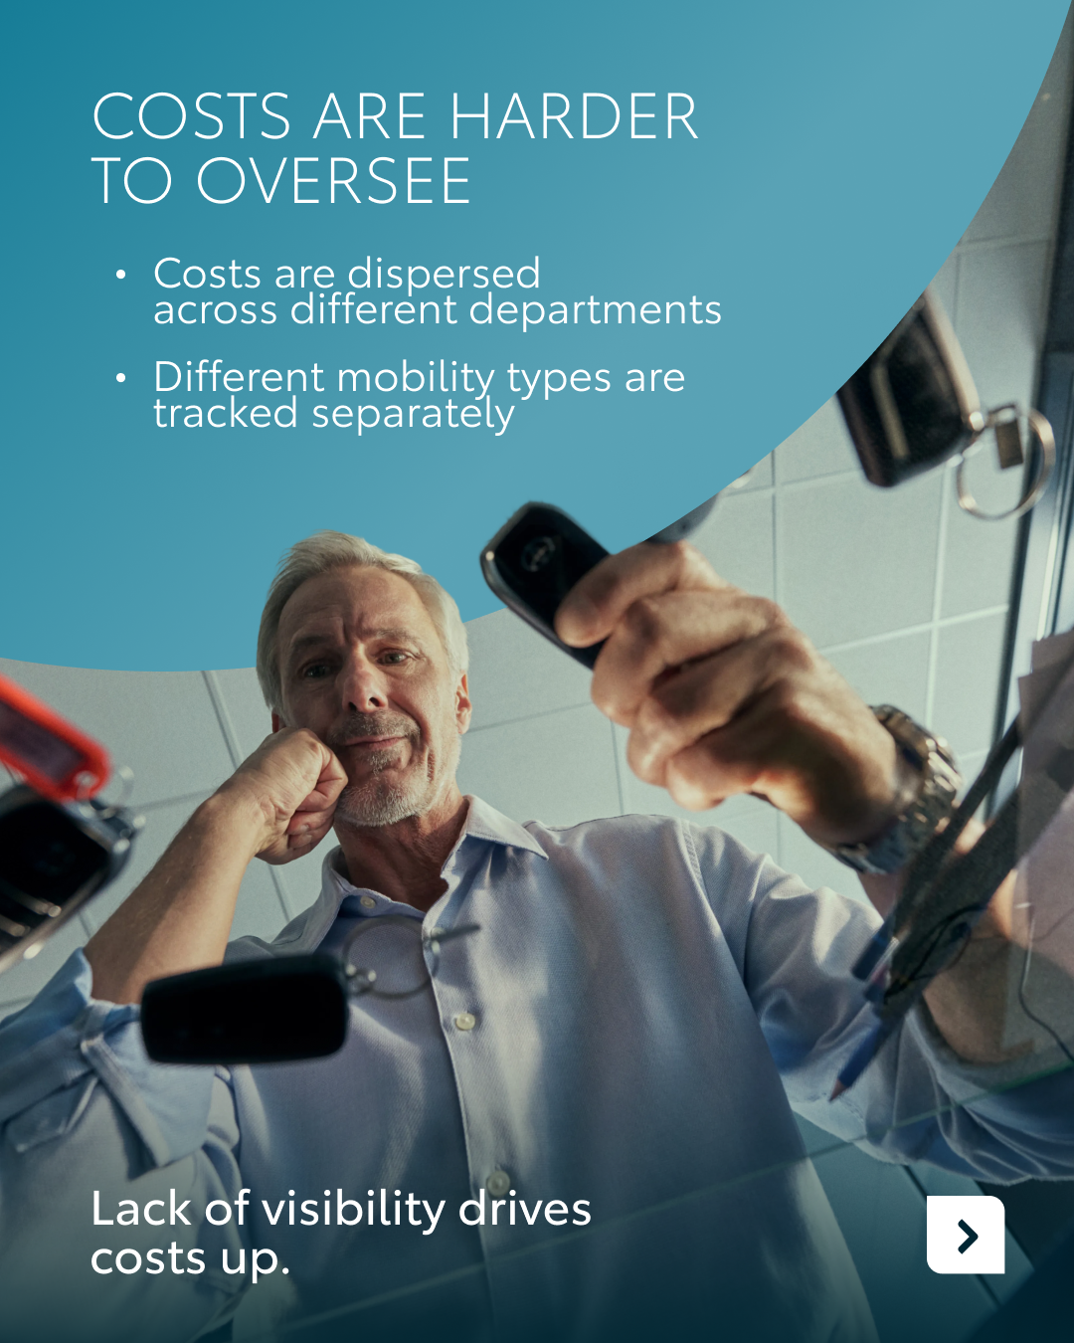
Valid for multibrand
2.VISUAL MOBILITY COSTS
COPY LI
CONTENT BUCKET 1- MAY
Are fragmented mobility costs slowing down your decision-making? 📉
In today’s market, managing mobility expenses is a structural challenge that’s not just about numbers anymore. When costs are dispersed across different departments and data visibility is limited, it becomes impossible to optimise the whole.
At KINTO, we create transparency by putting all mobility costs under one connected system. Therefore, we ensure your costs are visible, comparable and manageable.
Our goal? Faster, more insightful decisions based on data. Because when your costs are clear, your path to growth is too. 🤝
How does your organisation currently oversee mobility expenses? 👇
One partner. Every solution.
#KINTO #MobilityCosts #Transparency
FORMATS AVAILABLE:
4/5

Slide 10
Valid for multibrand
2.VISUAL MOBILITY COSTS
CONTENT BUCKET 1- MAY
COPY IG
Blurred vision on mobility costs? Let’s clear the view. 🔍
When data is scattered, making the right choice for your fleet becomes a game of guesswork. At KINTO, we create transparency so you can stop searching for the numbers and start using them to move your business forward. 🚗
Do you prefer a bird's-eye view or a deep dive into the data?
One partner. Every solution.
#KINTO #MobilityCosts #DataTransparency
FORMATS AVAILABLE:
4/5

Slide 11
Valid for multibrand
2.VISUAL MOBILITY COSTS
COPY FB
CONTENT BUCKET 1- MAY
When mobility expenses are spread across different departments, it’s a challenge to maintain a clear overview. 👀
At KINTO, we move beyond the clutter to create true transparency. By putting your mobility costs under one connected system, we ensure they are visible, comparable and manageable. That way you can focus on moving your business forward with confidence. 🚗
Does your team manage mobility costs through one central system or is it currently spread across departments? 👇
One partner. Every solution.
#KINTO #MobilityCosts #DataTransparency
FORMATS AVAILABLE:
4/5

Slide 12
Multipath/
Multiservice
Pillar 4

Slide 13





Valid for multibrand
3.WORLD ENVIRONMENTAL DAY
COPY - LI:
Today is World Environment Day. A moment to reflect on the footprint we leave behind.
At KINTO, we believe that sustainability shouldn’t be just a slogan on a wall. It’s about rethinking our daily journeys and making conscious choices that move us forward. 🍀
Whether it’s transitioning to an electrified fleet, optimizing shared mobility or encouraging smarter commuting habits, every step counts toward your emission targets.
Which KINTO service would best support your emission reduction goals? 👇
One partner. Every solution.
#WorldEnvironmentDay #SustainableMobility #KINTO
CONTENT BUCKET 1- MAY
FORMATS AVAILABLE:
1/1 - ⅘
Notes:
#KINTO #FleetManagement #CorporateMobility #FlexibleMobility #MobilitySolutions

Slide 14
Valid for multibrand
3.WORLD ENVIRONMENTAL DAY
COPY - IG:
Today is World Environment Day! A day to rethink the footprint we leave behind. 🌱
At KINTO, we’re committed to helping you find a better balance between business and the planet. Whether it’s choosing an electrified ride or sharing a journey, small shifts today lead to a cleaner road tomorrow. 🌎
How are you going green today? Let us know in the comments! 👇
One partner. Every solution.
#WorldEnvironmentDay #KINTO #SustainableMobility
CONTENT BUCKET 1- MAY
FORMATS AVAILABLE:
1/1- ⅘
Notes:
#KINTO #FleetManagement #CorporateMobility #FlexibleMobility #MobilitySolutions

Slide 15
Valid for multibrand
3. WORLD ENVIRONMENTAL DAY
COPY - FB:
Today is World Environment Day! A moment to think about the impact of our daily commute and business travels. 🌎
At KINTO, we believe that going green is about making smarter, more conscious choices that benefit both your business and the planet.
From choosing hybrid or electric vehicles to exploring shared mobility, we are here to help you reach your emission targets with ease. Every trip is an opportunity to pave the way for a cleaner tomorrow. 🌱
Which KINTO service would best support your emission reduction goals? 👇
One partner. Every solution.
#WorldEnvironmentDay #KINTO #SustainableMobility
CONTENT BUCKET 1- MAY
FORMATS AVAILABLE:
1/1 ⅘ -
Notes:
#KINTO #FleetManagement #CorporateMobility #FlexibleMobility #MobilitySolutions

Slide 16
Flexible mobility solutions
Pillar 3
Notes:
Baseline: Wherever life takes you, KINTO finds the right solution for you.

Slide 17


4.CAR TOY
COPY - LI:
We know that managing a fleet often comes with a lot of moving parts. But what if the process felt as simple as it did when we were kids playing with our favorite toys? 🏎️
KINTO aims to take the complexity out of mobility by combining flexible solutions with a proactive partnership.
Because when you have the right partner by your side, managing mobility truly becomes child’s play. 🪁
Ready to make mobility child’s play again? Discover more at kinto-mobility.eu
One partner. Every solution.
#KINTO #MobilitySolutions #BusinessFleet
CONTENT BUCKET 1- MAY
FORMATS AVAILABLE:
1/1 -- ⅘ -
Notes:
#KINTO #FleetManagement #CorporateMobility #FlexibleMobility #MobilitySolutions

Slide 18
4. CAR TOY
COPY - IG:
Remember when the hardest part of driving was choosing which toy car to pick up first? 🏎️
Growing up doesn’t mean your mobility should get complicated. At KINTO, we keep professional leasing simple, flexible, and effortless.
Discover more at kinto-mobility.eu
One partner. Every solution.
#KINTO #ChildsPlay #FleetManagement
CONTENT BUCKET 1- MAY
FORMATS AVAILABLE:
1/1 - 9/16 - ⅘ - 16/9
Notes:
#KINTO #FleetManagement #CorporateMobility #FlexibleMobility #MobilitySolutions

Slide 19
4. CAR TOY
COPY - FB:
Do you remember when ‘managing a fleet’ just meant lining up your favorite toy cars in the living room? 🏎️
At KINTO, we’re here to take the heavy lifting off your hands. From flexible leasing to proactive maintenance, we handle the details so you can keep your business moving without the headaches. That way professional mobility truly becomes child’s play. 🤝
Discover more at kinto-mobility.eu and make mobility child’s play again.
One partner. Every solution.
#KINTO #ChildsPlay #BusinessMobility
CONTENT BUCKET 1- MAY
FORMATS AVAILABLE:
1/1 ⅘
Notes:
#KINTO #FleetManagement #CorporateMobility #FlexibleMobility #MobilitySolutions

Slide 20
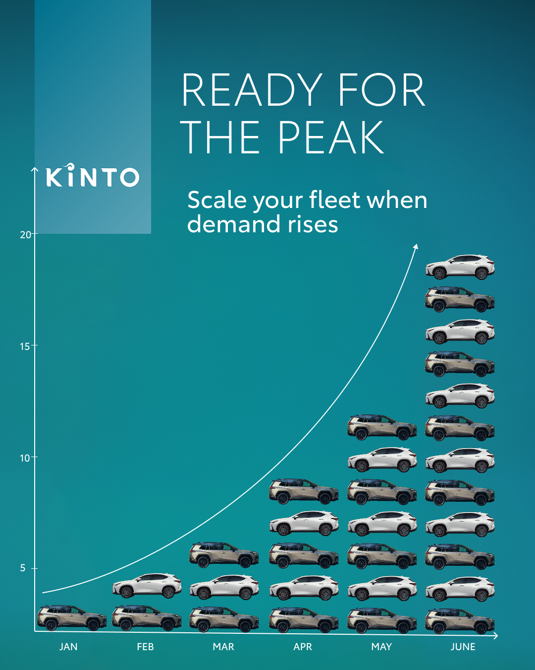
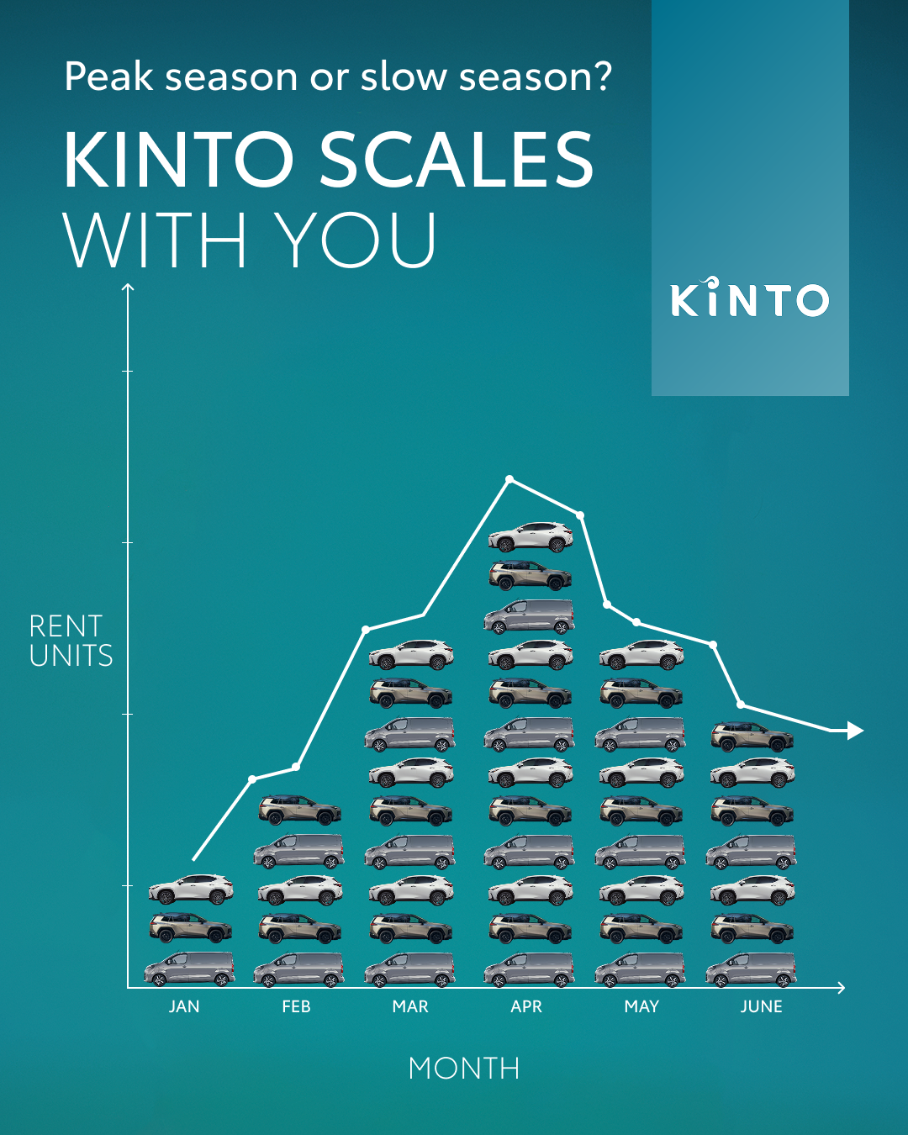
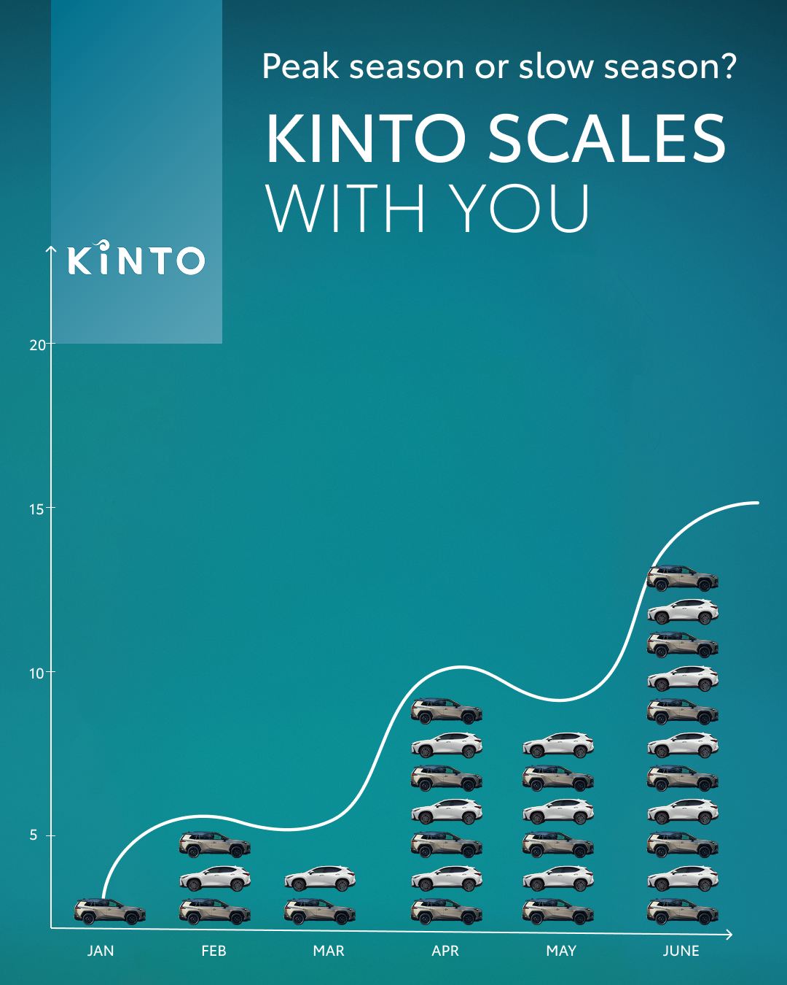
5.PEAK
COPY - LI:
Is your fleet ready for the unpredictable? 📈📉
In business, demand rarely follows a straight line. Whether you’re facing a sudden seasonal peak or a temporary trough, your mobility needs to be as agile as your strategy.
Our flexible solutions allow to scale with you whenever the moment demands it. From short-term projects to rapid growth phases, we provide the vehicles you need, exactly when you need them. Because the best way to handle a peak is with a partner who understands the curves. 💡
How do you manage sudden shifts in your mobility demand?
One partner. Every solution.
#KINTO #FleetManagement #BusinessAgility
CONTENT BUCKET 1- MAY
FORMATS AVAILABLE:
1/1 - 9/16 - ⅘ - 16/9
Notes:
#KINTO #FleetManagement #CorporateMobility #FlexibleMobility #MobilitySolutions

Slide 21
5.PEAK
COPY - IG:
Business doesn’t always move in a straight line. 📈📉
Renting with KINTO offers the flexibility to scale whenever you need to. This keeps you ready for the peaks and steady through the troughs. 👌
Is your business currently gearing up for a busy season?
One partner. Every solution.
#KINTO #BusinessGrowth #MobilitySolutions
CONTENT BUCKET 1- MAY
FORMATS AVAILABLE:
1/1 - 9/16 - ⅘ - 16/9
Notes:
#KINTO #FleetManagement #CorporateMobility #FlexibleMobility #MobilitySolutions

Slide 22
5. PEAK
COPY - FB:
Is your fleet growing with you or is it holding you back? 📈📉
In business, things rarely go exactly according to plan. One month you’re facing a huge seasonal peak, and the next might be a bit quieter. That’s why your mobility needs to be flexible.
We move with the needs of your business. Whether you need additional vehicles for a short-term project, seasonal activity, or unexpected demand, KINTO helps you flexibly expand your mobility solution when it matters most.
Do you find it difficult to predict your fleet needs for the coming months? Share your thoughts 👇
One partner. Every solution.
#KINTO #BusinessAgility #Flexibility
CONTENT BUCKET 1- MAY
FORMATS AVAILABLE:
1/1 - 9/16 - ⅘ - 16/9
Notes:
#KINTO #FleetManagement #CorporateMobility #FlexibleMobility #MobilitySolutions

Slide 23

6. BATTERY VIDEO
COPY - LI:
Where is your energy going today? 🔋
Between early mornings, school runs, and corporate chaos, our personal batteries drain fast. The last thing you need is for mobility issues to add to that mental load.
At KINTO, we believe mobility should take stress off your plate, not add to it.
When something happens to your car, you need to be able to rely on a partner who handles it quickly and efficiently, so you can put your energy into what really matters.
Need a mobility partner that helps recharge your day? Discover more at kinto-mobility.eu
One partner. Every solution.
#KINTO #EnergyManagement #WorkLifeBalance
CONTENT BUCKET 1- MAY
FORMATS AVAILABLE:
1/1 - 9/16 - ⅘ - 16/9
Notes:
#KINTO #FleetManagement #CorporateMobility #FlexibleMobility #MobilitySolutions

Slide 24
6. BATTERY VIDEO
COPY - IG:
Don’t let mobility drain your battery. 🔋🪫
Life moves fast. Between the office hustle and your personal time, your energy is a valuable resource. The last thing you need is a logistical headache adding to your mental load.
At KINTO, we handle the car, so you can end the day with a full charge.
Recharge your mobility at kinto-mobility.eu.
One partner. Every solution.
#KINTO #Recharge #PeaceOfMind
CONTENT BUCKET 1- MAY
FORMATS AVAILABLE:
1/1 - 9/16 - ⅘ - 16/9
Notes:
#KINTO #FleetManagement #CorporateMobility #FlexibleMobility #MobilitySolutions

Slide 25
6.BATTERY VIDEO
COPY - FB:
"I bumped into your car..." are words nobody wants to hear at the end of a long day. 🚗
When your personal battery is already at 10%, a dent feels like a major setback. But with KINTO, those logistical details don’t have to weigh you down. 🛠️
We take over the practical burden so you can keep your energy for your family, and your business.
Running low on energy? Recharge at kinto-mobility.eu.
One partner. Every solution.
#KINTO #CustomerCare #MobilityPartner
CONTENT BUCKET 1- MAY
FORMATS AVAILABLE:
1/1 - 9/16 - ⅘ - 16/9
Notes:
#KINTO #FleetManagement #CorporateMobility #FlexibleMobility #MobilitySolutions

Slide 26
Community & connection
Empowerment & Expertise
Notes:
Baseline: Join the KINTO community

Slide 27

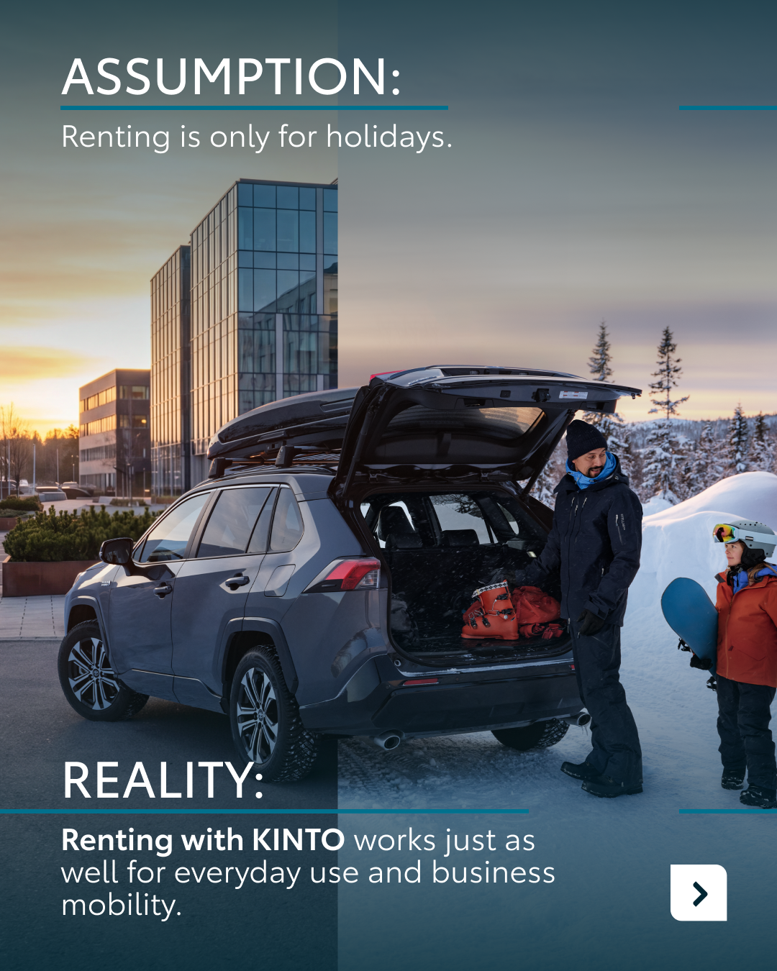
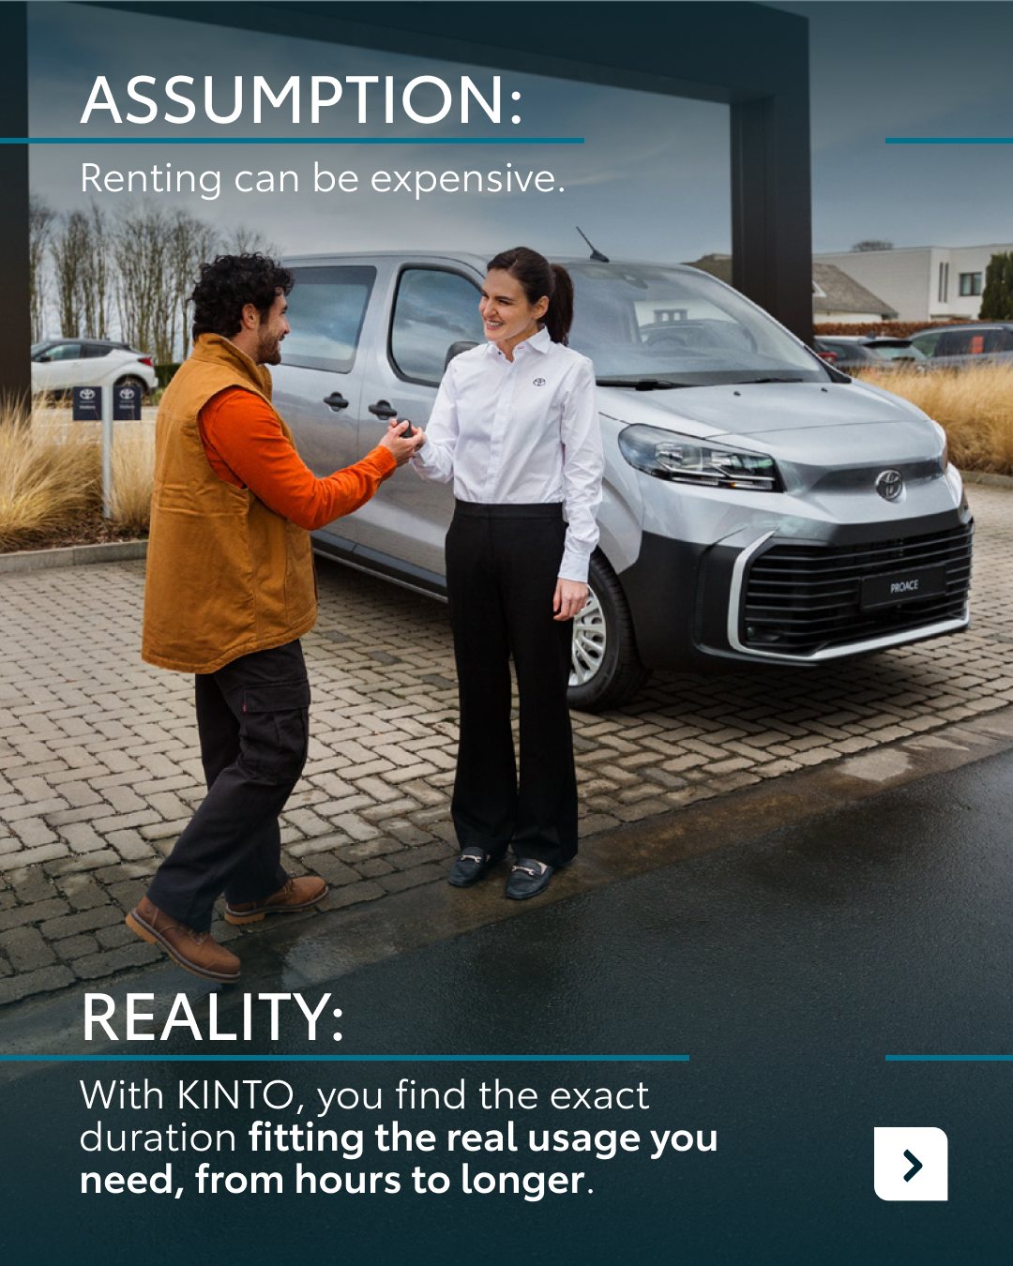
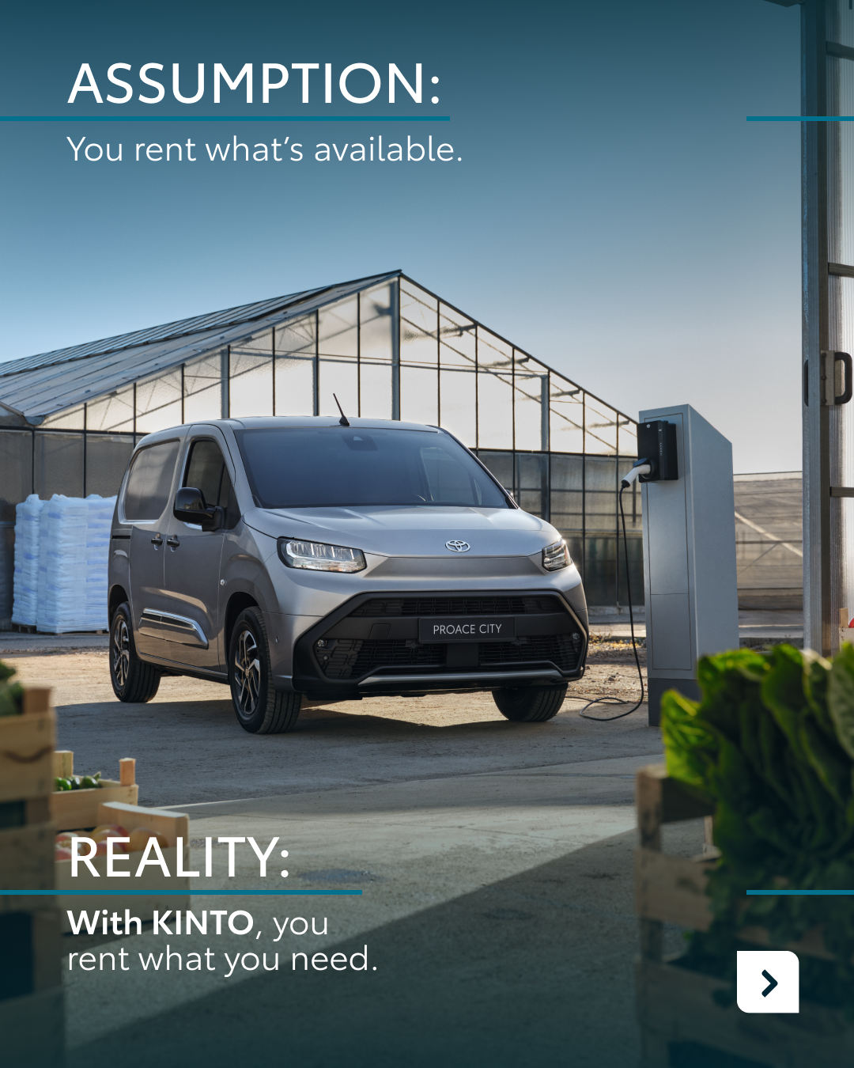
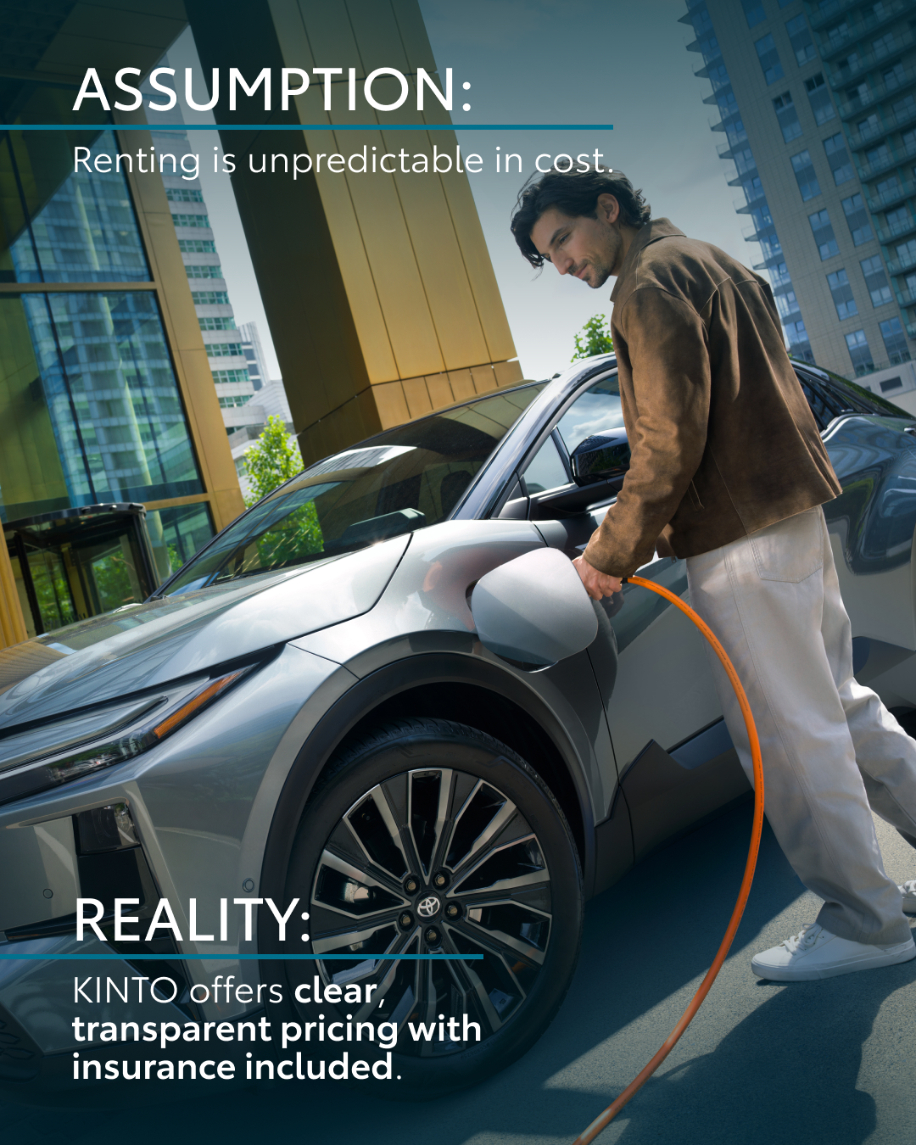


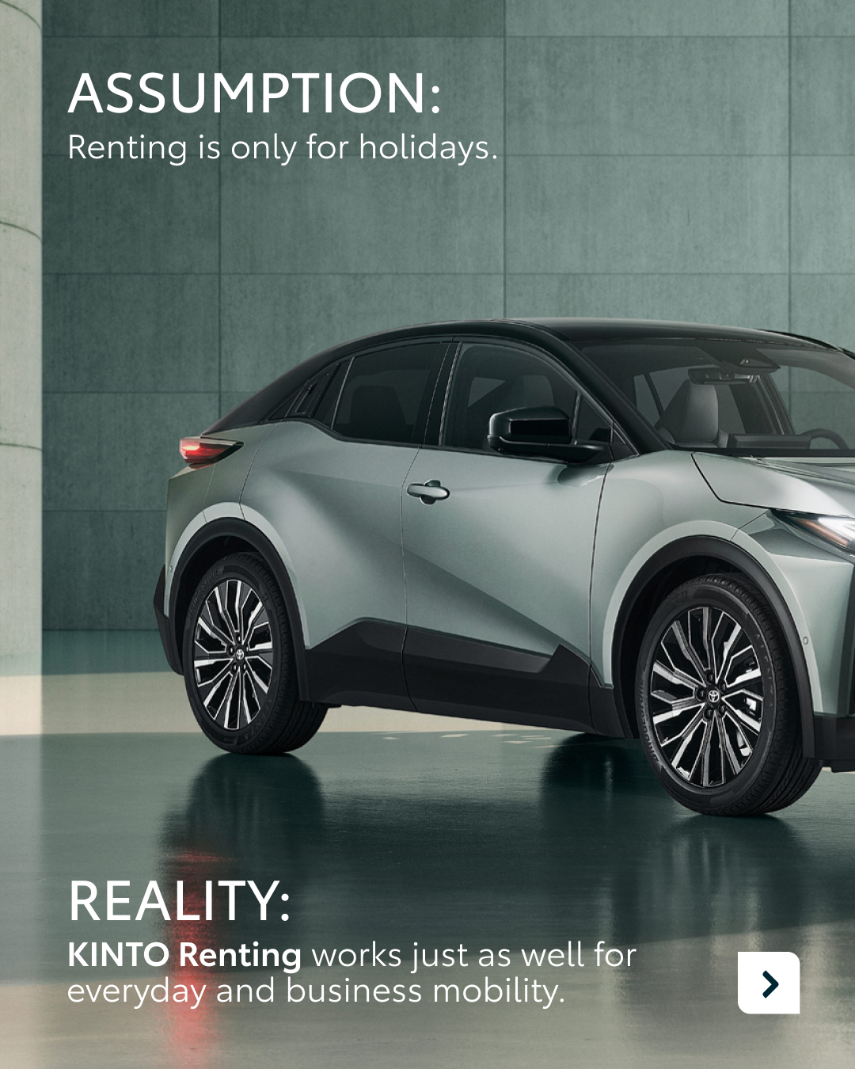
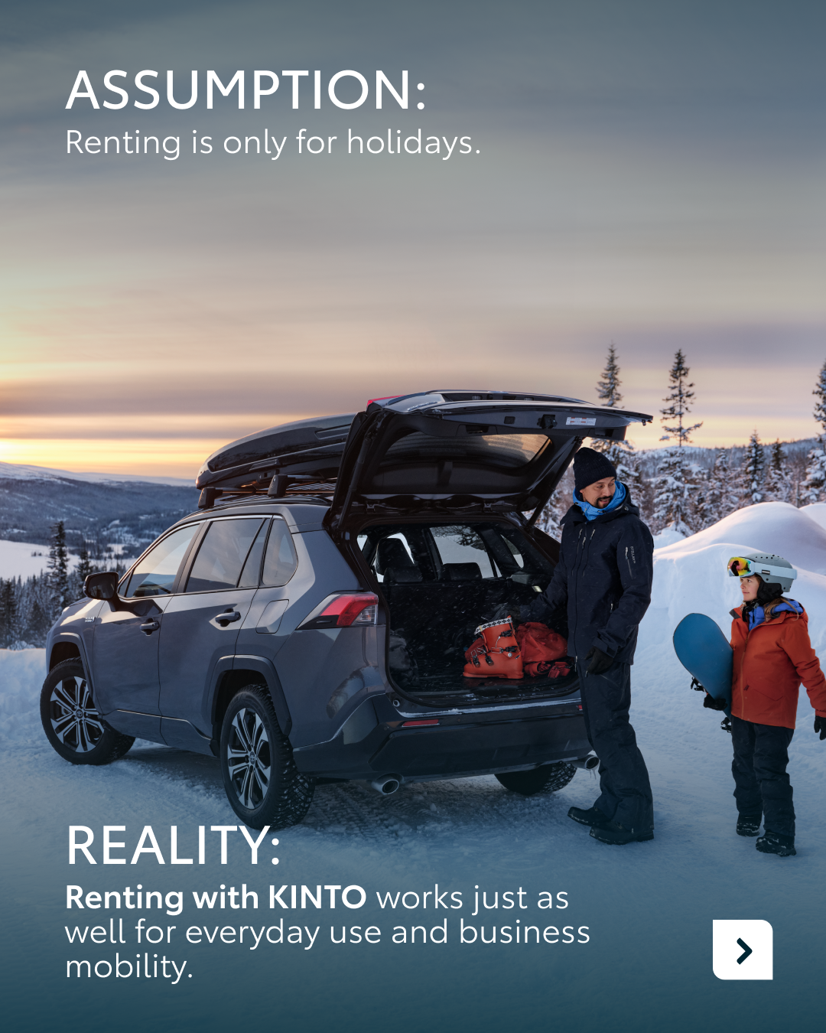
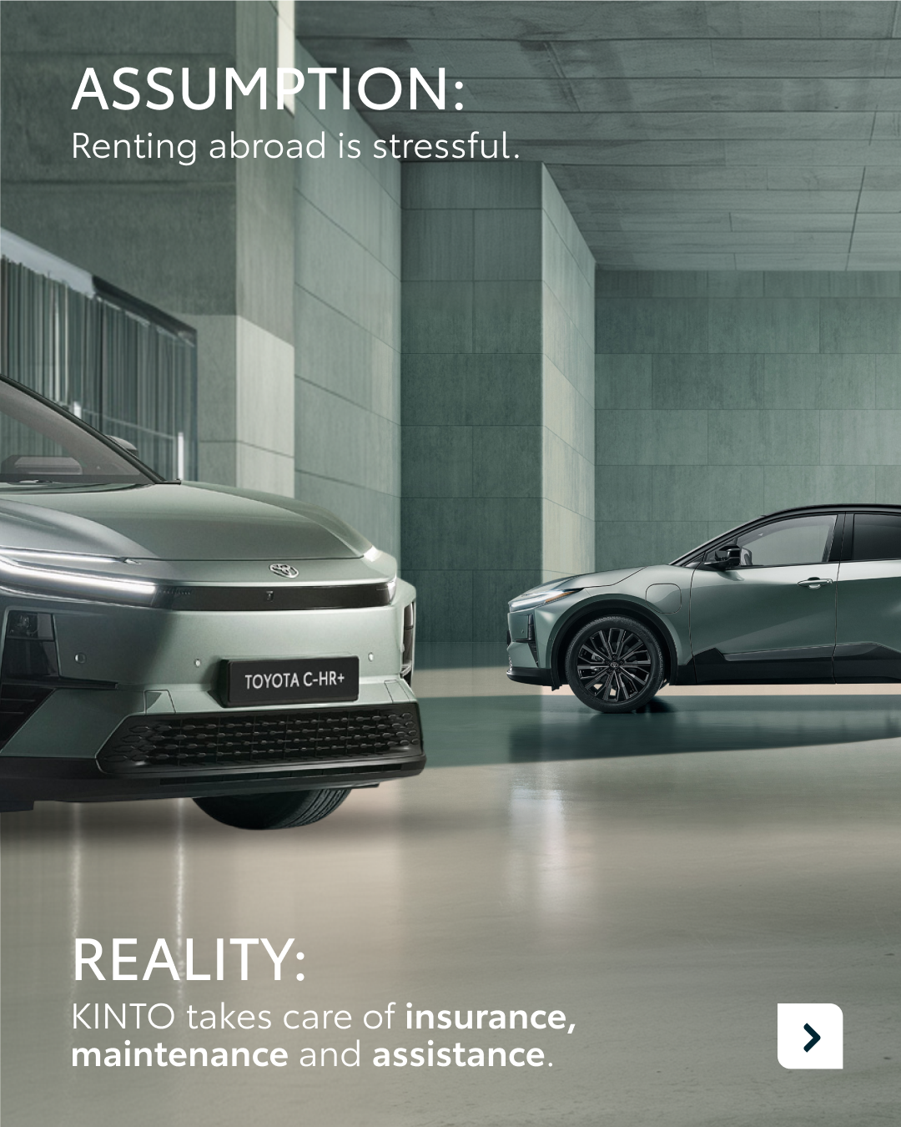
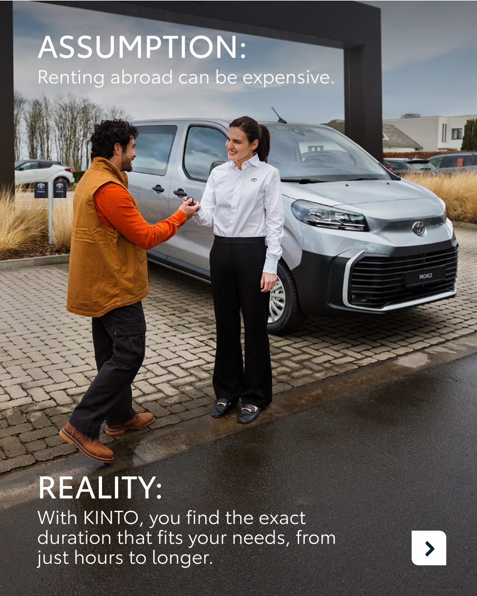

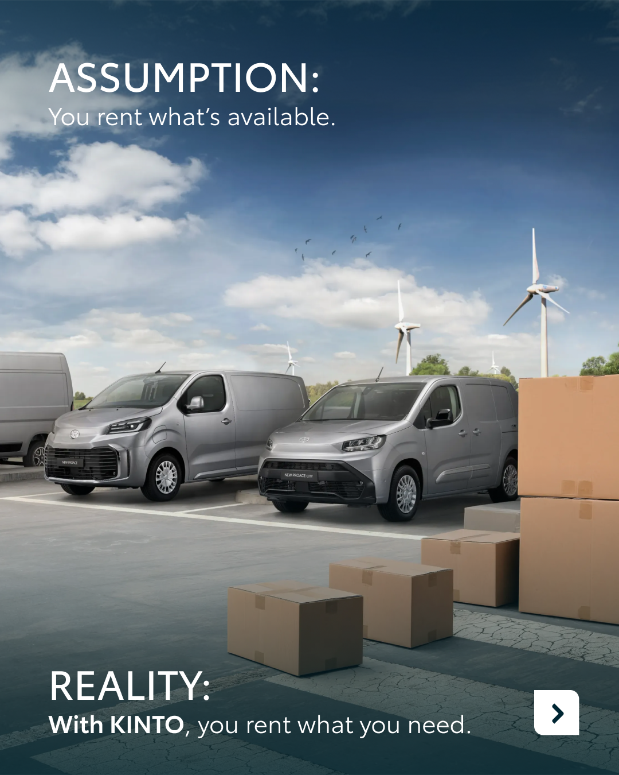

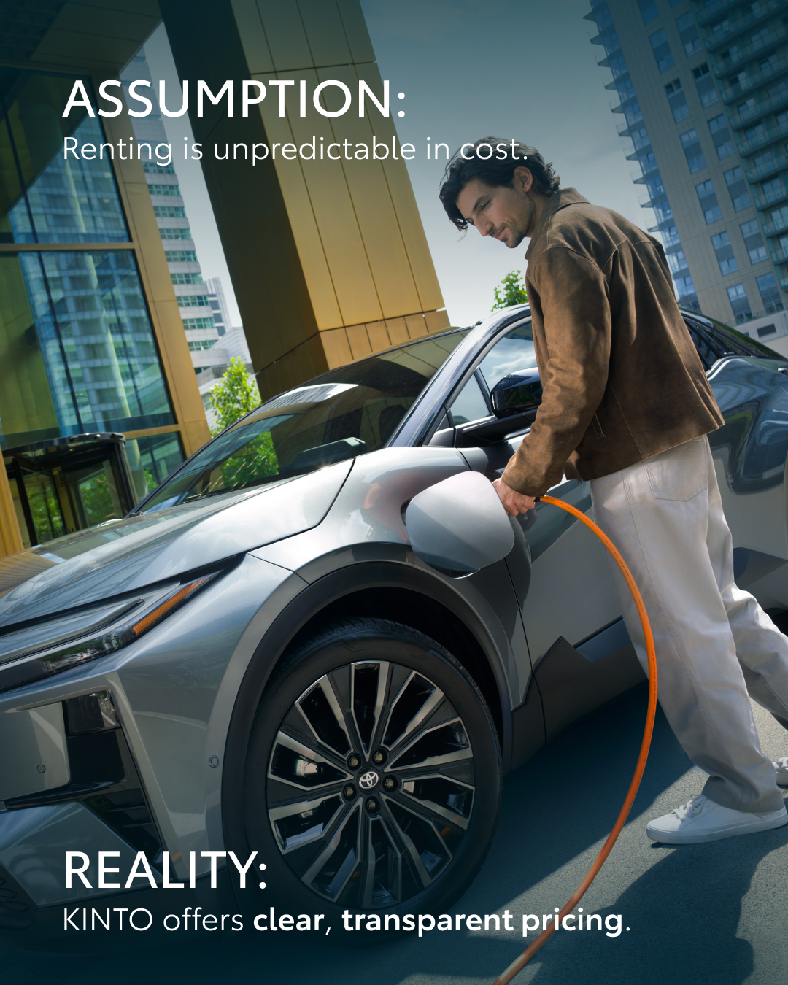
7.ASSUMPTION VS REALITY
CONTENT BUCKET 1- MAY
COPY LI
Is what you know about car rental still true today? 🤔
There are many assumptions when it comes to renting vehicles for business. Some think it’s only for holidays, others worry about unpredictable costs or durations. We’re here to show you the reality of flexible mobility.
🔹 Renting with KINTO works just as well for your daily business commute as it does for any other journey.
🔹 A few hours or a few weeks? You find the exact duration that fits your schedule.
🔹 You rent a car that matches the moment.
🔹 Full transparency about pricing without any hidden surprises.
It’s time to move beyond the assumptions. Experience mobility that adapts to you, instead of the other way around. 🤝
Which rental myth have you encountered most in your life?
Make this your own reality at kinto-mobility.eu
One partner. Every solution.
#KINTO #BusinessMobility #FleetManagement
FORMATS AVAILABLE:
4/5

Slide 28
7.ASSUMPTION VS REALITY
CONTENT BUCKET 1- MAY
COPY IG
Assumption vs. reality: business edition. 🔄
Think you know everything about renting a car? It might be time to think again. We’re busting the most common myths to show you how flexible mobility really works.
Swipe to see the reality of renting with KINTO. ➡️
Which slide surprised you the most? ✨
Discover how flexible mobility works with KINTO at kinto-mobility.eu
One partner. Every solution.
#KINTO #AssumptionVsReality #FlexibleRental
FORMATS AVAILABLE:
4/5

Slide 29
7.ASSUMPTION VS REALITY
CONTENT BUCKET 1- MAY
COPY FB
Is car rental only for holidays? We beg to differ. 💡
There are plenty of assumptions when it comes to renting vehicles for business. At KINTO, we’re here to show you a different reality. One where mobility actually adapts to your schedule.
It’s time to trade in the old assumptions for a solution that moves with you. 🤝
What’s your main reason for renting a car for business?
Curious? Discover more at kinto-mobility.eu
One partner. Every solution.
#KINTO #AssumptionVsReality #BusinessMobility
FORMATS AVAILABLE:
4/5

Slide 30
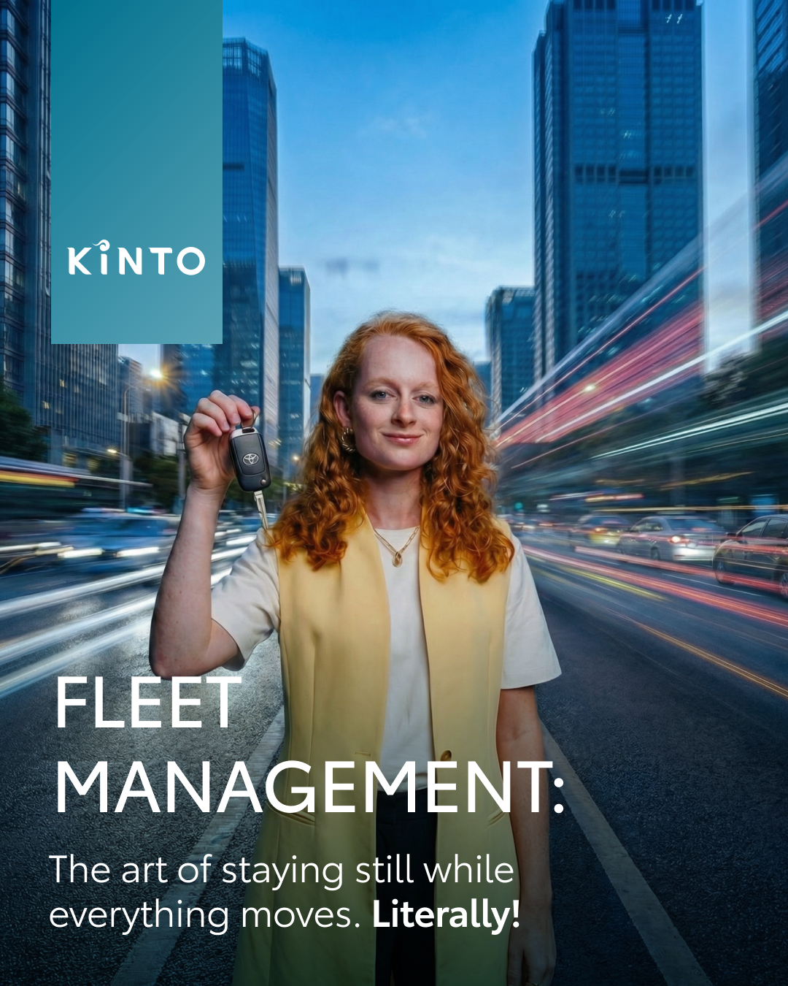

8.VISUAL INSPIRATIONAL QUOTE
COPY LI
In a world that never stops, staying still is an art form. 🏙️
KINTO makes it easier by taking the complexity out of mobility. We provide flexible access to high-quality vehicles, allowing you to focus on leading your business while we handle the logistics.
✅ Simplified solutions: No more admin headaches or rigid frameworks. ✅ Reliable quality: Peace of mind delivered through trusted legacy. ✅ Professional support: A smart advisor by your side every step of the way.
One partner. Every solution.
#FleetManagement #BusinessMobility #KINTO
CONTENT BUCKET 1- MAY
FORMATS AVAILABLE:
4/5

Slide 31
8.VISUAL INSPIRATIONAL QUOTE
COPY IG
The art of staying still. 🏙️✨
In a world that’s always moving, KINTO keeps your fleet steady. Seamless, smart, and stress-free. 🚗
One partner. Every solution.
#KINTO #FleetLife #UrbanMobility
CONTENT BUCKET 1- MAY
FORMATS AVAILABLE:
4/5

Slide 32
8.VISUAL INSPIRATIONAL QUOTE
COPY FB
Fleet management: The art of staying still while everything moves. 🧘‍♀️
We take the "rush" out of the rush hour by providing reliable vehicles and a service that speaks for itself.
One partner. Every solution.
#KINTO #StressFree #SmartBusiness
CONTENT BUCKET 1- MAY
FORMATS AVAILABLE:
4/5

Slide 33
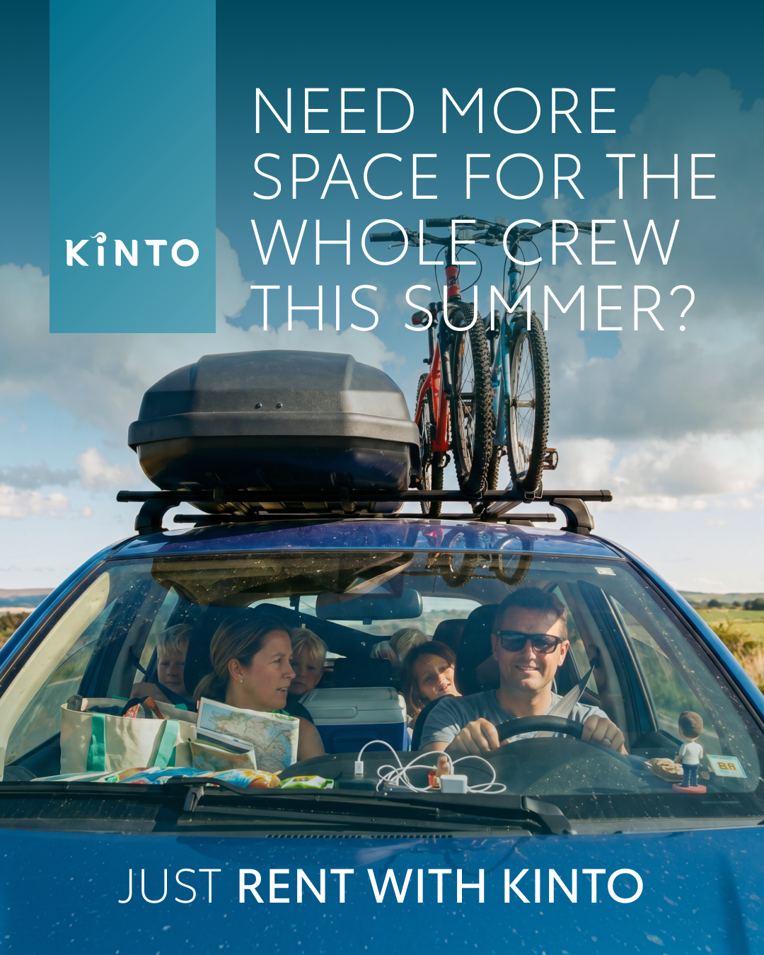
9. END OF SCHOOL
COPY LI
With the school year wrapping up, many parents are trading in their office desks for the driver's seat. Whether it’s summer camps, playdates or family getaways, your schedule is about to get a whole lot busier. 🎓
KINTO believes that being a family taxi driver should be as comfortable and stress-free as possible. Need a bit more space for the whole crew to manage the summer juggle?
Renting with KINTO gives you the flexibility to choose exactly the right car for the moment. We provide the reinforcement you need to keep everyone moving.
Ready to make this summer your smoothest journey yet? ☀️
One partner. Every solution.
#KINTO #SchoolsOut #FlexibleRental
CONTENT BUCKET 1- MAY
FORMATS AVAILABLE:
4/5

Slide 34
9. END OF SCHOOL
COPY IG
Promotion alert! 🎓 You’re officially the family’s favourite chauffeur.
School’s out, and your summer schedule is filling up fast. Need a bit more flexibility for all those extra drives? Renting with KINTO means you can swap your daily drive for a spacious upgrade whenever the moment asks for it. Enjoy the ride, we’ve got your back. ☀️
Tag your co-pilot for this summer! 👇
One partner. Every solution.
#KINTO #SchoolsOut i #RentingWithKINTO
CONTENT BUCKET 1- MAY
FORMATS AVAILABLE:
4/5

Slide 35
9.END OF SCHOOL
COPY FB
With schools closing their doors, a new challenge begins for many parents. Your calendar is likely filling up with summer camps, day trips, and family visits. Let’s be honest: that asks a lot from your car (and your patience). 🤫
Need a bit more room this summer? Renting with KINTO gives you the freedom to temporarily choose a larger model that perfectly fits your summer plans. ☀️
So tell us, what are your plans for the season?
One partner. Every solution.
#KINTO #SchoolsOut #FlexibleMobility
CONTENT BUCKET 1- MAY
FORMATS AVAILABLE:
4/5

Slide 36

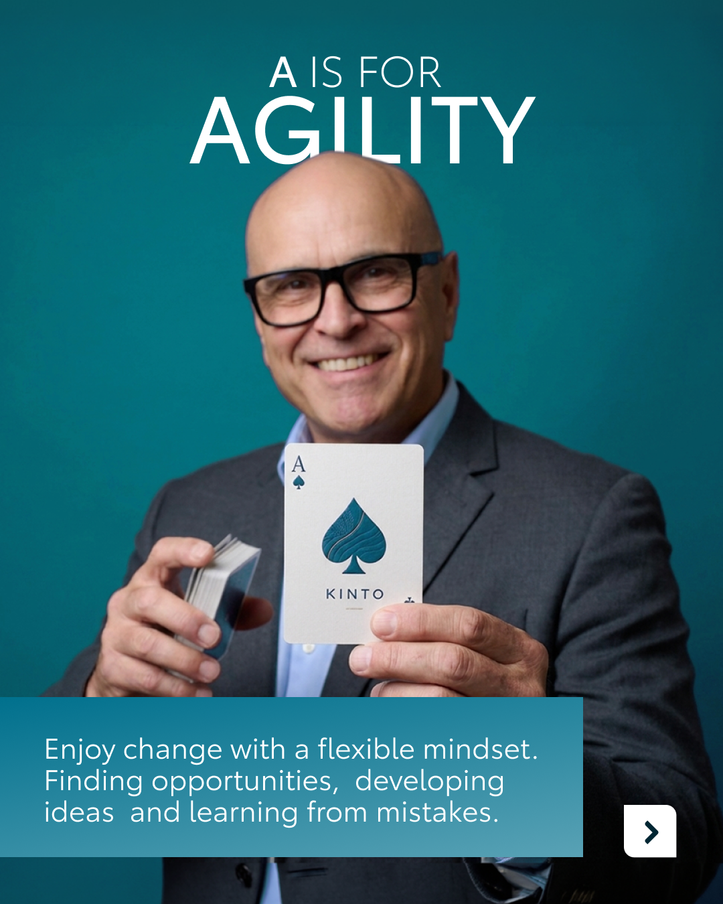
10. ACE VALUES
COPY LI
At KINTO, our identity is built on a foundation of shared values.
As part of the Toyota family, we combine a long-standing legacy of quality with a fresh, future-focused mindset.
To navigate the ever-changing world of mobility, we rely on our ACE values:
🔹 Agility: for us, every challenge is an opportunity to grow.
🔹 Collaboration: by working transparently and staying connected across every department, we support our customers and partners in the best way possible.
🔹 Excellence: we strive for quality in everything we do, ensuring our services truly contribute to the vision of 'mobility for all’.
These values are the engine that keeps us moving forward. By merging Toyota’s heritage with our entrepreneurial spirit, we make sure that every journey we facilitate is backed by people who truly care. 🤝
Which of these values is most important in your professional philosophy? 🤔
One partner. Every solution.
#Agility #Collaboration #Excellence
CONTENT BUCKET 1- MAY
FORMATS AVAILABLE:
4/5

Slide 37
10. ACE VALUES
COPY IG
Driven by values, moving as one. 🤝
At KINTO, we combine our Toyota heritage with a fresh, future-focused mindset. To keep us moving forward in the world of mobility, we live by our ACE values: agility, collaboration and excellence. 🂡
Which of these values resonates most with you? 👀
One partner. Every solution.
#Agility #Collaboration #Excellence
CONTENT BUCKET 1- MAY
FORMATS AVAILABLE:
4/5

Slide 38
10.ACE VALUES
COPY FB
At KINTO, our foundation is built on the legacy of the Toyota family.
To navigate the ever-changing world of mobility, we rely on our ACE values to keep us moving forward. 🂡
For us, it's about agility in every challenge, collaboration across every department, and excellence in every service we provide.
It’s this mindset that ensures we support your business with people who truly care. 🤝
Which of these values is most important in your professional journey? 👇
One partner. Every solution.
#Agility #Collaboration #Excellence
CONTENT BUCKET 1- MAY
FORMATS AVAILABLE:
4/5

