Slide 1

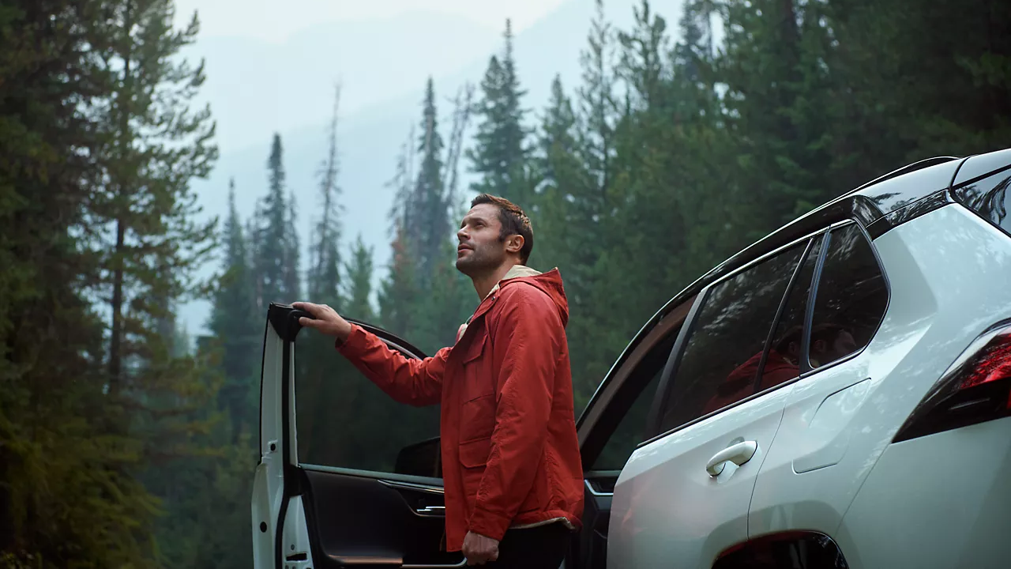

CONTENT
JULY 2026

Slide 2
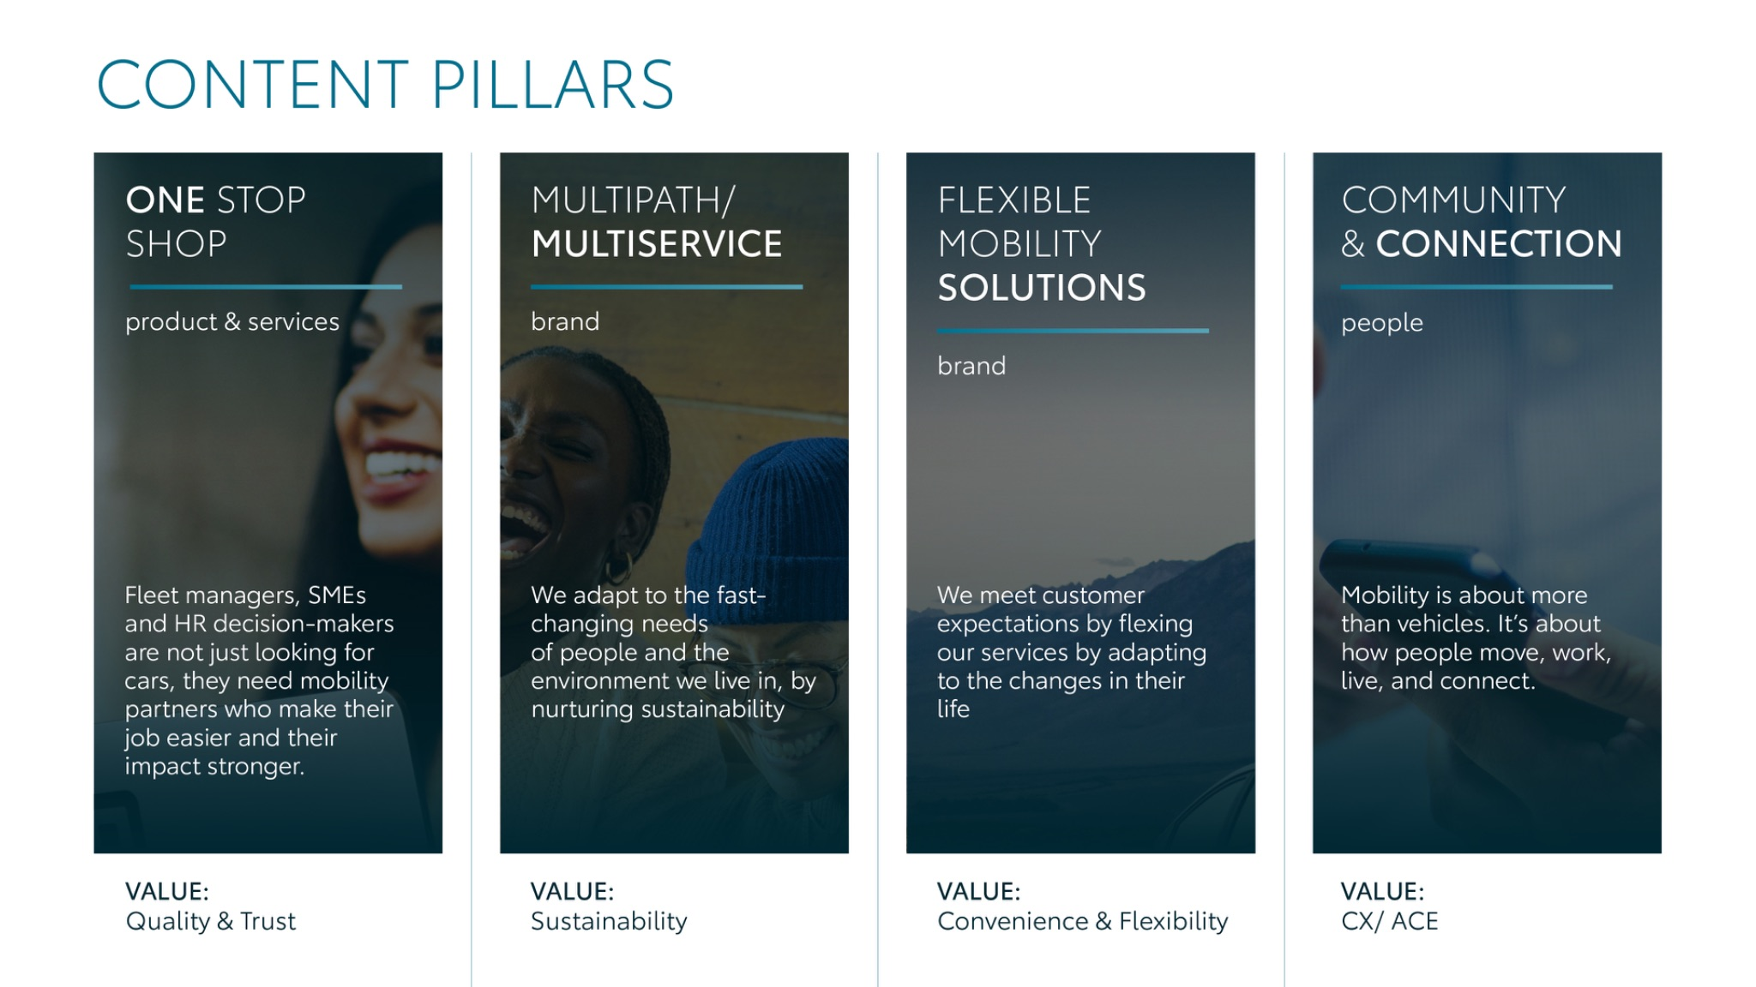
Notes:
“At KINTO, we work with content pillars: themes that carry our brand. We use different content types: inspiring, informative, topical. Your contributions add the human layer that makes the strategy work.”

Slide 3



Content pillars - content overview
JULY
What no one tells
Iceberg
Holiday Rent
PC vs LCV
Powertrain advantages
KINTO Markets
Decarbonisation targets
New model delivery UK
Q&A Employees
Community learnings
ONE STOP SHOP
MULTIPATH/ MULTISERVICE
FLEXIBLE MOBILITY SOLUTIONS
COMMUNITY/ CONNECTION

Slide 4
Tag lines pillars
1. One Stop Shop
One partner. Every solution.
2. Flexible Mobility Solutions
One partner. Every solution.
3. Community and connection (important to keep it broad enough to fit clients as well as people working at Kinto)
Join the KINTO community.
4. Vision & Impact (Multipath/multiservice)
One partner. Every solution.

Slide 5

One stop shop
Notes:
One place. Every solution. Always KINTO.

Slide 6





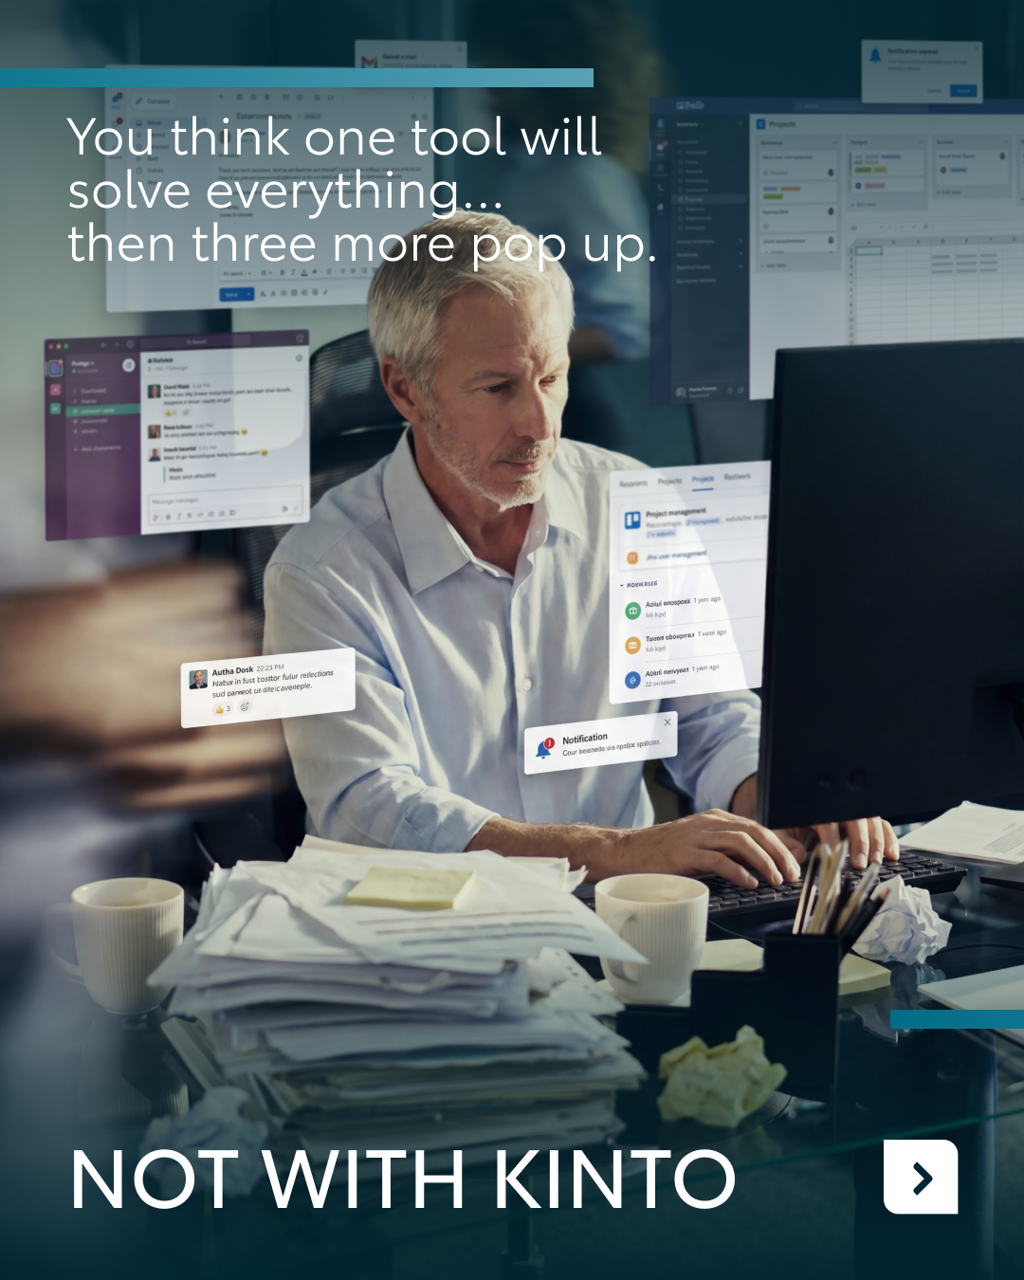
1.WHAT NO ONE TELLS
COPY LI
CONTENT BUCKET 1- JULY
Do you feel like an important piece is missing from your corporate puzzle? 🧩
With unforeseen changes in your business, managing your fleet can quickly start to feel like a complex jigsaw. But unexpected organizational shifts shouldn't have to slow your operations down.
Whether you need a temporary vehicle for a newly arriving colleague or short-term rental for an upcoming business trip, we help you fill the gaps with ease. From a few days to a few months, you choose the exact duration that keeps your business moving. 💼
Ready to complete the puzzle? Find your missing piece at kinto-mobility.eu.
One partner. Every solution.
#KINTO #FleetManagement #FlexibleMobility
FORMATS AVAILABLE:
4/5

Slide 7



Valid for multibrand
1.WHAT NO ONE TELLS
COPY IG
Is there a vital piece missing from your fleet puzzle? 🧩
Unforeseen business changes can quickly turn fleet management into a confusing jigsaw. From temporary cars for new team members to quick short-term rentals for business trips, we help you fill the gaps to keep things moving. No strings attached. 🚗
Complete your puzzle at kinto-mobility.eu.
What is the most unpredictable fleet challenge you’ve had to solve recently? 👇
One partner. Every solution.
#KINTO #FlexibleMobility #FleetManagement
CONTENT BUCKET 1- JULY
FORMATS AVAILABLE:
4/5

Slide 8
Valid for multibrand
1.WHAT NO ONE TELLS
COPY FB
Managing a corporate fleet can quickly feel like trying to solve a jigsaw puzzle with missing pieces. 🧩
An unforeseen change in your business can disrupt your entire rhythm. Suddenly, you need a temporary vehicle for a new colleague arriving next week, or a quick short-term rental for an unexpected business trip.
We are here to help you fill those gaps. We offer flexible solutions that adapt to your exact timeline, keeping your team moving forward. Find your missing piece at kinto-mobility.eu. ⚡
Are you currently puzzling through your team's mobility planning? Share your thoughts below! 👇
One partner. Every solution.
#KINTO #FleetManagement #FlexibleMobility
CONTENT BUCKET 1- JULY
FORMATS AVAILABLE:
4/5

Slide 9




Valid for multibrand
2. PC VS LCV
COPY LI
Are you currently running a fragmented fleet strategy? 🚗🚙
For many organizations, managing passenger cars and commercial vehicles on separate paths makes it difficult to maintain a clear view of your total cost of ownership. But a split approach is rarely the most efficient route.
Did you know that by bringing both your cars and vans into the same operational leasing strategy, fleet managers gain much-needed visibility while CFOs secure better financial predictability? 📈
Discover how we bring everything together at kinto-mobility.eu.
Share your insights on how you are running your fleet in the comments below! 👇
One partner. Every solution.
#KINTO #FleetManagement #OperationalLease
CONTENT BUCKET 1- JULY
FORMATS AVAILABLE:
4/5

Slide 10



Valid for multibrand
2. PC VS LCV
COPY IG
Running a fragmented fleet strategy? It might be clouding your view of your total cost of ownership. 🚗🚙
Did you know that combining your passenger cars and vans into a single operational leasing strategy changes the game? It gives fleet managers instant visibility over the data and provides CFOs with maximum predictability. 📈
Discover how we bring everything together at kinto-mobility.eu.
How are you running your fleet today? 👇
One partner. Every solution.
#KINTO #FleetManagement #OperationalLease
CONTENT BUCKET 1- JULY
FORMATS AVAILABLE:
4/5

Slide 11
Valid for multibrand
2. PC VS LCV
COPY FB
Are you running a fragmented fleet strategy within your business? 🚗🚙
When company cars and commercial vans run on separate tracks, keeping a clear view of your total cost of ownership can become a real headache.
Did you know that by bringing both into the exact same operational leasing strategy, everyone wins? Fleet managers gain complete visibility over the daily operations, while CFOs get much better predictability over the budget. 📈
Discover how we bring everything together at kinto-mobility.eu.
Share your insights on how you are running your fleet in the comments! 👇
One partner. Every solution.
#KINTO #FleetManagement #OperationalLease
CONTENT BUCKET 1- JULY
FORMATS AVAILABLE:
4/5

Slide 12


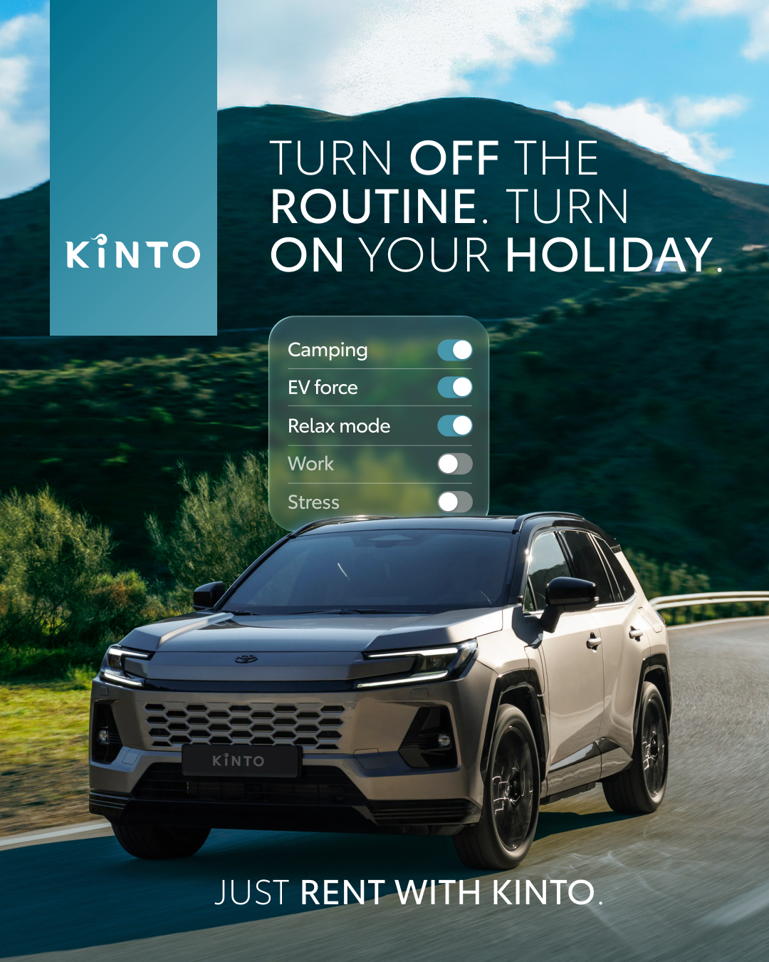
3.HOLIDAY RENT
COPY - LI:
Ready to step out of the office routine and into the summer vibes?
As the summer season arrives, stepping away from the office grind is top of mind. But transitioning from busy deadlines to open roads doesn't have to be a logistical challenge.
Renting with KINTO makes changing your mobility settings simple. Choose your holiday destination and effortlessly match your vehicle to fit your exact plans. Activate 'relax mode' with a sleek ride for a quiet weekend getaway, or scale up to a spacious model for that long-awaited family road trip. 🚙
Ready to turn off the routine? Discover your summer drive at kinto-mobility.eu.
One partner. Every solution.
#KINTO #HolidayRent #FlexibleMobility
CONTENT BUCKET 1- JULY
FORMATS AVAILABLE:
1/1 - ⅘
Notes:
#KINTO #FleetManagement #CorporateMobility #FlexibleMobility #MobilitySolutions

Slide 13

3. HOLIDAY RENT
COPY - IG:
Office routine: OFF. Summer vibes: ON. ☀️
Ready to flip the switch? Renting with KINTO makes changing your mobility settings simple. Toggle your way into a flexible summer ride, whether you're slowing down for a quiet weekend or powering up for a big road trip. Choose your destination and match your vehicle to fit your plans. 🚙
Find your holiday drive at kinto-mobility.eu. 🗺️
Where are you heading this summer?👇
One partner. Every solution.
#KINTO #HolidayRent #FlexibleMobility
CONTENT BUCKET 1- JULY
FORMATS AVAILABLE:
1/1 - ⅘ -
Notes:
#KINTO #FleetManagement #CorporateMobility #FlexibleMobility #MobilitySolutions

Slide 14
3.HOLIDAY RENT
COPY - LI:
Ready to step out of the office routine and into the summer vibes?
As the summer season arrives, stepping away from the office grind is top of mind. But transitioning from busy deadlines to open roads doesn't have to be a logistical challenge.
Renting with KINTO makes changing your mobility settings simple. Choose your holiday destination and effortlessly match your vehicle to fit your exact plans. Activate 'relax mode' with a sleek ride for a quiet weekend getaway, or scale up to a spacious model for that long-awaited family road trip. 🚙
Ready to turn off the routine? Discover your summer drive at kinto-mobility.eu.
One partner. Every solution.
#KINTO #HolidayRent #FlexibleMobility
CONTENT BUCKET 1- JULY
FORMATS AVAILABLE:
1/1 - ⅘
Notes:
#KINTO #FleetManagement #CorporateMobility #FlexibleMobility #MobilitySolutions

Slide 15
3.HOLIDAY RENT
COPY - FB:
Is your mind already switching from office routine to summer vibes? ☀️
Renting with KINTO makes changing your mobility settings effortless.
You can easily activate 'relax mode' with a compact car for a quiet weekend getaway, or power up your vacation with a spacious SUV for a family road trip. You choose the flexible ride that fits your exact plans, enjoying the freedom to travel without any long-term commitments. 🚙
Ready to turn off the routine? Find your summer match today at kinto-mobility.eu. 🗺️
Where are you heading this summer?👇
One partner. Every solution.
#KINTO #HolidayRent #SummerMobility
CONTENT BUCKET 1- JULY
FORMATS AVAILABLE:
1/1 - ⅘
Notes:
#KINTO #FleetManagement #CorporateMobility #FlexibleMobility #MobilitySolutions

Slide 16
3.HOLIDAY RENT
COPY - LI:
Ready to step out of the office routine and into the summer vibes?
As the summer season arrives, stepping away from the office grind is top of mind. But transitioning from busy deadlines to open roads doesn't have to be a logistical challenge.
Renting with KINTO makes changing your mobility settings simple. Choose your holiday destination and effortlessly match your vehicle to fit your exact plans. Activate 'relax mode' with a sleek ride for a quiet weekend getaway, or scale up to a spacious model for that long-awaited family road trip. 🚙
Ready to turn off the routine? Discover your summer drive at kinto-mobility.eu.
One partner. Every solution.
#KINTO #HolidayRent #FlexibleMobility
CONTENT BUCKET 1- JULY
FORMATS AVAILABLE:
1/1 - ⅘
Notes:
#KINTO #FleetManagement #CorporateMobility #FlexibleMobility #MobilitySolutions

Slide 17
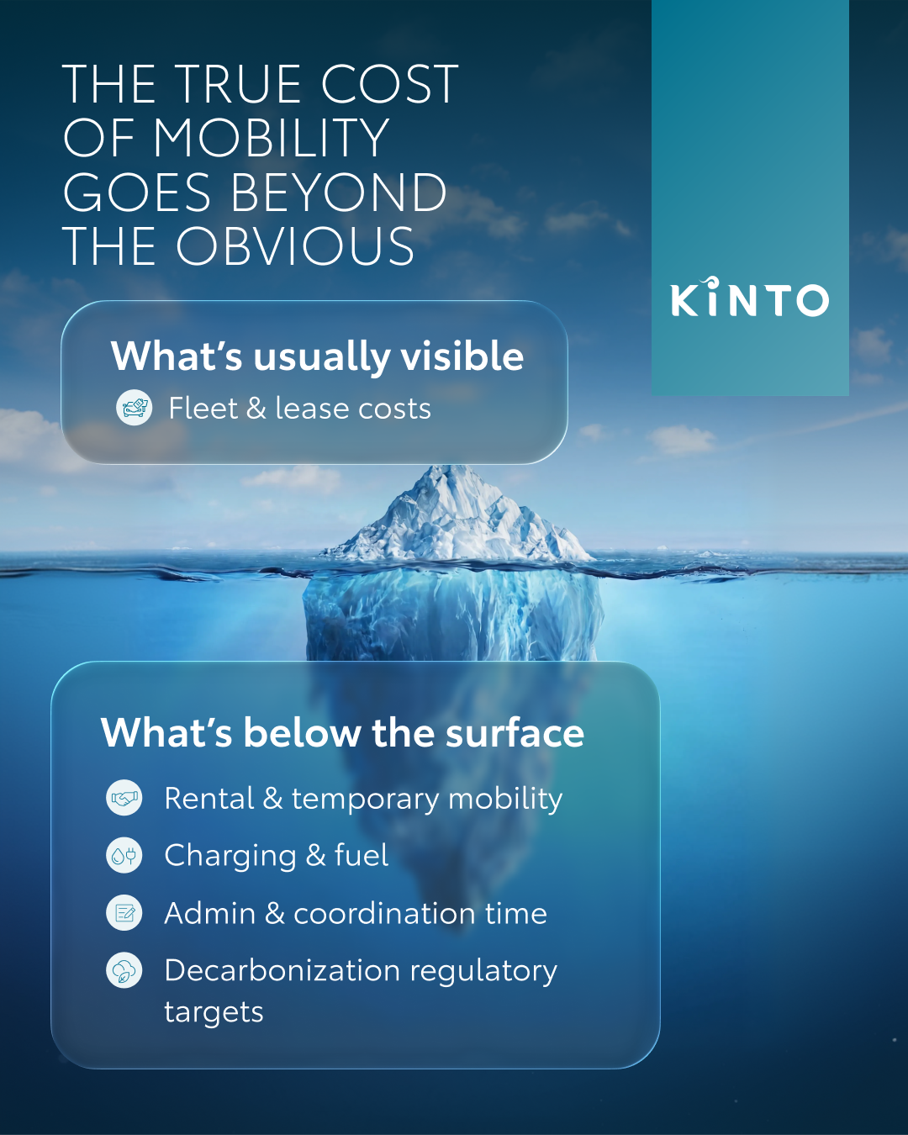
4. ICEBERG
COPY - LI:
Are you managing your fleet budget based only on what’s visible above the surface?
Focusing solely on monthly lease invoices leaves a huge part of your actual spend drifting out of sight. When operational costs are scattered across different tools and departments, getting a true view of what's under the surface might be a challenge.
We help you dive deeper, giving you visibility on all cost elements to keep you navigating in smooth waters. No cold surprises. 🧊
Bring your hidden costs to the surface today at kinto-mobility.eu.
One partner. Every solution.
#KINTO #FleetManagement #TotalCostOfOwnership
CONTENT BUCKET 1- JULY
FORMATS AVAILABLE:
1/1 - ⅘
Notes:
#KINTO #FleetManagement #CorporateMobility #FlexibleMobility #MobilitySolutions

Slide 18
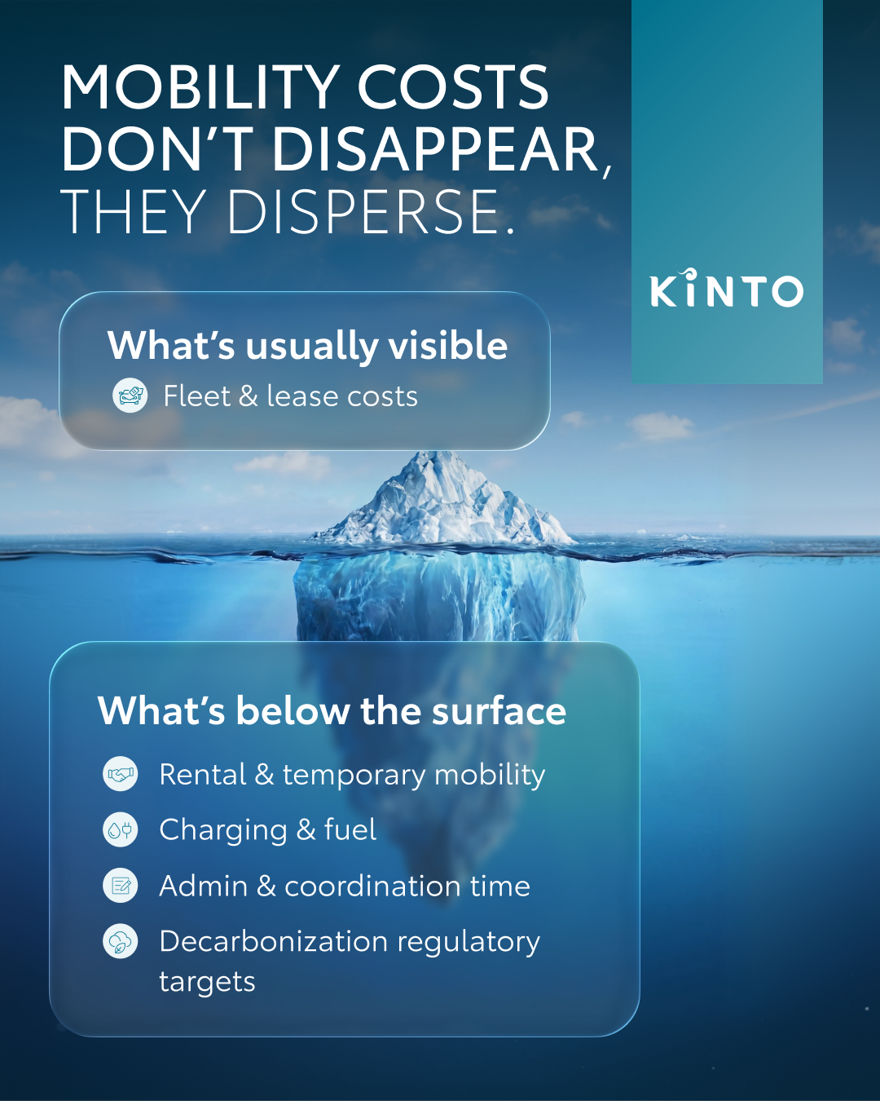
4. ICEBERG
COPY - IG:
Only seeing the tip of the iceberg? 🧊
Lease invoices are just the surface. True fleet transparency means diving under the waves to spot hidden operational costs before they drift out of control. We help you bring everything to light so you can captain your budget with total confidence. 🌊
Let’s keep your business strategy completely unsinkable. 🚢
One partner. Every solution.
#KINTO #FleetManagement #TotalCostOfOwnership
CONTENT BUCKET 1- JULY
FORMATS AVAILABLE:
1/1 - ⅘ -
Notes:
#KINTO #FleetManagement #CorporateMobility #FlexibleMobility #MobilitySolutions

Slide 19
4.ICEBERG
COPY - FB:
Are you managing your fleet budget based only on the tip of the iceberg? 🧊
Focusing solely on monthly lease invoices leaves a large part of your actual spend drifting out of sight.
We help you dive below the surface. By bringing every hidden cost element together into one clear overview, we give you the transparency needed to captain your budget with total confidence. 🫡
Navigate your fleet safely at kinto-mobility.eu.
One partner. Every solution.
#KINTO #FleetManagement #TotalCostOfOwnership
CONTENT BUCKET 1- JULY
FORMATS AVAILABLE:
1/1 - ⅘
Notes:
#KINTO #FleetManagement #CorporateMobility #FlexibleMobility #MobilitySolutions

Slide 20
Multipath/
Multiservice
Pillar 4

Slide 21
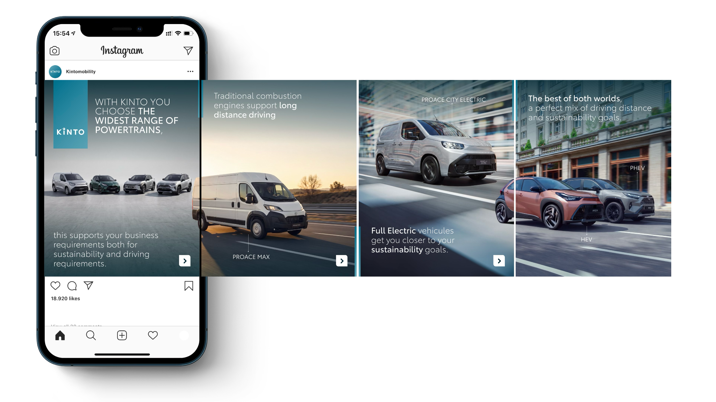

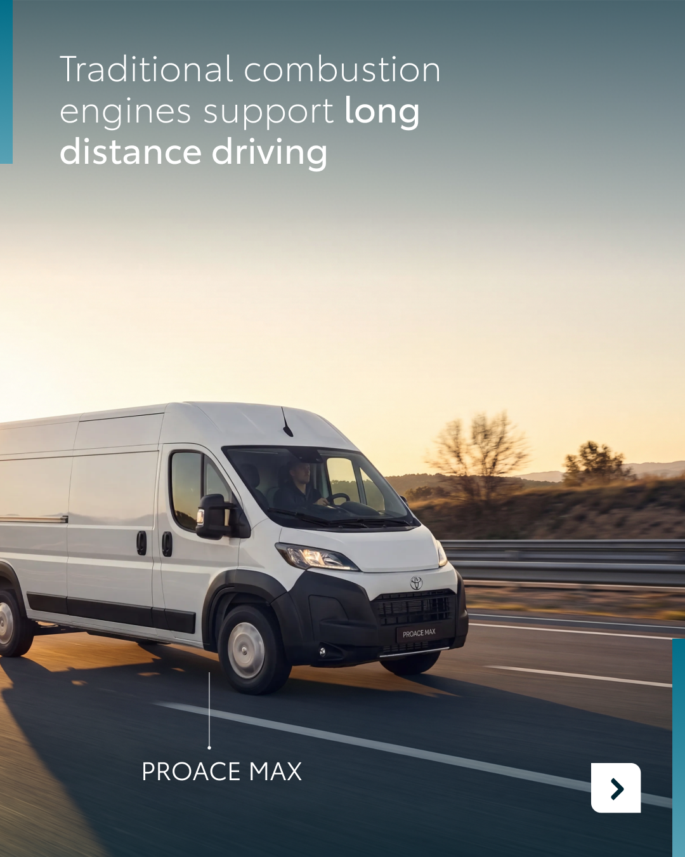


Valid for multibrand
5. POWERTRAIN ADVANTAGES
CONTENT BUCKET 1- JULY
COPY LI
How are you choosing your fleet powertrains? 📊
A successful strategy doesn't force your business into ‘one fits all’. With our multi-path line-up, you get the freedom to match the exact energy source to the right job.
🔹 Traditional internal combustion engine: for long distance and uninterrupted driving.
🔹 Full electric: driving your business straight toward ESG compliance with zero-emission wins.
🔹 Hybrid & plug-in hybrid: the best of both worlds. Delivering maximum flexibility by seamlessly blending driving range with lower emissions.
Ready to build a diversified, future-proof fleet? Explore the widest range of options at kinto-mobility.eu.
Which of these powertrain options is currently driving the biggest results for your team? 👇
One partner. Every solution.
#KINTO #FleetManagement #SustainableMobility
FORMATS AVAILABLE:
4/5

Slide 22



Valid for multibrand
5. POWERTRAIN ADVANTAGES
CONTENT BUCKET 1- JULY
COPY IG
Don’t force your fleet powertrains into a single box. 📦
When it comes to your daily drive, one size definitely doesn’t fit all. Swipe to check out our multi-path line-up. We bring together traditional engines for the long haul, full electrics for the green wins, and the best of both worlds for total flexibility. 🚙🌱
Find your perfect match at kinto-mobility.eu.
Which powertrain is currently winning the race in your fleet? 👇
One partner. Every solution.
#KINTO #FleetManagement #SustainableMobility
FORMATS AVAILABLE:
4/5

Slide 23
Valid for multibrand
5. POWERTRAIN ADVANTAGES
CONTENT BUCKET 1- JULY
COPY FB
Ever tried pushing a single car type onto a team with completely different daily schedules? 🚗
Your drivers don't all follow the exact same routine. Different jobs simply require different kinds of energy to keep your business moving efficiently. That is why our multi-path line-up adapts to your team. It’s all about total flexibility. 🌱
Explore the right mix for your team at kinto-mobility.eu.
What is currently the most requested type of vehicle among your drivers? 👇
One partner. Every solution.
#KINTO #FleetManagement #SustainableMobility
FORMATS AVAILABLE:
4/5

Slide 24
Flexible mobility solutions
Pillar 3
Notes:
Baseline: Wherever life takes you, KINTO finds the right solution for you.

Slide 25


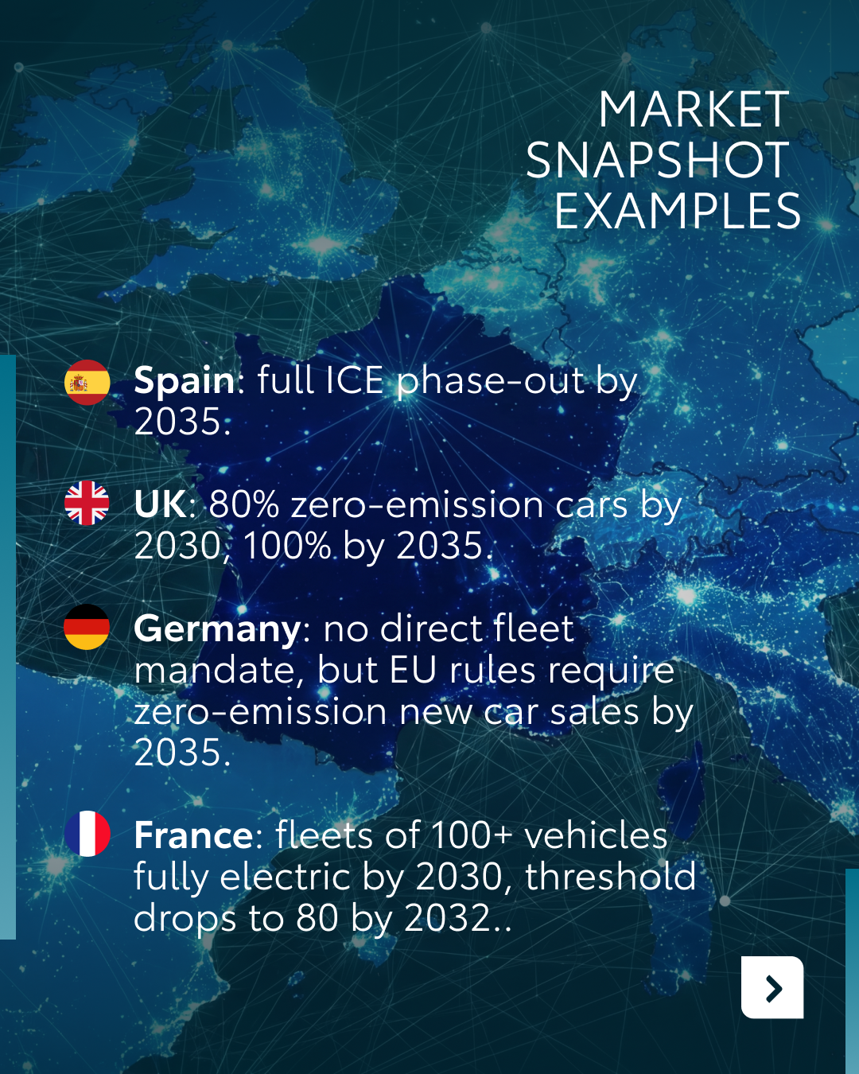


Valid for multibrand
6. DECARBONISATION TARGETS
COPY LI
Did you know that a corporate vehicle ordered today will likely still be active in your fleet in 2029? 🗓️
This means every single contract decision you make right now is already a decarbonization decision. However, keeping up with European emission regulations can be challenging, as different markets move at different speeds toward the exact same destination.
That is where KINTO acts as your trusted advisor. We map your fleet's exact contract expiry dates against local regulatory timelines, ensuring your business transitions to EV at the perfect moment without operational disruptions.
Gain clarity on what is changing and when. Swipe through our market snapshot and talk to us at kinto-mobility.eu.
One partner. Every solution.
#KINTO #FleetDecarbonisation #EVTransition
CONTENT BUCKET 1- JULY
FORMATS AVAILABLE:
4/5

Slide 26
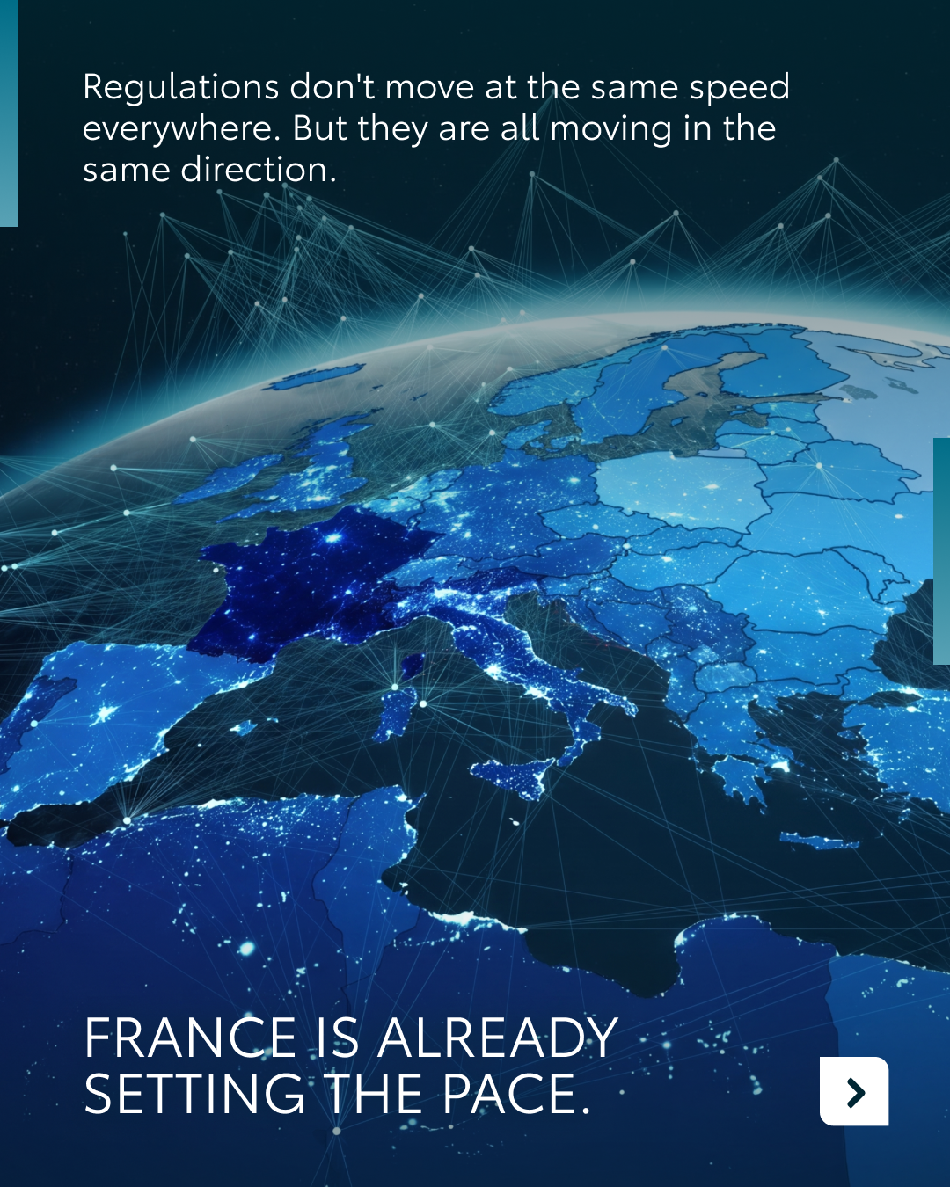





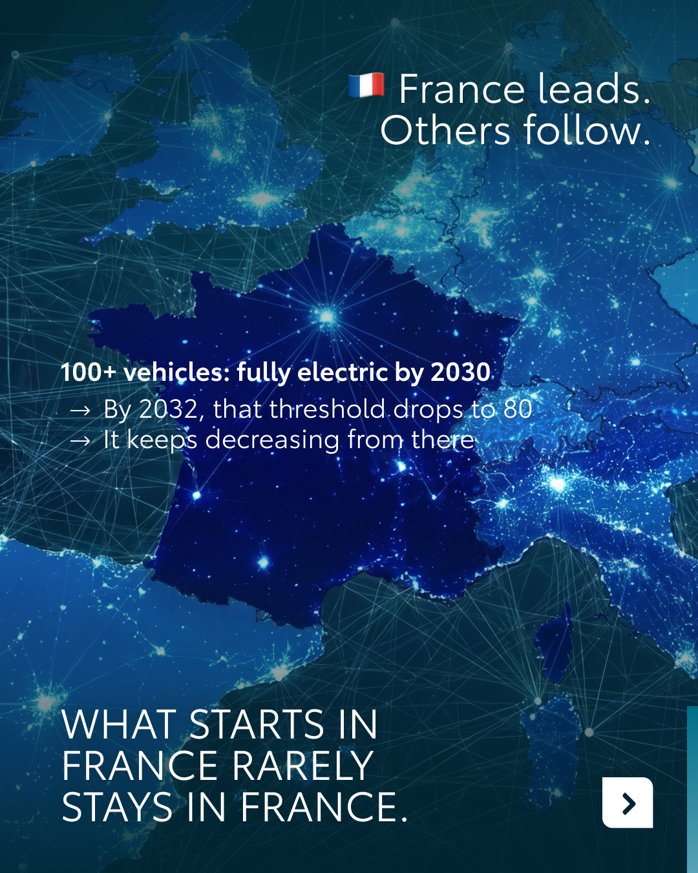
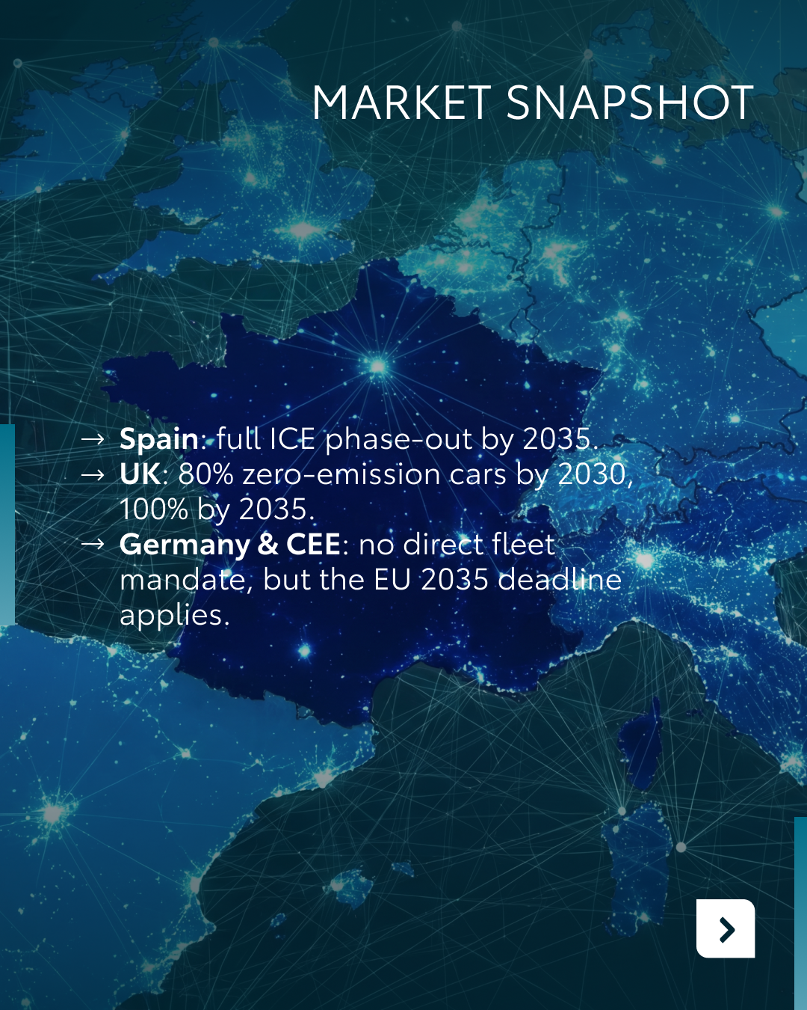
Valid for multibrand
6. DECARBONISATION TARGETS
COPY IG
Time travel isn't real, but your current fleet decisions are already living in 2029. 🗓️
A corporate vehicle ordered today will likely still be on the road when the end of the decade approaches. That means every single contract you sign right now is a decarbonization decision. ⚡
Is your team already driving toward a zero-emission future or are you still mapping out the route? 👇
One partner. Every solution.
#KINTO #EVTransition #SustainableMobility
CONTENT BUCKET 1- JULY
FORMATS AVAILABLE:
4/5

Slide 27
Valid for multibrand
6. DECARBONISATION TARGETS
COPY FB
Managing a corporate fleet means looking years into the future. Did you know a vehicle ordered today will still be on the road in 2029? 🚗
This reality turns every choice into a decarbonization decision. With European countries adopting green regulations at varying paces, staying compliant across different borders can feel overwhelming.
KINTO acts as your trusted advisor. We take the guesswork out of the EV transition, helping your business move forward at the right pace.
Discover how we streamline your transition at kinto-mobility.eu.
One partner. Every solution.
#KINTO #FleetManagement #Sustainability
CONTENT BUCKET 1- JULY
FORMATS AVAILABLE:
4/5

Slide 28
7.ANIMATION MARKETS
COPY - LI:
Six languages, multiple European markets, and a diverse range of mobility solutions. 🌍
Flexible mobility means something unique to everyone, everywhere. Each country holds a different piece of the puzzle. From fixed-cost leasing in Germany and short-term rentals in Italy, to smarter commuting for your team in France.
That is why KINTO is present across various countries with a versatile portfolio of products, carefully tailored to match specific local needs. No matter where your business operates, we combine international strength with the right regional expertise to keep your cross-border fleet running efficiently. 🗺️
Experience our approach across Europe at kinto-mobility.eu.
One partner. Every solution.
#KINTO #FlexibleMobility #InternationalFleet
CONTENT BUCKET 1- JULY
FORMATS AVAILABLE:
1/1 - 9/16 - ⅘
Notes:
#KINTO #FleetManagement #CorporateMobility #FlexibleMobility #MobilitySolutions

Slide 29
7.ANIMATION MARKETS
COPY - IG:
We take you on a high-speed tour across Europe, where mobility speaks the local language in every market. 🚗
Local requirements change from border to border, and so do our solutions. We offer a diverse range of products tailored to match the specific local needs of each country, ensuring your international fleet strategy never gets lost in translation. 🌎
How many languages does your corporate fleet speak? 💬
One partner. Every solution.
#KINTO #EuropeanMobility #FlexibleMobility
CONTENT BUCKET 1- JULY
FORMATS AVAILABLE:
1/1 - 9/16 - ⅘
Notes:
#KINTO #FleetManagement #CorporateMobility #FlexibleMobility #MobilitySolutions

Slide 30
7.ANIMATION MARKETS
COPY - FB:
Cross-border fleet management usually comes with a lot of mixed signals. 🌍
Every European market operates on its own wavelength, with its own unique mobility demands.
At KINTO, we combine our broad international presence with a diverse range of products specifically designed to match local market needs. We provide the right custom solutions for each country, keeping your business moving seamlessly across every border. 🗺️
Explore our European approach at kinto-mobility.eu.
One partner. Every solution.
#KINTO #EuropeanMobility #FleetManagement
CONTENT BUCKET 1- JULY
FORMATS AVAILABLE:
1/1 - 9/16 - ⅘
Notes:
#KINTO #FleetManagement #CorporateMobility #FlexibleMobility #MobilitySolutions

Slide 31
Community & connection
Empowerment & Expertise
Notes:
Baseline: Join the KINTO community

Slide 32
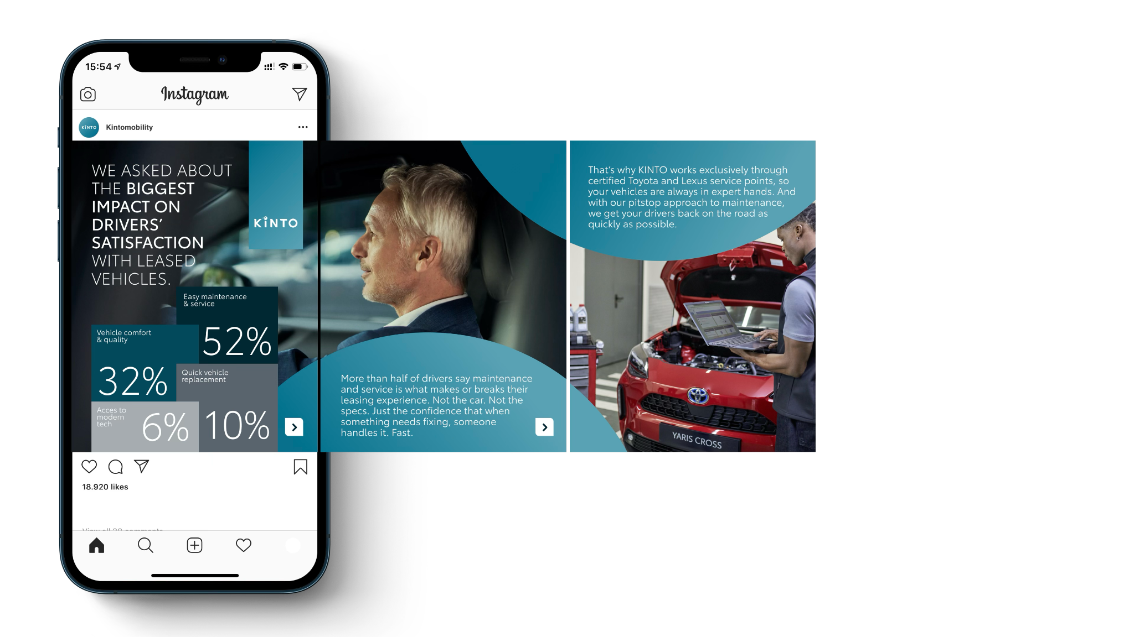
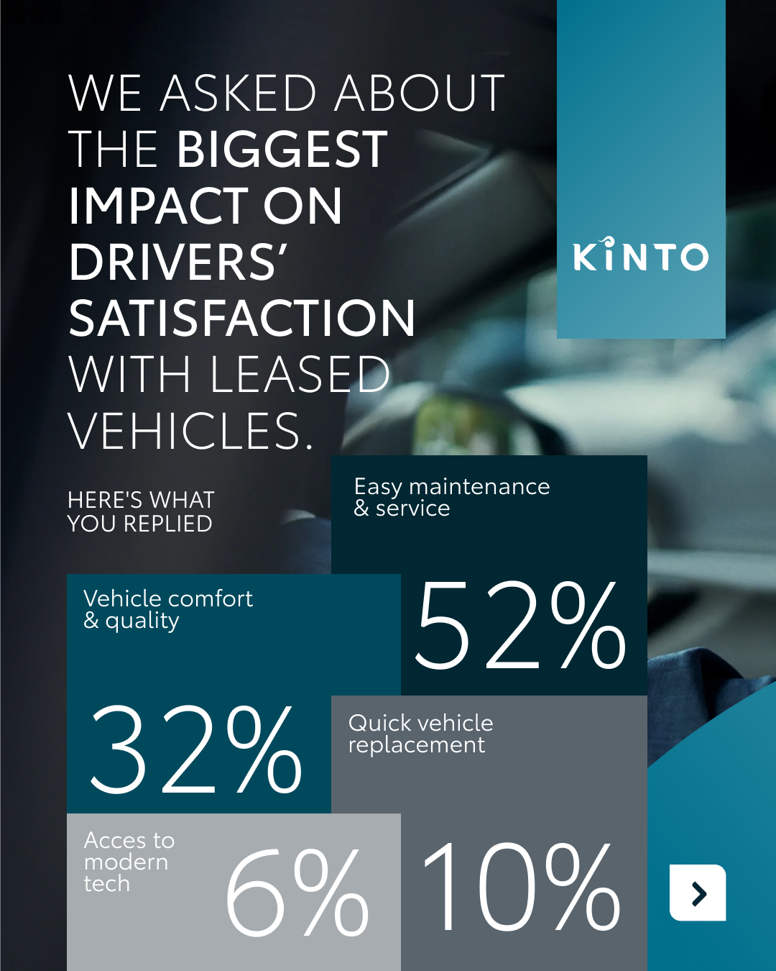

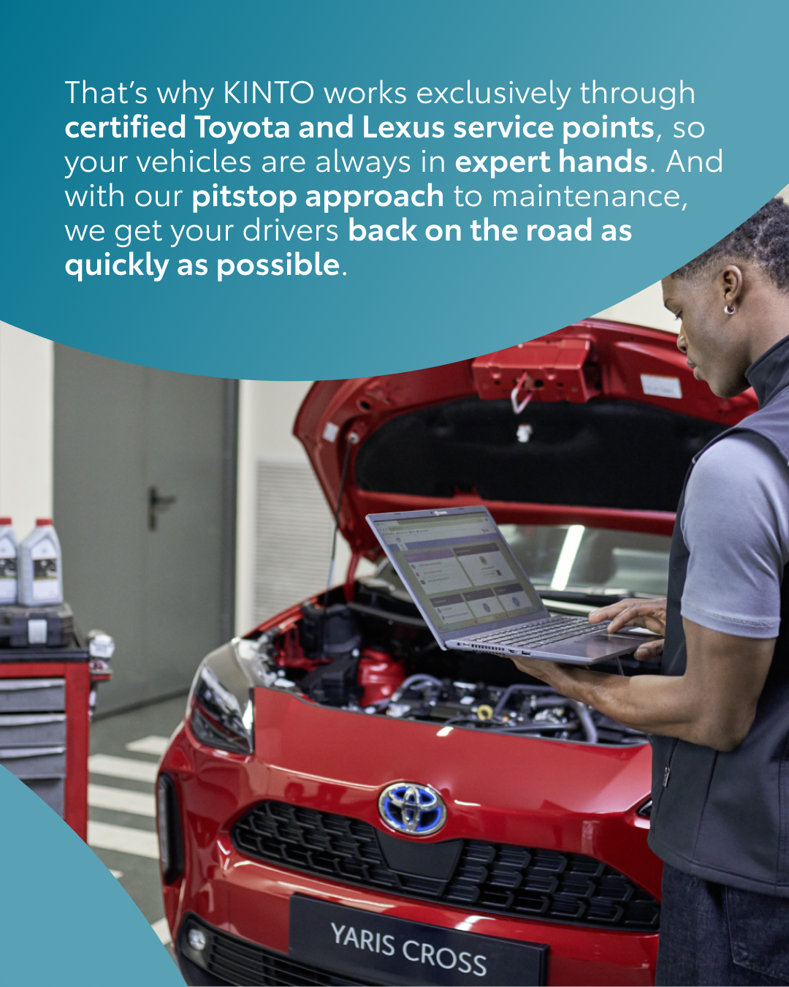

8.COMMUNITY LEARNINGS
COPY LI
We recently launched a poll to discover what actually drives satisfaction for lease drivers. The results are in, and the reality is much more practical than you think. 📊
52% of drivers say that service maintenance is what truly makes or breaks their leasing experience. It simply comes down to the confidence that when something needs fixing, it gets handled fast and without hassle. 🛠️
That is exactly why we focus on a seamless service experience. By working through certified Toyota and Lexus service points, we make sure every car is in expert hands. Fleet managers can easily plan maintenance directly through our platform, cutting out endless email threads. 🚙
When it comes to keeping your drivers happy, what do you find most important? 👇
One partner. Every solution.
#KINTO #FleetManagement #DriverSatisfaction
CONTENT BUCKET 1- JULY
FORMATS AVAILABLE:
4/5 - 1X1

Slide 33
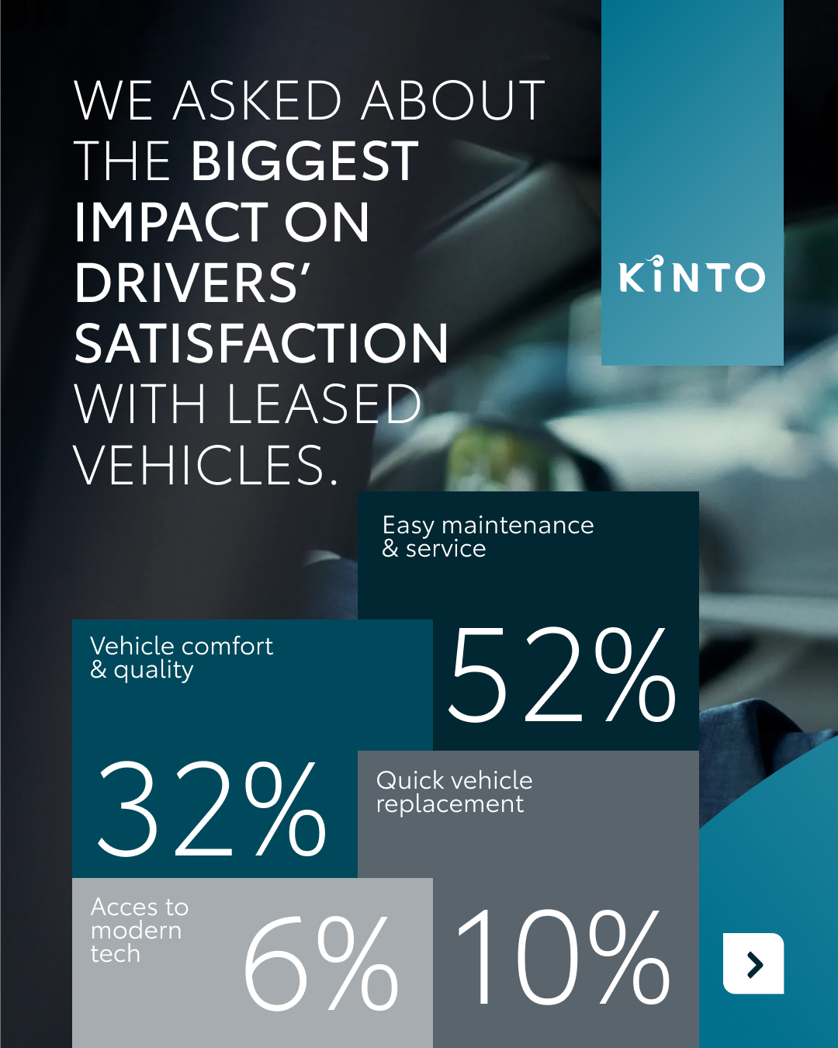

8. COMMUNITY LEARNINGS
CONTENT BUCKET 1- JULY
COPY IG
Our community has spoken, and the results of our poll are officially in! 🔧
A massive 52% of drivers agree that hassle-free service maintenance is what truly drives satisfaction. That’s why our pitstop approach uses certified Toyota and Lexus points to get your team out of the garage and back on the road, fast. 💨
What is your number one priority for keeping drivers happy? 👇
One partner. Every solution.
#KINTO #FleetManagement #DriverSatisfaction
FORMATS AVAILABLE:
4/5 1X1

Slide 34
8. COMMUNITY LEARNINGS
COPY FB
.
We asked our community what truly drives satisfaction for lease drivers. Today, we are sharing the results. 🚗
52% of drivers say hassle-free service maintenance is what makes or breaks their leasing experience. Genuine peace of mind wins from flashy features every single time.
That’s why our pitstop approach cuts out the drama. By working through certified Toyota and Lexus service points, we ensure quick turnarounds to get your team back on the road fast. ⚡
When it comes to keeping your drivers happy, what do you find most important? 👇
One partner. Every solution.
#KINTO #FleetManagement #DriverSatisfaction
CONTENT BUCKET 1- JULY
FORMATS AVAILABLE:
4/5 1X1

Slide 35
9. NEW MODEL DELIVERY
COPY - LI:
TBD
video:
YET TO BE RECORDED
CONTENT BUCKET 1- JULY
FORMATS AVAILABLE:
1/1 - 9/16 - ⅘ - 16/9
Notes:
#KINTO #FleetManagement #CorporateMobility #FlexibleMobility #MobilitySolutions

Slide 36
9. NEW MODEL DELIVERY
COPY - IG:
TBD
video:
YET TO BE RECORDER
CONTENT BUCKET 1- JULY
FORMATS AVAILABLE:
1/1 - 9/16 - ⅘ - 16/9
Notes:
#KINTO #FleetManagement #CorporateMobility #FlexibleMobility #MobilitySolutions

Slide 37
9. NEW MODEL DELIVERY
COPY - FB:
TBD
video:
YET TO BE RECORDED
CONTENT BUCKET 1- JULY
FORMATS AVAILABLE:
1/1 - 9/16 - ⅘ - 16/9
Notes:
#KINTO #FleetManagement #CorporateMobility #FlexibleMobility #MobilitySolutions

Slide 38


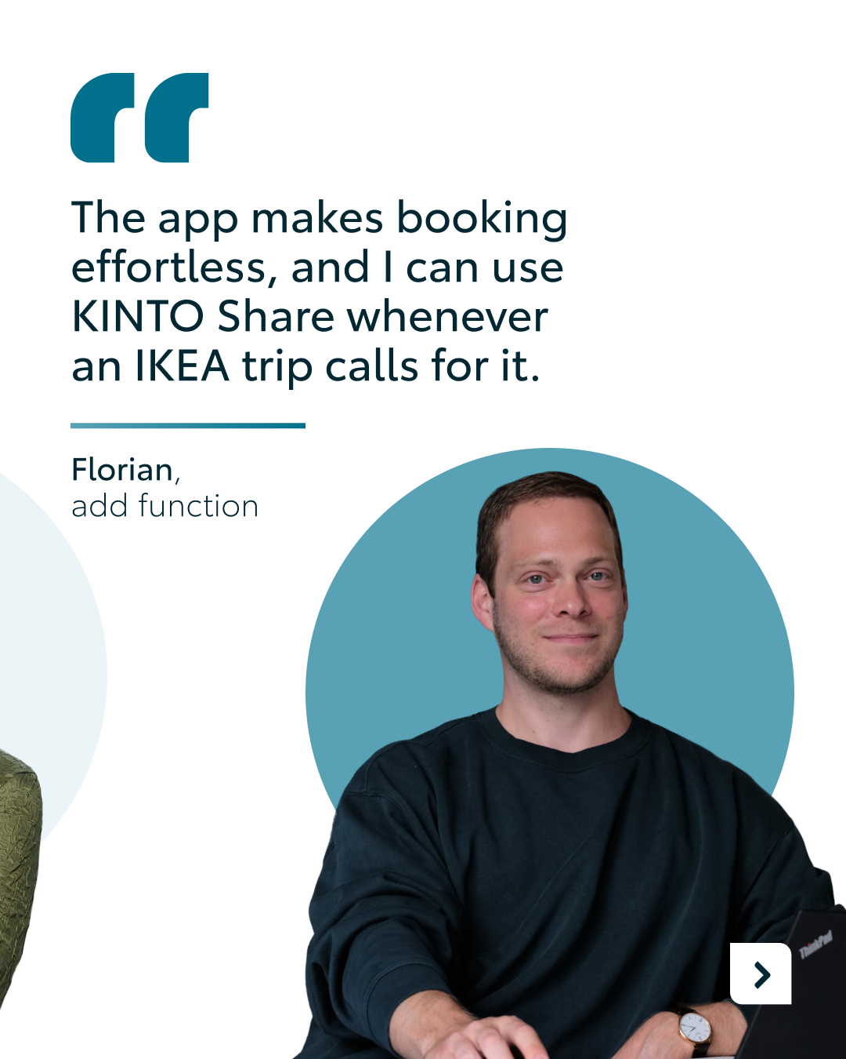
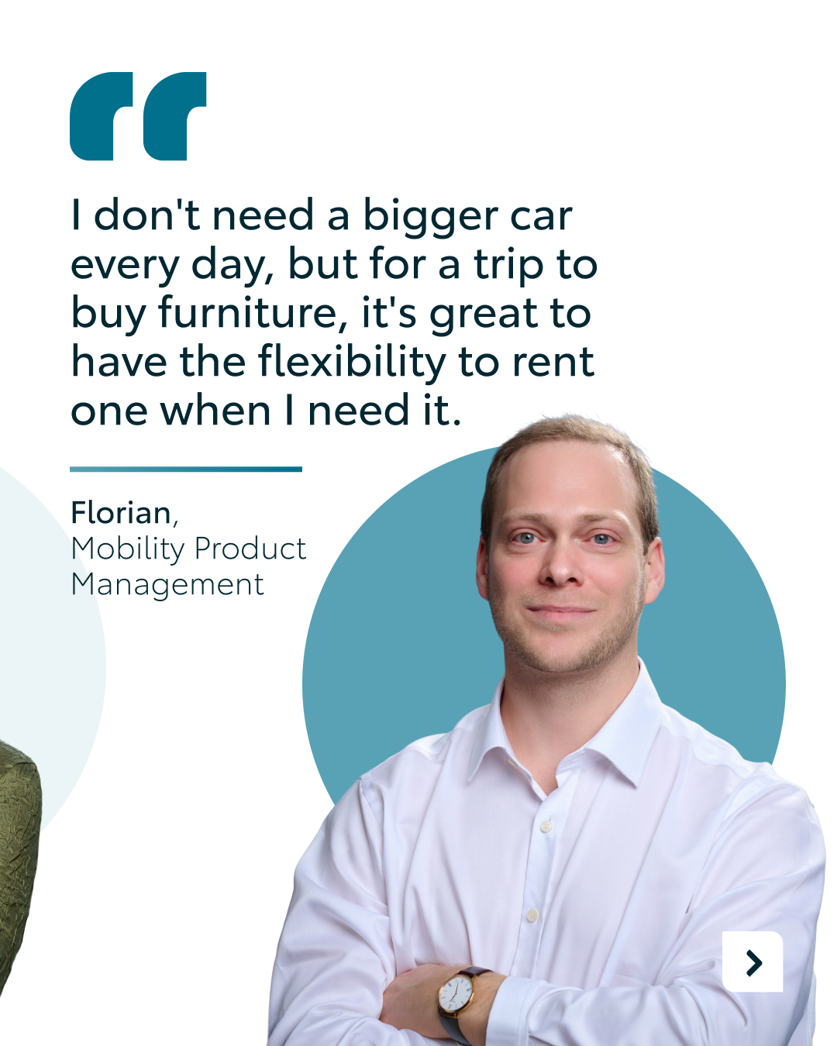
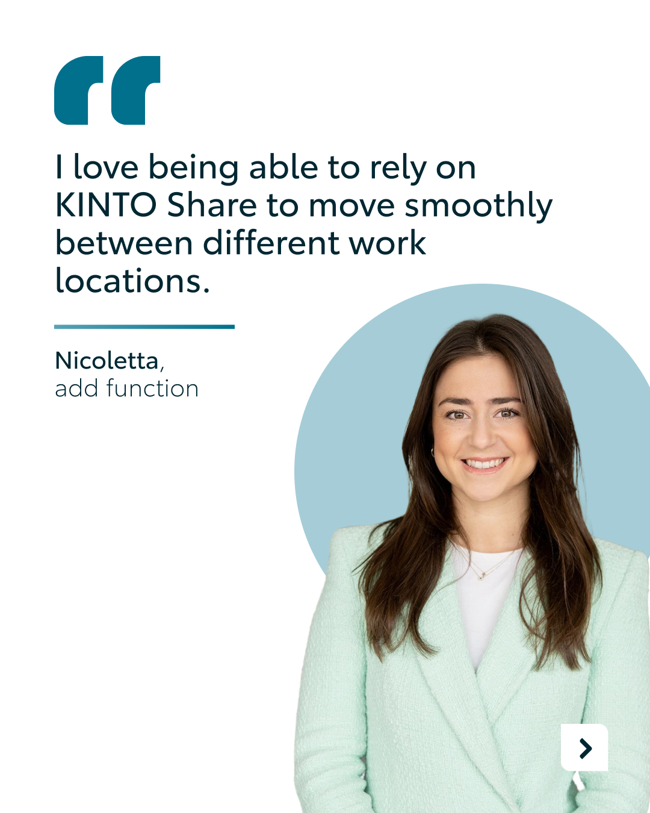
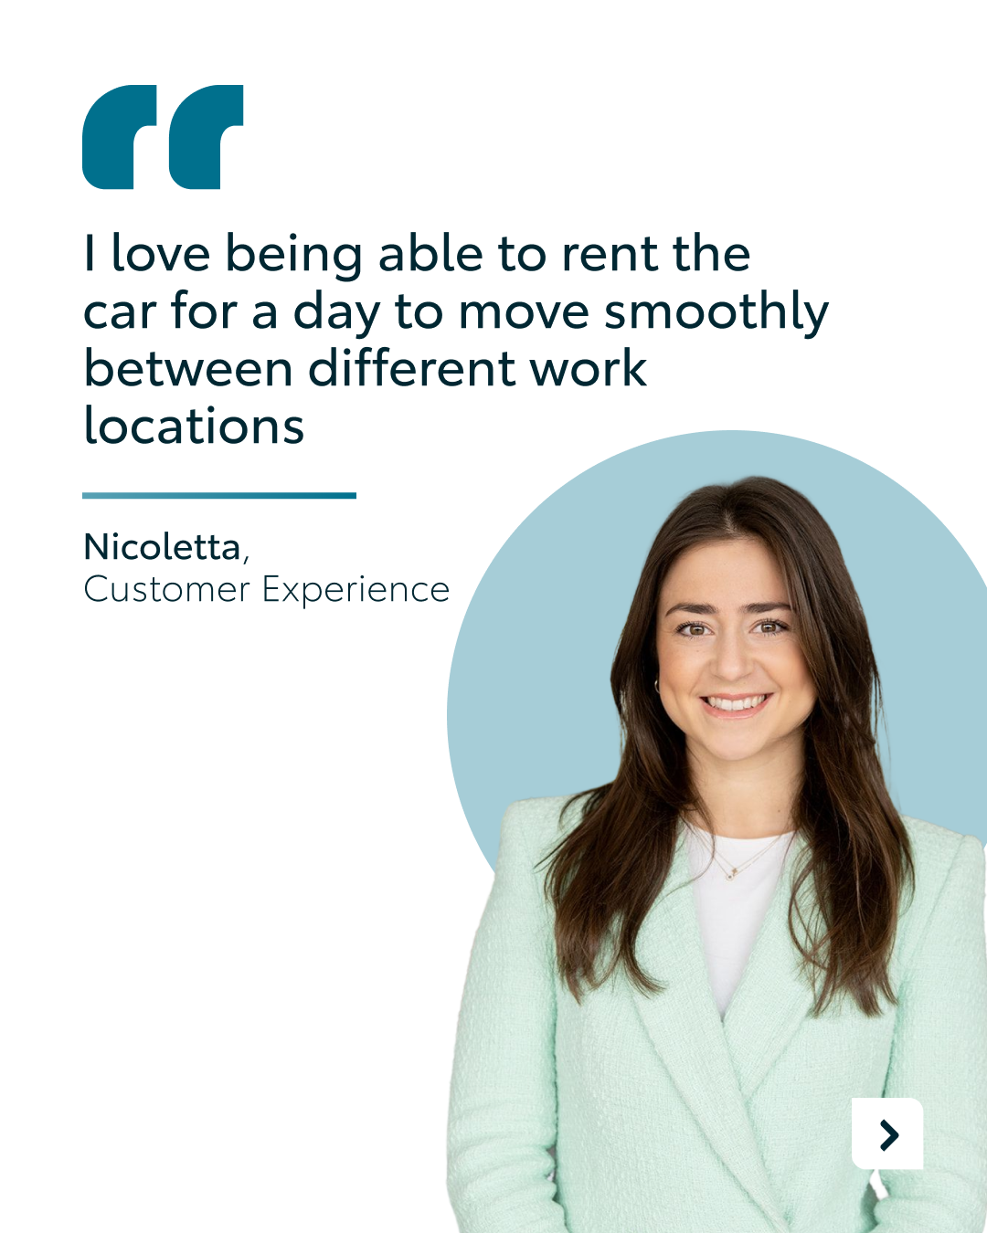
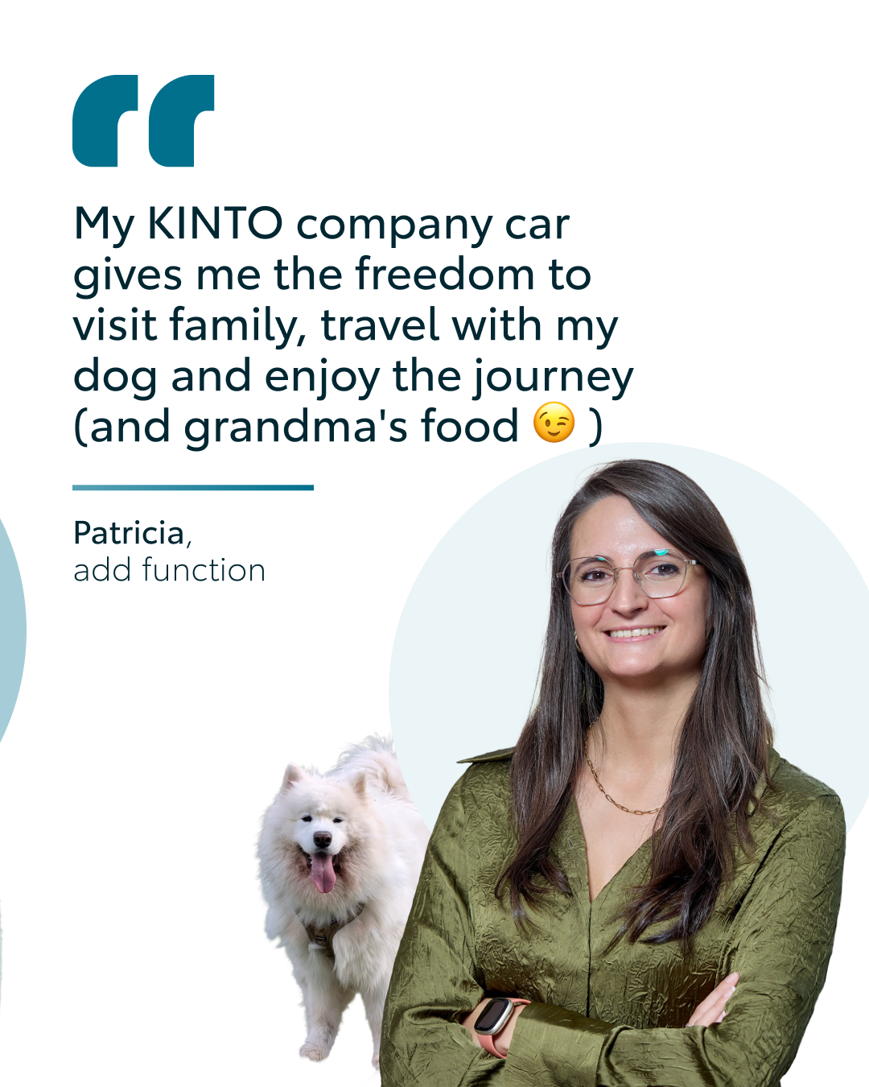

10. Q&A EMPLOYEES
CONTENT BUCKET 1- MAY
COPY LI
Who better to showcase the flexibility of our mobility solutions than the people who build them every day? ☀️
We asked our KINTO Europe team how they personally use our services during their summer holidays. From quick weekend logistics and single-day workplace changes to long-distance family road trips, their stories show how mobility should effortlessly adapt to any driver’s lifestyle.
How do you plan to utilize flexible mobility solutions during your upcoming holidays? 👇
One partner. Every solution.
#KINTO #FlexibleMobility #CompanyCulture
FORMATS AVAILABLE:
4/5

Slide 39
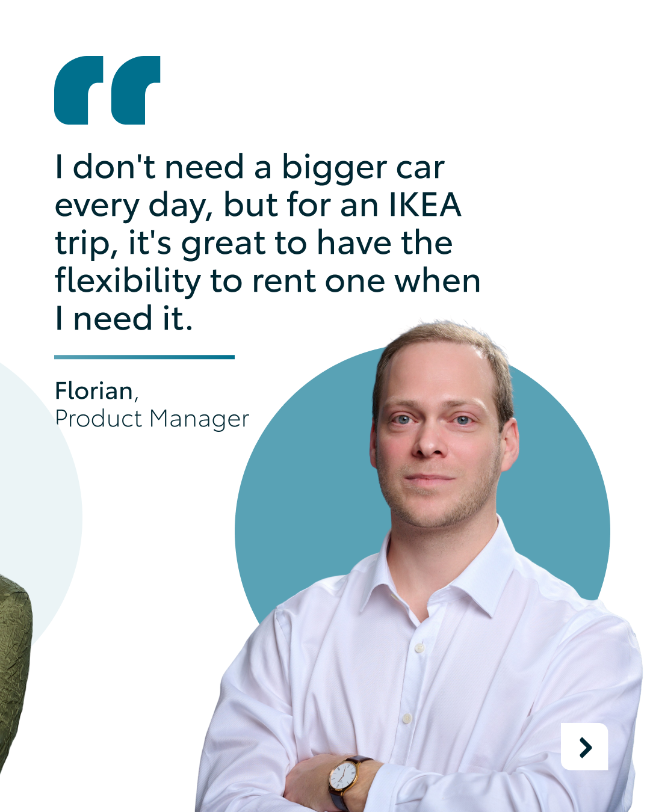
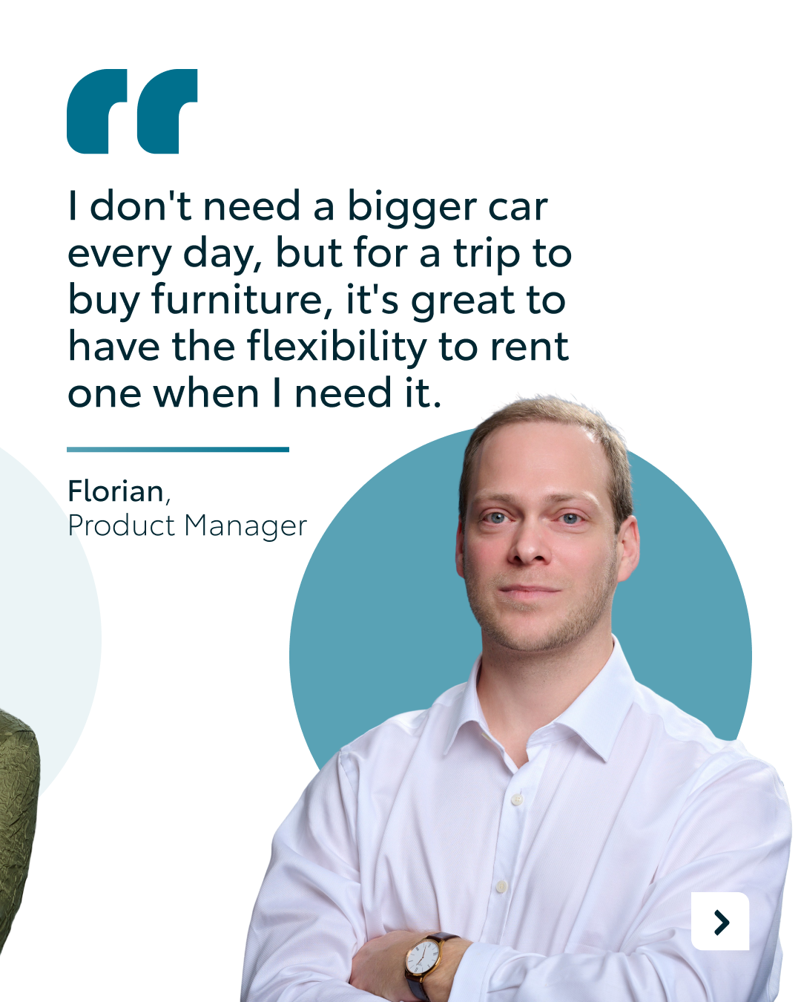

10. Q&A EMPLOYEES
CONTENT BUCKET 1- JULY
COPY IG
Ever wonder how the team behind KINTO navigates their holidays? ☀️
We asked our own crew how they use our flexible solutions during the summer. Swipe to see how they gear up for everything, from quick weekend hauls to long-distance road trips (grandma’s cooking included 👵).
What is your absolute go-to destination this summer? 🏖️
One partner. Every solution.
#KINTO #FlexibleMobility #SummerVibes
FORMATS AVAILABLE:
4/5

Slide 40
10. Q&A EMPLOYEES
CONTENT BUCKET 1- JULY
COPY FB
At KINTO, we love practicing what we preach. ☀️
We asked our KINTO Europe colleagues how they personally use our mobility solutions during their summer holidays. From quick weekend trips to long-distance family journeys, their setups prove that mobility should effortlessly adapt to the individual driver.
Check out their real-life solutions in the carousel and find your own match at kinto-mobility.eu.
How are you moving around this summer? Let us know in the comments! 👇
One partner. Every solution.
#KINTO #FlexibleMobility #SummerVibes
FORMATS AVAILABLE:
4/5

