Slide 1

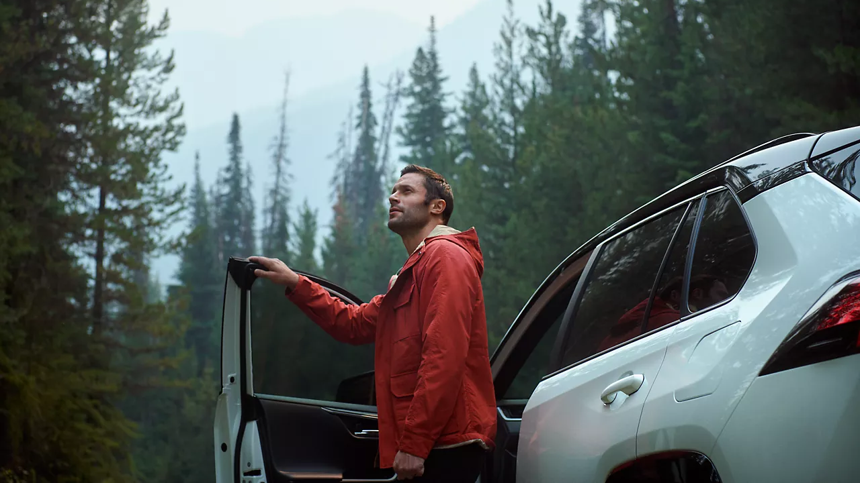

CONTENT
AUGUST 2026

Slide 2
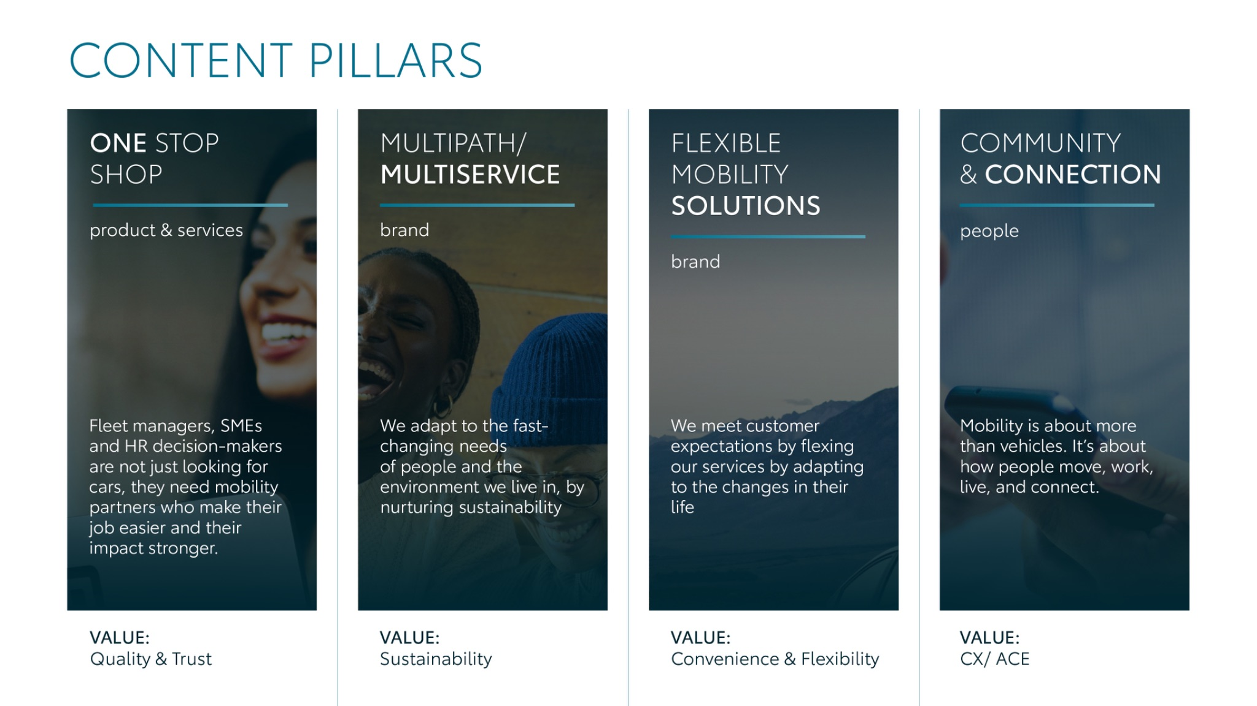
Notes:
“At KINTO, we work with content pillars: themes that carry our brand. We use different content types: inspiring, informative, topical. Your contributions add the human layer that makes the strategy work.”

Slide 3
Content pillars - content overview
AUGUST
We’re expecting
Express Service
KINTO JOIN website
Parking management
Rent - extra weekend
Fleet size changes
Q&A Employees
Community learnings AUGUST
KINTO’s there
Dance video
ONE STOP SHOP
MULTIPATH/ MULTISERVICE
FLEXIBLE MOBILITY SOLUTIONS
COMMUNITY/ CONNECTION

Slide 4
Tag lines pillars
1. One Stop Shop
One partner. Every solution.
2. Flexible Mobility Solutions
One partner. Every solution.
3. Community and connection (important to keep it broad enough to fit clients as well as people working at Kinto)
Join the KINTO community.
4. Vision & Impact (Multipath/multiservice)
One partner. Every solution.

Slide 5

One stop shop
Notes:
One place. Every solution. Always KINTO.

Slide 6





1.WE’RE EXPECTING
COPY LI
We’re expecting! Something exciting is cooking behind the scenes at KINTO, and the digital scans look incredibly promising. 🗓️
We are thrilled to announce that a brand-new online booking platform is coming soon. Our tech team has been hard at work for months, ensuring this new digital addition grows right on schedule.
This platform is designed to make your rental experience smoother than ever. Right now, we are fully focusing on the preparation phase to make sure everything is perfect for the grand launch. 🚗
Keep an eye on our feed as the due date approaches.
One partner. Every solution.
#KINTO #DigitalInnovation #FleetManagement
CONTENT BUCKET 1- AUGUST
FORMATS AVAILABLE:
4/5

Slide 7
1.WE’RE EXPECTING
COPY IG
We’re expecting! A brand-new digital addition is taking shape within the KINTO family. 👋
Our upcoming booking platform is officially on the way, designed to make securing your rides faster and completely seamless. As you can see from the scan, those digital genes are already looking strong. ⚡
We are busy behind the scenes with all the preparations, so stay tuned as we get closer to the big arrival! 🚗
One partner. Every solution.
#KINTO #TechInnovation #BookingPlatform
CONTENT BUCKET 1- AUGUST
FORMATS AVAILABLE:
4/5

Slide 8
1.WE’RE EXPECTING
COPY FB
Big news! The scans are in and we can finally share the secret: we are expecting a new arrival at KINTO. 💻
For months, our team has been nurturing a special project behind the scenes. We are introducing a brand-new online booking platform designed to give your business an even smoother rental experience.✨
Follow the journey to our launch here or at kinto-mobility.eu.
One partner. Every solution.
#KINTO #Innovation #FleetManagement
CONTENT BUCKET 1- AUGUST
FORMATS AVAILABLE:
4/5

Slide 9




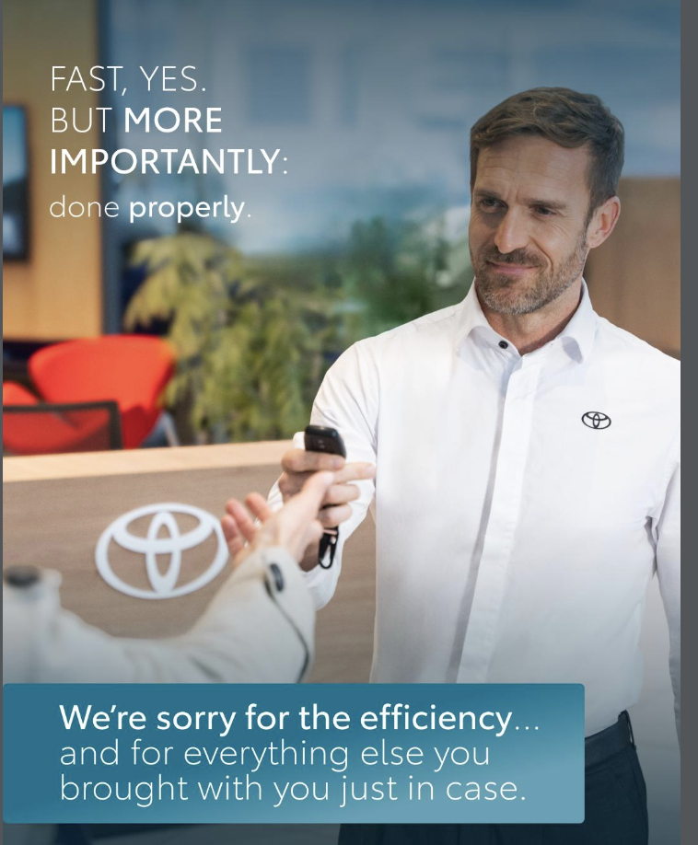
2. EXPRESS SERVICE
COPY LI
Have you ever been so efficient that it actually caused a minor scheduling crisis? 💼
At KINTO, our vehicle maintenance routine is engineered to feel more like a high-speed pitstop than a long, drawn-out delay. Through our certified network, our express service is optimized for absolute precision and speed. With no compromise on quality.
In fact, it might be a bit too fast for some drivers. But we believe in getting your team back on the road properly and promptly. We are deeply sorry for the hyper-efficiency. 😉
One partner. Every solution.
#KINTO #FleetEfficiency #ExpressService
CONTENT BUCKET 1- AUGUST
FORMATS AVAILABLE:
4/5

Slide 10
2. EXPRESS SERVICE
CONTENT BUCKET 1- AUGUST
COPY IG
When your fleet maintenance is too fast for your coffee break. ☕
We designed our express service to cut out the typical garage downtime and keep your corporate momentum going. With no compromise on quality. The only real downside? Your drivers won't have time to finish that spreadsheet or drink their latte.
What is your go-to way to kill time during maintenance?👇
One partner. Every solution.
#KINTO #Maintenance #HassleFree
FORMATS AVAILABLE:
4/5

Slide 11
2. EXPRESS SERVICE
CONTENT BUCKET 1- AUGUST
COPY FB
We would like to formally apologize to all the unfinished coffees out there. ☕
When a corporate vehicle goes in for service, we do not mess around. Our focus is getting your business moving safely and swiftly. With no compromise on quality. But as it turns out, our hyper-efficiency can sometimes ruin a driver's relaxation plans. Done properly, done promptly, so your operations don’t miss a single beat. 🛠️
Explore our streamlined leasing care at kinto-mobility.eu.
One partner. Every solution.
#KINTO #CorporateLife #CarMaintenance
FORMATS AVAILABLE:
4/5

Slide 12
Multipath/
Multiservice
Pillar 4

Slide 13
Flexible mobility solutions
Pillar 3
Notes:
Baseline: Wherever life takes you, KINTO finds the right solution for you.

Slide 14



3.JOIN WEBSITE REVAMP
COPY - LI:
Corporate mobility is shifting gears, and our digital blueprint is getting a major upgrade. 🗓️
Imagine an online destination that is effortless to browse through, brings a clear cost overview into focus, and puts total contract transparency right in front of you.
We have been retooling our online experience from the source code up. Why? Because managing your corporate vehicles should feel just as smooth as driving a premium car off the lot.
The countdown to a refreshed user experience has officially begun. Get ready to experience KINTO differently.
One partner. Every solution.
#KINTO #NewWebsite #FleetManagement
CONTENT BUCKET 1- AUGUST
FORMATS AVAILABLE:
1/1 - ⅘
Notes:
#KINTO #FleetManagement #CorporateMobility #FlexibleMobility #MobilitySolutions

Slide 15
3. JOIN WEBSITE REVAMP
COPY - IG:
Clear your cache and adjust your mirrors, our digital space is getting a serious makeover. ✨
We are currently in the middle of a major digital tune-up, rewriting the rules of how you interact with your fleet. Picture a single screen that is effortless to browse through, maps out a clear cost overview instantly, and drops full contract transparency right into your lap.
Stay tuned for the drop!
What is your number one feature that makes a business website a joy to use? 👇
One partner. Every solution.
#KINTO #WebsiteRevamp #NextGenMobility
CONTENT BUCKET 1- AUGUST
FORMATS AVAILABLE:
1/1 - ⅘ -
Notes:
#KINTO #FleetManagement #CorporateMobility #FlexibleMobility #MobilitySolutions

Slide 16
3.JOIN WEBSITE REVAMP
COPY - FB:
If you could write a wishlist for the ultimate fleet management website, what would be on it? 🤔
We asked ourselves that exact question, and then we started coding. We are giving our digital home a fresh coat of paint and some powerful new engines.
Something brand new is loading behind the scenes. We are building a platform that is easy to browse through, helps you get a clear cost overview, and ensures full contract transparency. It is the same flexible KINTO mobility you trust, rebuilt into a modern interface.
One partner. Every solution.
#KINTO #UserExperience #FleetSolutions
CONTENT BUCKET 1- AUGUST
FORMATS AVAILABLE:
1/1 - ⅘
Notes:
#KINTO #FleetManagement #CorporateMobility #FlexibleMobility #MobilitySolutions

Slide 17
3b.JOIN WEBSITE REVAMP
COPY - LI:
Workplace mobility is shifting gears, and our digital blueprint has received a major upgrade. 🗓️
Imagine an online destination that is effortless to browse through, shows you smarter ways to commute, and teaches you how to save costs and cut carbon.
We have been retooling our online experience from the ground up. Why? Because discovering smart commuting and community carpooling solutions should feel just as seamless as the ride itself.
Our refreshed website page is officially live. Head over to explore the new interface and get ready to experience KINTO JOIN differently.
One partner. Every solution.
#KINTO #KINTOJoin #WorkplaceMobility
CONTENT BUCKET 1- AUGUST
FORMATS AVAILABLE:
1/1 - ⅘
Notes:
#KINTO #FleetManagement #CorporateMobility #FlexibleMobility #MobilitySolutions

Slide 18
3b. JOIN WEBSITE REVAMP
COPY - IG:
Clear your cache and adjust your mirrors, our digital space just got a serious makeover. ✨
We have given our platform a major digital tune-up, rewriting the rules of workplace mobility. Picture a single screen that is effortless to browse through, shows you smarter ways to commute, and teaches you how to save costs and cut carbon.
Our refreshed page is officially live, so head over to kintojoin.io to check it out! 💻
What is your number one feature that makes a business website a joy to use? 👇
One partner. Every solution.
#KINTO #KINTOJoin #WorkplaceMobility
CONTENT BUCKET 1- AUGUST
FORMATS AVAILABLE:
1/1 - ⅘ -
Notes:
#KINTO #FleetManagement #CorporateMobility #FlexibleMobility #MobilitySolutions

Slide 19
3b.JOIN WEBSITE REVAMP
COPY - FB:
If you could write a wishlist for the ultimate workplace mobility website, what would be on it? 🤔
We asked ourselves that exact question, and then we brought it to life. We have given our digital home a fresh coat of paint and some powerful new features.
Our brand-new page is officially live. Go to kintojoin.io and explore a platform that is easy to browse through, shows you smarter ways to commute, and teaches you how to save costs and cut carbon. It is the same flexible KINTO JOIN mobility you trust, showcased in a modern interface.
One partner. Every solution.
#KINTO #KINTOJoin #WorkplaceMobility
CONTENT BUCKET 1- AUGUST
FORMATS AVAILABLE:
1/1 - ⅘
Notes:
#KINTO #FleetManagement #CorporateMobility #FlexibleMobility #MobilitySolutions

Slide 20
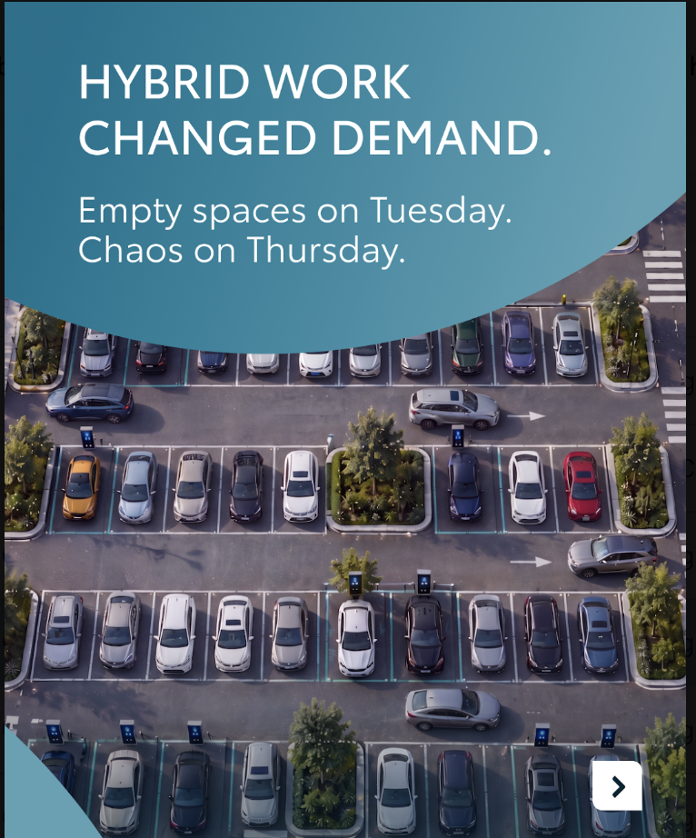

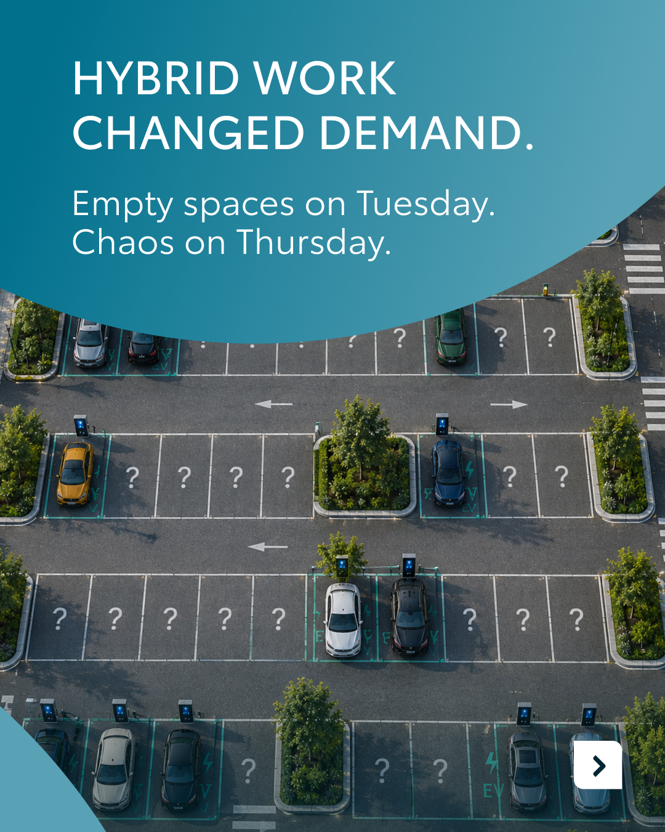

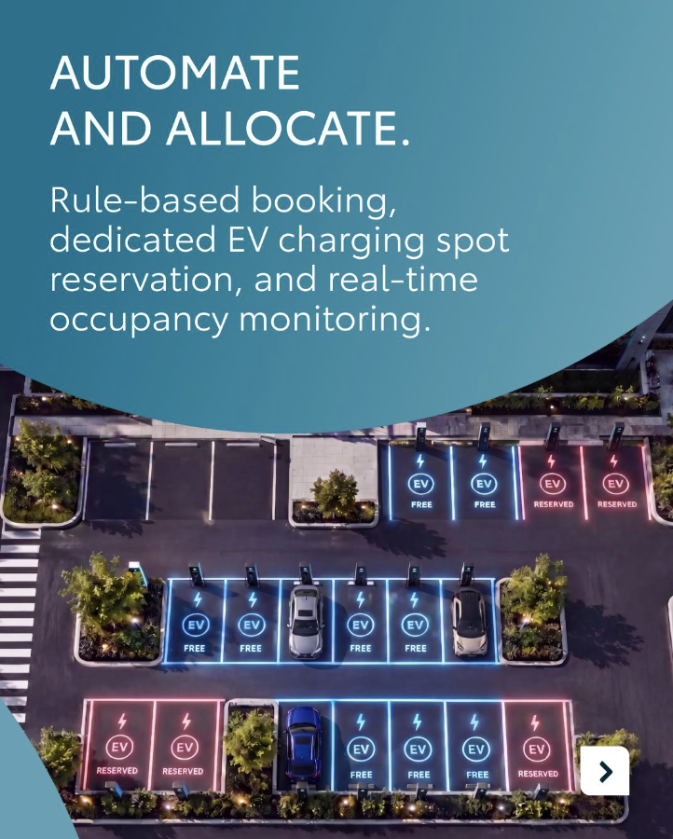

Valid for multibrand
4. PARKING MANAGEMENT
CONTENT BUCKET 1- AUGUST
COPY LI
Desks get booked effortlessly. Meeting rooms get managed to the minute. Yet, the corporate parking lot frequently remains the last frontier of the modern workplace. 🚗
With hybrid work, companies face a predictable scheduling headache: completely empty asphalt on Tuesdays, followed by absolute gridlock on Thursdays. This constant fluctuation leads to a costly waste of real estate and a frustrating start to the workday.
That is why JOIN with KINTO meets Parking Management. We are bringing rule-based automation to your parking infrastructure. Through real-time occupancy monitoring and dedicated EV charging spot reservations, facility managers trade the daily guesswork for data-driven allocation.
One partner. Every solution.
#KINTOJoin #SmartParking #WorkplaceMobility
FORMATS AVAILABLE:
4/5

Slide 21
Valid for multibrand
4. PARKING MANAGEMENT
CONTENT BUCKET 1- AUGUST
COPY IG
Playing musical chairs with corporate parking spots? Let’s pull the brake on the office chaos. 🎶
Hybrid work has officially broken traditional parking habits. Your lot looks like a total ghost town on Tuesday, but turns into an obstacle course by Thursday. 🤯
JOIN with KINTO changes the game of parking management. Swipe through to see how we turn tarmac into a smart asset.
What is the most chaotic parking showdown you’ve witnessed at the office? Spill the tea in the comments. 👇
One partner. Every solution.
#KINTOJoin #SmartParking #OfficeLife
FORMATS AVAILABLE:
4/5

Slide 22

Valid for multibrand
4. PARKING MANAGEMENT
CONTENT BUCKET 1- AUGUST
COPY FB
Why is it that office meeting rooms are perfectly organized, but the company parking lot is still an absolute free-for-all? 🚗
Hybrid working schedules have completely flipped workplace logistics upside down. Rows of empty spaces on a quiet Tuesday, followed by bumper-to-bumper frustration on a busy Thursday. 🤷‍♂️
It is time to steer away from the stress. JOIN with KINTO introduces smart parking management to make it simple to coordinate your spaces, track daily habits, and streamline the commute.
Discover how to manage your spaces, behavior, and impact at kinto-mobility.eu.
One partner. Every solution.
#KINTOJoin #WorkplaceMobility #FacilitiesManagement
FORMATS AVAILABLE:
4/5

Slide 23


5.RENT EXTRA WEEKEND
COPY - LI:
We have all experienced those slow afternoons where we stare at the clock, wishing we could add a couple of bonus days to Saturday and Sunday. While we cannot physically manufacture a 48-hour weekend extension, we can help you trade your desk chairs for driver seats. 🗓️
With KINTO’s flexible rental solutions, you can turn a brief pause into an extended getaway. Book a vehicle that matches your travel plans and transform the rest of the week into a full-scale holiday. 🚗
One partner. Every solution.
#FlexibleMobility #RentACar #HolidayRent
CONTENT BUCKET 1- AUGUST
FORMATS AVAILABLE:
1/1 - ⅘
Notes:
#KINTO #FleetManagement #CorporateMobility #FlexibleMobility #MobilitySolutions

Slide 24
5.RENT EXTRA WEEKEND
COPY - IG:
Current mood: actively searching for ways to make the weekend last longer. 😴
You cannot rent an extra weekend, but you can rent a premium ride with KINTO and take a holiday for the rest of the week. 🚙
If you could magically add one permanent day to the weekend, would you insert it before Monday or after Friday? Let us know below! 👇
One partner. Every solution.
#HolidayRent #OutofOffice #SummerVibes
CONTENT BUCKET 1- AUGUST
FORMATS AVAILABLE:
1/1 - ⅘
Notes:
#KINTO #FleetManagement #CorporateMobility #FlexibleMobility #MobilitySolutions

Slide 25
5.RENT EXTRA WEEKEND
COPY - FB:
Ever find yourself staring at your computer, wishing you could hit 'snooze' on the entire working week? 💻
We have all been there. Unfortunately, we haven't figured out how to stretch a 2-day weekend into a 5-day weekend yet. However, we did build the next best thing.
With KINTO’s flexible short-term rentals, you can pack up your suitcases, grab your favorite travel buddies, and leave the corporate grind behind. If the weekend isn't long enough, simply rent a car that fits your journey and turn the rest of the week into a holiday. 🚙
Discover your perfect getaway match today at kinto-mobility.eu.
One partner. Every solution.
#FlexibleMobility #RentalCar #WorkLifeBalance
CONTENT BUCKET 1- AUGUST
FORMATS AVAILABLE:
1/1 - ⅘
Notes:
#KINTO #FleetManagement #CorporateMobility #FlexibleMobility #MobilitySolutions

Slide 26
Community & connection
Empowerment & Expertise
Notes:
Baseline: Join the KINTO community

Slide 27
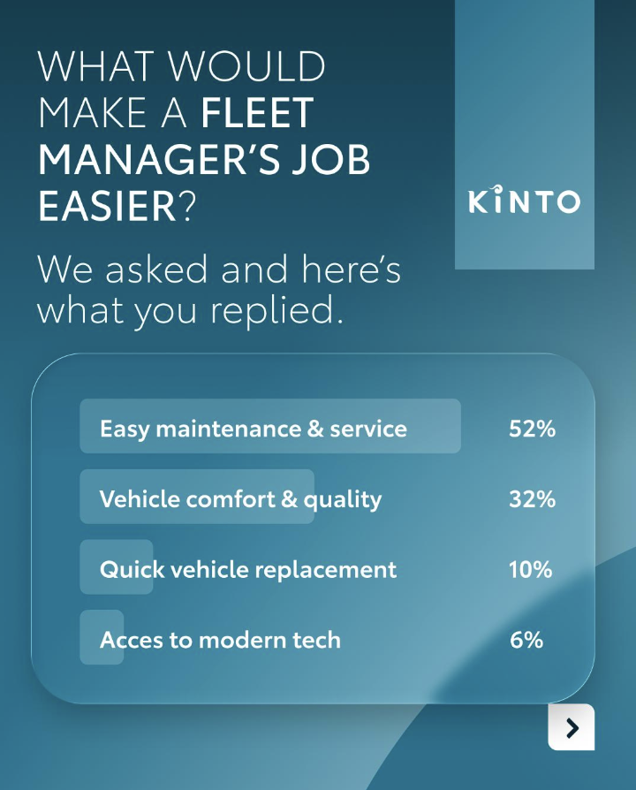
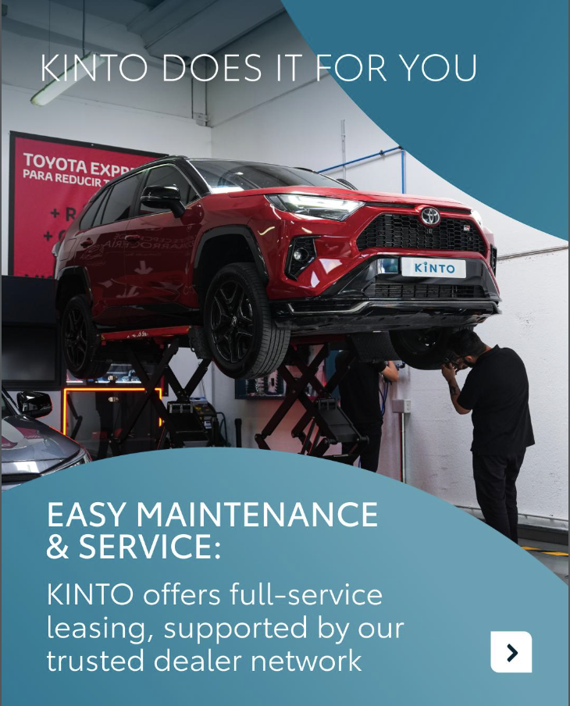

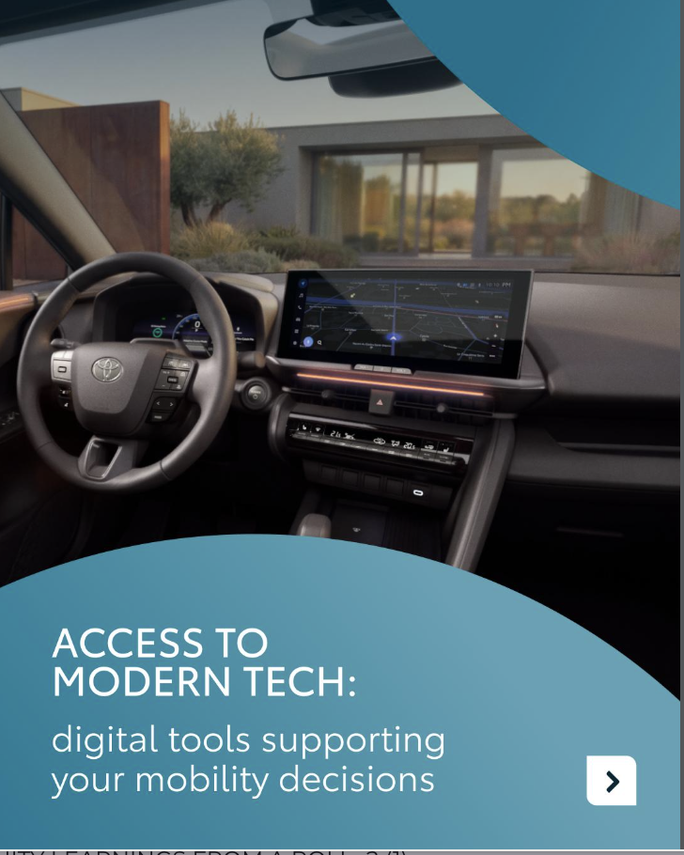

6. COMMUNITY LEARNING AUGUST
Valid for multibrand
CONTENT BUCKET 1- AUGUST
COPY LI
We asked you, our community, what would genuinely make a fleet manager's job easier. ❓
Here is exactly what you told us keeps your business moving forward:
🔧 52% highlighted easy maintenance and service as the absolute top priority.
🛋️ 32% voted for premium vehicle comfort and quality.
🔄 10% want quick vehicle replacement to completely eliminate downtime.
⚡ 6% prioritize staying ahead with instant access to modern tech.
KINTO is here to check all these boxes. From full-service leasing and trusted vehicles to integrated replacement cars, we ensure your daily operations run without any unexpected potholes. 🚗
One partner. Every solution.
#FleetManagement #BusinessEfficiency #ProcessAutomation
FORMATS AVAILABLE:
4/5

Slide 28
Valid for multibrand
6. COMMUNITY LEARNING AUGUST
CONTENT BUCKET 1- AUGUST
COPY IG
Breaking news: premium features are great, but effortless maintenance is the real corporate luxury. 👑
Our community poll results are officially in, and the verdict is clear:
🔧 52% want easy maintenance and service.
🛋️ 32% voted for premium vehicle comfort and quality.
🔄 10% need quick vehicle replacement.
⚡ 6% prioritize staying ahead with access to modern tech.
It turns out that keeping your team comfortable on the road and completely avoiding downtime is the real secret to an uninterrupted workday. Luckily, KINTO checks all these boxes. 🚗
What is your absolute number one priority when it comes to your company vehicles? 👇
One partner. Every solution.
#OfficeLife #SmartMobility #HassleFree
FORMATS AVAILABLE:
4/5

Slide 29
Valid for multibrand
6. COMMUNITY LEARNING AUGUST
CONTENT BUCKET 1- AUGUST
COPY FB
Are unexpected maintenance detours and vehicle downtime currently turning your working week into a bit of a balancing act? 🤯
We asked you, our community, what would make your lives as fleet managers easier.
Here is what you voted for:
🔧 52% want easy maintenance and service.
🛋️ 32% voted for premium vehicle comfort and quality.
🔄 10% need quick vehicle replacement.
⚡ 6% prioritize staying ahead with access to modern tech.
It is clear that keeping your team comfortable on the road while completely bypassing operational downtime is the real key to efficiency. Luckily, KINTO handles the maintenance detours behind the scenes so your business always has a clear route to success. 🚗
Discover effortless fleet management at kinto-mobility.eu.
One partner. Every solution.
#FleetSolutions #WorkplaceEfficiency #Paperwork
FORMATS AVAILABLE:
4/5

Slide 30
7.DANCE VIDEO
COPY - LI:
Does your current corporate mobility strategy have the right rhythm to keep up with changing business demands? 🕺
Managing a fleet is all about coordination. We believe your mobility setup should move like a perfectly choreographed routine. KINTO syncs every service to your operational beat. Turn up the energy and watch how we keep your business moving without skipping a single beat. 🎶
One partner. Every solution.
#FleetManagement #BusinessAgility #CorporateMobility
CONTENT BUCKET 1- AUGUST
https://limecraft.hotelbonka.be/api/s/xnVEZm-P6fw
FORMATS AVAILABLE:
1/1 - 9/16 - ⅘
Notes:
#KINTO #FleetManagement #CorporateMobility #FlexibleMobility #MobilitySolutions

Slide 31
7.DANCE VIDEO
COPY IG:
So you think you can KINTO? 🕺
We synchronize every moving piece of your fleet strategy. No complex choreography required, just pure, effortless momentum as fuel cards, charging setups, and winter tyres roll by. 🎶
What is your ultimate, high-energy track to get you through a busy workday? 👇
One partner. Every solution.
#WorkplaceGroove #SmartMobility #HassleFree
CONTENT BUCKET 1- AUGUST
https://limecraft.hotelbonka.be/api/s/xnVEZm-P6fw
FORMATS AVAILABLE:
1/1 - 9/16 - ⅘
Notes:
#KINTO #FleetManagement #CorporateMobility #FlexibleMobility #MobilitySolutions

Slide 32
7.DANCE VIDEO
COPY - FB:
Who says corporate fleet management can't have a little groove? 🕴️
KINTO brings all your essential mobility needs into one perfectly synchronized visual flow. Watch our fleet manager effortlessly drive the energy of the track, proving how easy it is to keep your business moving in total harmony. 🎵
Get your fleet moving in perfect sync at kinto-mobility.eu.
One partner. Every solution.
#CorporateMobility #FleetSolutions #WorkLifeHarmony
CONTENT BUCKET 1- AUGUST
https://limecraft.hotelbonka.be/api/s/xnVEZm-P6fw
FORMATS AVAILABLE:
1/1 - 9/16 - ⅘
Notes:
#KINTO #FleetManagement #CorporateMobility #FlexibleMobility #MobilitySolutions

Slide 33
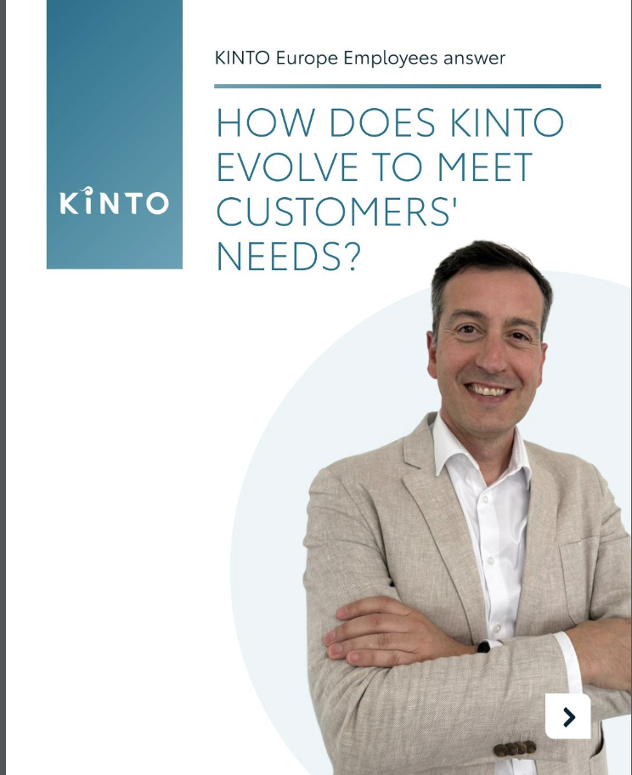
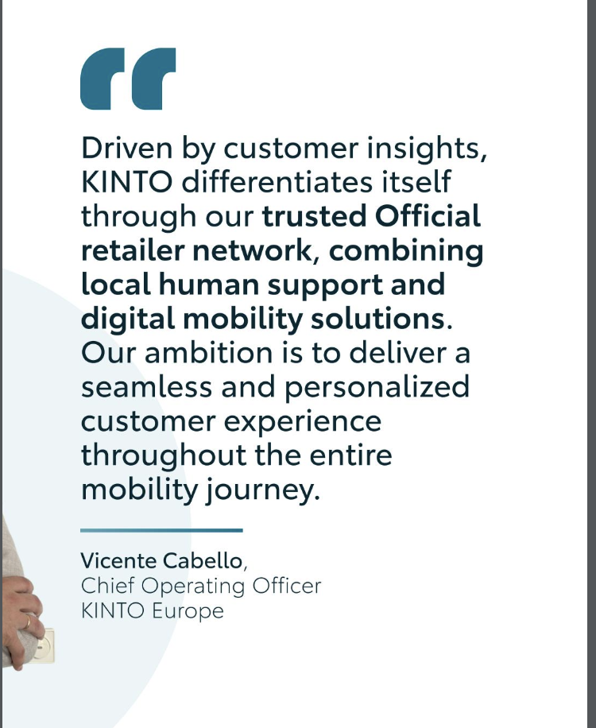
8.Q&A EMPLOYEES
COPY LI
To give you an inside look into our operational engine, we are opening up the floor. We sat down with Vicente Cabello, Chief Operating Officer at KINTO Europe, to answer a fundamental question from our community. 💡
For Vicente, our corporate momentum relies entirely on shared growth. We grow with our customers by listening to their needs and feedback, evolving our mobility services in a way that supports their business objectives. When your organizational goals shift, our solutions pivot right with you. 📈
One partner. Every solution.
#KINTO #ThoughtLeadership #CustomerSuccess
CONTENT BUCKET 1- AUGUST
FORMATS AVAILABLE:
4/5 - 1X1

Slide 34
8.Q&A EMPLOYEES
COPY IG
Your business challenges are the fuel behind our operational updates. 💪
Our Chief Operating Officer, Vicente Cabello, stepped up to the microphone to share how KINTO avoids driving on cruise control. Your live feedback keeps our entire ecosystem perfectly aligned with your changing business objectives. ⚙️
Got a question that will help us fine-tune our engine? Drop it below! 👇
One partner. Every solution.
#KINTO #FleetEvolution #SmartMobility
CONTENT BUCKET 1- AUGUST
FORMATS AVAILABLE:
4/5 - 1X1

Slide 35
8.Q&A EMPLOYEES
COPY FB
Keeping our fleet operations idling on a fixed route isn't really our style. ⚙️
Our Chief Operating Officer, Vicente Cabello, takes the wheel to share how we keep our mobility solutions highly responsive. Treating customer feedback as our operational roadmap ensures our ecosystem adapts smoothly to your shifting business milestones. This keeps your team moving forward without any administrative potholes. 🚗
Map out your next journey with us at kinto-mobility.eu. 👈
One partner. Every solution.
#KINTO #FleetStrategy #BusinessMobility
CONTENT BUCKET 1- AUGUST
FORMATS AVAILABLE:
4/5 - 1X1

Slide 36
9. KINTO’S THERE
COPY - LI:
Finding a corporate provider that satisfies all your operational needs can feel surprisingly similar to looking for a soulmate. 💼
In fleet management, true commitment isn't about grand promises during the sales pitch. It's about showing up when things get complicated on the road.
We believe your fleet deserves a partner that stays attentive through every mile. From rapid roadside assistance and vehicle upgrades to seasonal tyre changeovers and deep mechanical maintenance, KINTO handles the logistics so your company can fall back in love with the journey.
One partner. Every solution.
#FleetManagement #BusinessPartnership #OneStopShop
video: https://limecraft.hotelbonka.be/api/s/uUPWIlueuW-
CONTENT BUCKET 1- AUGUST
FORMATS AVAILABLE:
1/1 - 9/16 - ⅘ - 16/9
Notes:
#KINTO #FleetManagement #CorporateMobility #FlexibleMobility #MobilitySolutions

Slide 37
9. KINTO’S THERE
COPY - IG:
Looking for a partner who actually listens to your needs, gives you space, and keeps you safe? 💖
Stop settling for mobility providers who ghost you the second a warning light pops up.
Roadside assistance when your vehicle needs to feel whole again? Upgrades to larger models when you need extra room? Fresh summer tyres to keep your drivers safe? KINTO does it all. 🛠️
What is the ultimate 'green flag' you look for in a corporate fleet provider? 👇
One partner. Every solution.
#RelationshipGoals #SmartMobility #MobilityPartner
video: https://limecraft.hotelbonka.be/api/s/uUPWIlueuW-
CONTENT BUCKET 1- AUGUST
FORMATS AVAILABLE:
1/1 - 9/16 - ⅘ - 16/9
Notes:
#KINTO #FleetManagement #CorporateMobility #FlexibleMobility #MobilitySolutions

Slide 38
9. KINTO’S THERE
COPY - FB:
They say finding the perfect partner is hard work, but finding the perfect fleet provider shouldn't be a struggle. 🤷‍♂️
If your current mobility setup leaves you feeling misunderstood and abandoned, it might be time to officially upgrade your relationship status.
At KINTO, we act as the single point of contact that takes care of your entire automotive lifecycle. ⚡❤️
Check out the full story in our video and rewrite your fleet's love story at kinto-mobility.eu.
One partner. Every solution.
#FleetSolutions #CorporateCare #OneStopShop
video: https://limecraft.hotelbonka.be/api/s/uUPWIlueuW-
CONTENT BUCKET 1- AUGUST
FORMATS AVAILABLE:
1/1 - 9/16 - ⅘ - 16/9
Notes:
#KINTO #FleetManagement #CorporateMobility #FlexibleMobility #MobilitySolutions

Slide 39
10. POLL FLEET SIZE CHANGES
COPY LI
Scaling a business is rarely a linear journey, so why should your fleet size be locked into a rigid grid? 🗓️
To understand how European businesses navigate these operational waves, we are turning the microphone over to our community. We want to learn from your daily reality. Cast your vote in our poll and let us know:
How does your fleet change over the year?
It mostly increases
It mostly decreases
It fluctuates
It remains stable
Make sure to lock in your answer, as we will gather all your insights and share the official breakdown in an upcoming post very soon. 📊
One partner. Every solution.
#FleetManagement #BusinessAgility #FlexibleMobility
CONTENT BUCKET 1- AUGUST

Slide 40
10. POLL FLEET SIZE CHANGES
CONTENT BUCKET 1- AUGUST
COPY IG
How does your fleet change over the year?
Increases
Decreases
Fluctuates
Remains stable

Slide 41
10. POLL FLEET SIZE CHANGES
COPY FB
Trying to predict your company's vehicle needs twelve months in advance can feel a lot like trying to predict the weather. 🌤️
Instead of staying stuck in contracts that do not match your current reality, we believe corporate mobility should breathe with your operations. That why we want to hear from you! How does your fleet change over the year? Let us know below, we'll share the results soon.
It mostly increases
It mostly decreases
It fluctuates
It remains stable
One partner. Every solution.
#FleetSolutions #FlexibleMobility #WorkplaceLogistics
CONTENT BUCKET 1- AUGUST

