Slide 1

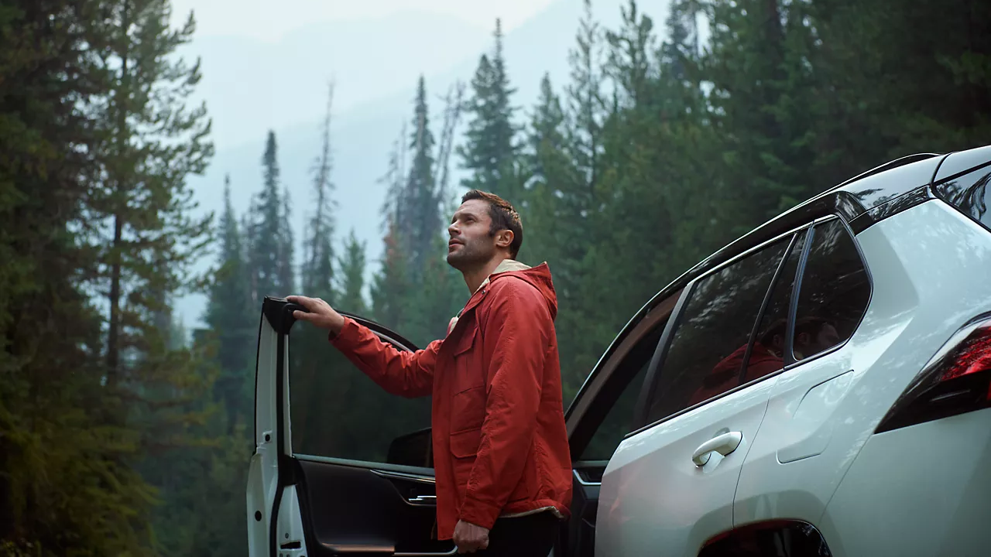

CONTENT
SEPTEMBER 2026

Slide 2
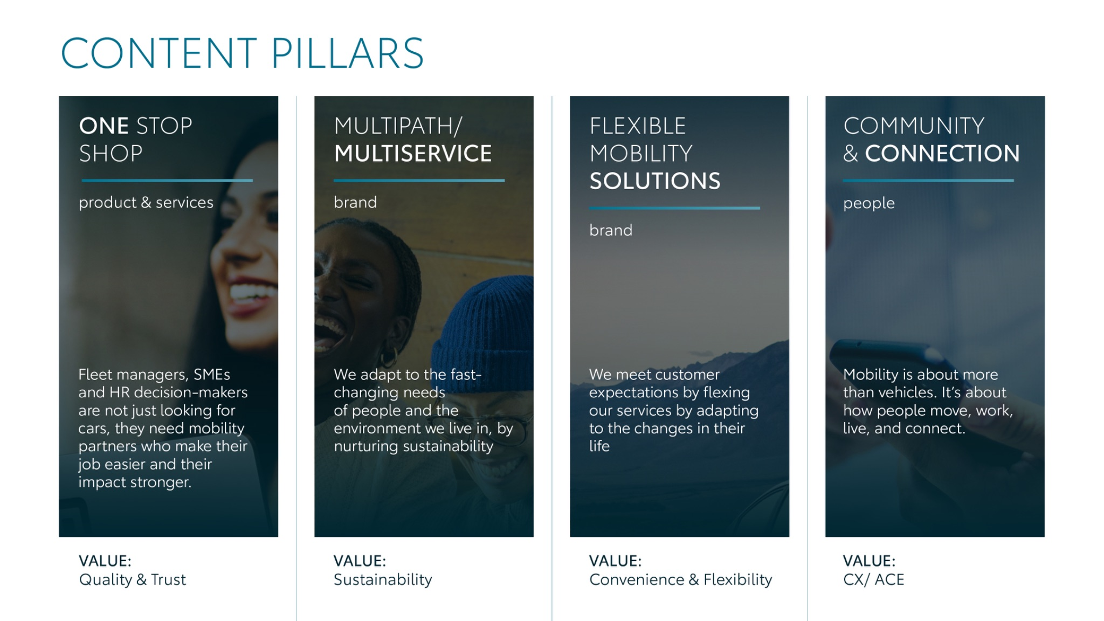
Notes:
“At KINTO, we work with content pillars: themes that carry our brand. We use different content types: inspiring, informative, topical. Your contributions add the human layer that makes the strategy work.”

Slide 3
Content pillars - content overview
SEPTEMBER
RAV4 RADIUS
Launch online booking platform
Rent website
Carpool Karaoke
Mobility week: Mobility match
Back to school
What does your powertrain mix look like?
Football event
Employee Q&A
ONE STOP SHOP
MULTIPATH/ MULTISERVICE
FLEXIBLE MOBILITY SOLUTIONS
COMMUNITY/ CONNECTION

Slide 4
Tag lines pillars
1. One Stop Shop
One partner. Every solution.
2. Flexible Mobility Solutions
One partner. Every solution.
3. Community and connection (important to keep it broad enough to fit clients as well as people working at Kinto)
Join the KINTO community.
4. Vision & Impact (Multipath/multiservice)
One partner. Every solution.

Slide 5

One stop shop
Notes:
One place. Every solution. Always KINTO.

Slide 6




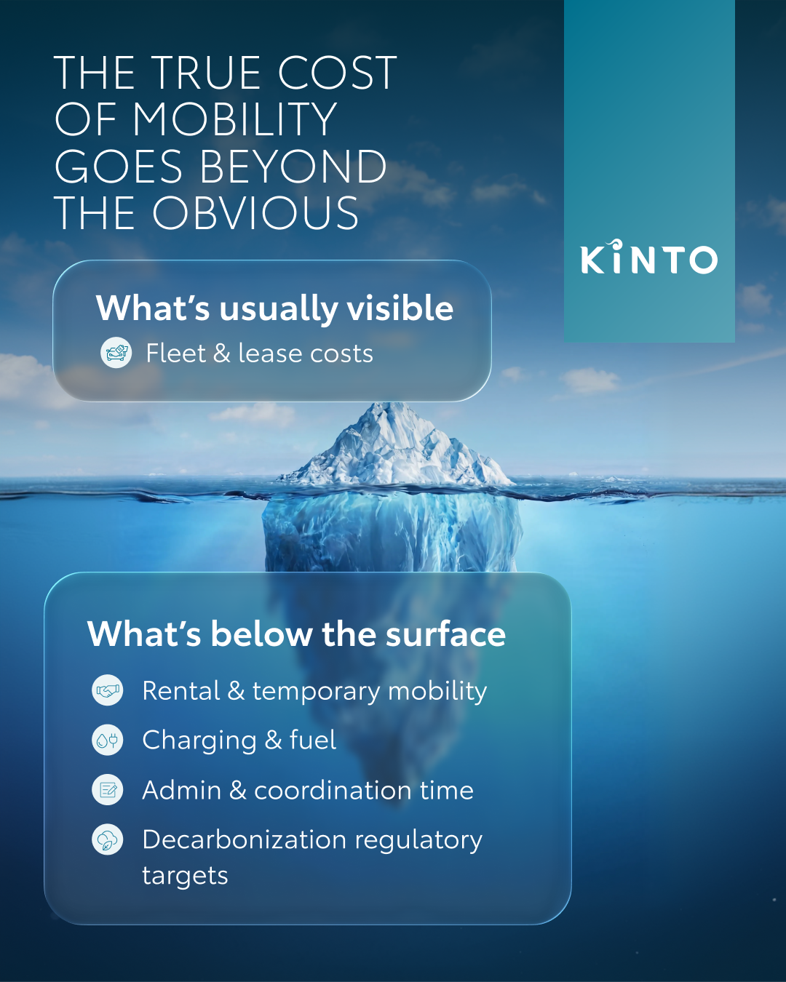
1. ICEBERG *MOVED FROM JULY
COPY - LI:
Are you managing your fleet budget based only on what’s visible above the surface?
Focusing solely on monthly lease invoices leaves a huge part of your actual spend drifting out of sight. When operational costs are scattered across different tools and departments, getting a true view of what's under the surface might be a challenge.
We help you dive deeper, giving you visibility on all cost elements to keep you navigating in smooth waters. No cold surprises. 🧊
One partner. Every solution.
#KINTO #FleetManagement #TotalCostOfOwnership
CONTENT BUCKET 1- SEPTEMBER
FORMATS AVAILABLE:
1/1 - ⅘
Notes:
#KINTO #FleetManagement #CorporateMobility #FlexibleMobility #MobilitySolutions

Slide 7
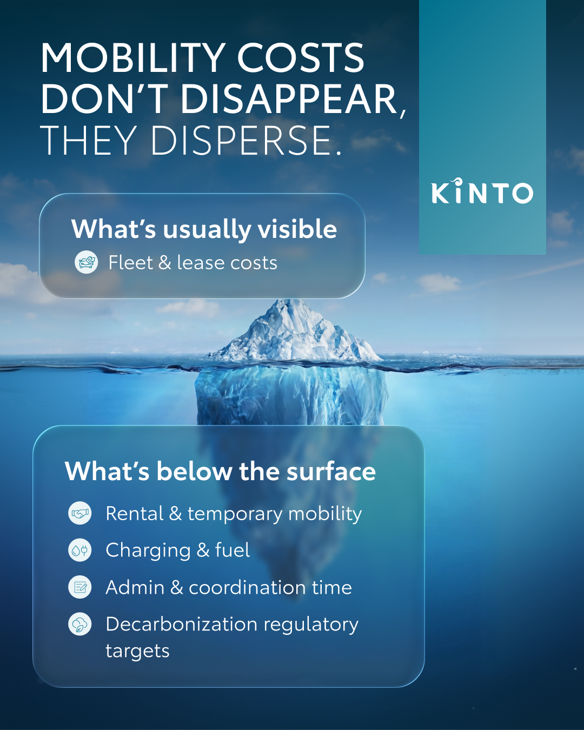
1. ICEBERG*MOVED FROM JULY
COPY - IG:
Only seeing the tip of the iceberg? 🧊
Lease invoices are just the surface. True fleet transparency means diving under the waves to spot hidden operational costs before they drift out of control. We help you bring everything to light so you can captain your budget with total confidence. 🌊
Let’s keep your business strategy completely unsinkable. 🚢
One partner. Every solution.
#KINTO #FleetManagement #TotalCostOfOwnership
CONTENT BUCKET 1- SEPTEMBER
FORMATS AVAILABLE:
1/1 - ⅘ -
Notes:
#KINTO #FleetManagement #CorporateMobility #FlexibleMobility #MobilitySolutions

Slide 8
1.ICEBERG *MOVED FROM JULY
COPY - FB:
Are you managing your fleet budget based only on the tip of the iceberg? 🧊
Focusing solely on monthly lease invoices leaves a large part of your actual spend drifting out of sight.
We help you dive below the surface. By bringing every hidden cost element together into one clear overview, we give you the transparency needed to captain your budget with total confidence. 🫡
Navigate your fleet safely at kinto-mobility.eu.
One partner. Every solution.
#KINTO #FleetManagement #TotalCostOfOwnership
CONTENT BUCKET 1- SEPTEMBER
FORMATS AVAILABLE:
1/1 - ⅘
Notes:
#KINTO #FleetManagement #CorporateMobility #FlexibleMobility #MobilitySolutions

Slide 9
Multipath/
Multiservice
Pillar 4

Slide 10


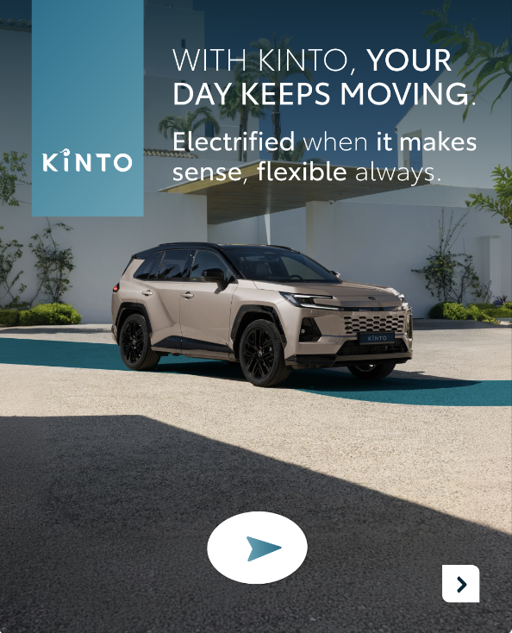
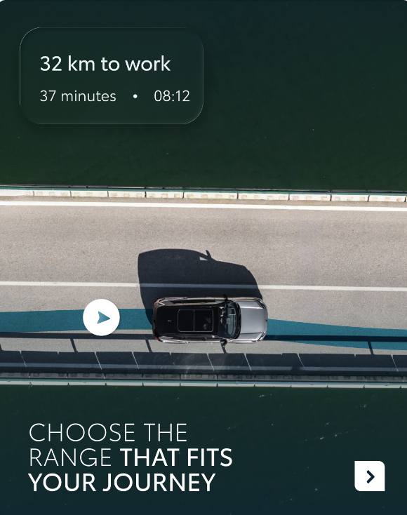
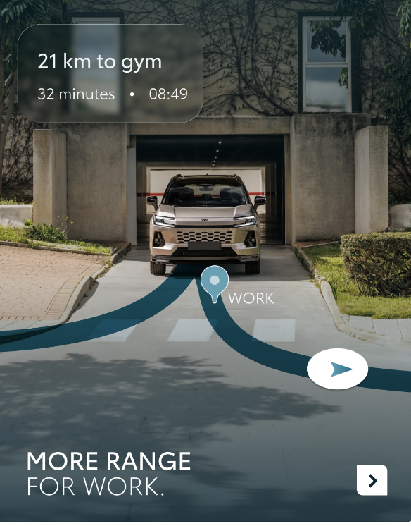
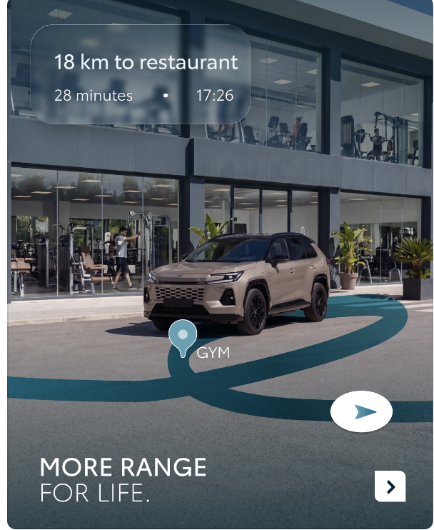
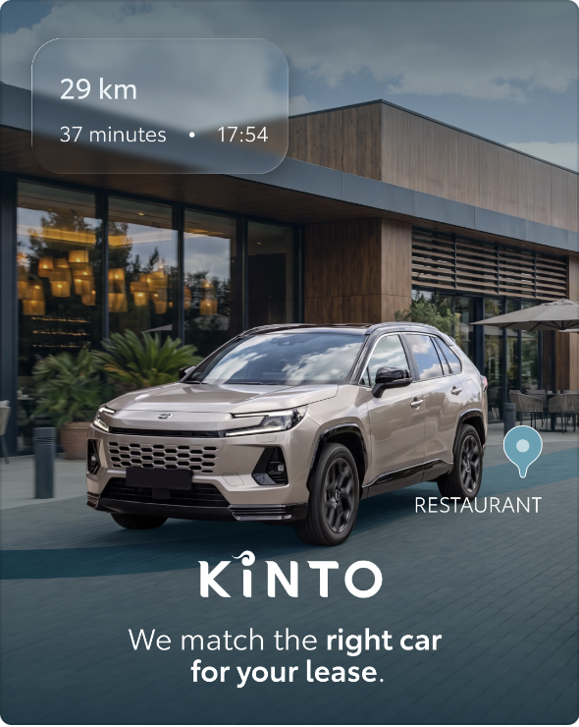
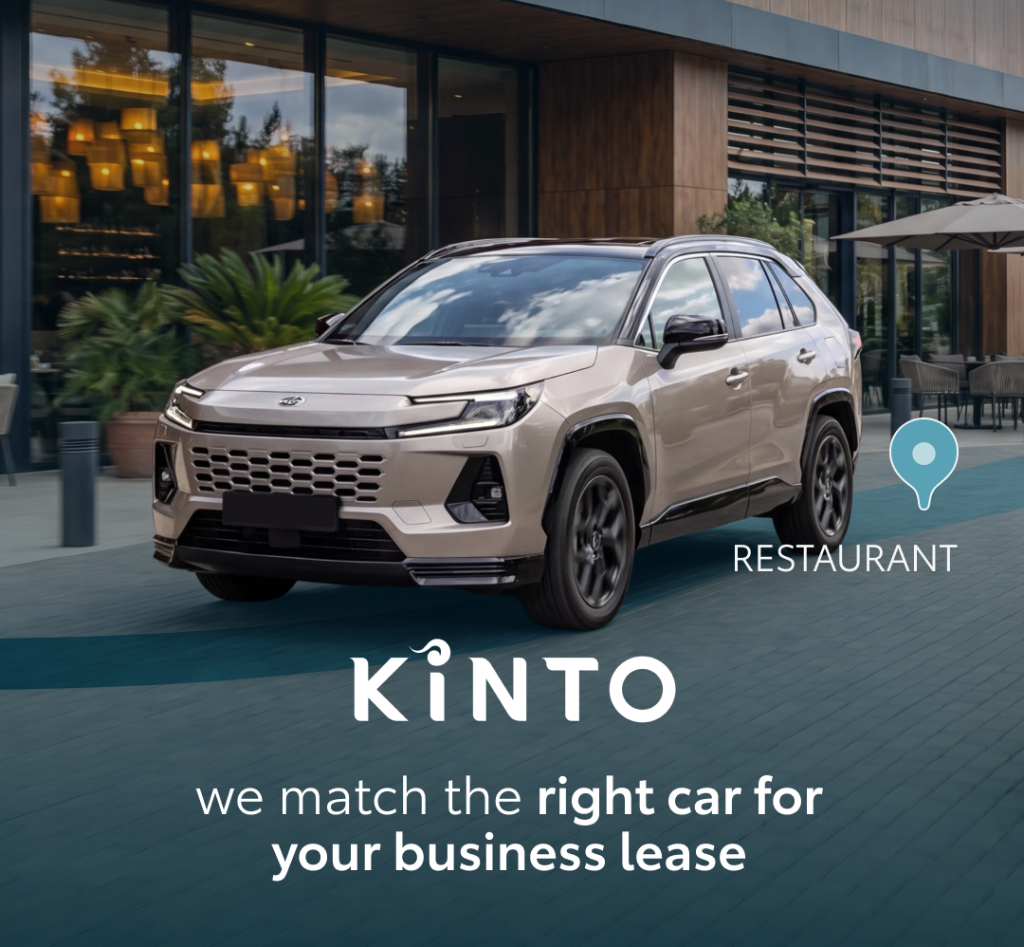
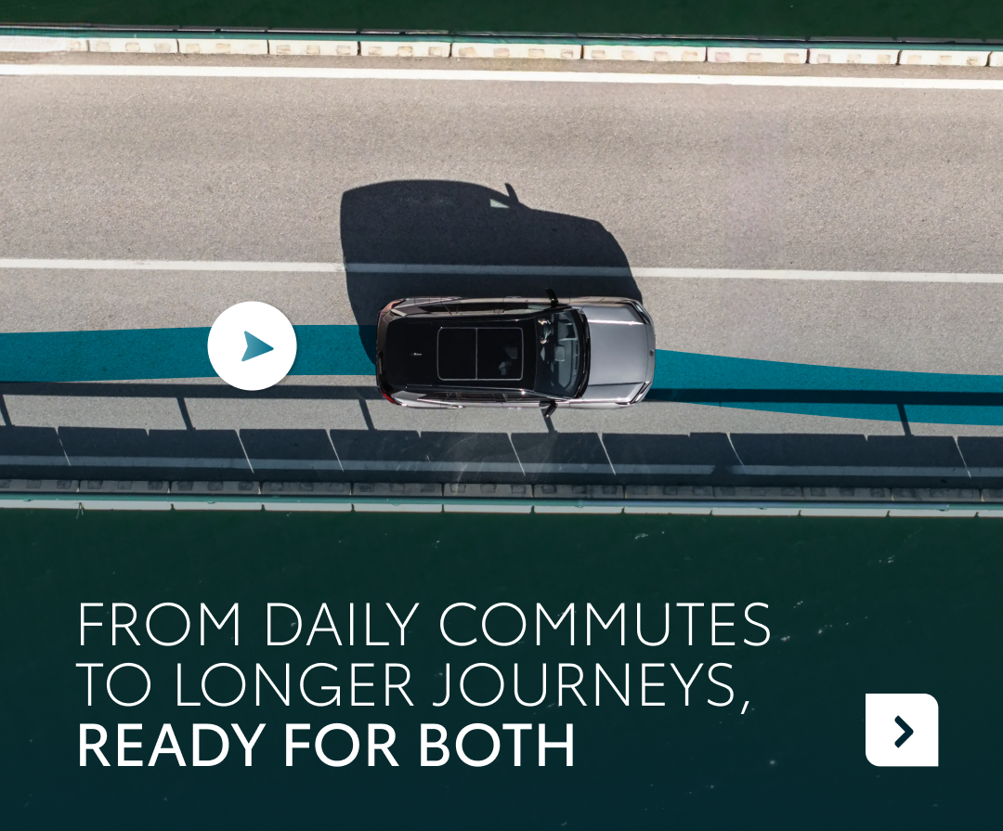
2. RAV4 RADIUS
CONTENT BUCKET 1- SEPTEMBER
COPY LI
When transitioning your fleet to electrified solutions, one question always rides shotgun: will the range actually be enough for a full, unpredictable day? 🔋
The Toyota RAV4 PHEV is built for exactly that challenge. It offers 100+ km of pure electric range for daily commutes and errands, with a hybrid engine that seamlessly takes over whenever the day gets longer. 🚗
Through KINTO, adding this kind of flexibility to your business is effortless. Whether you want to lease it for the long term or rent it for short-term needs, we make sure your fleet stays mobile on your terms.
With KINTO, your day keeps moving. Electrified when it makes sense, flexible when it matters.
One partner. Every solution.
#KINTO #FleetManagement #CorporateMobility
FORMATS AVAILABLE:
4/5 - 1/1, 9/16

Slide 11
2. RAV4 RADIUS
CONTENT BUCKET 1- SEPTEMBER
COPY IG
Range anxiety? That’s something we don’t know. 🔌
What does a real, busy workday actually look like for your drivers? Spoiler: it’s rarely just a straight line from home to the office and back.
Slide through to see how the new Toyota RAV4 PHEV effortlessly powers a full human day on 100+ km of pure electric range.
And the best part? KINTO gives you full flexibility on how you drive it. Need a long-term lease for your permanent team, or a quick short-term rental for a busy month? We’ve got your business covered either way. 🚗
How many kilometers does your average workday commute look like? 👇
One partner. Every solution.
#KINTO #PlugInHybrid #SmartMobility
FORMATS AVAILABLE:
4/5 - 1/1, 9/16

Slide 12
2. RAV4 RADIUS
CONTENT BUCKET 1- SEPTEMBER
COPY FB
If your drivers are still planning their entire day around where and when they can charge, it’s time to change the narrative. 🔋
One of the biggest hesitations when switching a fleet to electric or plug-in hybrid vehicles is range doubt. What if the day gets too long?
The new Toyota RAV4 PHEV answers that before it even becomes an issue. With 100+ km of pure electric range, it is built to effortlessly power a real, busy day. 🚗
And getting the right setup for your business is completely hassle-free. Because with KINTO, you choose the model that fits your operational needs. Whether that means long-term fleet leasing or flexible short-term rentals to cover temporary surges.
Discover how to electrify your fleet without the compromises at kinto-mobility.eu.
One partner. Every solution.
#KINTO #PlugInHybrid #SmartMobility
FORMATS AVAILABLE:
4/5 - 1/1, 9/16

Slide 13
Flexible mobility solutions
Pillar 3
Notes:
Baseline: Wherever life takes you, KINTO finds the right solution for you.

Slide 14

3. BOOKING PLATFORM BIRTHCARD
COPY - LI:
We are thrilled to announce the arrival of our newest digital family member. 🍼
The wait is officially over. We proudly present our rent booking platform, the logical next step in modern mobility.
To celebrate its launch, we’ve put together a little birth announcement card.
Say goodbye to booking hassle and endless coordination. Whether you need a car for a weekend trip, a quick daily errand, or a business drive, our new platform makes reserving a vehicle easier than ever.
Ready to meet our new addition? Head over to our platform today.
One partner. Every solution.
#KINTO #CarBooking #BookingPlatform
CONTENT BUCKET 1- SEPTEMBER
FORMATS AVAILABLE:
1/1 - ⅘ -
Notes:
#KINTO #FleetManagement #CorporateMobility #FlexibleMobility #MobilitySolutions

Slide 15
3. BOOKING PLATFORM BIRTHCARD
COPY - IG:
Our digital family just got a little bigger, and a whole lot smarter. Meet the brand-new rent booking platform! 🍼
We’ve built this platform with one clear goal in mind: making your next car rental bookable in a single click. 💻
Tap the link in our bio to explore the new interface and see how easily it fits into your daily routine.
One partner. Every solution.
#KINTO #BookingPlatform #BookACar
CONTENT BUCKET 1- SEPTEMBER
FORMATS AVAILABLE:
1/1 - ⅘ -
Notes:
#KINTO #FleetManagement #CorporateMobility #FlexibleMobility #MobilitySolutions

Slide 16
3. BOOKING PLATFORM BIRTHCARD
COPY - FB:
We have some big news to share! Our mobility family is growing, and we’ve just welcomed a game-changing new addition. 🍼
We proudly present our rent booking platform. Built from the ground up, this platform is on a mission to make renting a car bookable in just one click.
Why spend time on complicated bookings when you can get it done in seconds? Let our newest platform do the heavy lifting so you can focus on the journey ahead. 🚗
Discover our new booking platform now at kinto-mobility.eu.
One partner. Every solution.
#KINTO #SmartMobility #BookingPlatform
CONTENT BUCKET 1- SEPTEMBER
FORMATS AVAILABLE:
1/1 - ⅘ -
Notes:
#KINTO #FleetManagement #CorporateMobility #FlexibleMobility #MobilitySolutions

Slide 17


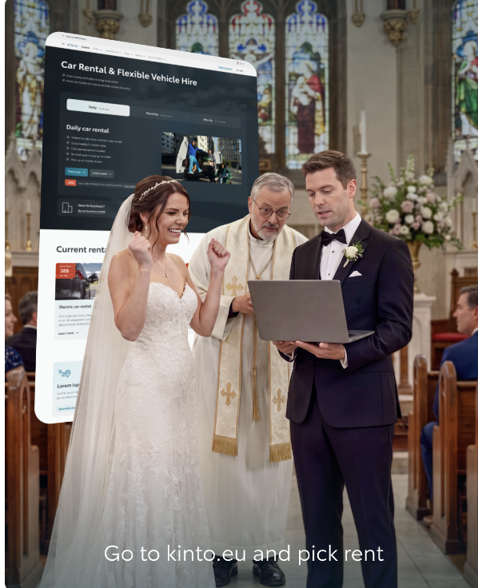
Valid for multibrand
4. RENT WEBSITE
COPY LI
While we certainly don't recommend scheduling your honeymoon ride during your wedding vows, it does prove one thing: when you need a car fast, every second counts. ⏱️
Life moves fast and plans change in a heartbeat. Whether it’s a spontaneous weekend getaway, a quick replacement ride, or a last-minute trip, we rebuilt our rental platform to be faster and more intuitive than ever.
You don't need a wedding emergency to appreciate lightning-fast car rental. Experience how easily you can keep your plans moving.
One partner. Every solution.
#KINTO#CarRental #SmartMobility
CONTENT BUCKET 1- SEPTEMBER
FORMATS AVAILABLE:
4/5

Slide 18
Valid for multibrand
4. RENT WEBSITE
COPY IG
Dearly beloved, we are gathered here today to... wait, did you seriously forget to book the honeymoon car? 🤦‍♂️
Luckily, KINTO’s updated renting platform is so fast, it can literally rescue you from the ultimate doghouse in seconds.
While we highly advise leaving your laptop at home on your wedding day, we do promise that our new online experience is built for high-pressure, last-minute moments.
Save your day (and maybe your marriage) by trying our updated rent platform. 👉 Head to the link in our bio and select 'Rent'.
One partner. Every solution.
#KINTO #SmartMobility #CarRental
CONTENT BUCKET 1- SEPTEMBER
FORMATS AVAILABLE:
4/5

Slide 19
Valid for multibrand
4. RENT WEBSITE
COPY FB
Forgot to book the car for your honeymoon? We’ve seen some tight deadlines, but this one definitely takes the wedding cake. 😬
Life moves fast, and unexpected moments happen in the blink of an eye. Whether you need a car for a spontaneous road trip, a weekend getaway, or a last-minute plan, you shouldn't have to waste time on complicated booking processes.
Our updated rental interface is built to handle the pressure. It takes the stress out of last-minute coordination, allowing you to secure reliable vehicles in seconds.
Keep the drama on the screen and out of your plans. 👉 Head over to kinto-mobility.eu, choose 'Rent', and experience car rental at its fastest.
One partner. Every solution.
#KINTO #SmartMobility #CarRental
CONTENT BUCKET 1- SEPTEMBER
FORMATS AVAILABLE:
4/5

Slide 20
Community & connection
Empowerment & Expertise
Notes:
Baseline: Join the KINTO community

Slide 21

5. BACK TO SCHOOL
COPY - LI
Long before we worried about corporate logistics, emission targets or morning traffic, we already had commuting figured out. 🚌
The school bus was, without a doubt, the original carpool. It got a group of people to the exact same place.
At KINTO, we aren’t reinventing carpooling. We are simply bringing that same bulletproof logic into the modern workplace with JOIN with KINTO.
Why let your team struggle with solo commutes, parking stress, and rising fuel costs when they can share the ride?
It’s the grown-up version of a concept that has always made total sense. Ready to upgrade your company's daily commute?
One partner. Every solution.
#KINTO #JOINwithKINTO #WorkplaceMobility
CONTENT BUCKET 1- SEPTEMBER
FORMATS AVAILABLE:
1/1 - ⅘
Notes:
#KINTO #FleetManagement #CorporateMobility #FlexibleMobility #MobilitySolutions

Slide 22
5. BACK TO SCHOOL
COPY - IG:
The original carpool had a giant stop sign on the side, squeaky vinyl seats, and a whole lot of noise. 🚌
As the kids head back to school this September, it’s the perfect time to look at our own daily commute. We don’t need to reinvent the wheel to make workplace travel smarter. We just need to bring back the simple logic of the school bus.
Meet JOIN with KINTO, the grown-up, sleek version of the ultimate shared ride. No yellow paint required. Just an easy way for your team to connect, share rides, save on fuel, and cut down on commute stress.
Would you swap your solo morning commute for a shared ride with your favorite colleague? 👇
One partner. Every solution.
#KINTO #JOINwithKINTO #Carpooling
CONTENT BUCKET 1- SEPTEMBER
FORMATS AVAILABLE:
1/1 - ⅘
Notes:
#KINTO #FleetManagement #CorporateMobility #FlexibleMobility #MobilitySolutions

Slide 23
5. BACK TO SCHOOL
COPY - FB:
As the school bells start ringing again, it is the perfect time to ask ourselves: why did we stop sharing our rides to work? 🎒
Everyone has been on a school bus. We all understand exactly what it does: it gets a group of people to the same destination.
With JOIN with KINTO, we are bringing that exact same logic straight to your company. We aren't introducing a complicated new concept, we're just making carpooling work for your business.
It is the flexible, community-driven mobility solution your business has been waiting for.
👉 Visit kinto-mobility.eu and discover how easy it is to bring KINTO JOIN to your company.
One partner. Every solution.
#KINTO #JOINwithKINTO #WorkplaceMobility
CONTENT BUCKET 1- SEPTEMBER
FORMATS AVAILABLE:
1/1 - ⅘
Notes:
#KINTO #FleetManagement #CorporateMobility #FlexibleMobility #MobilitySolutions

Slide 24
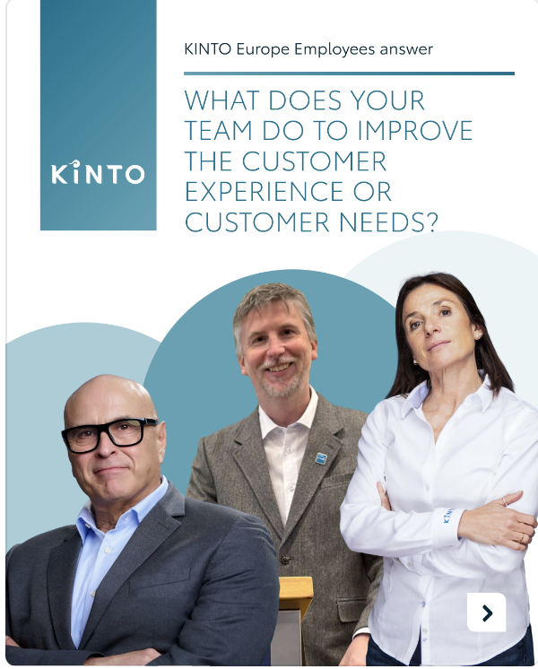
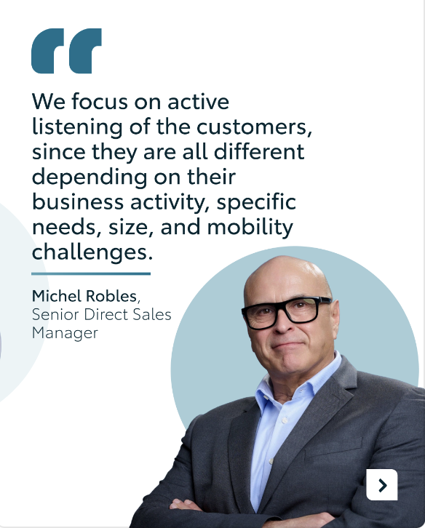
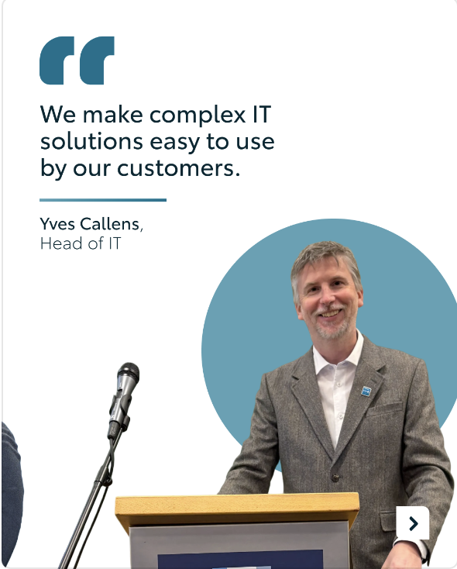

Valid for multibrand
6. Q&A EMPLOYEES
CONTENT BUCKET 1- SEPTEMBER
COPY LI
Behind every seamless fleet, every bookable ride, and every flexible mobility solution, there is a dedicated team of experts making it happen. 👥
We sat down with our KINTO Europe team (@Emanuela, @Yves, @Michel ) and asked them one fundamental question: "What does your team do to improve the customer experience or customer needs?"
Customer centricity is how we listen and communicate every single day to keep your business moving forward. Slide through the carousel to meet some of the faces behind the brand.
One partner. Every solution.
#KINTO #MeetTheTeam #SmartMobility
FORMATS AVAILABLE:
4/5

Slide 25
Valid for multibrand
6. Q&A EMPLOYEES
CONTENT BUCKET 1- SEPTEMBER
COPY IG
Who are the faces behind your favorite mobility solutions? Let’s meet the minds of KINTO! 🧠
Behind the screens, the code, and the contracts are real people dedicated to making your corporate travel as smooth as possible.
We asked Michel, Yves, and Emanuela one question: "What does your team do to improve the customer experience?"
Slide to hear from them.
Which of these three pillars is most important to you when choosing a mobility partner? 👇
One partner. Every solution.
#KINTO#MeetTheTeam #MobilitySolutions
FORMATS AVAILABLE:
4/5

Slide 26
Valid for multibrand
6. Q&A EMPLOYEES
CONTENT BUCKET 1- SEPTEMBER
COPY FB
Ever wondered who keeps your business moving behind the scenes at KINTO? 👥
We pride ourselves on offering flexible, reliable mobility solutions. But the real engine of our success is our team.
We asked some of our KINTO Europe employees how they work daily to put your business needs first. No matter your fleet size or mobility challenge, our team is right there to make it easy.
Discover our team-backed mobility solutions at kinto-mobility.eu. 💻
One partner. Every solution.
#KINTO #SmartMobility #FleetSolutions
FORMATS AVAILABLE:
4/5

Slide 27
7. FOOTBALL EVENT VIDEO
COPY - LI:
Different accents, same shirt. 🌍
At KINTO, we talk a lot about seamless connections and moving forward. But from time to time, we put our products aside to celebrate the real engine behind our brand: our people.
We recently gathered in Köln for our annual football competition. It is a unique day where employees from different markets and Toyota sister companies, like KINTO, lace up their boots, face off on the pitch, and reconnect. ⚽
The energy was unmatched. It perfectly highlighted what KINTO is made of from the inside. The same core values, but with each market bringing its own unique flavor and passion.
Watch the video to feel the energy of the day and meet the team behind your mobility solutions. 🎥
One partner. Every solution.
#KINTO #CompanyCulture #TeamBuilding
video: TO BE MADE
CONTENT BUCKET 1- SEPTEMBER
FORMATS AVAILABLE:
1/1 - 9/16 - ⅘ - 16/9
Notes:
#KINTO #FleetManagement #CorporateMobility #FlexibleMobility #MobilitySolutions

Slide 28
7. FOOTBALL EVENT VIDEO
COPY - IG:
The right matchday energy! ⚽
We traded our keyboards for football boots and headed to Köln for our annual cross-market competition.
This yearly tournament brings employees from different countries and Toyota sister companies together to show what KINTO is truly made of: our amazing people.
No matter where we’re from or which language we speak, we play as one team.
Turn your sound up and press play to see the best moments and team celebrations in action. 🎥
One partner. Every solution.
#KINTO #FootballTournament #ToyotaFamily
video: LINK
video: TO BE MADE
CONTENT BUCKET 1- SEPTEMBER
FORMATS AVAILABLE:
1/1 - 9/16 - ⅘ - 16/9
Notes:
#KINTO #FleetManagement #CorporateMobility #FlexibleMobility #MobilitySolutions

Slide 29
7. FOOTBALL EVENT VIDEO
COPY - FB:
What happens when teams from different markets and Toyota sister companies, like KINTO, meet on the pitch? A whole lot of passion, laughter, and team spirit. ⚽
Our annual football competition in Köln was the perfect post-summer reunion. We might have different accents, but we all wear the same shirt.
Want to experience the highlights of our big sports day? Check out the video below. 🎥
One partner. Every solution.
#KINTO #TeamSpirit #OneTeam
video: LINK
video: TO BE MADE
CONTENT BUCKET 1- SEPTEMBER
FORMATS AVAILABLE:
1/1 - 9/16 - ⅘ - 16/9
Notes:
#KINTO #FleetManagement #CorporateMobility #FlexibleMobility #MobilitySolutions

Slide 30
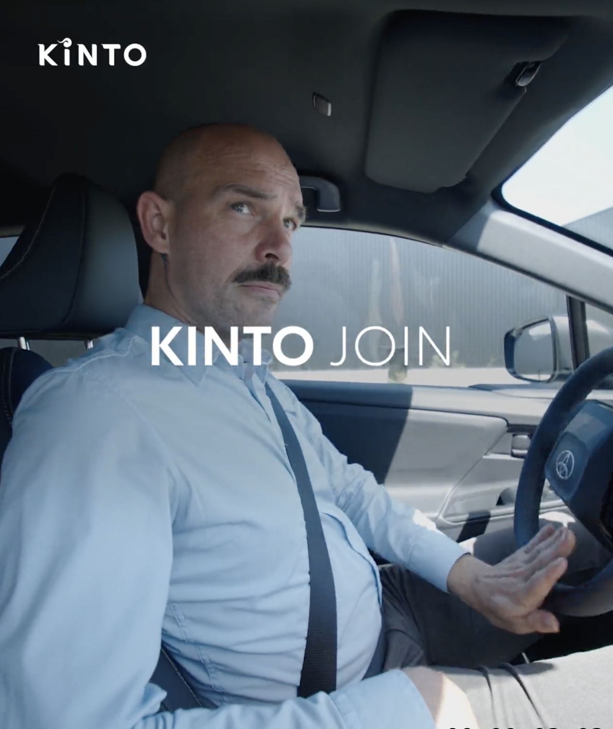
8. CARPOOL KARAOKE
COPY - LI:
Corporate carpooling is often treated as a perk. But in reality, it is a highly practical business solution. 📈
Empty car seats are a massive wasted opportunity for your business. When you look at your daily commute, how many of your employees are driving the exact same route to the office entirely alone? 🚗
That is where KINTO JOIN steps in. We help companies assess their actual mobility needs and design smarter, more efficient employee transport plans.
Watch the video below to see the instant impact of filling those empty seats. 🎥
One partner. Every solution.
#KINTO #KINTOJoin #WorkplaceMobility
CONTENT BUCKET 1- SEPTEMBER
FORMATS AVAILABLE:
1/1 - 9/16 - ⅘ - 16/9
Notes:
#KINTO #FleetManagement #CorporateMobility #FlexibleMobility #MobilitySolutions

Slide 31
8. CARPOOL KARAOKE
COPY - IG:
Organizing the corporate carpool? That’s our job. Deciding who gets control of the radio? We’ll leave that to your team. 😉
Empty backseats are a massive missed opportunity for your company’s budget and your green goals.
With KINTO JOIN, we make it easy for your team to share the ride. We design smart, efficient workplace mobility plans that bring colleagues together, slash travel costs, and hit those ESG targets. 🌳
Turn your sound up and press play to see the magic of a fully packed car in action. 🎥
One partner. Every solution.
#KINTO #KINTOJoin #CarpoolKaraoke
CONTENT BUCKET 1- SEPTEMBER
FORMATS AVAILABLE:
1/1 - 9/16 - ⅘ - 16/9
Notes:
#KINTO #FleetManagement #CorporateMobility #FlexibleMobility #MobilitySolutions

Slide 32
8. CARPOOL KARAOKE
COPY - FB:
Are your employees spending their morning commute staring at tailbacks, sitting entirely alone in their cars? 🚗
It is time to change the way your team gets to work. KINTO JOIN helps your company design an efficient employee mobility plan. By making corporate carpooling seamless, we reduce parking hassle, cut down on daily travel costs, and take the pressure off your corporate ESG goals.
Check out the video below to see how we transform the daily drive from a solo chore into a shared experience. 🎥
Discover smarter commuting solutions at kinto-mobility.eu.
One partner. Every solution.
#KINTO #KINTOJoin #WorkplaceMobility
CONTENT BUCKET 1- SEPTEMBER
FORMATS AVAILABLE:
1/1 - 9/16 - ⅘ - 16/9
Notes:
#KINTO #FleetManagement #CorporateMobility #FlexibleMobility #MobilitySolutions

Slide 33
9. POLL POWERTRAIN MIX
COPY LI
The transition to sustainable mobility is a strategic journey, and every business is moving at its own pace. 📈
Some companies have already gone fully electric, while others find their perfect balance in a hybrid setup or a diverse mix that matches different driver profiles. 🔋
We want to listen to our community and map out where corporate fleets stand today.
What does your fleet powertrain mix look like today?
Mostly EV
Hybrid/Plug-in hybrid
Mixed fleet
Mostly combustion
Your input helps us understand the current priorities and needs of modern fleet managers. And will directly shape our upcoming content and insights. Vote above and stay tuned to see the results!
One partner. Every solution.
#KINTO #FleetManagement #SmartMobility
CONTENT BUCKET 1- AUGUST

Slide 34
9. POLL POWERTRAIN MIX
CONTENT BUCKET 1- AUGUST
COPY IG
What does your fleet powertrain mix look like today?
Mostly EV
Hybrid/Plug-in hybrid
Mixed fleet
Mostly combustion

Slide 35
9. POLL POWERTRAIN MIX
COPY FB
Every company's fleet is a unique puzzle. 🧩
With so many options on the table, finding the right mix for your business operations can be a balancing act. We are curious to know how your company is tackling the transition right now.
What does your fleet powertrain mix look like today?
Mostly EV
Hybrid/Plug-in hybrid
Mixed fleet
Mostly combustion
Let us know your choice and why it works best for your business. Your answers will directly shape our upcoming content and insights. 💬
One partner. Every solution.
#KINTO #FleetManagement #SmartMobility
CONTENT BUCKET 1- AUGUST

