Slide 1

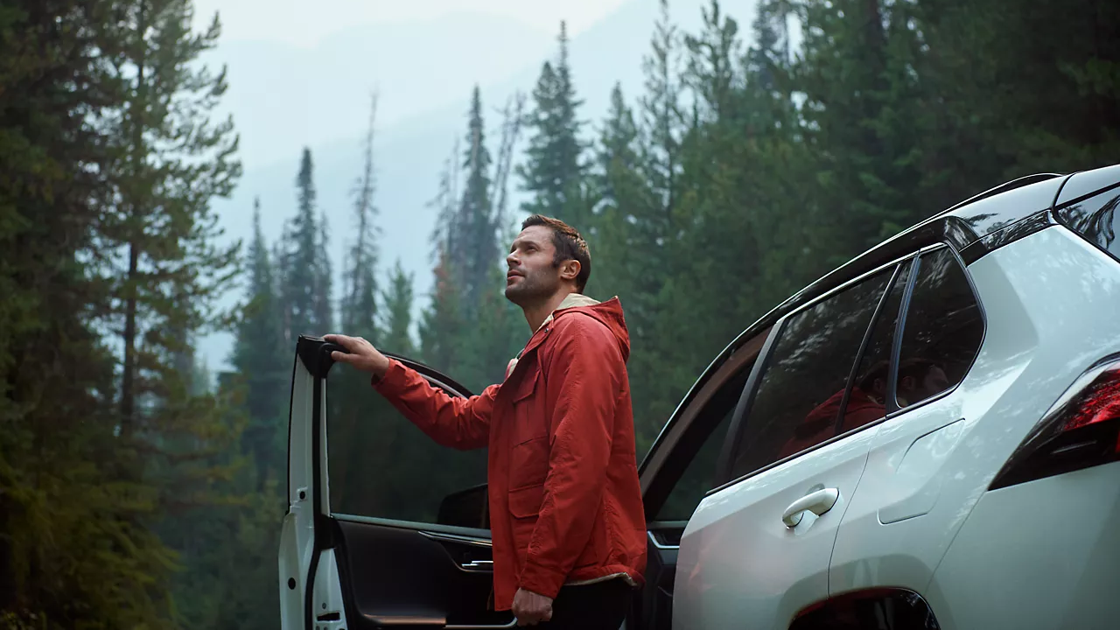

CONTENT
NOVEMBER 2026

Slide 2
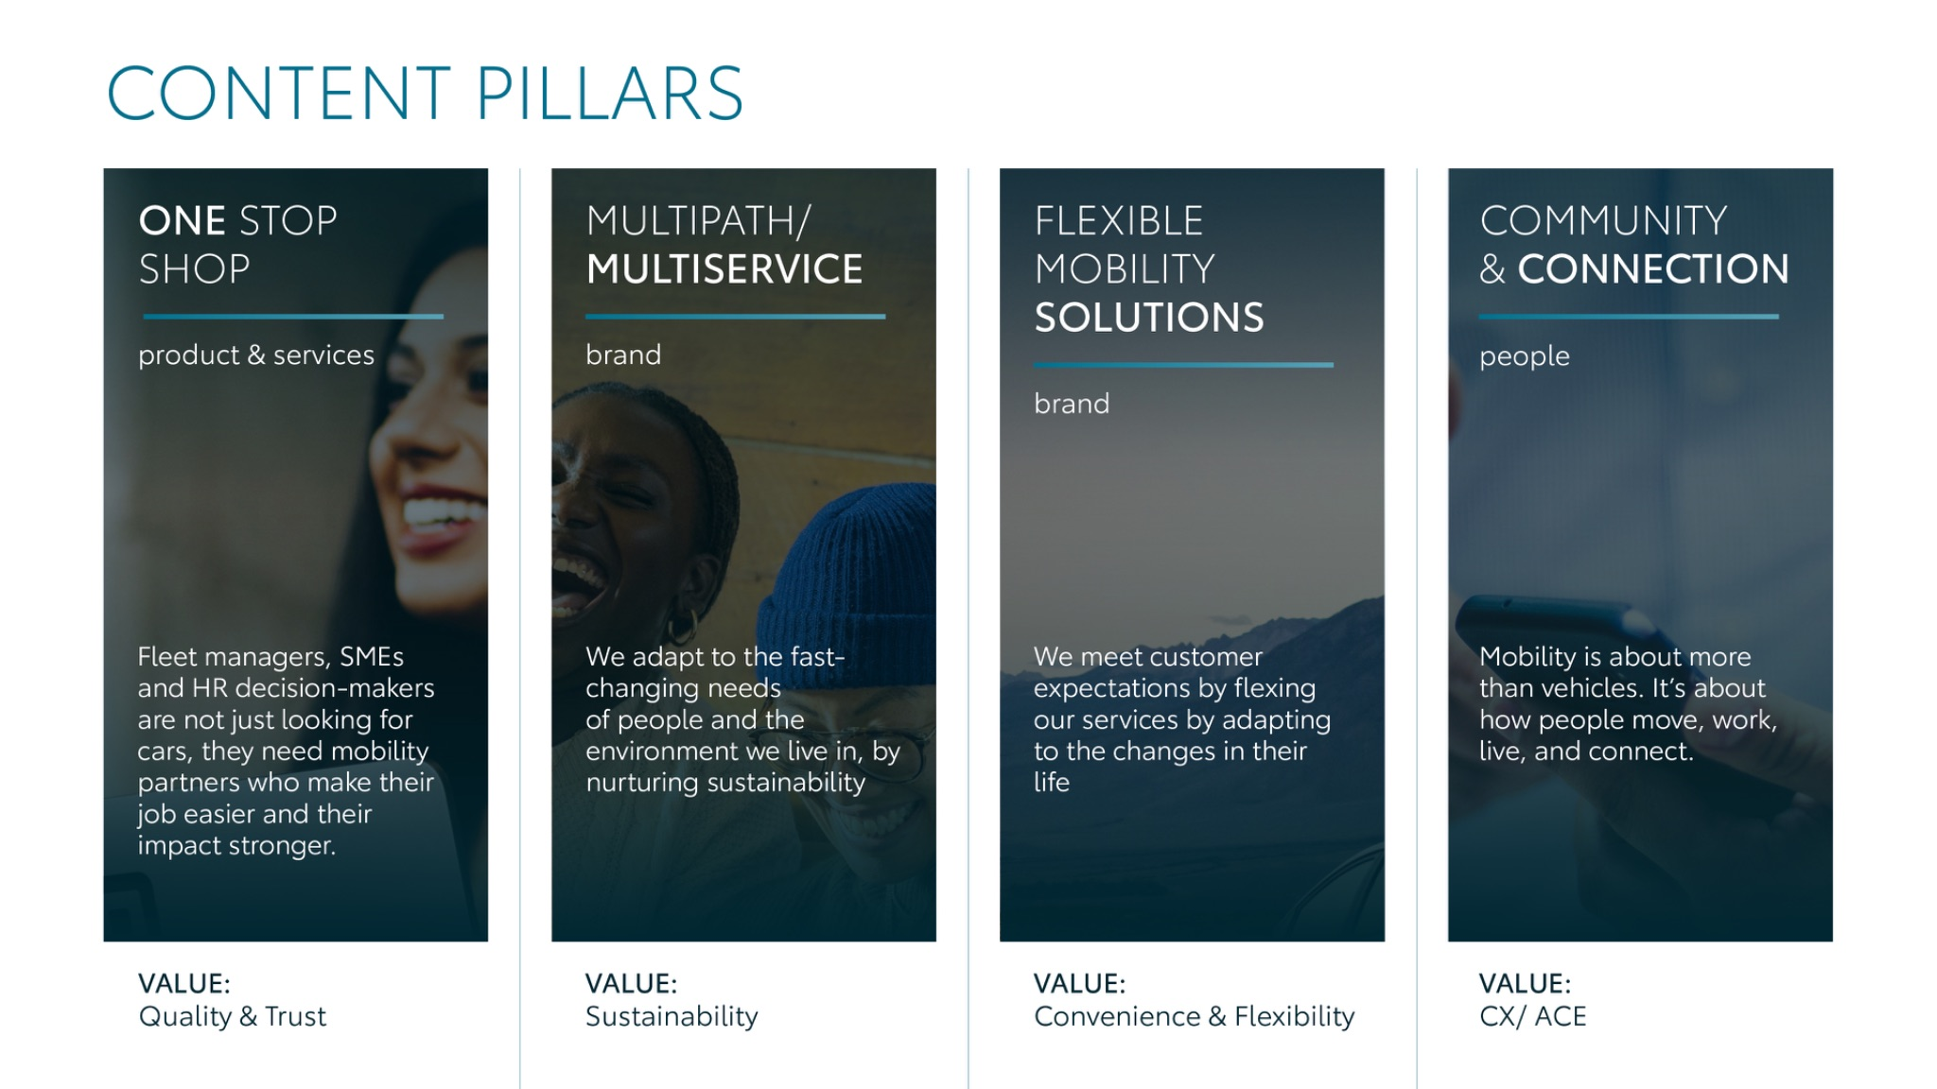
Notes:
“At KINTO, we work with content pillars: themes that carry our brand. We use different content types: inspiring, informative, topical. Your contributions add the human layer that makes the strategy work.”

Slide 3
Tag lines pillars
1. One Stop Shop
One partner. Every solution.
2. Flexible Mobility Solutions
One partner. Every solution.
3. Community and connection (important to keep it broad enough to fit clients as well as people working at Kinto)
Join the KINTO community.
4. Vision & Impact (Multipath/multiservice)
One partner. Every solution.

Slide 4
Content pillars - content overview
NOVEMBER
What does full service leasing mean?
Mobility Mythbusters E2 (Paul)
One fleet, multiple paths
Body Types video
Q&A
Fleet electrification strategy?
Vox pop EU Fleet days
Aftermovie EU fleet days
Executive series- Didier
Black Friday
ONE STOP SHOP
MULTIPATH/ MULTISERVICE
FLEXIBLE MOBILITY SOLUTIONS
COMMUNITY/ CONNECTION

Slide 5

One stop shop
Notes:
One place. Every solution. Always KINTO.

Slide 6


AI generated image
Valid for multibrand
1. WHAT DOES FULL SERVICE LEASING MEAN
COPY - LI:
Full-service leasing isn’t what it used to be. Because the modern fleet looks completely different. 💡
The days of rolling out identical combustion models under a single standard policy are behind us. Today, fleet managers are coordinating an intricate mix of powertrains, vehicle types and lifecycle stages.
Each comes with its own mileage profile, servicing demands, and cost structure. When your fleet is that diverse, 'full-service' can no longer be just a monthly fee and a set of keys. It has to be about operational control.
That’s where KINTO steps in. We bring your entire fleet together under one single contract, backed by one clear overview to track contracts, maintenance, costs, and mileage across your whole operation.
Swipe for three common questions about leasing, and how KINTO makes it all clearer. ➡️
One partner. Every solution.
CONTENT BUCKET 1- NOVEMBER
FORMATS AVAILABLE:
1/1 - ⅘
Notes:
#KINTO #FleetManagement #CorporateMobility #FlexibleMobility #MobilitySolutions

Slide 7
AI generated image
Valid for multibrand
1. WHAT DOES FULL SERVICE LEASING MEAN
COPY - IG:
Remember when 'full-service leasing' was just a set of keys and a monthly invoice? 🗝️
Today’s mobility is a whole different ballgame. Between running mixed vehicle types and managing separate contracts, services, and admin, you need more than just cars. You need one clear overview. 🤝
Swipe for three common questions about lease, and how KINTO simplifies the day-to-day with one integrated approach. ➡️
One partner. Every solution.
CONTENT BUCKET 1- NOVEMBER
FORMATS AVAILABLE:
1/1 - ⅘
Notes:
#KINTO #FleetManagement #CorporateMobility #FlexibleMobility #MobilitySolutions

Slide 8
AI generated image
Valid for multibrand
1. WHAT DOES FULL SERVICE LEASING MEAN
COPY - FB:
'Full-service leasing' means a lot more today than just handing over a car. 🚗
Modern fleet managers have to navigate diverse vehicle types, multiple contracts, and ongoing day-to-day admin. At KINTO, we turn that rising complexity into one clear overview by bringing contracts, maintenance, and fleet management together under one integrated approach.
Swipe for three common questions about lease, and head over to kinto-mobility.eu to discover our solutions. 👈
One partner. Every solution.
CONTENT BUCKET 1- NOVEMBER
FORMATS AVAILABLE:
1/1 - ⅘
Notes:
#KINTO #FleetManagement #CorporateMobility #FlexibleMobility #MobilitySolutions

Slide 9

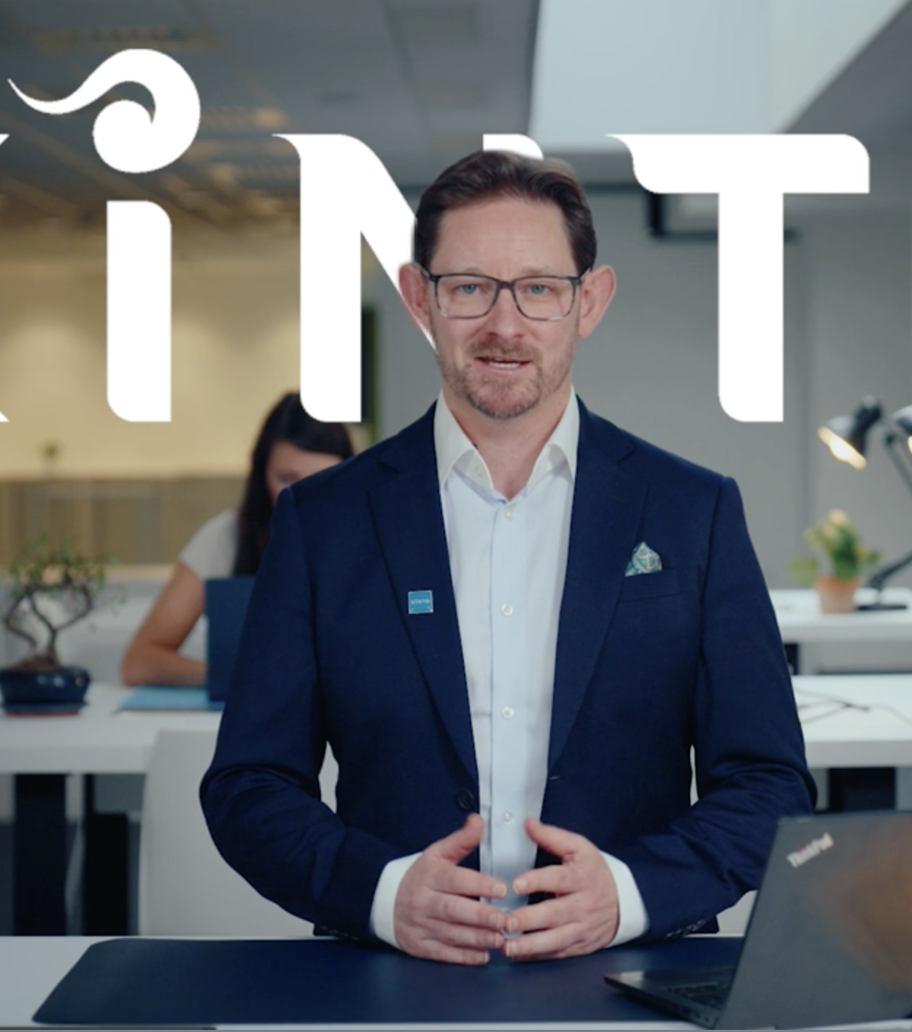
AI generated image
Valid for multibrand
2. MOBILITY MYTHBUSTERS E2
COPY - LI
Can one single provider really cover all your company’s mobility needs? 🤔
For years, the consensus was that they couldn't. Fleet managers were forced to juggle separate vendors. But with 60% of companies looking to expand their mobility services as part of their fleet or HR strategy by 2027, that fragmented model simply doesn't work anymore.
@Paul, Head of Direct Sales at KINTO Europe, breaks down why you no longer need multiple suppliers. From permanent fleet leasing and short-term rentals to carpooling with KINTO Join and ESG reporting with ZERO by KINTO, bringing everything under one roof changes the game.
Watch the full video below to see the myth busted. 👇
One partner. Every solution.
CONTENT BUCKET 1- NOVEMBER
FORMATS AVAILABLE:
1/1 - ⅘
Notes:
#KINTO #FleetManagement #CorporateMobility #FlexibleMobility #MobilitySolutions

Slide 10
Multipath/
Multiservice
Pillar 4

Slide 11

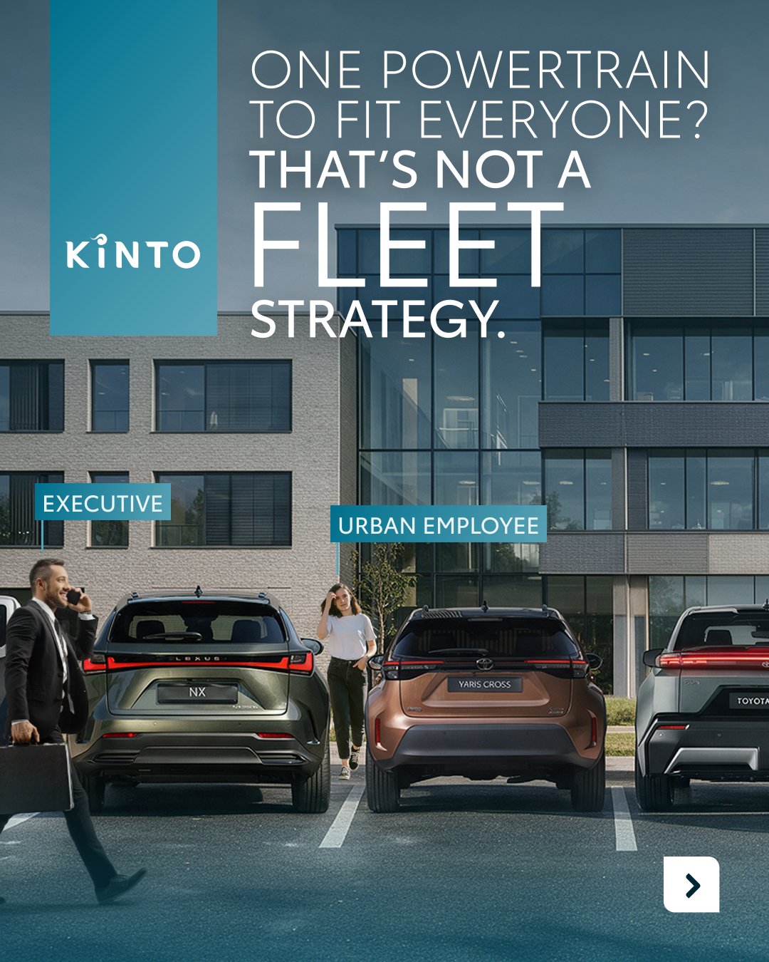
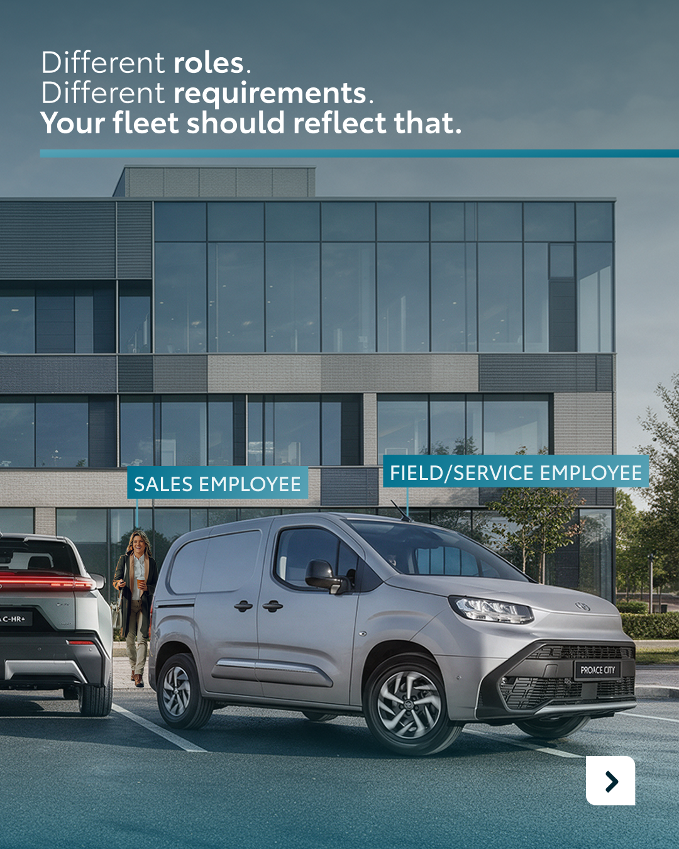
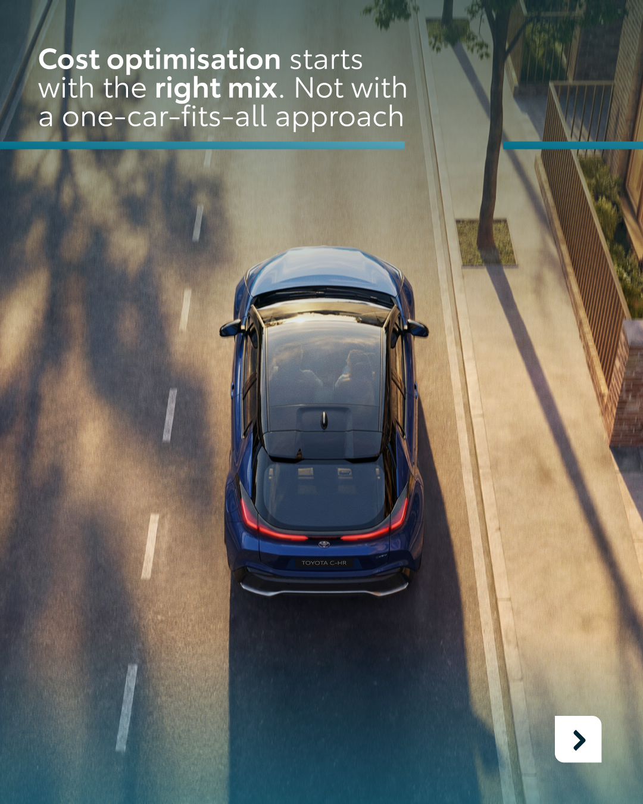
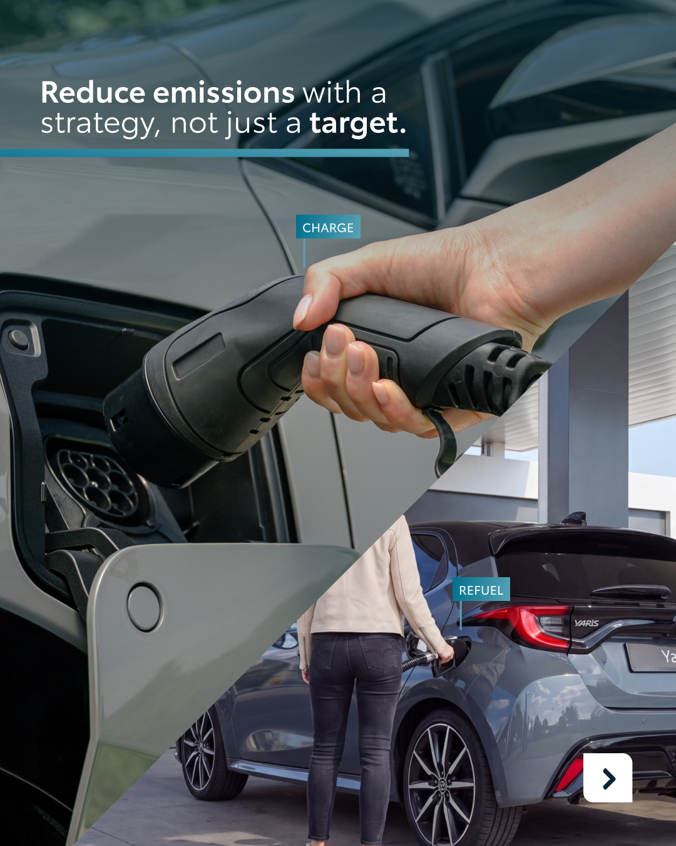
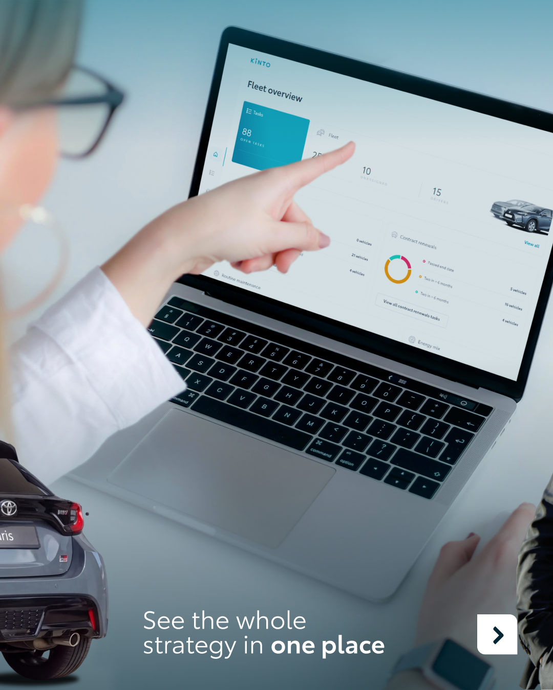

AI generated image
Valid for multibrand
3. ONE FLEET, MULTIPLE PATHS
CONTENT BUCKET 1- NOVEMBER
COPY - LI:
Giving everyone in your company the exact same type of vehicle? That’s not a fleet strategy. That’s just a bulk order. 🚗
Unless your entire team shares the exact same route and role, a single-powertrain or bodytype approach won't cut it anymore. Your field service employees have completely different requirements on the road than your urban commuters or executives.
At KINTO, we know that true cost optimization and emission control start with finding the right mix, not forcing a one-car-fits-all approach.
One partner. Every solution.
FORMATS AVAILABLE:
1/1 - ⅘
Notes:
#KINTO #FleetManagement #CorporateMobility #FlexibleMobility #MobilitySolutions

Slide 12
3. ONE FLEET, MULTIPLE PATHS
AI generated image
Valid for multibrand
CONTENT BUCKET 1- NOVEMBER
COPY - IG:
Handing out the exact same car keys to everyone in the office? Yeah, that’s not a fleet strategy. 🚫
From your field service reps to your city commuters, different roles mean different requirements. To truly optimize costs and hit your emission targets, you need the right mix of vehicles, not a one-car-fits-all approach.
Swipe to see how we build one fleet with multiple solutions. ➡️
One partner. Every solution.
FORMATS AVAILABLE:
1/1 - ⅘
Notes:
#KINTO #FleetManagement #CorporateMobility #FlexibleMobility #MobilitySolutions

Slide 13
Valid for multibrand
3. ONE FLEET, MULTIPLE PATHS
CONTENT BUCKET 1- NOVEMBER
COPY - FB:
Does your whole team drive the exact same routes every day? Probably not. So why should they all drive the exact same type of vehicle? 🤔
A smart fleet strategy is about building the right mix of vehicles to match the different roles within your company. That’s how you actually optimize costs and control emissions with a strategy, rather than just crossing your fingers and hoping for the best.
Discover how KINTO creates one fleet with multiple solutions and head over to kinto-mobility.eu to start optimizing your fleet today. 👈
One partner. Every solution.
FORMATS AVAILABLE:
1/1 - ⅘
Notes:
#KINTO #FleetManagement #CorporateMobility #FlexibleMobility #MobilitySolutions

Slide 14
Flexible mobility solutions
Pillar 3
Notes:
Baseline: Wherever life takes you, KINTO finds the right solution for you.

Slide 15



4. BODY TYPES
COPY LI
Try asking a landscaper to haul trees in an executive sedan, or sending a sales rep to close deals in a heavy-duty flatbed. 🤔
Sounds absurd, yet traditional fleet management still tries to force every company into the same contract. But every workday moves to its own rhythm.
At KINTO, we build around the actual work being done. Whether your operation relies on electric pickups, agile hybrids for urban appointments, or zero-emission executive comfort, every role gets the exact vehicle it demands. All managed under a single, flexible lease with one clear point of contact.
Your business is unique. Your lease should be too.
Which vehicle type does your business rely on most to keep daily operations running smoothly? 👇
One partner. Every solution.
CONTENT BUCKET 1- NOVEMBER
FORMATS AVAILABLE:
4/5 - 1/1 - 9/16

Slide 16
4. BODY TYPES
COPY IG
You wouldn’t hand the exact same tool to a builder, an accountant, and a sales rep. So why do so many companies give everyone the exact same car? 🔨
That’s where KINTO comes in. Instead of boxing your team into a rigid template or forcing you to juggle multiple vendors, we bundle the exact vehicle mix your business needs into one flexible, full-service contract. Because your business is unique. Your lease can be too. 💡
Which vehicle would make your daily work run ten times smoother? 👇
One partner. Every solution
CONTENT BUCKET 1- NOVEMBER
FORMATS AVAILABLE:
4/5 - 1/1 - 9/16

Slide 17
4. BODY TYPES
COPY FB
Need the right fit for your business? 💡
Because hauling nursery plants on a Monday morning looks entirely different from pitching new clients on a Wednesday afternoon.
Some roles call for a dependable electric pickup loaded with equipment. Others require a sharp electric vehicle ready for client presentations. With KINTO full-service leasing, you skip the compromises and equip your team with the vehicles they actually need, all grouped under one seamless contract.
Your business is unique. Your lease can be too.
Head to kinto-mobility.eu to discover flexible leasing designed for your everyday reality. 👈
One partner. Every solution.
CONTENT BUCKET 1- NOVEMBER
FORMATS AVAILABLE:
4/5 - 1/1 - 9/16

Slide 18
Community & connection
Empowerment & Expertise
Notes:
Baseline: Join the KINTO community

Slide 19
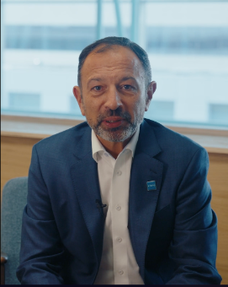
Valid for multibrand
5.EXECUTIVE SERIES - DIDIER
COPY - LI
For decades, fleet management was defined by a single question: which vehicle do you need? 🚗
Today, that question is officially outdated.
Businesses are no longer purchasing for a specific car. They're looking for the mobility solutions that genuinely fit their reality. The vehicle itself is no longer the main differentiator; adaptability, predictability, and peace of mind are.
In the first episode of our Executive Series, @Didier Gambart (CEO of KINTO Europe) breaks down the forces reshaping corporate mobility. Watch the full episode below to hear Didier’s perspective on where business mobility is heading next. 👇
One partner. Every solution.
CONTENT BUCKET 1- NOVEMBER
FORMATS AVAILABLE:
1/1 - ⅘
Notes:
#KINTO #FleetManagement #CorporateMobility #FlexibleMobility #MobilitySolutions

Slide 20
6. EU FLEET DAYS AFTERMOVIE
COPY - LI
CONTENT BUCKET 1- NOVEMBER
TBD- VIDEO TO BE MADE
FORMATS AVAILABLE:
1/1 - ⅘ 9X16
Notes:
#KINTO #FleetManagement #CorporateMobility #FlexibleMobility #MobilitySolutions

Slide 21
6. EU FLEET DAYS AFTERMOVIE
COPY - IG
CONTENT BUCKET 1- NOVEMBER
TBD- VIDEO TO BE MADE
FORMATS AVAILABLE:
1/1 - ⅘ 9X16
Notes:
#KINTO #FleetManagement #CorporateMobility #FlexibleMobility #MobilitySolutions

Slide 22
6. EU FLEET DAYS AFTERMOVIE
COPY - FB
CONTENT BUCKET 1- NOVEMBER
TBD- VIDEO TO BE MADE
FORMATS AVAILABLE:
1/1 - ⅘ 9X16
Notes:
#KINTO #FleetManagement #CorporateMobility #FlexibleMobility #MobilitySolutions

Slide 23
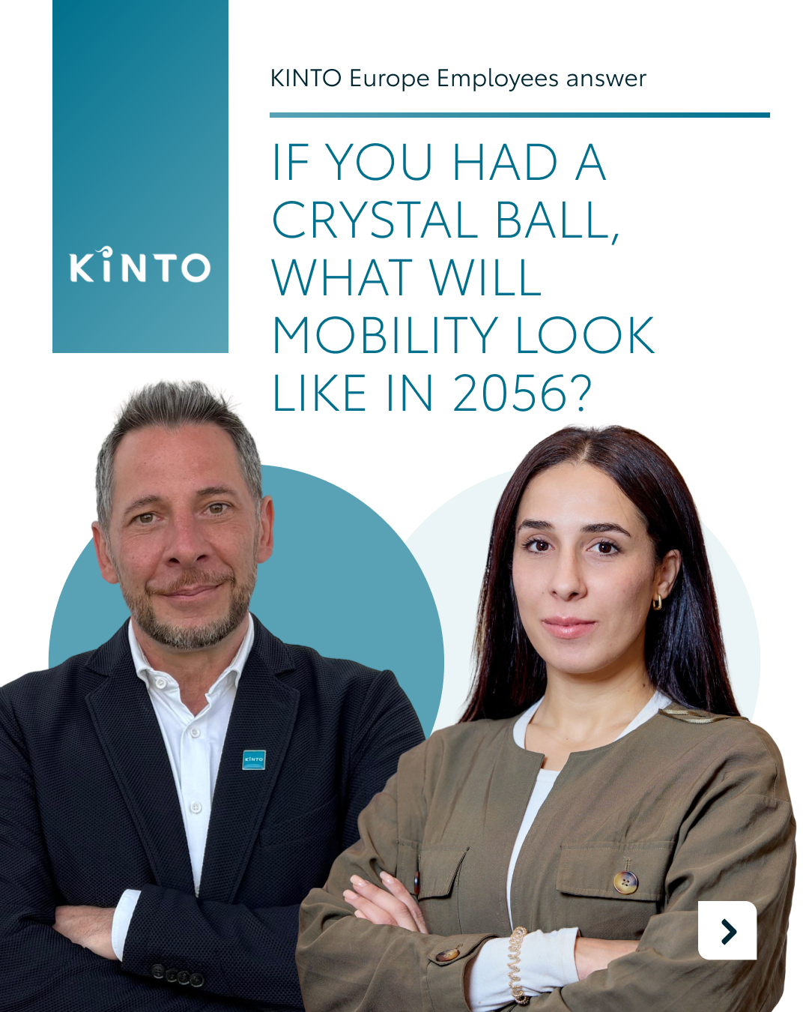
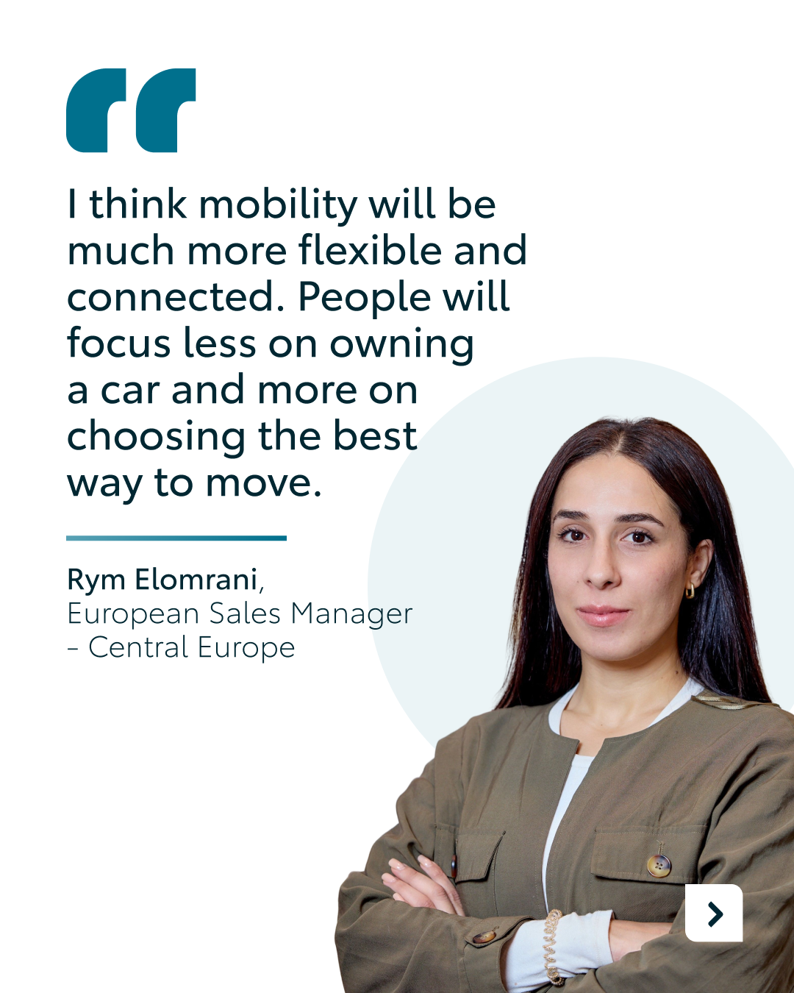
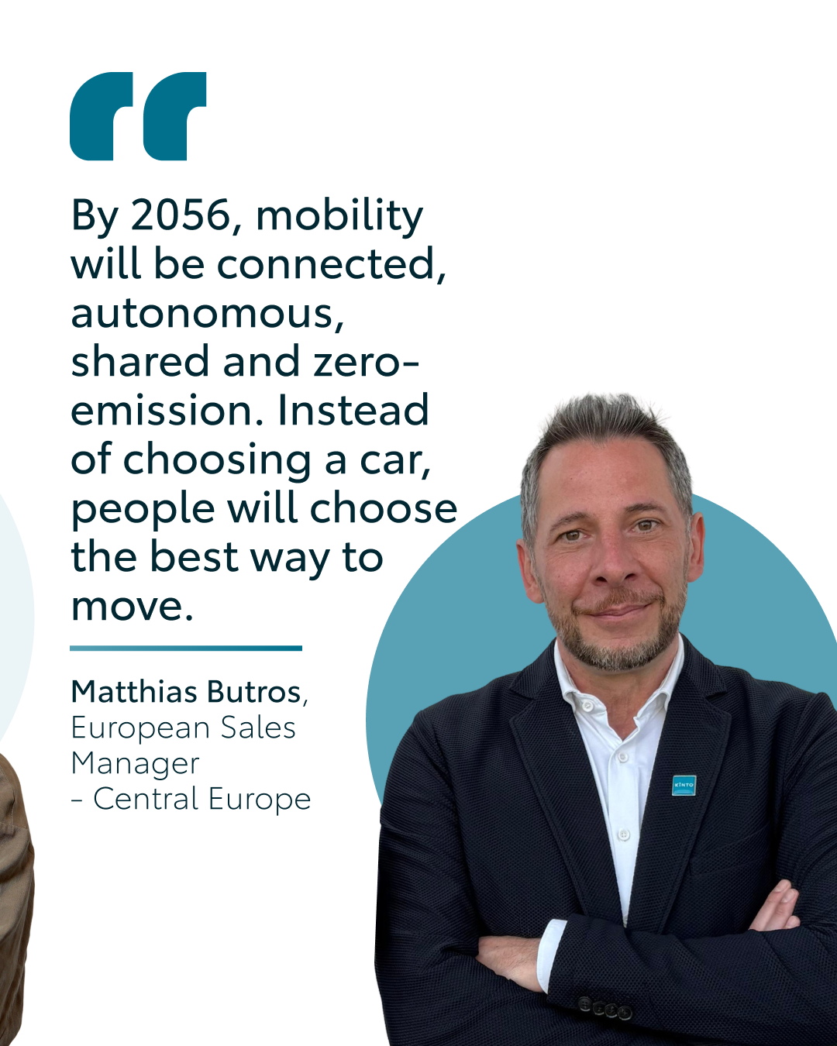
Valid for multibrand
7.Q&A EMPLOYEES
COPY - LI
Forget flying cars and teleporters for a second... what does mobility actually look like over the next decade? 🔮
We dusted off the company crystal ball and put the big question to two of our own: @Rym and @Matthias.
For our European Sales Managers, looking at the decade ahead reveals a major shift in how we view transportation. Think complete flexibility, connected and autonomous fleets, and a future where the focus moves entirely from owning a specific vehicle to simply choosing the smartest way to get from A to B.
What’s your prediction for mobility over the next decade? 👇
One partner. Every solution.
CONTENT BUCKET 1- NOVEMBER
FORMATS AVAILABLE:
1/1 - ⅘
Notes:
#KINTO #FleetManagement #CorporateMobility #FlexibleMobility #MobilitySolutions

Slide 24
Valid for multibrand
7.Q&A EMPLOYEES
COPY - IG
Did anyone bring a crystal ball to the office today? Because we’re looking straight into the next decade. 🔮
We sat down with Rym and Matthias to ask one big question: where is mobility headed over the next ten years?
Between autonomous fleets, fully connected systems, and leaving car ownership in the past, their answers did not disappoint. 🚗
Swipe to see their takes and tell us in the comments: over the next decade, are you still owning a car, or simply choosing the smartest way to move? 👇
One partner. Every solution.
CONTENT BUCKET 1- NOVEMBER
FORMATS AVAILABLE:
1/1 - ⅘
Notes:
#KINTO #FleetManagement #CorporateMobility #FlexibleMobility #MobilitySolutions

Slide 25
Valid for multibrand
7.Q&A EMPLOYEES
COPY - FB
Predicting the future is tricky, but our team wasn't afraid to give it a shot. 🔮
What happens when you ask KINTO experts where mobility will be over the next decade? You hear less about owning a specific car, and a lot more about flexible, connected networks and simply choosing the smartest way to get around. 🚗
We sat down with Rym and Matthias to hear where they see fleet and personal mobility heading in the years ahead.
Swipe to check out their predictions and head over to kinto-mobility.eu to see how we’re driving mobility forward today. 👈
One partner. Every solution.
CONTENT BUCKET 1- NOVEMBER
FORMATS AVAILABLE:
1/1 - ⅘
Notes:
#KINTO #FleetManagement #CorporateMobility #FlexibleMobility #MobilitySolutions

Slide 26
AI generated image
8.BLACK FRIDAY
COPY - LI:
The real Black Friday deal? Don’t buy anything.
Because when it comes to business mobility, the question is simple: why buy when you can use?
You can expand your operations with top-tier vehicles without adding heavy fixed assets to your balance sheet. From compact city cars and electric crossovers to executive rides and commercial vans, full-service leasing gives you all the driving power with none of the ownership headaches.
Ready to click 'add to fleet' on a smarter business mobility strategy?
One partner. Every solution.
CONTENT BUCKET 1- NOVEMBER
FORMATS AVAILABLE:
1/1 - ⅘
Notes:
#KINTO #FleetManagement #CorporateMobility #FlexibleMobility #MobilitySolutions

Slide 27
AI generated image
8.BLACK FRIDAY
COPY - FB:
Forget impulse buys this Black Friday, let’s talk about smart mobility for your business. 💡
When it comes to fleet growth, the real question is: why buy when you can use?
Upgrading your business fleet should be as straightforward as clicking 'add to fleet', without the balance sheet burden or ownership headaches. From compact city cars like the Toyota Aygo X to versatile vans and electric crossovers, KINTO gives you the flexibility to drive what you need, exactly when you need it.
Head over to kinto-mobility.eu to explore our range and “add to fleet” today. 📲
One partner. Every solution.
CONTENT BUCKET 1- NOVEMBER
copy to be adapted
FORMATS AVAILABLE:
1/1 - ⅘
Notes:
#KINTO #FleetManagement #CorporateMobility #FlexibleMobility #MobilitySolutions

Slide 28
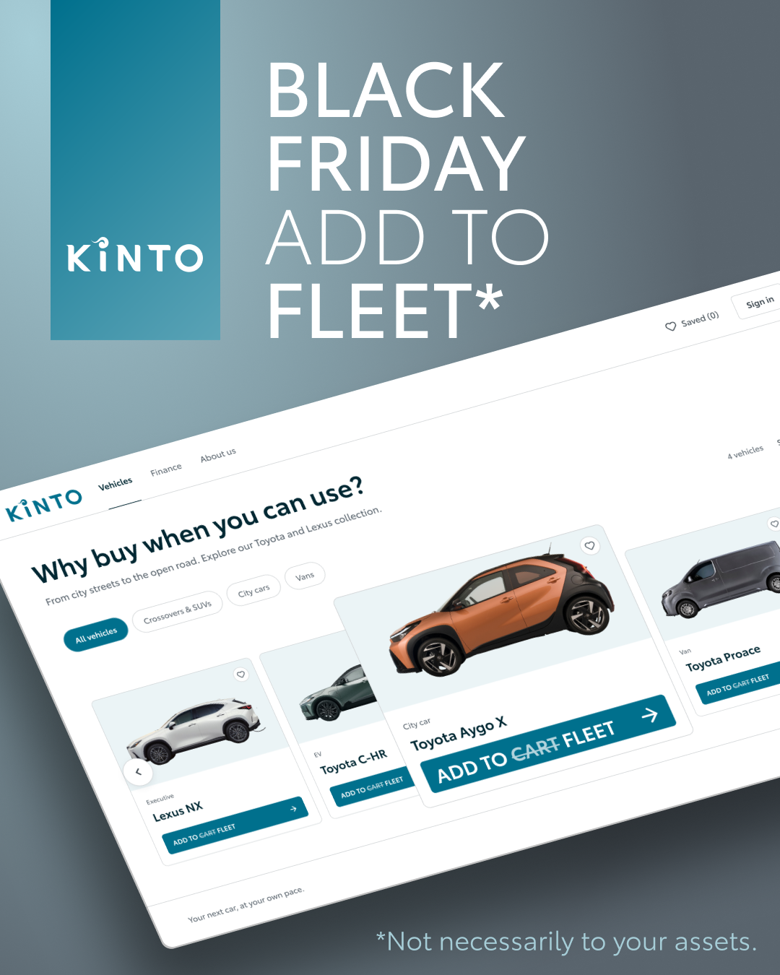
AI generated image
8.BLACK FRIDAY
COPY - FB:
Forget impulse buys this Black Friday, let’s talk about smart mobility for your business. 💡
When it comes to fleet growth, the real question is: why buy when you can use?
Upgrading your business fleet should be as straightforward as clicking 'add to fleet', without the balance sheet burden or ownership headaches. From compact city cars like the Toyota Aygo X to versatile vans and electric crossovers, KINTO gives you the flexibility to drive what you need, exactly when you need it.
Head over to kinto-mobility.eu to explore our range and “add to fleet” today. 📲
One partner. Every solution.
CONTENT BUCKET 1- NOVEMBER
copy to be adapted
FORMATS AVAILABLE:
1/1 - ⅘
Notes:
#KINTO #FleetManagement #CorporateMobility #FlexibleMobility #MobilitySolutions

Slide 29
Valid for multibrand
9. TEAM TAKEOUTS
EU FLEET DAYS
COPY - LI:
CONTENT BUCKET 1- NOVEMBER
TBD- VIDEO TO BE MADE
FORMATS AVAILABLE:
1/1 - ⅘ 9X16
Notes:
#KINTO #FleetManagement #CorporateMobility #FlexibleMobility #MobilitySolutions

Slide 30
10. POLL FLEET ELECTRIFICATION STRATEGY
What will drive your fleet electrification strategy most by 2028?
TCO savings
Sustainability targets
Regulation / zero-emission zones
Employee demand
COPY LI
We all know the future of fleet mobility is electric, but what is actually keeping your foot on the accelerator? ⚡
The road to 2028 looks a bit different for everyone. For some businesses, it’s all about maximizing cost efficiency. For others, it’s about hitting ambitious ESG goals or staying ahead of new city regulations.
What will drive your fleet electrification strategy most by 2028?
TCO savings
Sustainability targets
Regulation / zero-emission zones
Employee demand
Your vote helps us tailor our future mobility insights and content to exactly what you need. Cast your vote below and stay tuned to see the results. 📊
One partner. Every solution.
CONTENT BUCKET 1- NOVEMBER

Slide 31
10. POLL FLEET ELECTRIFICATION STRATEGY
What will drive your fleet electrification strategy most by 2028?
TCO savings
Sustainability targets
Regulation / zero-emission zones
Employee demand
COPY IG
What will drive your fleet electrification strategy most by 2028?
TCO savings
Sustainability targets
Regulation / zero-emission zones
Employee demand
CONTENT BUCKET 1- NOVEMBER

Slide 32
10. POLL FLEET ELECTRIFICATION STRATEGY
What will drive your fleet electrification strategy most by 2028?
TCO savings
Sustainability targets
Regulation / zero-emission zones
Employee demand
COPY FB
Transitioning your fleet isn't a one-size-fits-all journey. While some businesses are focused on cost savings, others are prioritizing strict sustainability targets or navigating new city regulations. 🌍
What will drive your fleet electrification strategy most by 2028?
TCO savings
Sustainability targets
Regulation / zero-emission zones
Employee demand
Cast your vote! We use your direct feedback to shape our upcoming tools, tips, and fleet insights. 📈
One partner. Every solution.
CONTENT BUCKET 1- NOEVMBER

